Slide 1
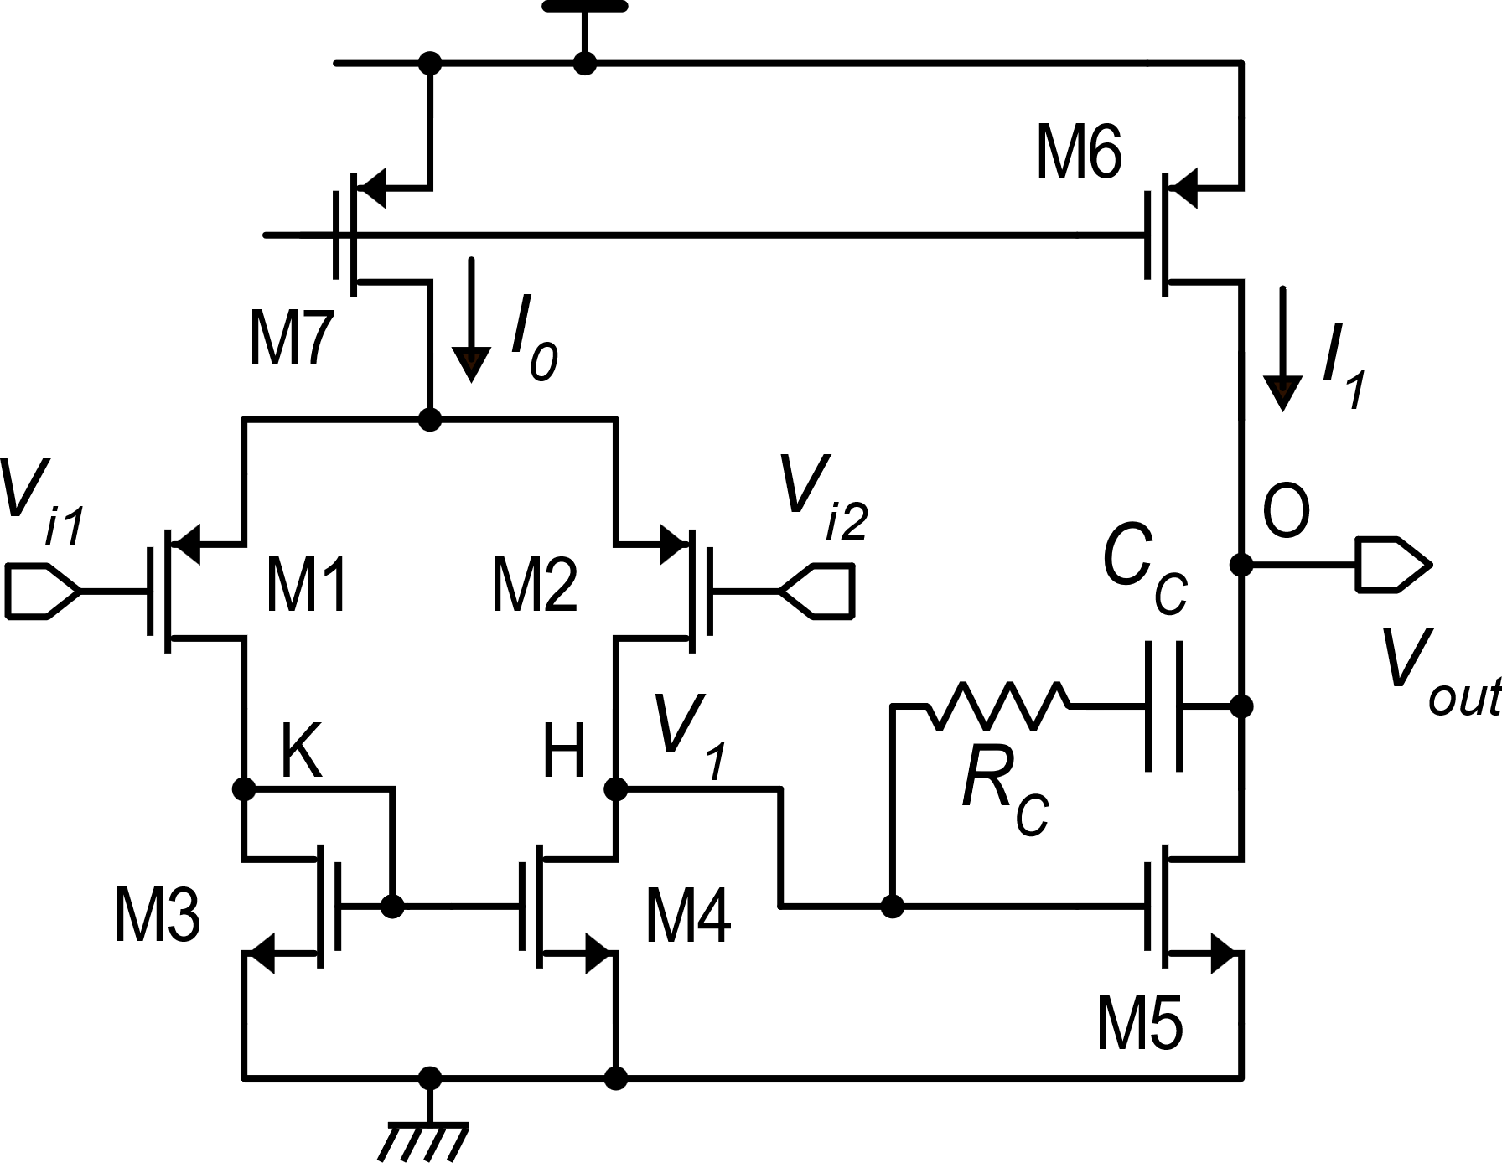
Two-stage op-amp: design for GBW and Phase Margin
Small signal equivalent circuit
Singularities
Topology

Slide 2
Preliminary assumptions
In this design procedure, we decide to cancel the zero:
We consider that the GBW and phase margin can be estimated by using a two-pole approximation of the frequency response, with a dominant pole (ω_{p}):

Slide 3
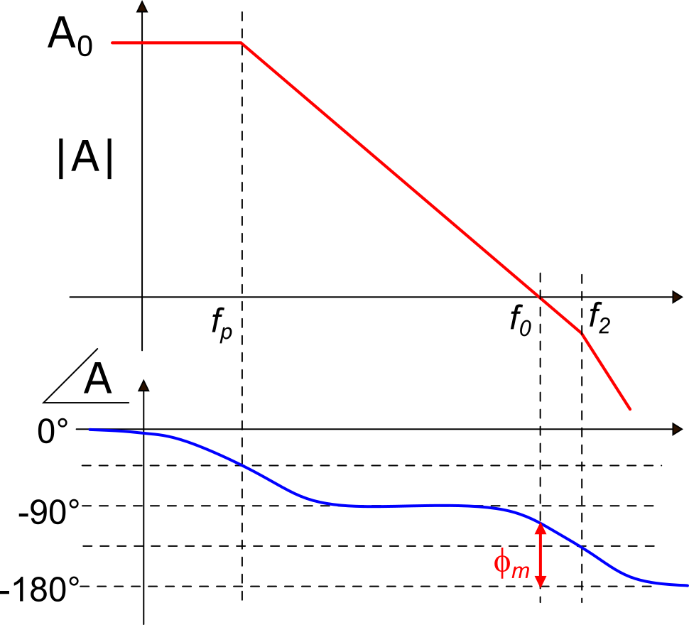
GBW and unity-gain angular frequency (ω₀)

Slide 4
GBW and stability specifications
Then, we impose:

Slide 5
An approximate approach: Hypothesis 1
Hypothesis 1: C₁ is much smaller than C₂ and C_{C}:
Motivation:
C₂ includes the load capacitance, C_{L}
C_{C} can be made arbitrarily large to satisfy the hypothesis

Slide 6
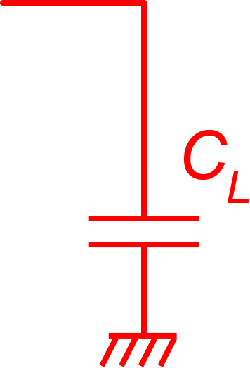
An approximate approach: Hypothesis 2
Hypothesis 2: The parasitic component C₂' is much smaller than C_{L}:
Now the expression of ω₂ is strongly simplified
Hypotheses 1 and 2 correspond to consider that all parasitic capacitances of the amplifier are negligible with respect to C_{L} and C_{C}, which are external to the amplifier (C_{L}) or are purposely placed devices (C_{C}).

Slide 7
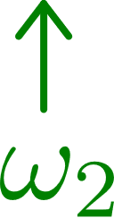
The GBW specification shapes the second stage (G_{m2})
stability
specification
For the stability requirement:
GBW specification

Slide 8
Back to the first stage
We have two degrees of freedom, G_{m1} and C_{C}: a smaller G_{m1} would allow for a smaller C_{C} value, saving area. However, C_{C} cannot get too small, otherwise hypothesis 1 risks to fail.
To guide the choice, it is convenient to relate C_{C} to C_{L} and to the G_{m1}/G_{m2} ratio, through the stability condition
stability condition

Slide 9
C_{C} and C_{L}, the "rule of thumb" and its limits
(a)
Hypothesis 1
(b)
If we make C_{C}=C_{L}, validity of condition (a) makes also condition (b) automatically true. Making C_{C} even larger than C_{L} does not add validity to hypothesis 1 and requires more area.
Rule of thumb:
With σ=3 ($φ_{m}≅70°)$
We have determined both G_{m1} and G_{m2}

Slide 10
Limits of the rule of thumb
Often, it is convenient to apply a different choice
Rule of thumb:
Case of large C_{L}: If the maximum load capacitance is particularly large (> tens pF), using the rule of thumb can result in too large a compensation capacitance, and then, in non-acceptable chip area occupation. In those cases, the C_{C}/C_{L} can be made smaller than one (C_{C}<C_{L}) in order to make C_{C} easily integrable.
For example: with C_{L}=100 pF,
I choose: C_{C}=10 pF

Slide 11
Application of the design procedure to our simple two-stage op-amp
Once the M1 and M5 overdrive voltages have been chosen, the GBW specification determines the aspect ratios (W/L) of both MOSFETs
in strong inversion

Slide 12
GBW and supply current

Slide 13
GBW, C_{L} and supply current
The higher the GBW and load capacitance C_{L}, the higher the supply current and then the power consumption
For the same GBW and C_{L} specifications, lower supply currents can be obtained with the lowest V_{TE5} and V_{TE1}.

Slide 14
Robustness against C_{L} variations
We have designed the op-amp for the maximum C_{L}. It must be stable also for smaller values
If we reduce C_{L}, then C₂ reduces and hypothesis 1 may be no more valid. Then we have to use the complete expression for ω₂:
Effects of C₂ reduction:
gets smaller
ω₂ increases!
gets smaller
Both denominators reduces

Slide 15
Robustness against C_{L} variations
C_{L} increases:
smaller phase margin
C_{L} decreases:
greater phase margin
Is nearly unaffected by C_{L}
In a two-stage amplifier:
Reducing (or even removing) the load capacitance improves stability
Increasing the load capacitance reduces stability and eventually causes instability

Slide 16
Limits of the simplified design procedure
Given a GBW specification, the procedure can be summarized in the following way
1. Find the required G_{m2} value from the equation:
2. Choose a proper C_{C}/C_{L} ratio, depending on the value of C_{L}
3. Find the required G_{m1}:
It seems that using the required current to set G_{m2} and G_{m1} to the correct value, we can reach an arbitrarily high GBW, independently of the process being used. This is clearly not reasonable.

Slide 17
Limits of the simplified design procedure
The problem stands in the hypotheses the procedure is based on.
The hypotheses derive from the fact that C_{L} is generally prevalent over the parasitic capacitances:
Hyp. 2
Hyp. 1
can be satisfied choosing a large enough C_{C}.
Trying to get larger and larger G_{m2} and G_{m1} increases also the size of the MOSFETs in the first and second stage, causing violation of the hypotheses

Slide 18
Limits of the simplified design procedure
I can still set C_{C} as large as to make C_{S}/C_{C} <<1

Slide 19
Limits of the simplified design procedure

Slide 20
Maximum achievable GBW
Increasing g_{m5} for a given f_{T5}, increases C_{gs5} proportionally
GBW
In strong inversion
In this region the hypotheses are valid
L₅ (V_{GS}-V_{t})₅
GBW tends to saturate to f_{T5}/σ

Slide 21
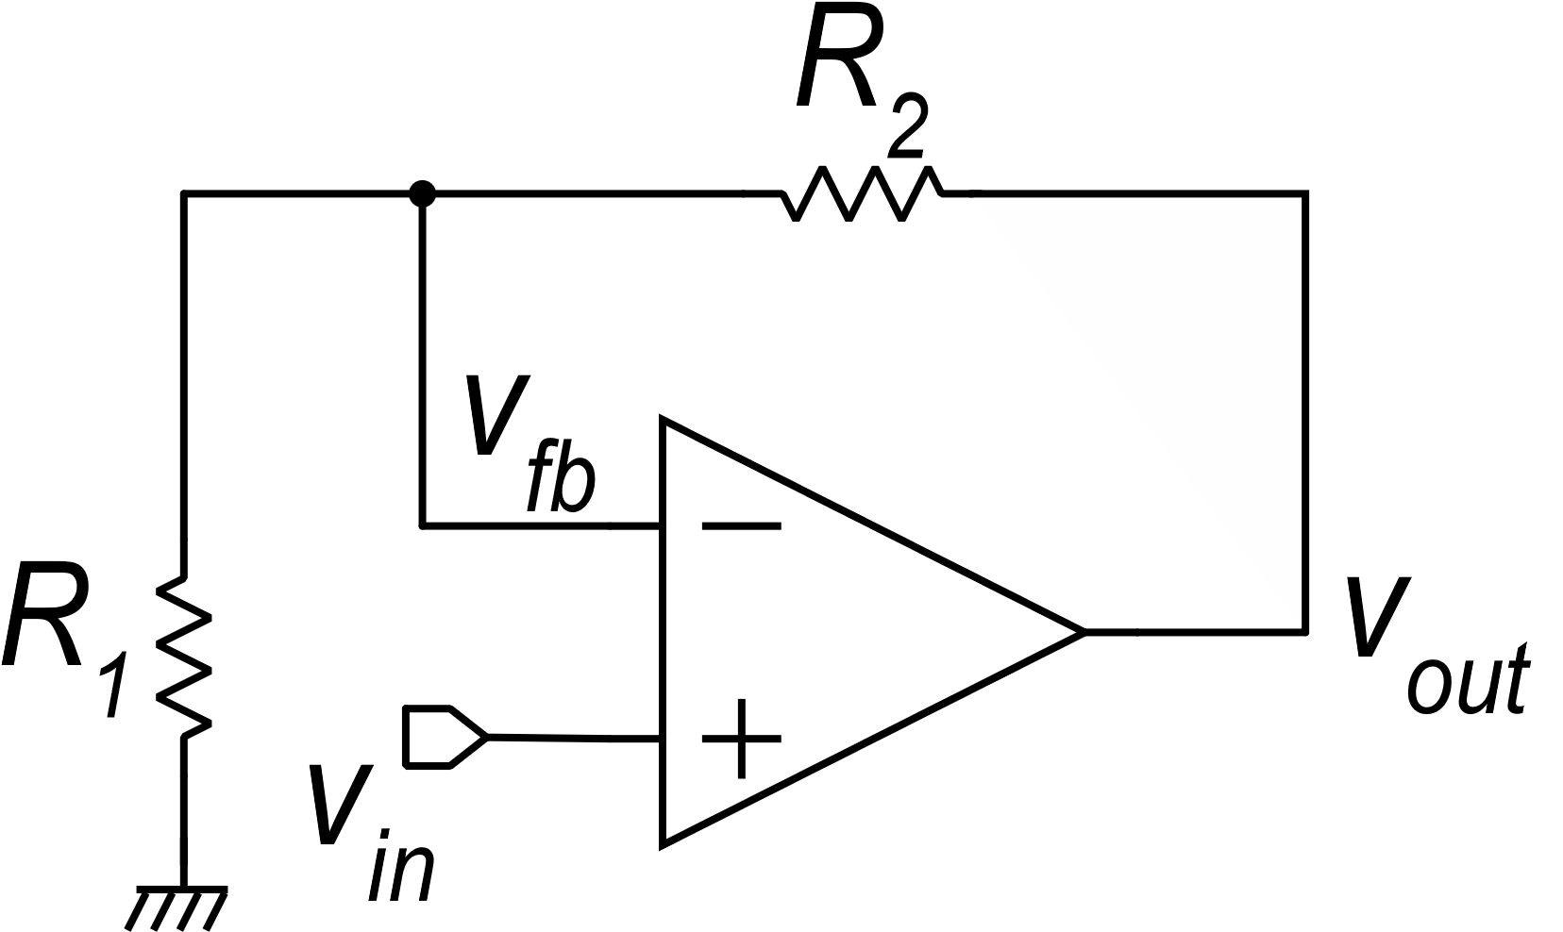
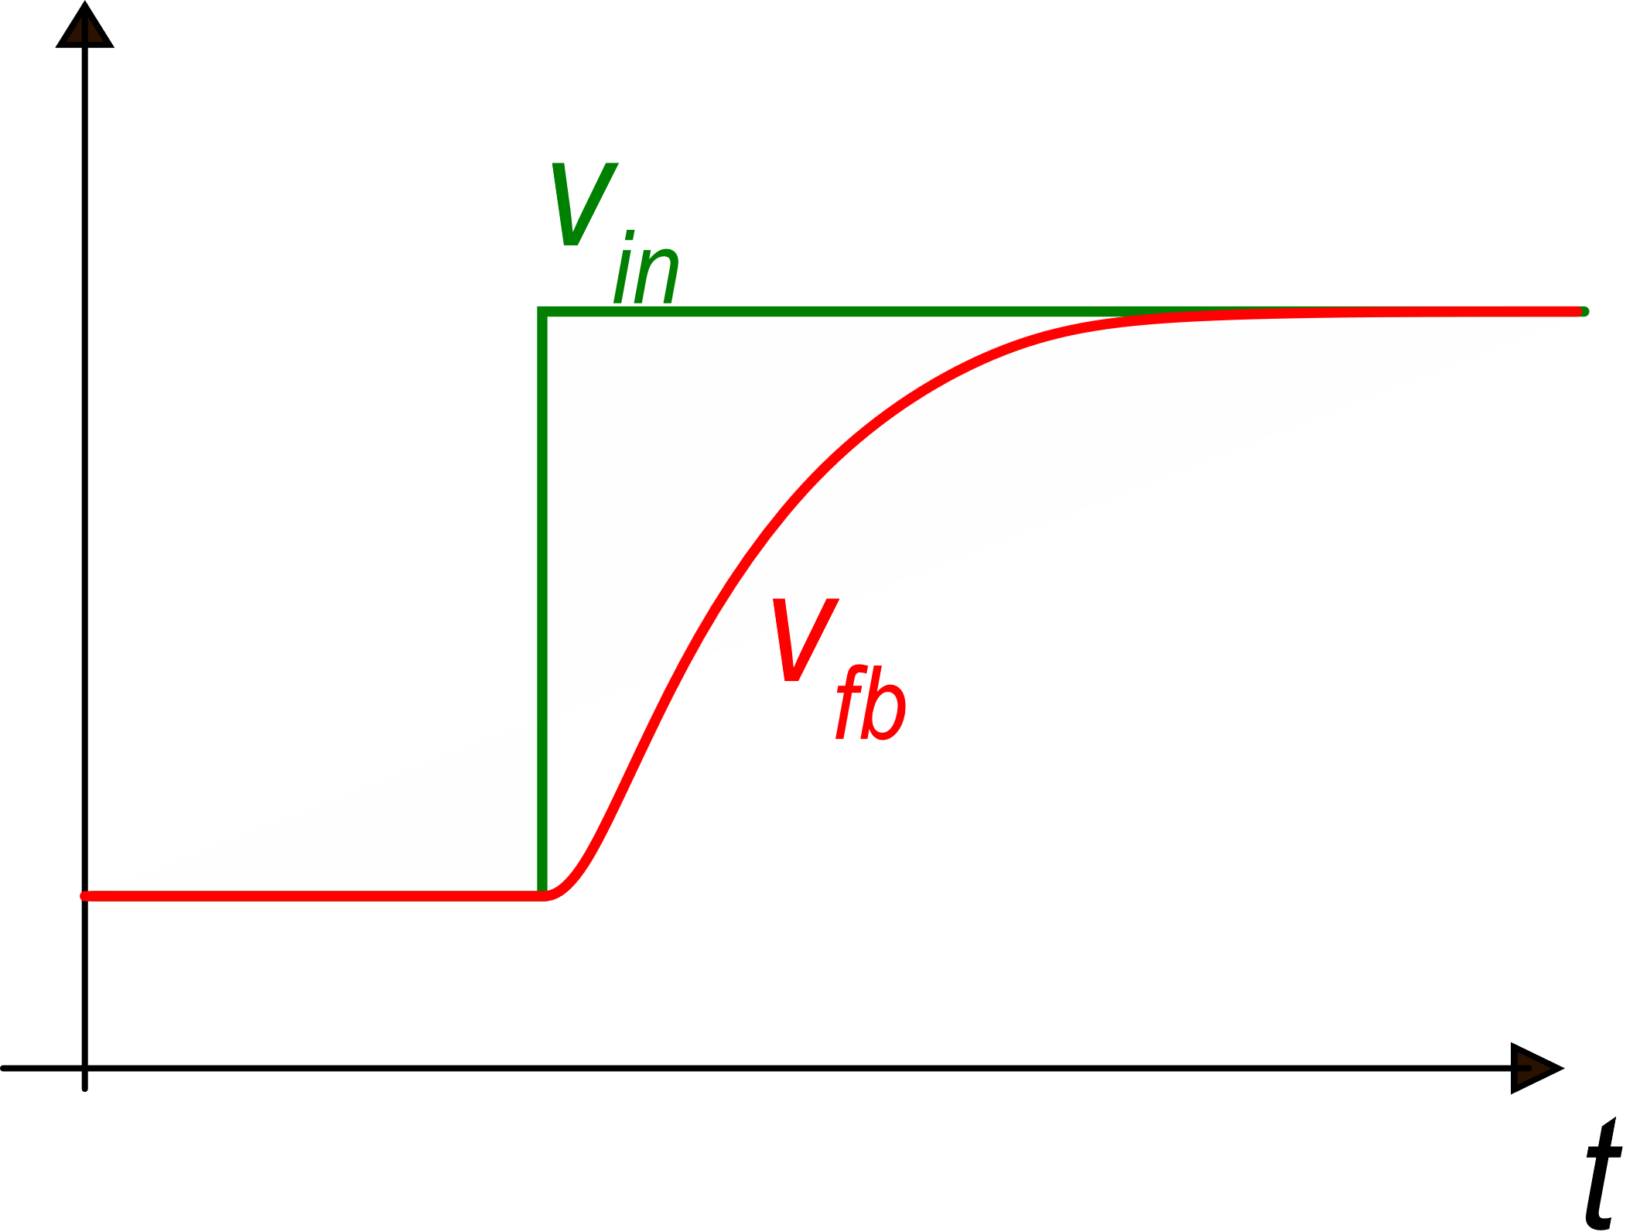
The slew rate problem
If the input step is large enough, the input stage saturates
Just after a step variation of the input voltage, the feedback voltage, derived by the output voltage, cannot change instantaneously and the input differential voltage of the op-amp can be driven out of the linearity region of the first stage
v_{id}

Slide 22
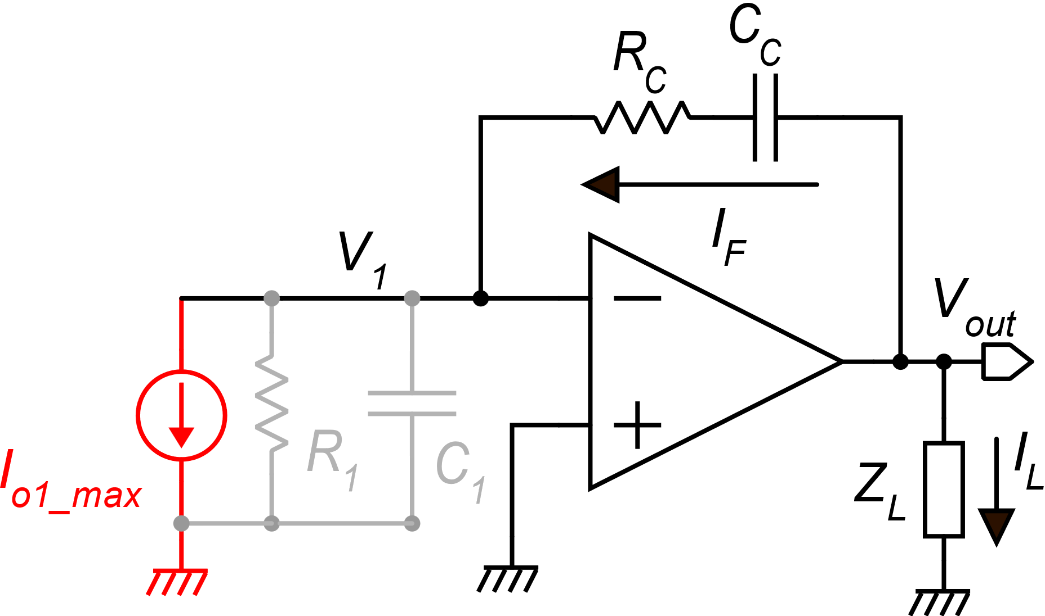
Slew rate in Miller-compensated two-stage op-amps
The second stage can be represented as an inverting amplifier with gain G_{m2}R₂.
Impedance Z_{L} represents the load condition. If Z_{L} has a resistive component, the gain of the second stage will be smaller than G_{m2}R₂. Z_{L} includes the load capacitance

Slide 23
Slew rate in Miller-compensated two-stage op-amps
(I_{o1-max} can be either negative or positive)
If the gain of the second stage is high enough, we can consider virtual gnd at input v₁.
Note that current I_{F} flows also through the output terminal of the amplifier. Then, the analysis shown above is applicable if the second stage (output stage) is capable of producing the total current I_{F}+I_{L}

Slide 24
Slew rate of the simple class-A, two stage op-amp.
From simple inspection of the first stage:
For a given GBW, the higher V_{TE1} , the higher the slew rate

