Slide 1
Practical Rules for noise calculations
Idealized amplifier noise density
Noise PSD in Low-Pass Systems
PSD: Power Spectral Density
S_{X}
Typically first order decay
flicker noise
broadband
total noise
noise
Definition of flicker corner frequency
S_{X-BB}
f_{k}
B
f
signal frequency band
f_{min}
f_{max}
B=equivalent noise bandwidth

Slide 2
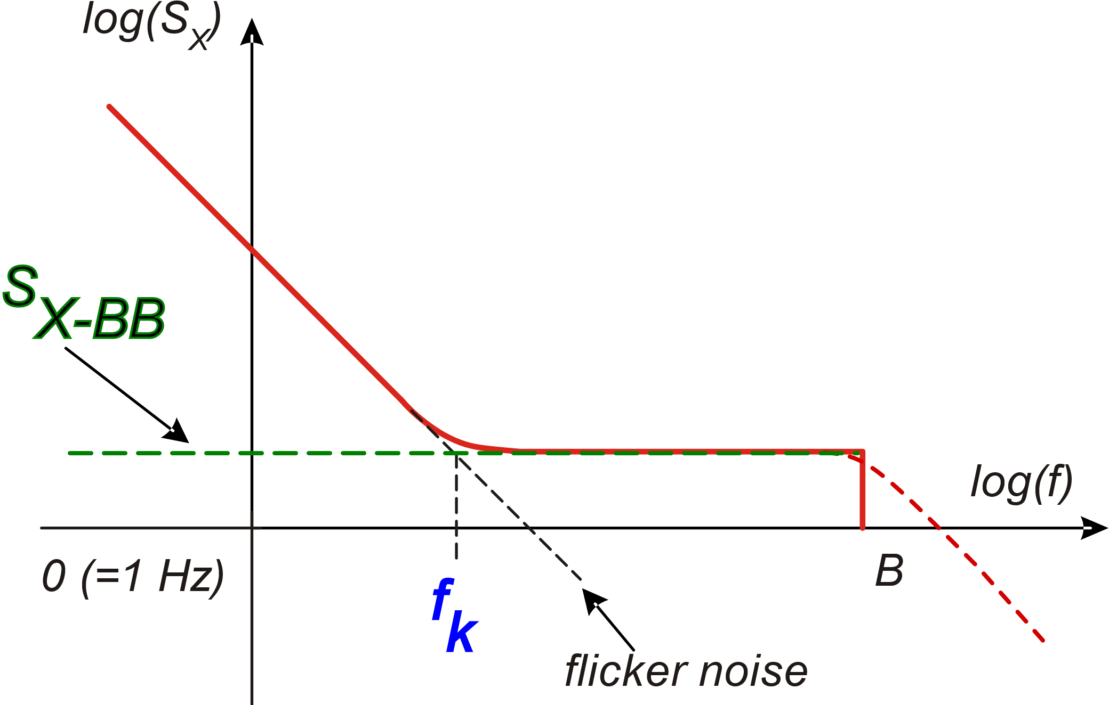
Amplifier noise spectrum in logarithmic axes
for any f₀ in the region where
flicker noise dominates
f₀

Slide 3
Total rms noise in the signal bandwidth
Broad-band
Flicker
n_{dec} =number of decades from f_{min} to f_{max}

Slide 4
Flicker noise for signal bands that include dc
If f_{min} =0, the integral is infinity
Many signals of interest include dc. This is true for practically most signals produced by sensors like temperature, pressure, acceleration etc.
The solution to this paradox is that, in practical cases, speaking of a real dc component is meaningless, since it would be constant across an infinite interval of time.
For every practical scenario, there is always a finite “observation time period”, across which we require a signal to be constant to state that this is a dc component.

Slide 5
Flicker noise for signal bands that include dc
Then, we use the flicker noise expression:
with
Where T_{obs} is the observation time.
If the signal band includes dc, we generally set T_{obs} = 10s-100s, resulting in f_{min}= 0.1-0.01 Hz.

Slide 6
Example
Specifications: f_{max}=1kHz, f_{min}=0 (dc)
n_{dec}=5
The flicker component to <(x_{n})²>
is increased by 60% and the rms component by 26%
For T_{obs}=100 s, f_{min}=0.01 Hz
For T_{obs}=10⁵ s (> 1 day) s, f_{min}=10 μHz
n_{dec}=8
In terms of resolution, this is quite a negligible increase. To have an increase of 1 unit in the ENOB associated to the DR we need an increase of 100 % in x_{rms} , i.e. a factor of 4 in <(x_{n})²> . The presence of a significant contribution from S_{XBB} makes this flicker increment even less important.
The choice of T_{obs} (f_{min}) is not critical !

Slide 7
Something more about the broad-band component
S_{XBB} has units [X]²/Hz where [X] are the units of quantity X.
For example if X is a voltage, we have V²/Hz
This is not the specification that is generally used in practical cases
(e.g. amplifier datasheets).
What is generally given, is the square root of the PSD:
Units:

Slide 8
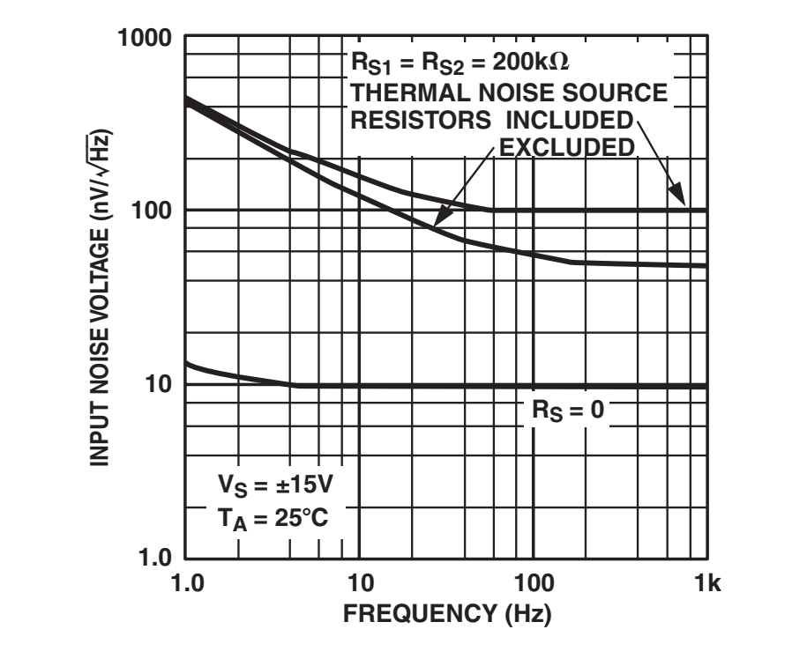
Example
or nV/sqrt(Hz)
«noise density»
(instead of :
noise power spectral density)

Slide 9
Practical rms noise calculation:
It is sufficient that one of the two contribution is 5 times smaller than
the other to get practically negligible (with a 2 % error)

Slide 10
Example
Includes both flicker and BB noise
> X_{pp-F} over two
decades

Slide 11
Schematic two-sided representation of amplifier noise
Total additive error: offset + noise
x_{io} is a stationary, non-ergodic
stochastic process.
Noise and offset are independent
processes
Generalized spectrum that represents noise and offset together

Slide 12
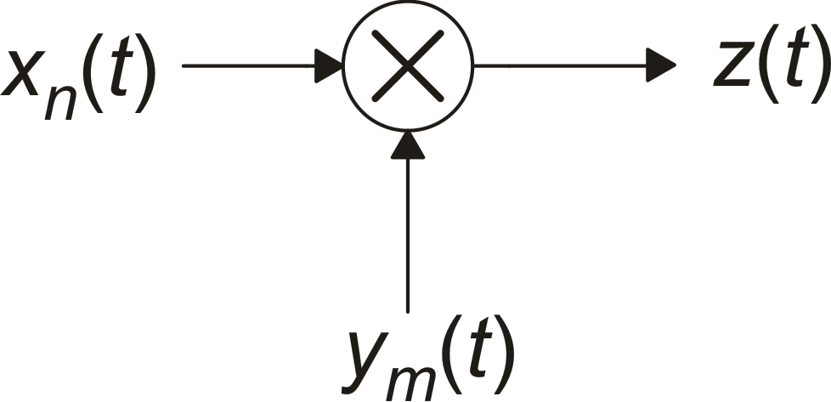
Modulation of a stochastic process
Stationary
stochastic process
(e.g. noise)
We can consider y_{m} a stochastic process by adding some randomness. It is sufficient to introduce a random delay to make z(t) stationary. Or we can refer to the formalism of cyclostationary processes
Modulated
process
Modulating signal (e.g. local oscillator)
But ...
If y_{m} is a periodic
deterministic signal,
Z(t) is generally no more a
stationary process
The auto-correlation function
is no more a simple function of
the delay τ and a PSD cannot be
calculated

Slide 13
Modulation of stochastic processes
Complex Fourier series representation of the modulating signal y_{m}(t)

Slide 14
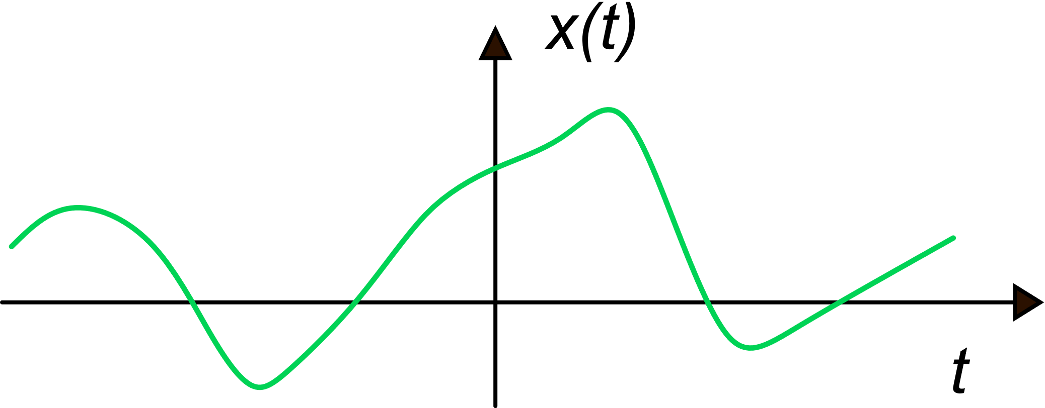
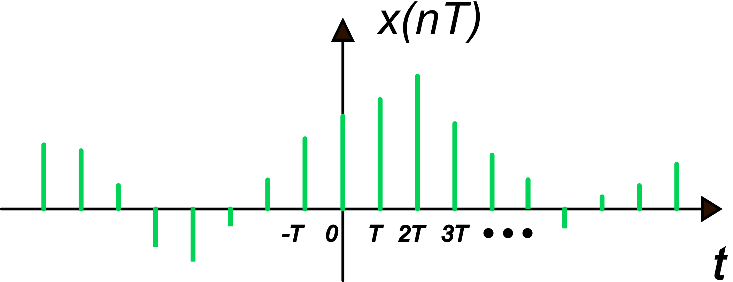
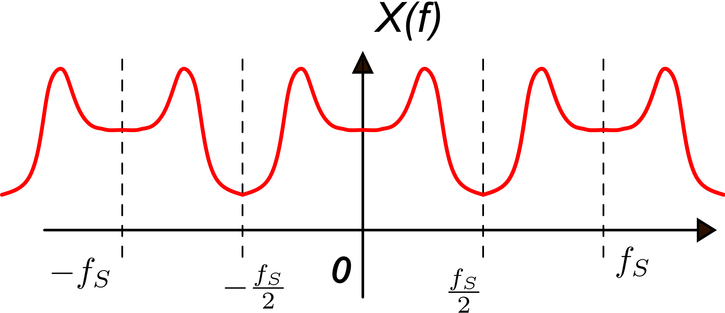
Discrete-time (DT) and continuous-time (CT) signals
Even band-limited signals have a Fourier transform that extends to infinity
CT signal
…. and their Fourier transform
DT signal

Slide 15
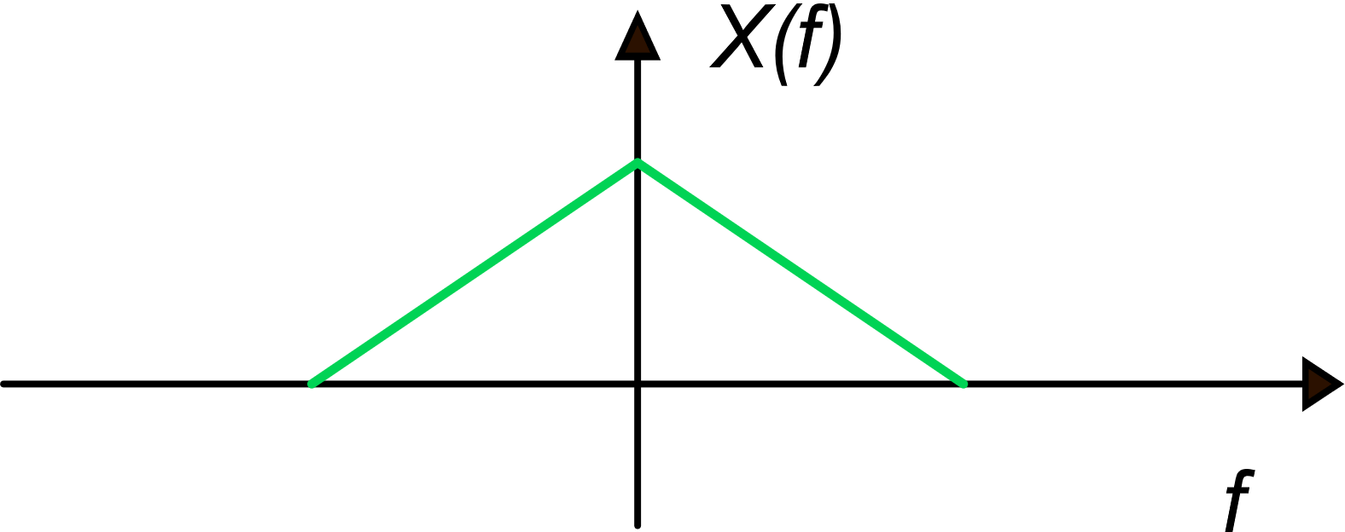
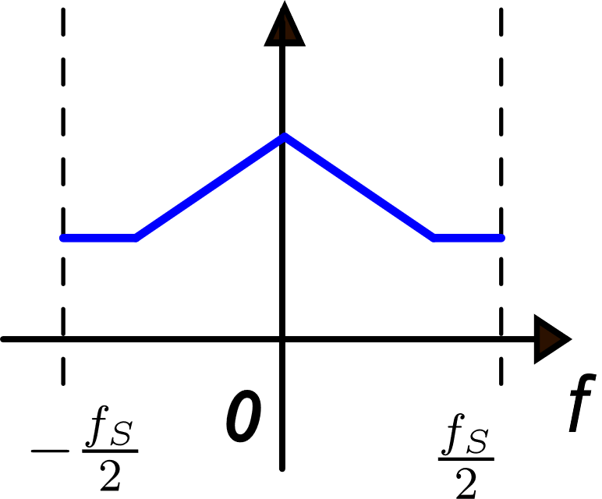
DT signals from sampling of CT signals
Place a replica of the original spectrum across each multiple of f_{S}
Add the replicas only across the DT frequency interval

Slide 16
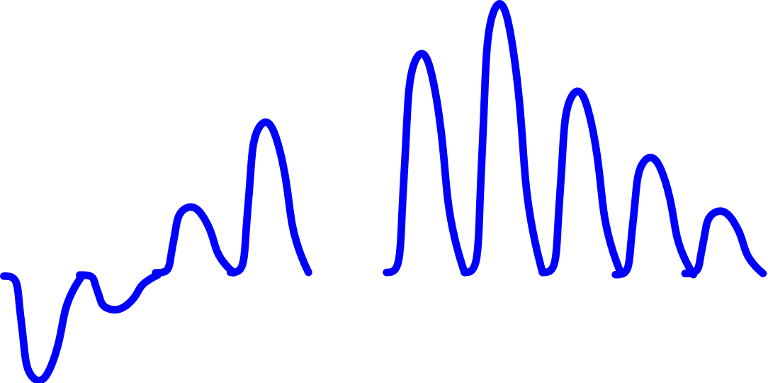
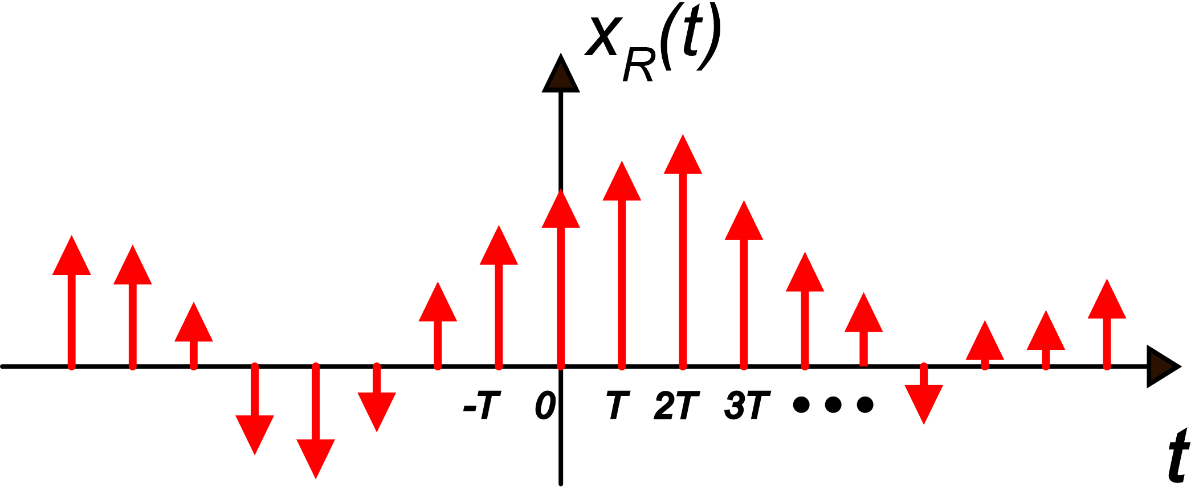
CT signals from DT ones
For our purposes, we are interested in:
Reconstruction with delta functions δ(t)
Hold - reconstruction
Replicas are multiplied by $\frac{1}{T}$

Slide 17
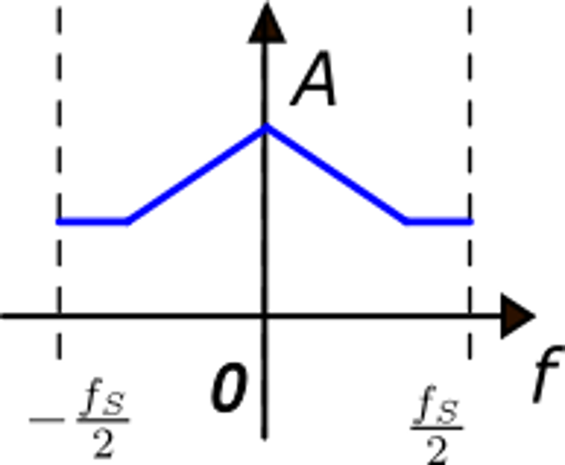
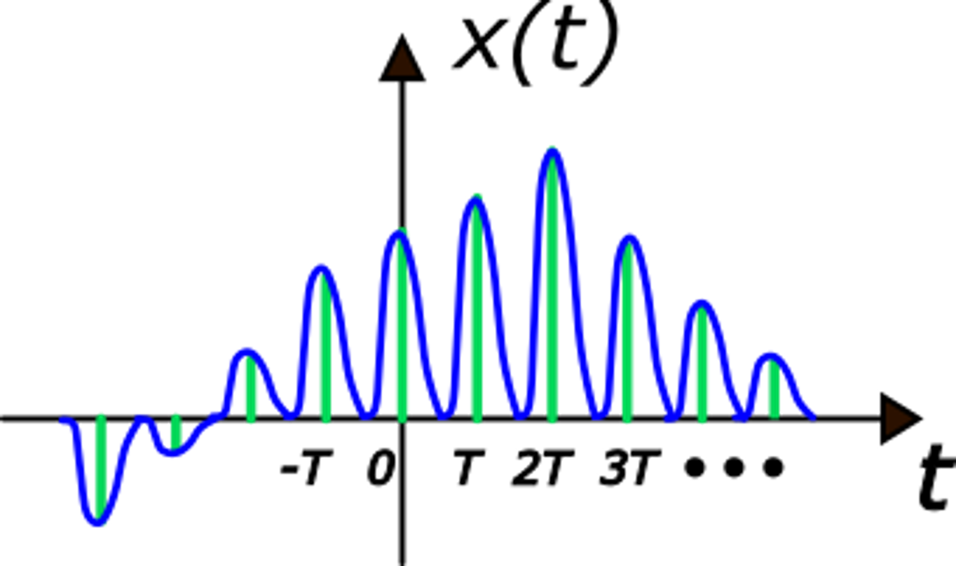
DT-CT reconstruction with an arbitrary pulse
replicate and multiply by 1/T
H(f)
multiply by H(f)
H(f)
Theoretical (non real) process

Slide 18
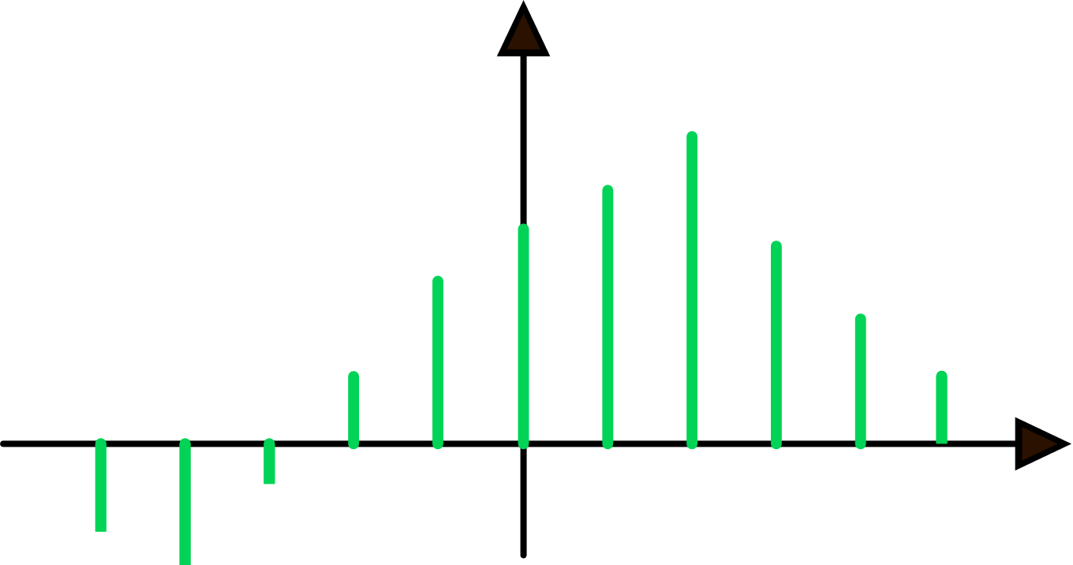
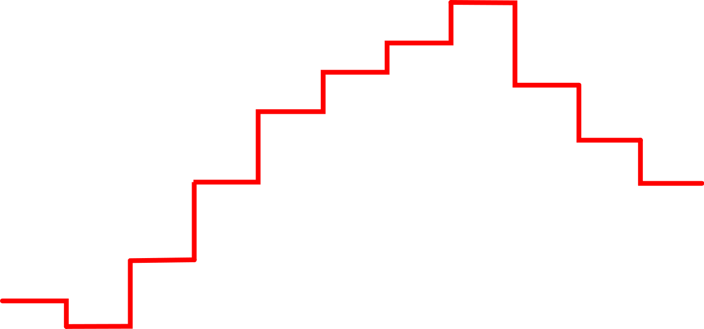
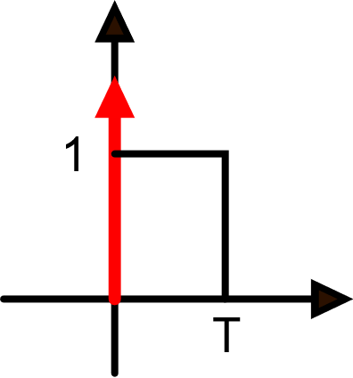
Hold reconstruction
It is the simpler way to convert a digital signal (data sequence) into an analog one by means of a DAC
Multiply by
Reconstruction pulse

Slide 19
Hold - reconstruction: summary
Start from the discrete time fourier transform
Multiply by:
Replicate the spectrum (non scaled) across any multiple of f_{s}
1

Slide 20
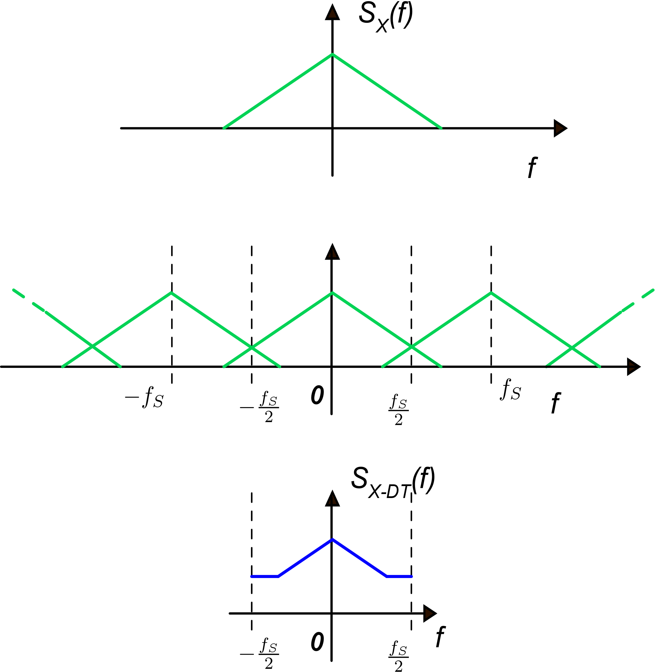
Sampling and holding a stochastic process
PSD of the CT stochastic process
The procedure is similar to the case of a deterministic signal but for a stochastic process it is the PSD to be involved
The PSD is replicated and
the replicas are
added
Only the spectrum in the –f_{S}/2, +f_{S}/2
interval is retained

Slide 21
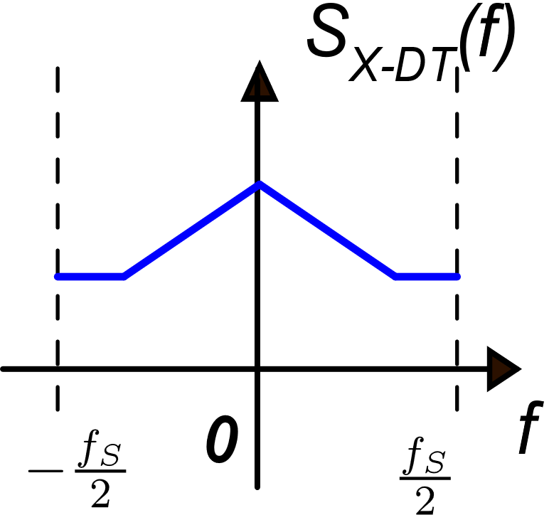
Reconstruction by hold-operation
Replicate with f_{s} step
PSD of the DT stochastic process
multiply by
1

