Slide 1
DAS: Data Acquisition Systems
A DAS is required to allow an electronic system to get information on the external environment
The development of extremely miniaturized DASs capable of detecting a large number of different and inhomogeneous quantities is currently urged by emerging fields, such as robotics, security and health care.
This is giving a significant contribution to the request for analog and mixed signal integrated SoCs
The design of a DAS involve architectures and specifications that recur in many other branches of analog and mixed signal microelectronic circuits.

Slide 2
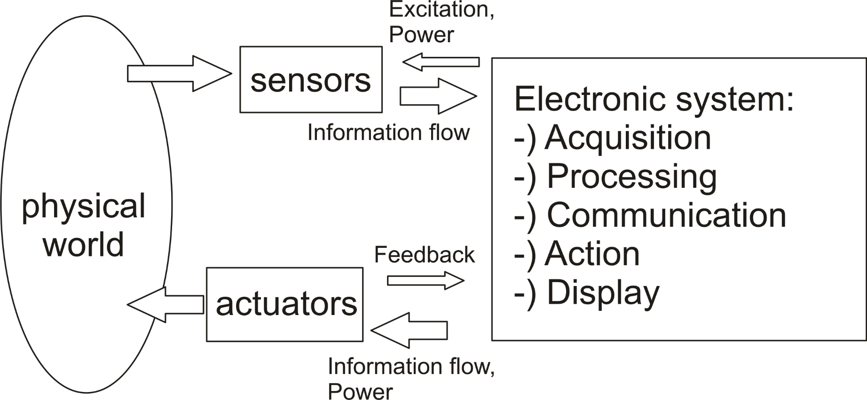
The electronic system and the enviroment
Electronic system
Electronic system

Slide 3
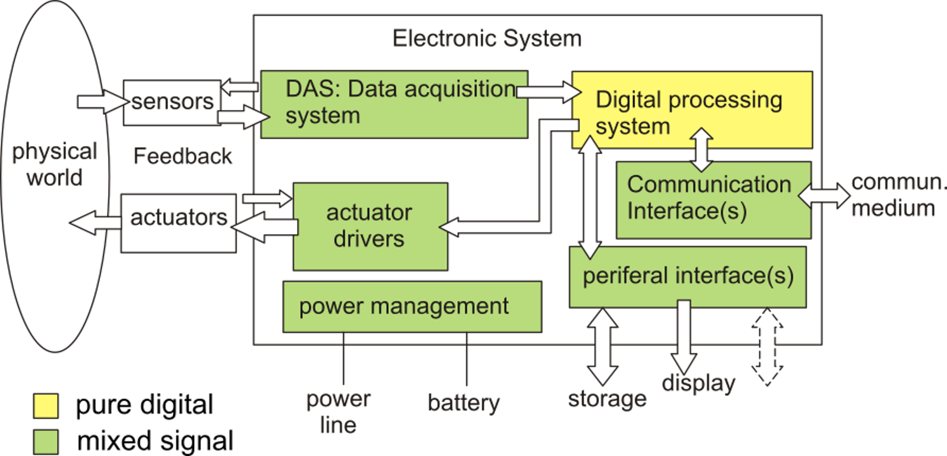
Main blocks of an Electronic System
DAS (full acquisition operations)

Slide 4
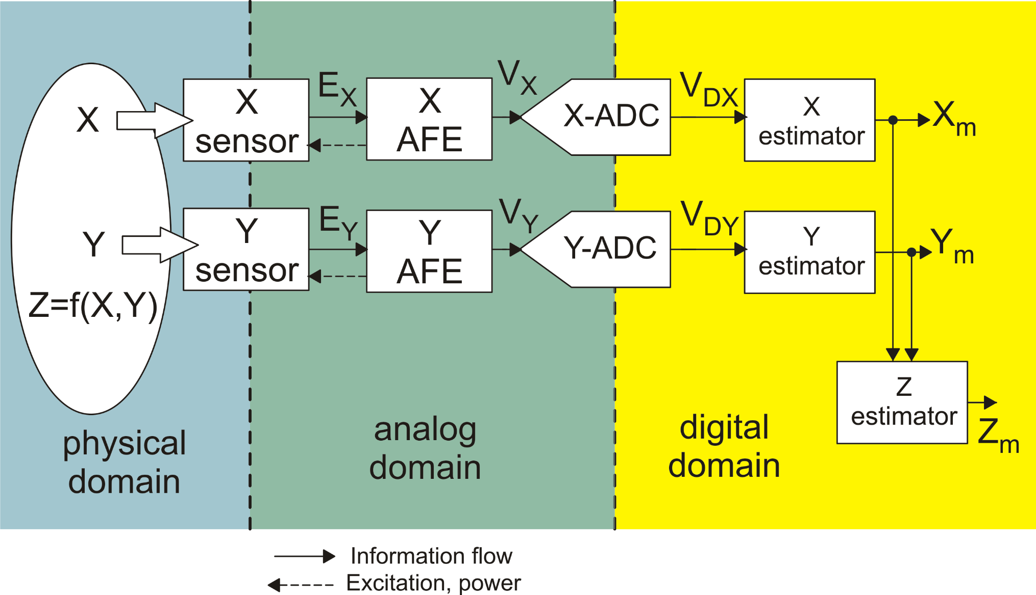
Elements of a DAS: a two-channel case

Slide 5
Signal classification on the basis of quantization
Magnitude
Time

Slide 6
Errors on the ideal transfer function
Nominal (ideal) case:
Once V is known, X can be known exactly:
Real case:
is the output error defined as: V_{ideal} − V
In an acquisition system, the error is not known in a deterministic way.
To find the input quantity (X) we can only apply the inverse of the nominal transfer function to the real output quantity (we do not know the real t.f.):

Slide 7
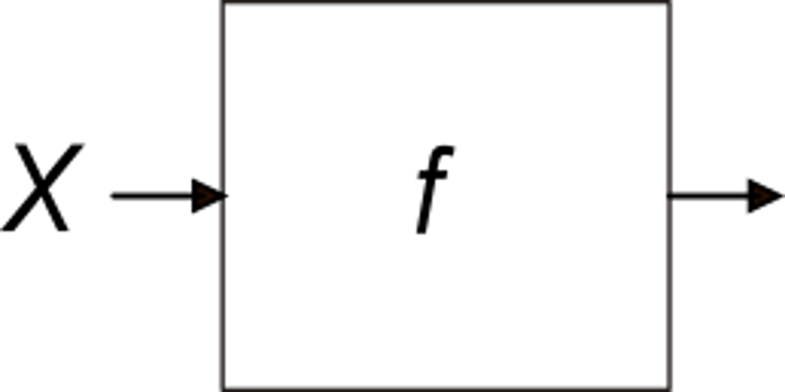
RTI (Referred to Input) Error
Property of Inverse Functions
RTI Error

Slide 8
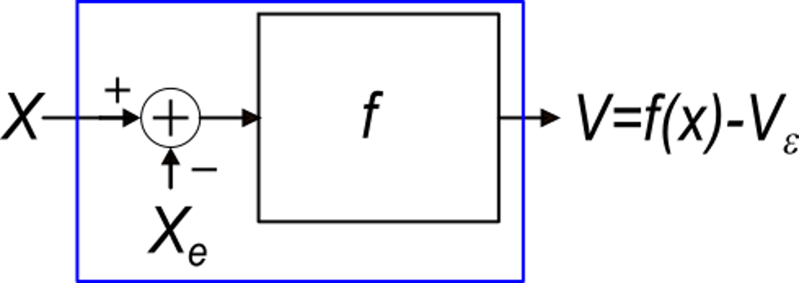
RTI Error: Equivalent block diagram for small errors
If the first order approximation that we have seen holds, it is possible to use the following equivalent representation:
Verification:
Ideal block
Equivalent representation
of the real block
Then, the equivalent block behaves as the real block
X_{e} is the value of the input quantity X that nulls the output
In this case, the dc value of Xe is the input offset

Slide 9
System performance vs type of errors
Offset
Gain error
Non-linearity errors
System
Static Accuracy
Noise
System Resolution
Dynamic errors
(finite response time)
System response speed

Slide 10
Non-linearity errors
Generally, the maximum non-linearity error in the whole range of the input quantity X is indicated in the specifications
If the non-linear curve is well reproducible, the non-linearity error can be compensated for by means of a non-linear estimator.
For random non-linearities, individual multi-point trimming is necessary.

Slide 11
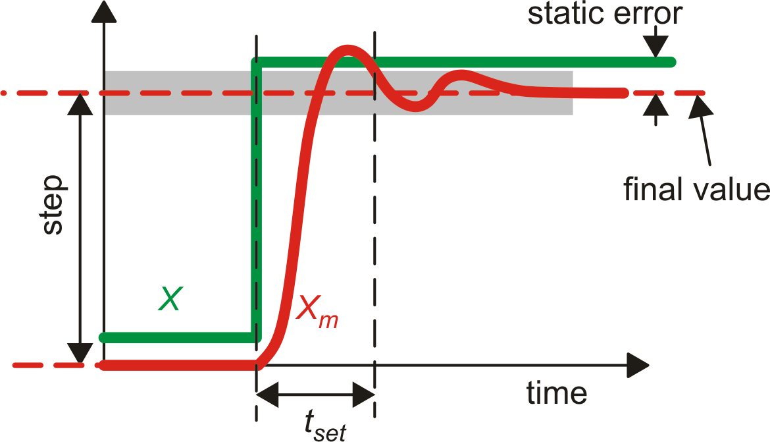
Dynamic errors
Settling time t_{set}:
Time required to have the
output voltage stay close
to the final value within
a given relative error
Typical error specs:
1 % (low accuracy)
0.01 % (high accuracy)

Slide 12
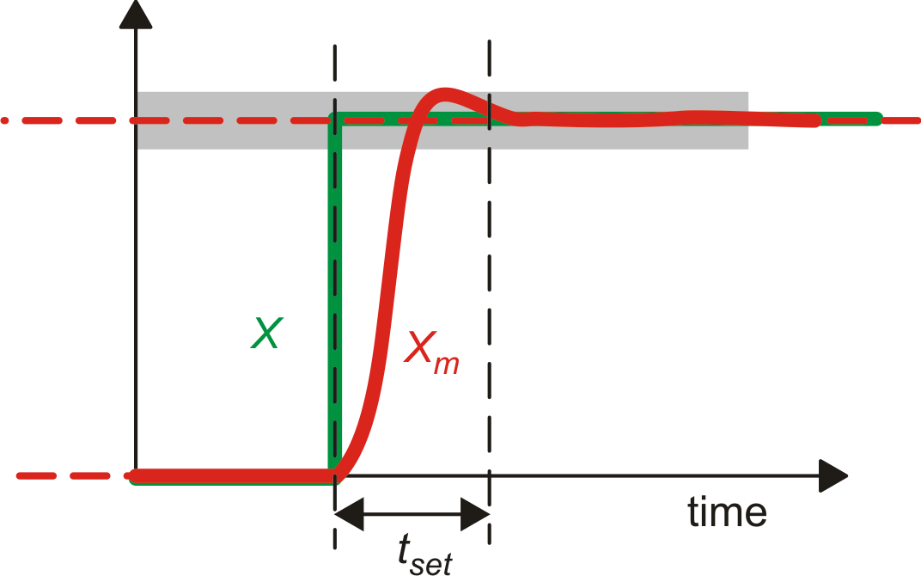
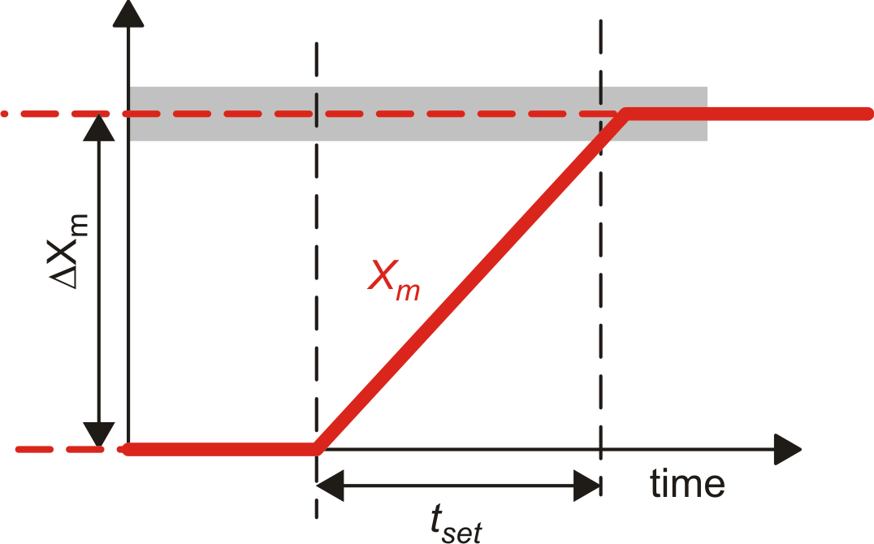
Linear time and slew-rate time
Linear-time only
(all stages behave linearly)
Slew-rate only
(most of the transition time at least one stage is saturated)

Slide 13
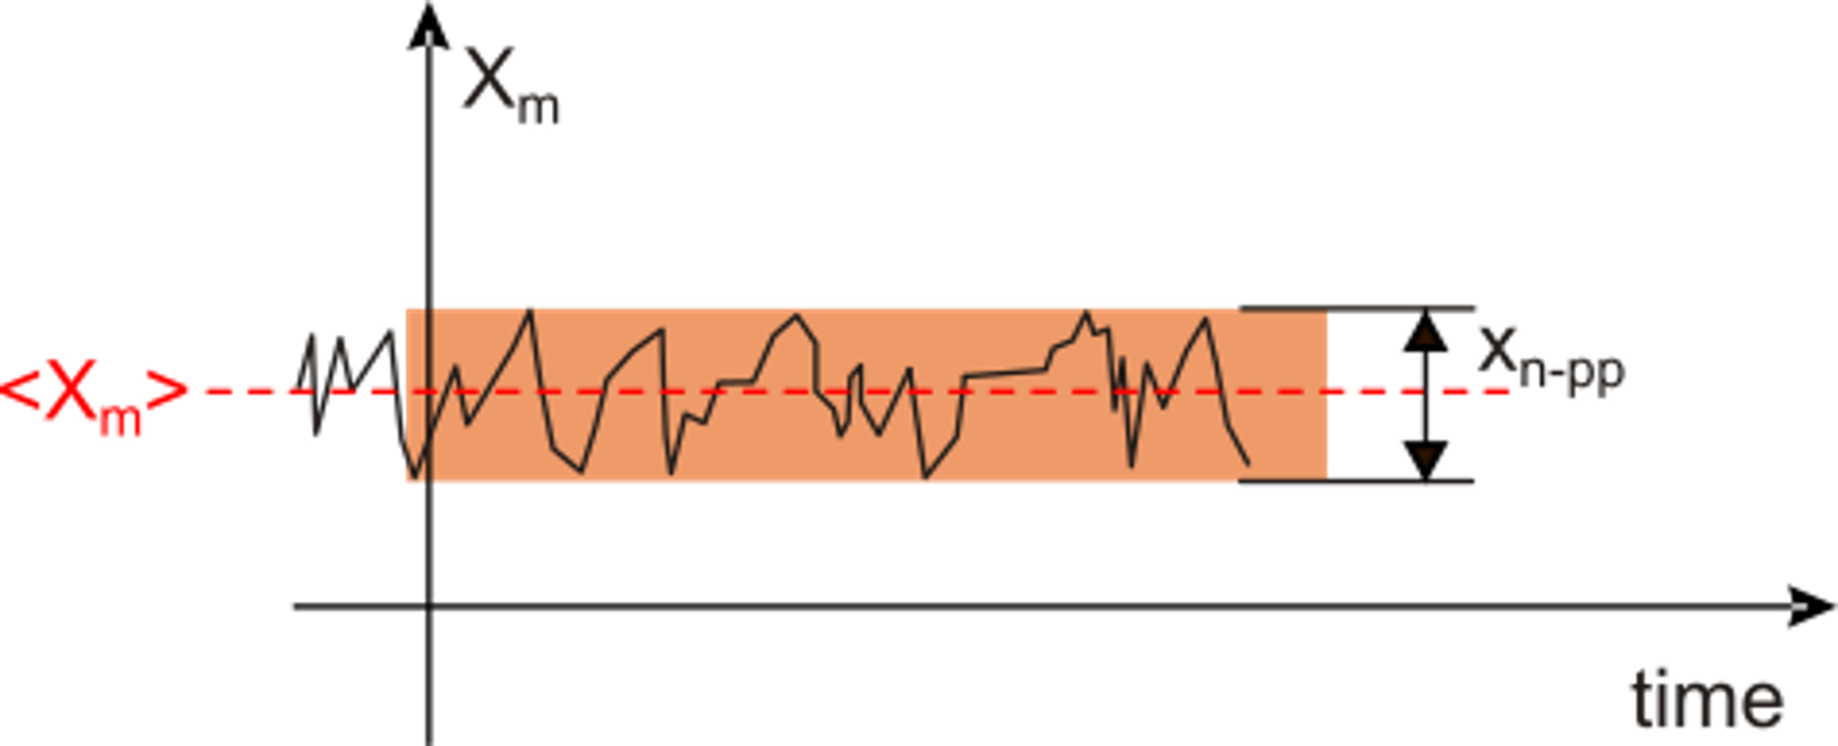
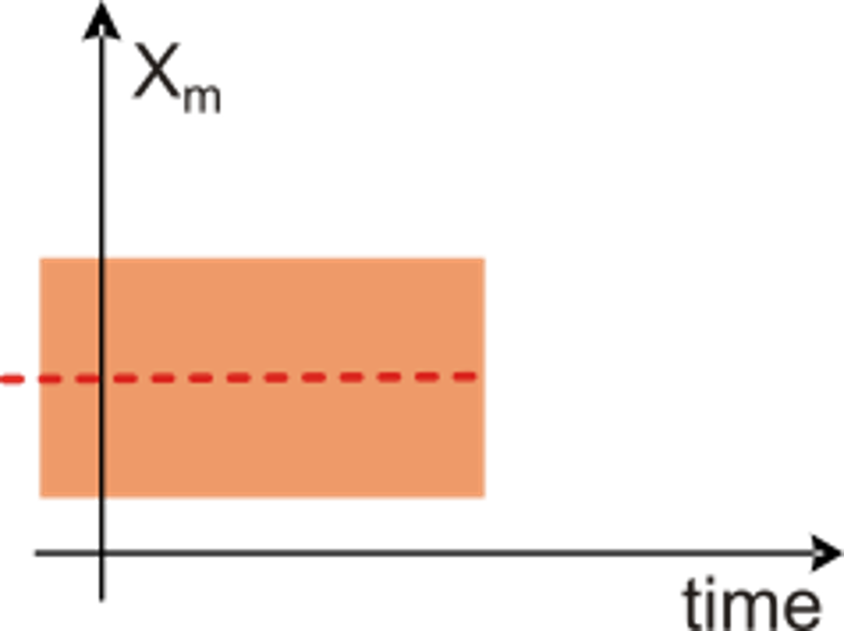
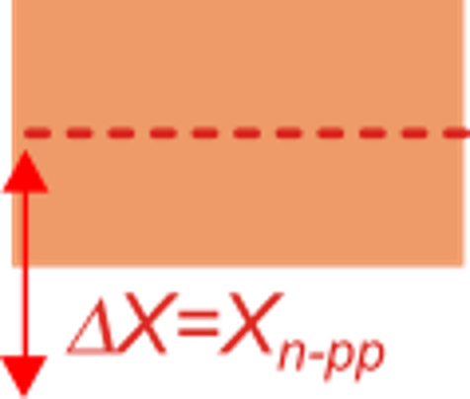
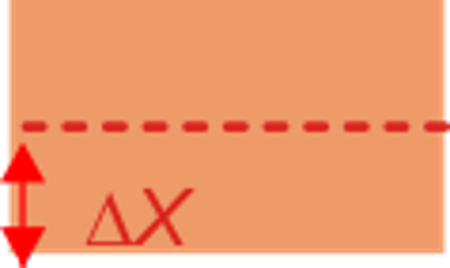
Noise and resolution
Samples in this range are compatible
with both the X and X+ΔX input.
Therefore, it is not guaranteed that
a difference ΔX can be recognized
Minimum difference ΔX that can be reliably detected:

Slide 14
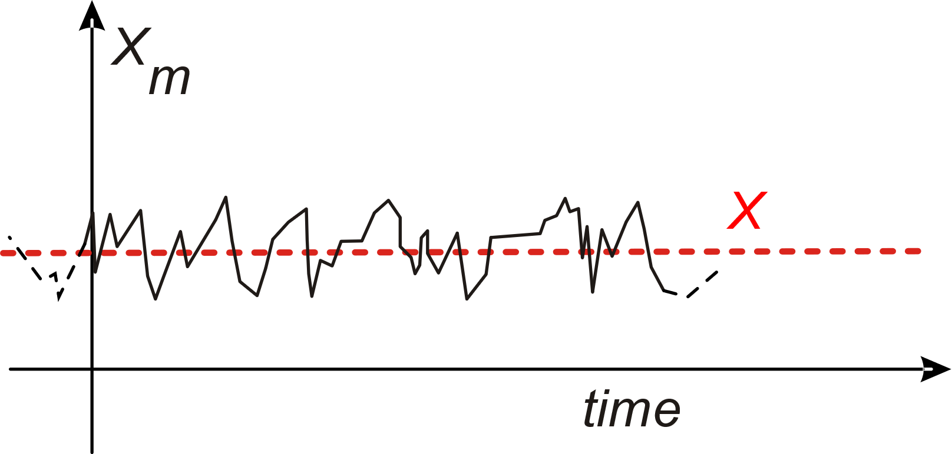
Noise: peak-to-peak, rms and standard deviation
X_{n-pp}
C_{f}= crest factor
For gaussian noise
If we sample the noise
x_{n}, then the standard
deviation of the samples is:
Interval | Total interval width (x_{np-p}) | Probability | 1 − probability
±σ | 2 σ | 0.683 (68.3 %) | 0.317
±2σ | 4 σ | 0.954 (95.4 %) | 0.046
±3σ | 6 σ | 0.997 (99.7 %) | 0.003
±4σ | 8 σ | 0.999936 (99.9936 %) | 6.4×10⁻⁵
Our choice:

Slide 15
The Dynamic Range (DR)
Signal range
X_{max}
δx generally is the resolution
X_{max}−X_{min}=X_{FS}
Full scale (excursion)
X_{min}

Slide 16
DR and maximum number of significant levels
X_{max}
Number of distinguishable levels = DR
X_{FS}
The presence of noise cause a sort of quantization of the analog signal, at least in terms of usable levels
Fist level that the system can distinguish from X_{min}
δx
X_{min}

