Slide 1
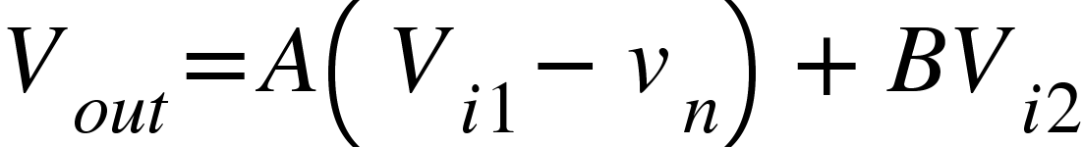
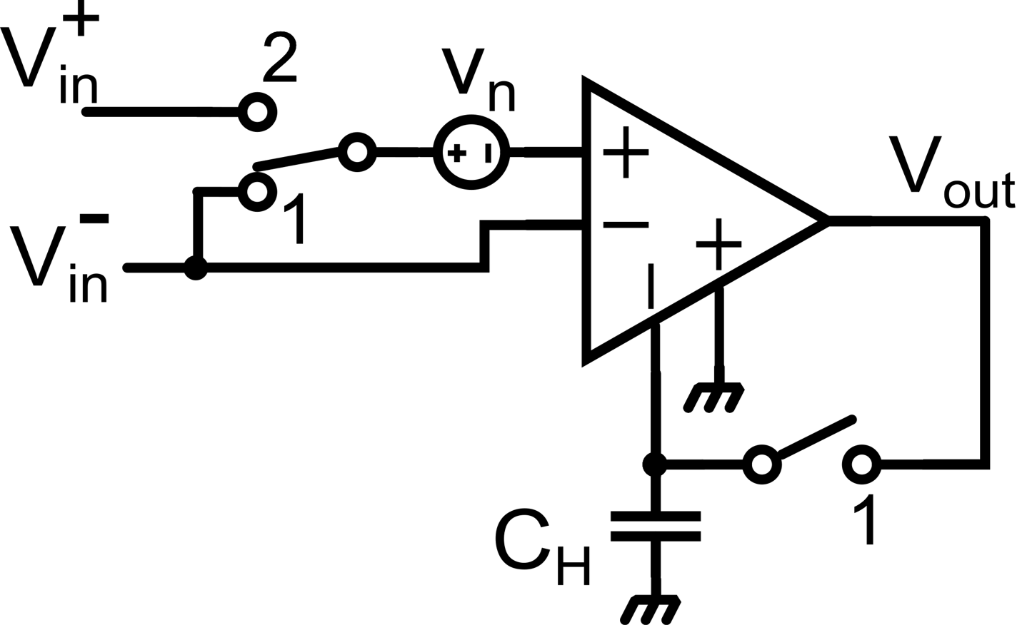
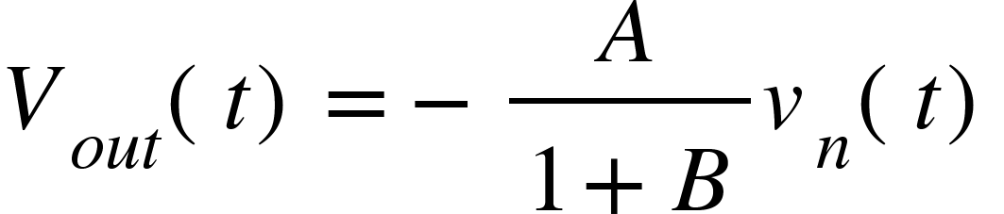
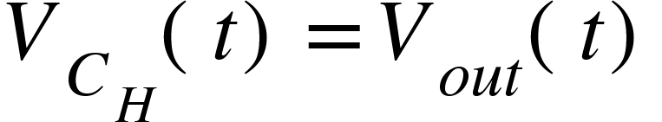
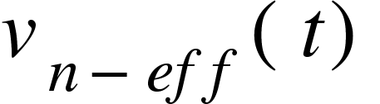
Offset compensation using an additional input port
V_{i1} is the input signal port, V_{i2} is the offset calibration port
(offset and noise are referred to the input signal port)
AZ compensation:
Phase 1:
Phase 2:

Slide 2
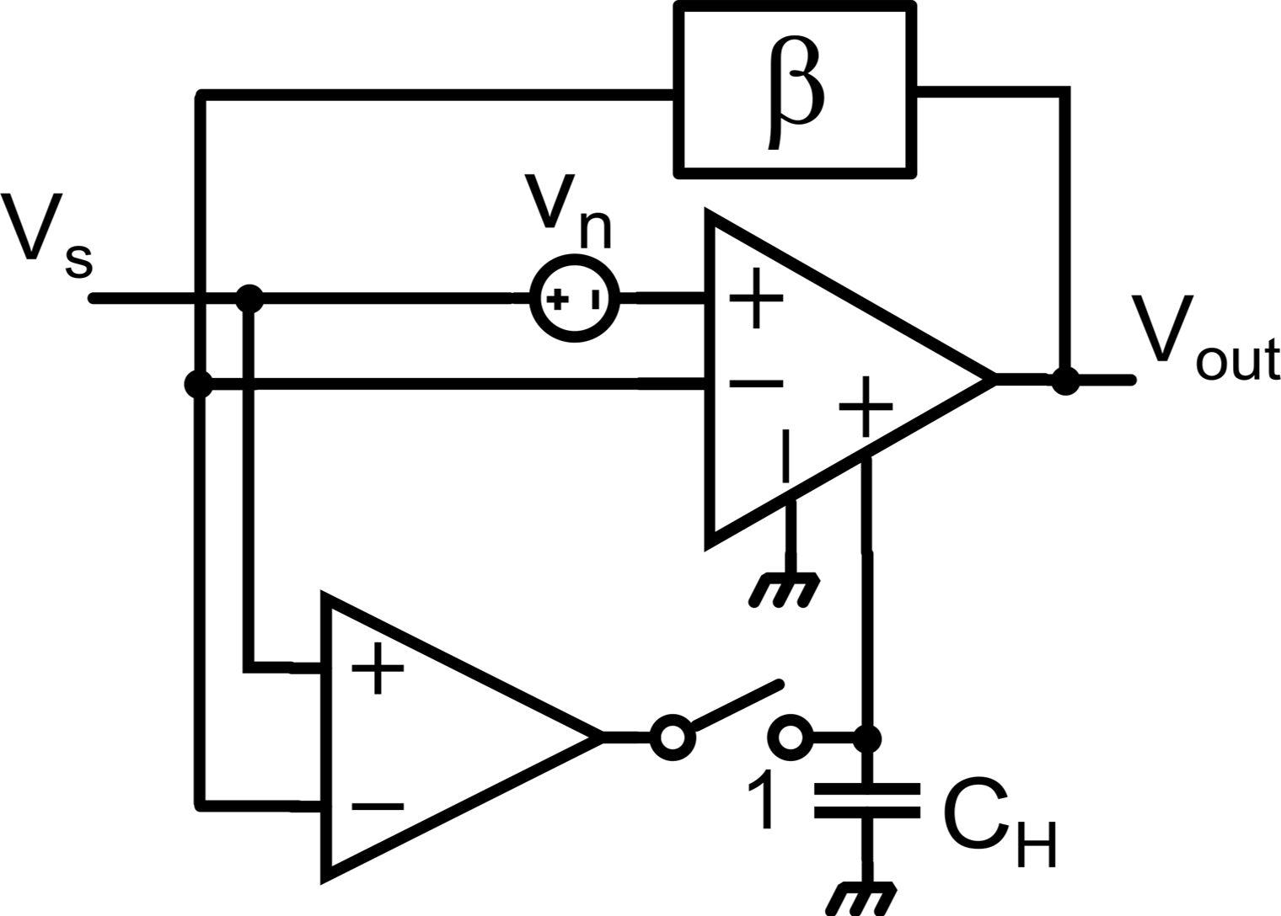
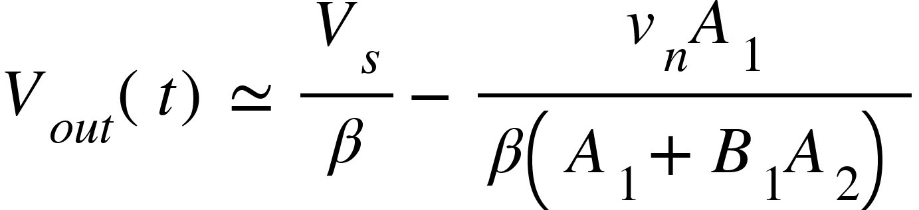
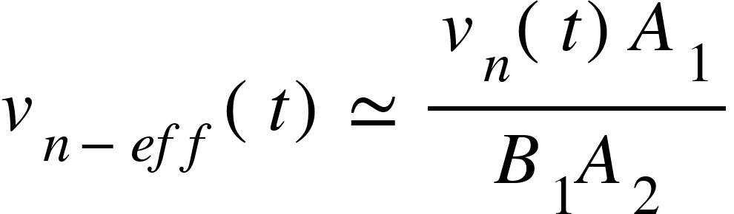
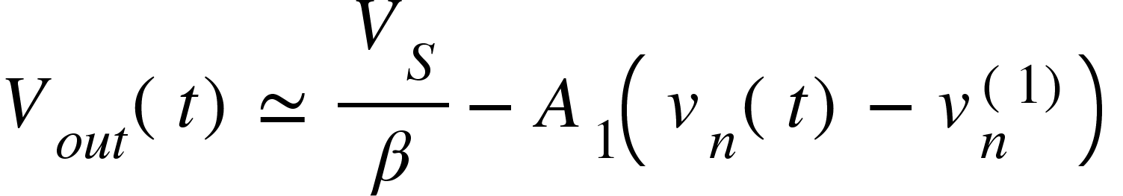
Continuous-time AZ amplifiers
Main Amplifier (A₁)
Hp.: Null Amplifier without offset
Phase 1:
Null Amplifier (A₂)
Phase 2:

Slide 3
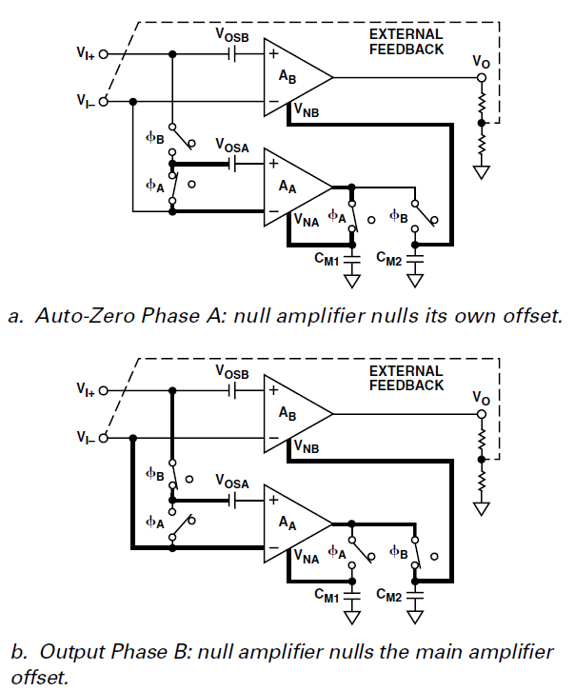
Commercial Zero-Drift Operational Amplifiers based on AZ
(AD8551, TLC2654, OPA335…)
Main Amplifier
Main Amplifier
Null Amplifier
Null Amplifier

Slide 4
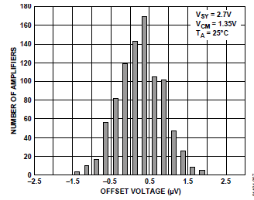
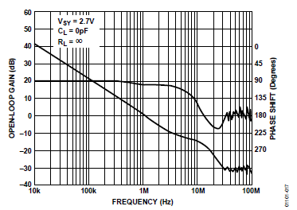
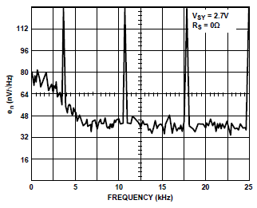
Commercial Zero-Drift Operational Amplifiers based on AZ
(AD8551)
f_{AZ} = 4 kHz

Slide 5
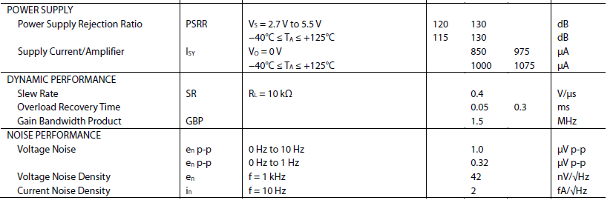
Commercial Zero-Drift Operational Amplifiers based on AZ
(AD8551, TLC2654, OPA335…)

Slide 6
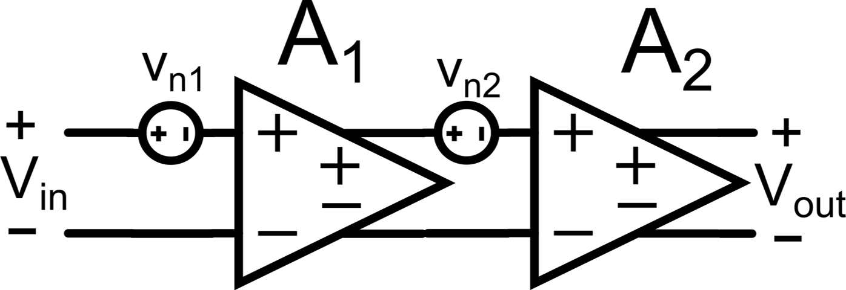
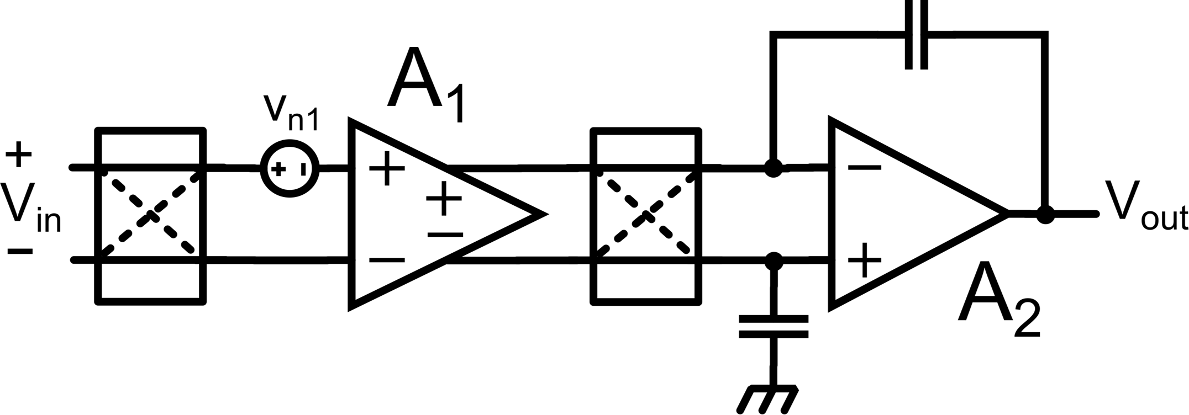
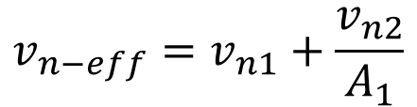

Chopper Amplifier
$$v_{n−out}=A_{1}A_{2}v_{n1}+A_{2}v_{n2}$$
$$v_{n−eff}=v_{n1}+\frac{v_{n2}}{A_{1}}$$
RTI offset of the second stage is attenuated by A₁
We can apply CHS only to the first stage and use the second stage as 1° order LPF (e.g. Miller Compensation)
Offset ripple is too large to be rejected by a 1° order LPF
* Y. Jusuda, “Auto Correction Feedback for Ripple Suppression in a Chopper Amplifier” – IEEE JSSC 2010

Slide 7
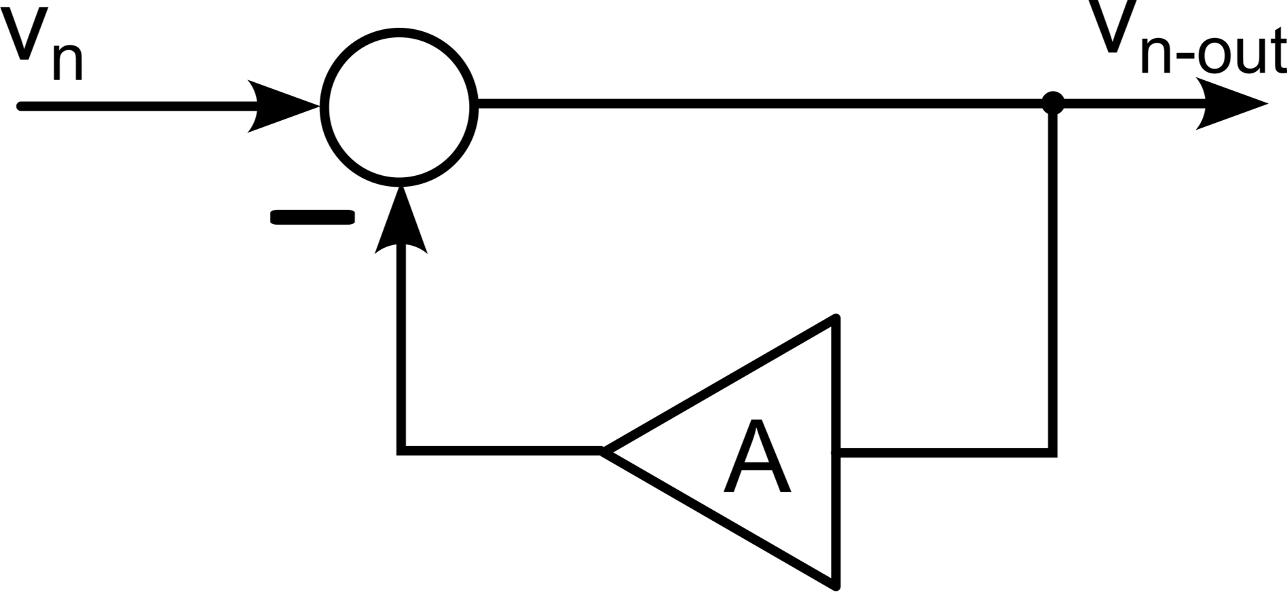
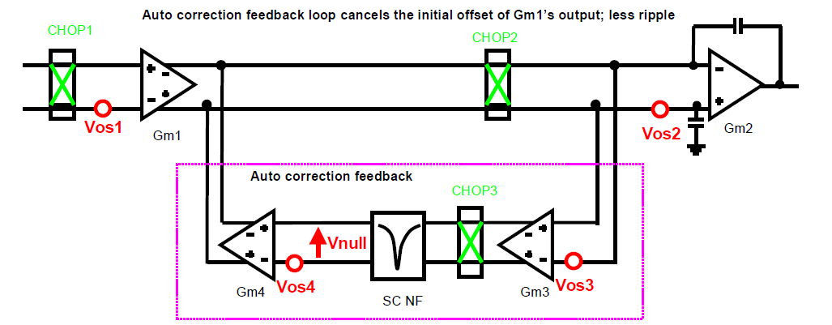
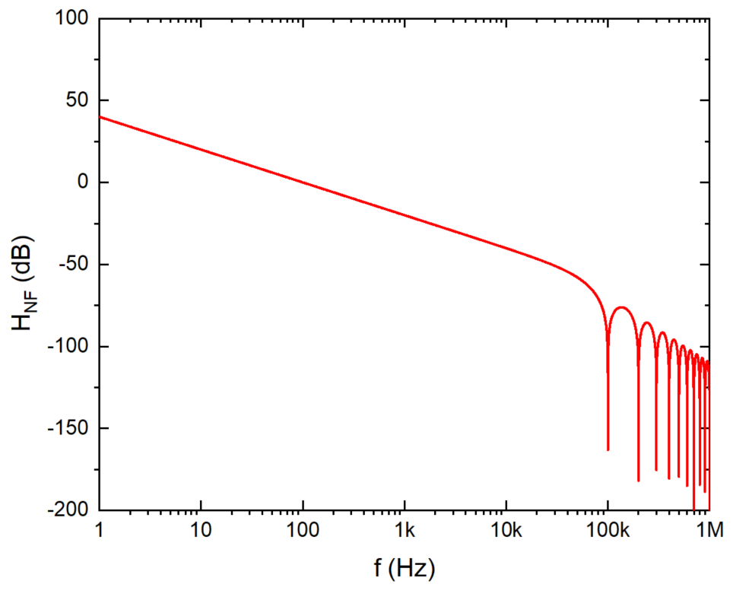




Auto-Correction Feedback for Ripple Suppression*
$$v_{n−out}=v_{n}−Av_{n−out}$$
$$v_{n−out}=\frac{v_{n}}{1+A}$$
Amplifier A must be without offset and input signal must not be attenuated!
A₁
A₂
$$v_{n−out}$$
Ex.: f_{ch}=100 kHz
$$v_{n−out}=v_{os1}A_{1}−v_{n−out}A_{3}A_{4}−v_{os4}A_{4}$$
A₄
A₃
$$v_{n−out}=\frac{v_{os1}A_{1}}{1+A_{3}A_{4}}−\frac{v_{os4}}{A_{3}}$$
* Y. Jusuda, “Auto Correction Feedback for Ripple Suppression in a Chopper Amplifier” – IEEE JSSC 2010

Slide 8
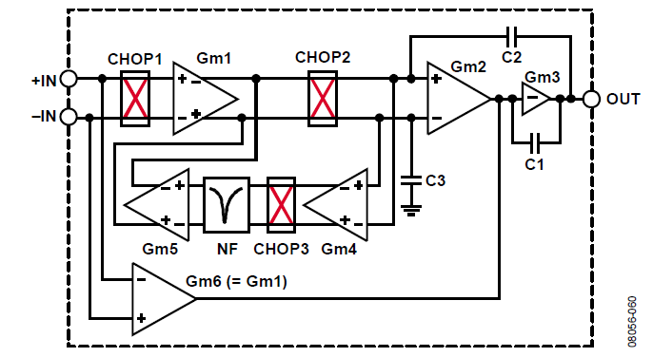
Commercial Zero-Drift Operational Amplifiers based on CHS (ADA4051)
DC Path
Feedforward Path

Slide 9
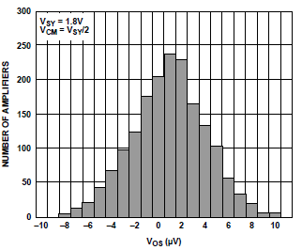
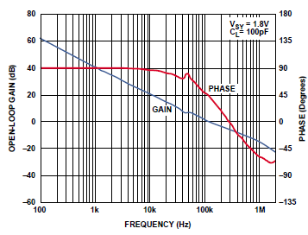
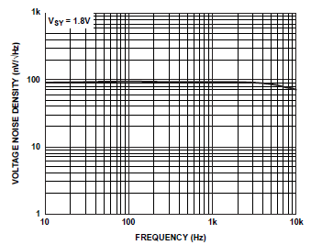
Commercial Zero-Drift Operational Amplifiers based on CHS (ADA4051)
f_{ch} = 40 kHz

Slide 10
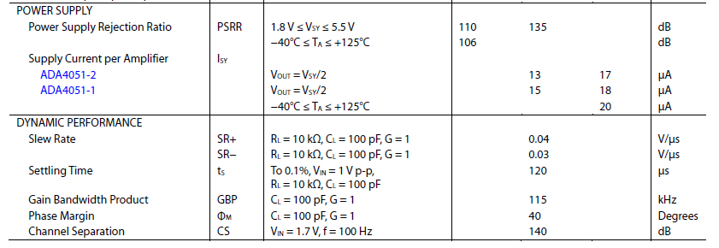

Commercial Zero-Drift Operational Amplifiers based on CHS (ADA4051)

