Slide 1
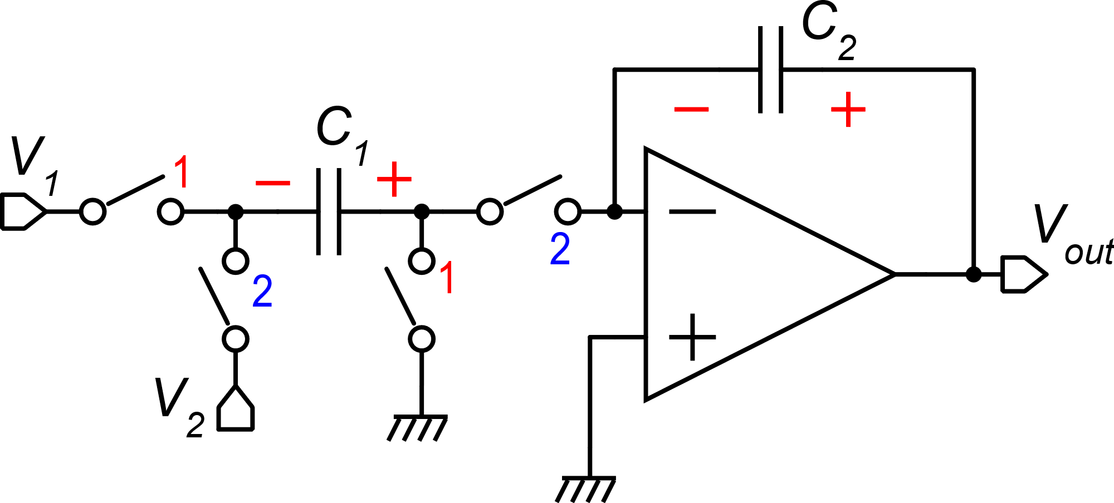
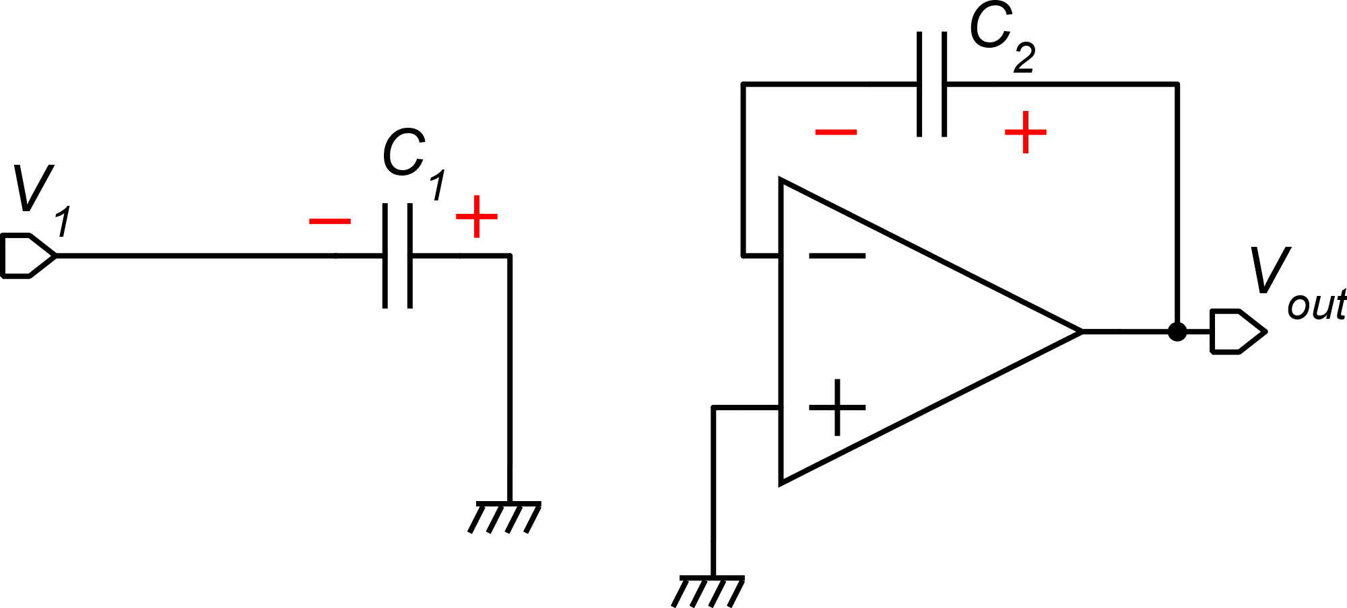
Parasitic insensitive SC integrator
Phase 1
Simplifying hypotheses:
No offset / noise
Perfect virtual short circuit
No charge injection
2-prev
1
2

Slide 2
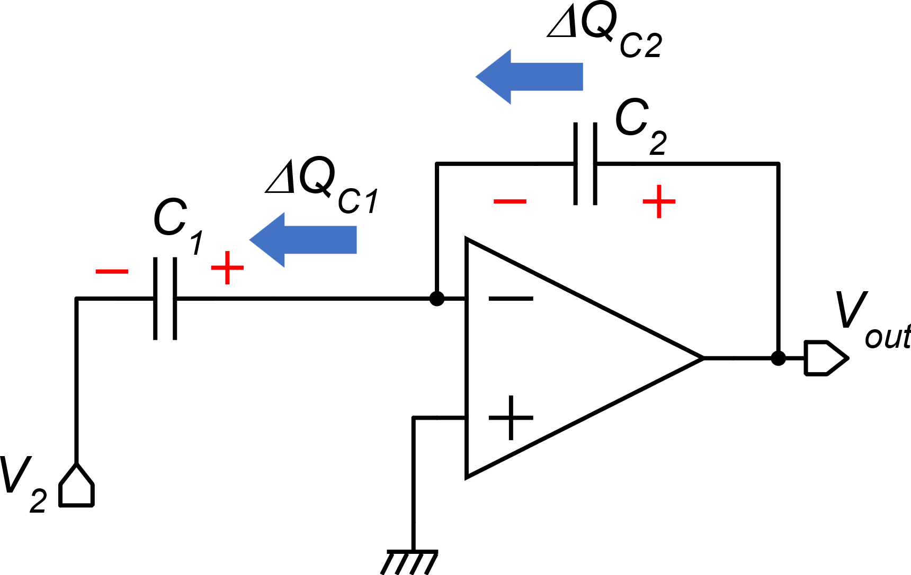
Parasitic insensitive SC integrator
Phase 2

Slide 3
Parasitic insensitive SC integrator
If we consider that V₁ is sampled
at the end of phase 2 and maintained
across phase 1:
2-prev
1
2
(n-1)T
nT

Slide 4
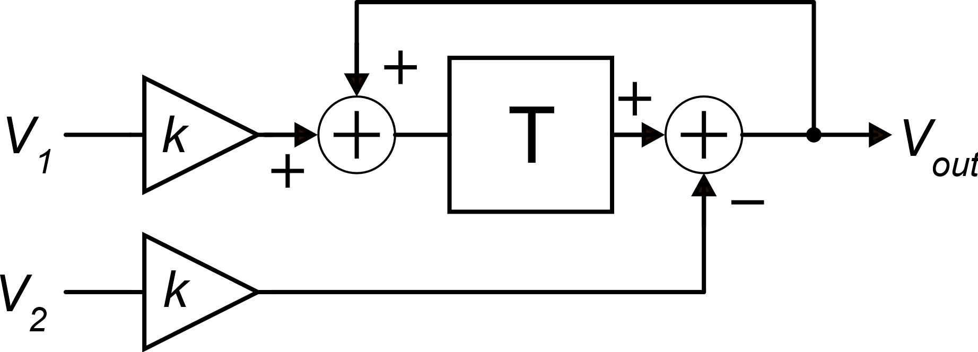
Block diagram and Z-transform
Z-transform
Equivalent block diagram

Slide 5
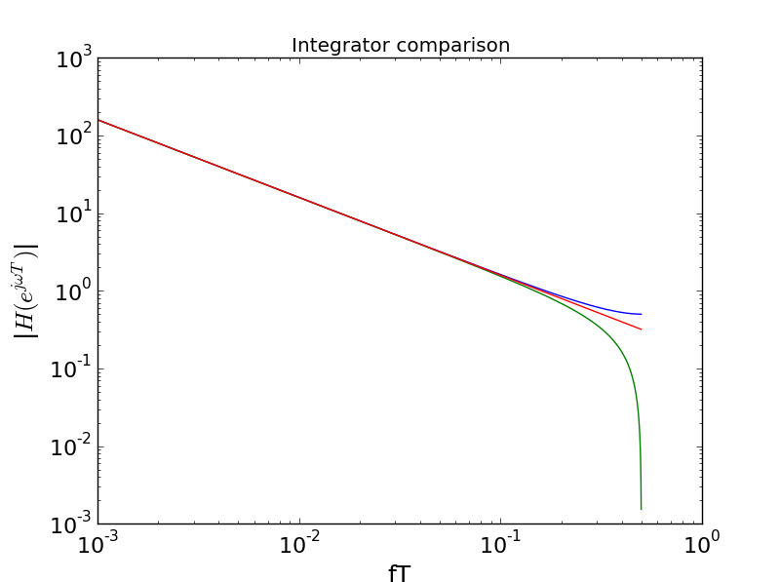
Frequency response
Integrators compared
Forward Euler Integrator
Euler
Backward Euler Integrator
CT
bilinear
0.5
CT: continuous time integrator

