Slide 1
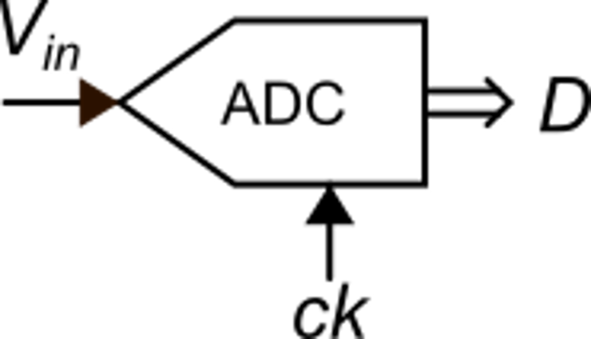
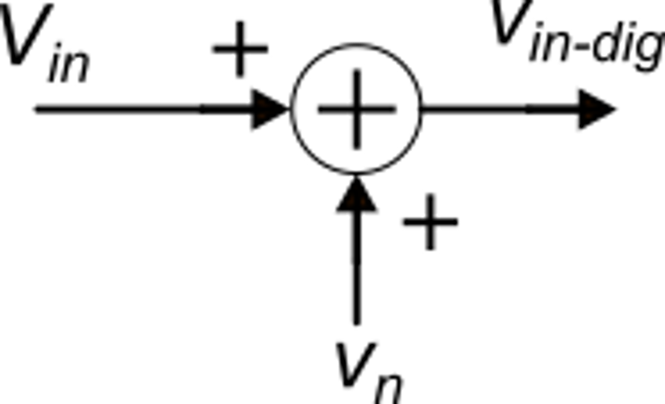
ADC linearized model
Linearized model
v_{n} includes all causes that make v_{in-dig} different from V_{in}
The error due to quantization can be represented by a component of v_{n}: the quantization noise:

Slide 2
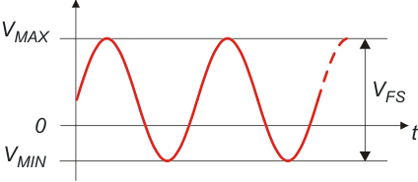
Signal to Noise Ratio and resolution
Input range of the ADC
Considering only quantization noise:

Slide 3
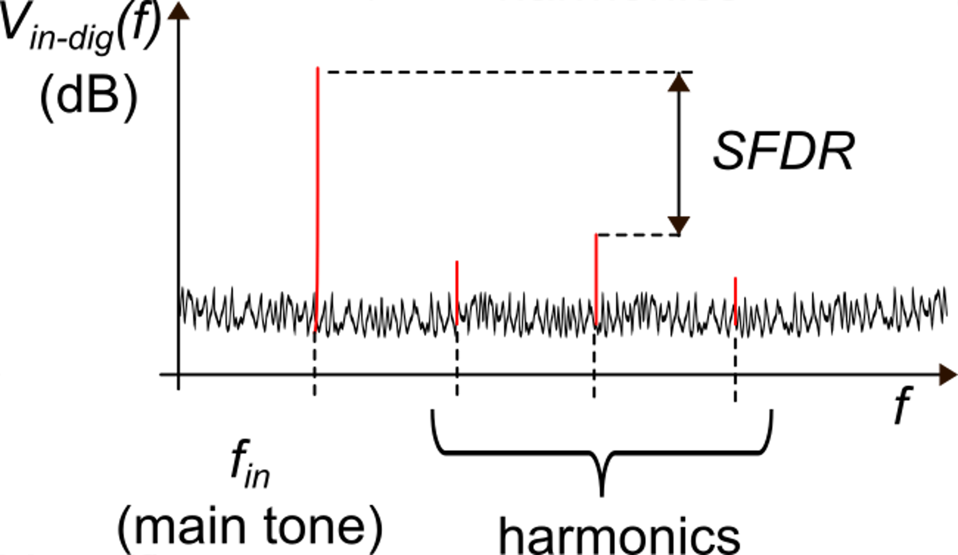
Effective Number Of Bits (ENOB)
Distortion and SFDR (spurious free dynamic range)
P_{D}=total power of the harmonics
Also indicated with SNDR
Quantization and electrical noise

Slide 4
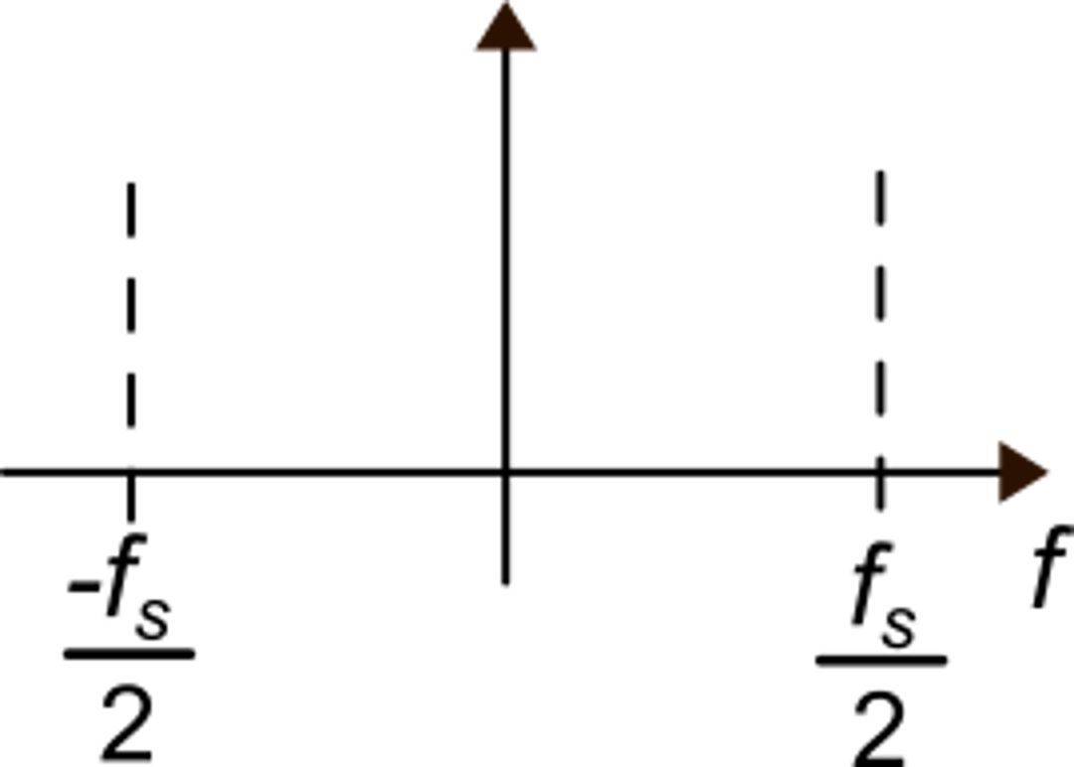
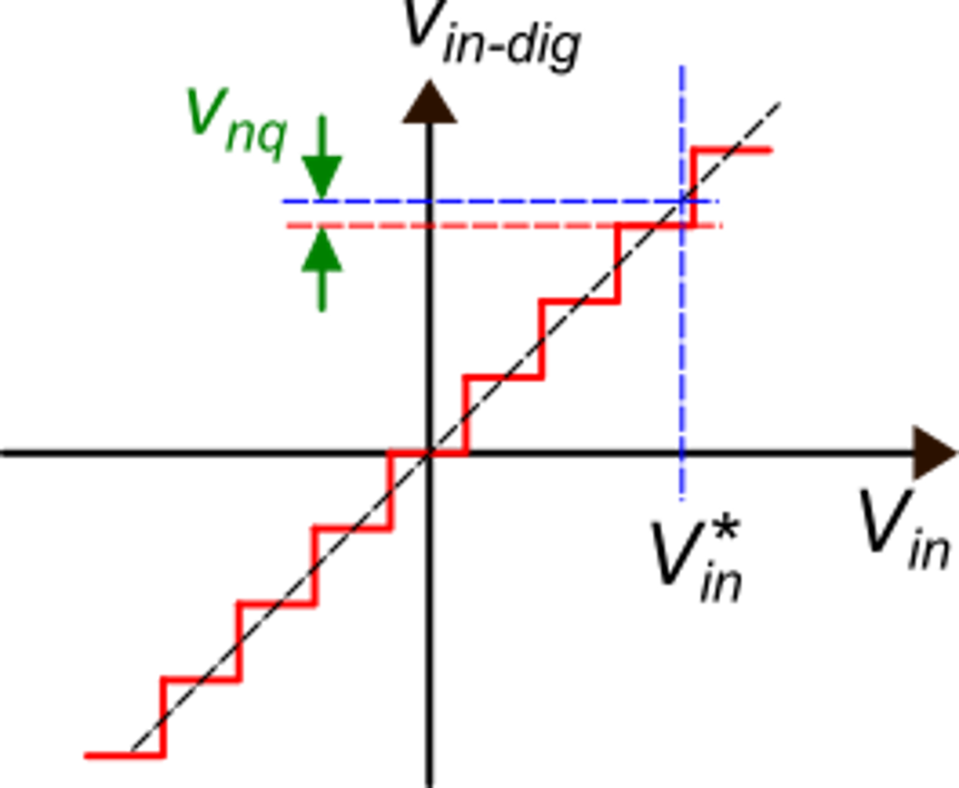
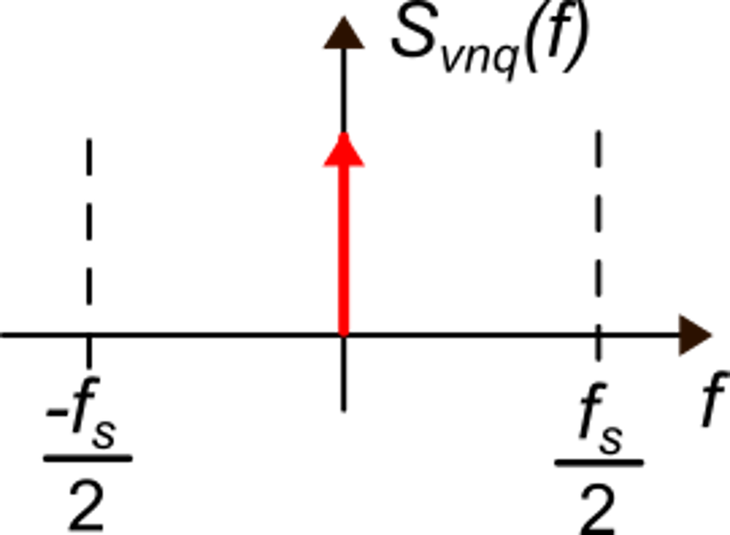
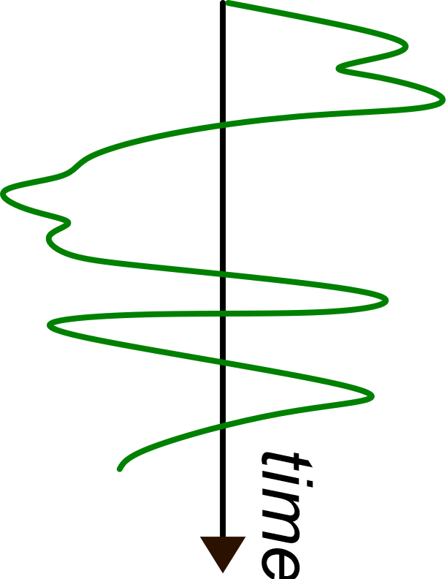
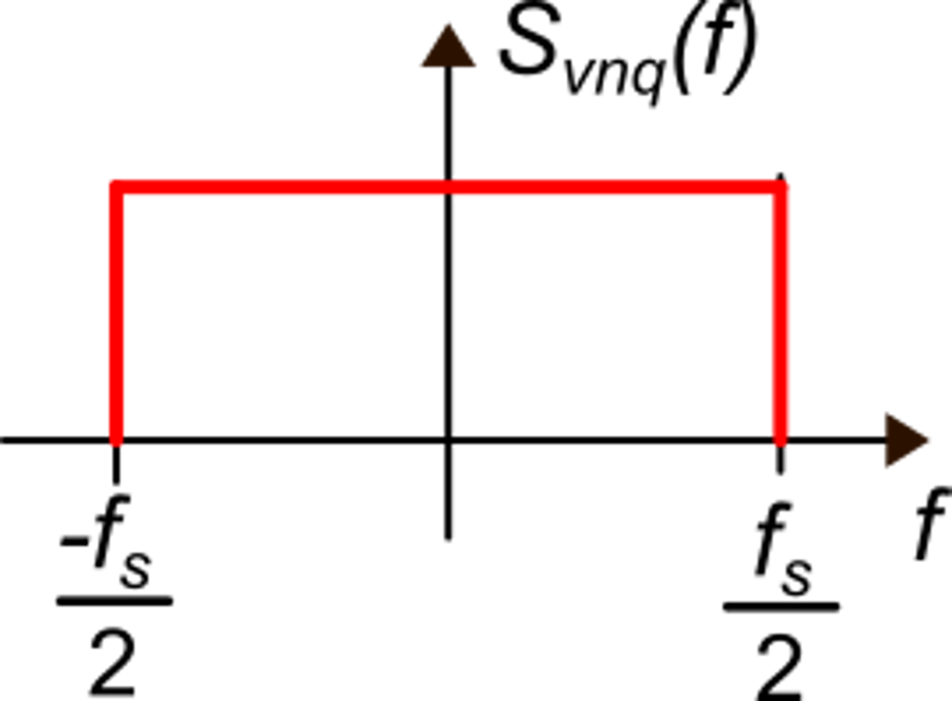
Quantization noise in the frequency domain
The v_{nq} spectrum
is a Dirac delta
Since the ADC samples the input data, the output frequency domain is
[-f_{s}/2,+f_{s}/2]
V_{in} is a dc signal
V_{in} is fast-varying signal
of magnitude >> LSB
Two extreme cases
uniform distribution

Slide 5
The uniform power spectral density (PSD) model for the quantization noise
This model is very useful and simple but should be applied with much care.
In real cases, the quantization noise depends on the input signal, and so does its spectrum.
The uniform spectral density model is acceptable when the input signal has magnitude and/or frequency such that the output levels are changed in a fast and almost random way.
This happens when the average time spent by the signal on a single level is short (of the order of the sampling time).

Slide 6
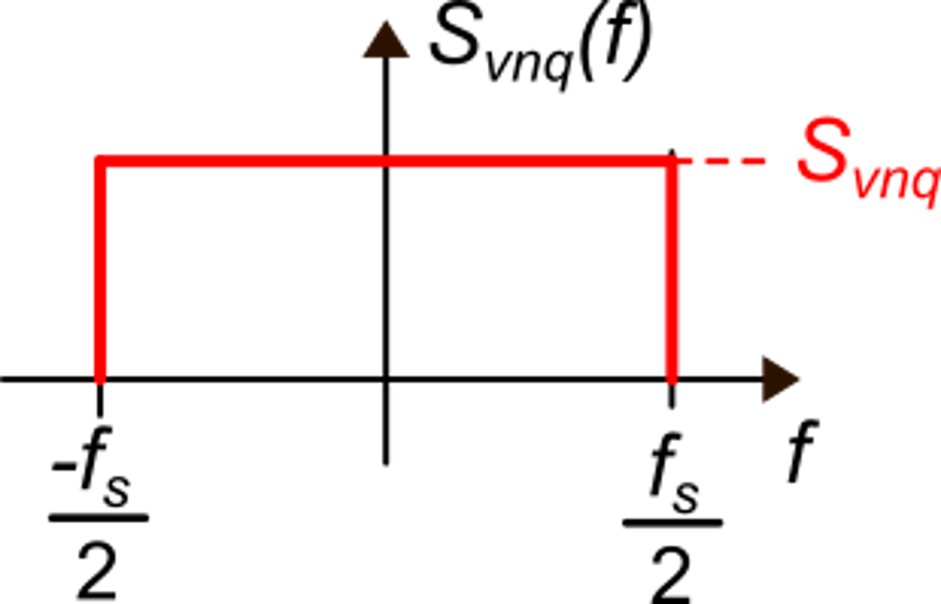
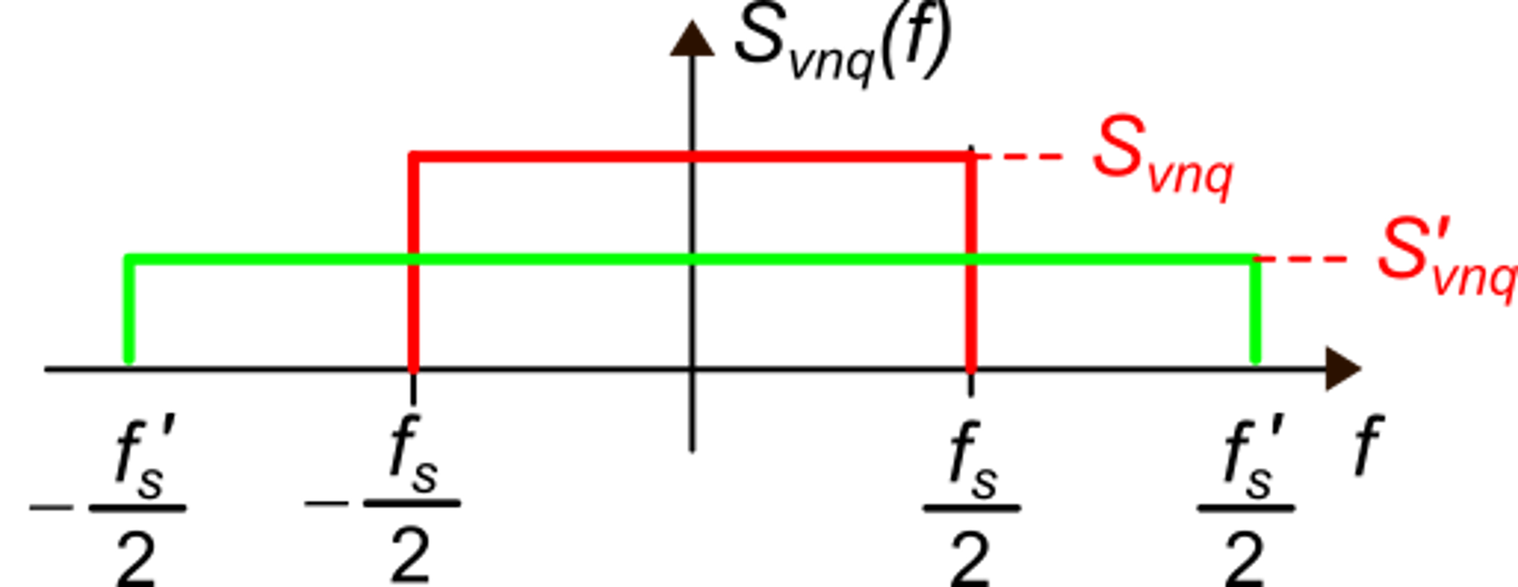
Uniform quantization noise PSD: properties
Total v_{nq} power:
For the same ADC, increasing the sampling frequency reduces the PSD of the quantization noise

Slide 7
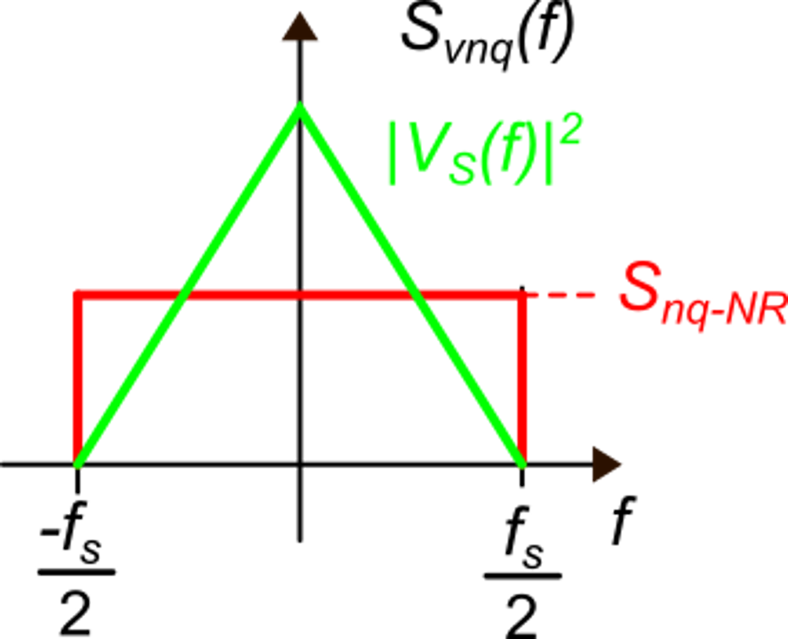
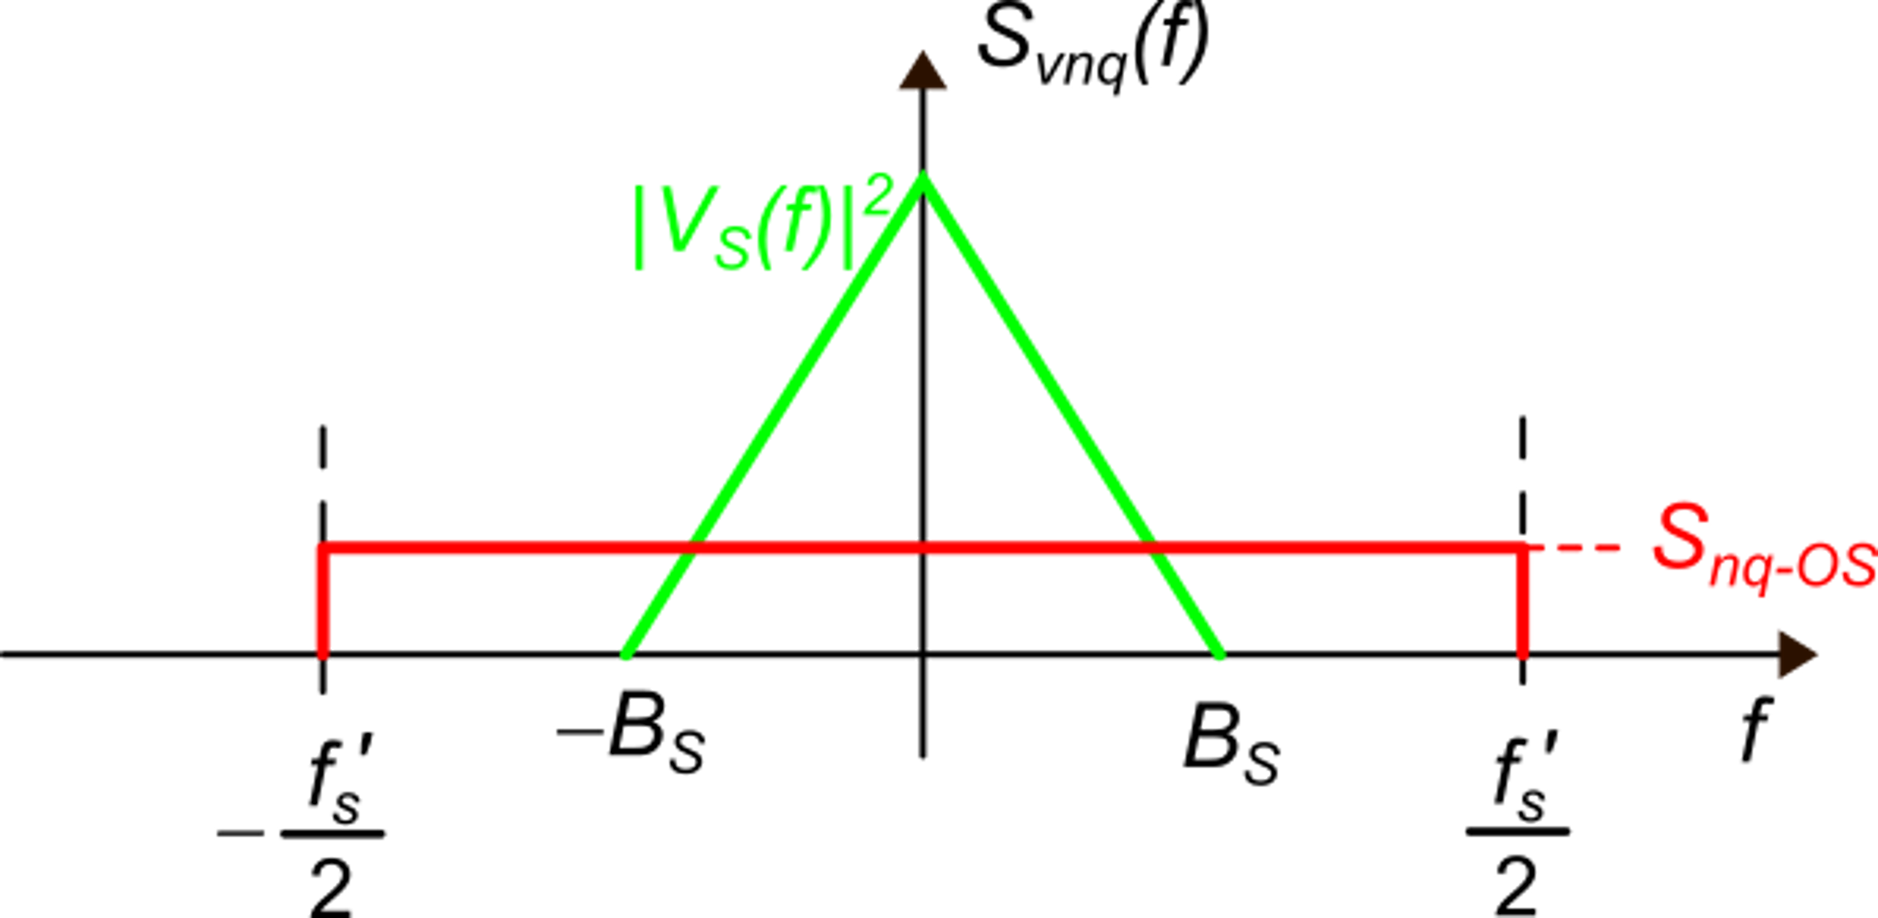
Oversampling ADCs
Nyquist
rate
r_{OS}=Over-Sampling Ratio (OSR)
LPF
Oversampling ADC

Slide 8
Resolution increment in a pure oversampling ADC
Premise
ADC₁: SQNR₁, n₁
ADC₂: SQNR₂, n₂
Considering two ADCs with same V_{FS}

Slide 9
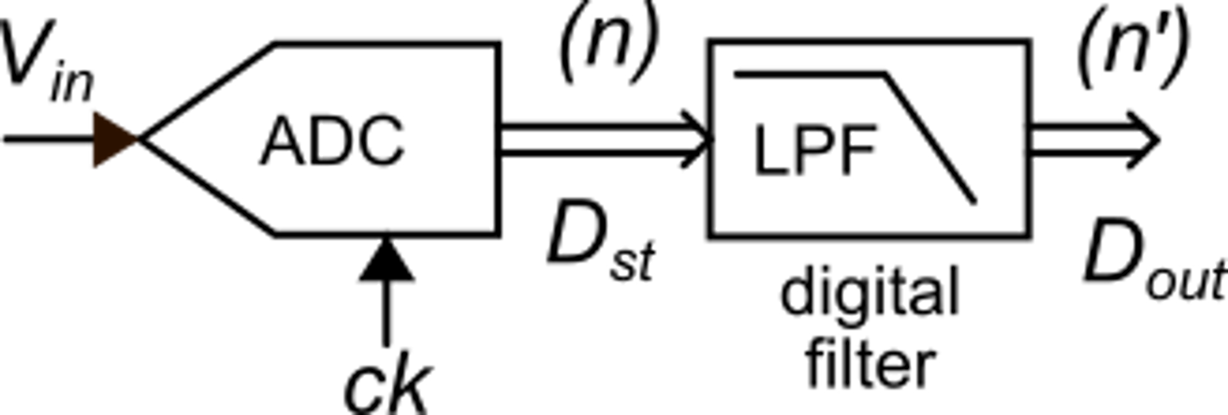
Resolution increment in a pure oversampling ADC
"data stream"
ADC1
ADC2 (oversampling)
same ADC
Resolution improvement

Slide 10
Pure oversampling ADCs: limits
A minor limit:
The oversampling approach is based on the assumption that the quantization noise respects the uniform PSD model
If the input signal is a dc, the quantization noise superimposed on the data stream will be constant and then will be unaffected by the LPF. A similar problem occurs with signals that are slowly-varying and/or have a small magnitude.
constant input
constant datum

Slide 11
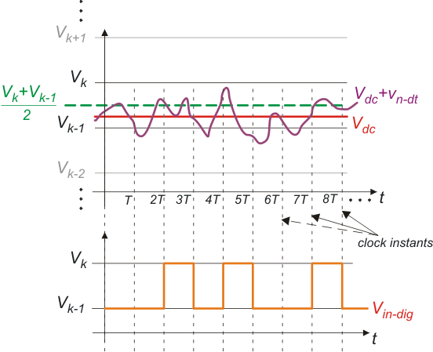
Signal dithering
Noise makes the ADC switch across the two adjacent levels closer to V_{in}
Dithering
Dithering consists in adding noise to the signal.
The added noise must have spectral components out of the signal band so that it is rejected by the LPF

Slide 12
The real limitation of the pure oversampling approach
In order to obtain a resolution increment of a single bit, the sampling frequency must be incremented by a factor of 4
Example:
To obtain 16 bits of resolution from a 12 bit ADC:
The pure oversampling approach is highly inefficient !

Slide 13
The Delta-Sigma (Δ−Σ) ADC
The Delta-Sigma converter combines two principles:
Oversampling: f_{s}>>2B_{s}
Noise shaping
It was introduced in 1960
The term "Sigma-Delta (Σ−Δ)" ADC is simply a synonym.

Slide 14
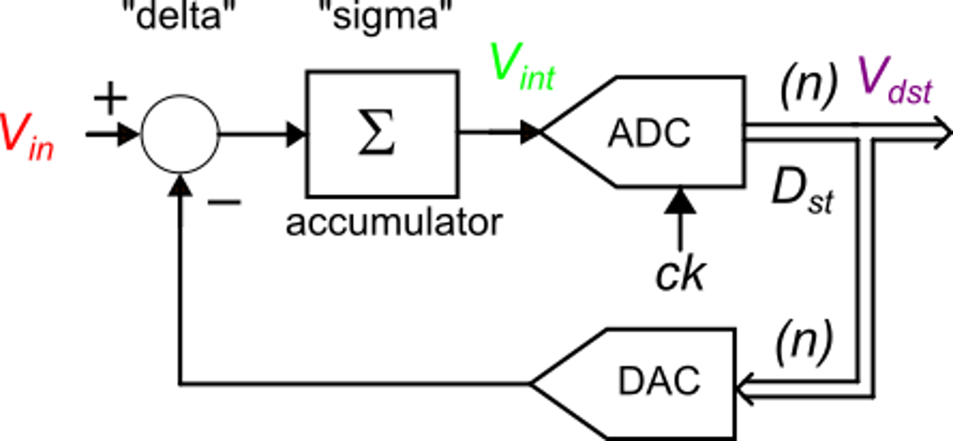
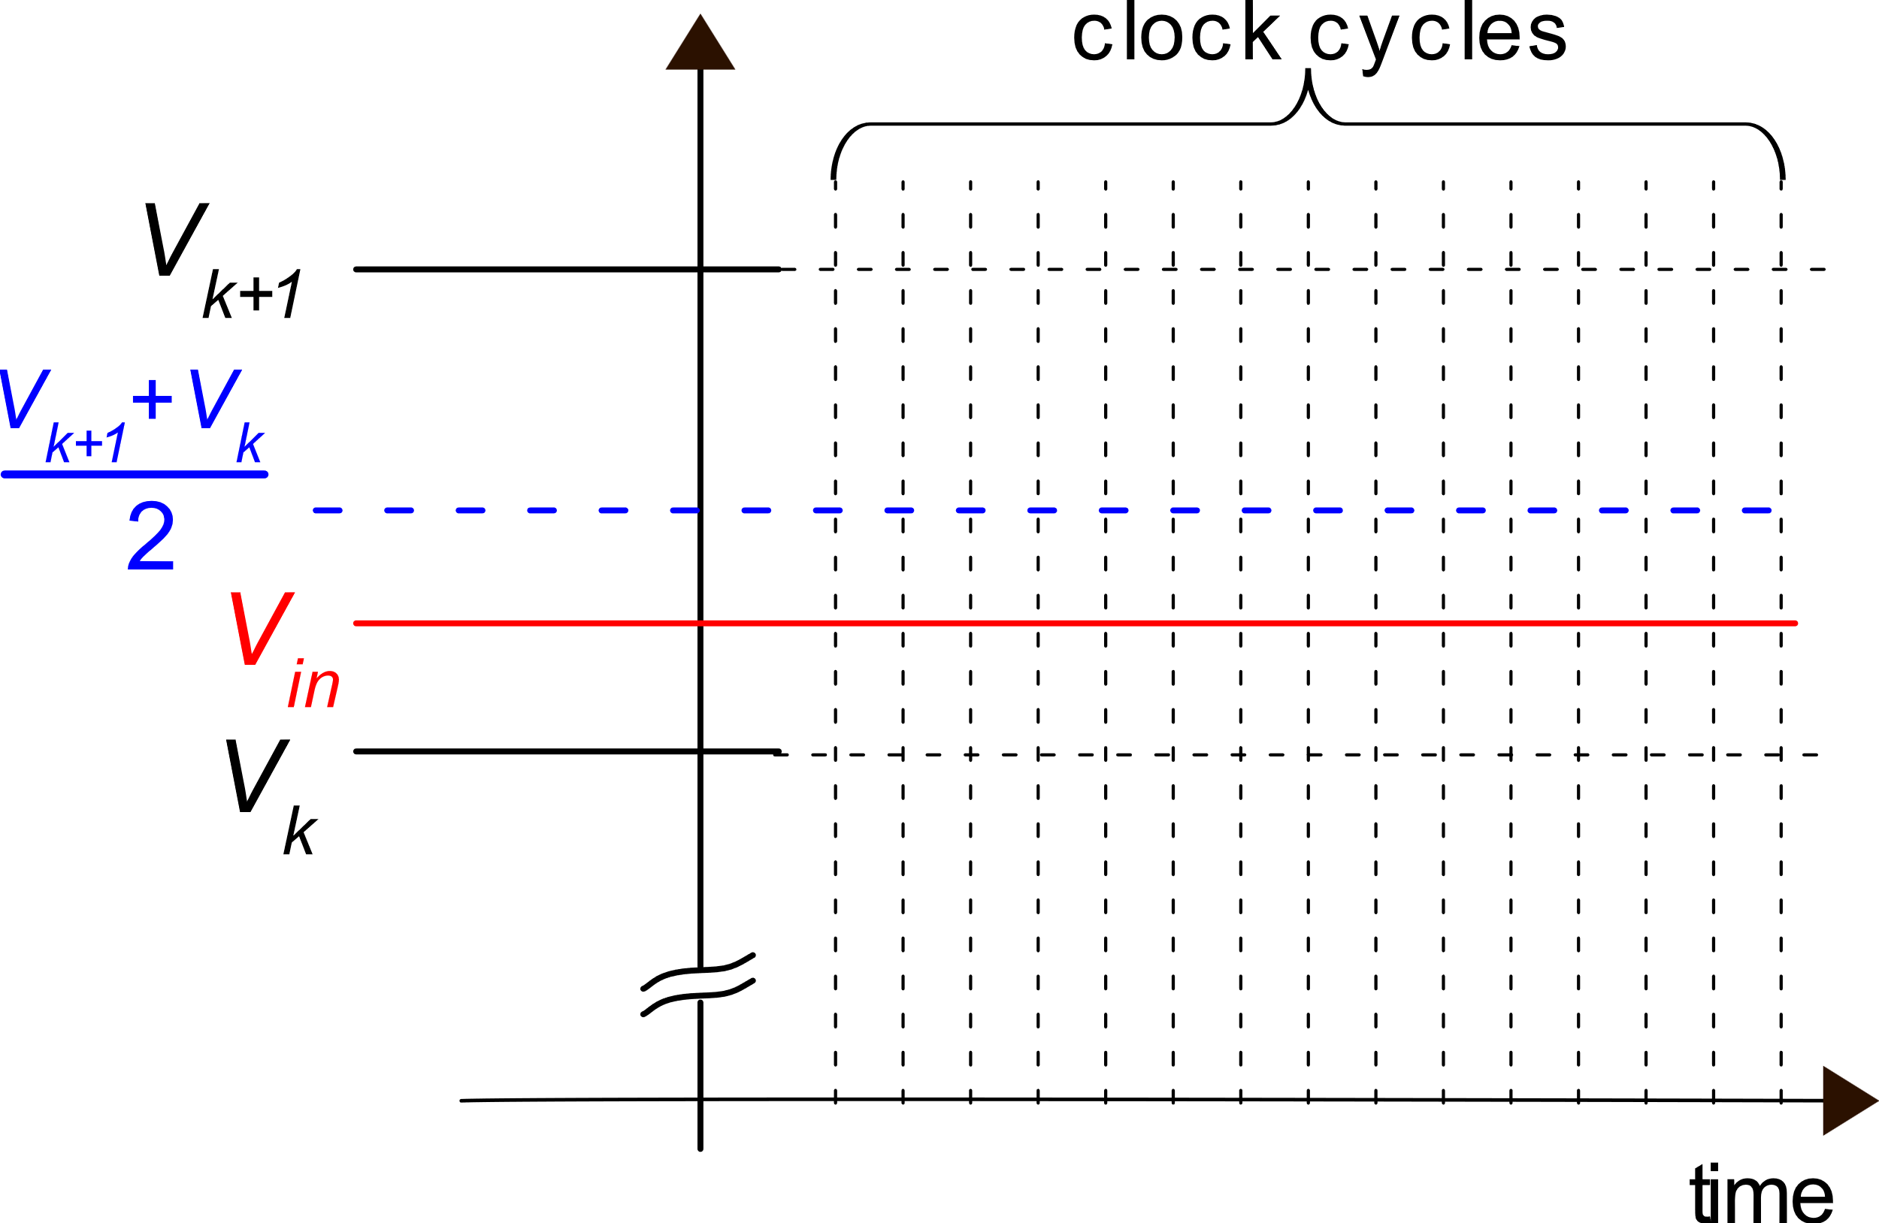
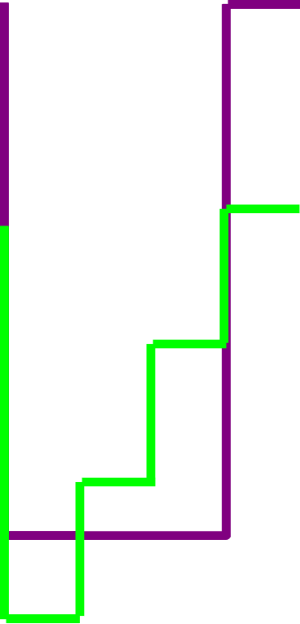
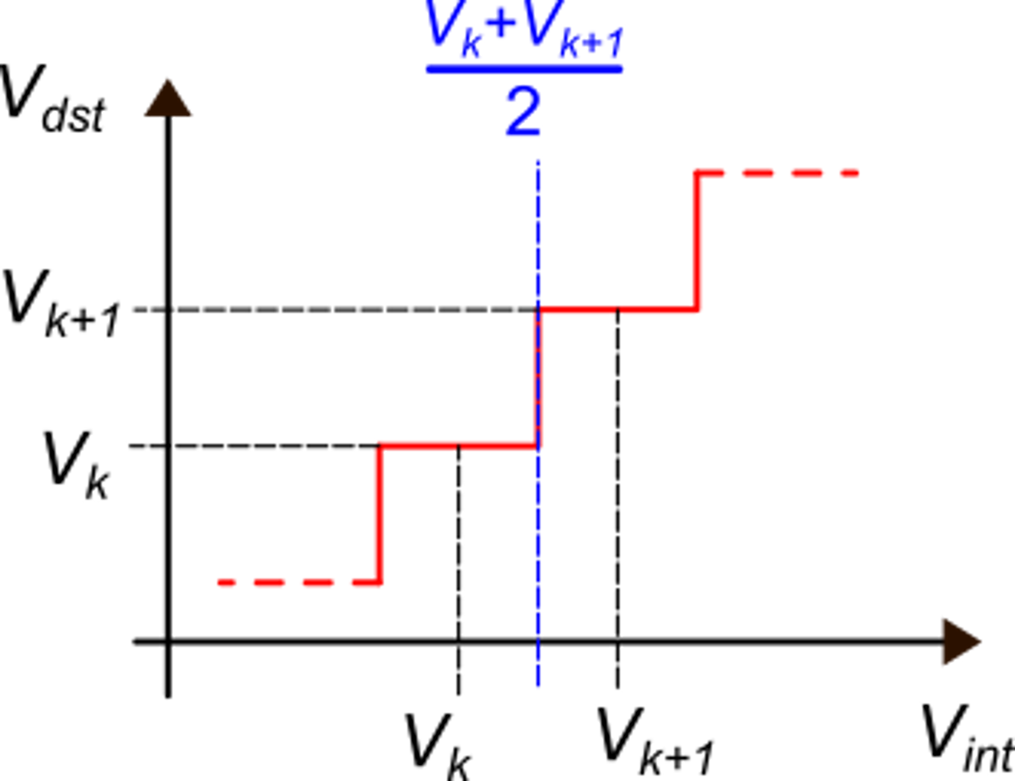
Delta-Sigma principle
The Delta-Sigma modulator (1st order)
V_{fb}
V_{fb} = V_{dst}
ideal DAC
V_{dst}
V_{int}
we imagine to start with V_{int}=0

Slide 15
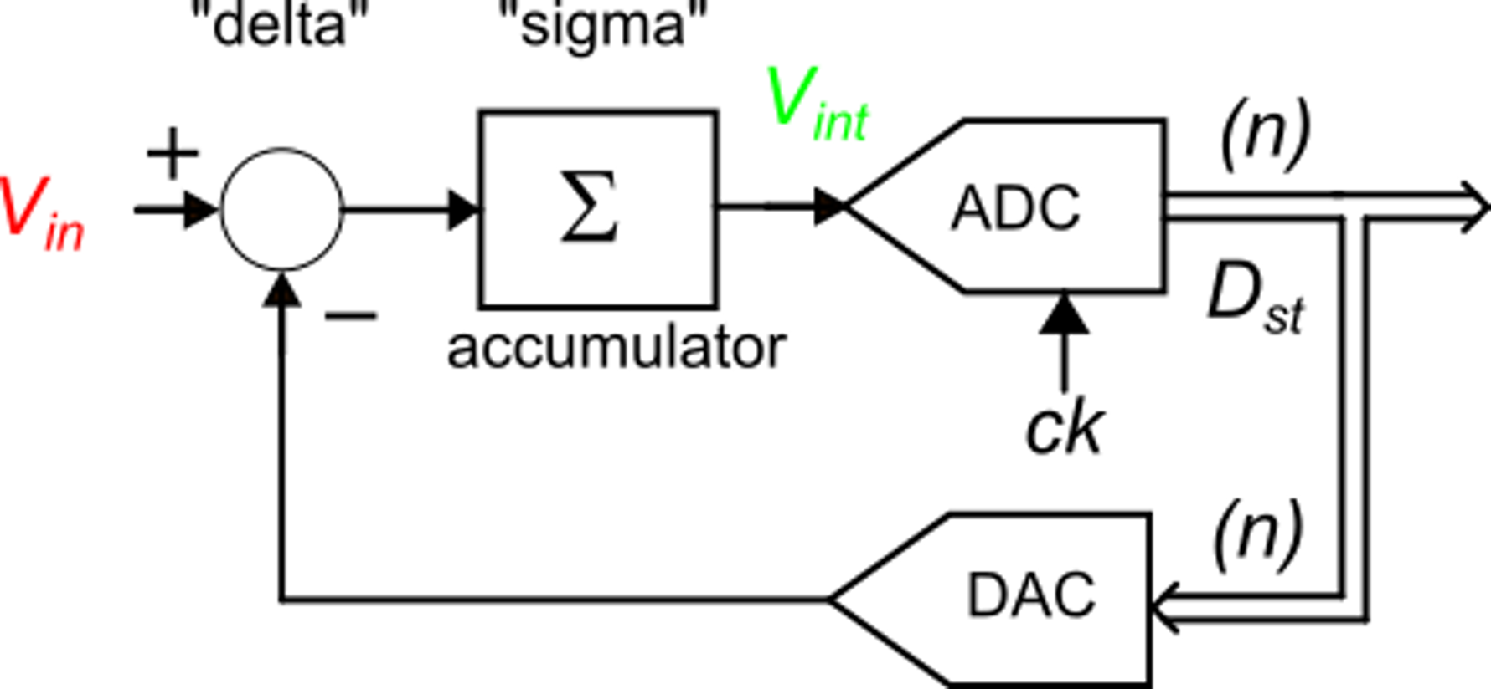
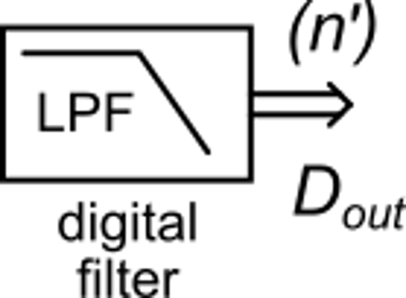
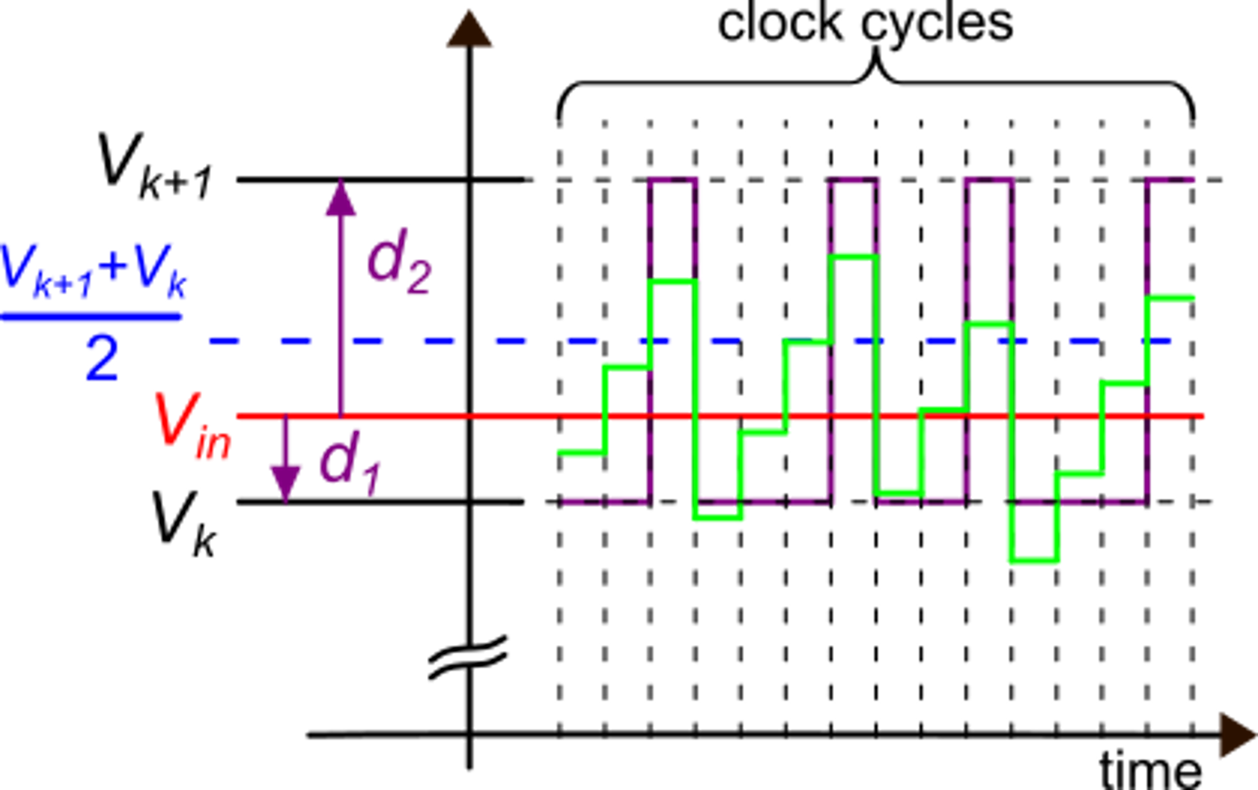
Delta-Sigma principle
The digital filter averages the data stream that, in the example, contains only V_{k} and V_{k+1} levels.
The average will be a value between the two levels and will be closer to V_{in}.than both V_{k} and V_{k+1}
In this example, value V_{k} appears more frequently than V_{k+1}. Then the average will be closer to V_{k}, as actually V_{in} is.

Slide 16
Delta-Sigma principle
v_{e}
The average of V_{e}, performed over a very long time, must be zero, otherwise the output of the accumulator would diverge.
v_{fb}
If the LPF filter has a bandwidth small enough, it can extract the average of the data stream D_{k} with arbitrary accuracy. If the DAC is ideal (no distortion), then the average of D_{k} gives V_{in} with an arbitrary resolution.

Slide 17
Delta-Sigma principle
What we have seen so far suggests that the delta-sigma modulator can produce a data stream that, once properly filtered, can yield V_{in} with a higher resolution than the original ADC.
Differently from the pure oversampling ADC, the delta-sigma is capable of producing the alternation of two adjacent codes (V_{k,} V_{k+1}) even with a dc signal without dithering. In the case of an input dc signal, the constant error v_{n} is modulated (this is the origin of the name) and can be filtered out.
As in the oversampling approach, it is necessary to filter the output data stream, reducing the bandwidth to the minimum required by the signal spectrum. We will show that high resolution increments can be obtained with moderate OSRs.

Slide 18
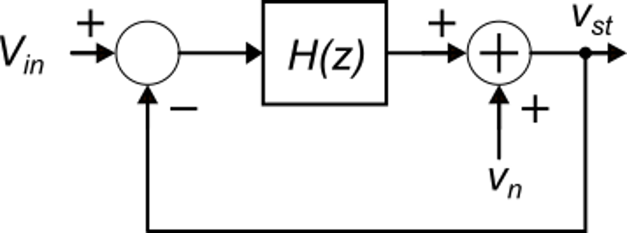
Analysis of a first order delta-sigma modulator
H(z) is a discrete time transfer function, properly represented with its z-transform.
Linearized model of the modulator. The DAC is considered ideal; thus, it simply translates the voltage representation of D_{st} (v_{st}) in an exactly corresponding analog voltage (v_{fb}=v_{st})
Δ−Σ modulator

Slide 19
Analysis of a first order delta-sigma modulator

Slide 20
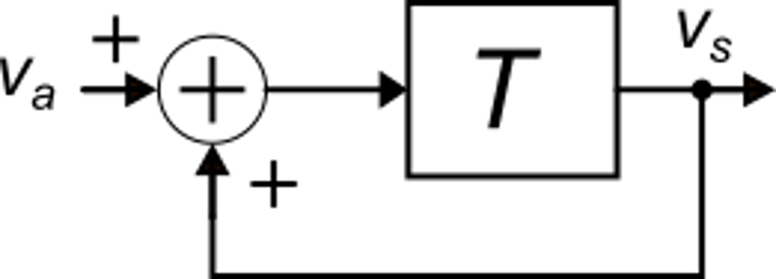
Analysis of a first order delta-sigma modulator
accumulator

Slide 21
Analysis of a first order delta-sigma modulator
A simple delay of one clock cycle
This is the equivalent of the derivative in the DT domain

Slide 22
NTF in the frequency domain

Slide 23
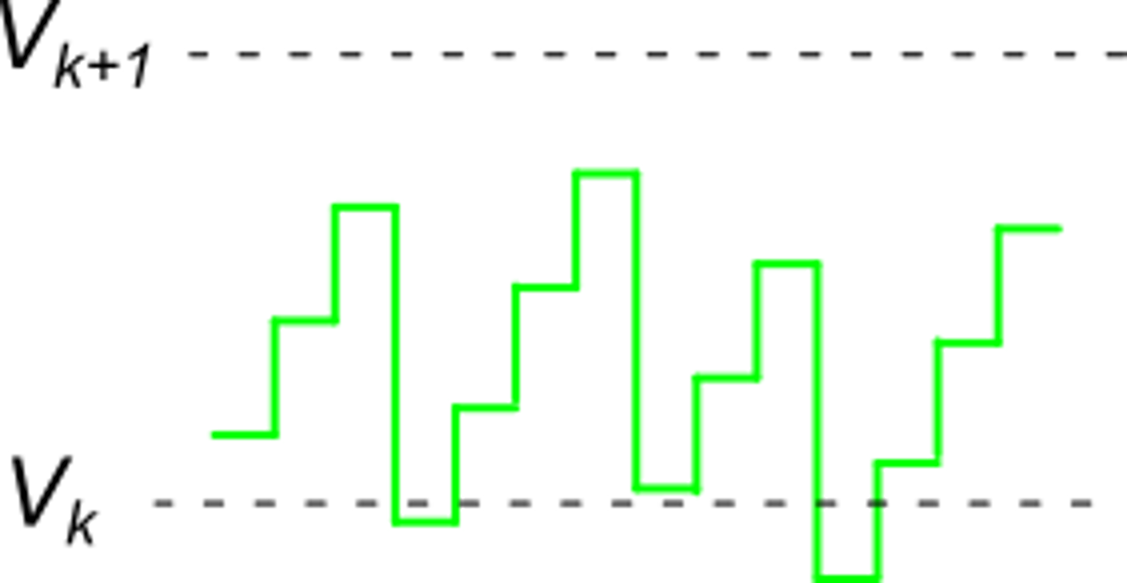
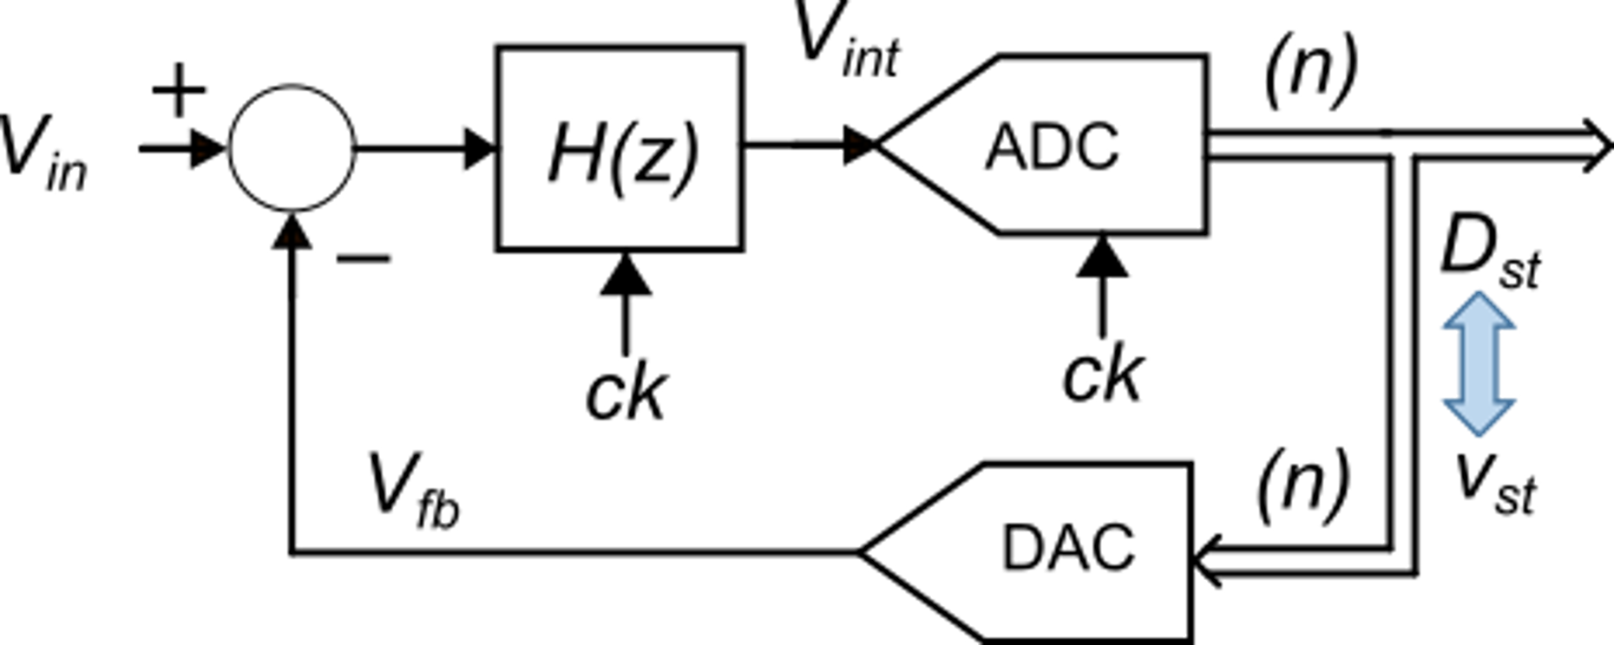
Output spectral density of the quantization noise
The uniform PSD model of the quantization noise is acceptable because the modulator continuously changes the input of the original ADC, sweeping across the whole range [-Δ/2, +Δ/2] of the quantization noise.
For more accurate analysis of second order effects, the limits of the uniform PSD model should be taken into account.

Slide 24
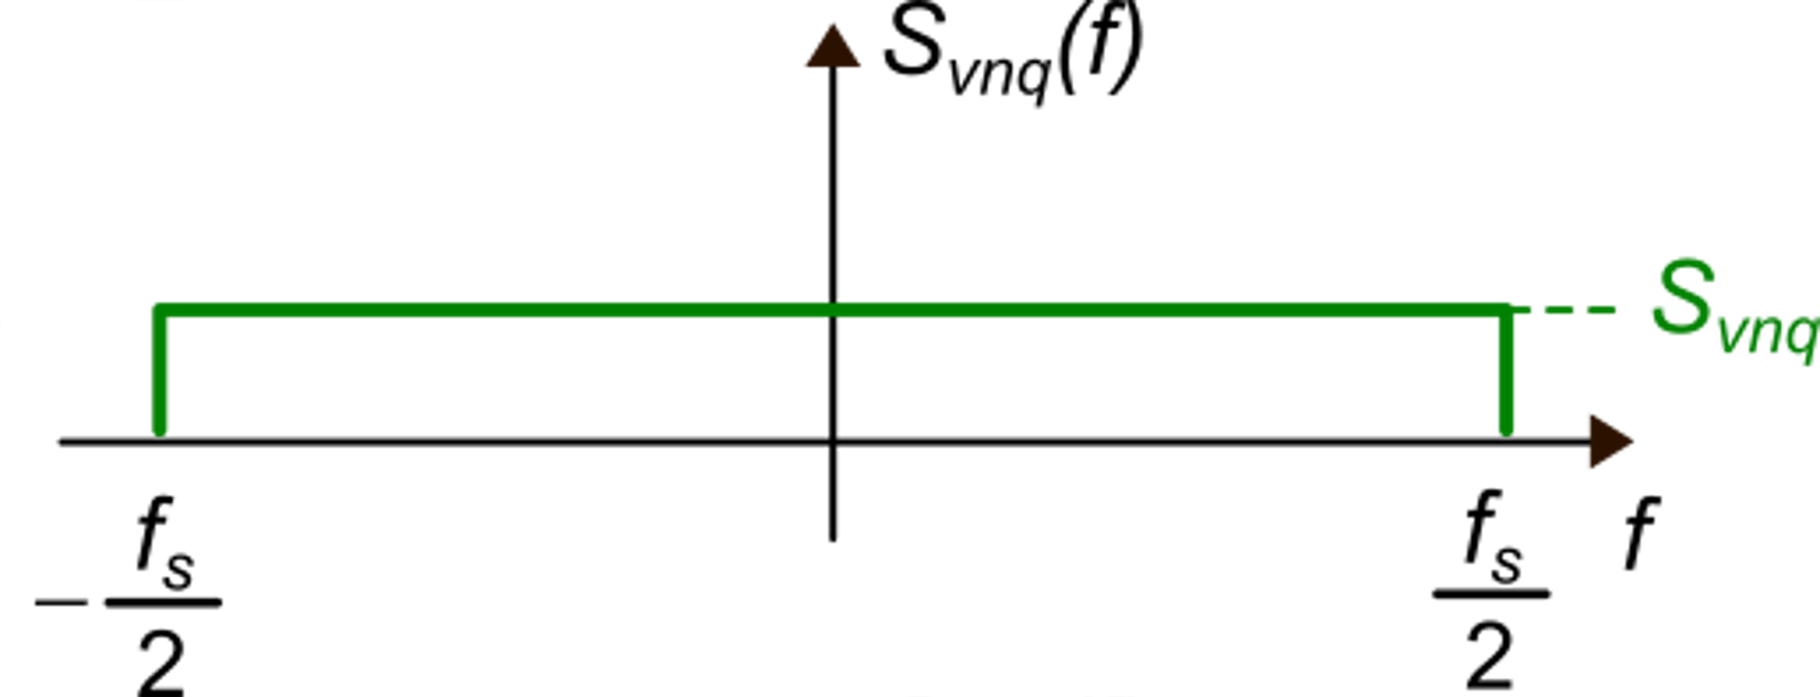
Quantization noise PSD at the output of the Δ−Σ modulator
S_{n-OS}(f)

Slide 25
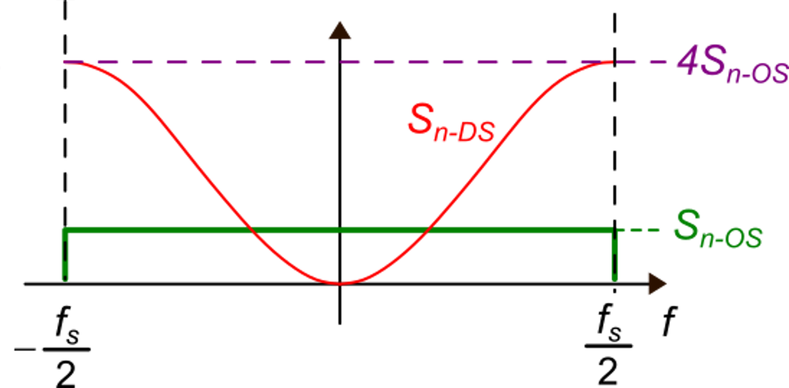
Quantization noise PSD at the output of the Δ−Σ modulator
for f=f_{S}/2, the argument of sin² is π/2

Slide 26
Output noise power in the Delta-Sigma ADC

Slide 27
Output noise power in the Delta-Sigma ADC

Slide 28
Resolution increment in the first-order Δ−Σ ADC

Slide 29
Resolution increment in the first order Δ−Σ ADC
Every increment of r_{OS} by a factor of 2 produces a resolution gain of 1 and 1/2 bit (1.5 bits).
This gain was only 1/2 bit in the pure oversampling ADC
Example
This OSR value is rather large, but also the gain in resolution is very large

Slide 30
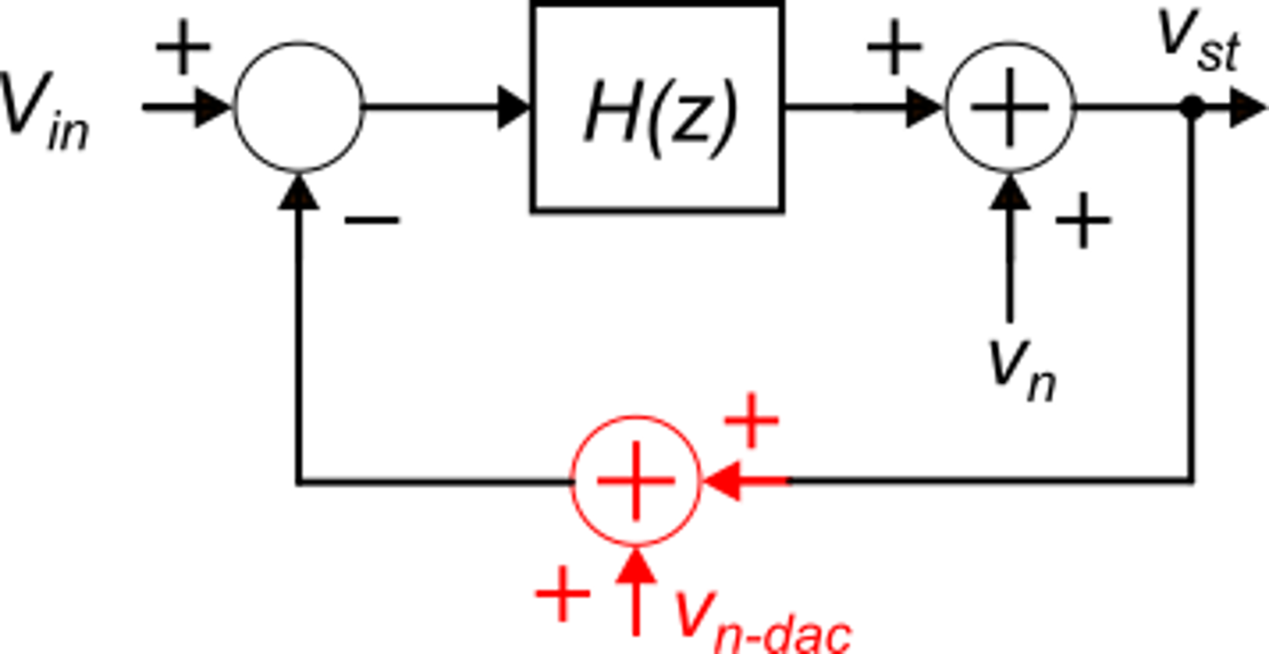
ADC and DAC non idealities in Δ−Σ ADC
Electrical noise, offset and non-linearity errors of the ADC are shaped by the high pass NTF of the modulator, then the effect on the signal BW is negligible.
ADC
DAC
The DAC should be linear because it is in the feedback path. The DAC noise (that includes also non-linearity errors) are simply summed-up to the input signal.

Slide 31
Single-bit Δ−Σ ADC
As we have seen, the DAC linearity is a main issue of the Δ−Σ approach
A very elegant and widely used solution is the single bit Δ−Σ ADC
In the single bit D-S ADC the internal Nyquist-rate ADC is a single bit quantizer, i.e., a comparator
ADC-1 bit
bit-stream
DAC-1 bit

Slide 32
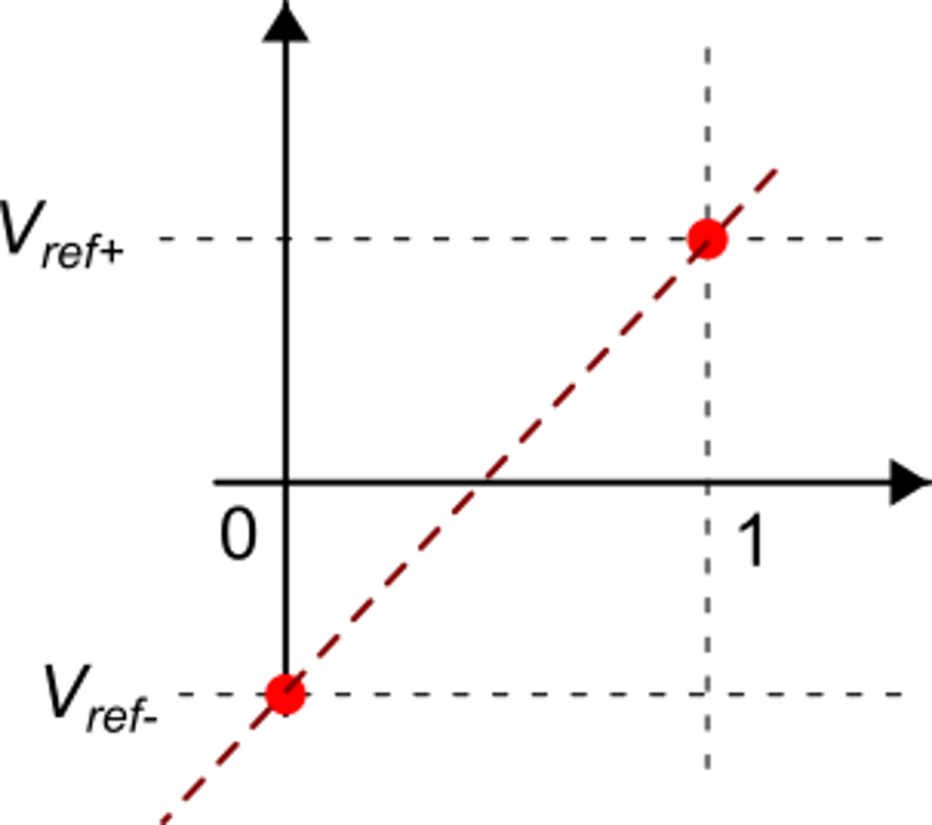
Single-bit Δ−Σ ADC
bit-stream
f_{out} = 2B_{S} << f_{S}
f_{S}
The filter operates also
decimation (decimator filter)
A 1-bit DAC is inherently linear

Slide 33
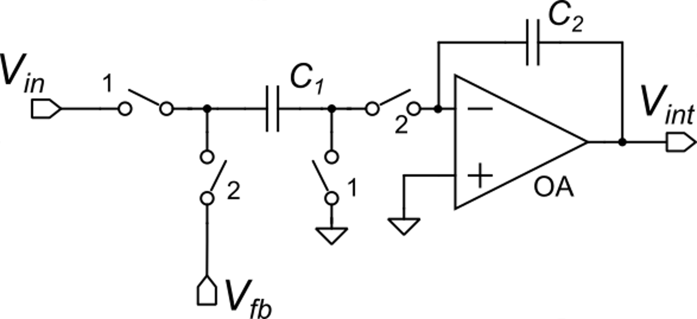
H(z) implementation (Single ended)
Classical, "parasitic insensitive" Switched Capacitor Integrator
Note: electrical noise and distortion of the DT integrator are not shaped by the NTF: careful design of the integrator is required.

Slide 34
Higher order Δ−Σ ADCs
Example: second-order ADC
Two integrators 2nd order
Advantage: 2.5 bits are gained doubling the OSR (instead of 1.5 bits). Same final resolution with a much smaller OSR
The 2nd order D-S ADC is a very popular converter for sensor interfaces.

