Slide 1
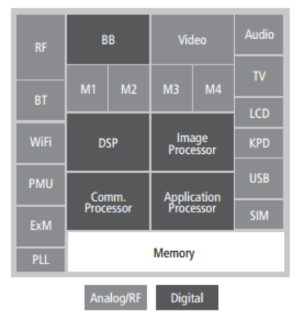
Mixed Signal Design Flow
Traditional mixed circuit system
(e.g. interface for a MEMS sensor)
System on a chip with distribution of analog and digital units
Digital control
unit
Analog units
Both are examples of Mixed Signal integrated circuits

Slide 2
Possible design flows
Analog centric (or analog on top): the analog and digital units are designed with their proper tools and integration is performed using the analog tool.
Digital centric (or digital on top): the analog and digital units are designed with their proper tools and integration is performed using the (highly automated) digital tool.

Slide 3
Analog Design Flow and examples of CAD tools
Schematic design
Virtuoso schematic editor
Electrical simulation
Analog Design Environment (ADE)
Spectre electrical simulator
CADENCE
Layout design
Virtuoso layout editor
Verification:
DRC
LVS
PEX
Assura
Calibre
Mentor
Graphics
PEX: Parasitic extraction (for post-layout simulations)

Slide 4
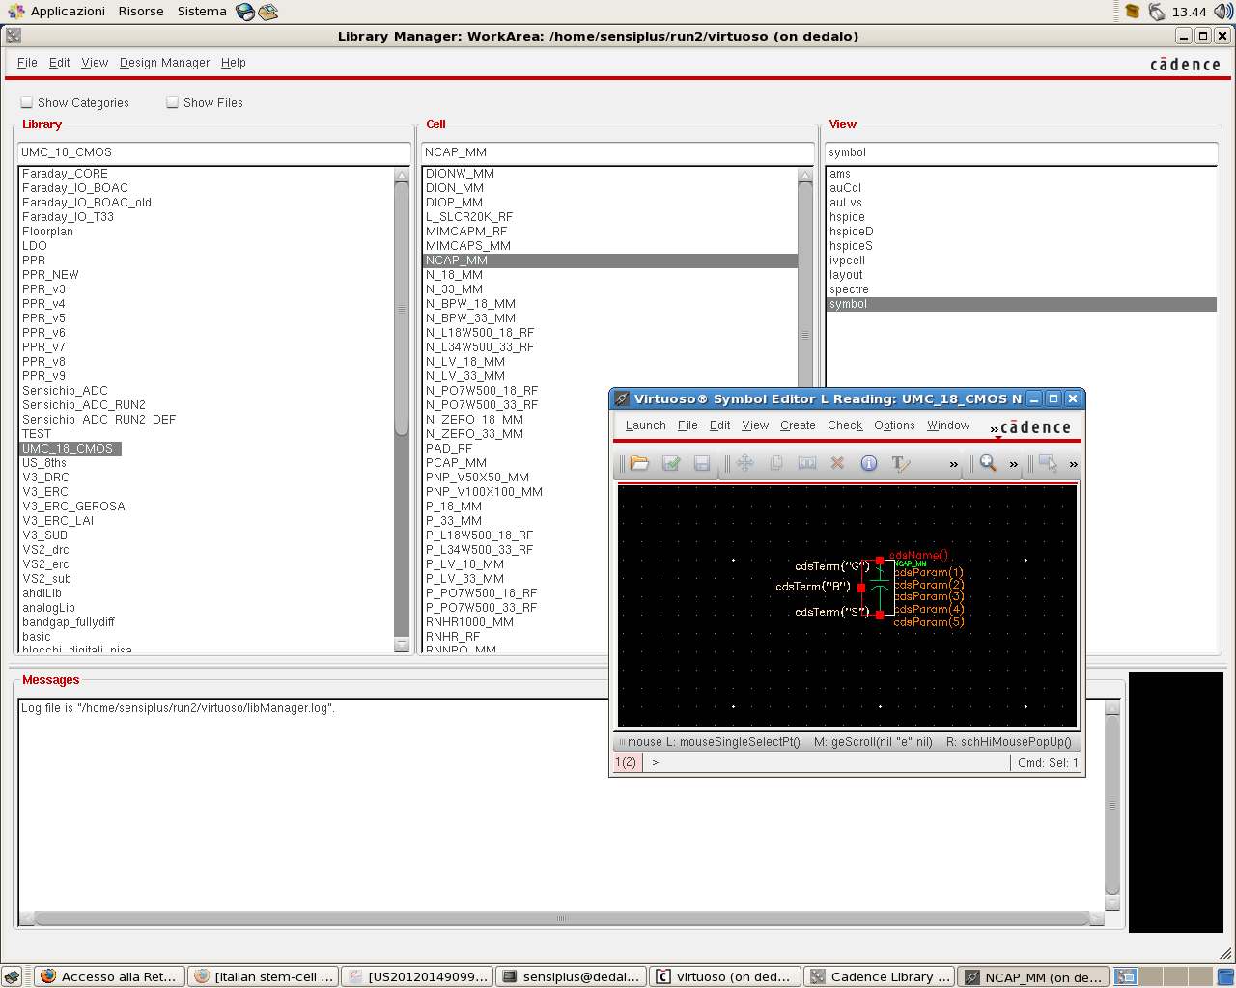
A few screenshots from the Cadence environment
Library Manager:
Collects all libraries, cells and views

Slide 5
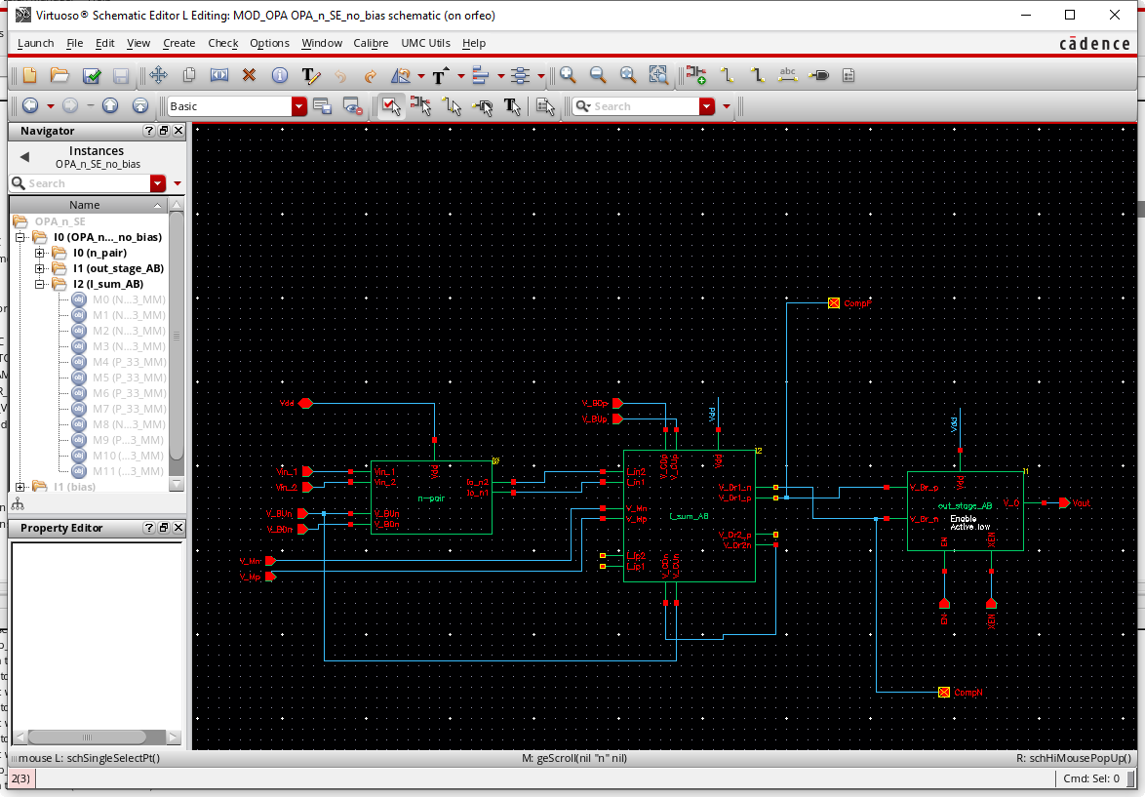
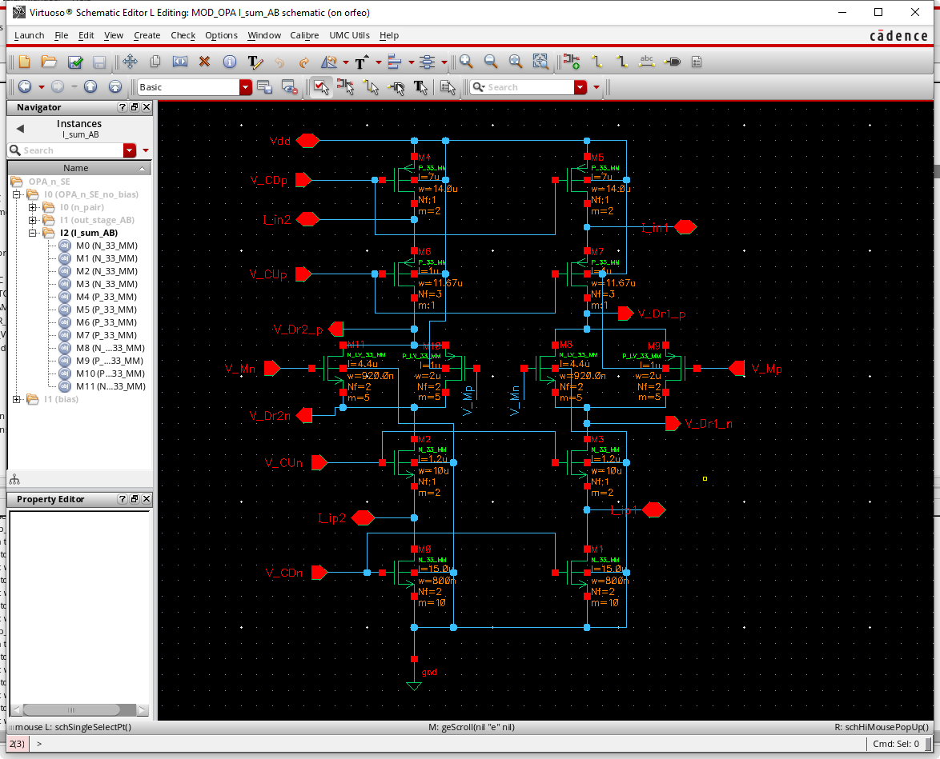
The schematic editor

Slide 6
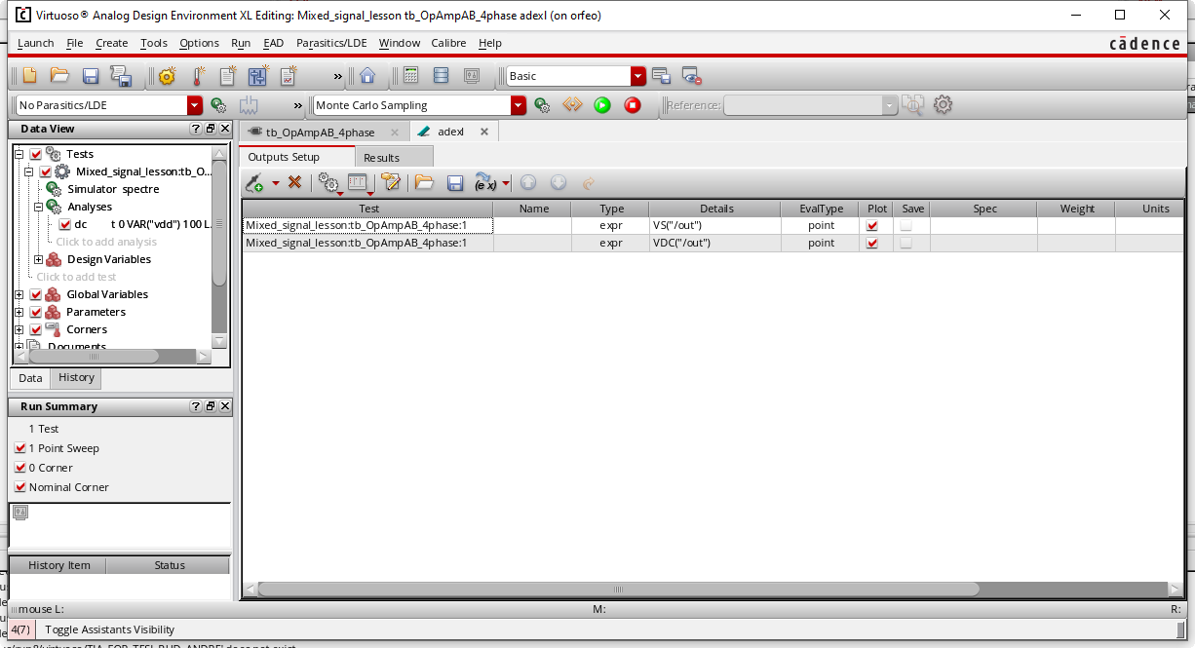
ADE (Analog Design Environment)

Slide 7
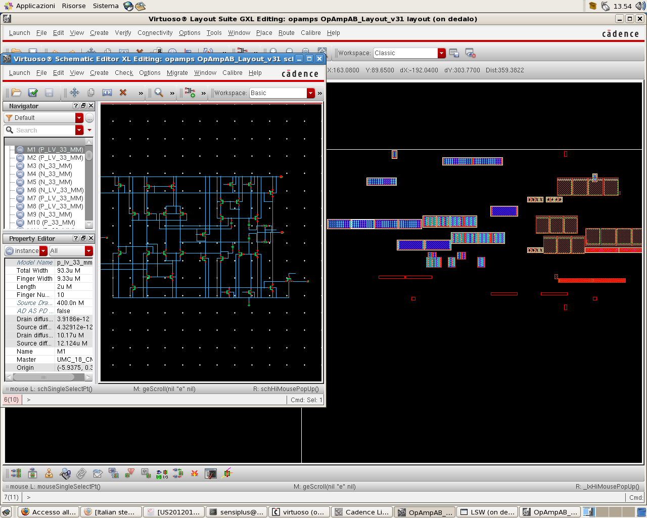
Layout: Automatic generation of components
It is possible to generate the instances of all cells or selected cells into the layout view
Moving the individual instances into the final position and connecting the cells together is generally performed manually, although automatic tools exist

Slide 8
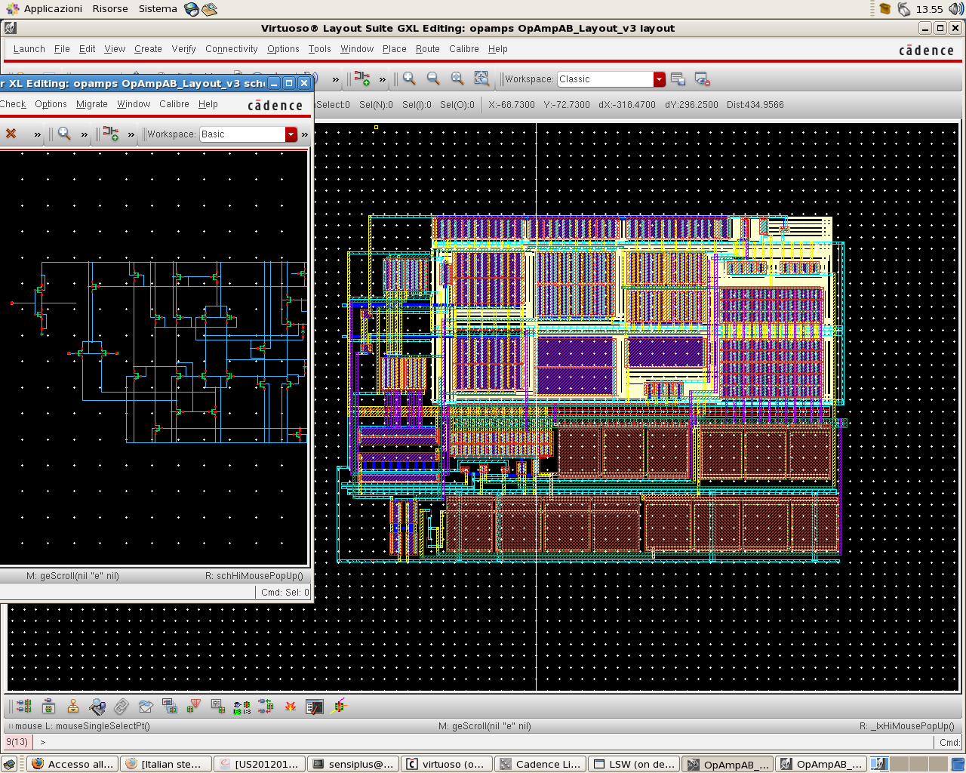
Layout Design: Manual Place and Route
The connection between components (instances) of the schematic view and their corresponding instances in the layout is maintained. Connection to be made in the layout are suggested dynamically.
Violations (DRC and, partly, LVS) are shown immediately during creation of the layout.
Final DRC and LVS performed on the whole circuit are still strictly necessary

Slide 9
Digital Design Flow and CADENCE tools
High level description
(HDL - RTL)
Text Editor (e.g. "Gedit")
Logic Simulation
CADENCE “Xcelium”
Gate-Level Synthesis
CADENCE “Genus”
Automatic Place and Route
CADENCE “Innovus”

Slide 10
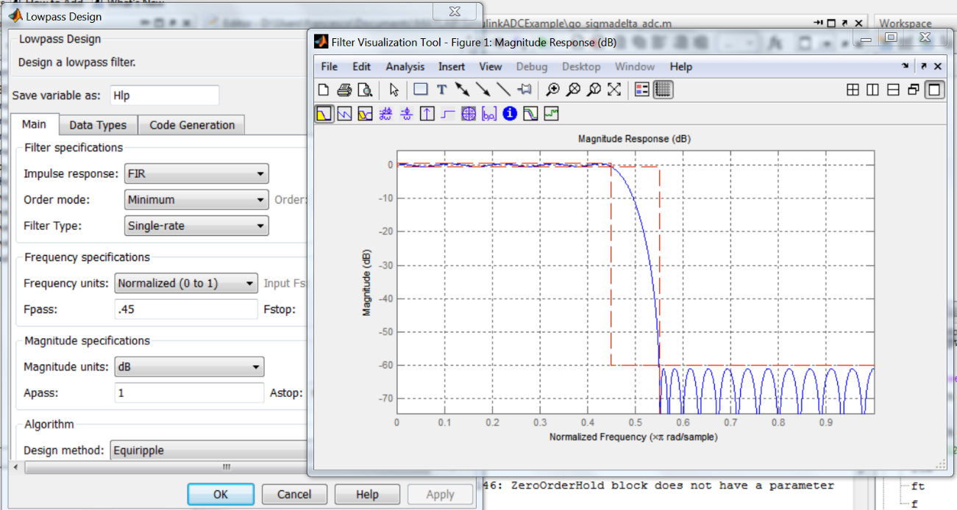
High level description
The HDL description (e.g. in vhdl or verilog languages) must be done adhering to the RTL (Register Transfer Level) format, in order to enable the synthesis with all kind of digital standard cells. The RTL is ideal for the description of finite state machines.
Additionally, portions of code can be generated using specialized tools. For example, using dedicated MATLAB toolbox, it is possible to design digital filters and translate them into vhdl code.

Slide 11
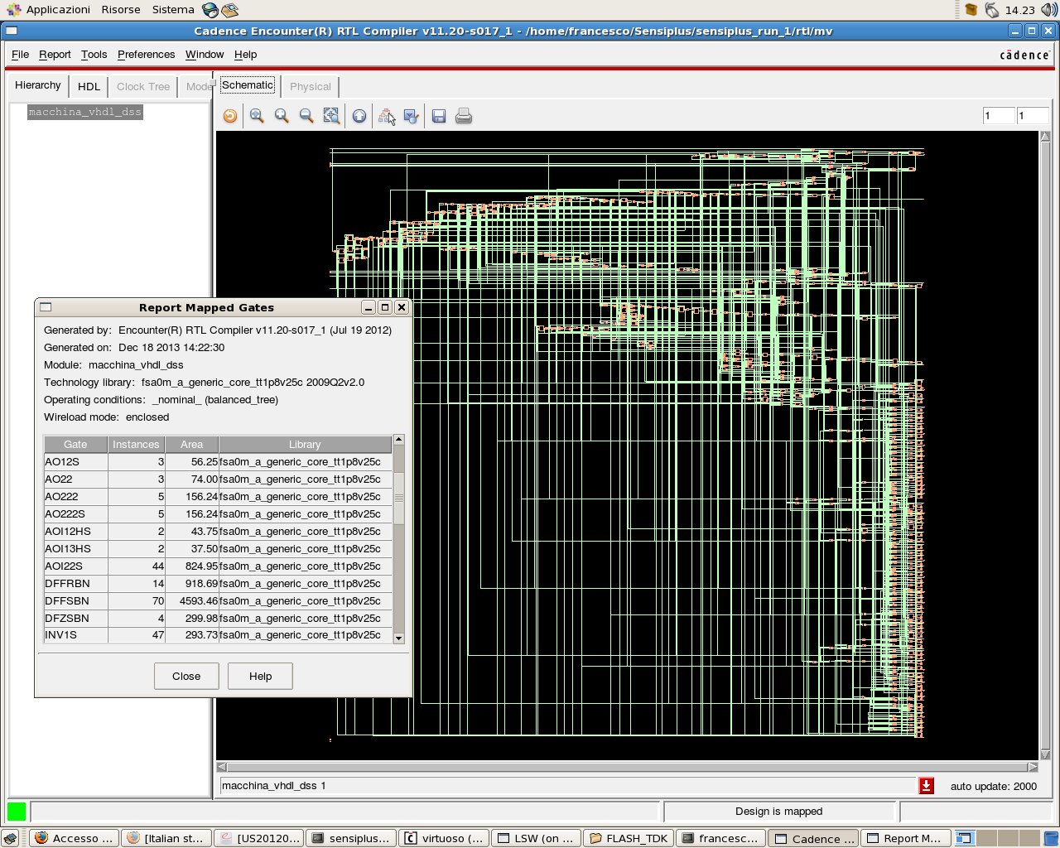
Gate Level Sinthesis
The RTL description is translated into a digital network formed by the elementary standard cells of the process.
The standerd cells are characterized with their timing parameters (delays) that the synthesiser use to produce a network free of set-up and hold violations.

Slide 12
Automatic layout generation (Automatic Place and Route, P&R)
The LEF format is more versatile than GDS, since it allows easy partial description (e.g. creation of layout abstract views, where only the information for the P&R are included
Standard cells:
Velirog description
Layout (LEF or GDS)
Automatic P&R tool
Layout (GDS)
Gate level netlist:
Verilog description
Delay file
Post P&R netlist (verilog)
In the P&R operation, the tool change the original network adding components that allow respecting the timing requirements (e.g. clock buffers)
Automation script file

Slide 13
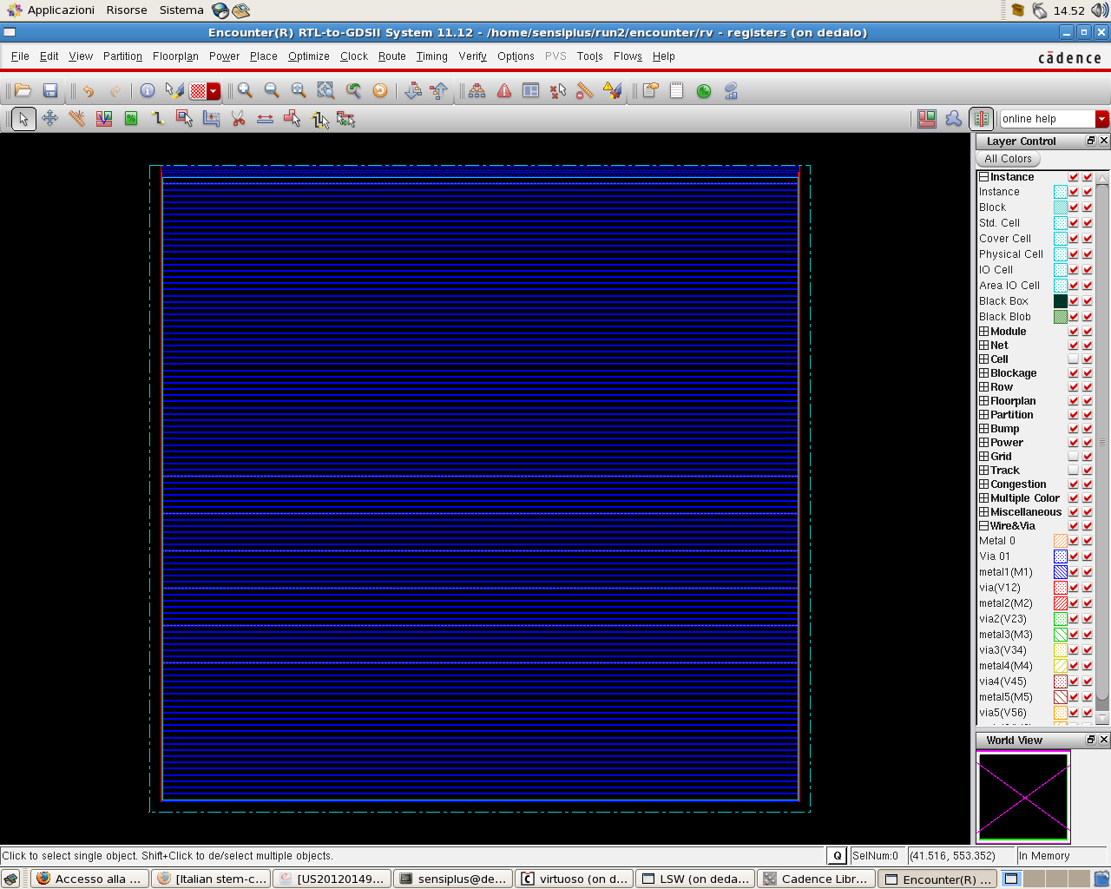
P&R: a few important steps (can be automated)
At the beginning of the process, it is necessary to decide the area where the network must be placed by choosing the aspect ratio and the "density". Then the "channels" that host the standard cells are defined, with their power rails

Slide 14
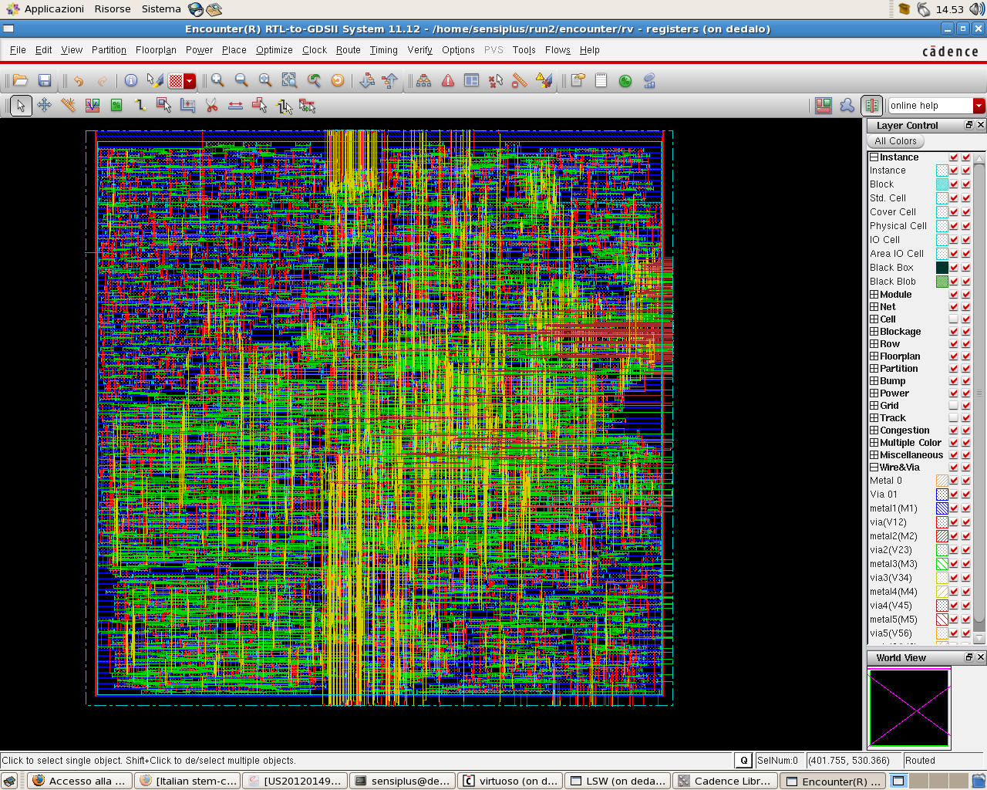
Result of P&R
Empty spaces between cells are covered by "filler" elements in the final layout. Fillers includes n-wells and other layers that improve continuity between cells

Slide 15
Mixed Signal Design Flow: Analog Centric Approach
Mixed Signal system level design
("pen-and-paper, SIMULINK-SIMSCAPE, VHDL-AMS, Verilog-A ...)
Analog cells
Digital cells
Analog Schematic design
High level description
(HDL - RTL)
Electrical simulation
Logic Simulation
digital netlists
Gate-Level Synthesis
Mixed Signal simulation
Mixed Signal Schematic design
Automatic Place and Route
Verification
Analog Layout
(mainly manual)
Digital layout
Layout of the Mixed Signal Circuit
(mainly manual)

Slide 16
Creation of the Mixed Signal schematic view
The Mixed Signal schematic is a conventional analog layout where a digital block is instantiated.
After a digital cell described with vhdl is imported into an analog library, three views are created:
view: entity
entity counter is
.....
view: symbol
architecture fsm of counter is
.....
view: fsm
cell: counter
VHDL description

Slide 17
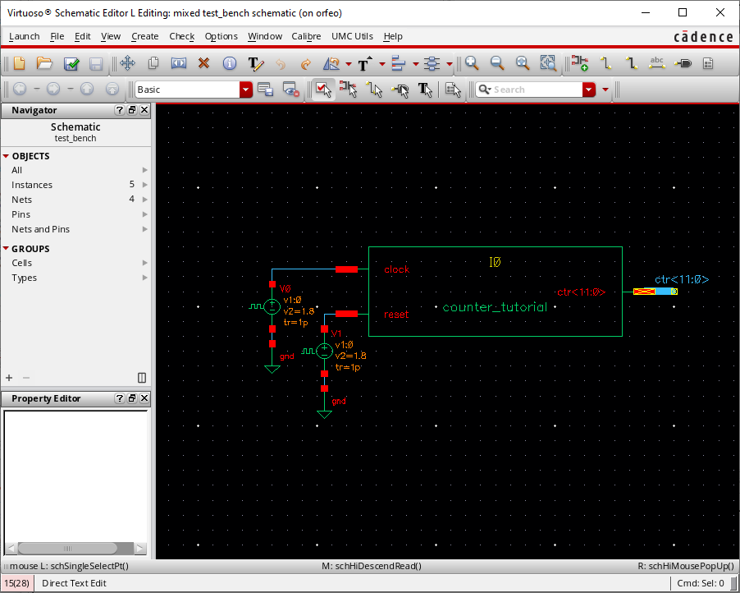
View symbol
The view "symbol" is created automatically starting from the "entity" part of the vhdl description, where the input and output pin are declared.
It is the symbol view that has to be used to create an instance of the digital cell inside an analog schematic view, forming the mixed signal schematic.

Slide 18
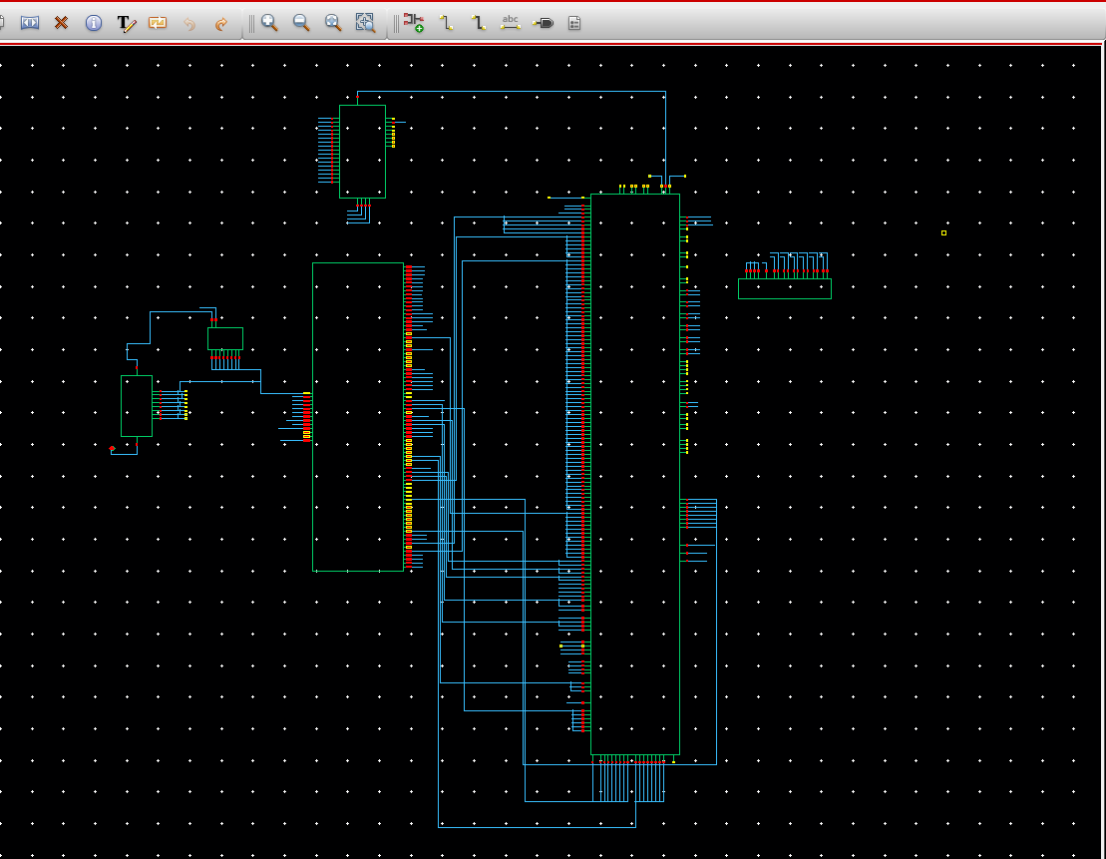
Example of mixed signal schematic view
Analog cell
Digital cell

Slide 19
Objects that are necessary for the Mixed Signal simulation
Views:
schematic
adexl
config
Mixed Signal Schematic
The view used by the ADE simulation environment
A view that has to be explicitly created and includes, for each instance, indication on which view has to be used in the simulation
ADE
The connect rules associate electrical quantities to the logical values. They represent the interface between the digital (logical) and electrical world
Connect Rules

Slide 20
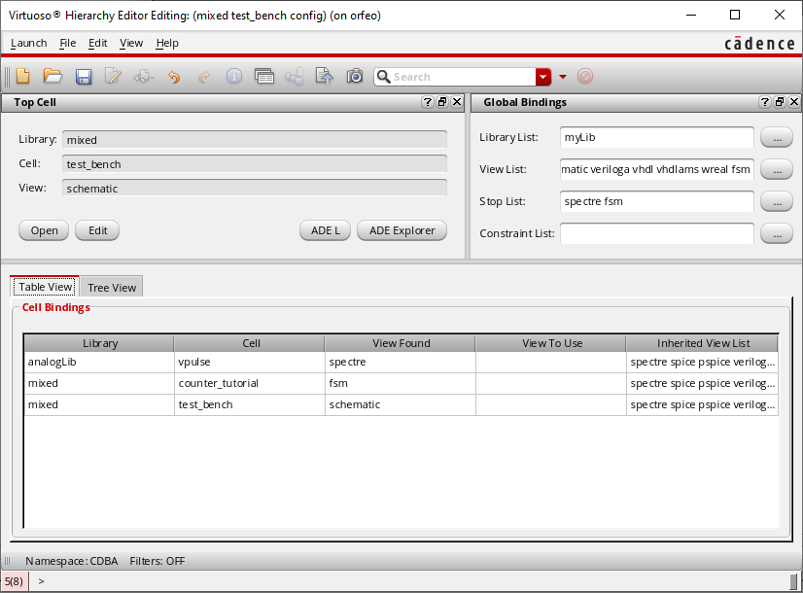
The config view
Instances of
cells
View to be used in the simulation

Slide 21
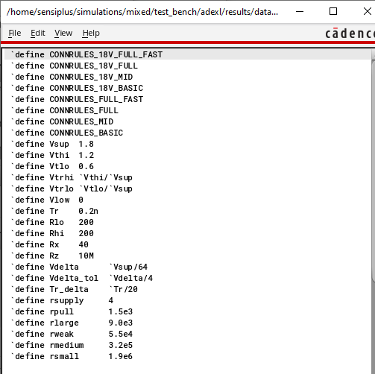
Example of connect rules
High logic level: 1.8 V
Low logic level: 0 V

Slide 22
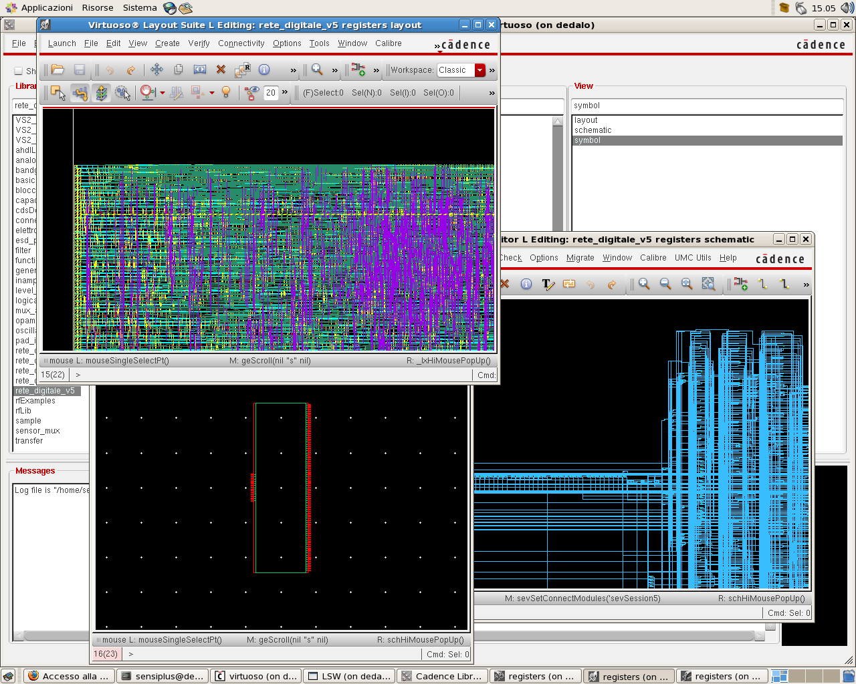
Importing the digital cells after synthesis and P&R
Layout: gds file generated by the P&R
Views of the imported cell , as they appear in the library manager
Netlist gate-level
(imported as a schematic view)
Symbol

Slide 23
Creation of the final layout of the mixed signal integrated circuit
In the analog centric flow, the analog and digital cells are automatically instantiated into the layout following the schematic view. Generally, P&R is performed manually
Digital cell
Analog cell
Schematic view
Layout view

Slide 24
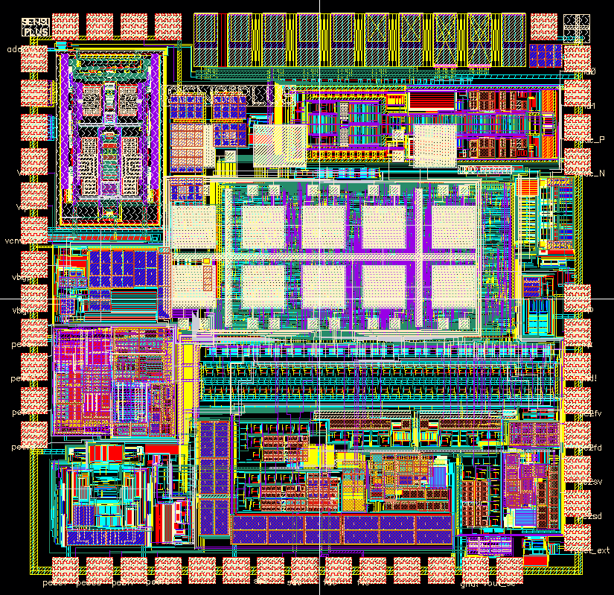
Example: the SENSIPLUS versatile sensor interface
Digital pads with I/O buffers
Process: CMOS 0.18 μm
Digital finite state machine
1.5 mm
Analog pads

