Slide 1
Single-Ended operational amplifiers
Typical requirements
Voltage amplifiers
Very large DC gain
Stability over a wide range of negative feedback conditions.
High input impedance on both inputs
Differential input

Slide 2
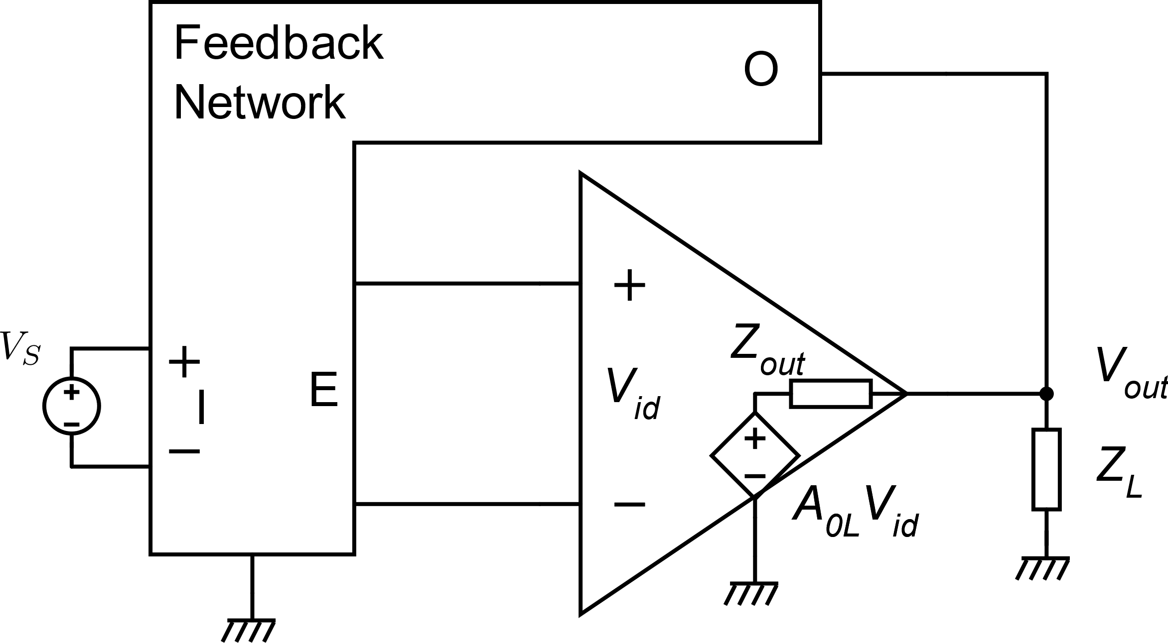
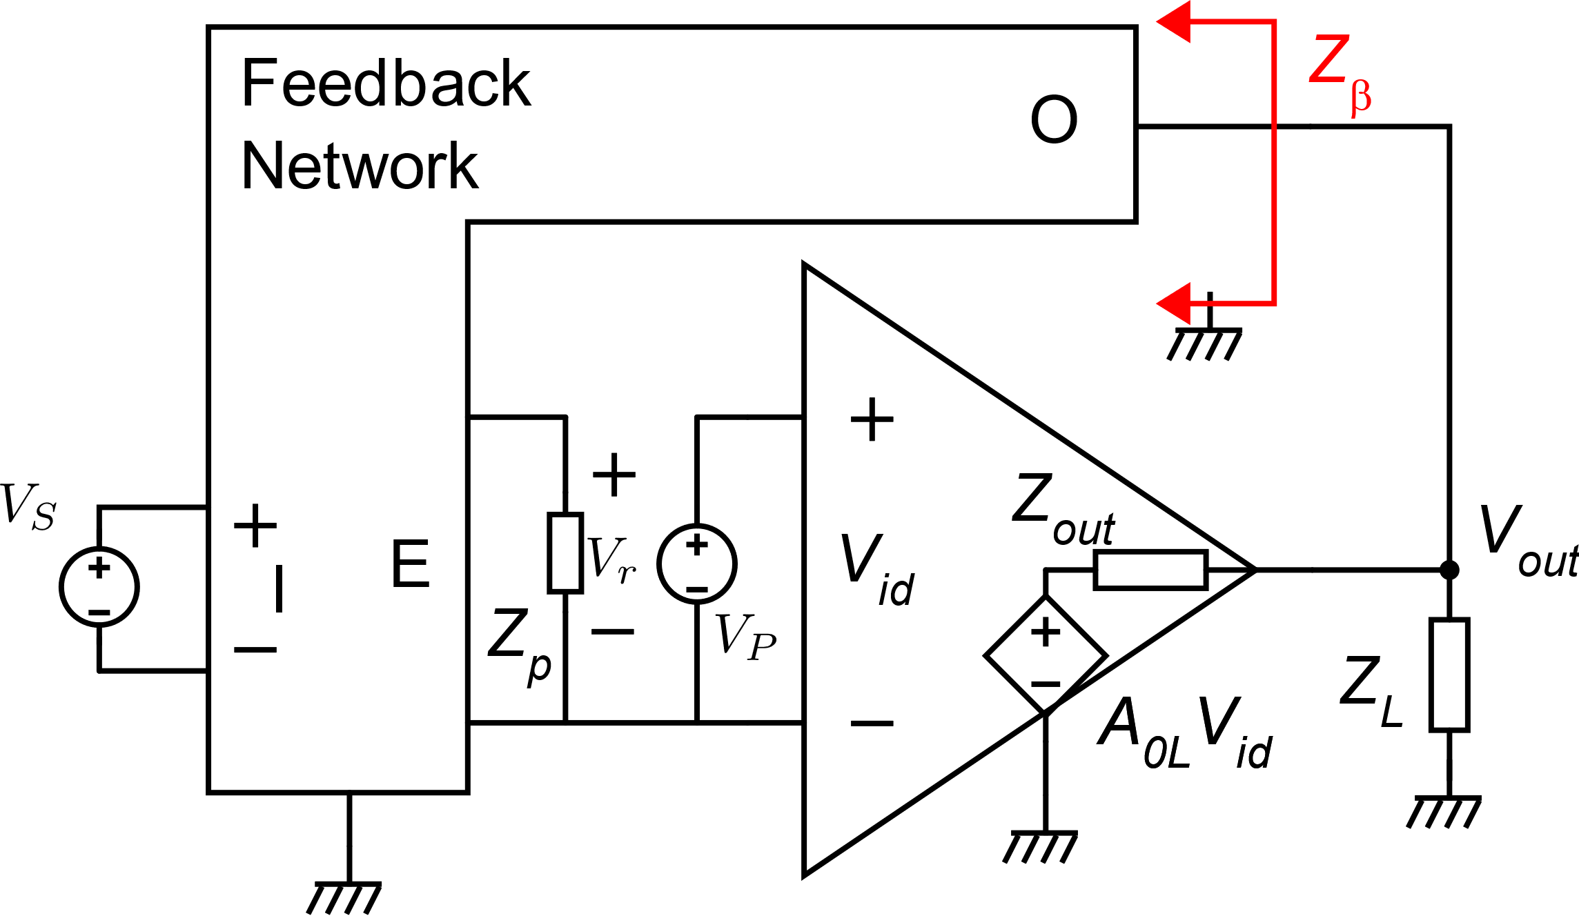
Typical op-amp-based negative feedback loop
This is a design specification

Slide 3
Requirement on the output impedance
Z_{out} should be low enough to guarantee that A is large enough to maintain the relative error below the maximum value allowed in all the expected load conditions

Slide 4
Example ADA4628 (Analog Devices)
R_{L1}
A₁
A₂
R_{L2}
Passing from R_{L}=10kΩ to R_{L}=2 kΩ the amplifier looses around 8 dB

Slide 5
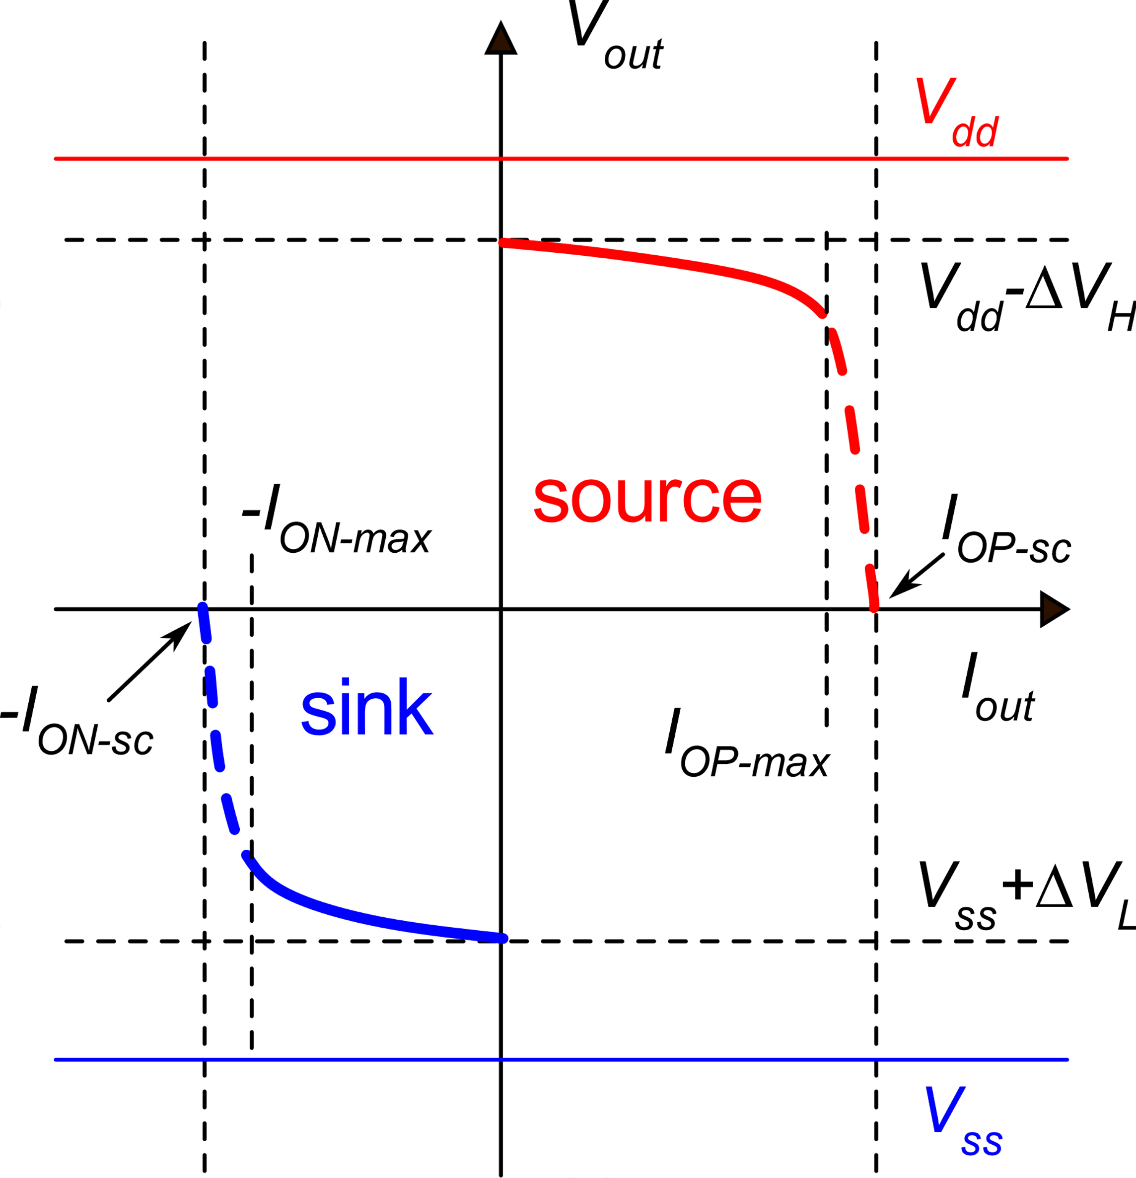
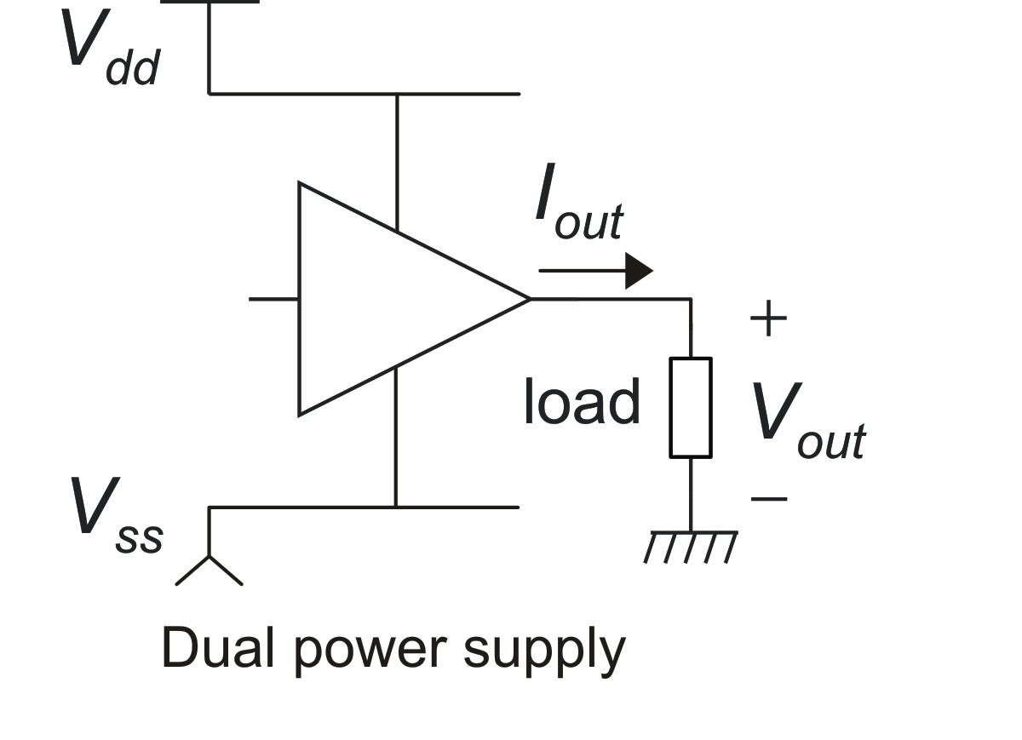
Output stages - specifications
Sink
Source

Slide 6
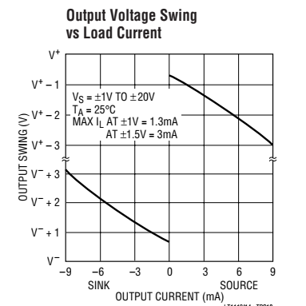
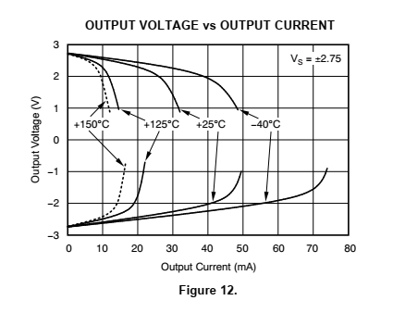
Examples
OPA 377 (Analog Devices)
Linear Tech.

Slide 7
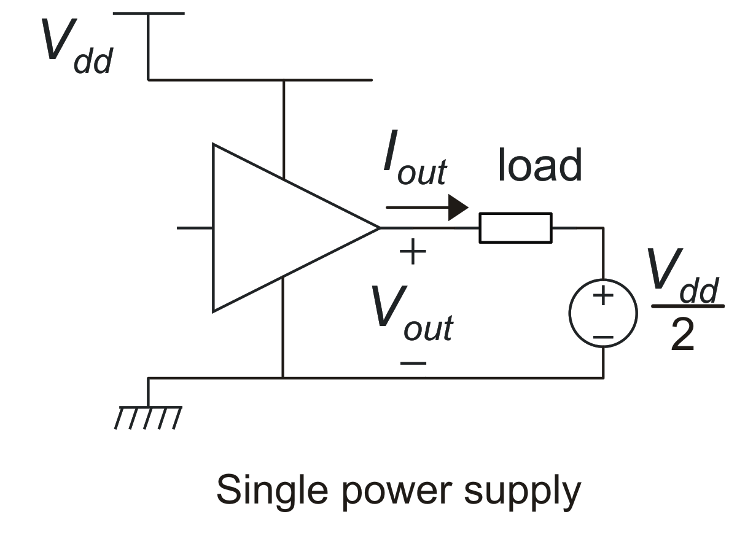
Single supply case
In a single supply voltage circuit, the load cannot be connected to gnd (or V_{dd}) if we want a to impose both positive and negative voltages across it.
To achieve this result, the load should be applied across the amplifier output port and a proper constant voltage, typically equal to V_{dd}/2.
This voltage must be generated by a proper cell, starting from V_{dd}.

Slide 8
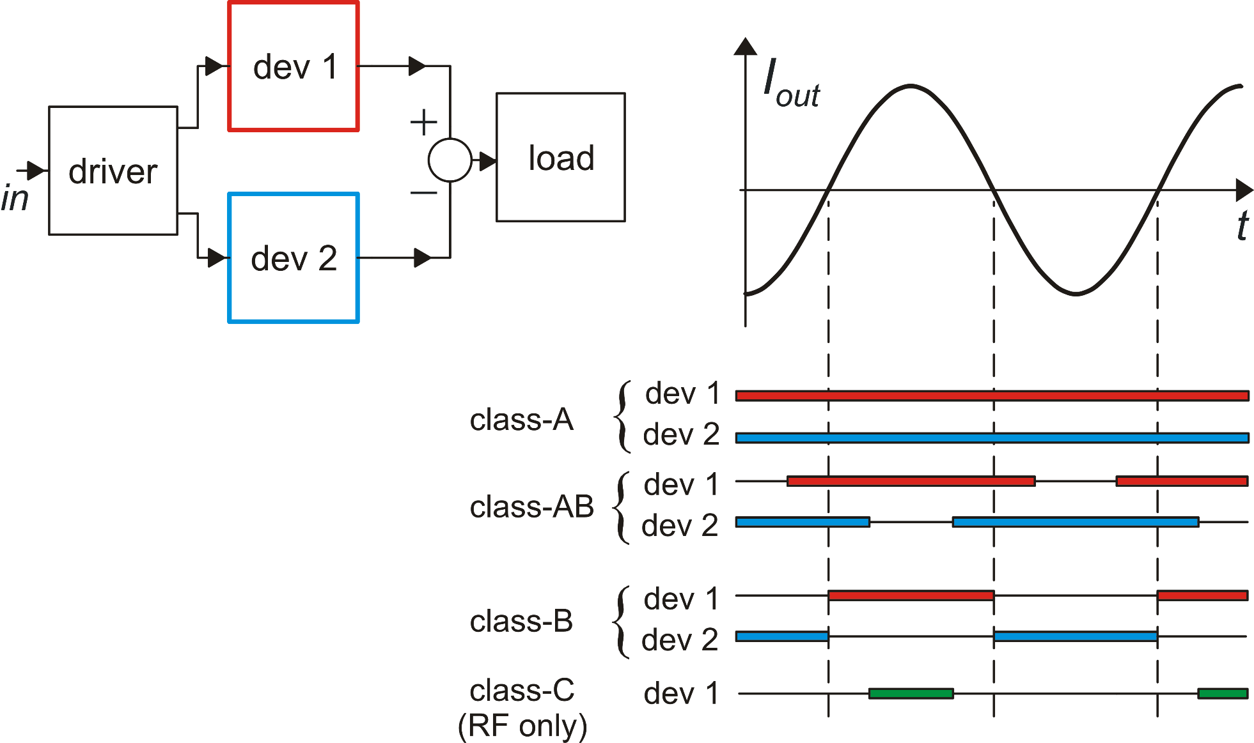
Oputput stage classes
constant I_{dev2}
By subtracting two unipolar
currents, we obtain a bi-directional output current

Slide 9
Low power efficiency of class A output stages
The maximum symmetrical current coincides with I_{dev 2}, which is a constant bias current.
Therefore, the maximum (symmetrical) output current is smaller than the quiescent current absorption.

Slide 10
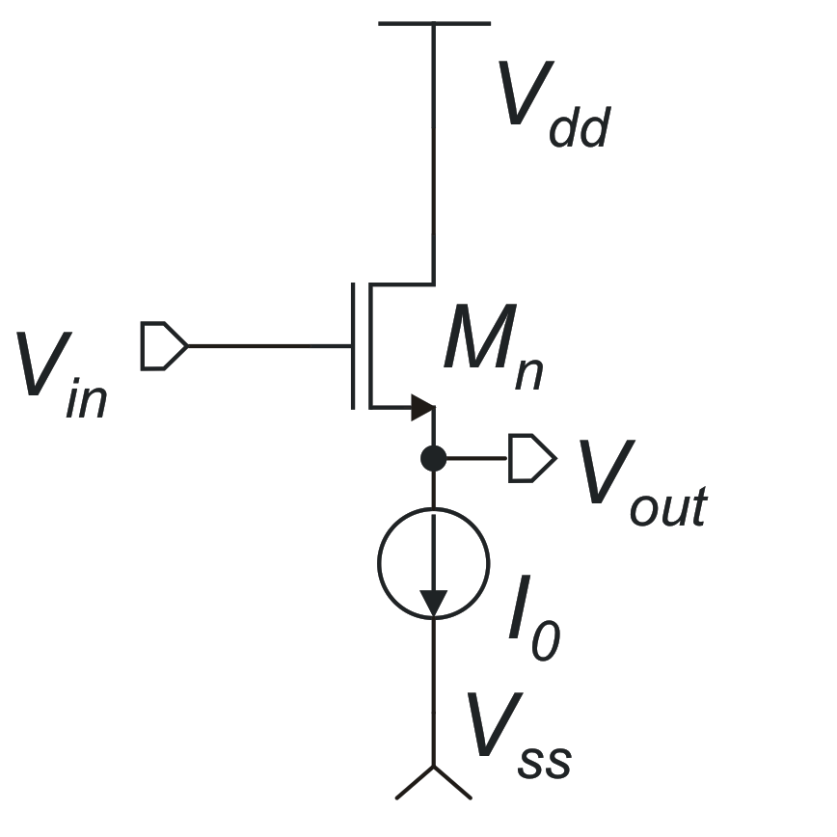
Class – A source followers
The n-MOS source follower can be used as a negative voltage-shifter
Because the circuit that produces V_{in} (driver) uses the same V_{dd}
The large margin to to V_{dd} makes it not suitable for rail-to-rail output stages (practically mandatory in modern, low voltrage applications)

Slide 11
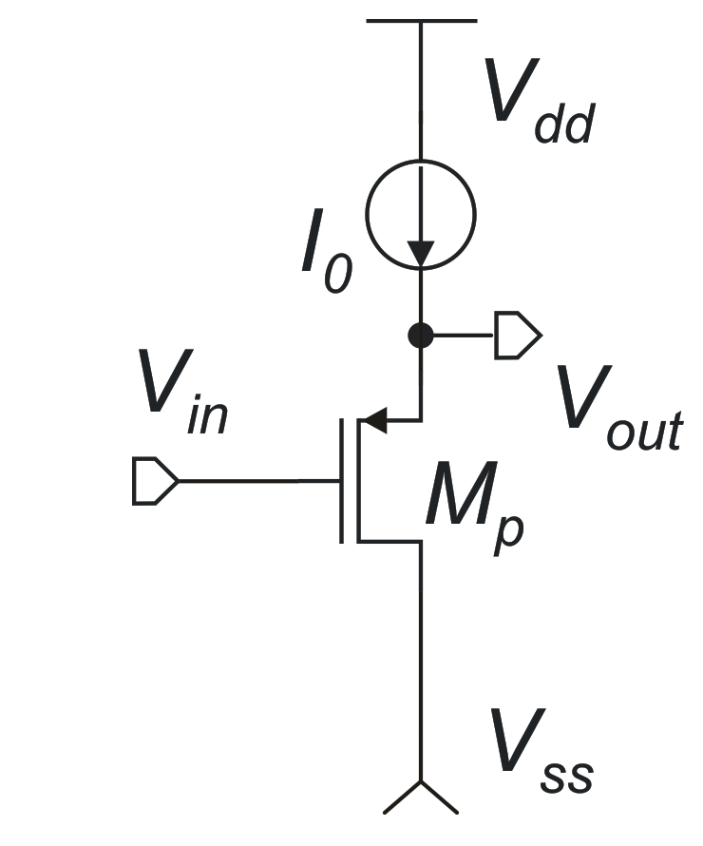
The p-MOS source follower can be used as a positive voltage shifter.
Margin to V_{ss}
(too large for typical supply voltages used in modern CMOS processes)

Slide 12
Class-A source followers: output current limits
The positive output current (I_{OP}) is limited only by the MOSFET size
The negative output current (I_{ON}) is limited by I₀, which is the quiescent supply current
opposite condition: it is the positive current to be limited by I₀,
n source follower
p source follower

Slide 13
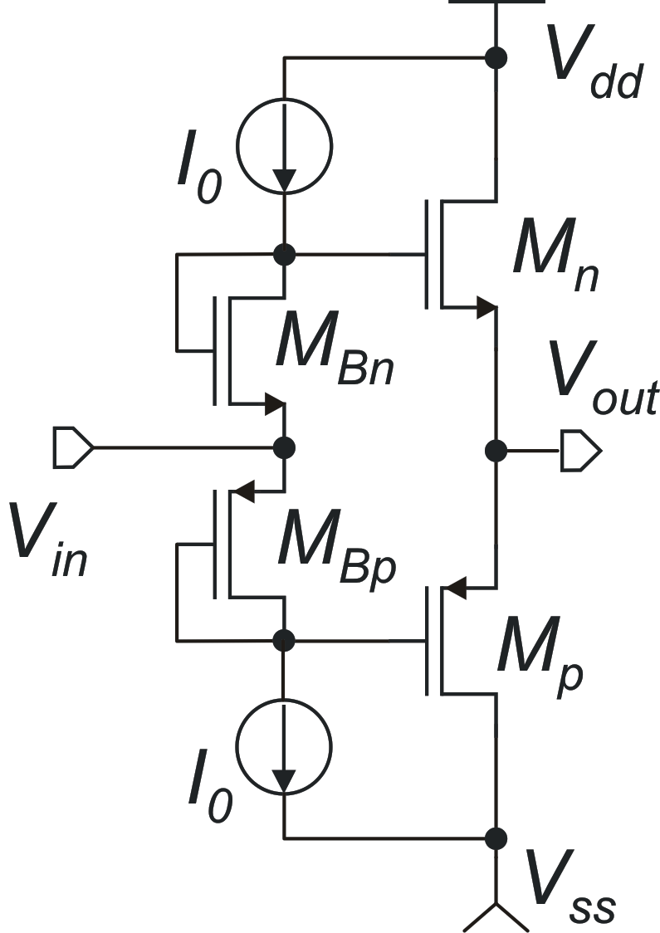
Class AB – push pull source follower
Imposes large margins to both the positive and negative rail
Practically useless for the low supply voltages used in modern analog circuits, which require rail-to-rail output voltage swings

Slide 14
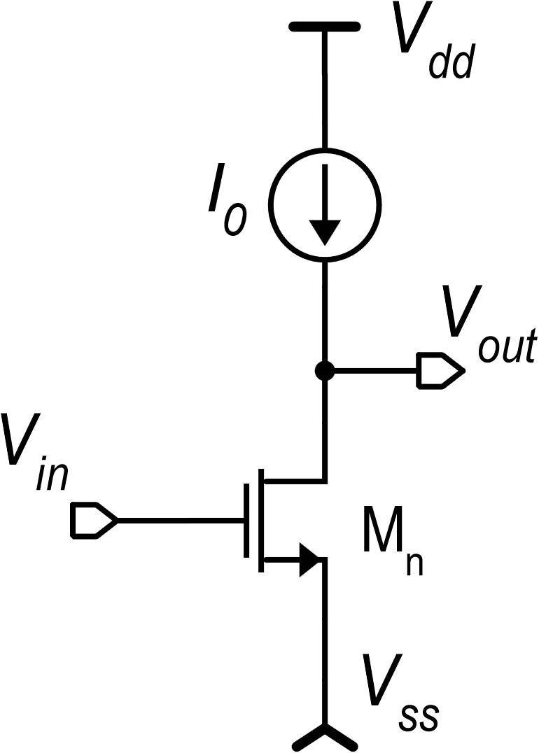
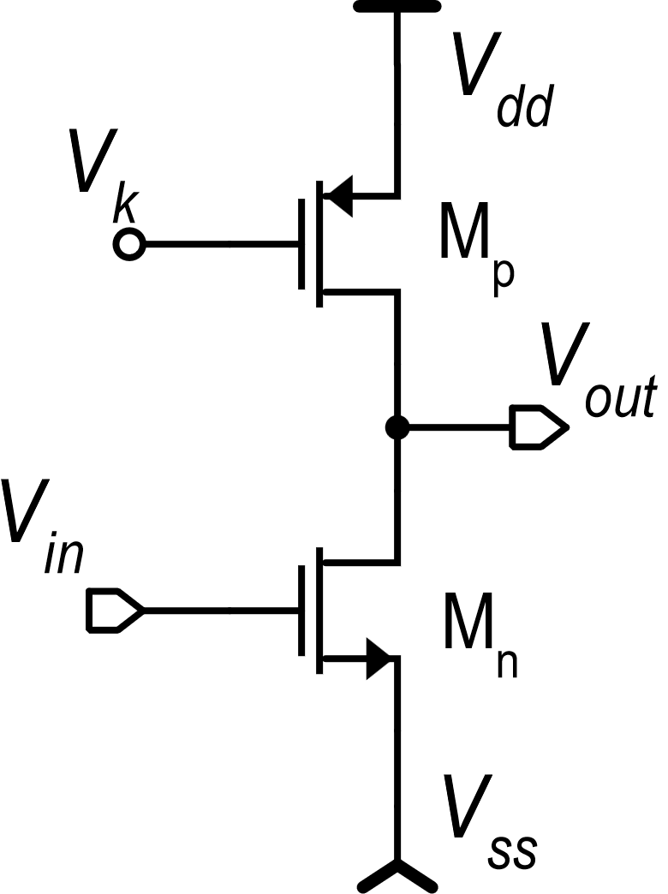
Common source output stages: class-A case
Margins to the rails are now only a V_{DSAT}, which is much smaller than a V_{GS}.
The common source output stage has a practically rail-to-rail output swing

Slide 15
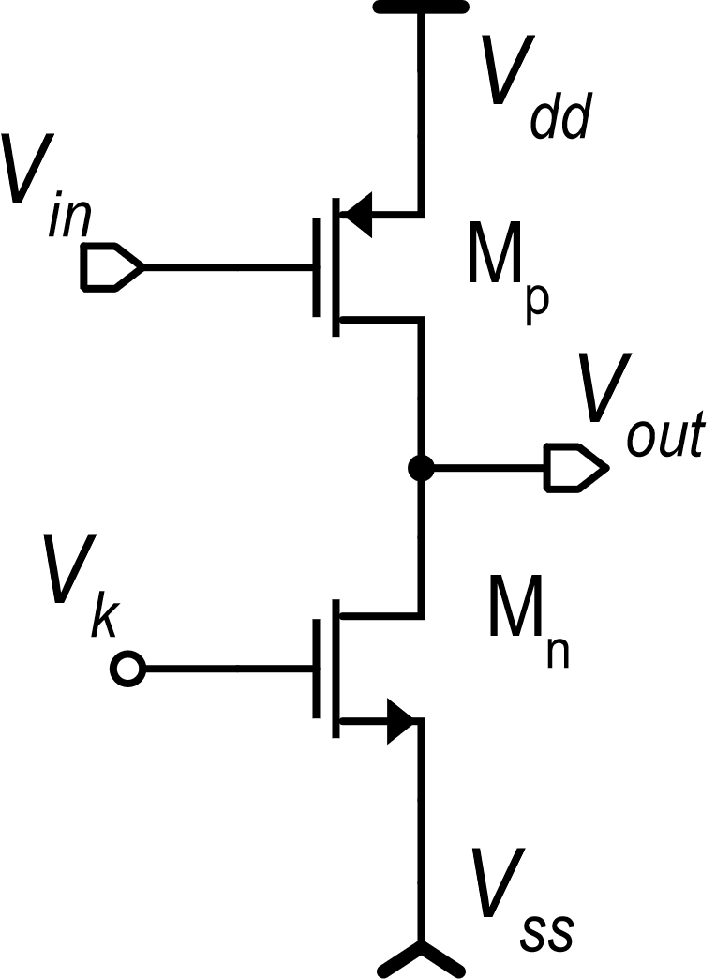
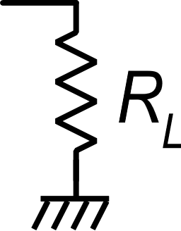
Other info on the class-A common source
n-version
-V_{GSp}
I₀
I₀
V_{GSn}
class-A
class-A
p-version:
(the input signal is invariant when referred to V_{dd})
The input voltage is invariant to the supply voltages when it is referred to V_{ss}: the preceding stage should provide an output with the same property

Slide 16
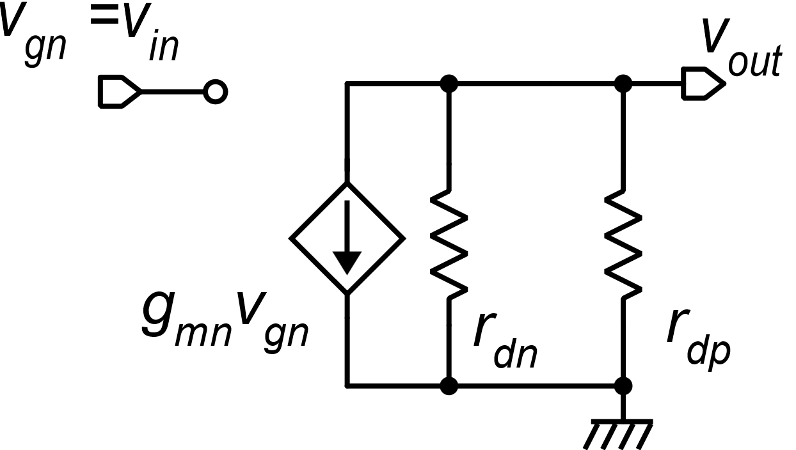
Small signal properties of the class-A common source stage

Slide 17
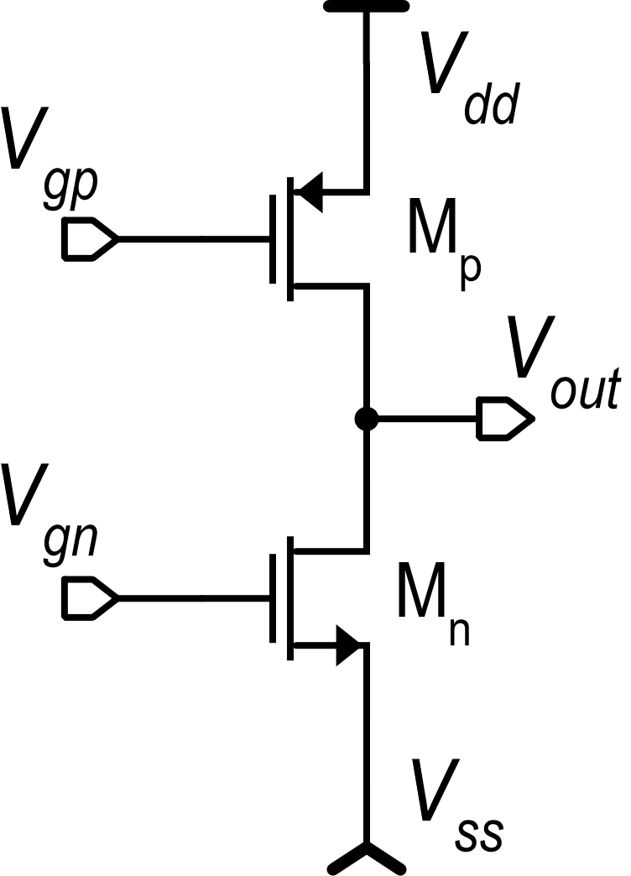
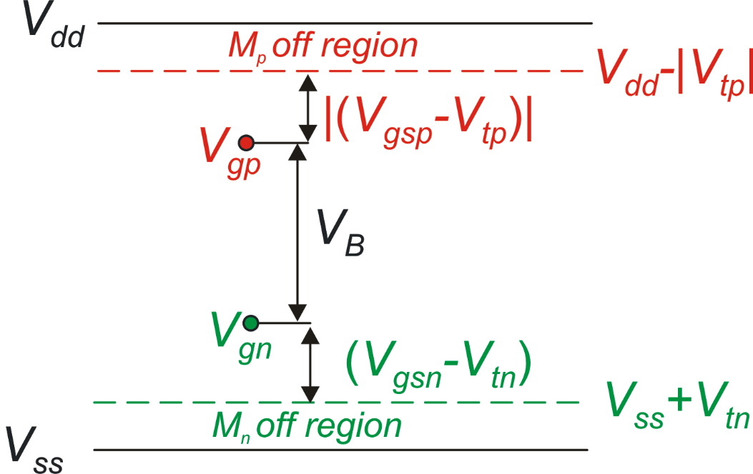
Class-AB common source: principle of operation
push
class-AB control
(driver)
operating
point
M_{p} turns off
pull
M_{n} turns off

Slide 18
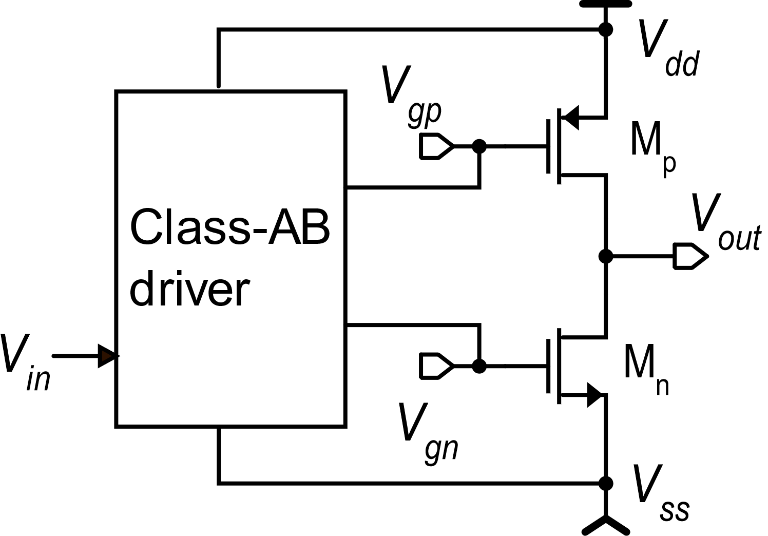
Class-AB common-source output stages: maximum output currents
Driver
β_{p} , β_{n}
Different topologies are available for the class-AB driver. They differ for the maximum V_{GS} that can be delivered to M_{p} and M_{n} and for the minimum supply voltage

Slide 19
Class-AB common-source output stages: quiescent current
Quiescent condition:
The driver must be able to set the quiescent current with a good accuracy, since I_{Q} sets the operating point power consumption and the small signal performances of the stage

Slide 20
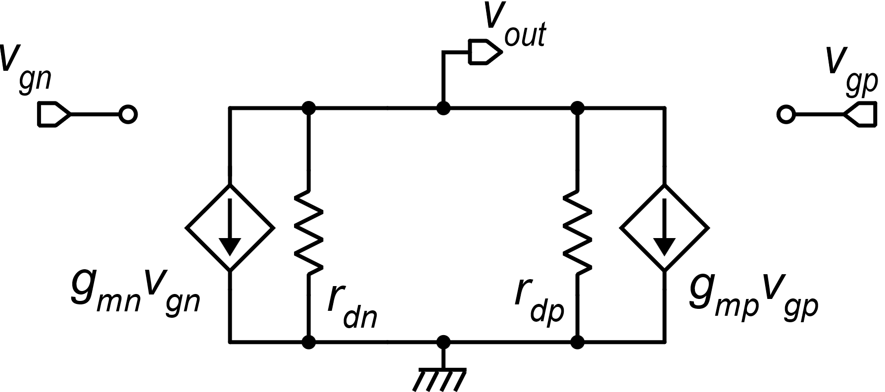
Class-AB common-source output stages: small signal behavior
v_{gn} and v_{gp} must have the same sign to produce in-phase effects on v_{out}
Frequent case:

Slide 21
Class-AB common-source output stages: equivalent voltage source
V_{dd}
V_{gp}
M_{p}
V_{B}
V_{out}
V_{gn}
At least for small signals, this is equivalent to have a voltage source (battery) across the two gates.
M_{n}
V_{ss}

Slide 22
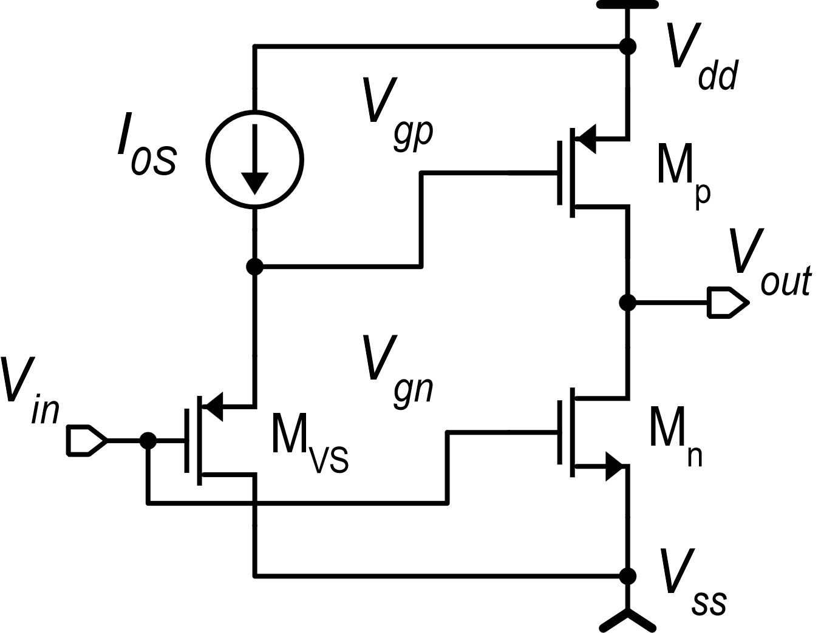
Class-AB common source: voltage shifter case
Alternatively, we can connect V_{in} to V_{Gp} and use a negative voltage shifter to produce V_{Gn}.
Advantage: Simplicity
Drawback: low efficiency in terms of maximum V_{GS}.
Voltage Shifter (positive)

Slide 23
Frequency response requirements: closed loop gain (βA)
The phase margin (φ_{m}) is the main stability indicator
|βA|
|β(0)A(0)|
The closed loop configuration is stable for φ_{m}>0
However, φ_{m} must be significantly greater than 0 to guarantee:
f_{p}
f_{0βA}
f₂
f₃
f₄
Stability even against all possible PVT variations
A step response with reduced ringing and overshoot
βA
180°
90°
φ_{m}
Typically, we require: φ_{m}>70°
0°

Slide 24
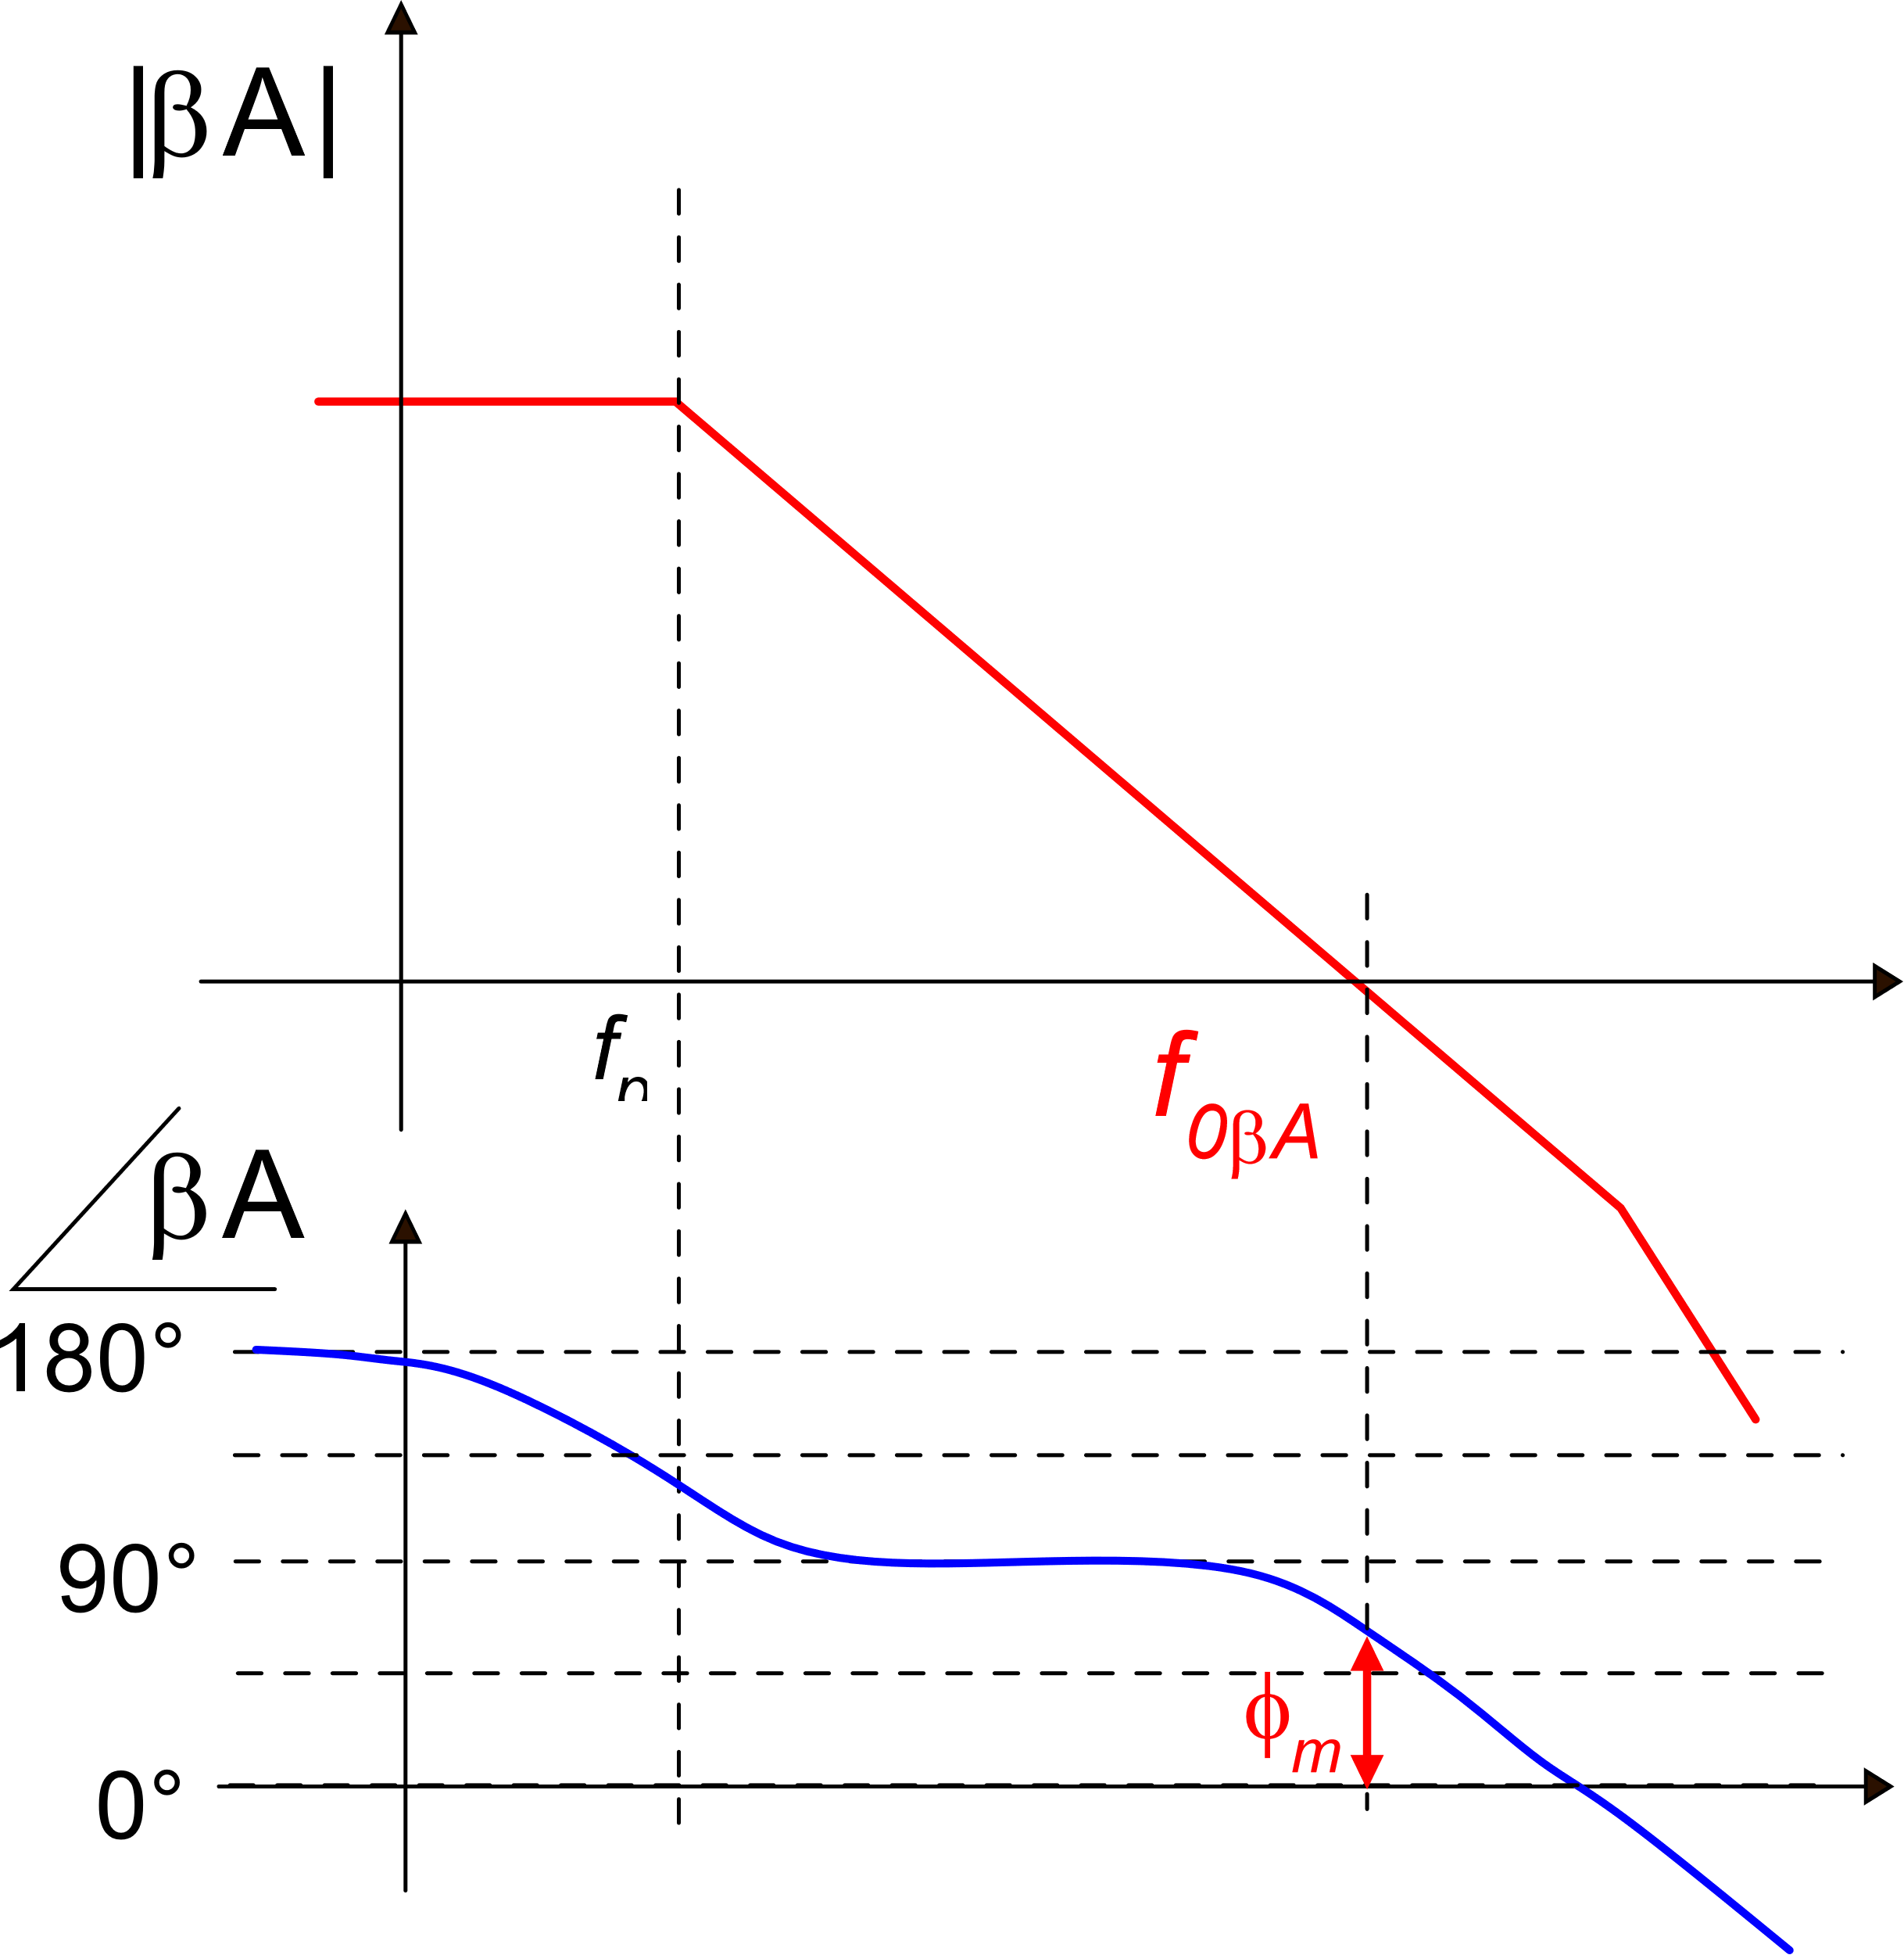
Amplifier gain and loop gain: role of the β factor
resistor-only or capacitor-only feedback networks
f₀ is the unity gain frequency of the amplifier, equal to GBW (Gain-BandWidth for a dominant pole response
In this case, f_{0bA} represents the -3dB upper band limit of the closed loop transfer function.

Slide 25
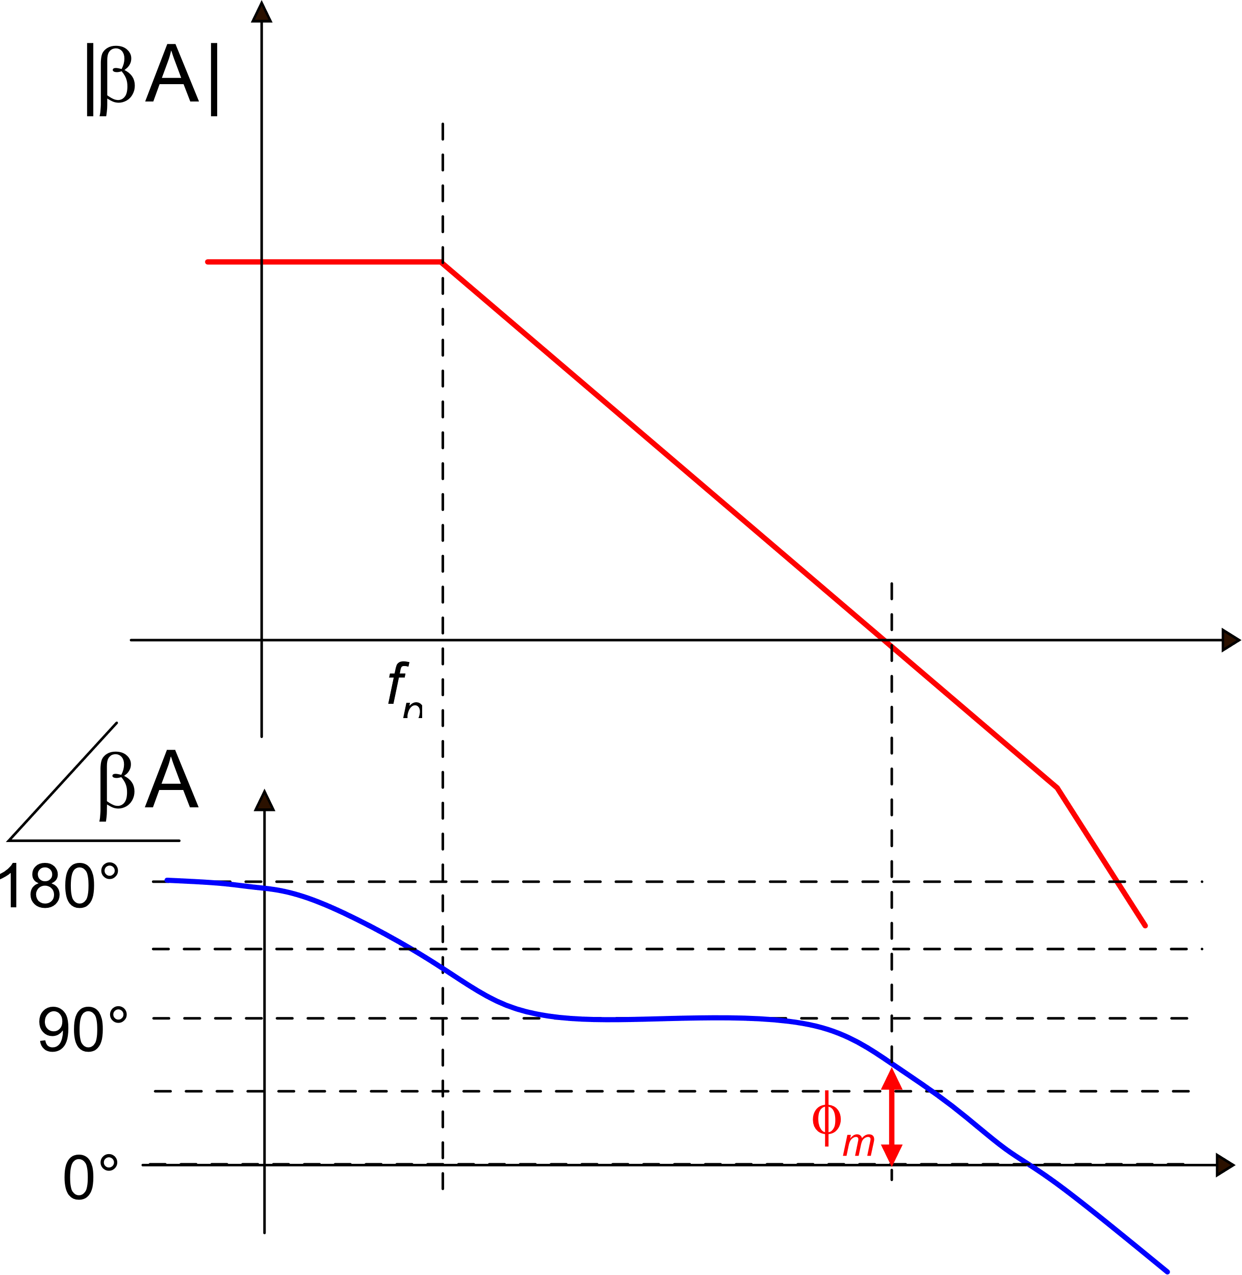
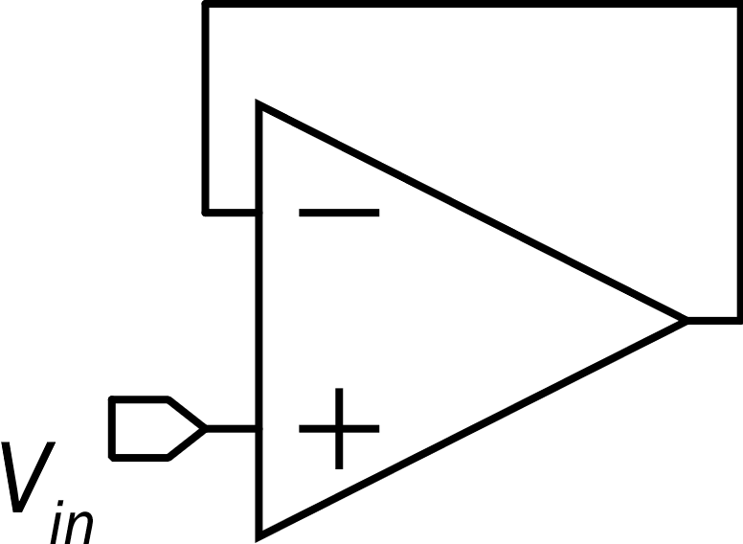
Amplifier gain and loop gain: role of the β factor
β= -1
β₁
β₂
f_{0βA} gets lower: smaller bandwidth for the closed loop transfer function.
φ_{m} increases: greater stability
f_{0β A}
f_{0β A}
2
1
Worst case for stability:
maximum |β|: β= -1
φ_{m}
Smallest phase margin
Unity gain configuration

Slide 26
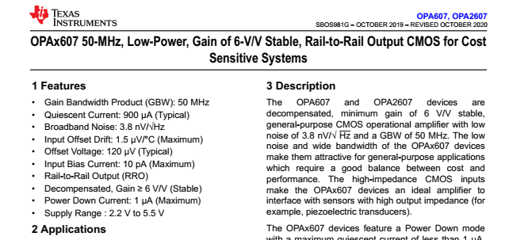
Example of non-unity-gain stable op-amp
Stability for gains $≥6⟹β≤\frac{1}{6}$ for non-inverting amplifiers config.
The advantage is a large GBW

Slide 27
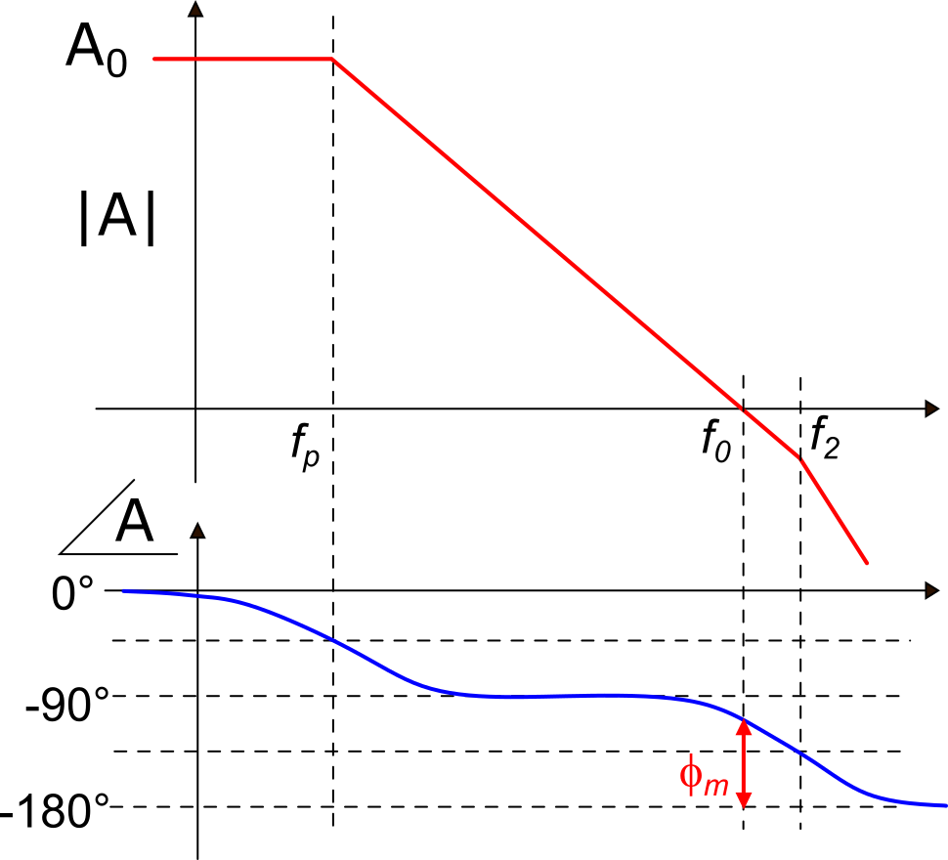
Single non-dominant pole case
design for
unity-gain stable
op-amps
σ is an important design parameter
σ | 0.5 | 1 | 2 | 3 | 5
φ_{m} | 26.6° | 45° | 63.4° | 71.6° | 78.7°
frequent choice

Slide 28
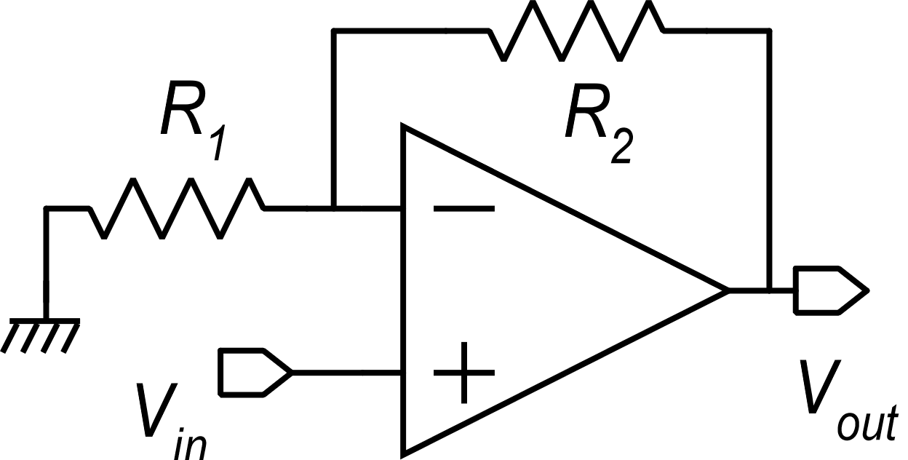
Design specifications for the amplifier response speed
Gain-BandWidth product (GBW)
For a single pole frequency response:
1.
2.
In a closed loop configuration, the upper
band limit is given by: $f_{H}=GBW∙\left|β\right|$
3.
For the non-inverting amplifier:
The same relationships are approximately valid for dominant-pole
frequency responses
Slew rate (s_{R}): this is the maximum slope that can be obtained from the output voltage. The slew rate affects the behavior for large and fast input transients

Slide 29
A possible set of specification for design of a CMOS op-amp
dc gain A₀
Speed: Gain-Band-Width product (GBW) and Slew rate (s_{R})
Closed loop stability: e.g. phase margin in unity gain configuration and with a maximum capacitive load (C_{L})
Input referred voltage noise: Thermal : S_{vT}, Flicker: k_{F}=fS_{vF}(f)
Offset (Input offset voltage: V_{io})
Static power consumption (I_{supply}, minimum V_{dd})
Maximum output current I_{OP-max}, I_{ON-max}
Ranges: Input common mode range (CMR), output swing.
CMRR, PSRR
Area

Slide 30
Design of an anolog cell: phases
Specifications
Choice of the topology
Number of stages, use of cascodes, amplifier class ...
We have to set the values of the Degrees of Freedom (DOFs): W, L, I_{bias}, V_{GS}-V_{t} ...
Device sizing

Slide 31
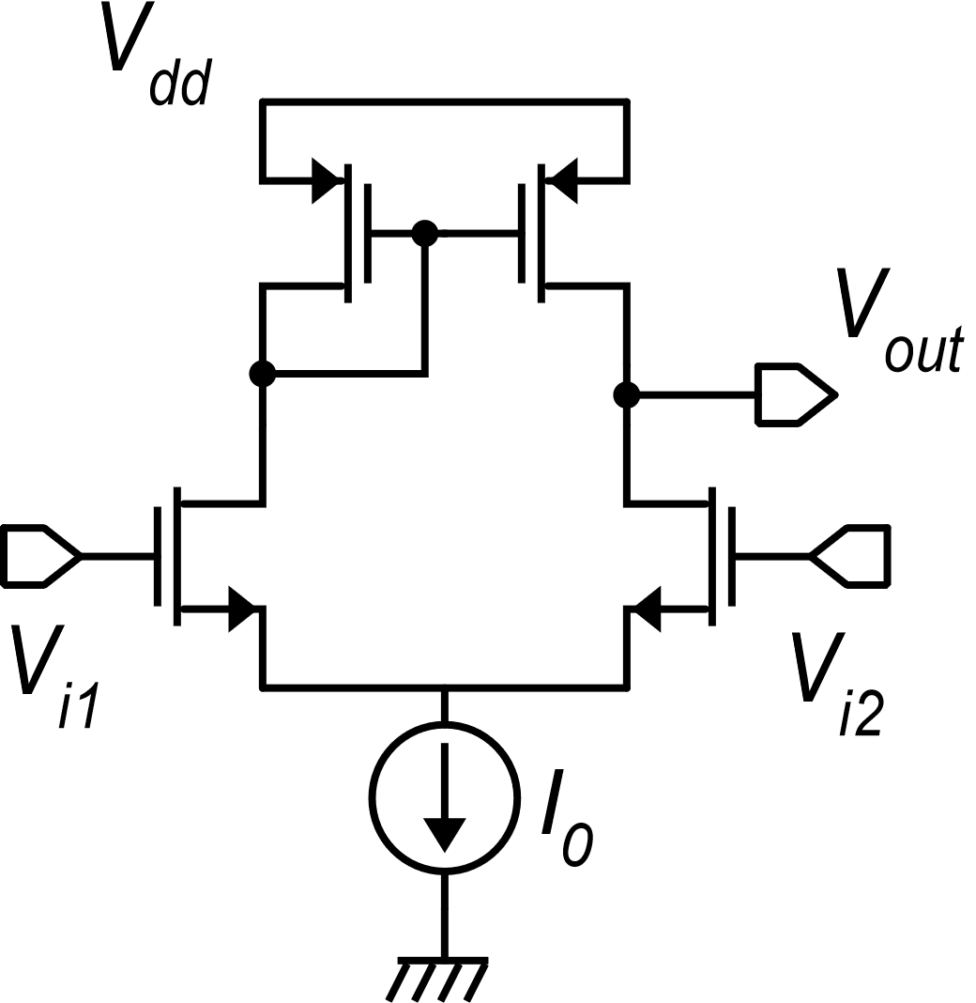
Operational amplifiers: number of stages
In the op-amp design terminology, the number of stages refer only to gain stages.
Example
A gain stage is formed by a V-to-I converter and a network I-to-I that brings the output current(s) of the V-to-I converter to the output port.
I-to-I
single output:
k=1
V-to-I : two inputs n=2
two outputs m=2

Slide 32
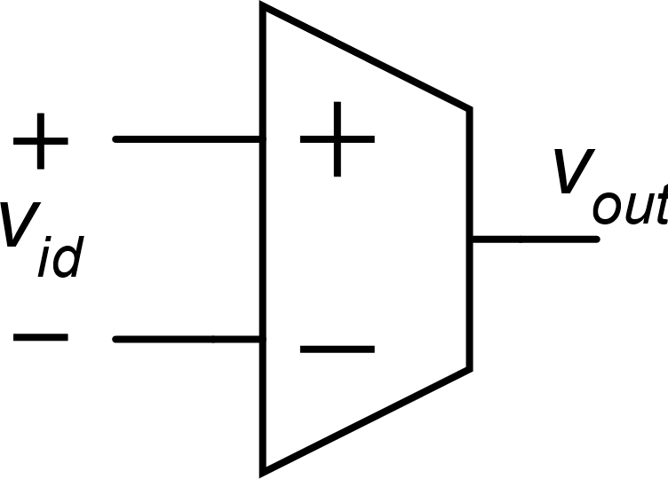
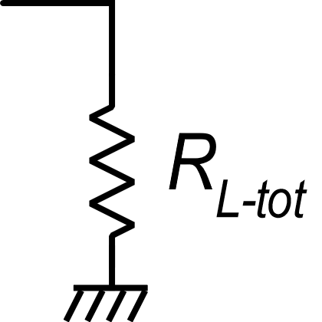
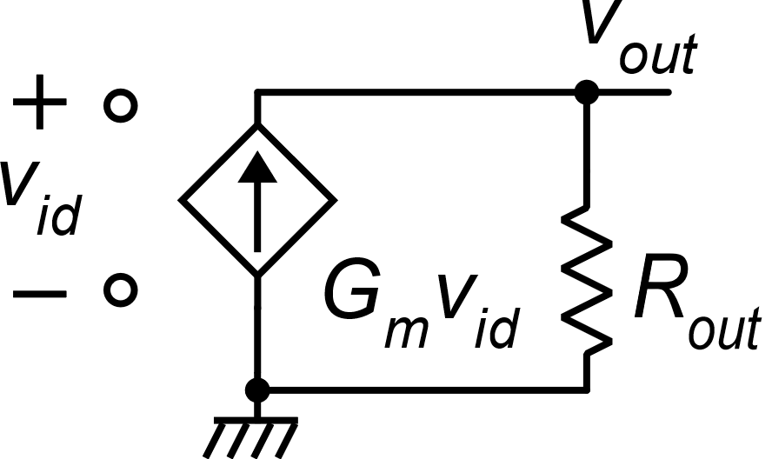
Single stage op-amps
In the case of no resistive load (only capacitive load, as in switched-cap. circuits:
With very large R_{out} values, gains up to 100 dB can be obtained (cascode and regulated cascode architectures)
In the case of resistive loads, the gain falls down to
Includes the load brought by the feedback network

Slide 33
Single stage op-amps with resistive load
Can be as low as several tens of kΩ
In single gain stages, G_{m} coincides with the transconductance (g_{m}) of a single device or is a linear combination of device transconductances
In most practical cases, loading a single stage op-amp with an even moderate resistive loads means reducing the gain to very small values, not suitable for op-amp closed loop applications.

Slide 34
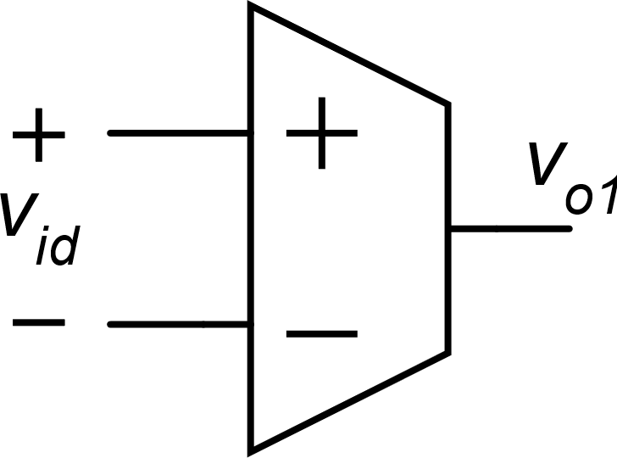
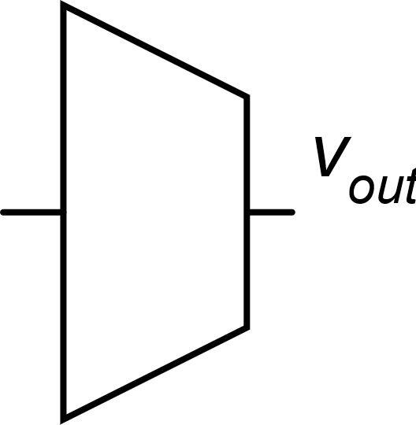
Two-stage op-amps
The resistive loads affects only the gain of the second stage.
Even in the case that the gain of the second stage falls down to a few units, the total dc gain remains as large as to be suitable for most closed-loop configurations.
The second stage is the output stage and must be designed to provide the required current and voltage ranges to the load.
(40 dB - 100 dB)

Slide 35
Considerations on the op-amp number of stages
Single stage op-amps: they can be designed to provide enough gain for a large variety of applications only in the case that the load and the feedback networks are capacitive (switched capacitor circuits). Their advantage is their simple frequency compensation and their power efficiency. Their stability increases with large capacitive loads.
Two-stage amplifiers: they are the most popular options for general purpose op-amps since they are suitable for both capacitive and resistive loads and can be designed to provide very large dc gains. Their stability decreases with large capacitive loads.
Three-stage amplifiers: this option is necessary when two stage amplifiers cannot provide enough gain. This is the case, for example of very low supply voltages that prevent the use of cascodes. The gain of two-stage amplifiers can be too low also in the case of very fast op-amps, where the gain of each single stage is limited by the necessity to use short-length MOSFETs. Three stage amplifiers requires complicated frequency compensation strategies, such as the nested-Miller compensation combined with feed-forward paths (multi-path architectures)

