Slide 1
Instrumentation Amplifiers (In-Amps)
Required features:
Precise gain
High input resistance
Other important features
Differential input
Low input referred offset voltage
Low bias currents
Low input referred voltage and current noise
High CMRR (for differential amplifiers)
Large bandwidth

Slide 2
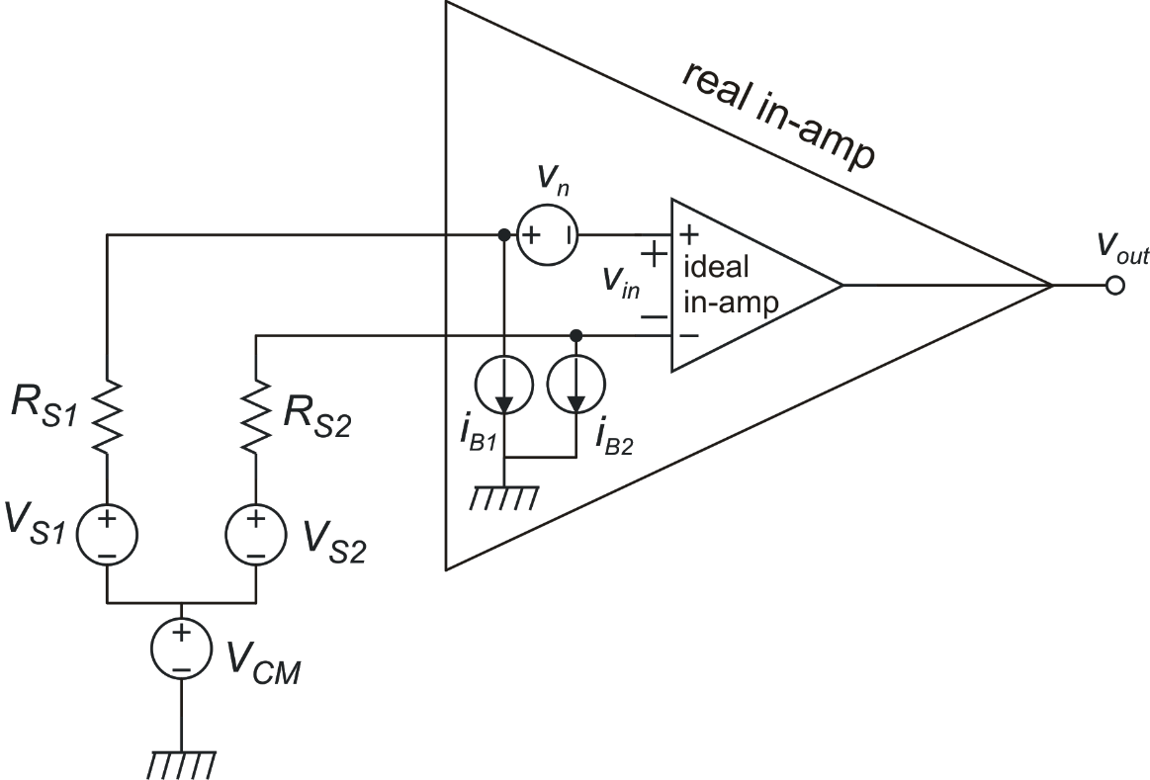
In-amps: errors due to the input noise/offset voltage and currents
Useful Signal:
Differential signal source
(Thevenin equivalent circuit)
Balanced source case (R_{S1}=R_{S2}=R_{S})

Slide 3
Total voltage noise expressions
Balanced source case (R_{S1}=R_{S2}=R_{S})
DC components:
Noise components:
If i_{n1} and i_{n2} are uncorrelated and S_{I1}:= S_{I2} =S_{I}:

Slide 4
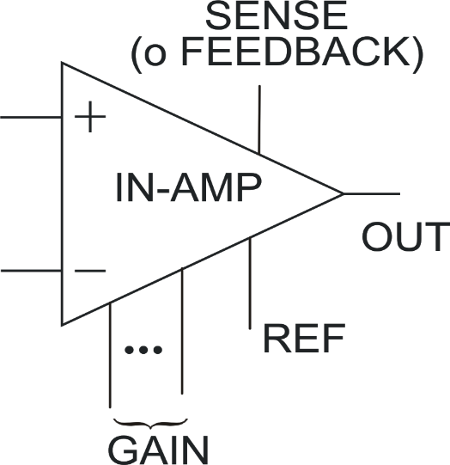
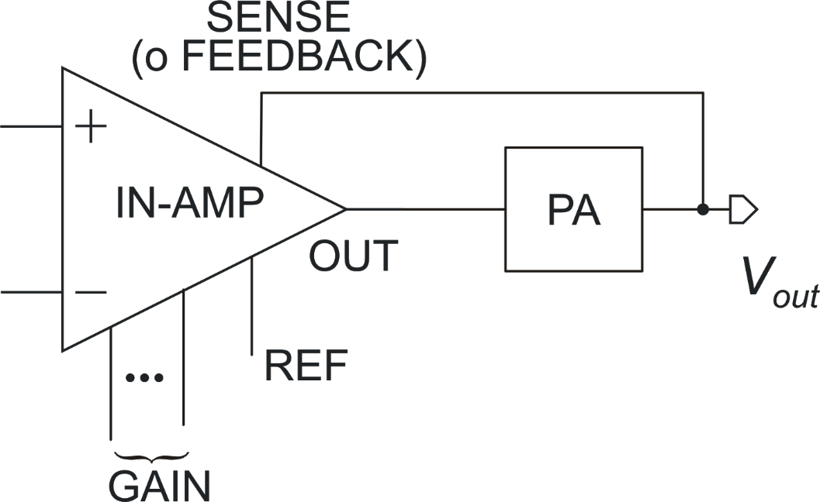
Discrete monolithic In-Amps
Typical pin configuration
One possible use of the SENSE terminal

Slide 5
In-Amp with variable gain: Input and Output offset and noise
Typical two-stage architecture of In-amps
: input noise
Generally, A₂= 1, thus:
: output noise

Slide 6
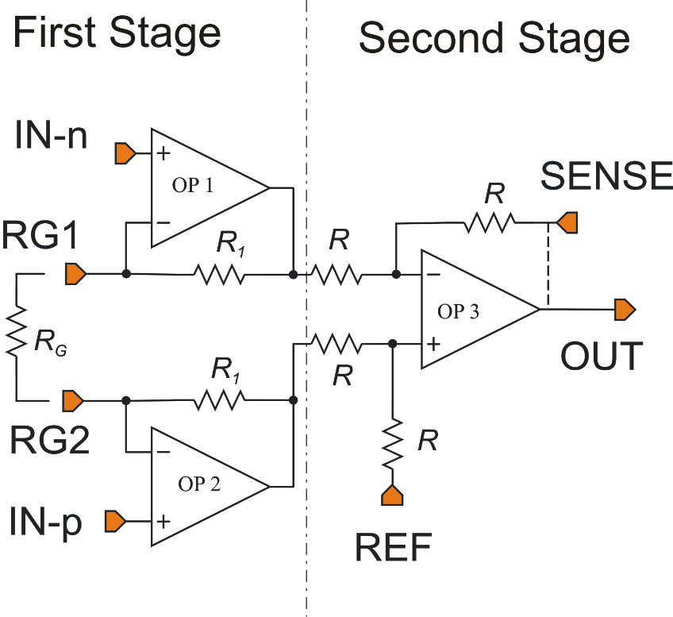
Three-Op-Amp Instrumentation Amplifier
Mismatch of these resistors degrades the CMRR of the second stage. Resistor trimming is necessary for CMRRs > 60 dB
The circuit that provides V_{REF} must have a very low output resistance (<<R)

Slide 7
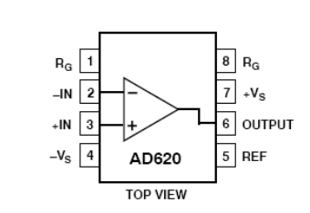
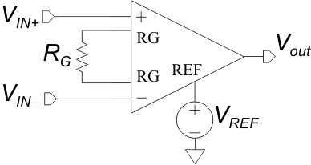
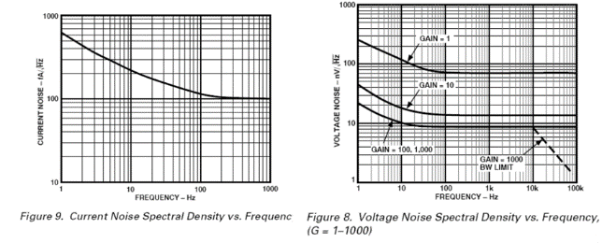
AD 620
The RTI noise
decreases with G
At G≥100 the
amplifier BW is
larger than 100kHz.
The noise density
starts to fall for
f> 100kHz

Slide 8
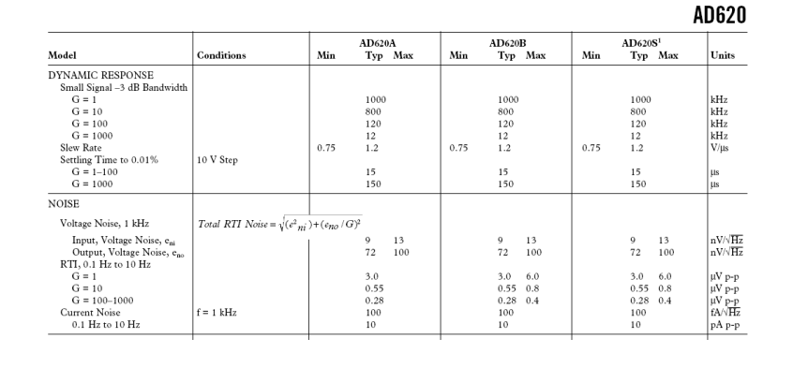
AD 620
GBW does not increase much beyond the G=10 case: BW affected by second stage
Nearly constant GBW product: BW determined by first stage
Slew -Rate
Settling times
Output noise >> input noise
Broad-Band Noise: √S_{BB}
Broad-Band Noise: √S_{BB}
Current
Low Frequency Noise
Integrated over 0.1-10 Hz
Low Frequency Noise
Integrated over 0.1-10 Hz

Slide 9
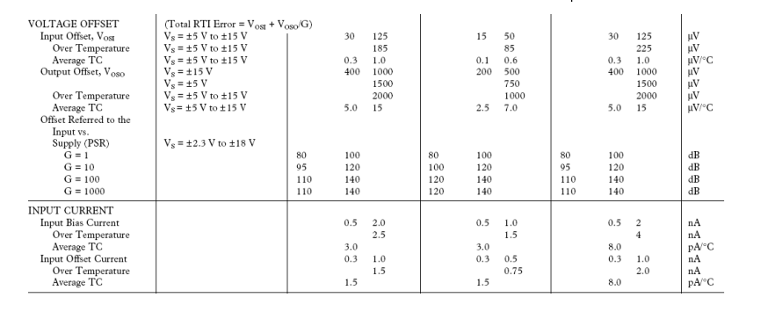
The effective input referred offset (RTI)
is a combination of the input and output offset
AD 620
Input offset
Output offset
The input bias current and input offset current are similar, since
such a small bias current is the result of internal bias current cancellation
The AD 620 in-amp represent a good trade-off between input noise voltage, input bias currents and supply current (quiescent current)

Slide 10
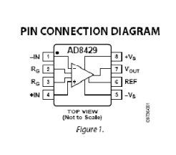
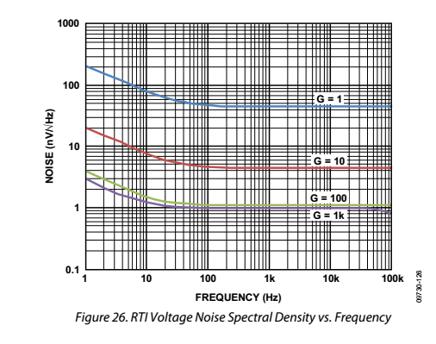
AD 8429
The AD8429 has a much smaller input referred noise than the AD620
(BB-noise) ……..
..... but its input current noise is much larger..

Slide 11
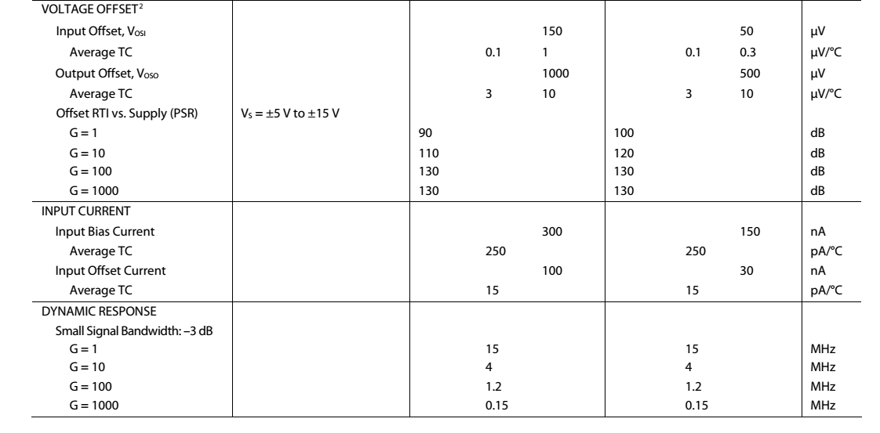
AD 8429
The bias current (dc value) is also much larger than AD620 one
The AD8429 is faster than the AD620
…. but it requires much more quiescent current

Slide 12
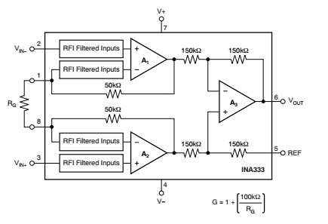
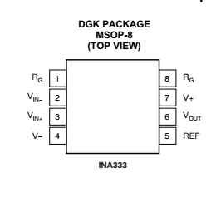
The INA333 is a very low-power instrumentation amplifier
(I_{supply}: 50 μA)
As a result, its input referred voltage noise is larger and its bandwidth smaller.

Slide 13
INA 333
Small bandwidths
Very low input bias current
Large noise density
(For AD620 was 9 nV/√Hz)

Slide 14
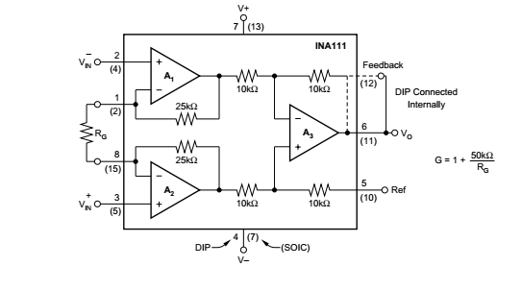
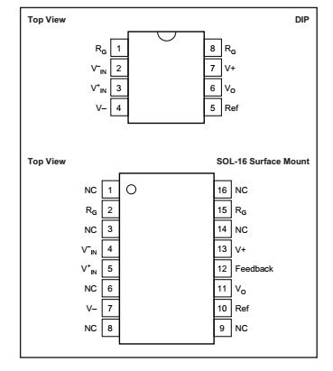
INA 111: J-Fet input
Note the presence of a
sense (Feedback) terminal in
the 16 pin case
Offset is considerably worse than
AD620 which has a BJT input stage

Slide 15
INA 111
…. but the (integrated) low-frequency
voltage noise is much worse (was 0.28 μV) in
the AD 620
The broad-band input referred noise density
is similar to AD 620 …..
The strong advantage of a JFET input is the
negligible noise current density

Slide 16
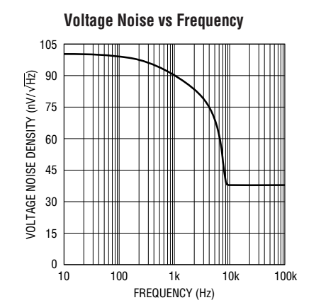
The LTC 1100 uses an Autozero
technique to cancel the input offset and
flicker noise.
The side-effect is foldover, resulting in an
increased low-frequency noise density.

Slide 17
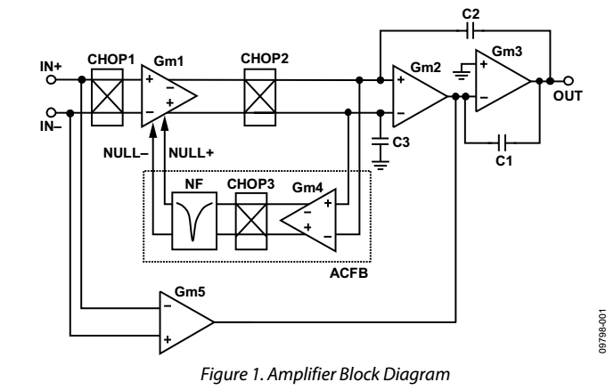
AD 4528 equivalent block diagram (from AN-1114 application note of Analog Design)
Chopper modulation is
applied only to the first stage
Feedback loop for reduction
of the offset ripple
High frequency path (not chopped)
to obtain a wide bandwidth

Slide 18
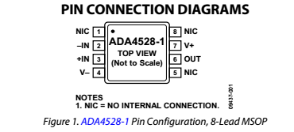
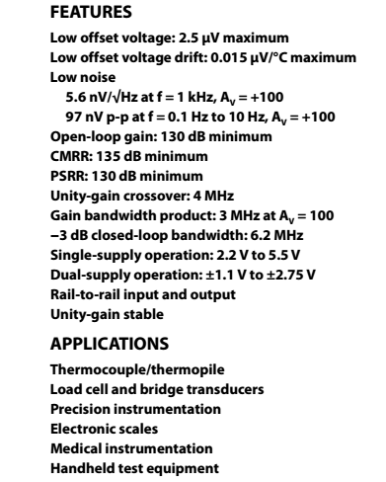
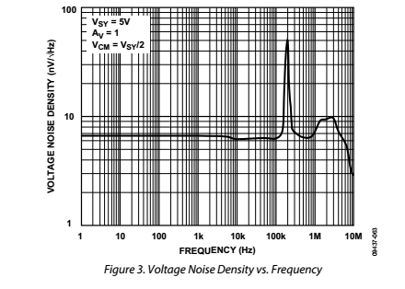
A recently introduced chopper op-amp
Very low offset voltage
Note: residual
offset and flicker noise
shifted at the clock frequency
Very low noise density down
to low frequencies

Slide 19
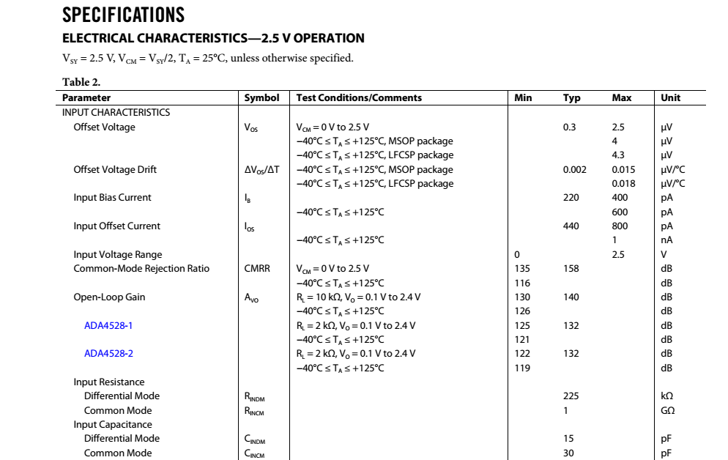
Note: relatively high bias currents
for a CMOS amplifier: effect of
charge injection from the input
switches
Note: relatively low input resistance
(effect of alternating Vin and –Vin
across the input capacitance)

Slide 20
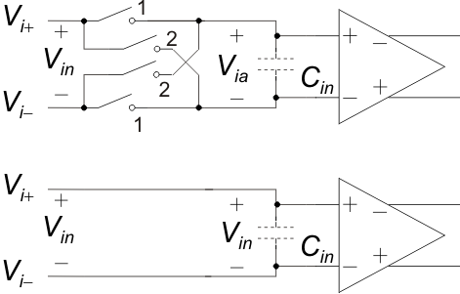
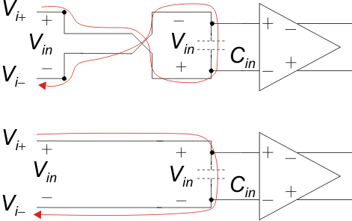
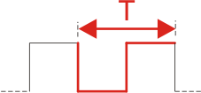
Finite input resistance of chopper amplifiers
Input modulator
Amplifier input
capacitance
Phase 2
Let us start from phase 1 …
Phase 1 again
(one period)

