Slide 1
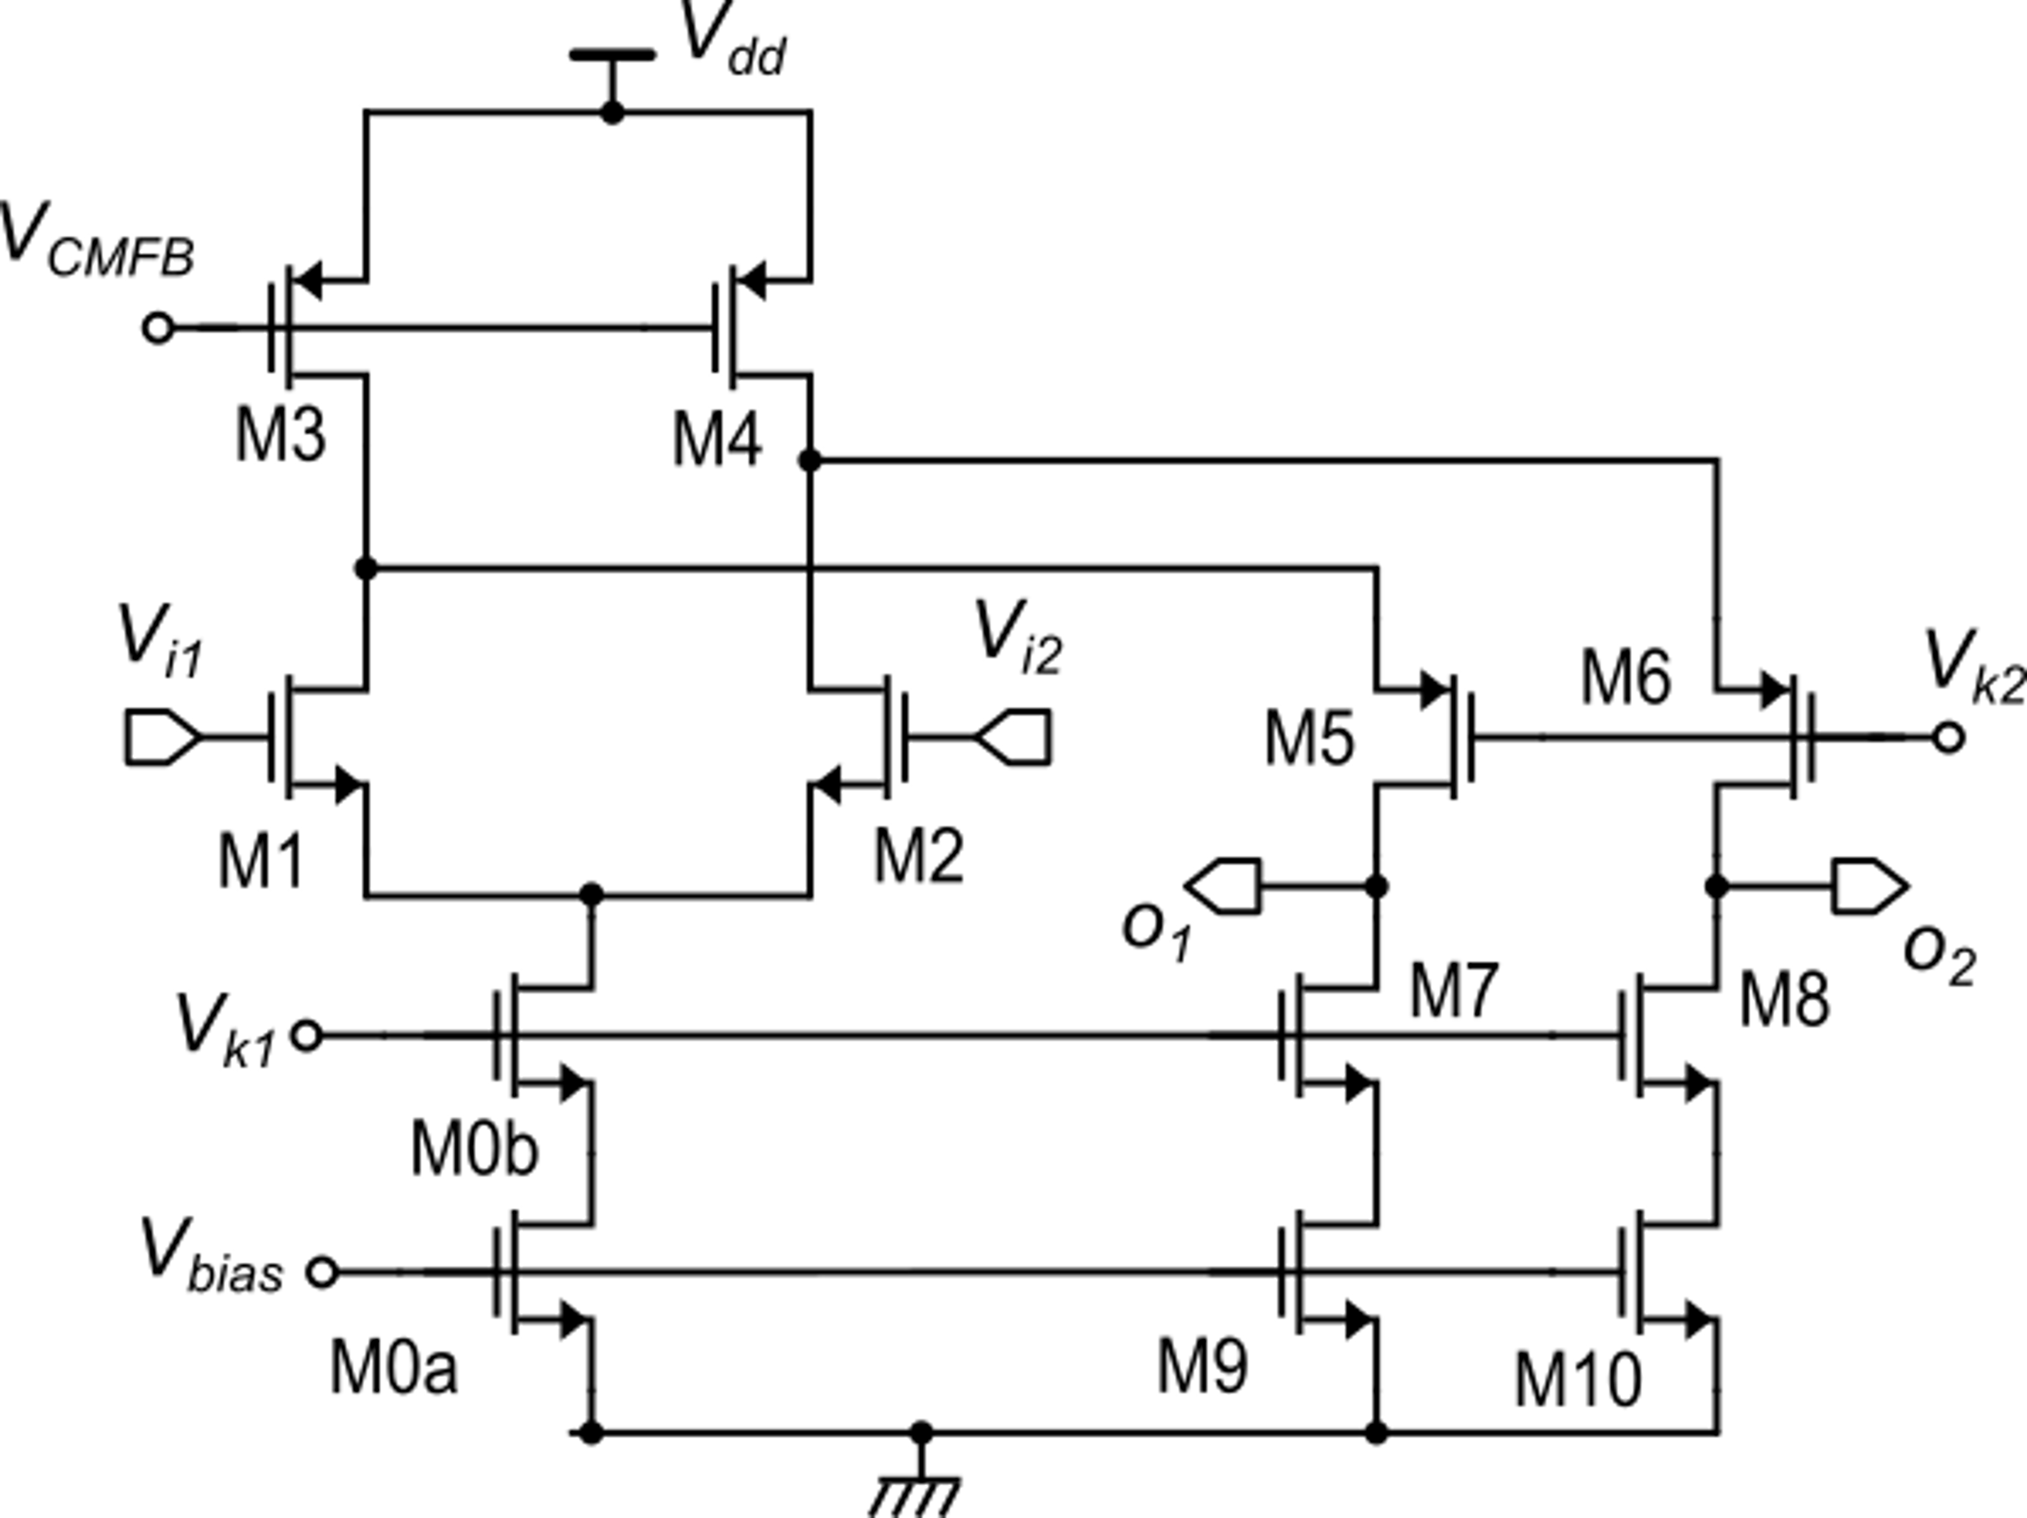
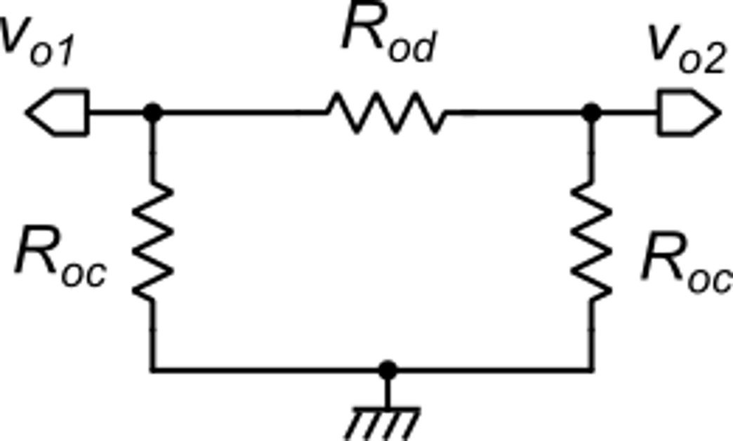
Accurate representation of the output port in fully-differential circuits
Small-signal representation of the output port for a symmetrical FD amplifier with no input signal
Example of fully-differential folded cascode amplifier

Slide 2
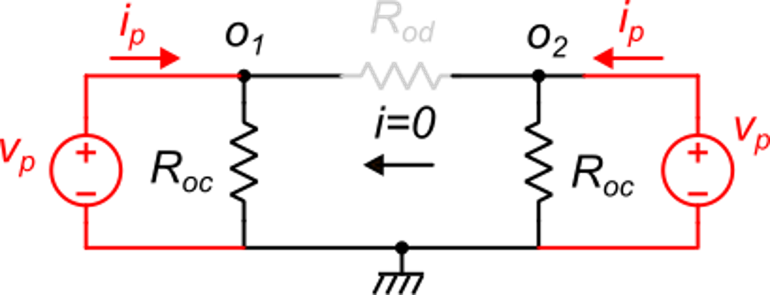
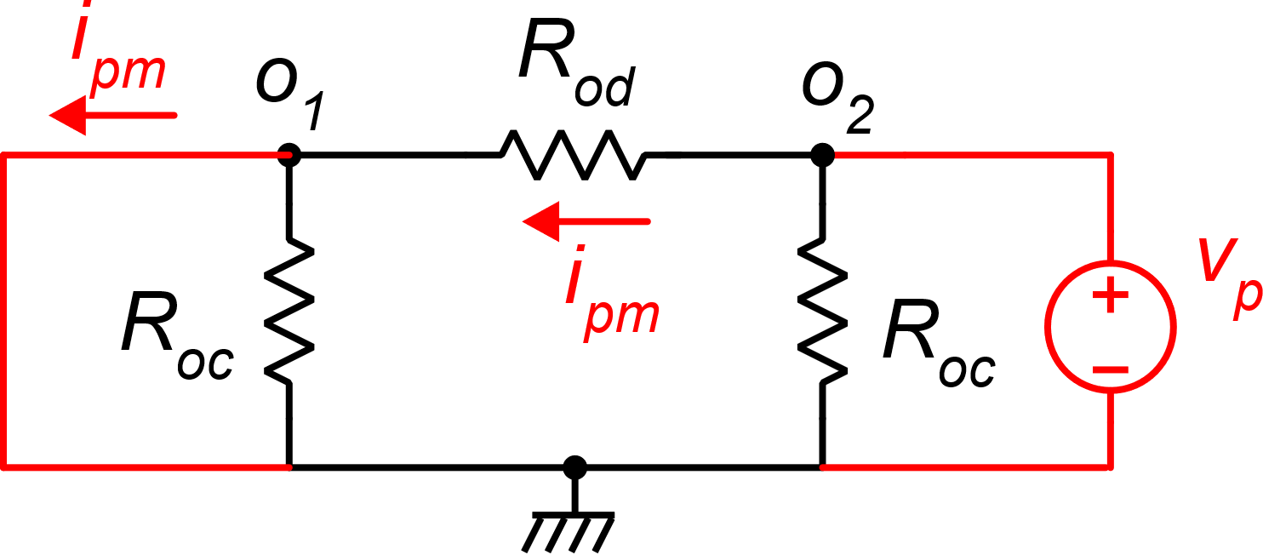
Determination of R_{oc} and R_{od}
Configuration for R_{oc}:
Configuration for R_{od}:
Identical voltage sources are applied to both output terminals. Voltage across RD is null and so is current through it. Then:
A voltage sources is applied to one terminal, while the other terminal is shorted. ipm is the current measured through the short circuit.

Slide 3
Application to the fully-differential folded cascode
We study the circuit on the left, as iit is shown, with no CMFB circuit. In other words, we consider the CMBF circuit as a separate block. Then, while modeling the circuit on the left, no common-mode feedback is considered and V_{CMFB} is treated as an input that should be shorted to gnd when studying the output small-signal resistance.

Slide 4
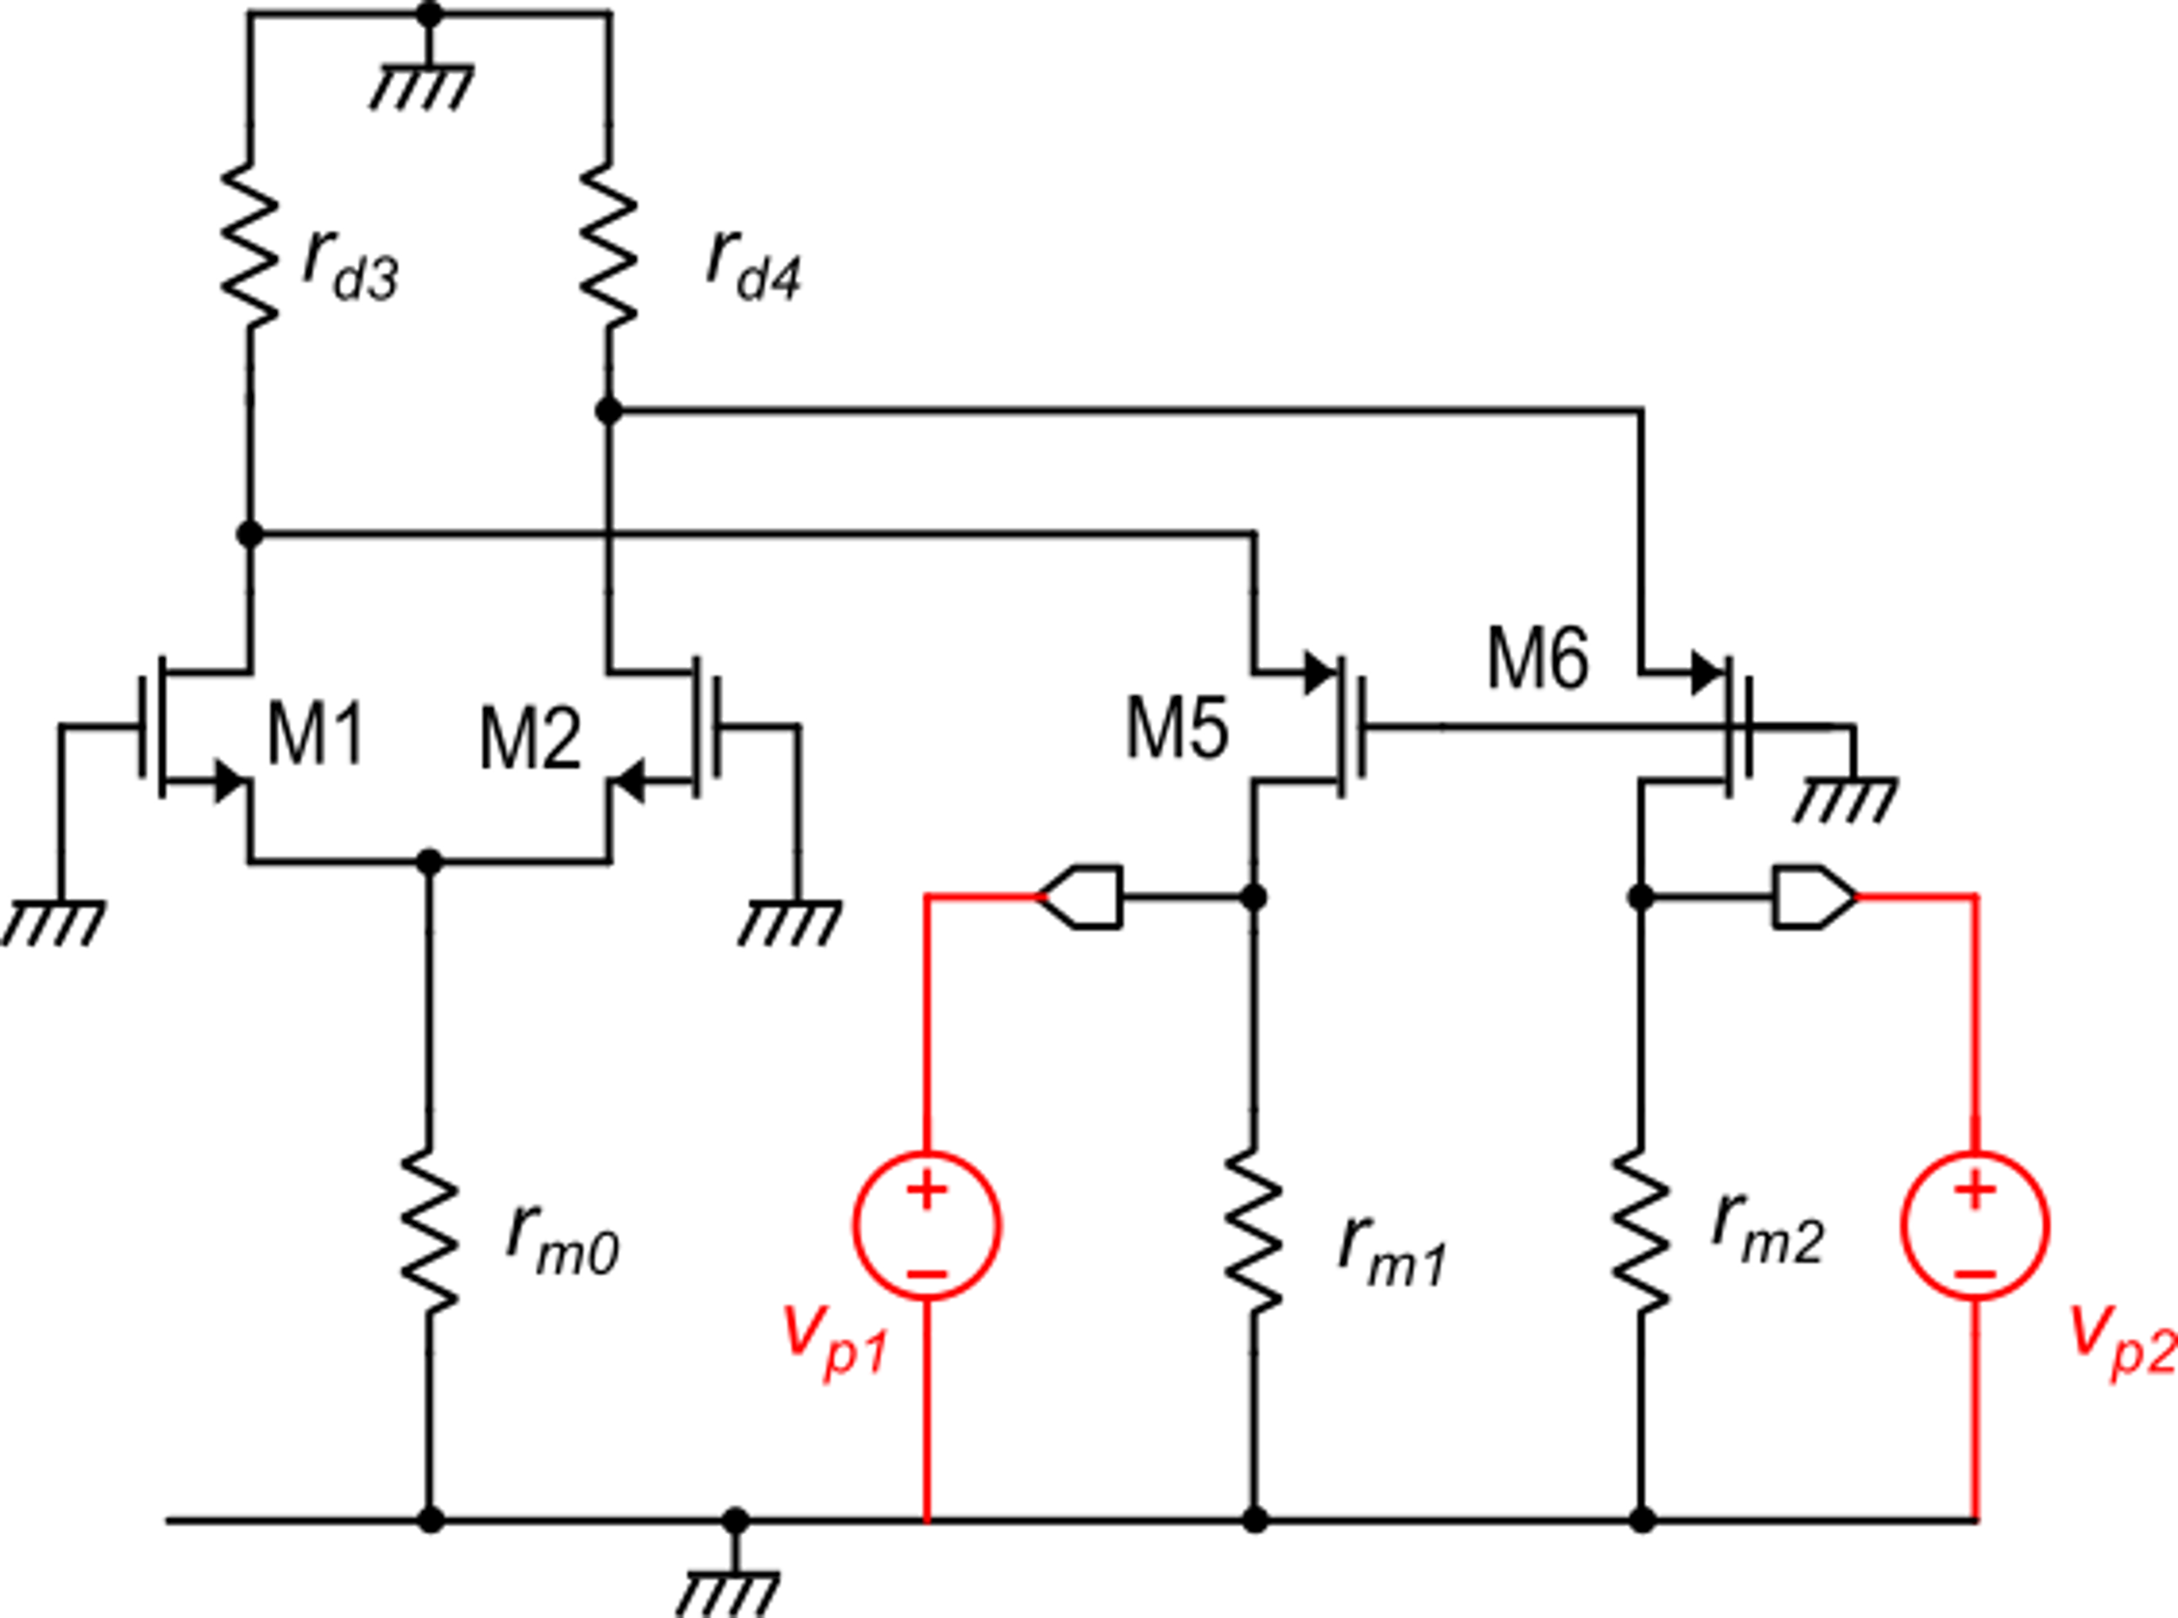
Application to the fully-differential folded cascode
Equivalent small signal circuit for calculation of the output resistances

Slide 5
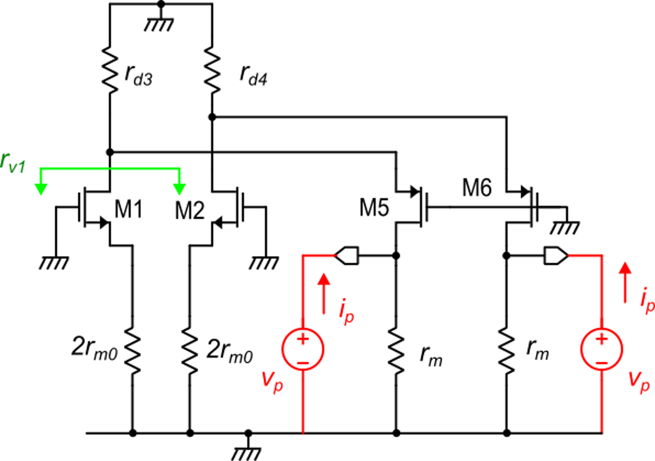
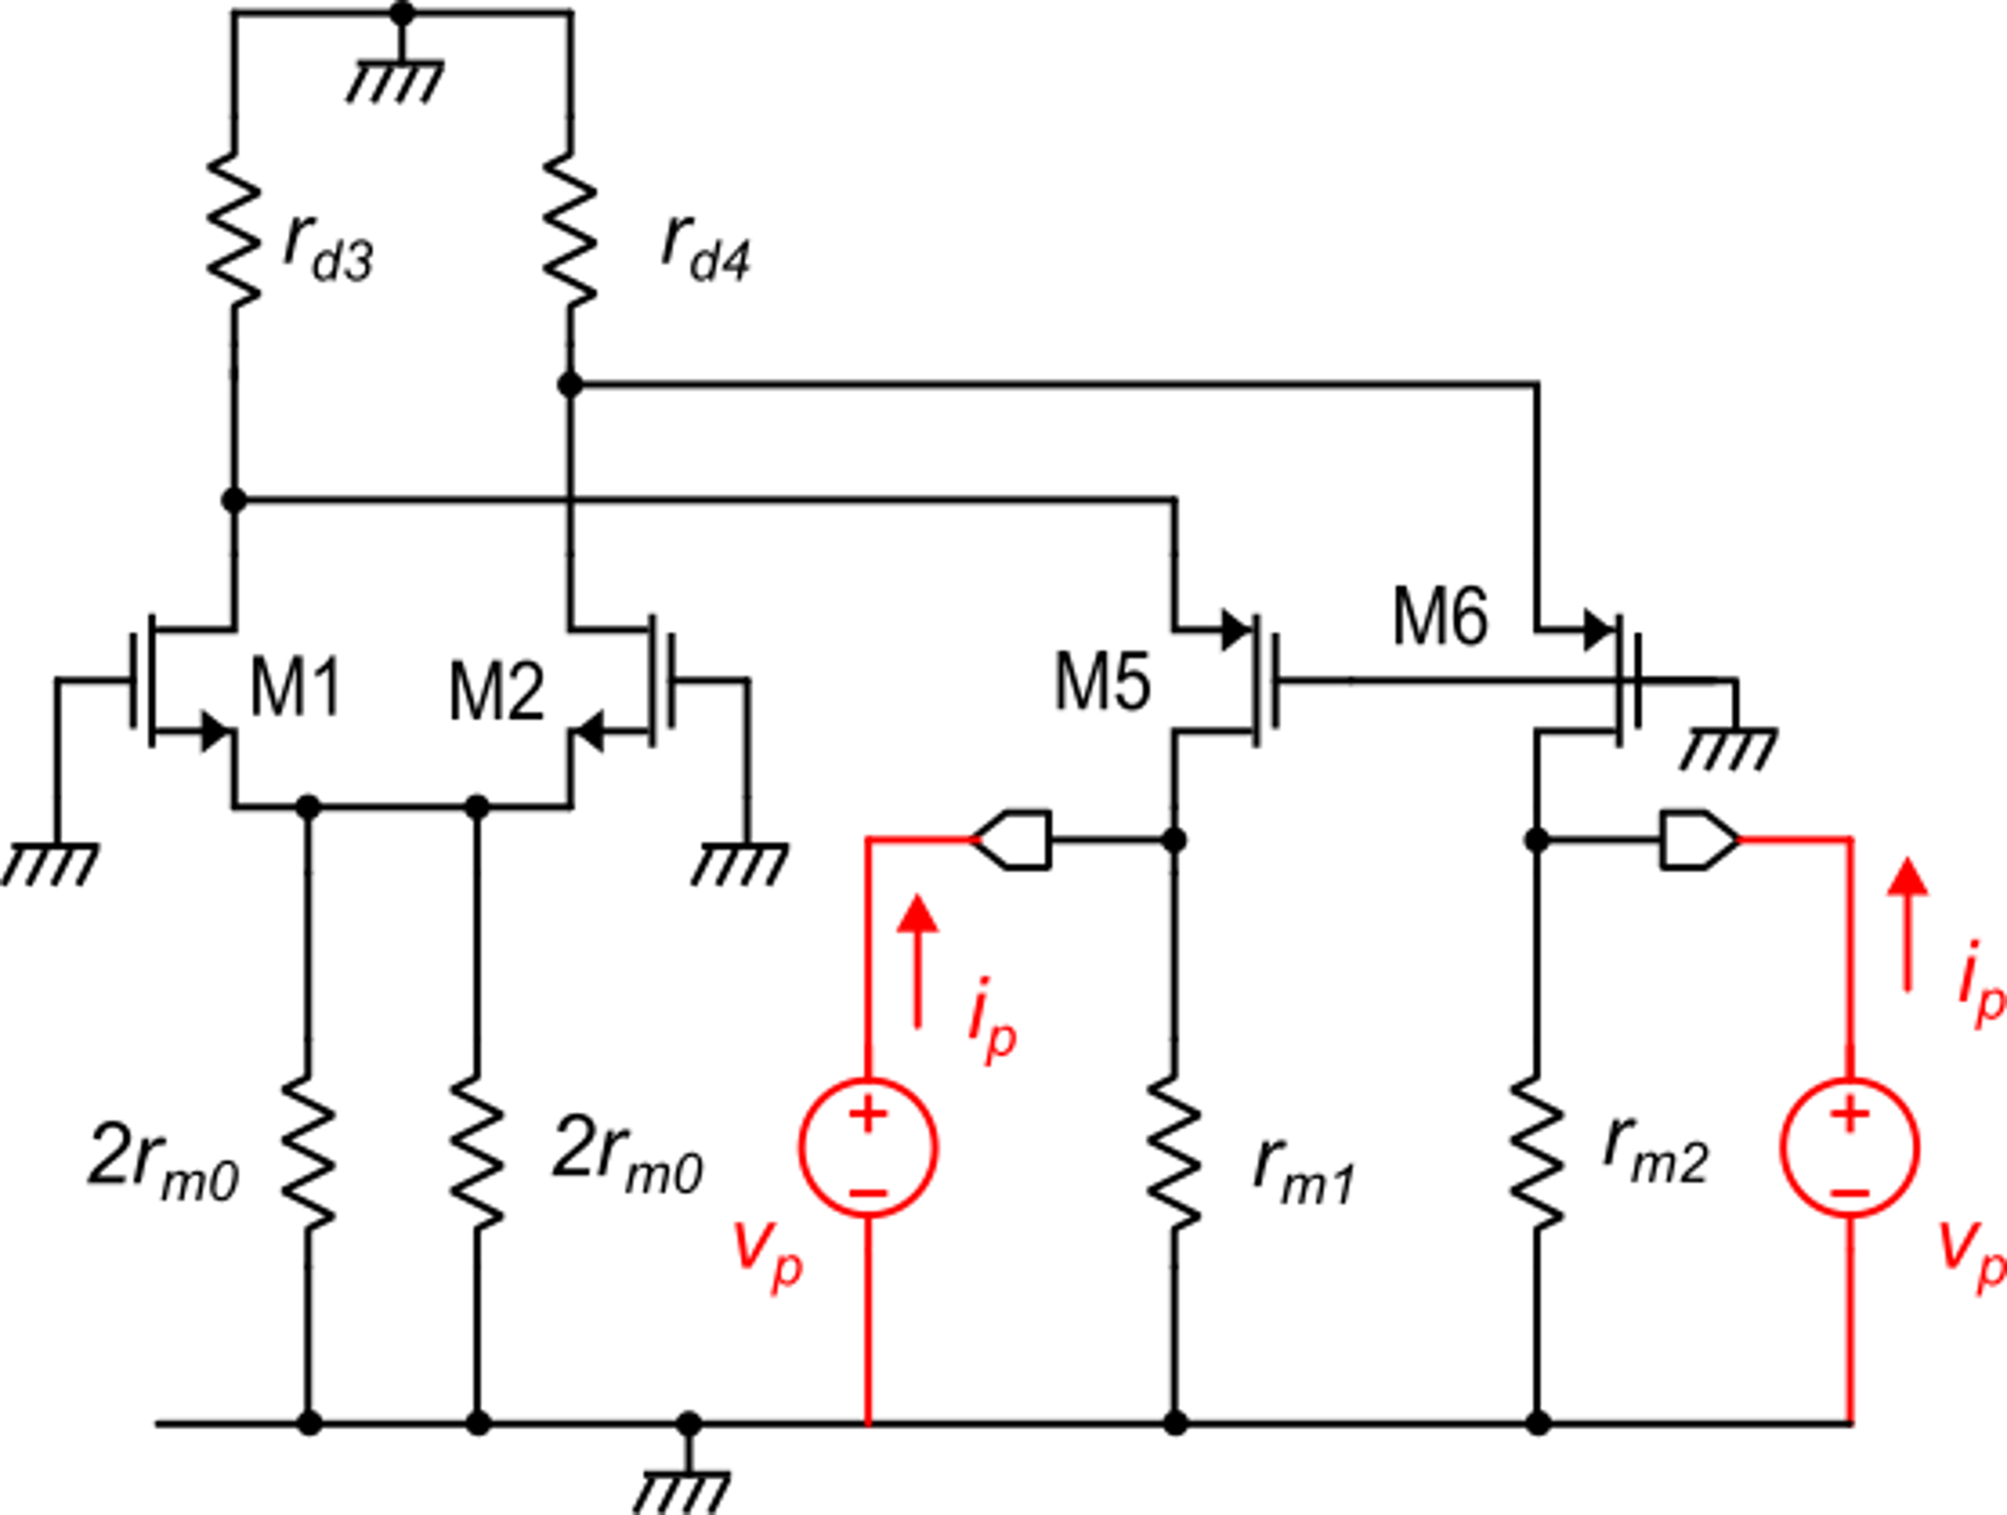
Determination of R_{oc}
symmetry: no current
through this branch
r_{v1} >> r_{d3}

Slide 6
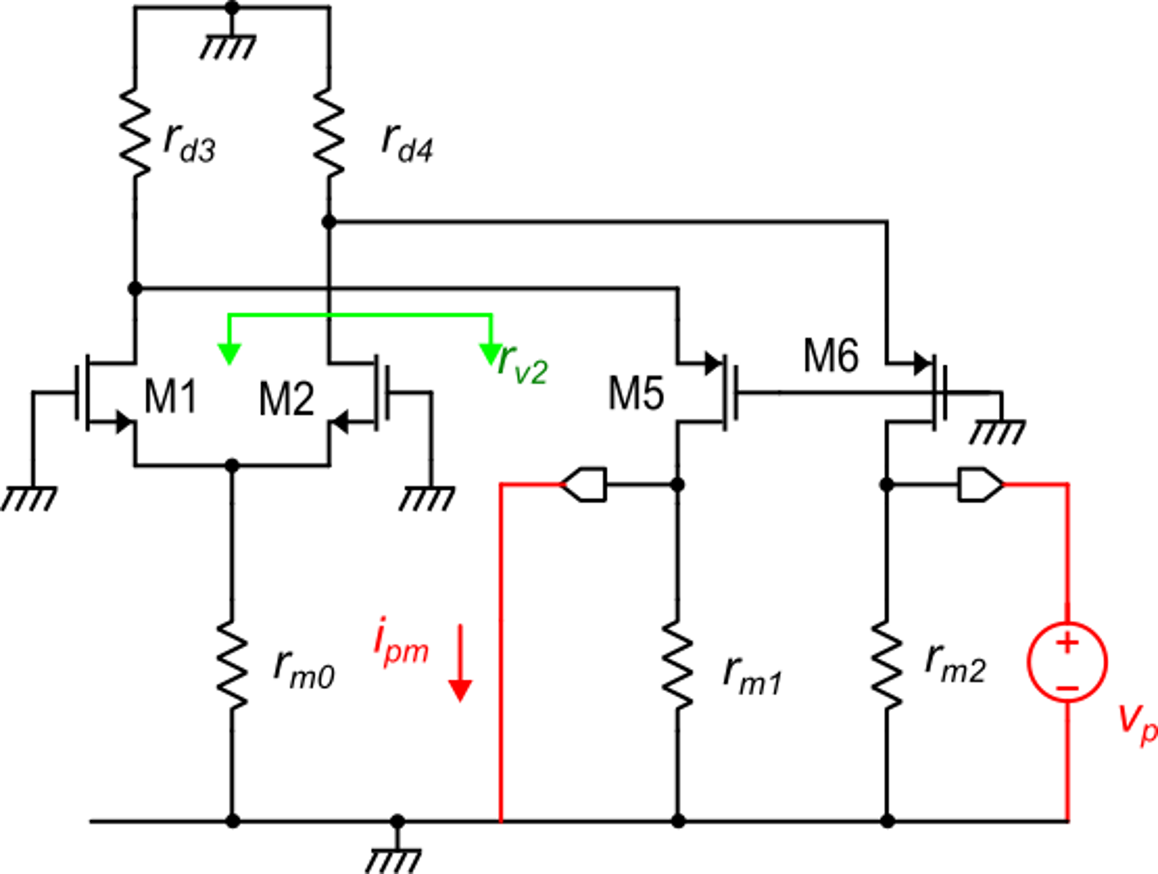
Determination of R_{od}
i_{up}
i_{pm}

Slide 7
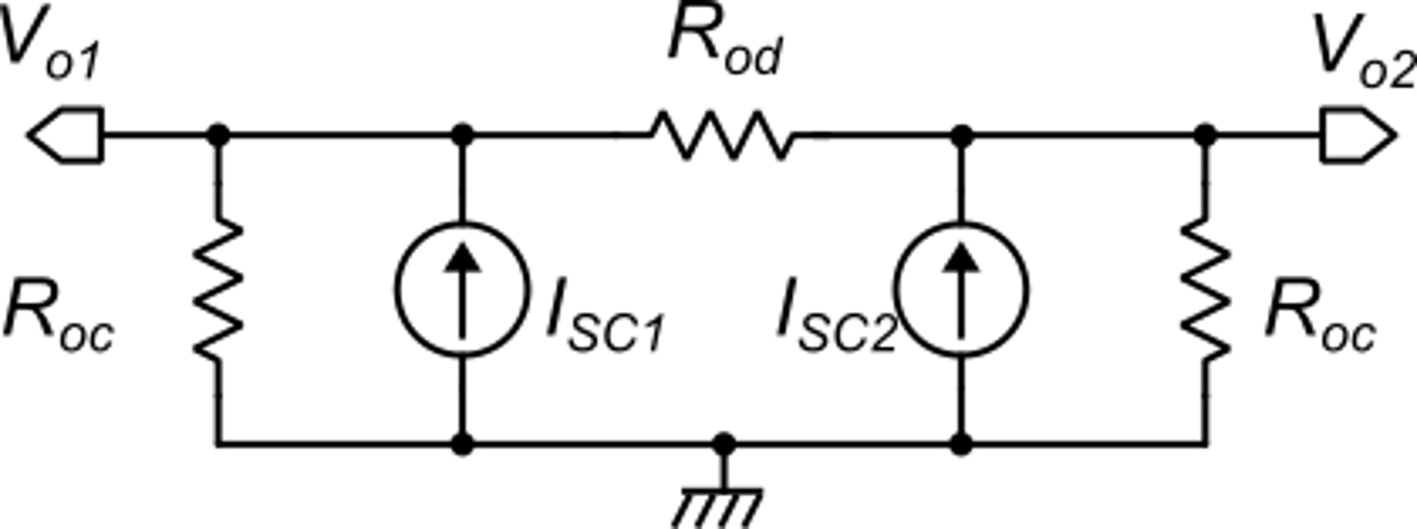
Differential mode gain
in dc and with
only differential mode
CMFB
common gate

Slide 8
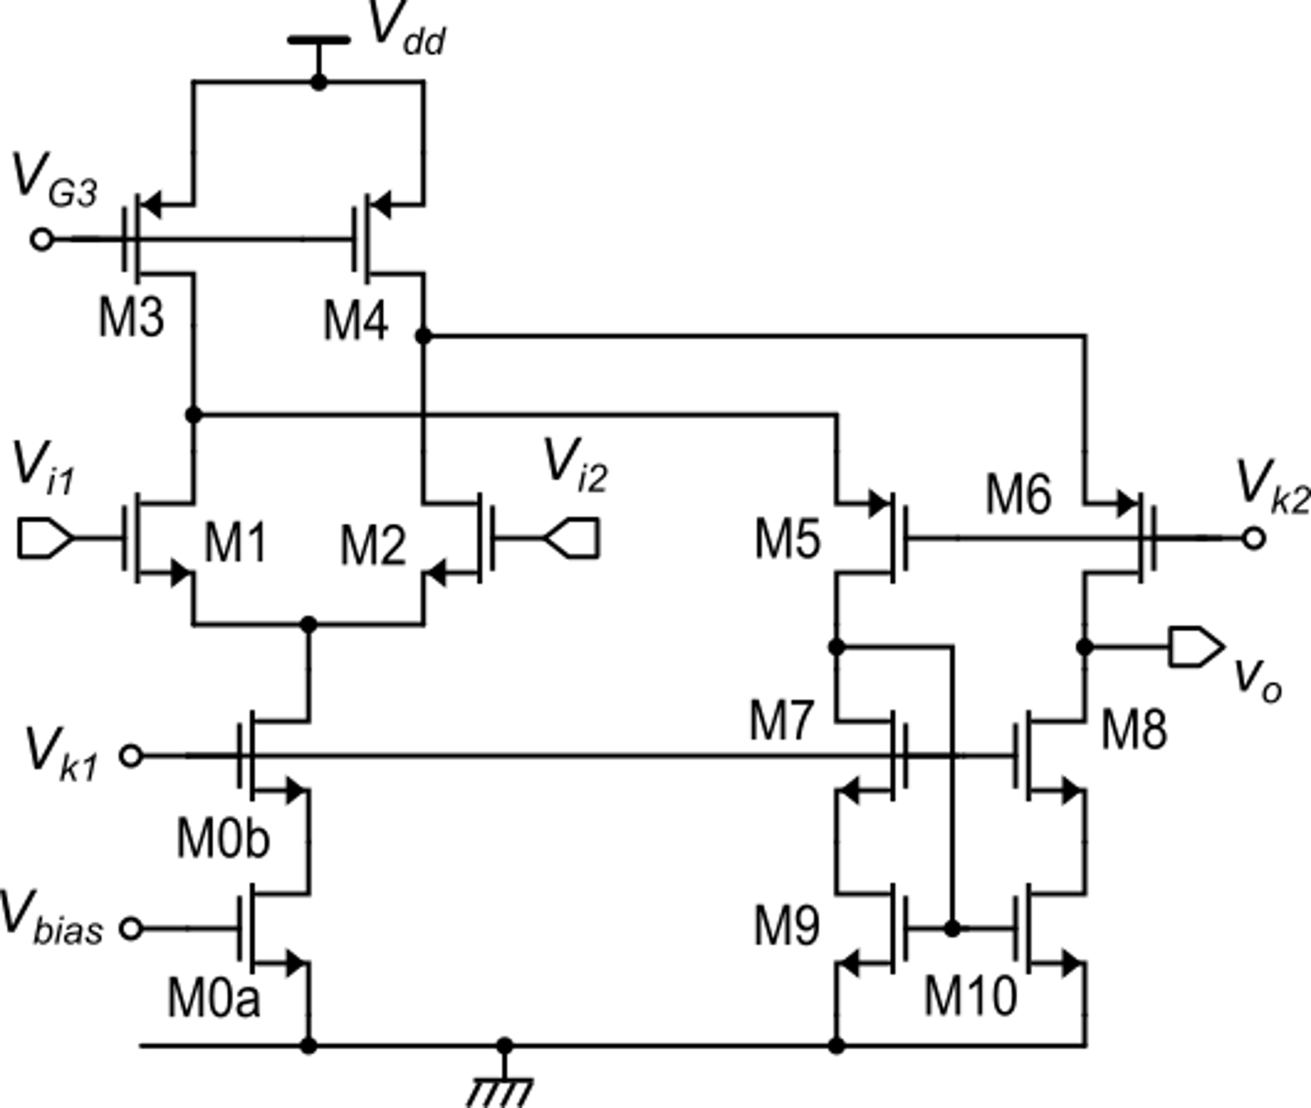
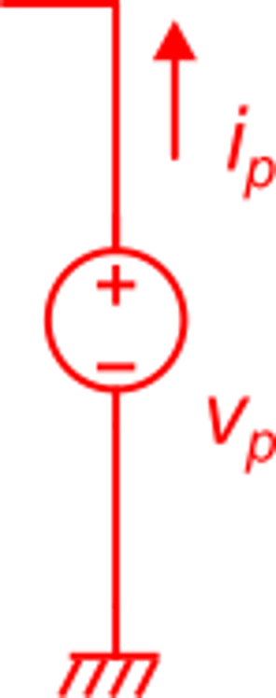
Comparison with the gain of the single-ended folded cascode
The A_{d} gain of the S/E is equal to the A_{dd} of the fully-diff.

