Slide 1
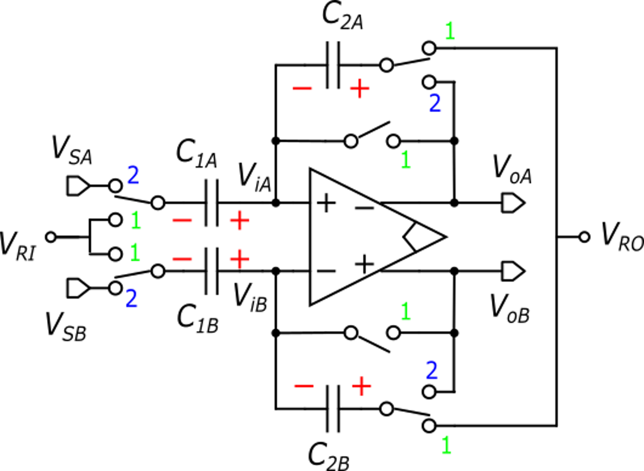
Fully-differential switched capacitor amplifier
V_{RO} and V_{RI} are constant voltages used to periodically discharge capacitor pairs. They substitute gnd in a single-supply circuit
We will consider the nominal case for the capacitors:
Input. diff. voltage
Output. diff. voltage

Slide 2
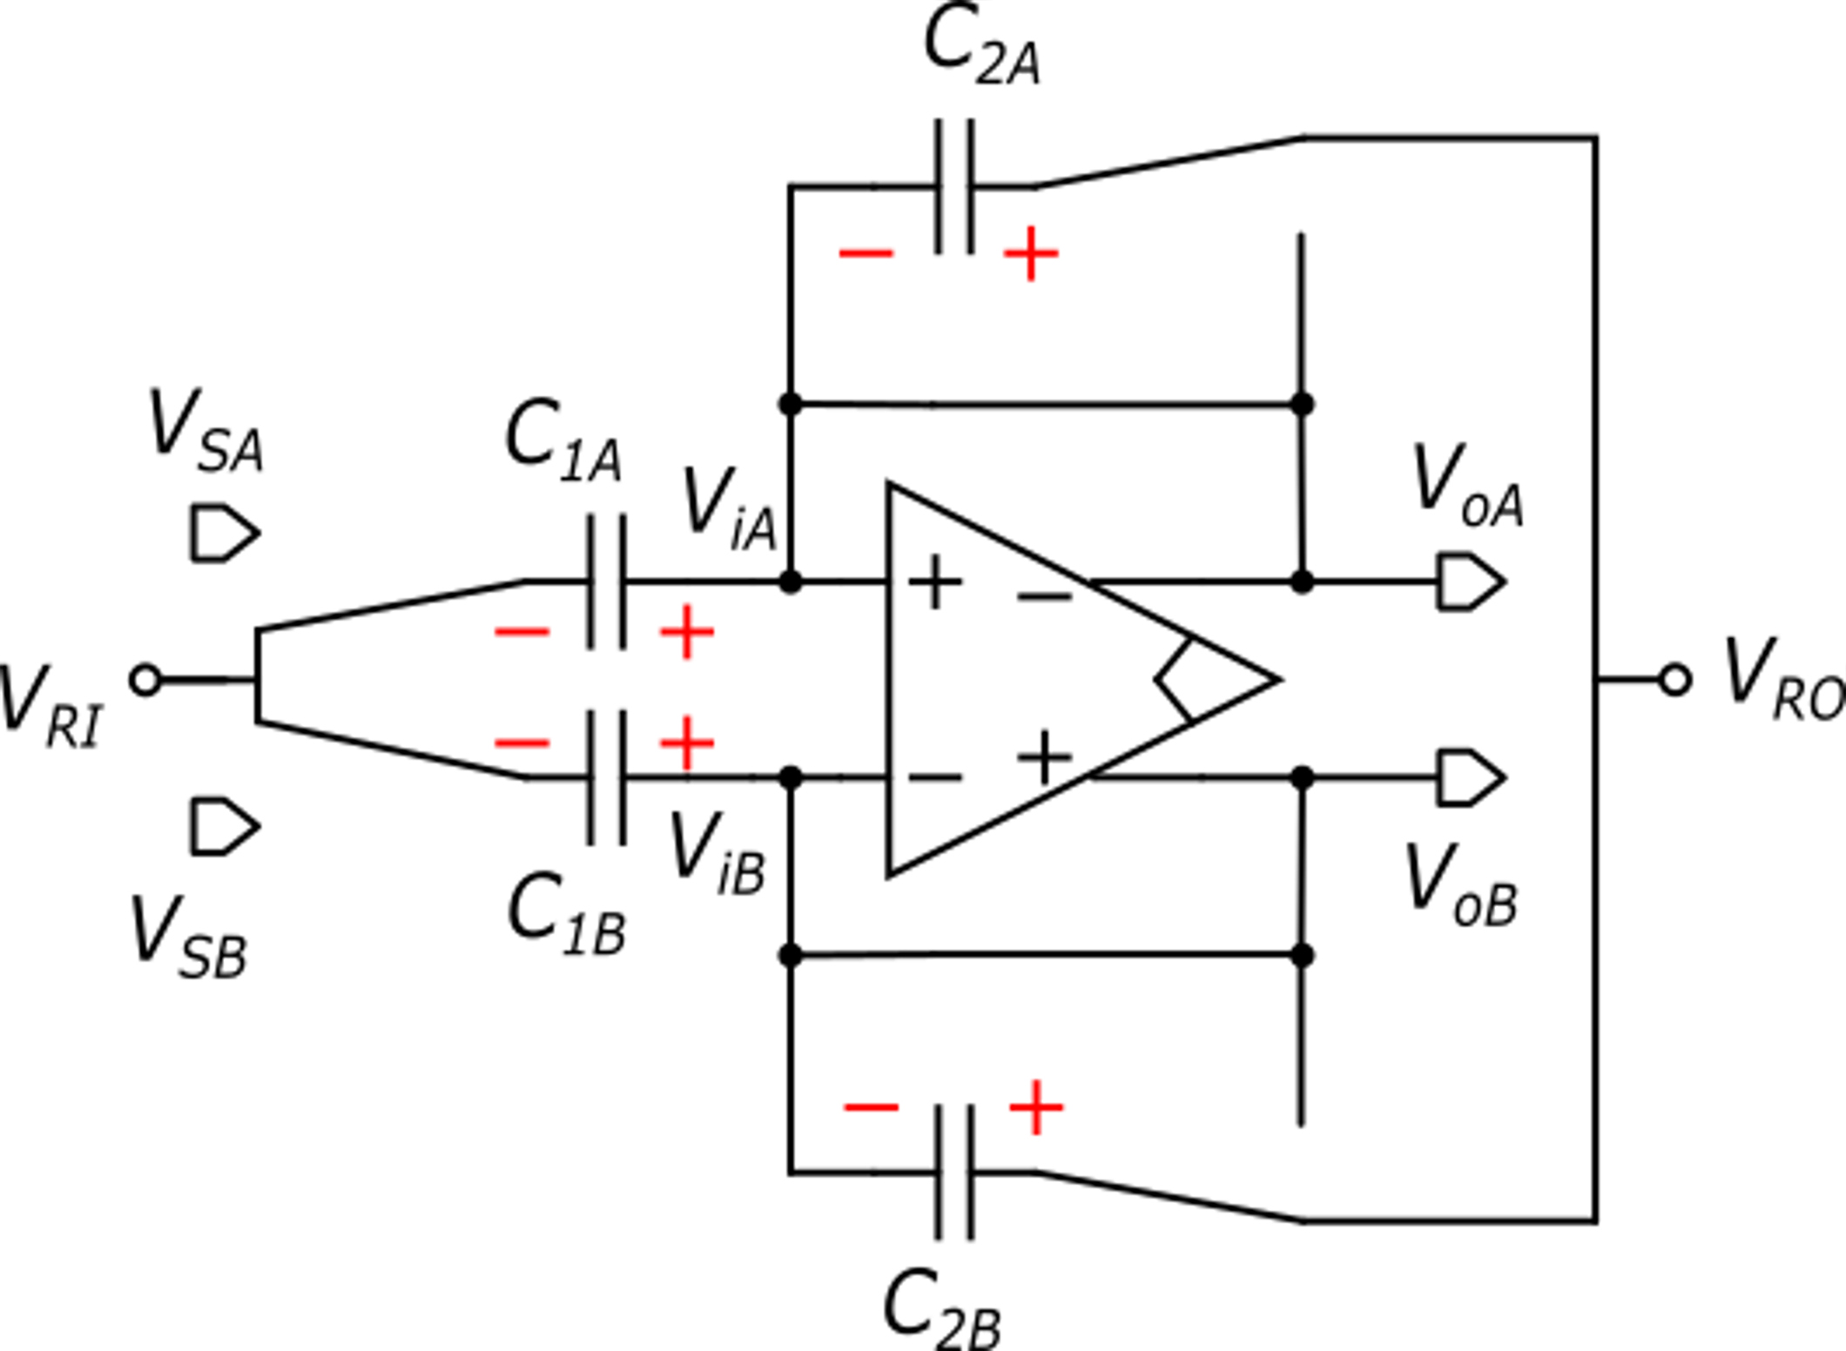
Phase 1

Slide 3
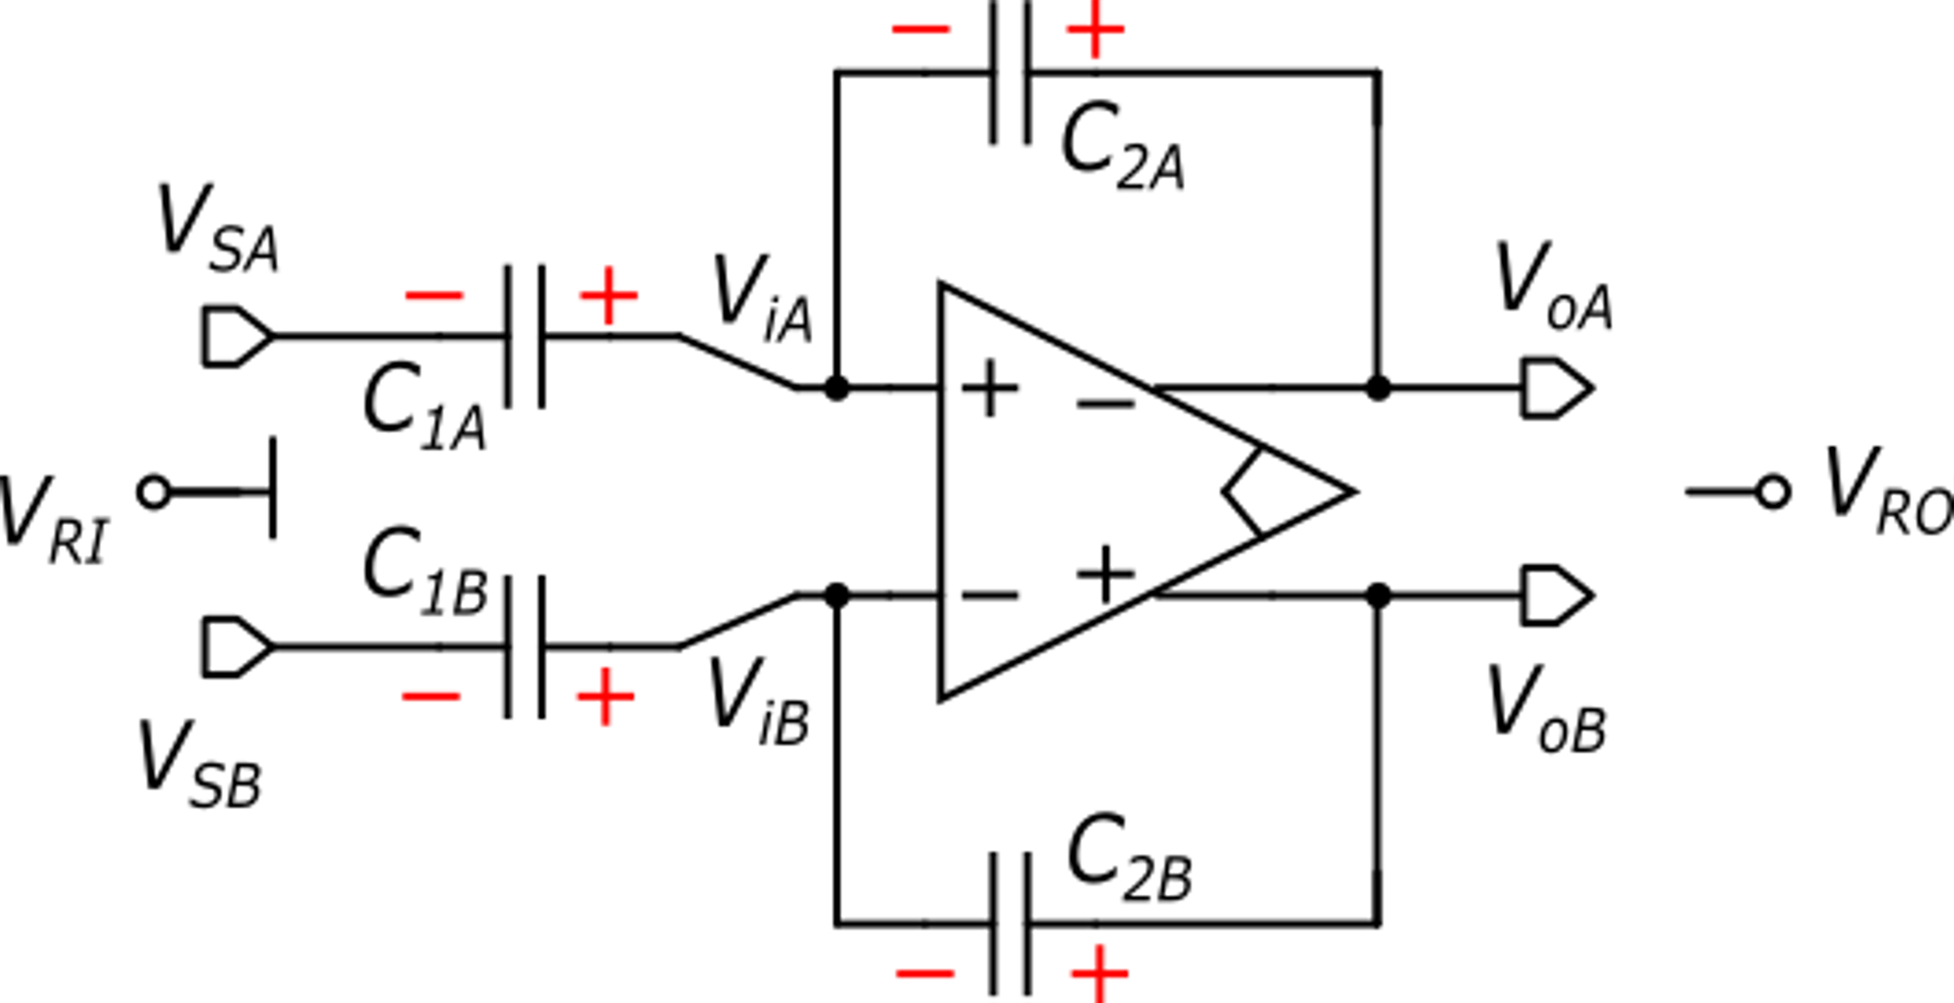
Transition to phase 2
In this analysis we will neglect the kT/C noise, for simplicity
unknown

Slide 4
Phase 1
Phase 2

Slide 6
−
+
Differential mode analysis

Slide 7
output noise due
to the amplifier
output error due
to charge injection
Errors referred to the input
Note that CDS is applied to the amplifier noise

Slide 8
Common mode components
Neglecting the charge injection (calculation of the CM components require less accuracy)

Slide 9
Common mode components
Since in phase 1 V_{ic} is equal to V_{CMO}, it is desirable that it does not change passing into phase 2.
This is not always possible to guarantee, since the common mode of the source may be not predictable
To obtain this, we set:

Slide 10
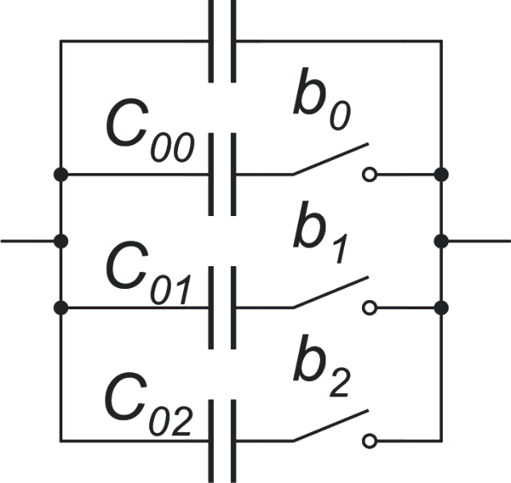
Programmable gain amplifier (PGA)
Capacitors can be made easily programmable.
The advantage with respect of resistive feedback amplifier is that the switch resistance does not affect accuracy (it affects only speed)

Slide 11
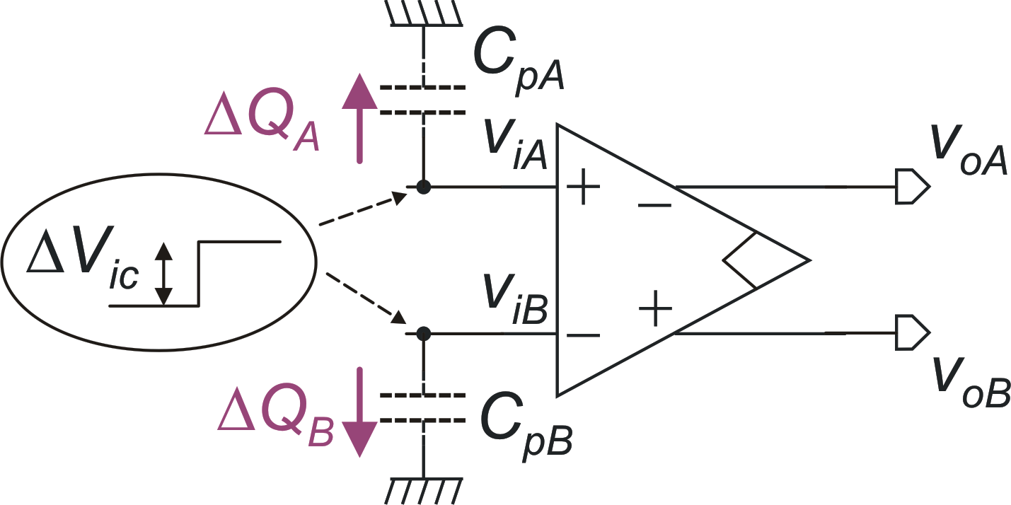
Additional charge injection from non-constant V_{ic}
In this simplified picture, switches and feedback capacitors are not represented
These charges contribute to Q_{JA} and Q_{JB} together with charge injection from the switches
Since parasitic capacitance may have some mismatch, a differential voltage may result.

