Slide 1
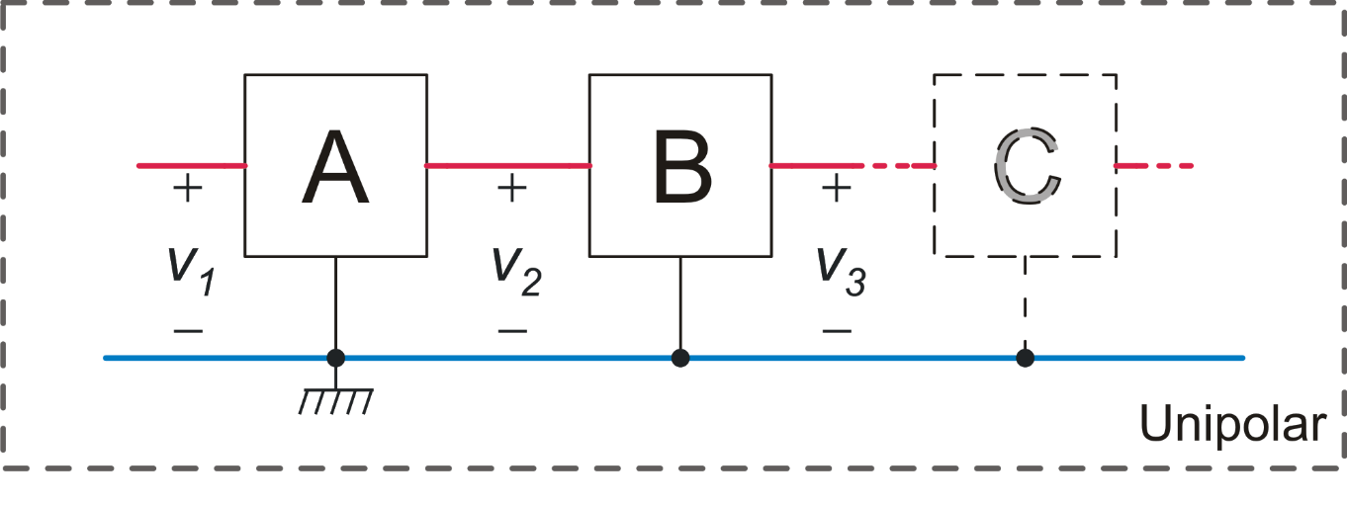
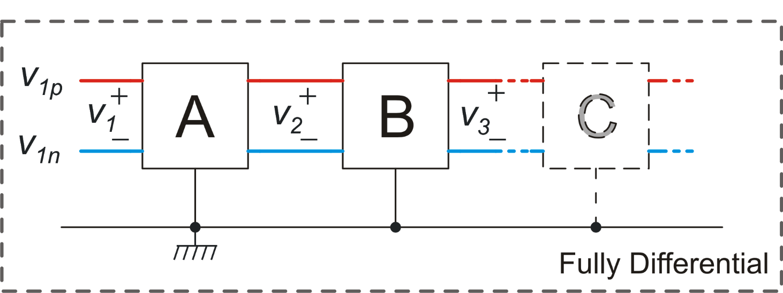
Fully differential and unipolar (single-ended) circuits
Each signal is carried by a single wire. Signals (v1, v2, ...) are voltages differences between the wires and a common node (usually gnd).
Each signal is carried by a wire pair. Signals (v1, v2 ...) are the voltage difference between the wires that form the pairs..

Slide 2
Fully differential systems: motivations
Advantages of fully differential circuit with respect to unipolar circuits
Lower sensitivity to interference
Wider output range
Better linearity
Drawbacks
Greater complexity (e.g. the feedback networks are formed by twice the components as in the unipolar case).
Require stabilization of common mode voltages.

Slide 3
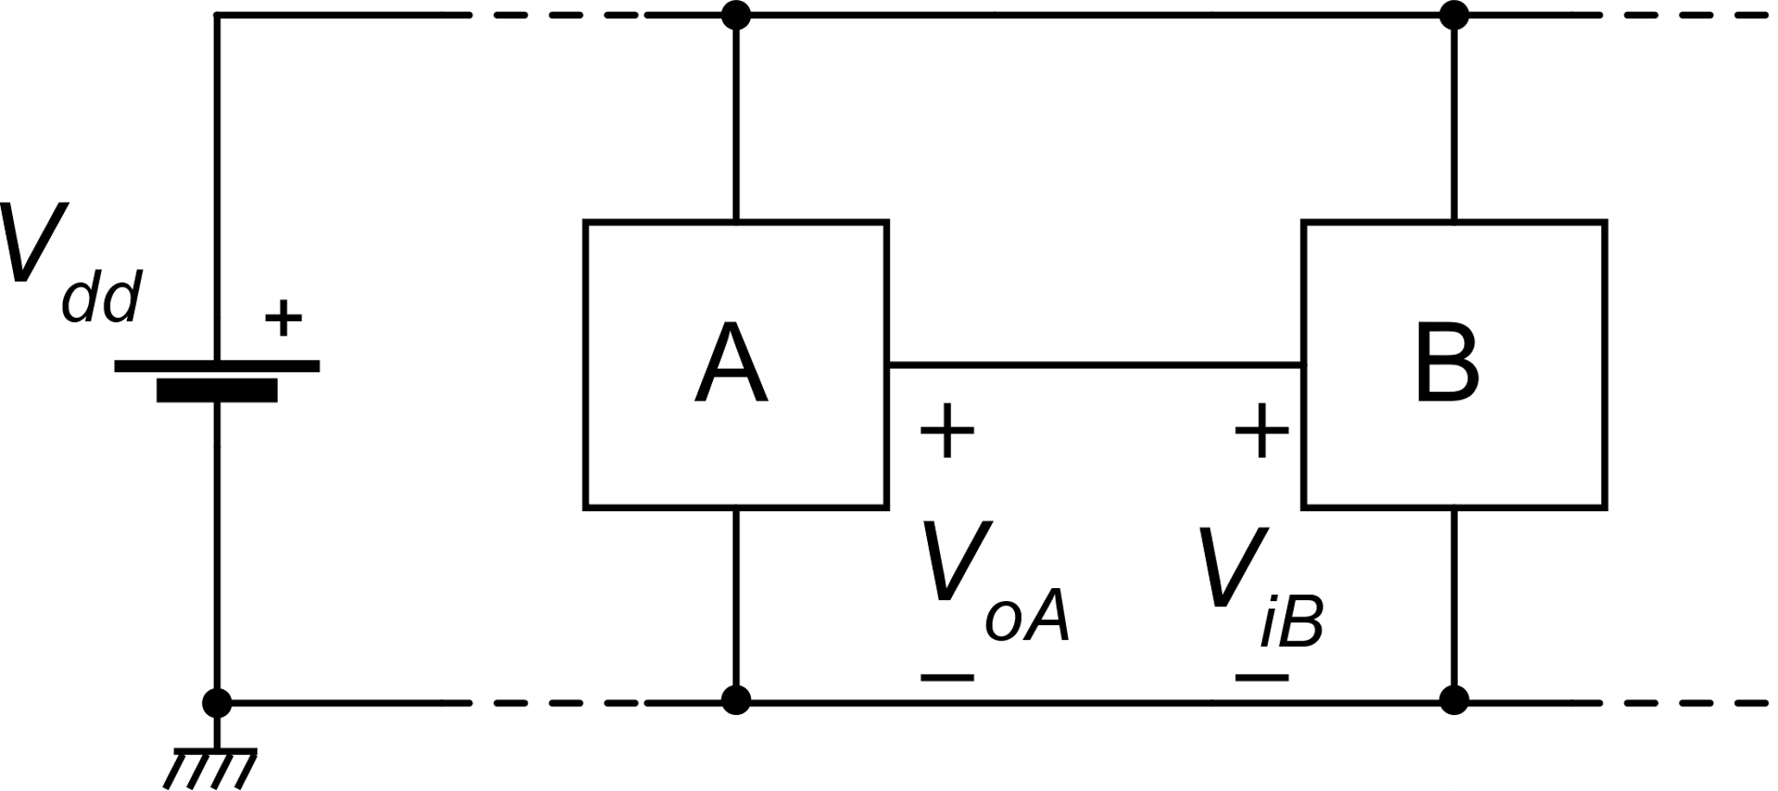
Interference coupling mechanisms
Ground currents (non-uniform gnd)
Vdd variations
Capacitive coupling
Substrate noise
Ground currents: ideal case
All interconnections have null series impedance. Gnd and Vdd can be considered as single nodes.

Slide 4
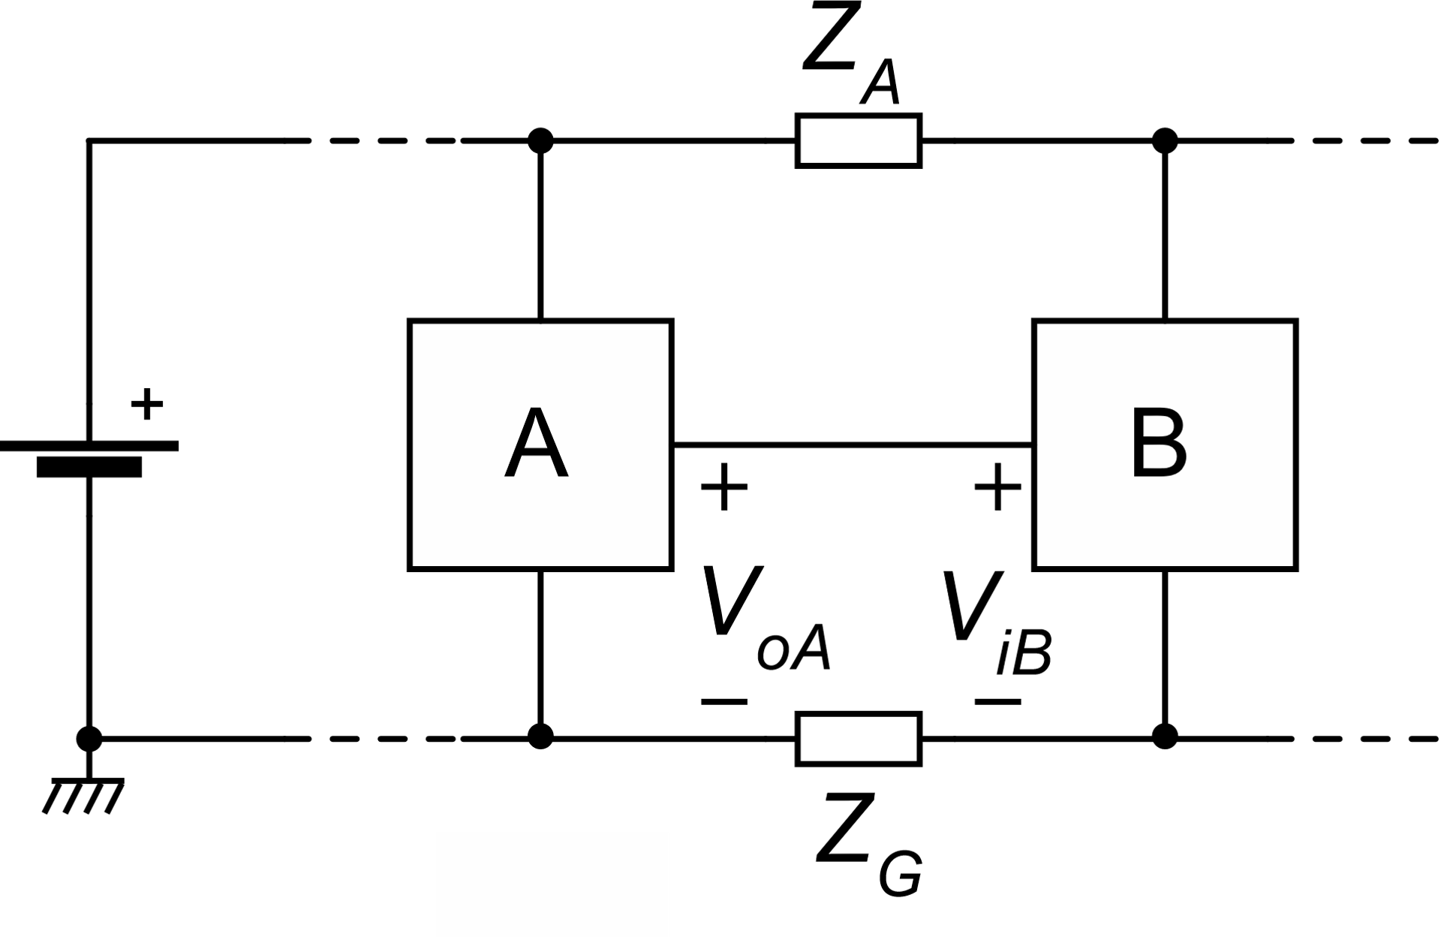
Ground currents: real case
Physical interconnections have non-zero resistance and non-zero inductance
Gnd and Vdd conductors carry considerable currents since they distribute power to all blocks.
i_{G}
v_{G}
Current i_{G} flowing in the ground conductor creates a difference v_{G} between the two local grounds in the vicinity of blocks A and B.

Slide 5
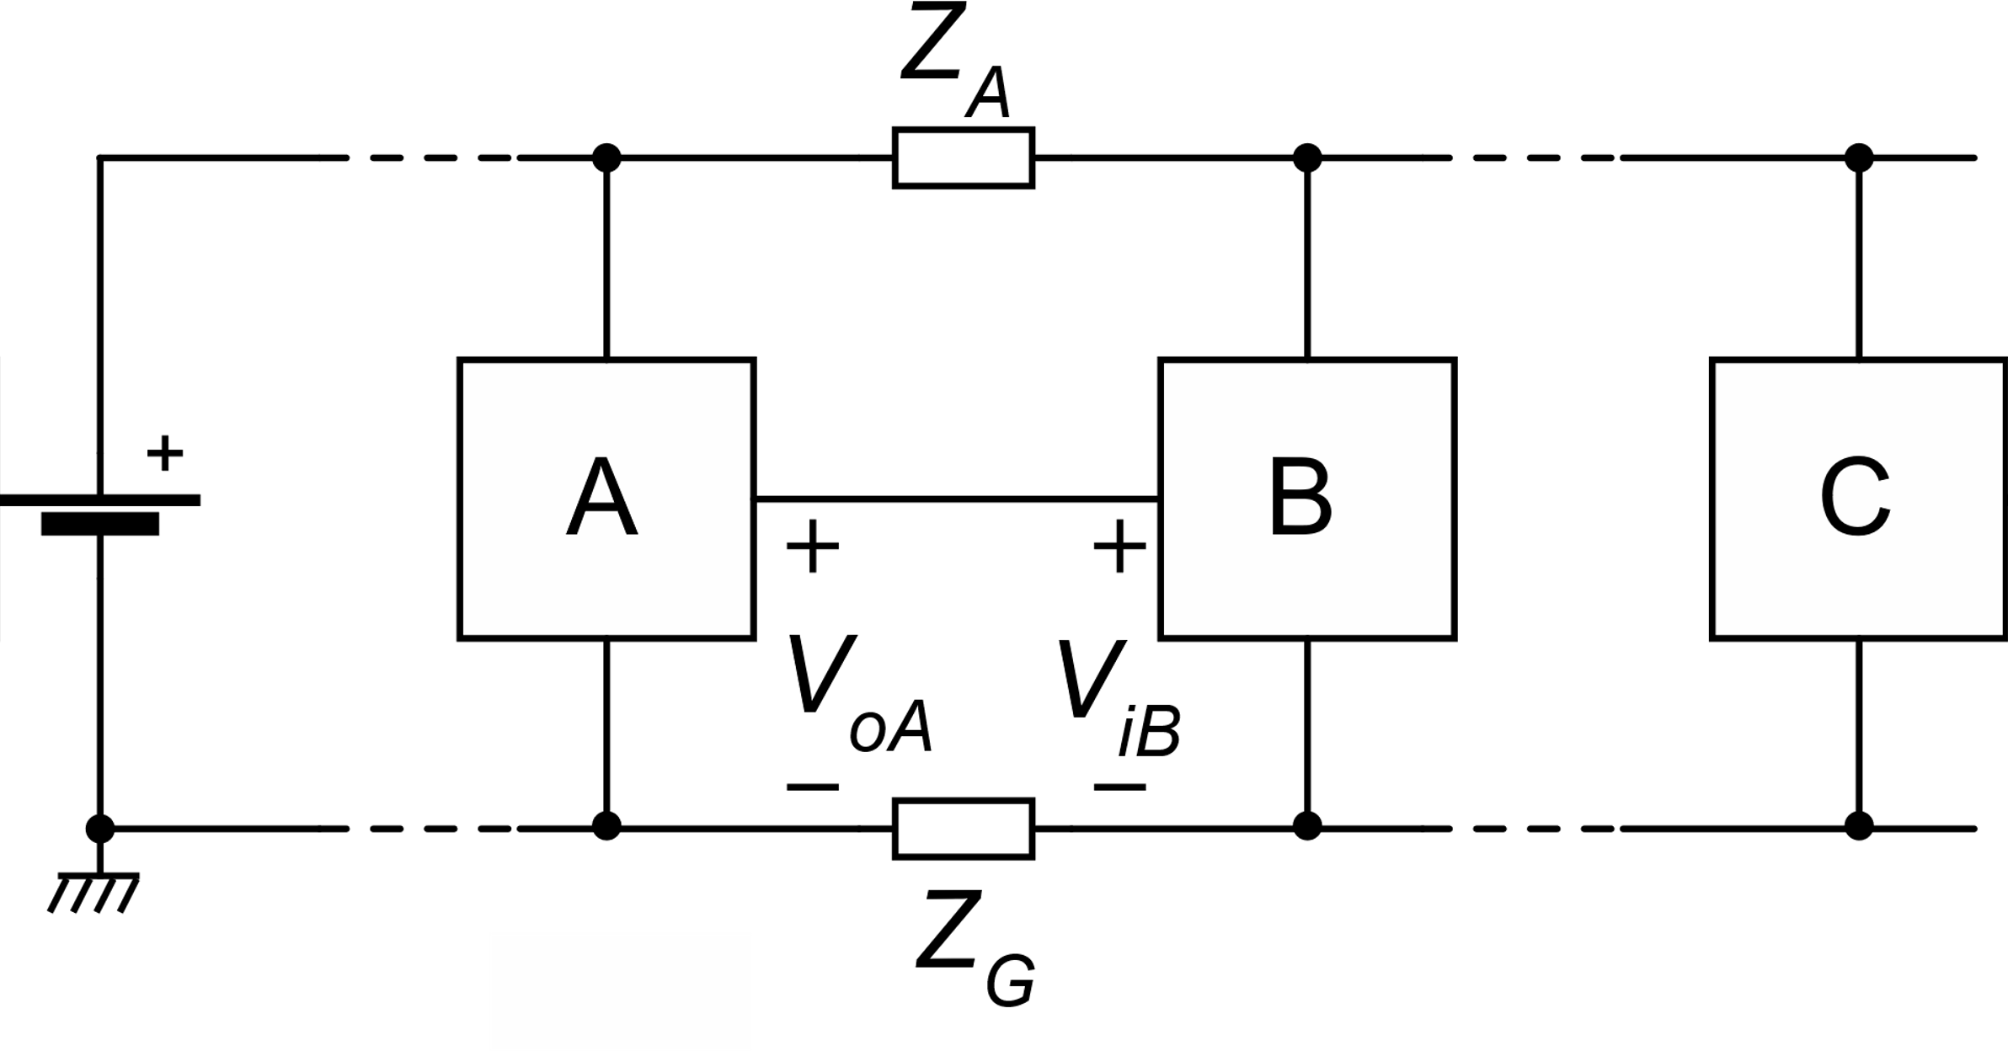
Critical cases
I_{sup-C}
If block C is a digital circuit synchronized by a fast clock, its supply current I_{sup-C}, contains spectral components up to very high frequencies.
I_{sup-C}
The resulting interference on the analog circuits can be difficult to reject since high frequency components can fold-back to low frequencies through sampling (ADCs, SC circuits) or non-linearities.

Slide 6
Origin of the Z_{G} impedance.
Integrated circuits
Interconnect lines (tens of Ohm if gnd routing is not performed properly)
Vias (typically 0.1 Ohm / via)
Inductance is generally negligible up to a few GHz
Printed Circuit Boards (PCBs)
Interconnect resistances are in the mΩ range
Inductances can be significant
Board-to-Board interconnections (connecting wires)
Inductance is generally dominant
Contact resistance in connectors can be important

Slide 7
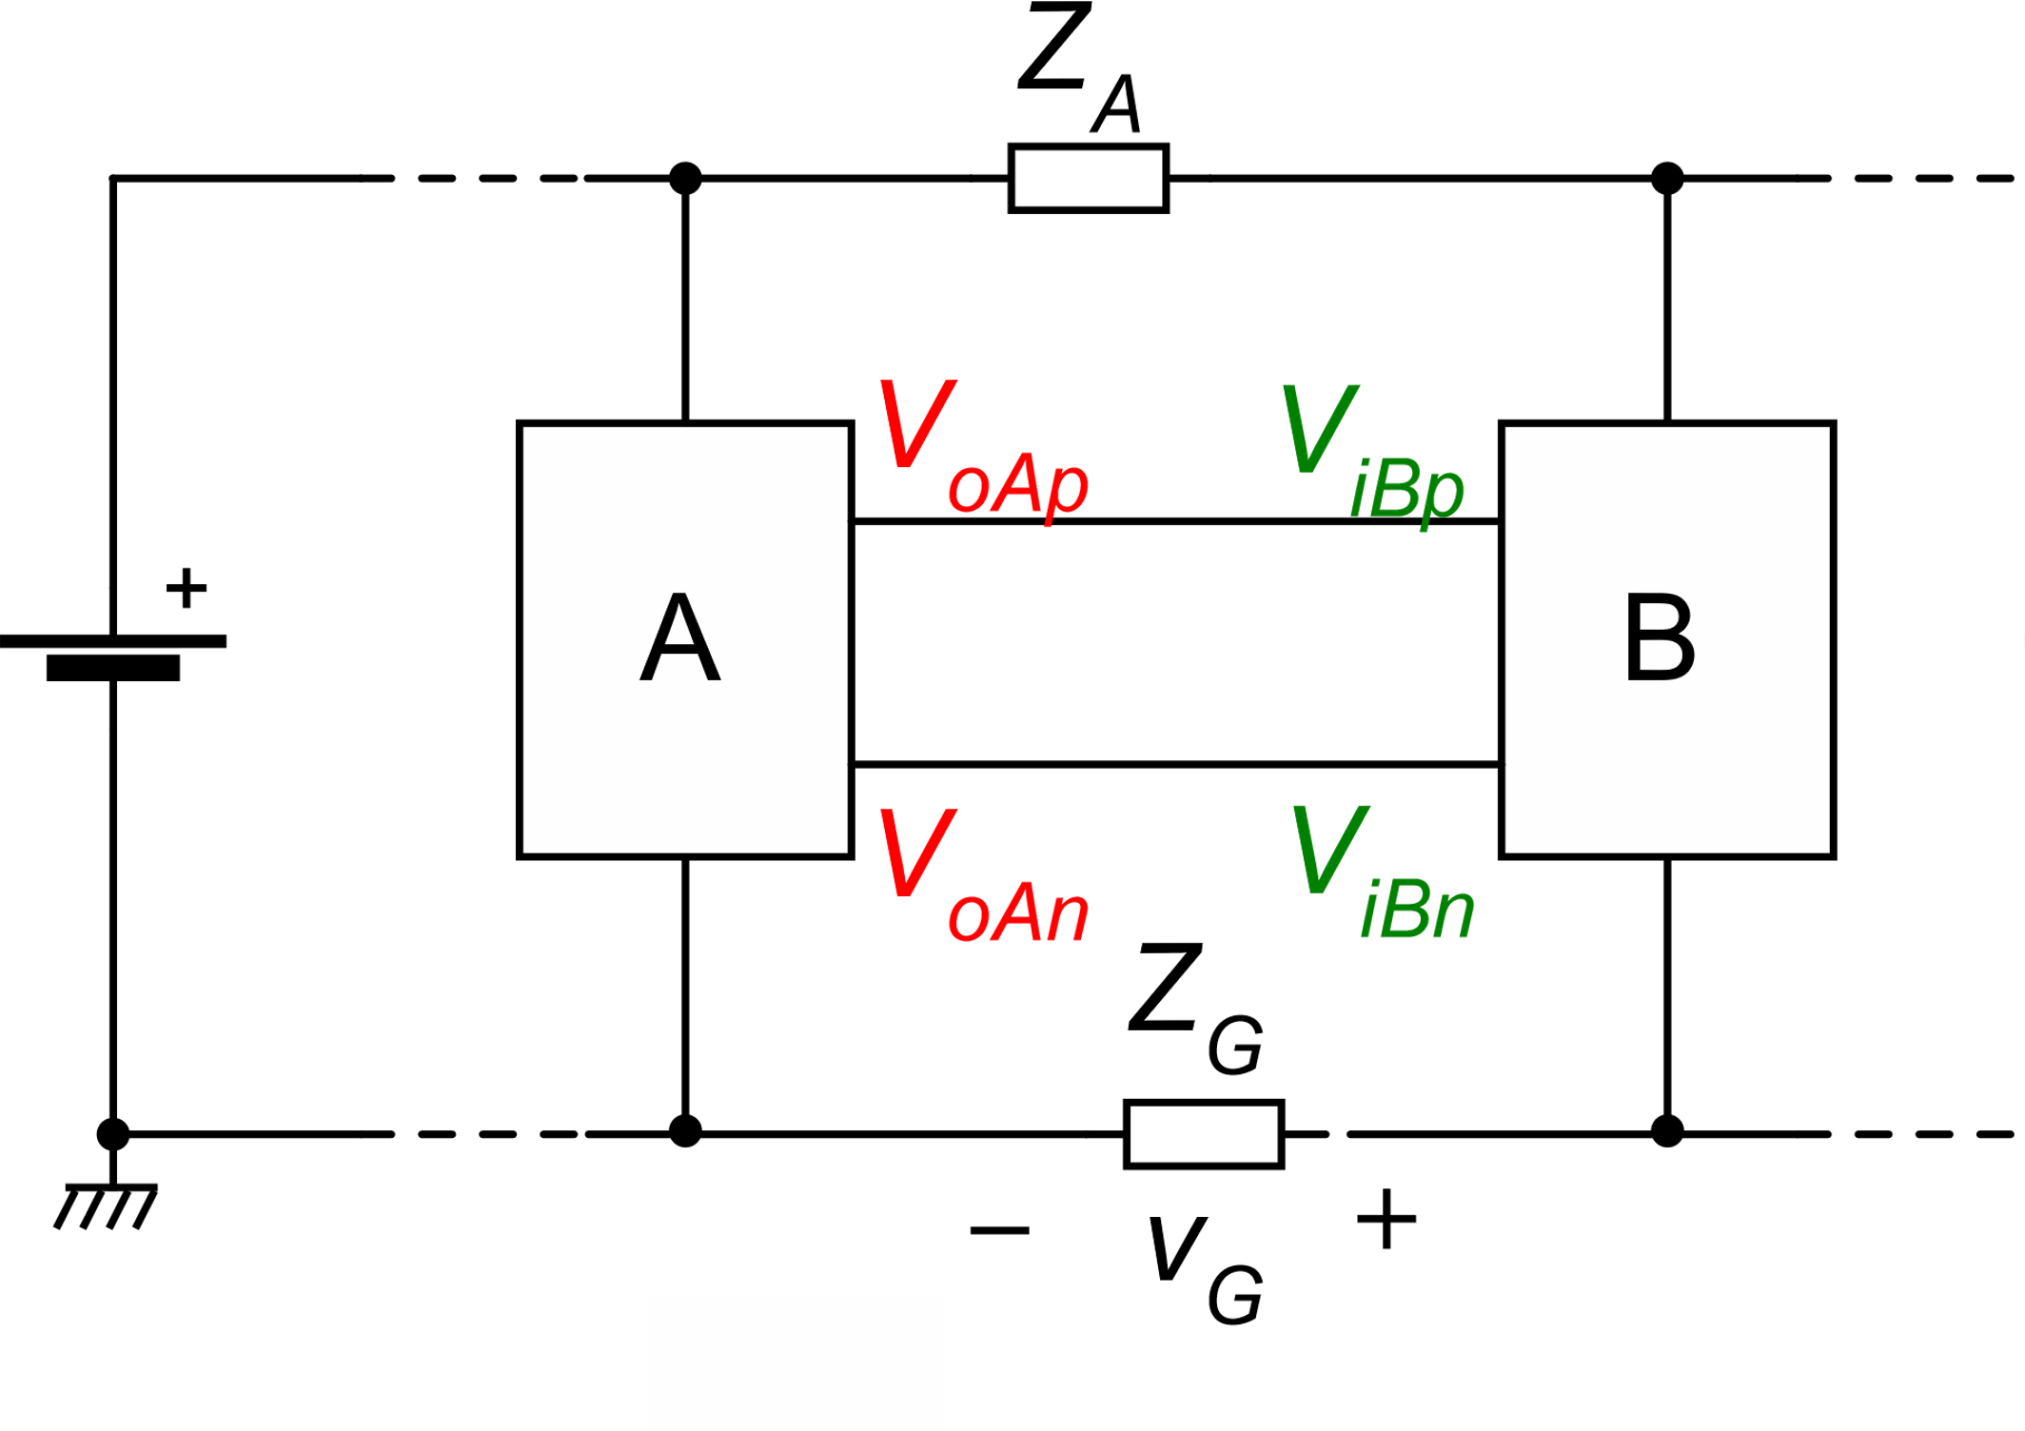
Immunity of differential architectures to non-uniform gnd potential
The wires that carry the signals do not experience significant voltage drops, since the currents that pass through them is generally negligible.
Block B Diff. input
Differential components (signals)
Common mode components

Slide 8
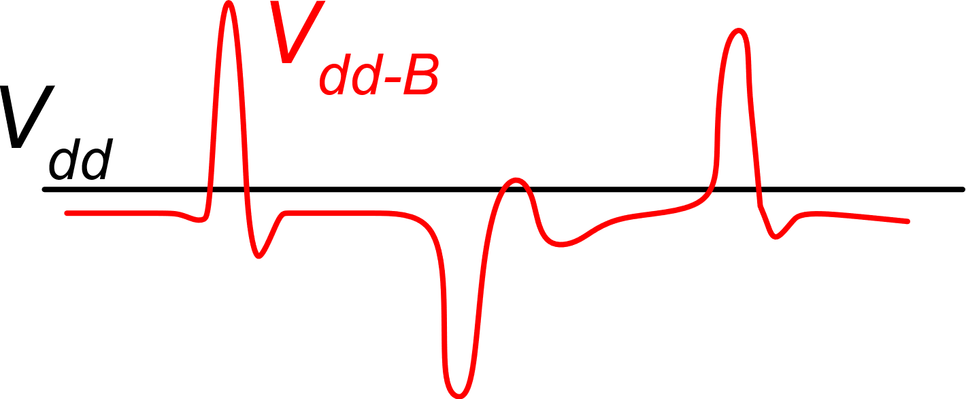
V_{dd} variations
I_{sup}
The cause of V_{dd} variation is the same that produces the gnd non-uniformity.
The effect on the signal is smaller, since V_{dd} is not commonly used as a reference for block-to-block signal transmission.
V_{dd}
Coupling to the signal is mainly due to low PSSR. Single ended blocks have a PSSR that decreases steeply at high frequencies.
Note that the V_{dd} variation can be caused by the supply current of block B itself. Since the supply current generally depends on the input signal, this effect may result in an unstable feedback loop.

Slide 9
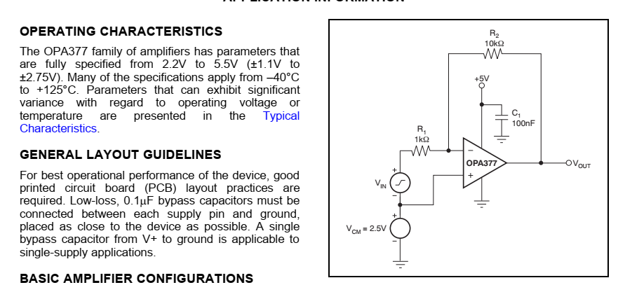
Just a look to datasheets
100 nF
Impulsive and high frequency currents (zero mean) are provided by the capacitor and do not run through the interconnections
This practice can be also applied inside integrated circuits, but the small values of on-chip capacitors make it effective only for very high frequency components and comes at the expense of large area occupation.

Slide 10
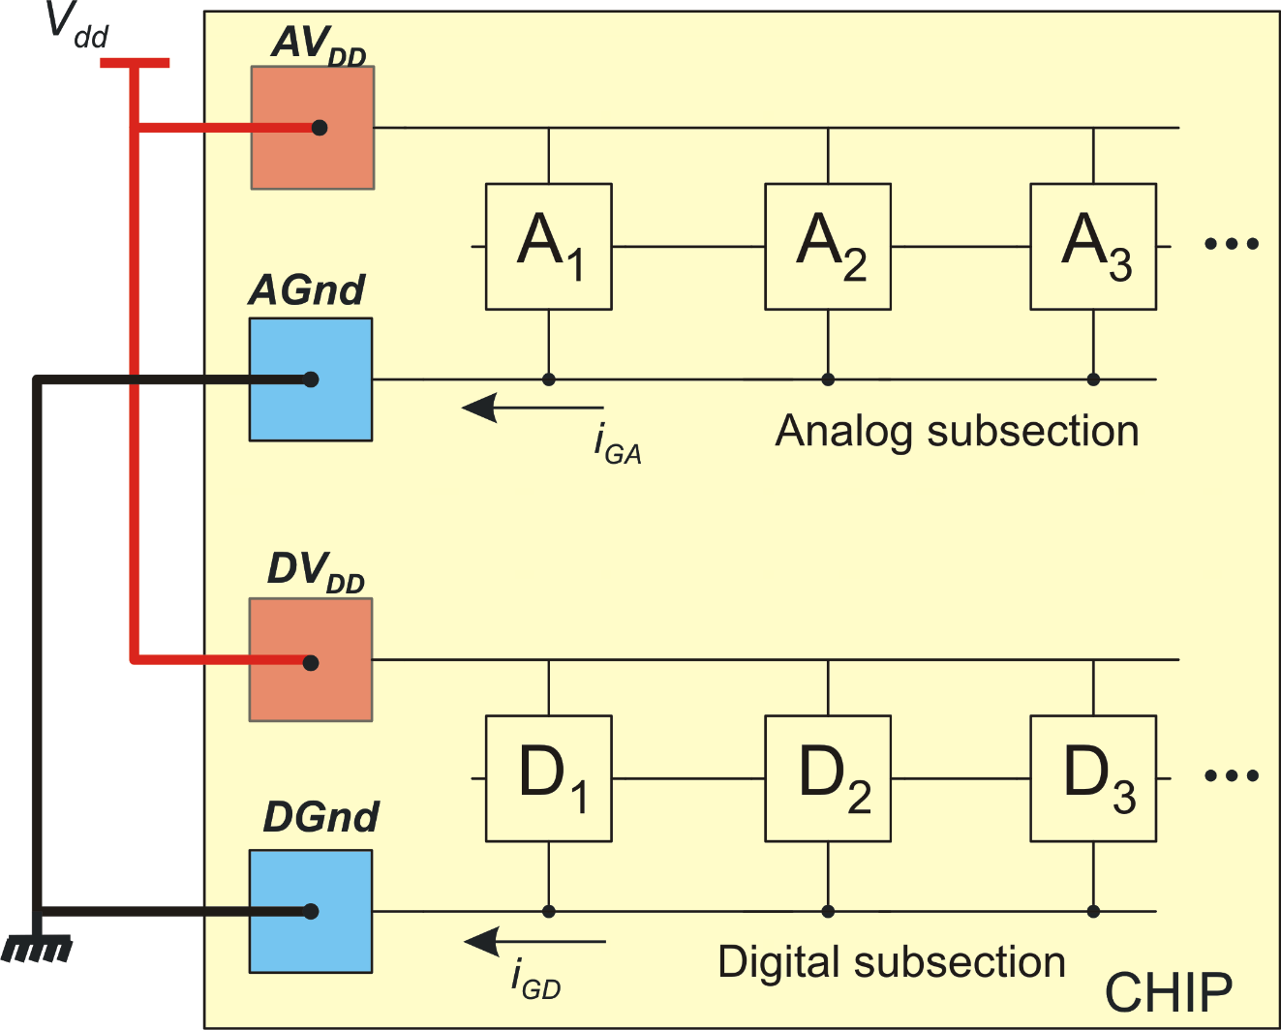
Optimal ground and Vdd distribution in mixed signal ICs.
Sensitive cells, such as analog blocks and noisy circuits, such as digital sub-units should be provided of separate gnd and Vdd power buses. The AGnd (analog gnd) and DGnd (digital gnd) will be connected in a single point, as close as possible to the gnd pad. Even better, they may have separate pads and the connection is made on the PCB.

Slide 11
PSSR and CMRR characteristics of fully differential blocks
Symmetrical stimuli
Gnd potential variations
Vdd variations
Common mode signals
Global process errors
All types of symmetrical stimuli cannot produce any effect on the differential output voltage if the circuit is perfectly symmetric.
Symmetry axis
A reduced amount of leakage from symmetrical stimuli and differential quantities can be due to the unavoidable asymmetries caused by (1) process errors and (2) presence of large differential components due to large input signals.

Slide 12
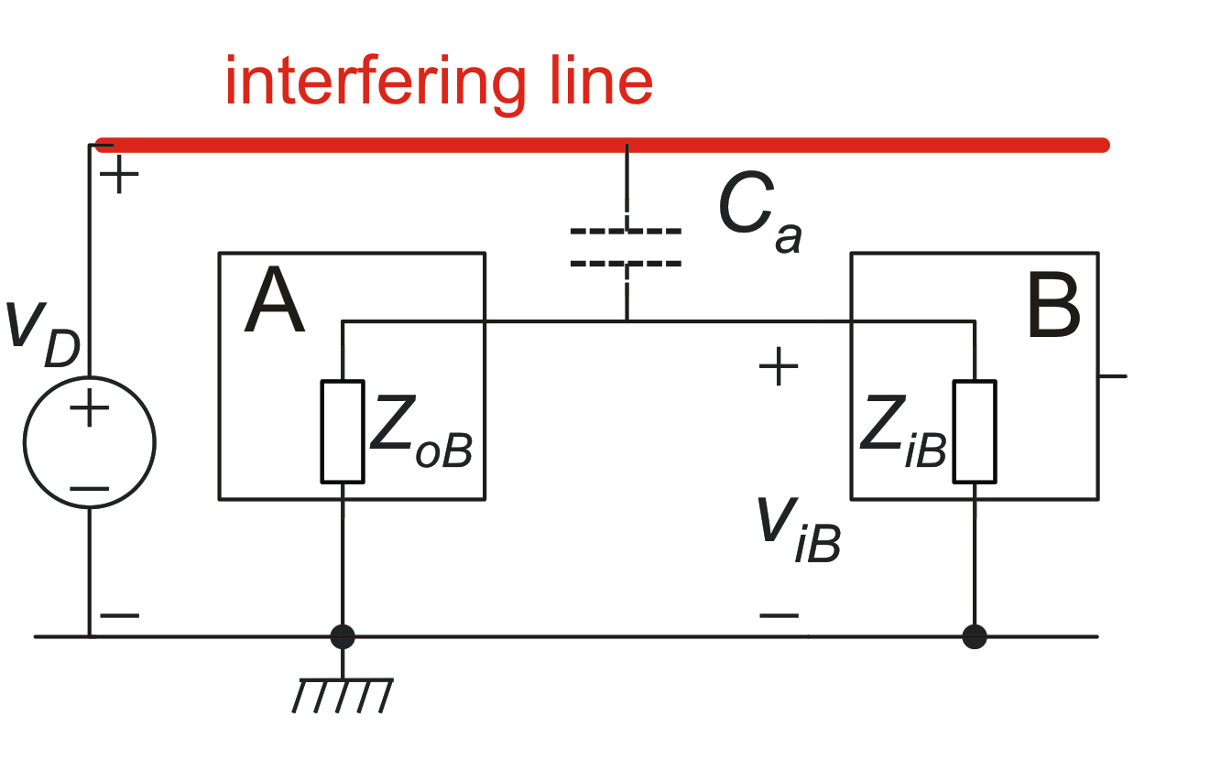
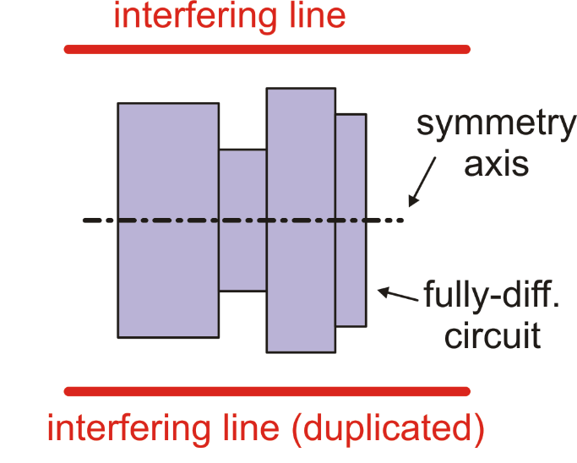
Interference capacitive coupling
It is possible to exploit the symmetry of a fully-differential block to get same interference signals on the two wires that form the input and output ports. To obtain this a symmetrical layout and environment is essential.

Slide 13
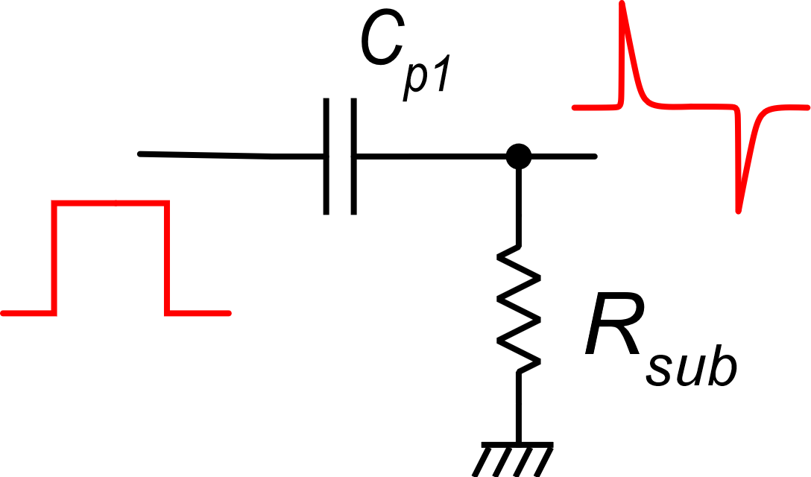
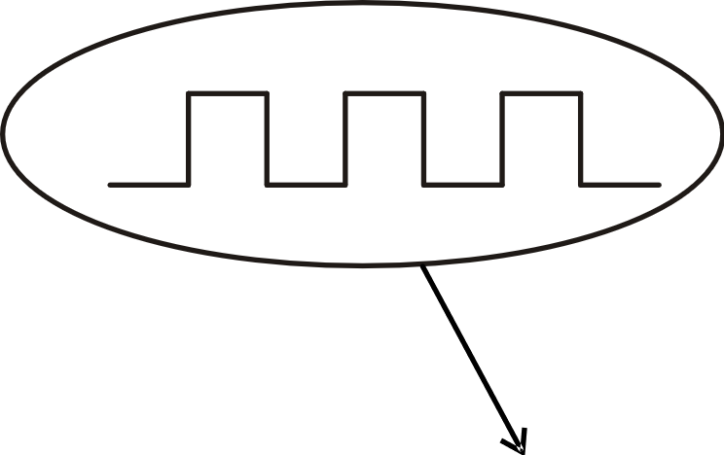
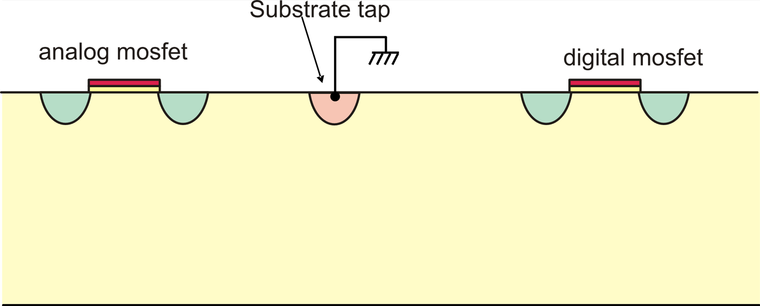
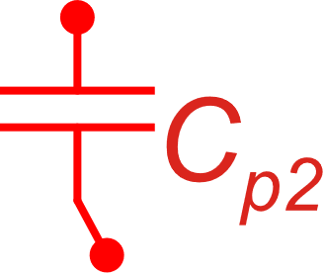
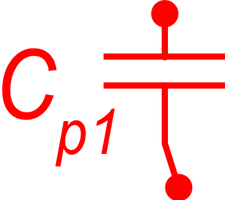
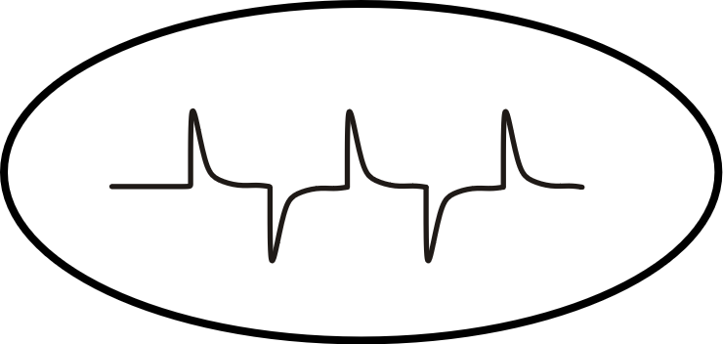
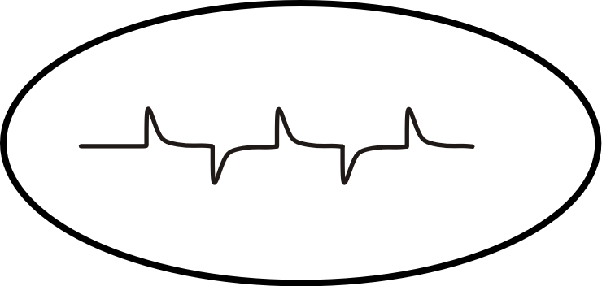
The substrate noise
body effect
Lightly doped
epi-layer
progagation and
attenuation
Highly doped substrate

Slide 14
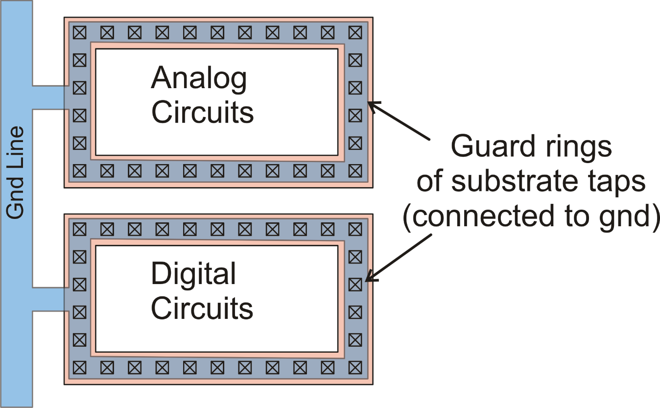
Approaches to reduce substrate noise
Separate as much as possible the digital and analog circuit
Use guard rings of substrate taps to reduce propagation
If the sensitive circuits (e.g. analog circuits) and the interference source (i.e. digital circuits) are sufficiently far apart, then substrate noise can be considered uniform over the area of the sensitive circuit.
In fully-differential architectures, it acts as a common mode interference and is rejected

Slide 15
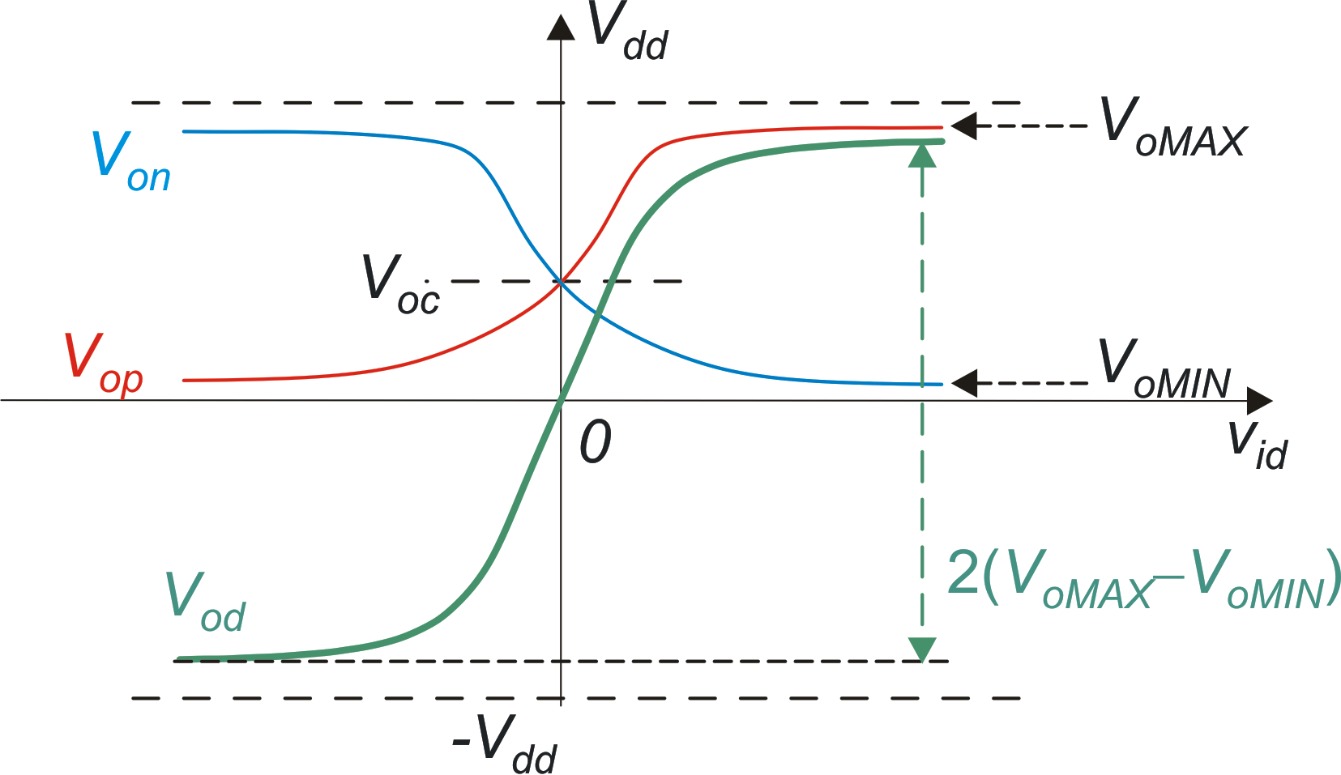
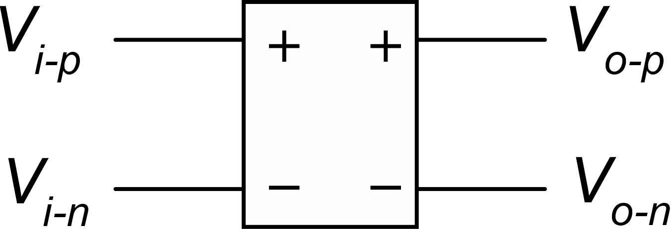
Other advantages of fully-differential circuits: double output range
Each single output (V_{on}, V_{op}) has a range
The differentia output (V_{op}−V_{op}) has a range

Slide 16
Other advantages of fully-differential circuits: increased linearity
V_{od} has the odd symmetry, then its Taylor polynomial calculated from the origin has no even terms
Greater linearity, lower harmonic distortion
(no even harmonics)
The single outputs (Von,Vop), in principle, have no symmetries, then all terms are generally present in the Taylor polynomial

Slide 17
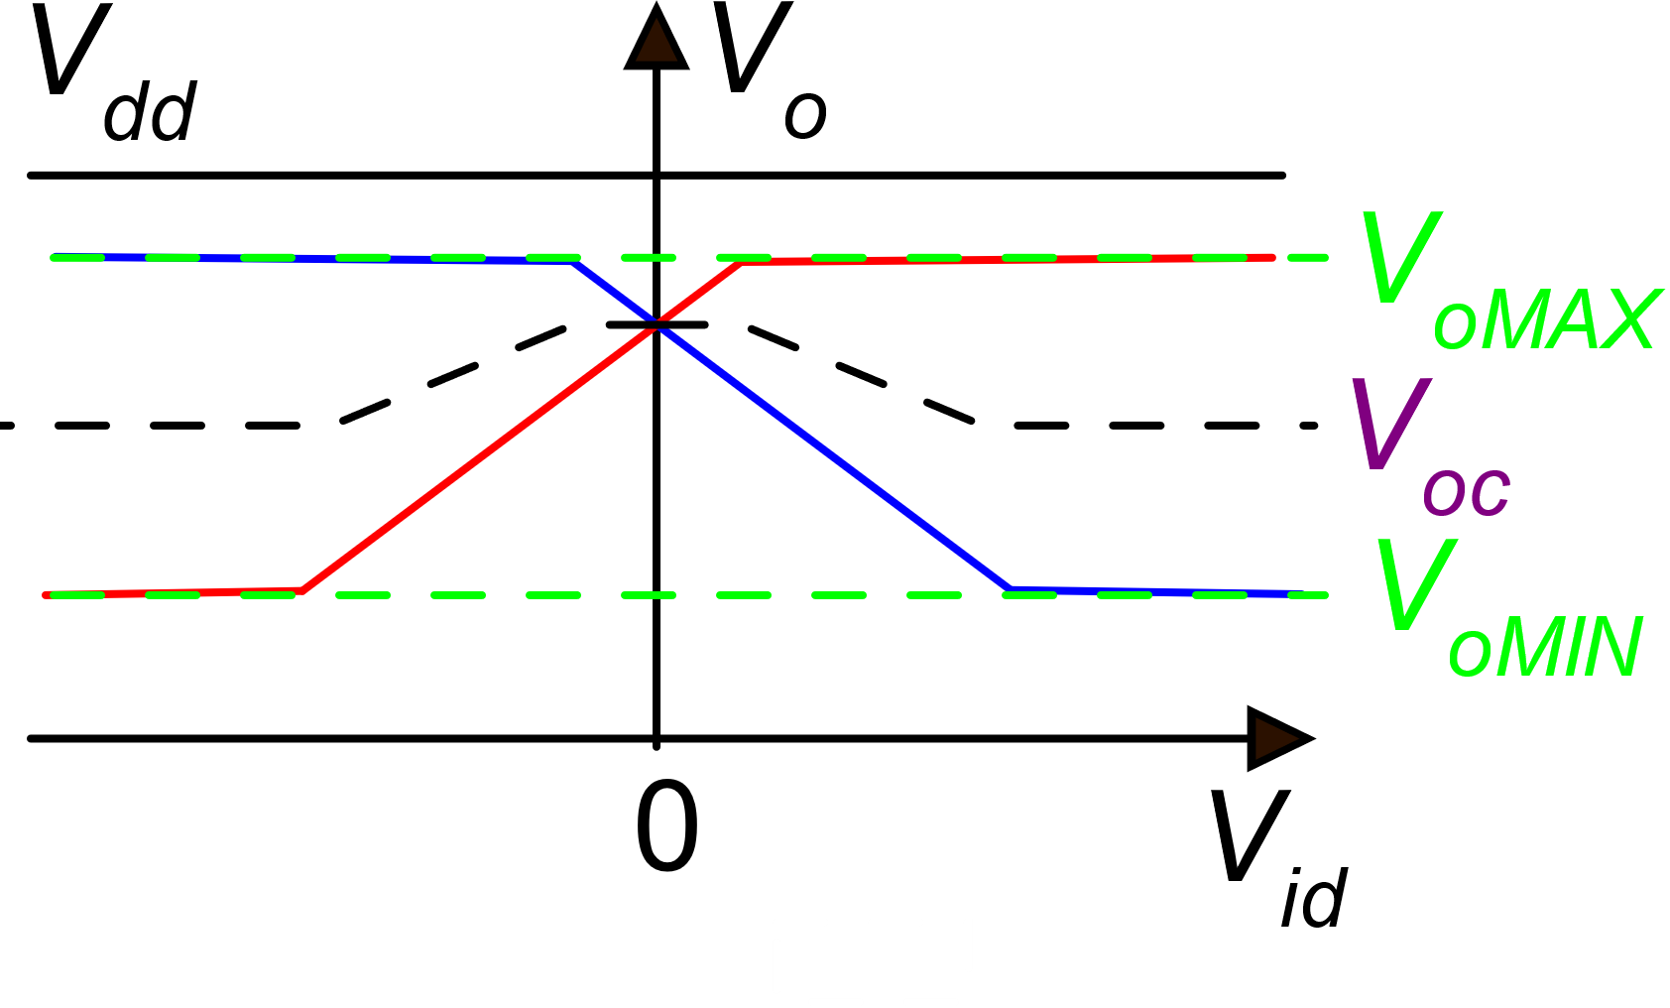
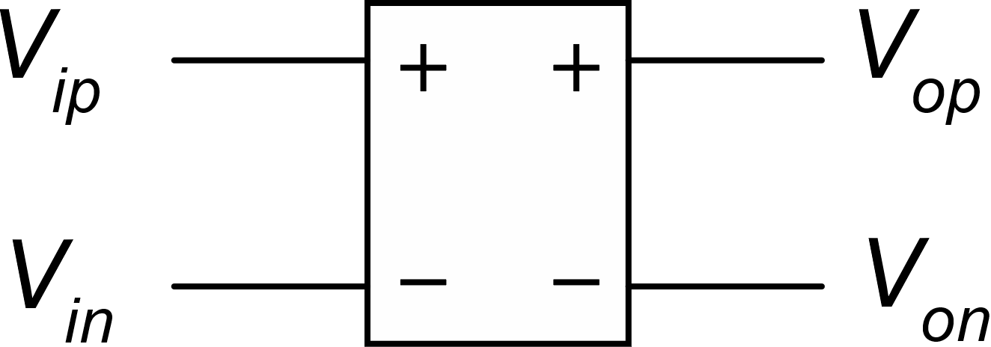
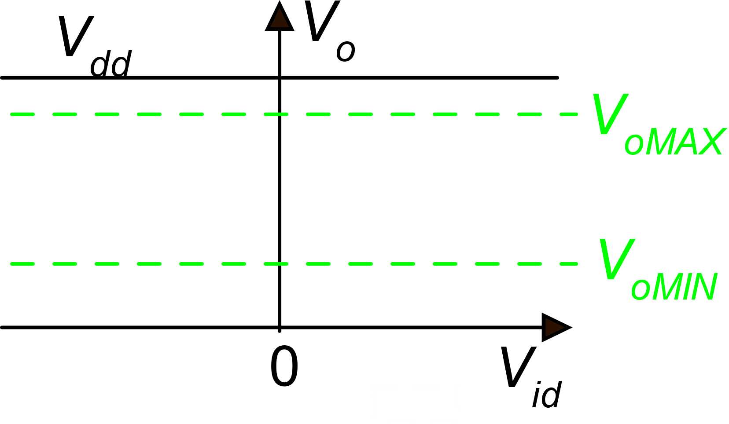
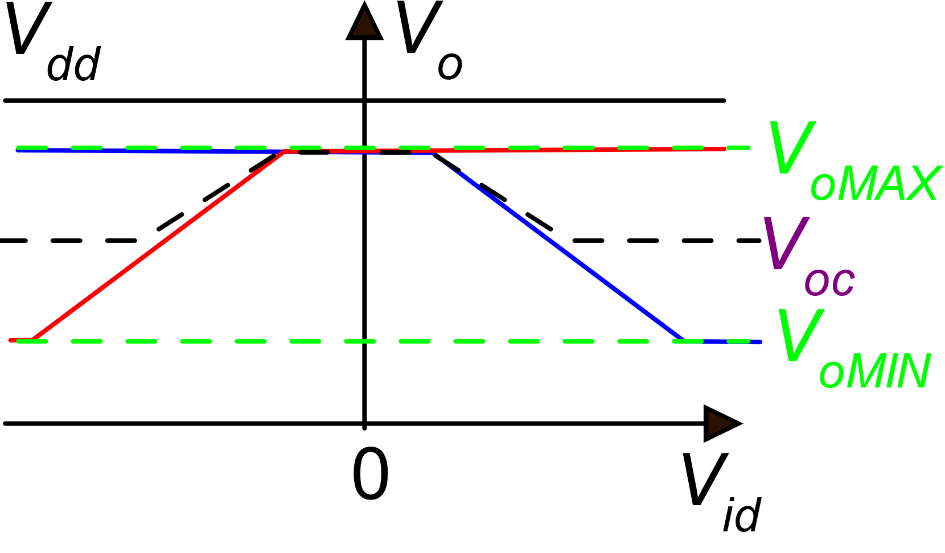
Fully differential circuits: the need for a stabilized output common mode voltage
V_{ic} V_{id}
V_{oc} V_{od}
V_{oC} is too high: reduced range
Ideal in-out relationship
An extreme case: no linear range

Slide 18
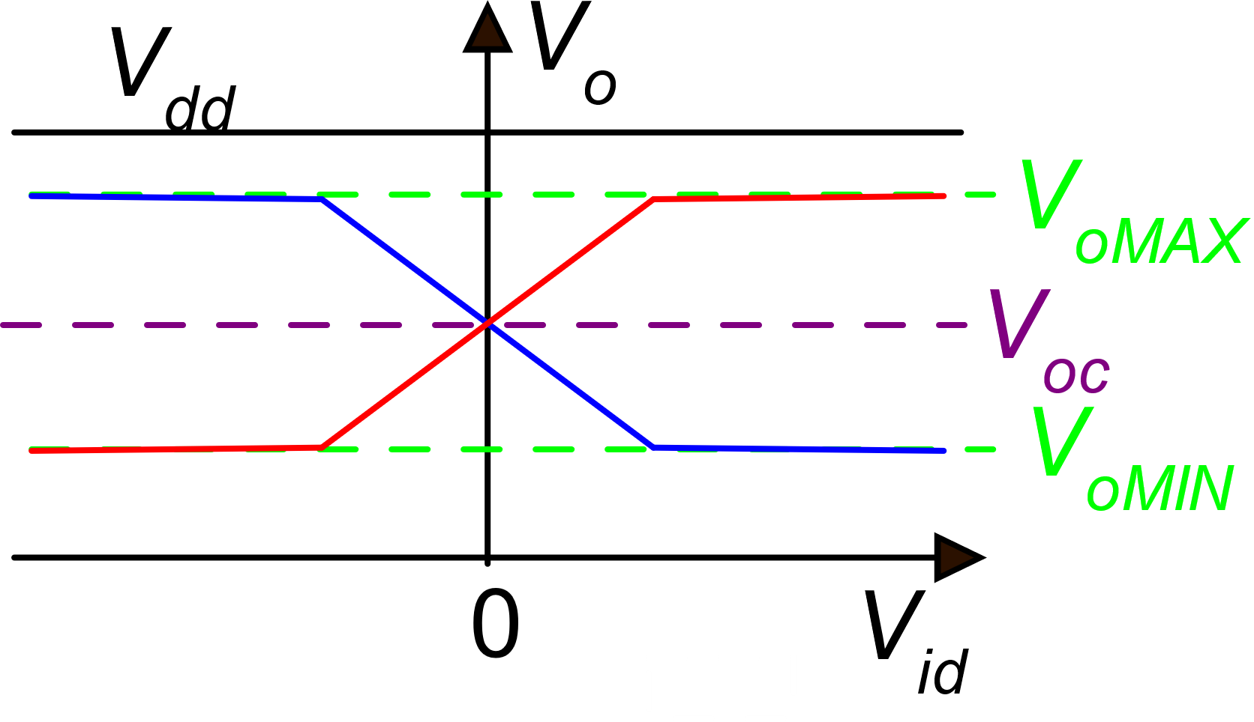
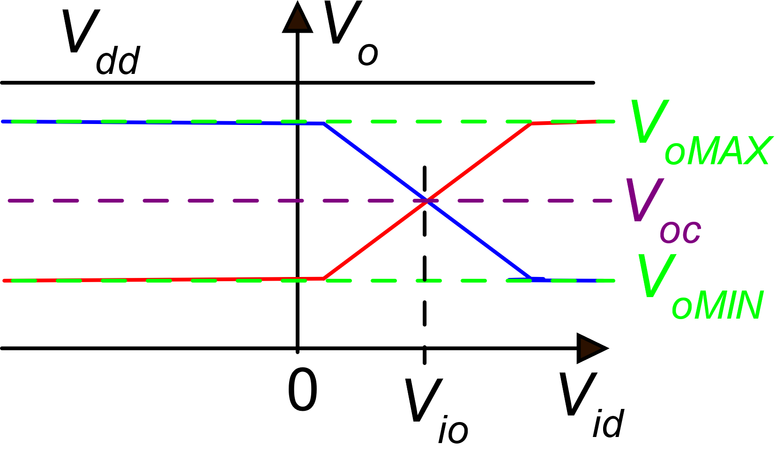
Input output characteristics in a fully-differential circuit: the correct feasible case
Ideal: zero input offset voltage (not possible, due to process errors)
Possible: there is an offset voltage, but the linearity range is still maximum
In the majority of fully-differential cells, the output common mode voltage should be stabilized and fixed to a convenient value.

Slide 19
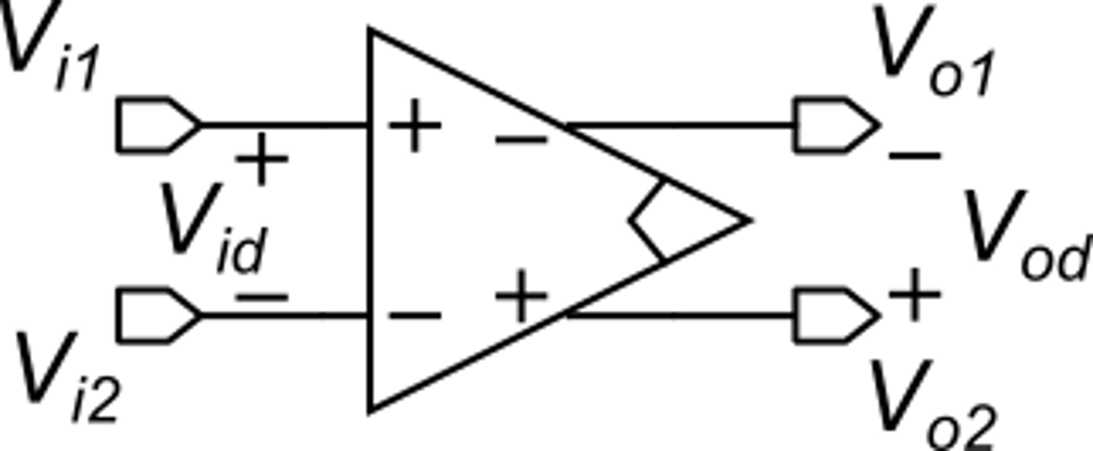
The fully-differential operational amplifier: definitions
This symbol means that the amplifier includes a common mode stabilization circuit
The inverting output is placed on the same side of the non-inverting input to simplify drawing of closed loop configurations

Slide 20
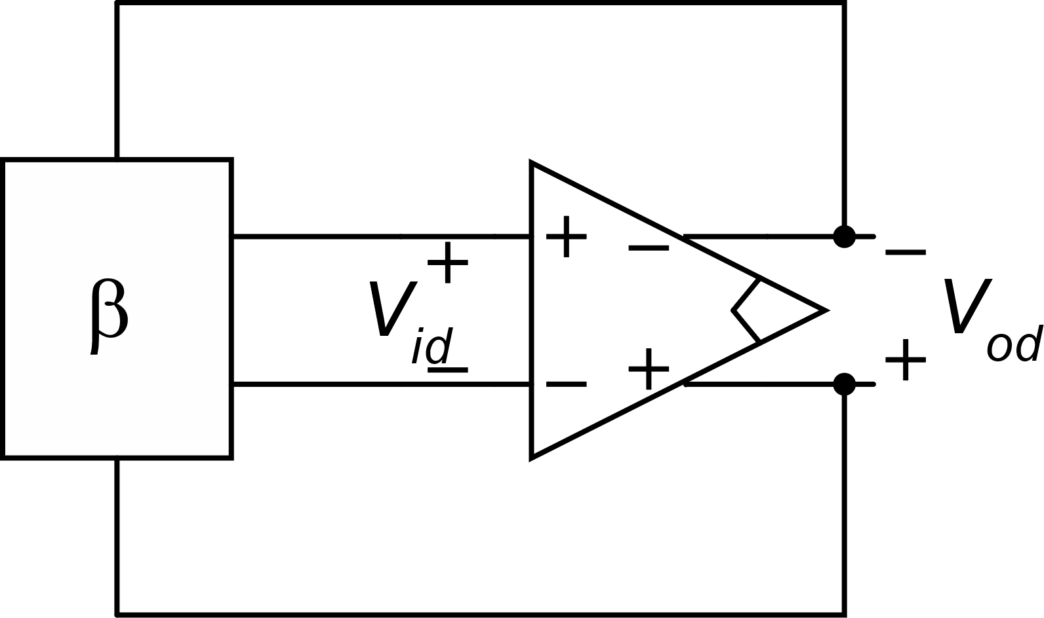
The fully-differential operational amplifier: properties
Imperfect virtual short circuit
Contribution of noise to the input differential voltage in closed loop
Filtered version of the input noise voltage

Slide 21
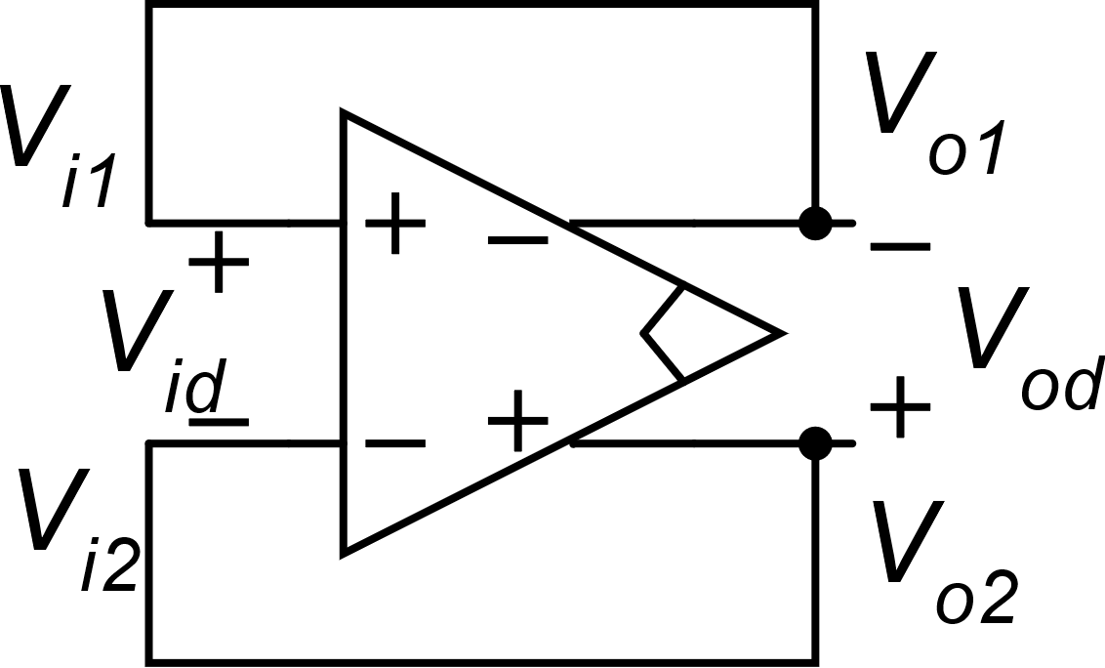
The "unity gain configuration"
It is common practice to indicate this configuration by "unity-gain".
This is improper because there is no available port to insert a signal.
However, this configuration is particularly useful in switched-capacitor circuits.

Slide 22
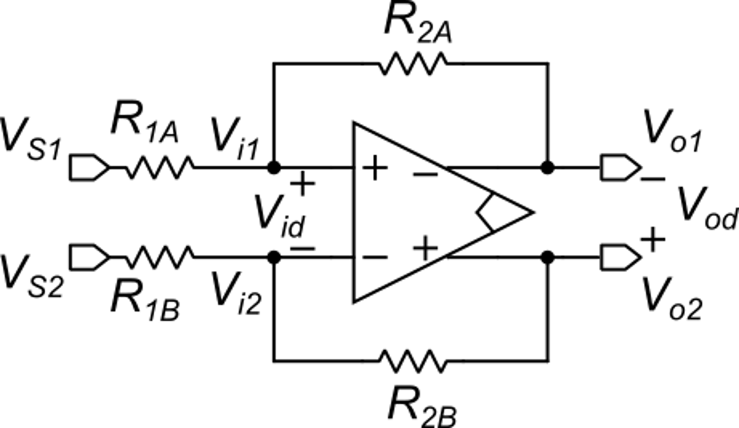
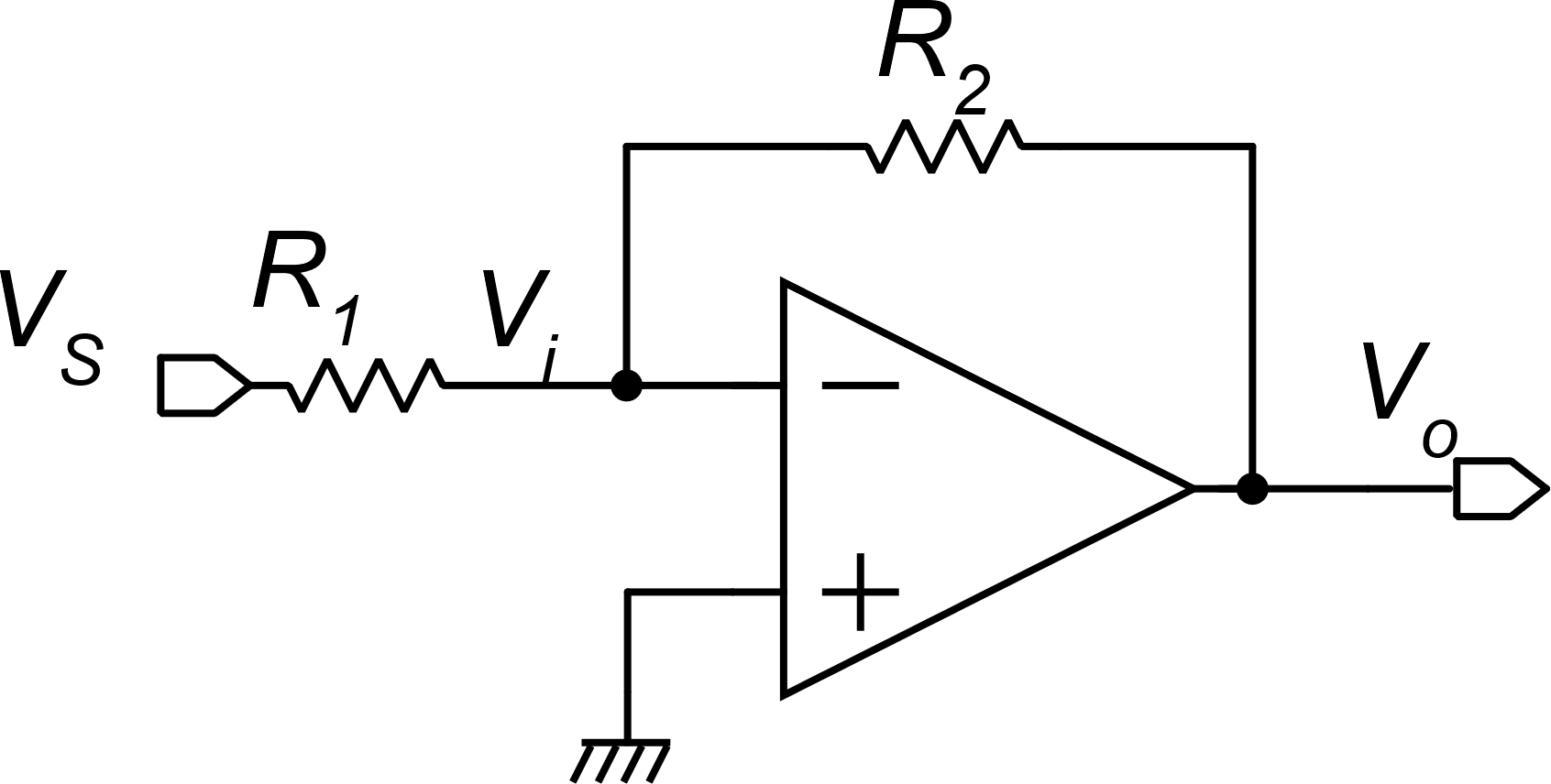
Fully differential amplifier with resistive feedback
Analogous S/E configuration: inverting amplifier.
The fully-diff. version needs twice the passive components
In fully-differential architecture, speaking of inverting and non-inverting topologies is meaningless, since a sign change can be obtained by simply swapping the wires

Slide 23
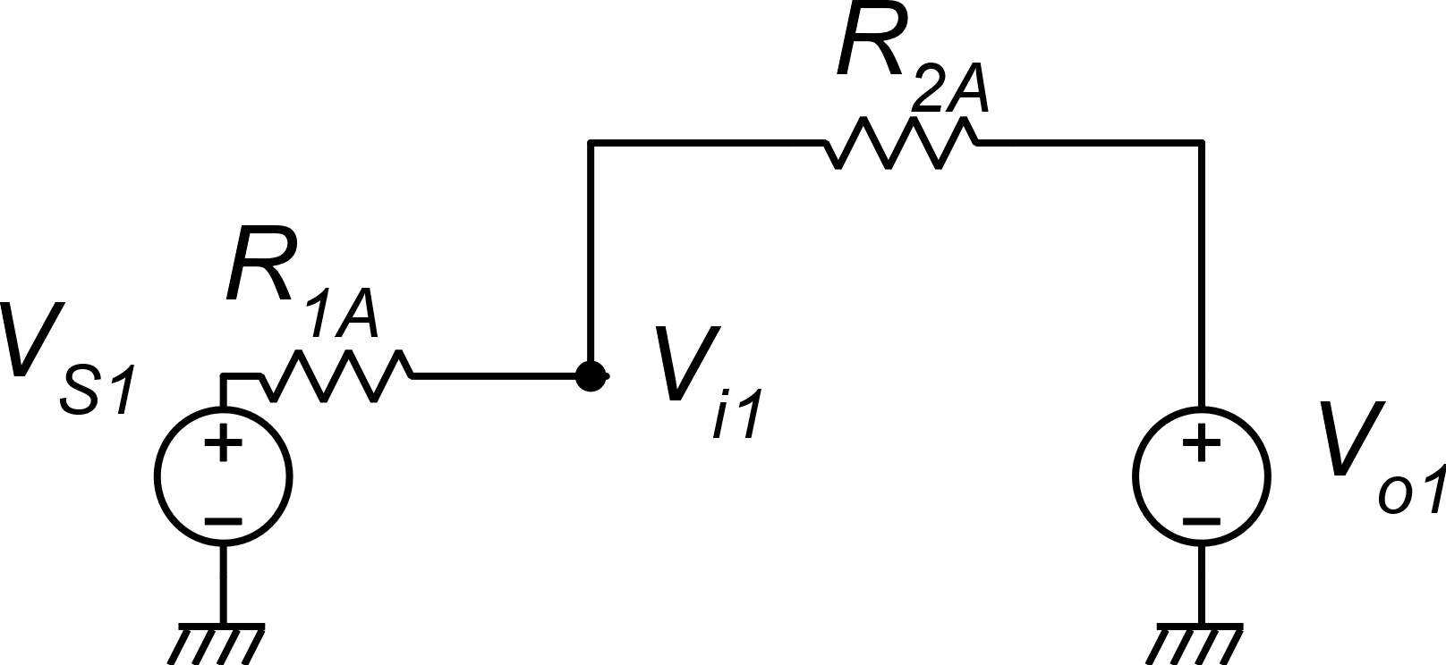
Fully differential amplifier with resistive feedback
β₁
1−β₁

Slide 24
Fully differential amplifier with resistive feedback
It is convenient to split the two coefficients as a mean value and a difference:
Nominally β₁=β₂, but unavoidable
process errors (local errors) make
them different

Slide 25
Fully differential amplifier with resistive feedback
Differential mode analysis
−
+

Slide 26
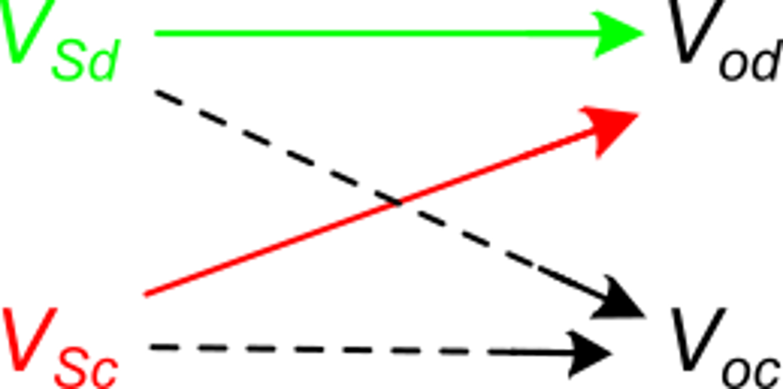
Fully differential amplifier with resistive feedback
A_{dd}
relative
matching error
A_{cd}

Slide 27
Fully differential amplifier with resistive feedback
Nominal case:

Slide 28
Fully differential amplifier with resistive feedback
Generally, determination of the common mode voltage does not require high accuracy. We can use the nominal case.
We do not know the input common mode voltage
We have to check that for all possible values of v_{SC}, the input common mode voltage does not exceed the amplifier input CM range

Slide 29
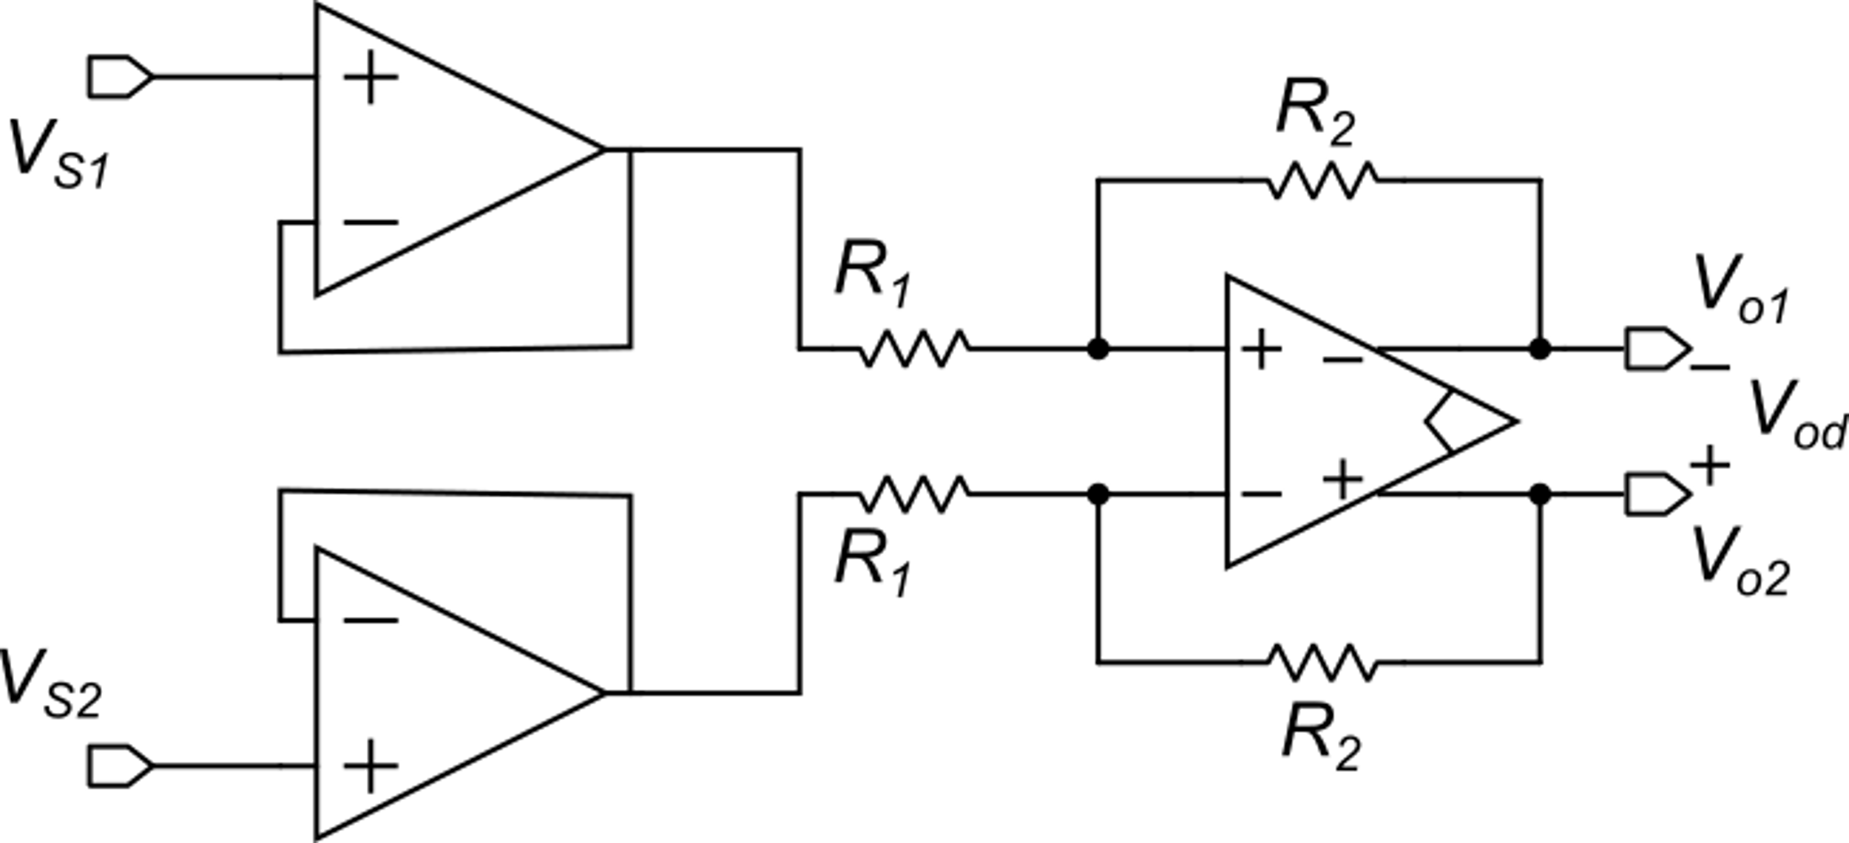
3-op-amp fully-differential instrumentation amplifier
Nominal case
R_{in-d}=2R₁
We could use input buffers built with single-ended operational amplifiers.
But there is a more versatile option ...
This circuit alone cannot be used as an instrumentation amplifier
since it has too low an input resistance

Slide 30
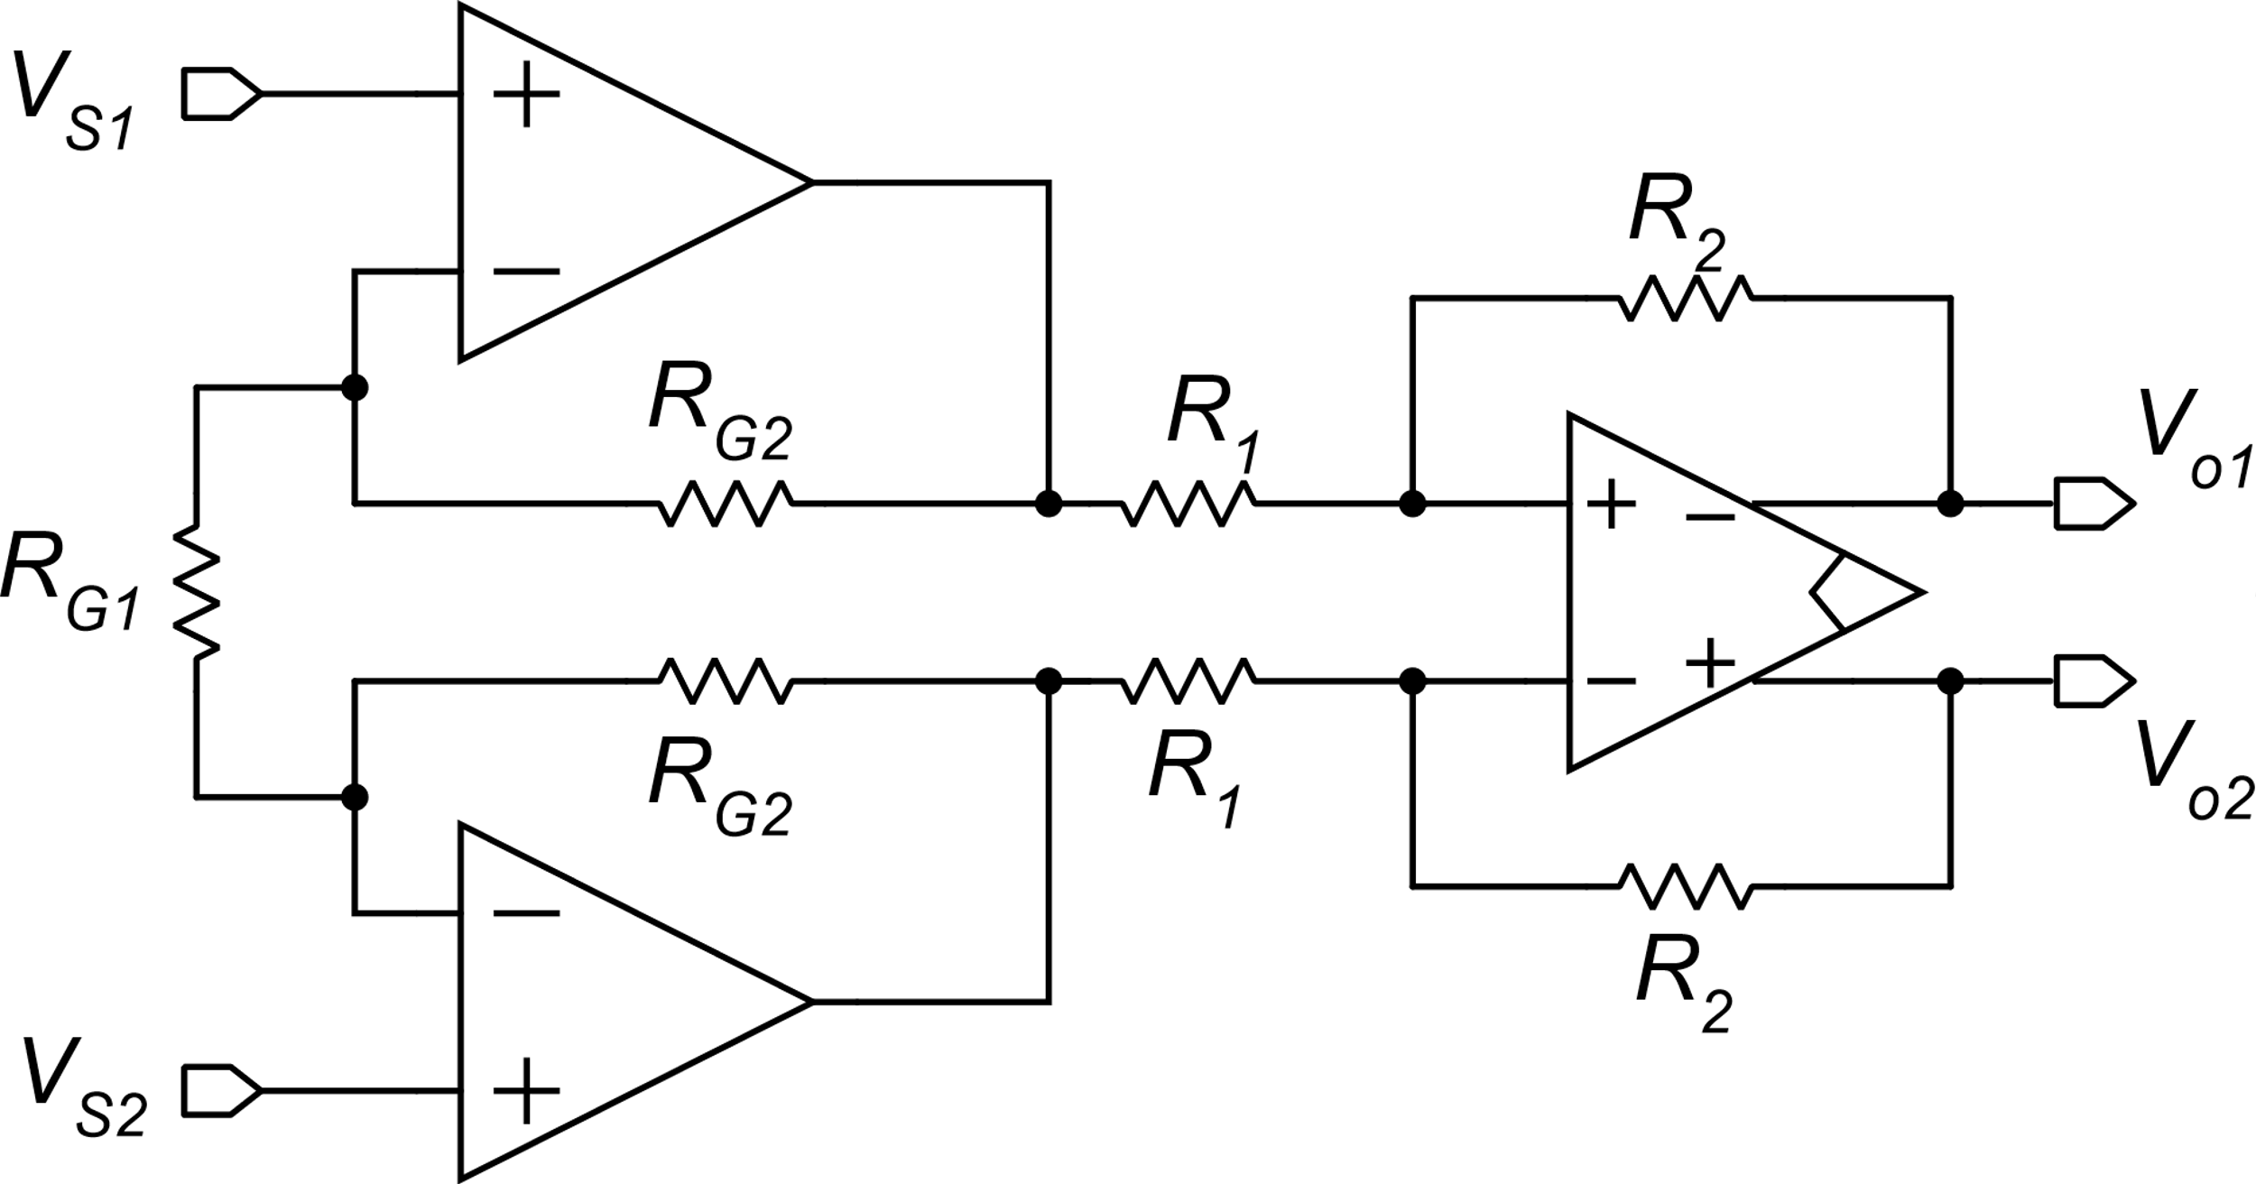
3-op-amp fully-differential instrumentation amplifier
Second stage: reject the input common mode voltage and produces a stabilized output common mode voltage.
Often its gain is set to 1
First stage: is identical
to the first stage of the single-ended in-amp

Slide 31
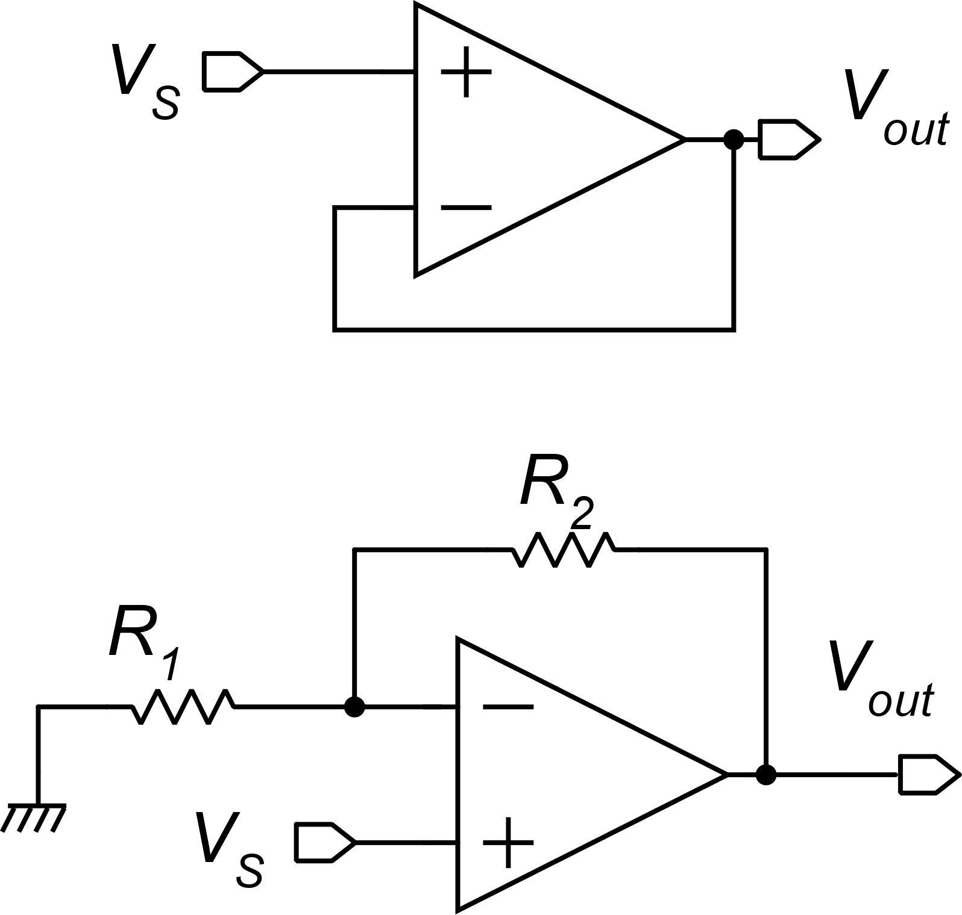
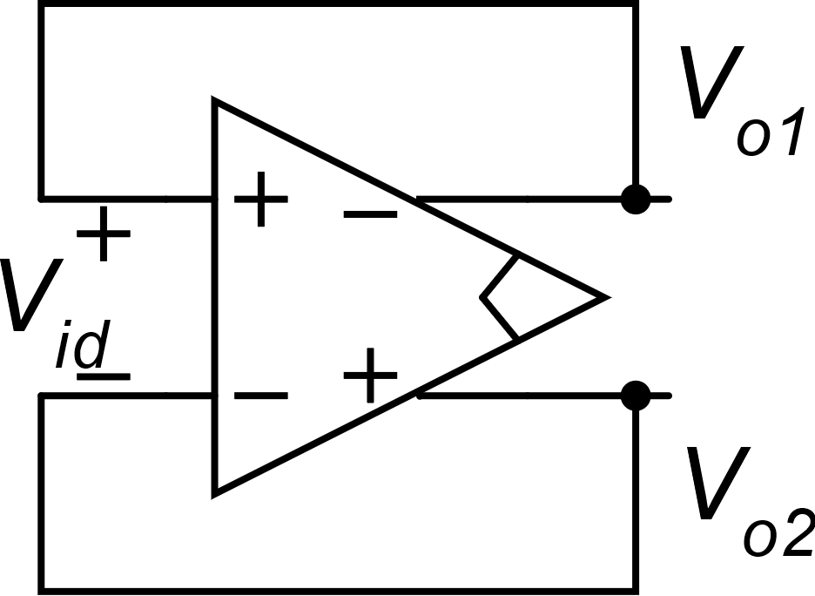
Versatility limits of the fully-differential operational amplifier
For example, the fully-differential unity-gain configuration, differently from its S/E counterpart cannot work as a buffer. There is not an input port available for the signal.
These are topologies that present a high input resistance. They cannot be implemented in the fully differential domain using a FD op-amp.

Slide 32
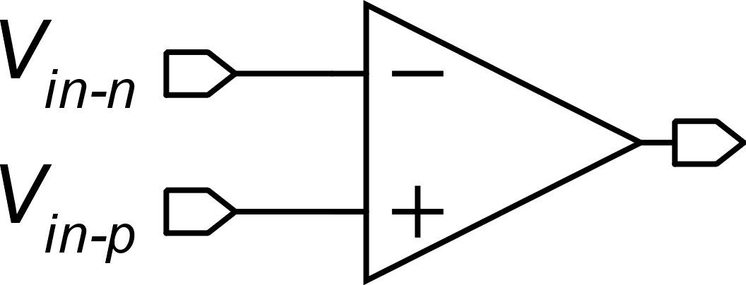
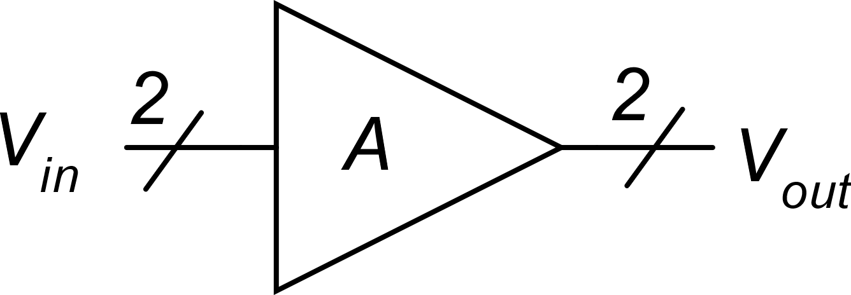
Versatility limits of the fully-differential operational amplifier
Single ended op-amp (electrical symbol)
Fully-differential op-amp (electrical symbol)
Functional representation: in fully differential architectures every wire pair is a single signal
Functional representation

Slide 33
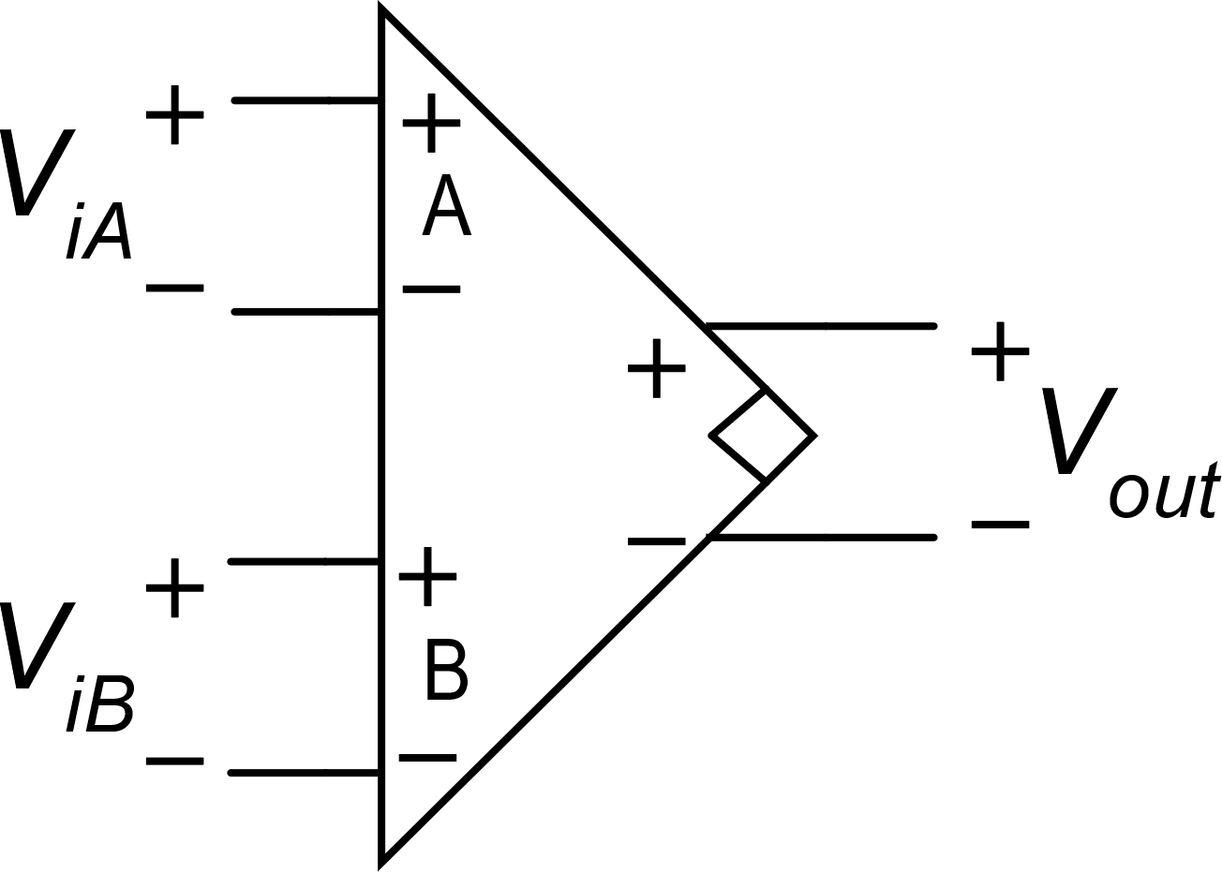
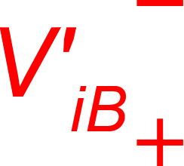
The DDA: Difference Differential Amplifier
In a closed loop configuration, if the circuit is stable and the amplifier is in its linearity range (A>>1)
This is the equivalent of the virtual short circuit in DDAs. Note that, individually V_{iA} and V_{iB} can be large

Slide 34
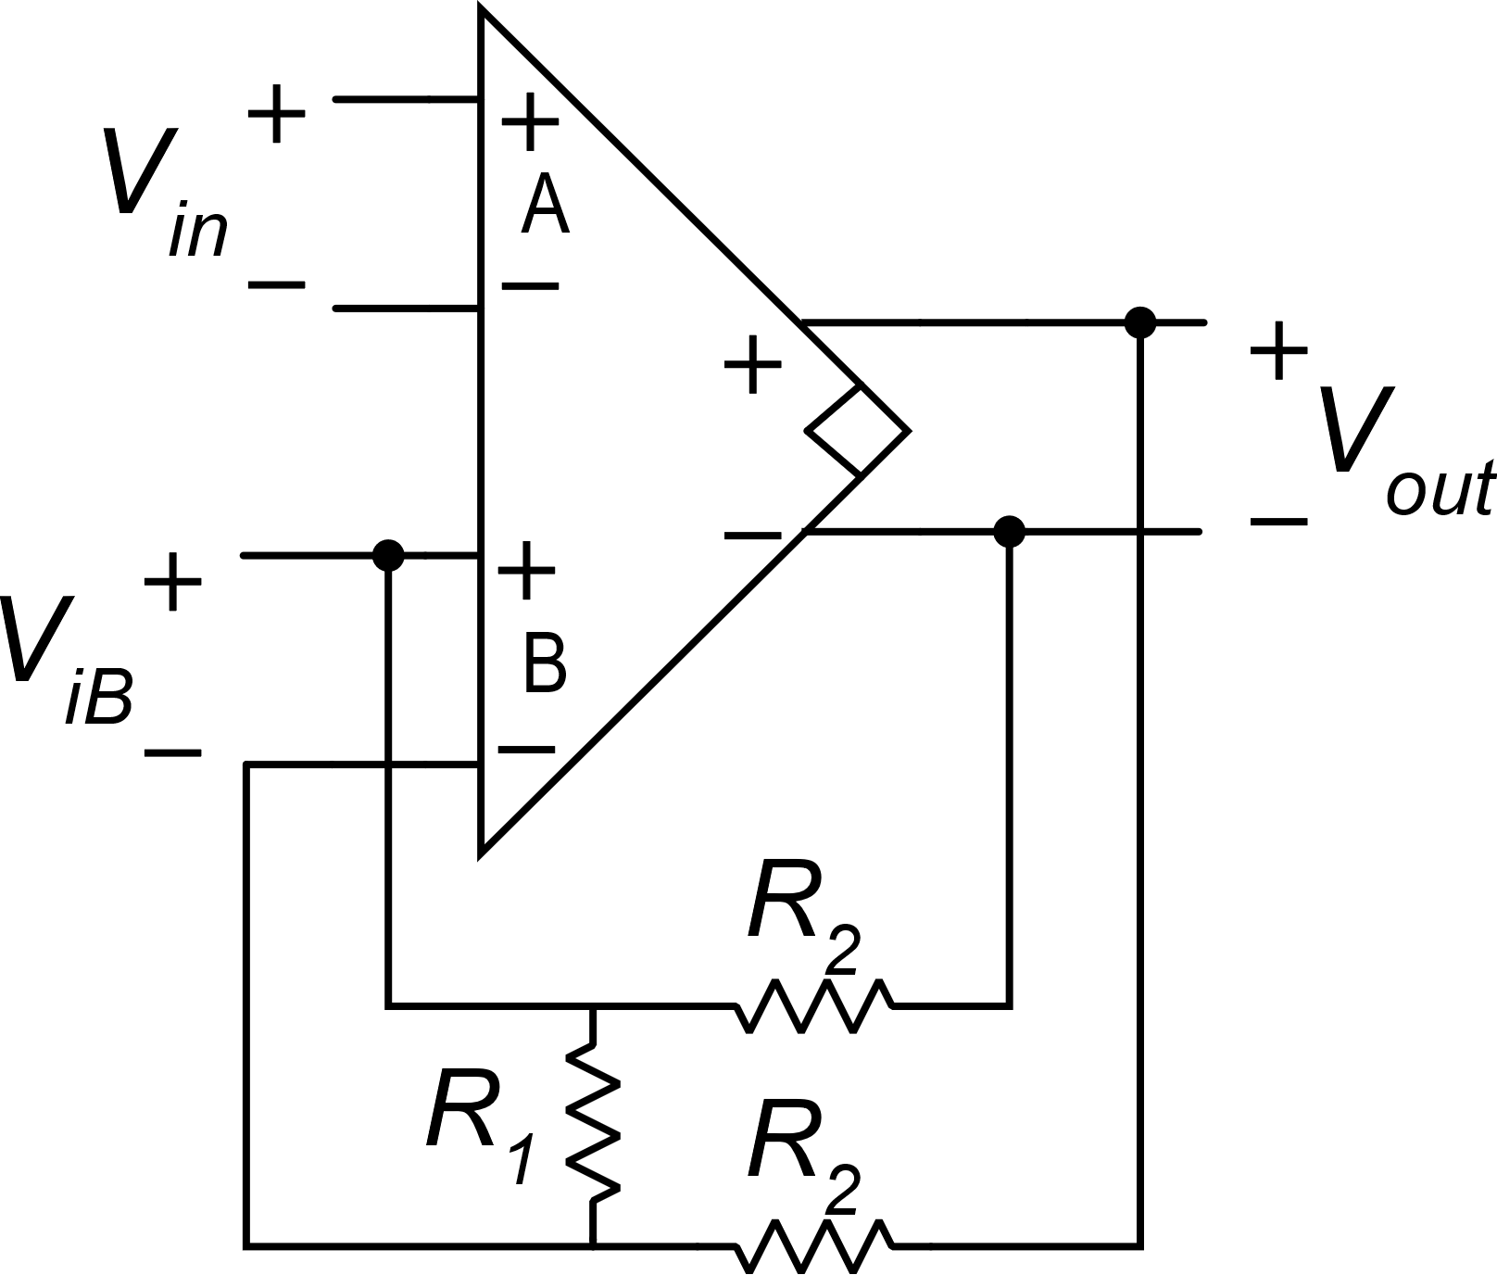
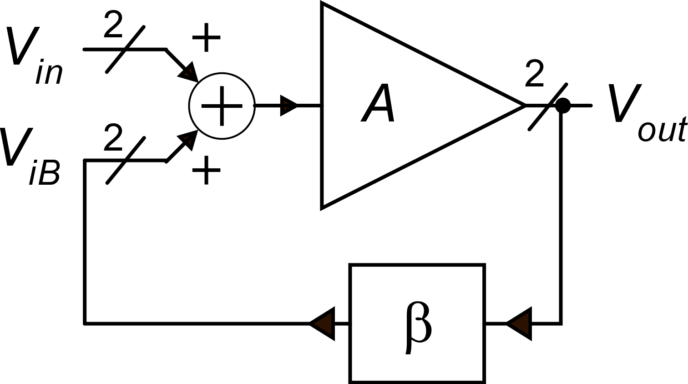
DDA-based instrumentation amplifier

