Slide 1
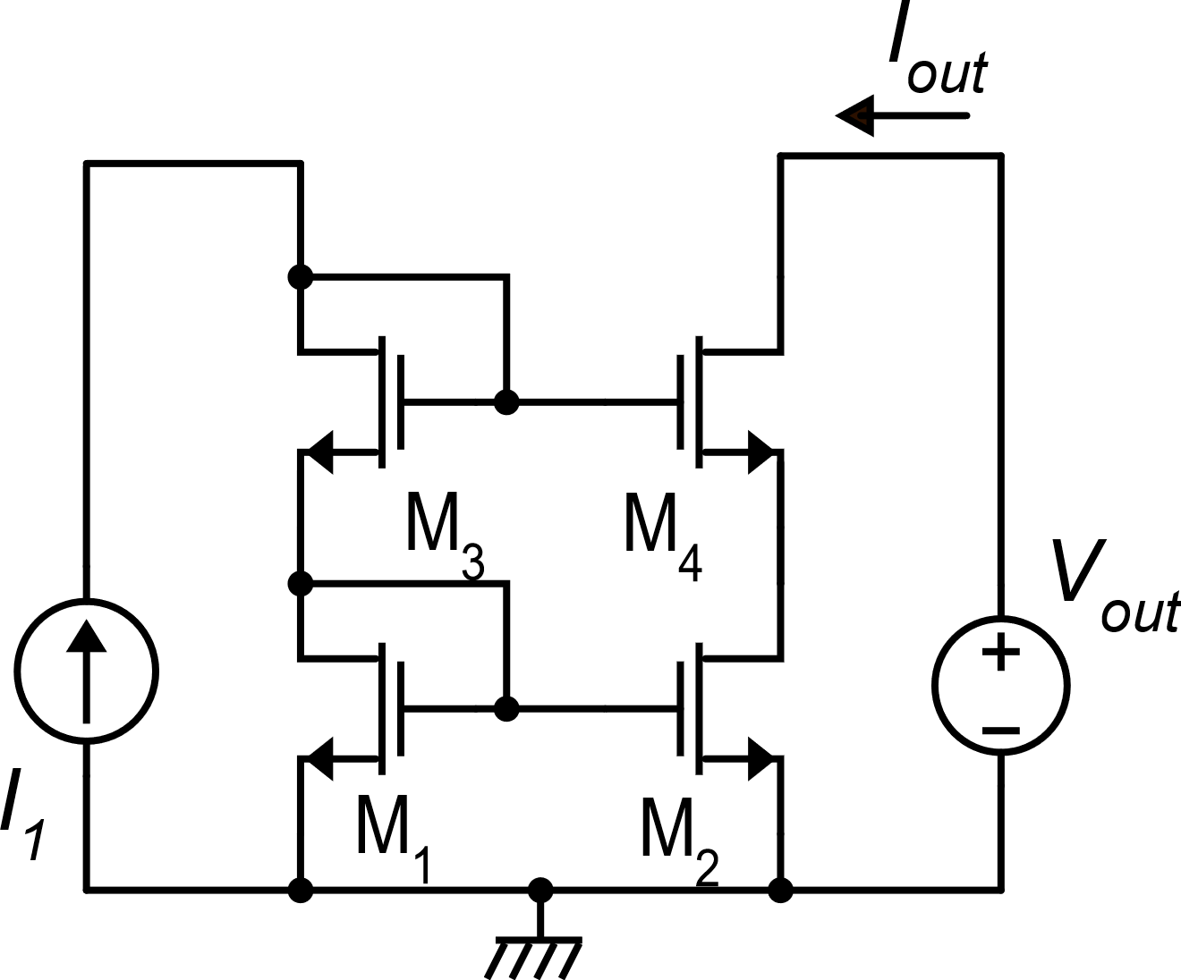
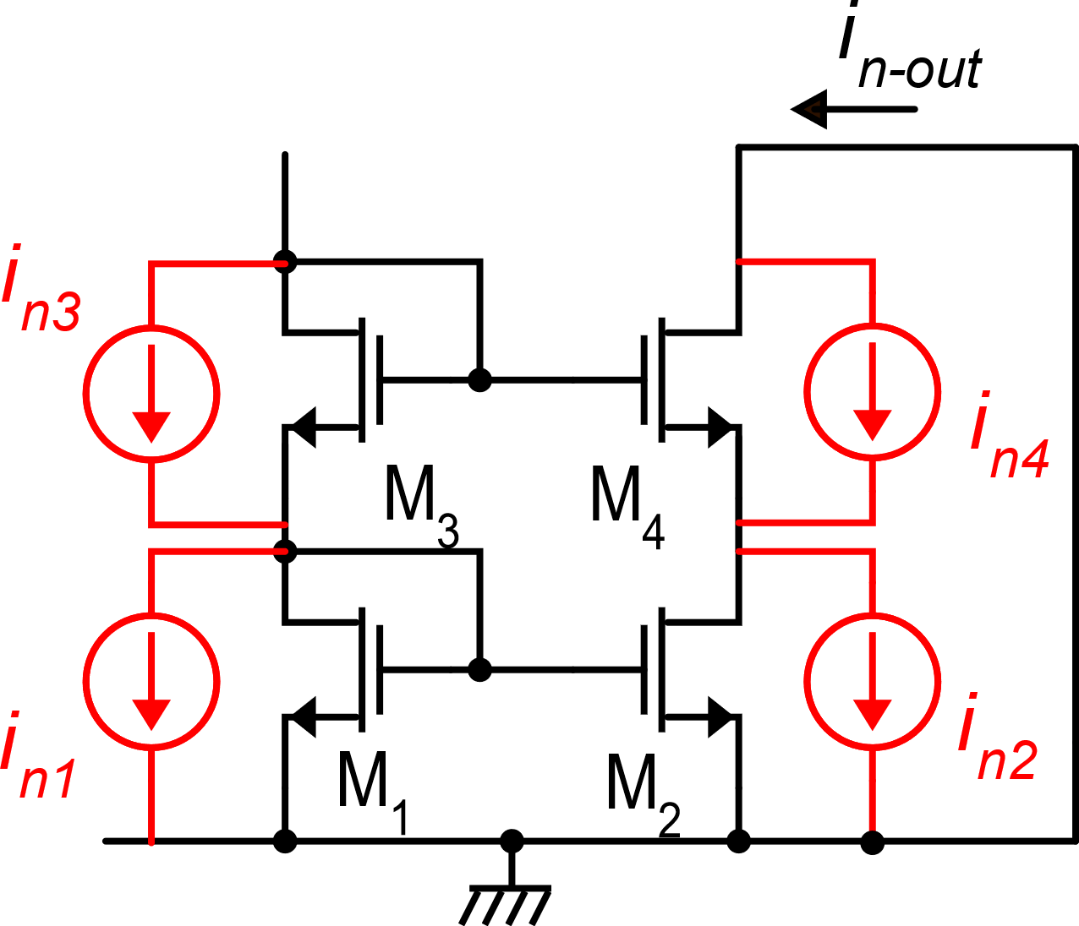
Noise in cascode current mirrors
Standard cascode current mirror
Small signal circuit with noise current sources
In these slides, the analysis of the output noise will be performed neglecting parasitic capacitances, then the results will be applicable in a frequency range where the response is the same as that exhibited at dc (f=0).

Slide 2
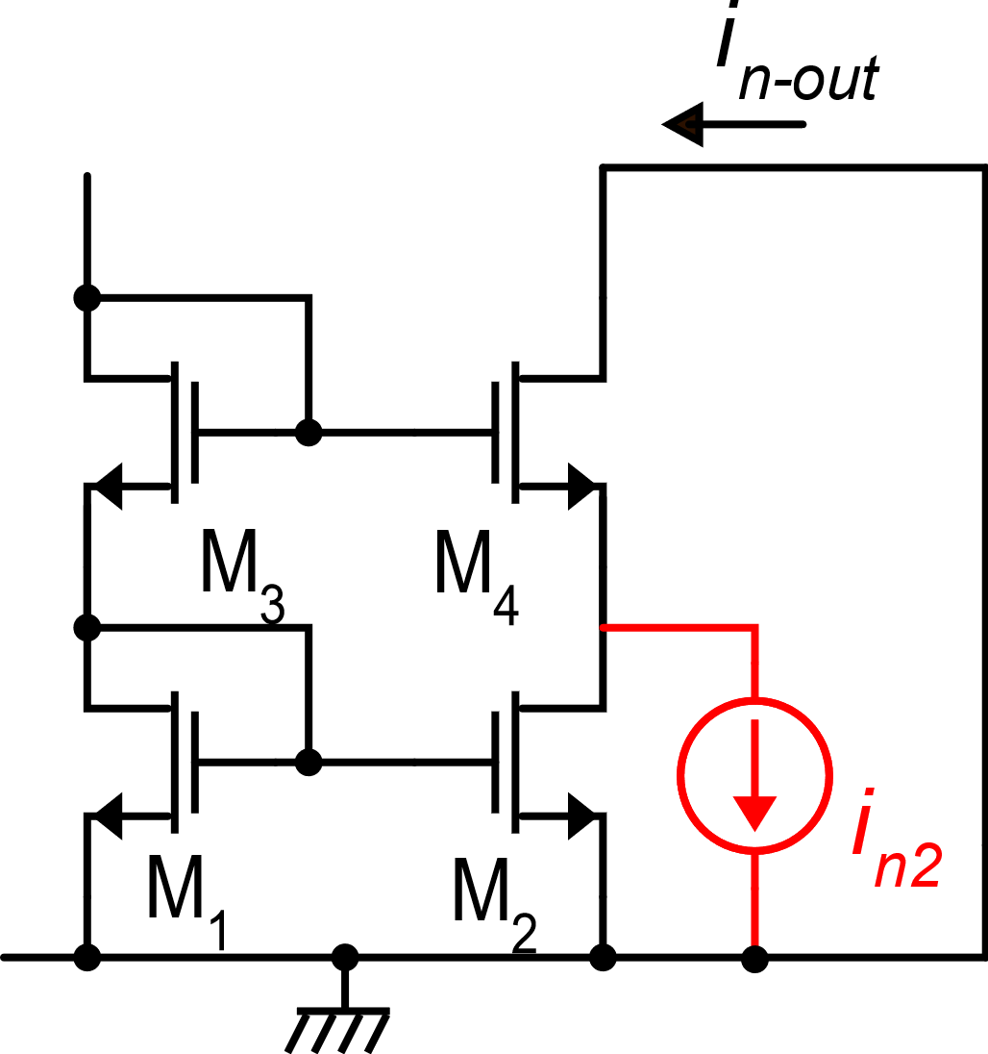
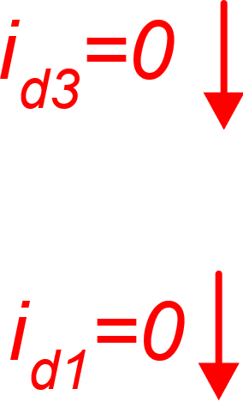
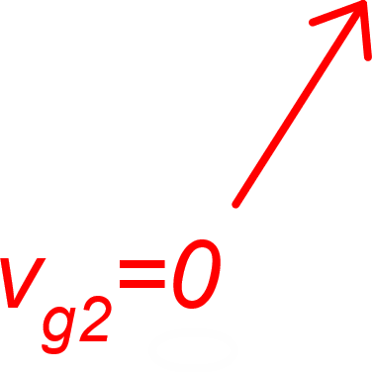
Current i_{n2}
M2 is off and it can be replaced by its output resistance r_{d2}
i_{n2} is applied at the input of a common gate stage (M₄) and reaches the output terminal of the mirror through a gain:

Slide 3
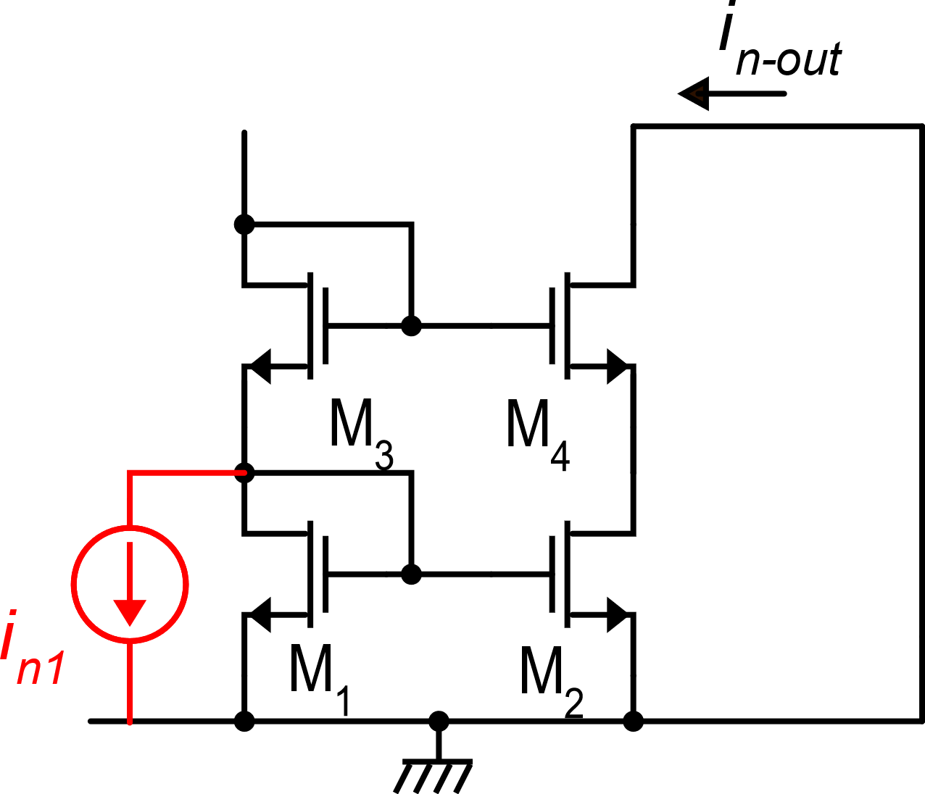
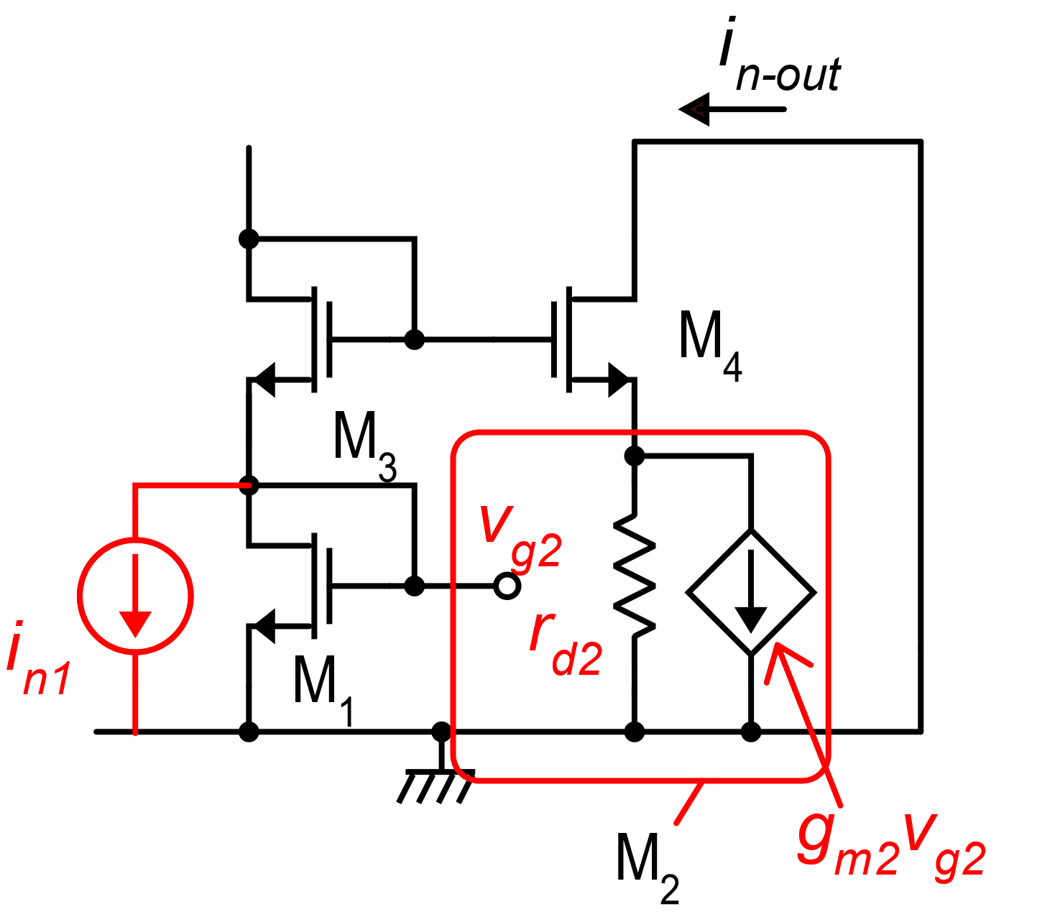
Current i_{n1}

Slide 4
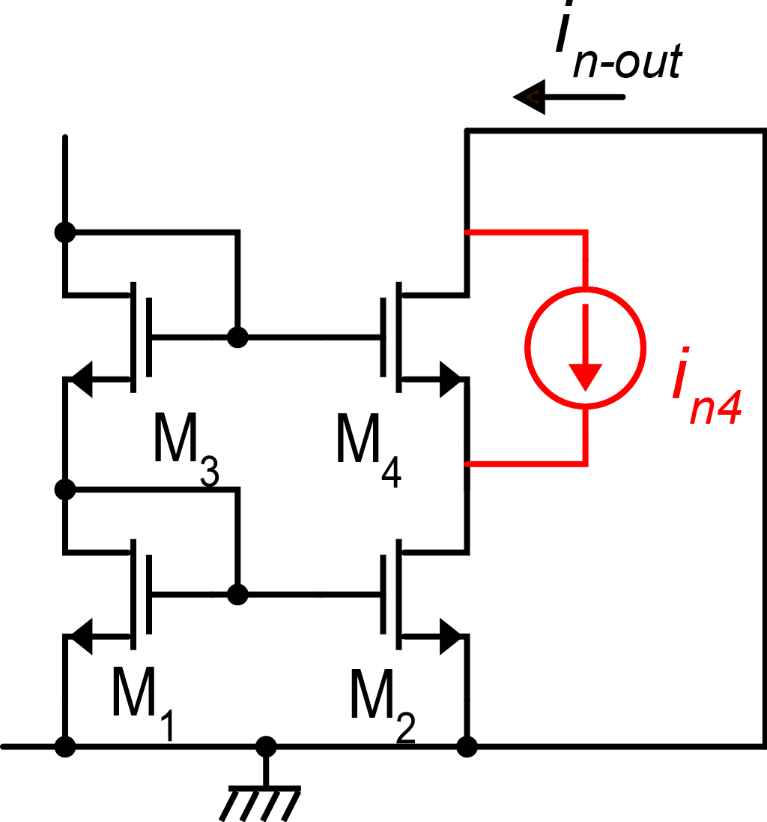
Current i_{n4}
i_{n4} is the noise source of the MOSFET that forms the common gate stage. We can apply the transfer function between this current and in-out that we have already calculated for the CG stage (at dc):
In dc and at low frequencies, the CG device give a negligible contribution compared to the effect of i_{n1} and i_{n2}

Slide 5
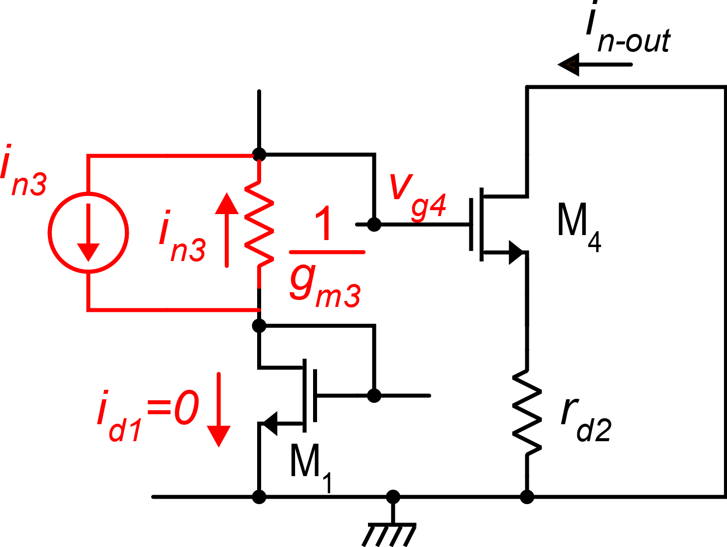
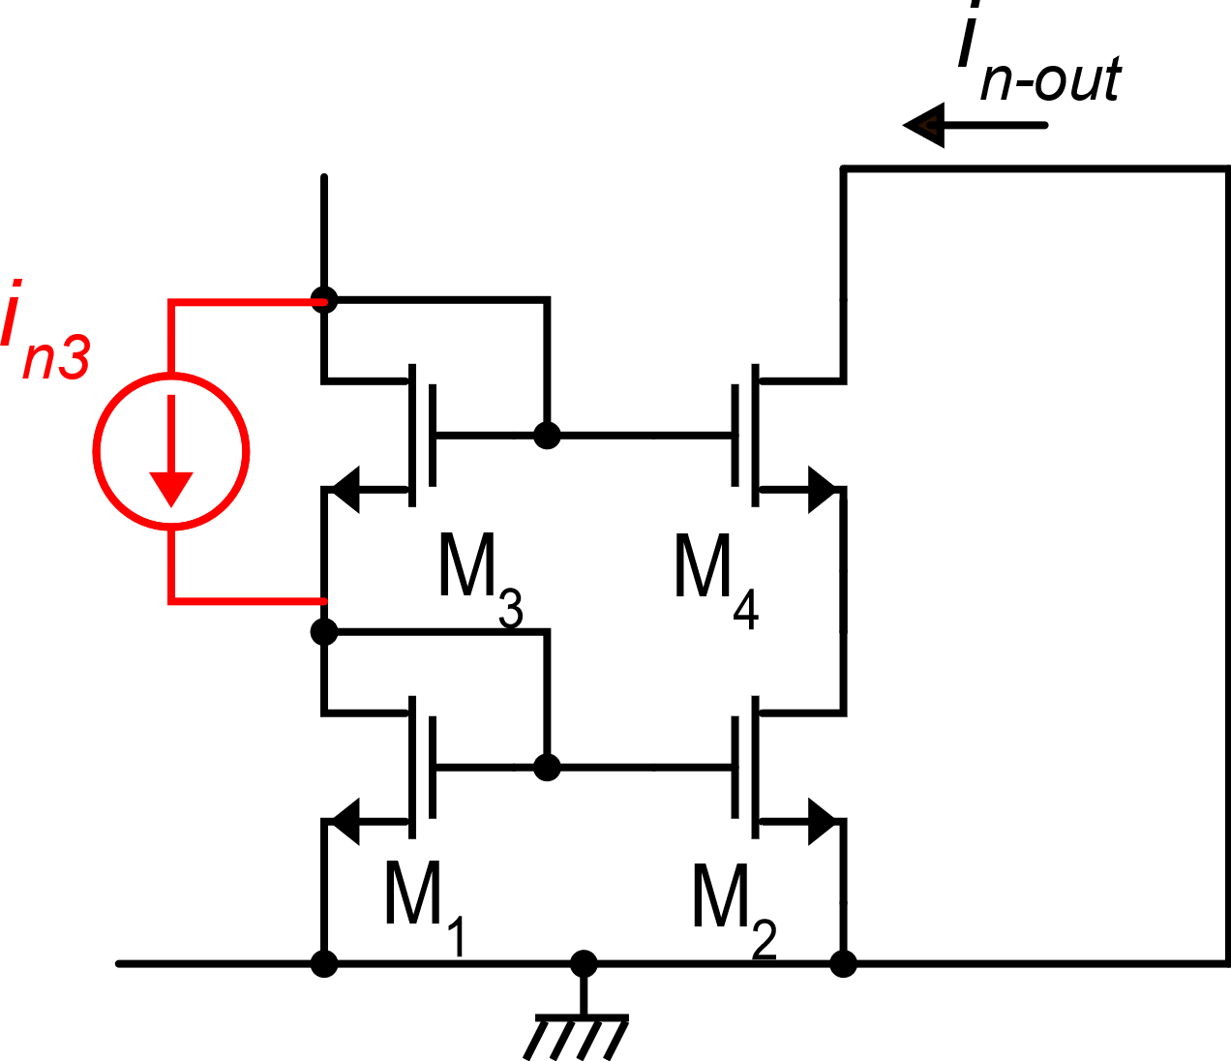
Effect of i_{n3}

Slide 6
In summary
M₁, M₂: practically the same effect as in the simple mirror:
M₃, M₄: their contribution to the output noise current is equal to their noise currents divided by a factor g_{m}r_{d} and, generally, can be neglected
In a correctly designed mirror this is also the k_{M}

