Slide 1
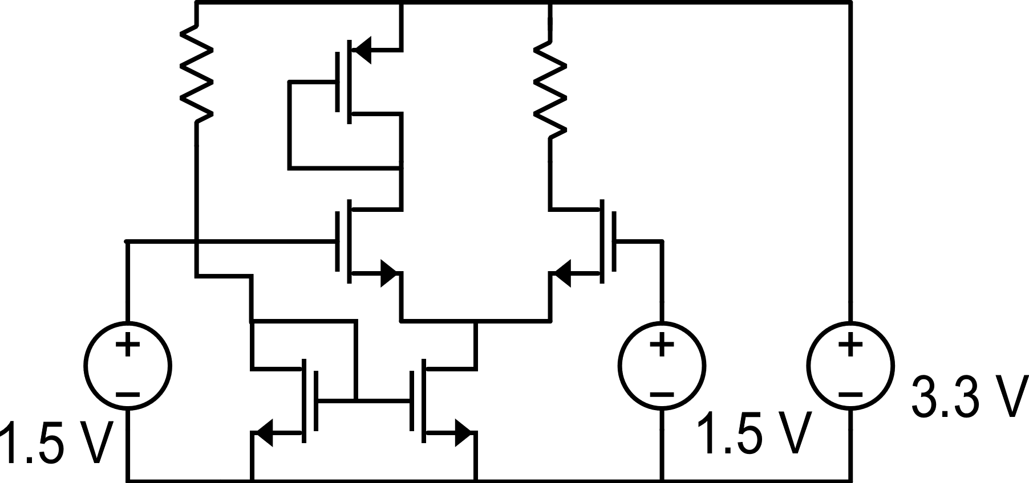
A small-signal method to calculate the effect of component variations
The problem is: if we consider the dc solution of a network, what happens to this solution if the parameters of one or more devices undergoe a small change
Example of non-linear network

Slide 2
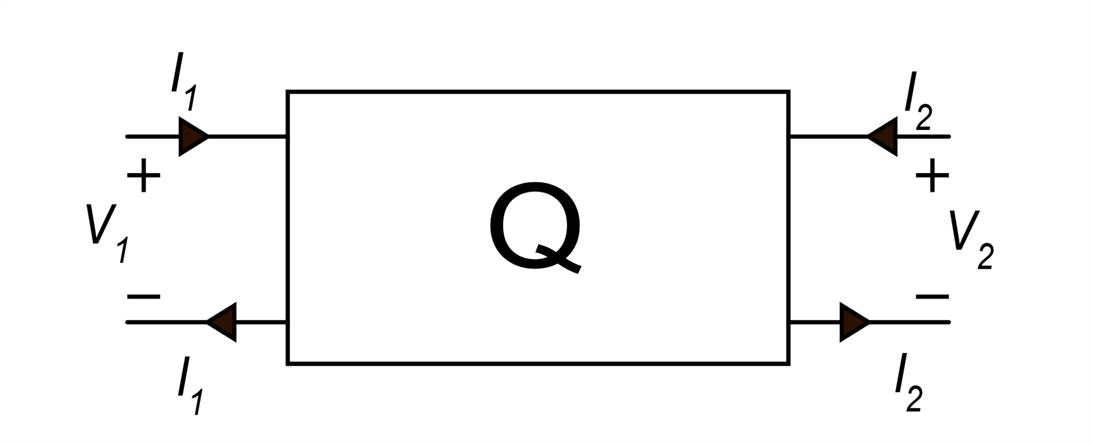
Small signal approach to parameter variations
(P)
We consider that the component
whose parameters change can be
represented by a two-port network
Both the selected two-port network
(Q) and the remaining network (N) can be
highly non-linear (g₁,g₂,f₁,f₂ : non-linear)
Variation of the network solution

Slide 3
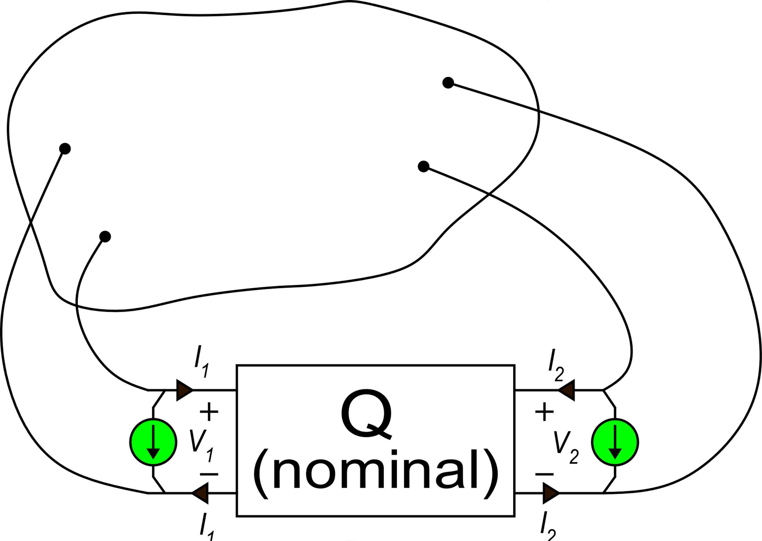
Method
Apply two-currents to the nominal network, as in the
figure, with values:
N
The variations caused by the change P-> P+ΔP can be calculated solving the small-signal circuuit of the whole network with the only independent sources i_{1P} and i_{2P}.

Slide 4
Example of parameter change: resistance change

Slide 5
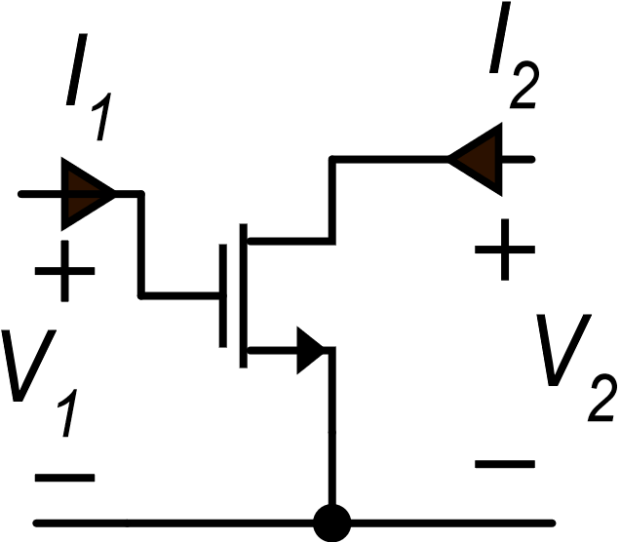
MOSFET

Slide 6
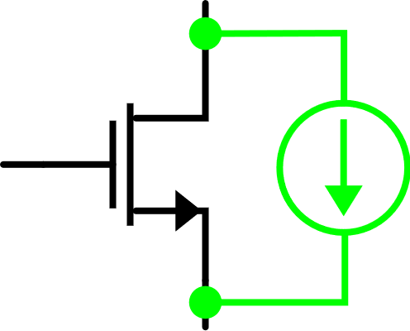
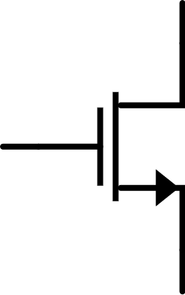
MOSFET: strong inversion + saturation
actual device
nominal
device
nominal device
nominal parameters
nominal operating point

Slide 7
MOSFET: strong inversion + saturation
DEF

Slide 8
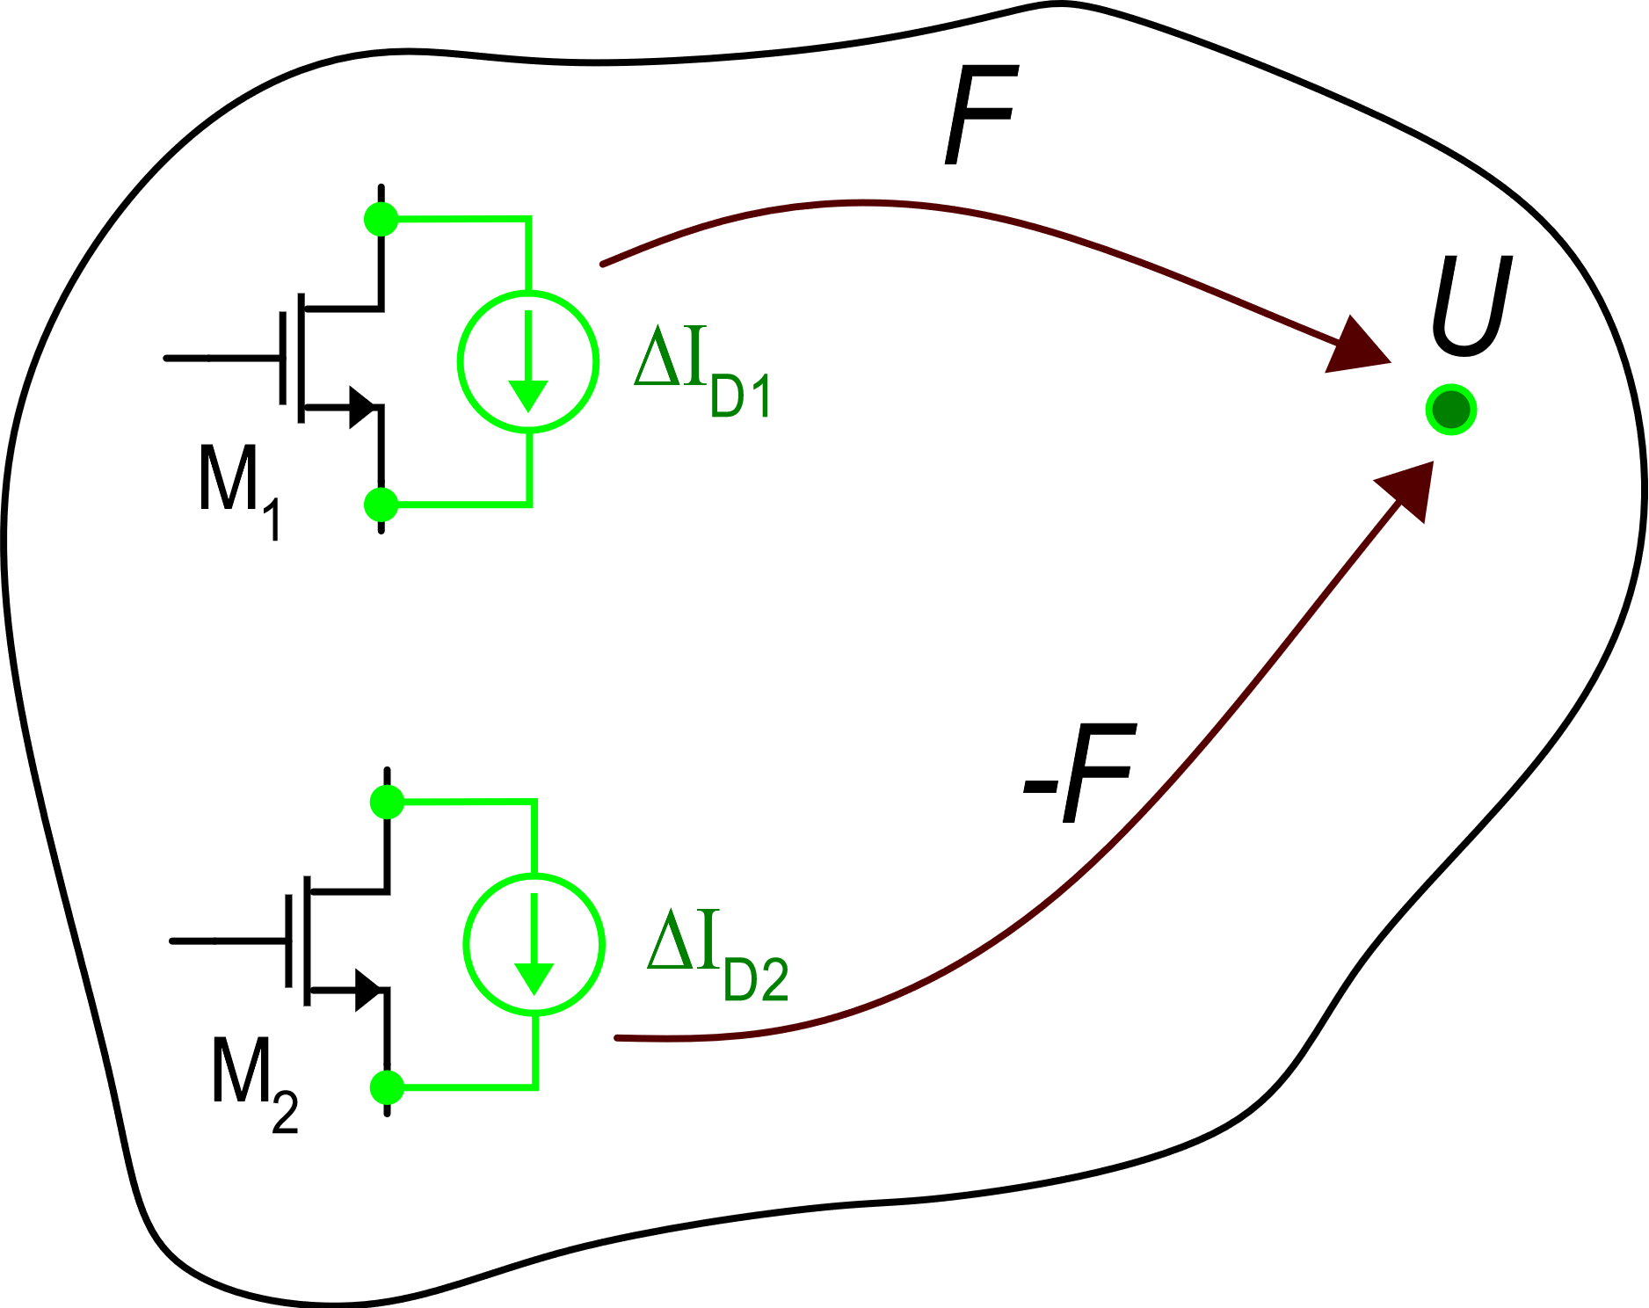
Matched devices
Quantity of interest
The two device are nominally identical.
The bias conditions (quiescent currents and voltages) are identical.
The transfer functions that tie the quantity of the interest for the circuit (for example the output voltage of an amplifier) to the parametric currents of the two devices (ΔI_{D1} and ΔI_{D2}) are opposite.

Slide 9
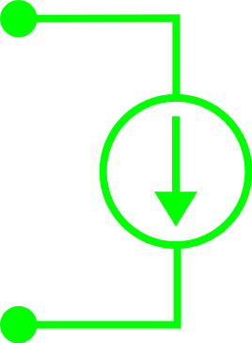
Matched devices
M1
F
U
-F
Same functions, calculated at the same operating point because the device are matched
M2
DEF

Slide 10
Matched Mosfets
Combined effect of two matched MOSFETs
Effect of parameter change of a single device:

Slide 11
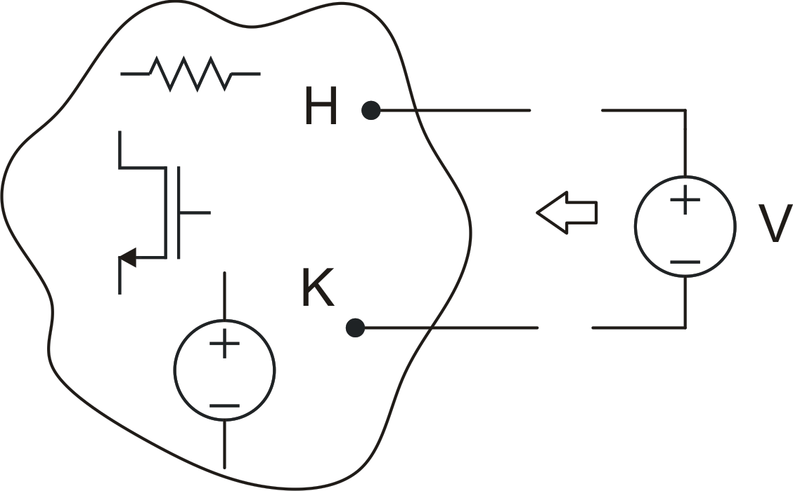
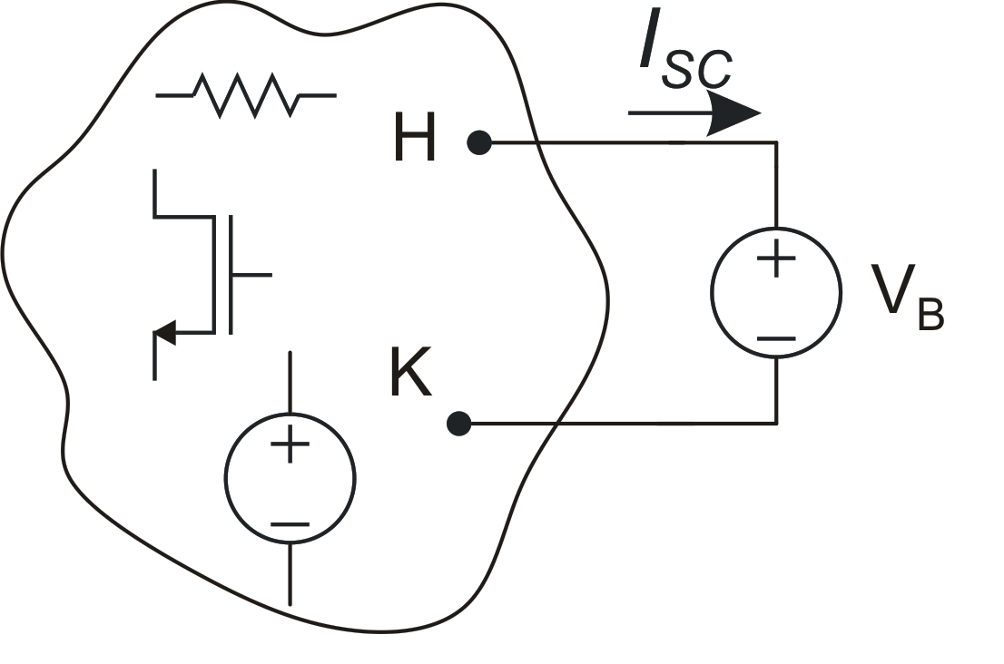
Norton equivalent circuit with dc component
Probing a non.linear network with an arbitrary voltage source V
Test 1. Short circuit current when the probing source assumes a voltage V_{B}. (complete solution, including dc components)

Slide 12
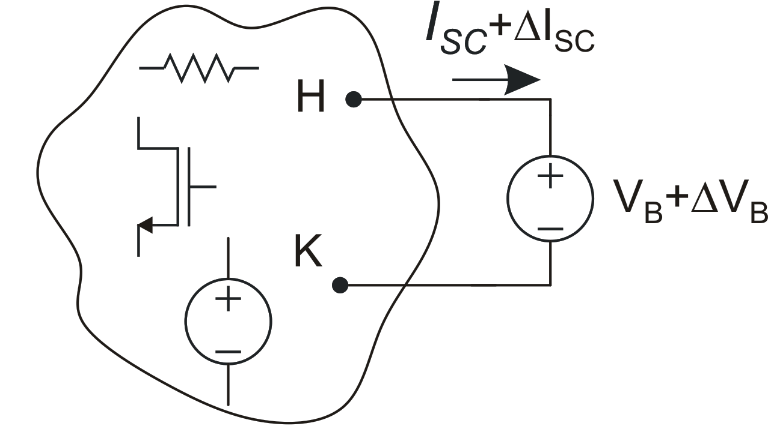
Norton equivalent circuit with dc component
Note: R_{out} is the small-signal resistance seen
across terminals H-K in the operating point forced
by imposing voltage V_{B} across H-K terminals

Slide 13
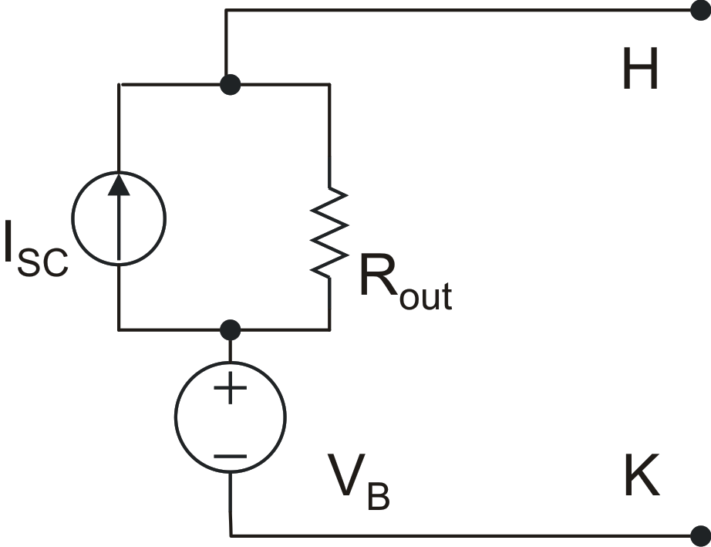
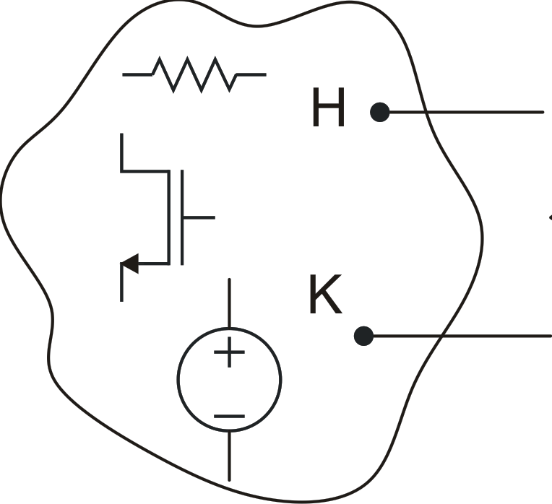
Equivalent circuit of the network
The equivalent circuit is valid until voltage
V_{HK} is close enough to VB that the output resistance
does not change significantly

Slide 14
Example

Slide 15
Use of Pellegrini's cut-insertion theorem for the design of feedback systems

Slide 16
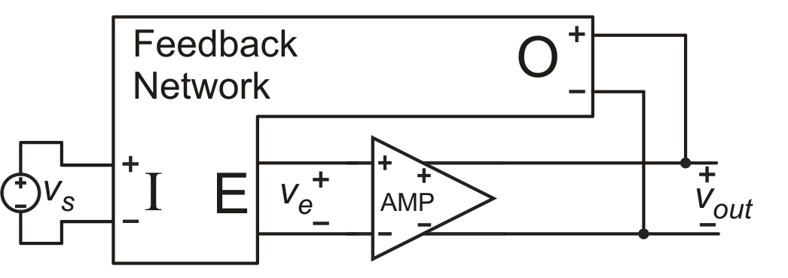
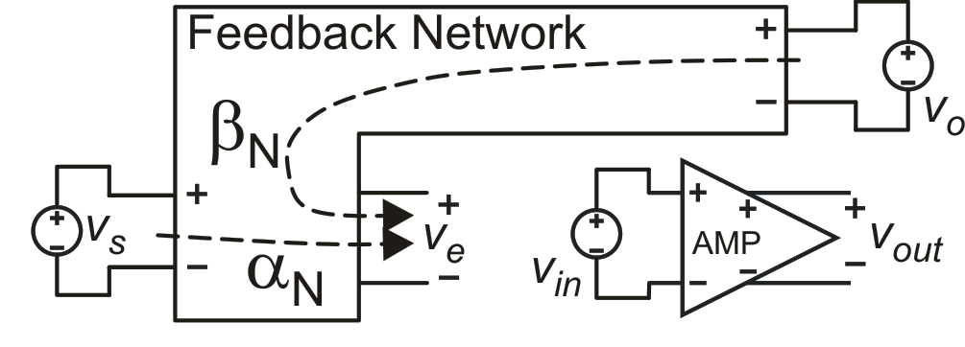
Passive network:
linear and reliable
In a real electronic network:
?
Desired correspondence
Separation of feedback network and gain element (AMP)

Slide 17
Problems that prevent a direct correspondence between the
electrical circuit and the simplified block diagram
of a feedback system
Loading effects of the feedback network on AMP
Loading effect of the amplifier input impedance on the feedback network
Direct signal path from the input signal V_{S} and the output voltage through the feedback network (occurs if the amplifier has a non-zero output impedance).

Slide 18
Pellegrini's cut-insertion theorem
now are calculated taking into account loading effects
takes into account the feed-forward path through the feedback network
ρ is zero if the op-amp is unidirectional

Slide 19
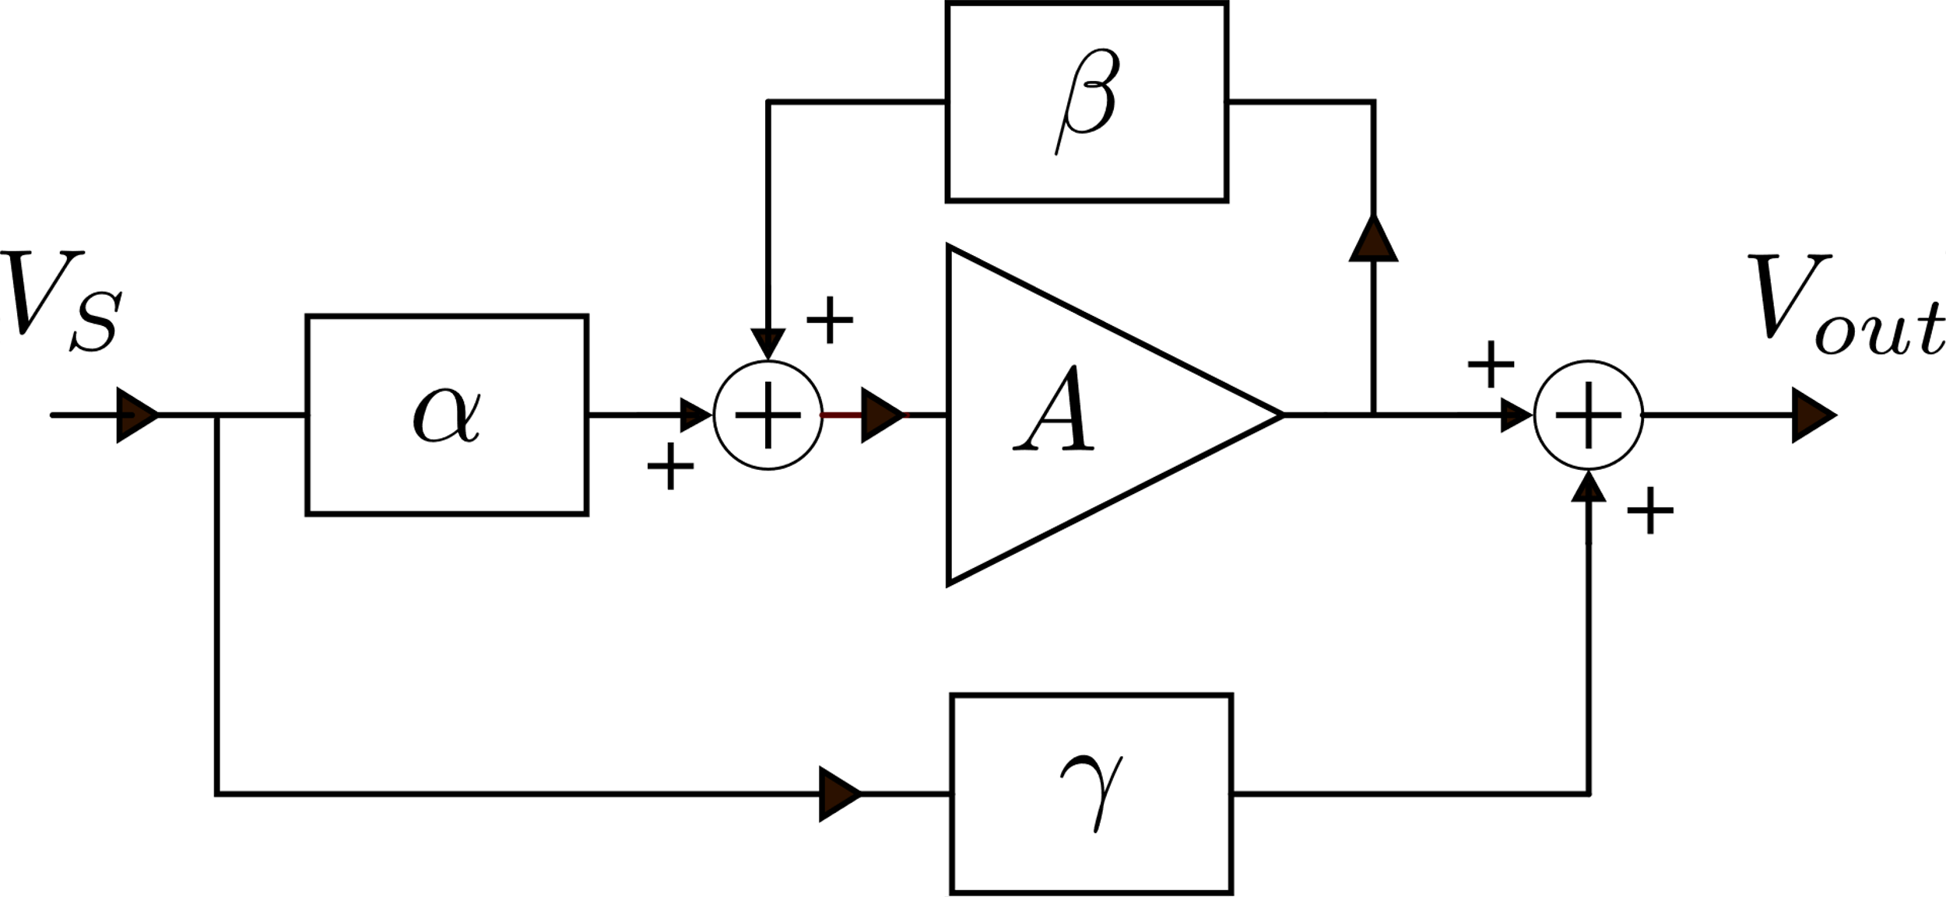
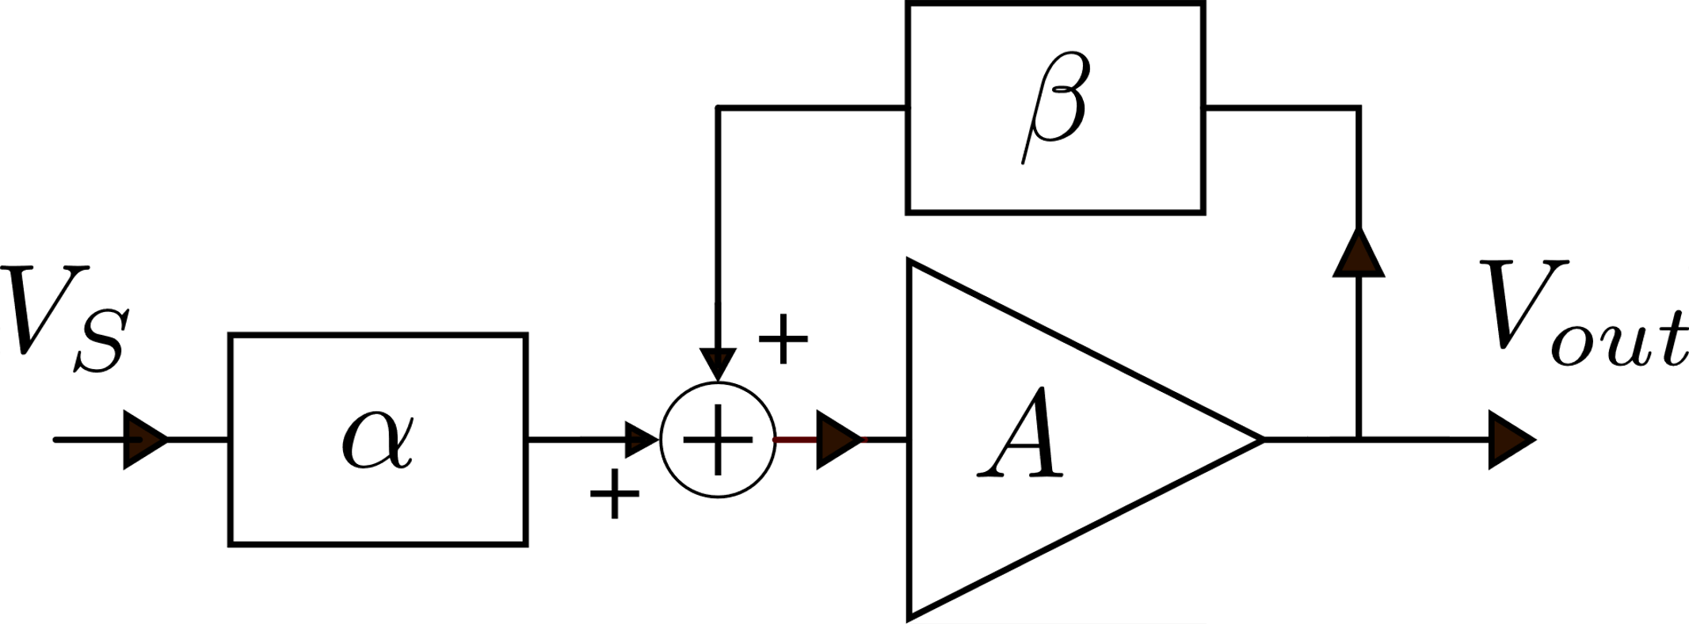
Block diagram corresponding to the cut-insertion schematization
Ideal feedback system

Slide 20
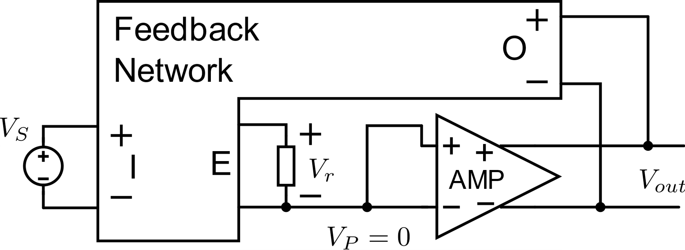
Problems when using the cut-inserion theorem for design purposes
I have to design the feedback network for three transfer functions (α, β and γ) instead of only two.
α and γ depend on the output impedance of the amplifier, Zo, which is a parameter that varies much and cannot be predicted reliably.
Only in the case that Zo is much smaller than the typical impedances of the feedback network, we can design the network for α, β and γ) with port "O" short circuited (γ=0).
Configuration for

Slide 21
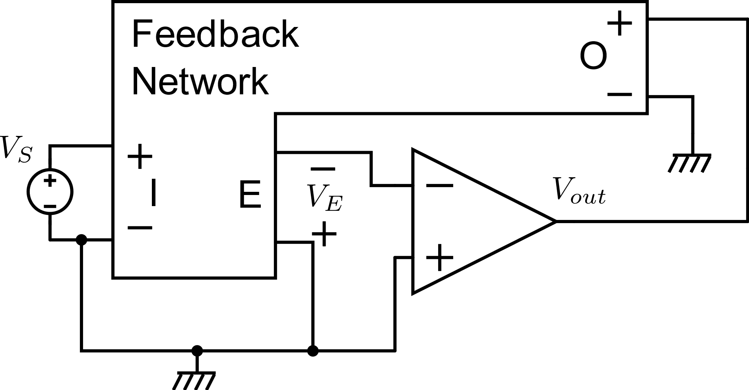
Example
I want to design an inverting amplifier
A passive network, including only resistors, capacitors and inductors (with no mutual inductance) cannot give transfer functions that are negative at dc.
We need an amplifier provided of a inverting terminal

Slide 22
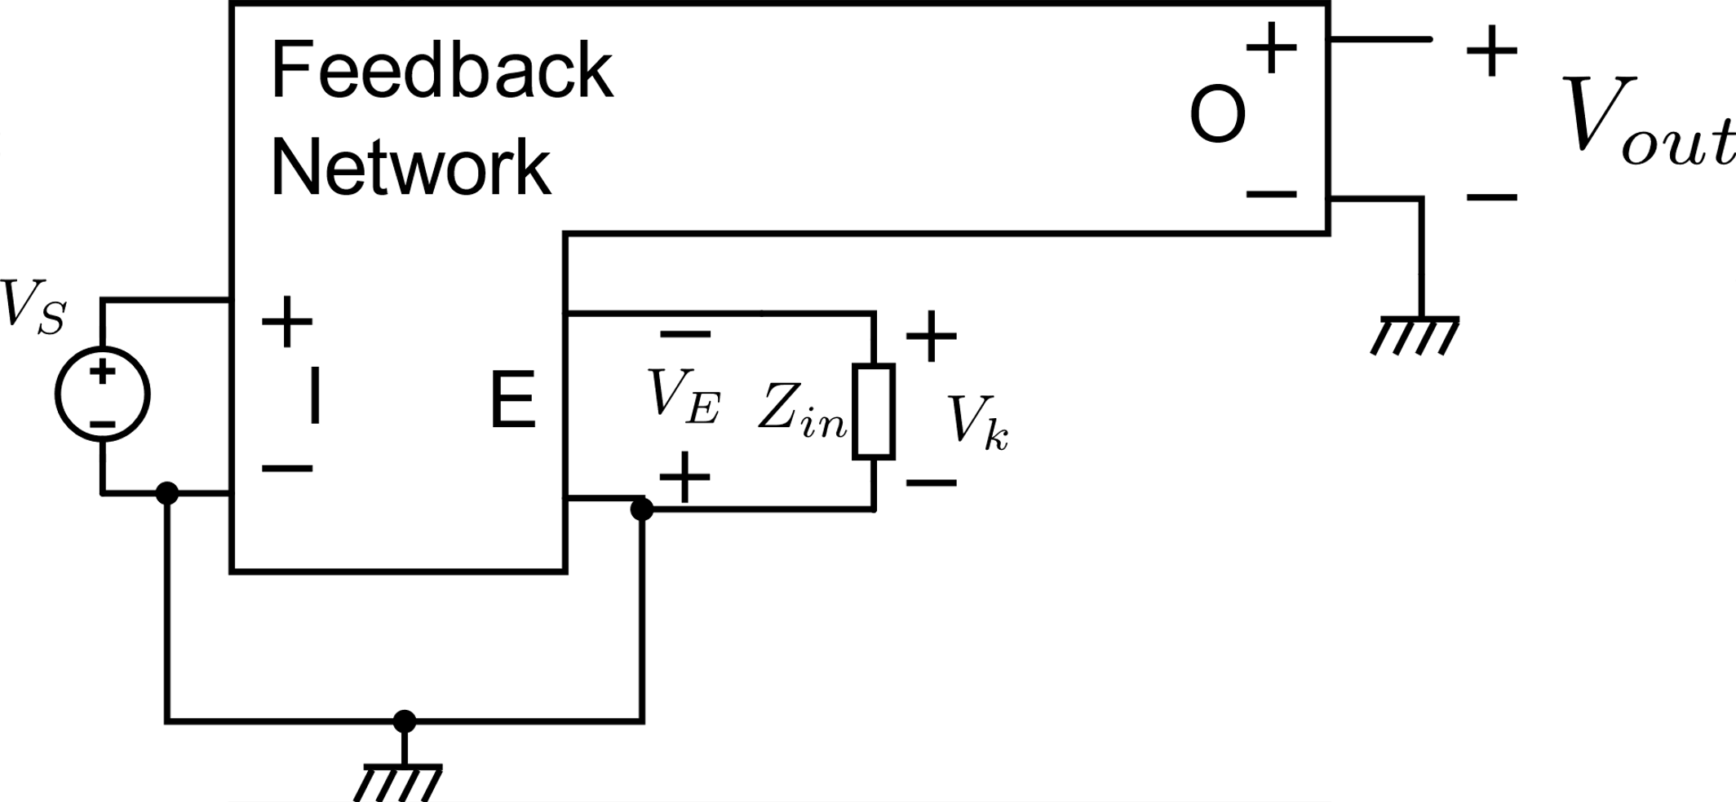
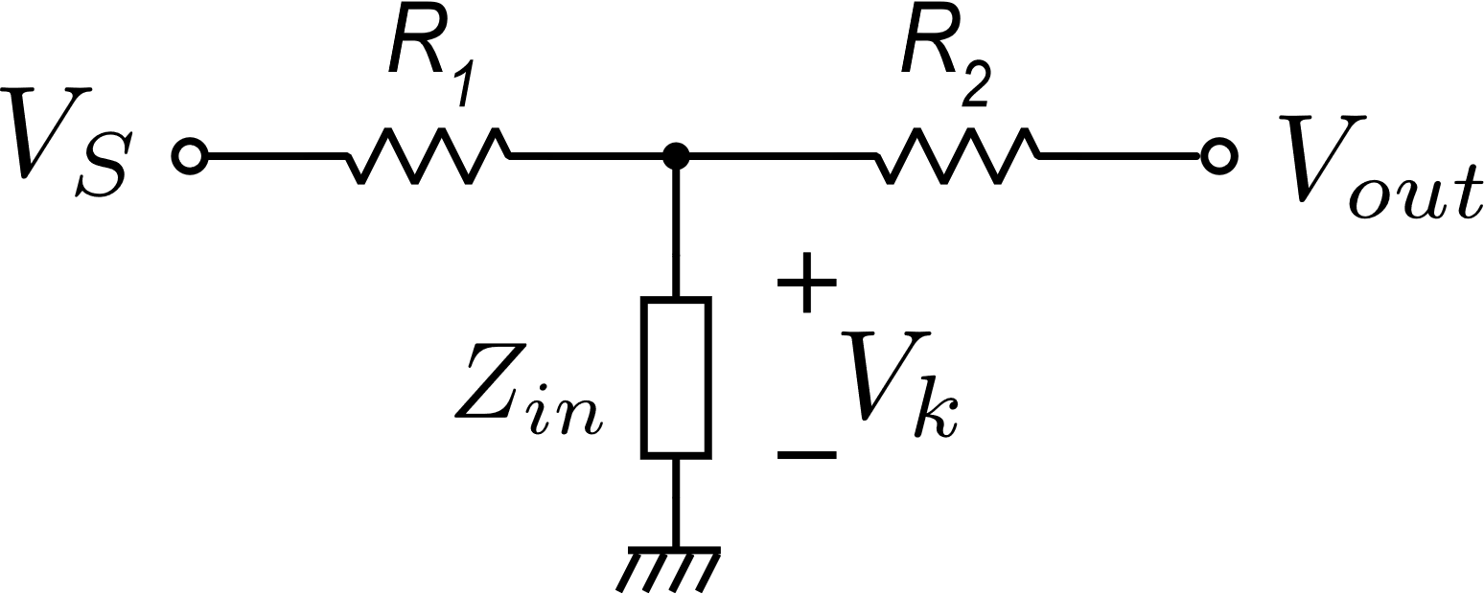
Design of the feedback network
β
α

Slide 23
Real transfer function by means of the cut-inserion theorem

Slide 24
Cut insertion theorem with modified definition of α
If AMP communicates with the feedback network only through the input and output ports (no intermediate signal paths) ......
A new definition of α and β (renamed α* and β*)
and:

Slide 25
Cut insertion theorem with modified definition of α
The definition of α* is deeply different from that of α.
Also the definition of β* is different from that of β. but the two values coincides in most practical cases.
Now γ is divided by the loop gain βA
α* and β* are very similar to α_{N} and β_{N} that are the functions for which we design the feedback network
We will show that this ratio is equal to the ideal transfer function

