Slide 1
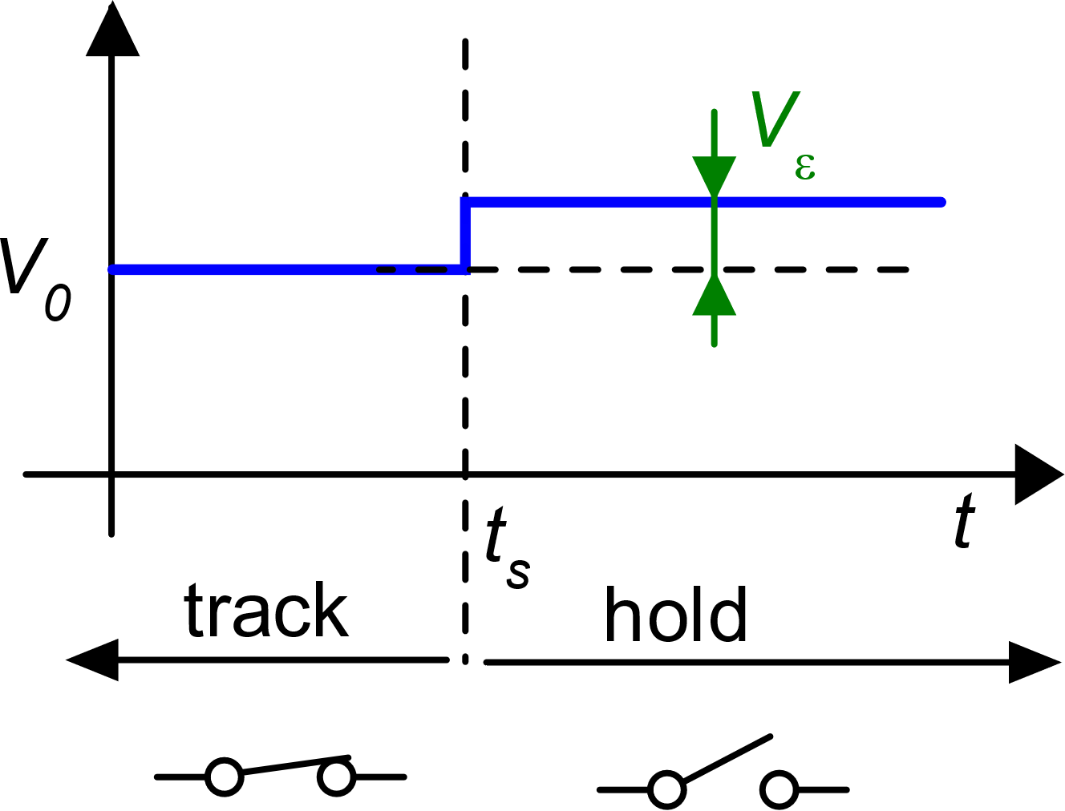
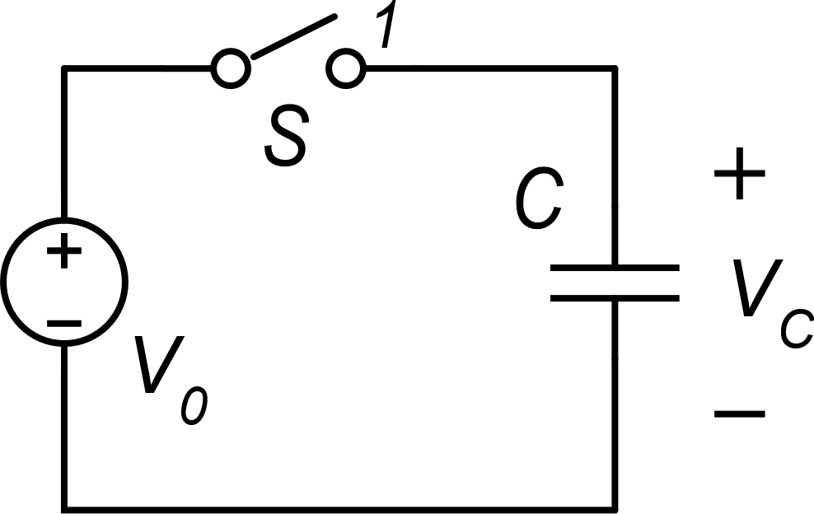
General considerations on switched capacitor (SC) circuits
Sampling of a voltage on a capacitor: errors
kT/C noise
Charge injection
Vε is present even if the switch is perfectly ideal
The kT/C noise
What is the origin of Vε ?
Phase 1: track
Phase 2: hold

Slide 2
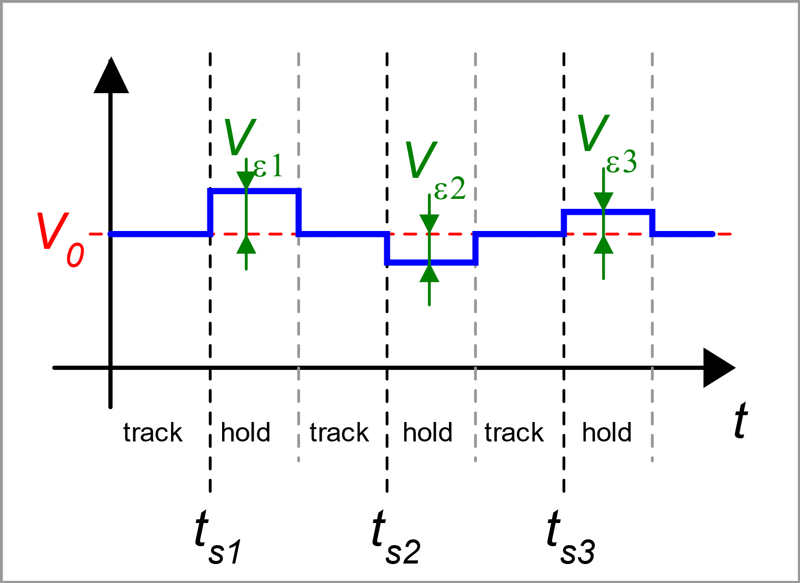
Random nature of Vε
Repeating the sampling operation several time, the error is everytime different both in terms of magnitude and sign: it is a random process
Its mean square value is determined only by:
capacitor value
temperature

Slide 3
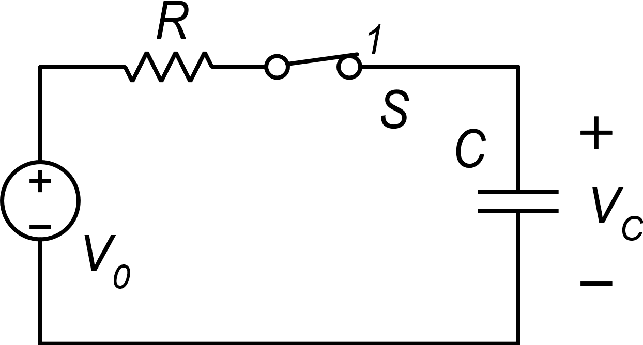
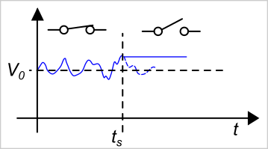
Origin of the kT/C noise
Let us add a series resistance
This is the kT/C noise!
Now it is clearer: voltage V_{C} was already fluctuating due to the noise of the resistor and we simply sample V₀ together with the noise sampled at t_{S}

Slide 4
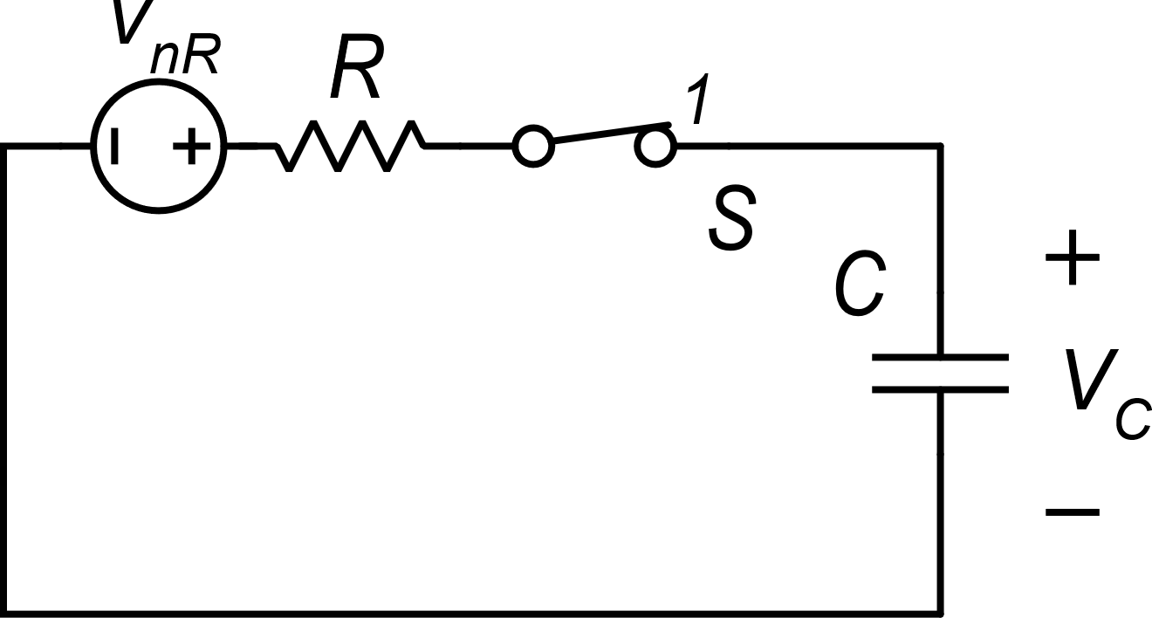
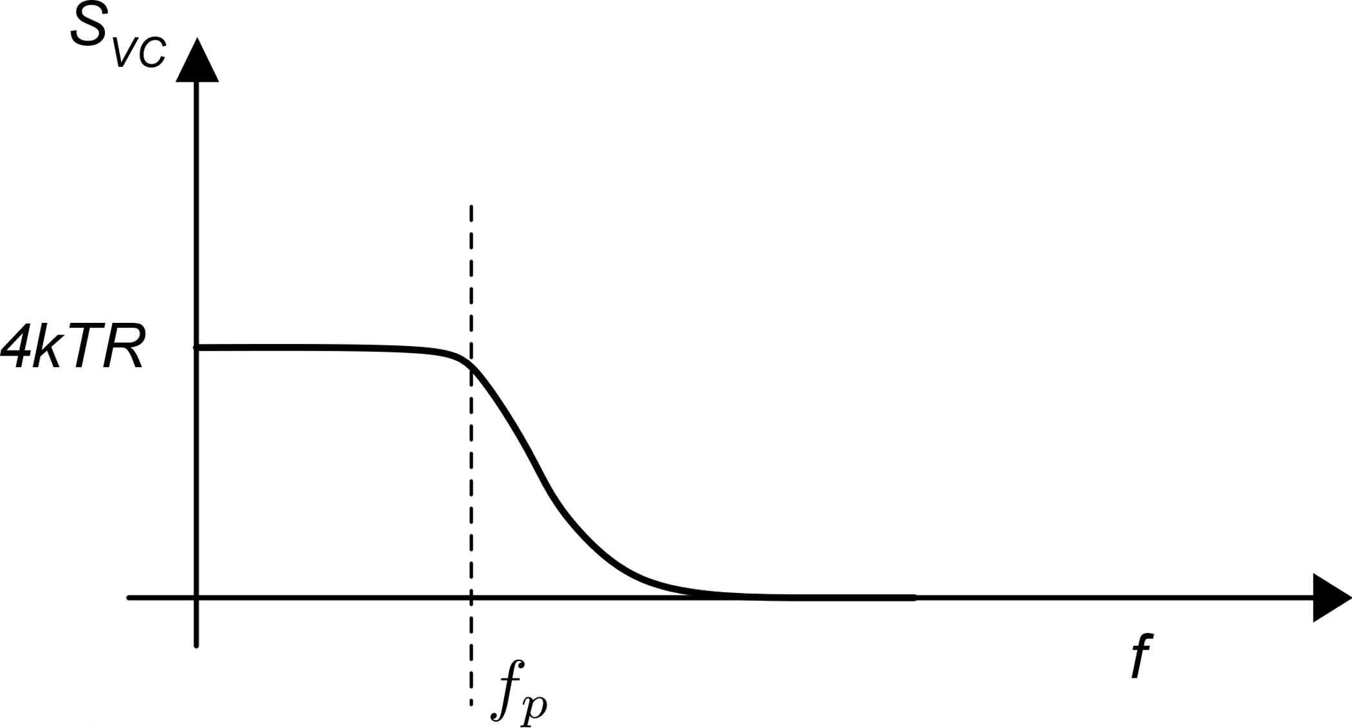
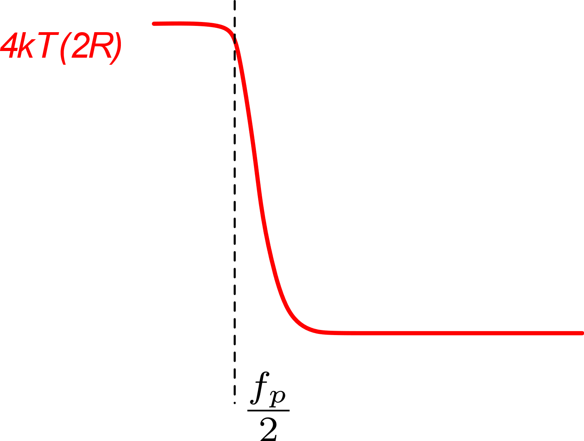
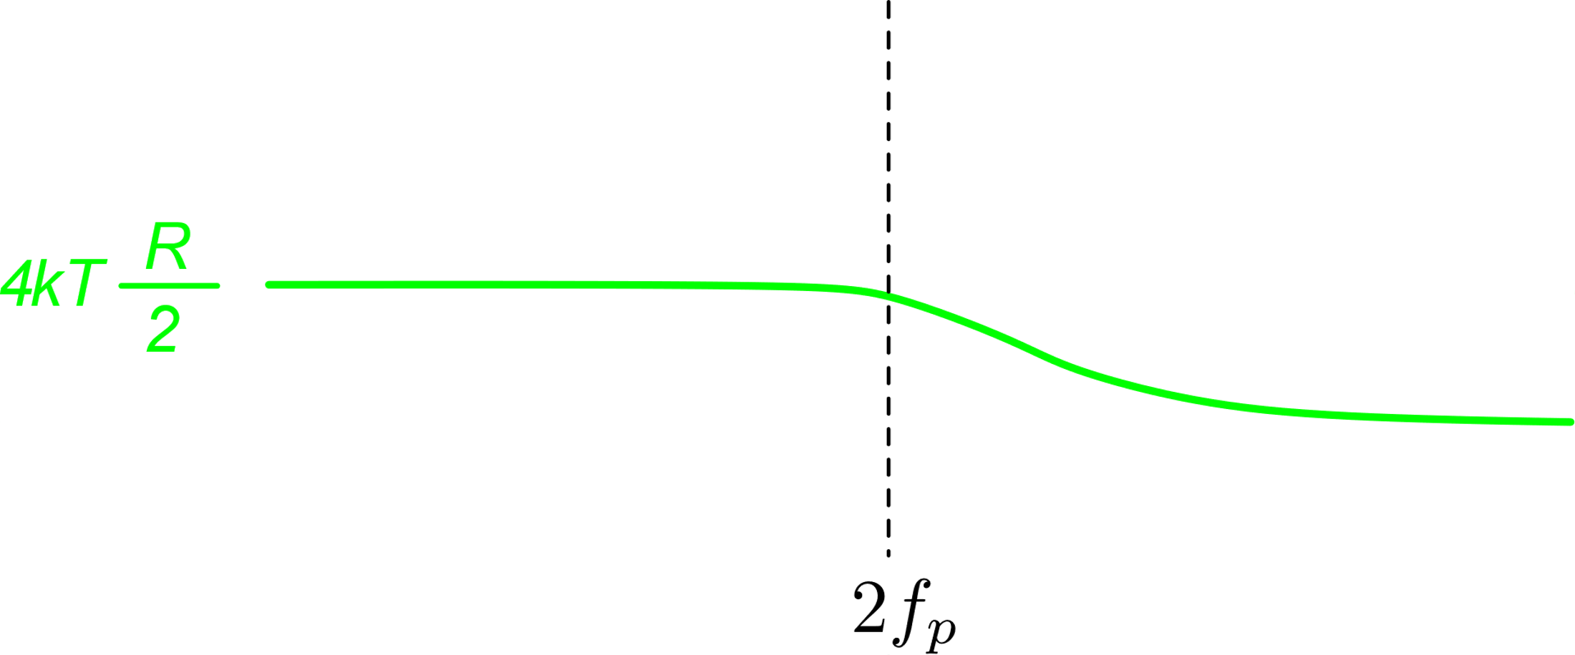
Origin of the kT/C noise
R-> 2R
R-> R/2
The ideal case (R=0) represents a limit where 4kTR tends to zero and f_{p} tends to infinity: the integral is still the same

Slide 5
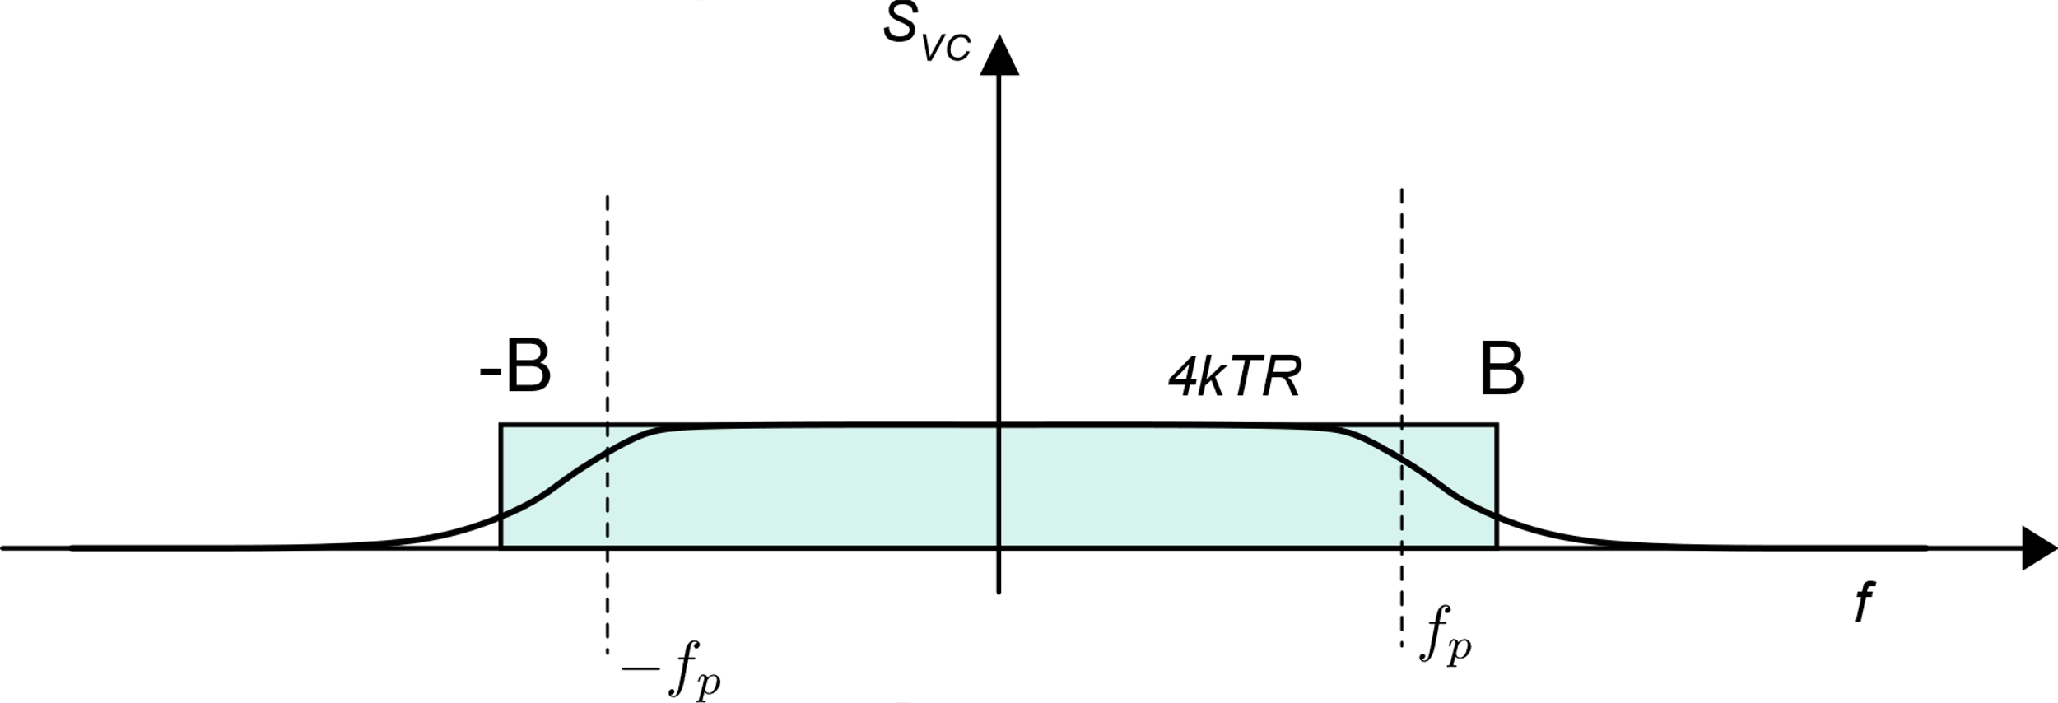
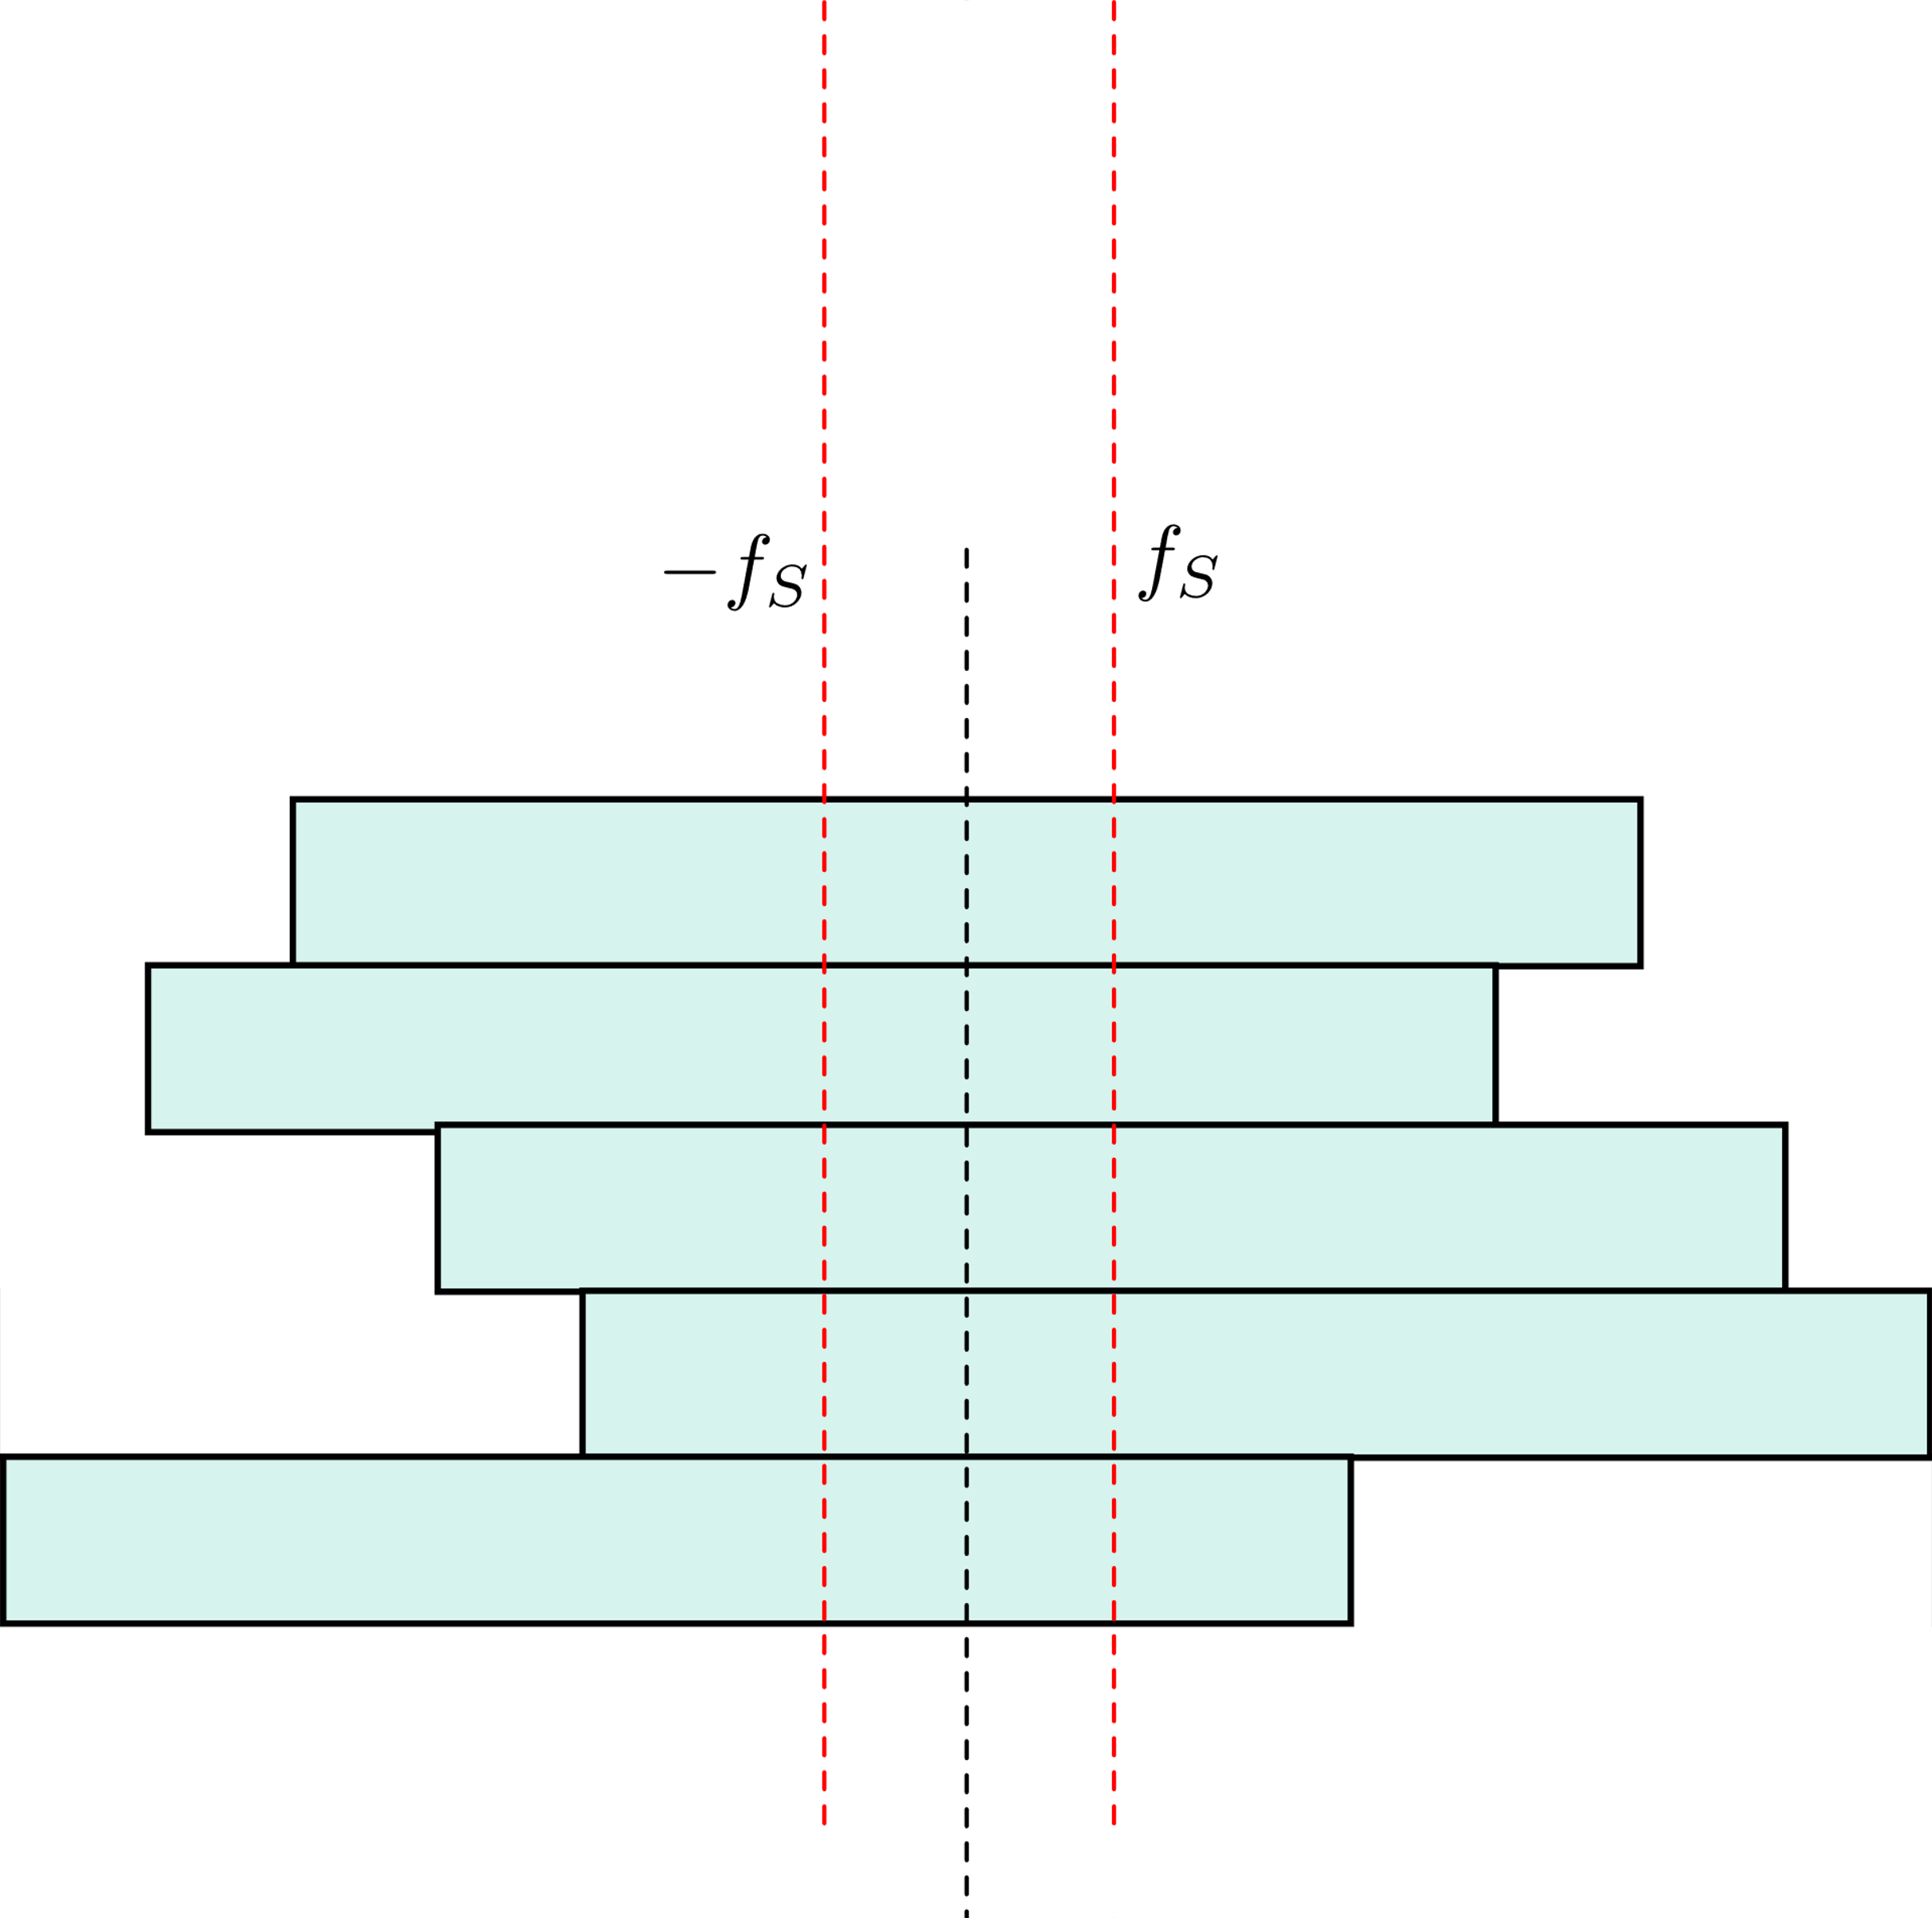
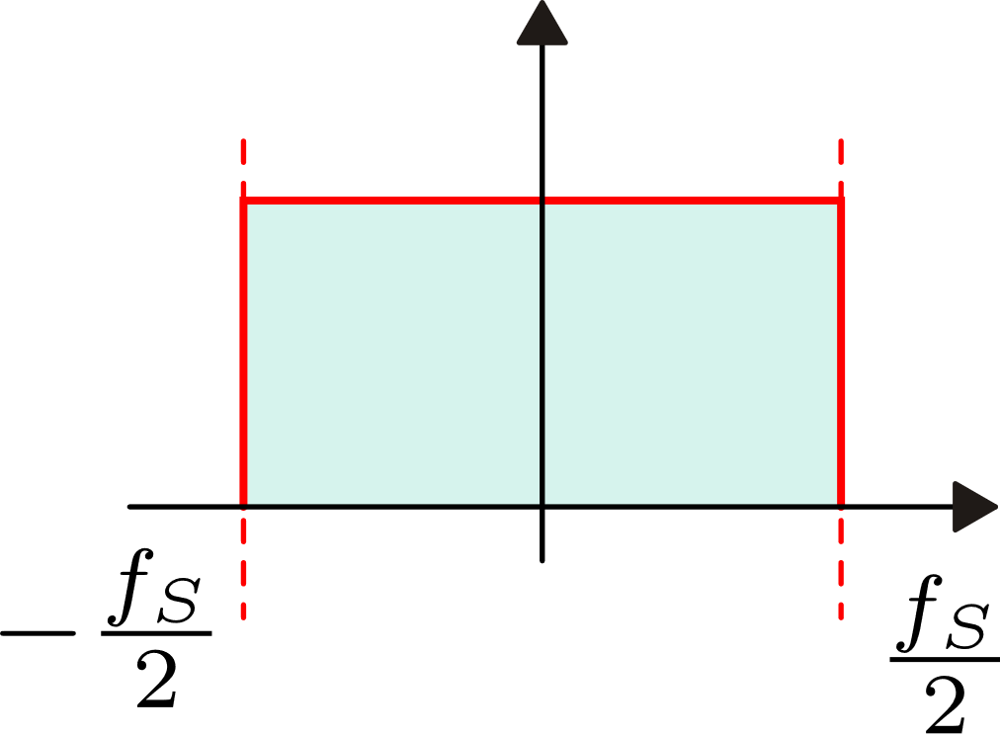
kT/C noise as a result of continuous time noise sampling
Two-sided spectral density of voltage V_{C}
The green rectangle is a simplified representation of the PSD
Effect of sampling and aliasing
For the integral (i.e. mean square voltage of V_{C}) to be the same B must be the effective noise BW:

Slide 6
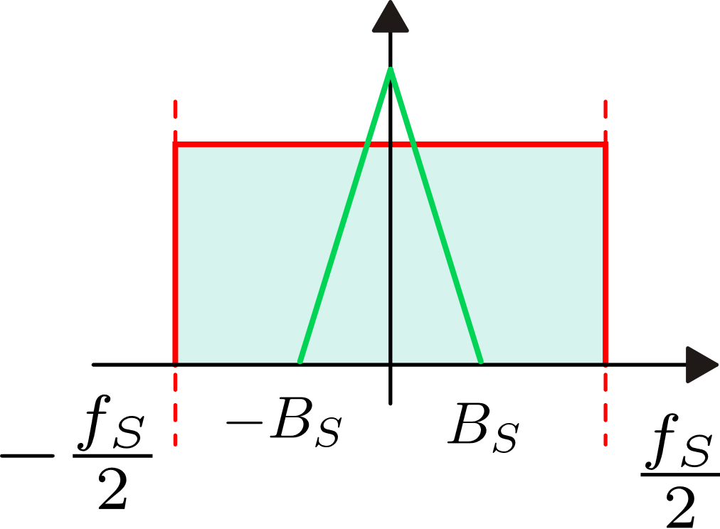
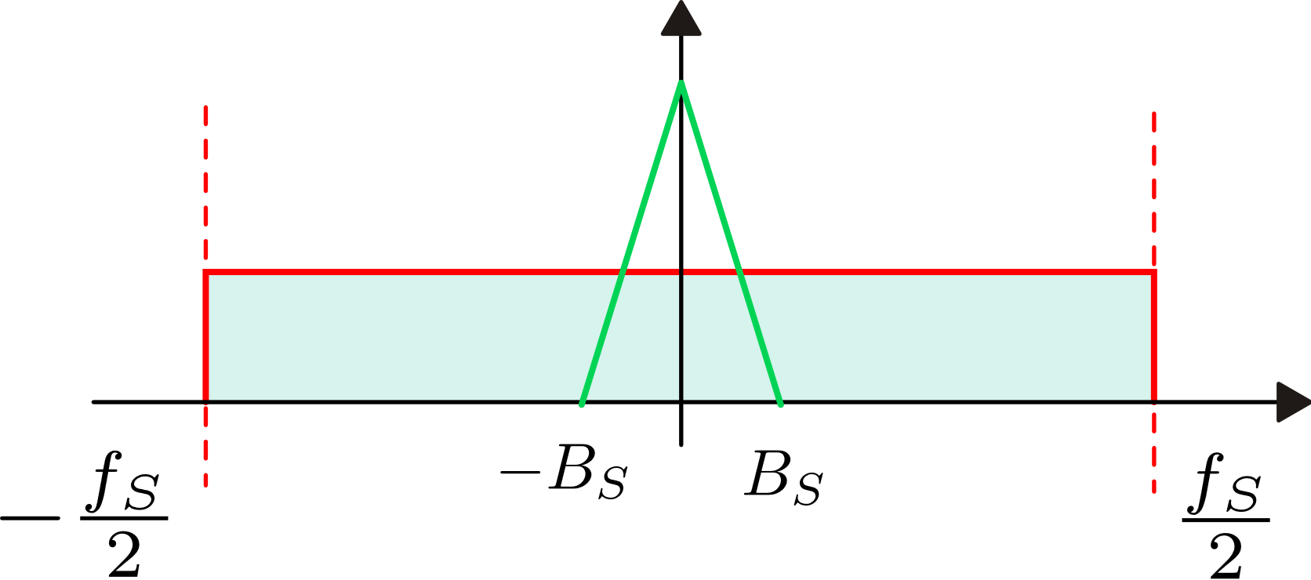
Changing the sampling frequency
The integral of the kT/C noise PSD is
equal to kT/C, independently of the
sampling frequency
Increasing the sampling frequency,
the PSD is reduced proportionally to maintain
the integral constant
In this way, filtering the output sequence in
the discrete time domain (either by digital
or analog processing), we get less noise in
the signal bandwidth

Slide 7
kT/C noise in summary
kT/C noise is always present when we sample a voltage on a capacitor. The mean-square voltage of the samples is equal to kT/C and is independent on the series resistances of the switch, voltage source and capacitor.
The result of sampling with a uniform sampling period produces a discrete time sequence affected by kT/C noise.
If the sampling frequency f_{S} is >> f_{p}, then the PSD of the kT/C noise is constant over the DT-frequency interval -f_{S}/2, f_{S}/2.
Sometimes it is convenient to refer to the noise in terms of charge accumulated into the capacitor. In this case:

Slide 8
The charge injection phenomenon: a systematic error in SC circuits
Differently from the kT/C noise, charge injection is due to switch non-idealities
The n-MOS switch
Presence of overlap capacitance between the switch terminals and the control voltage
In the on-state, there is charge accumulated into the channel (the mobile charge) that have to be drawn from the drain and source where it has to be pushed back when the switch is turned off

Slide 9
Charge injection during the on-to-off transient

Slide 10
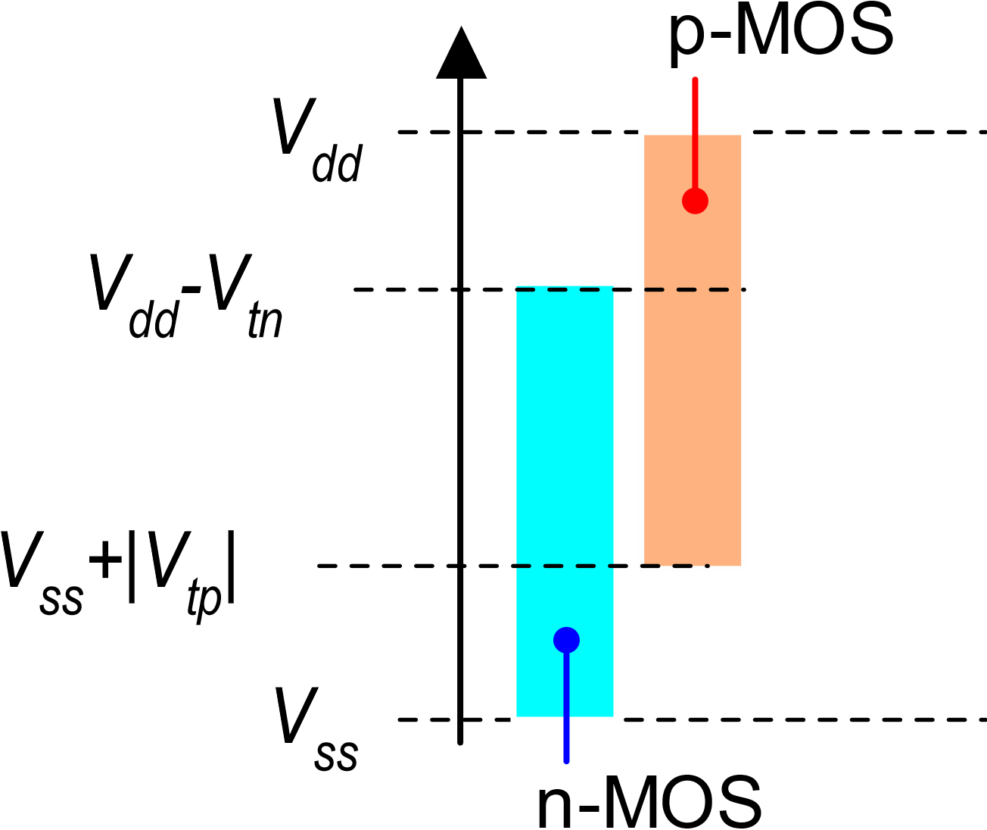
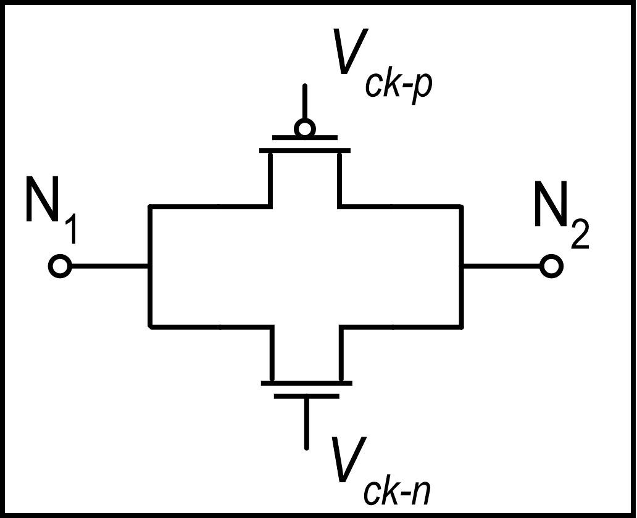
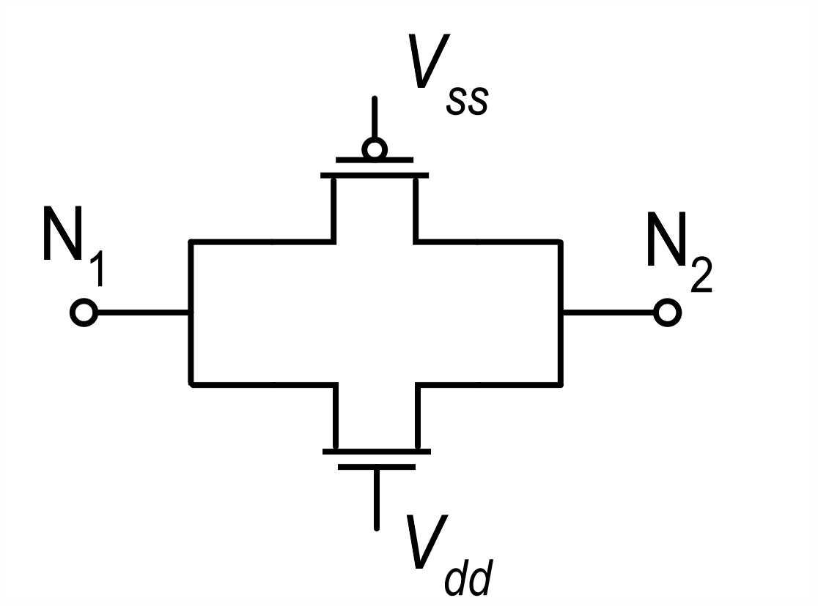
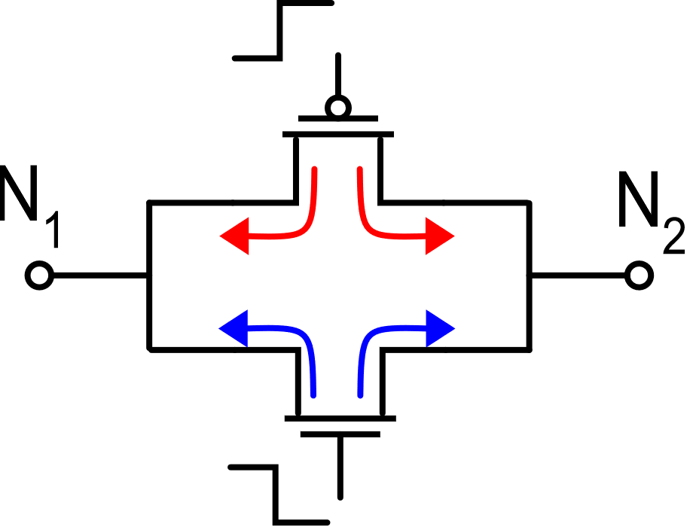
Charge injection in the pass-gate (transmission gate)
on-state
pass gate
Voltage levels that are correctly transmitted by the n-MOS and p-MOS switches in the on-state
Charge injection in the on-to-off transient:
charges are of opposite sign, but compensation is
imperfect since the mobile charge depends on the
V_{GS} and then on voltages at the N₁, N₂ nodes

Slide 11
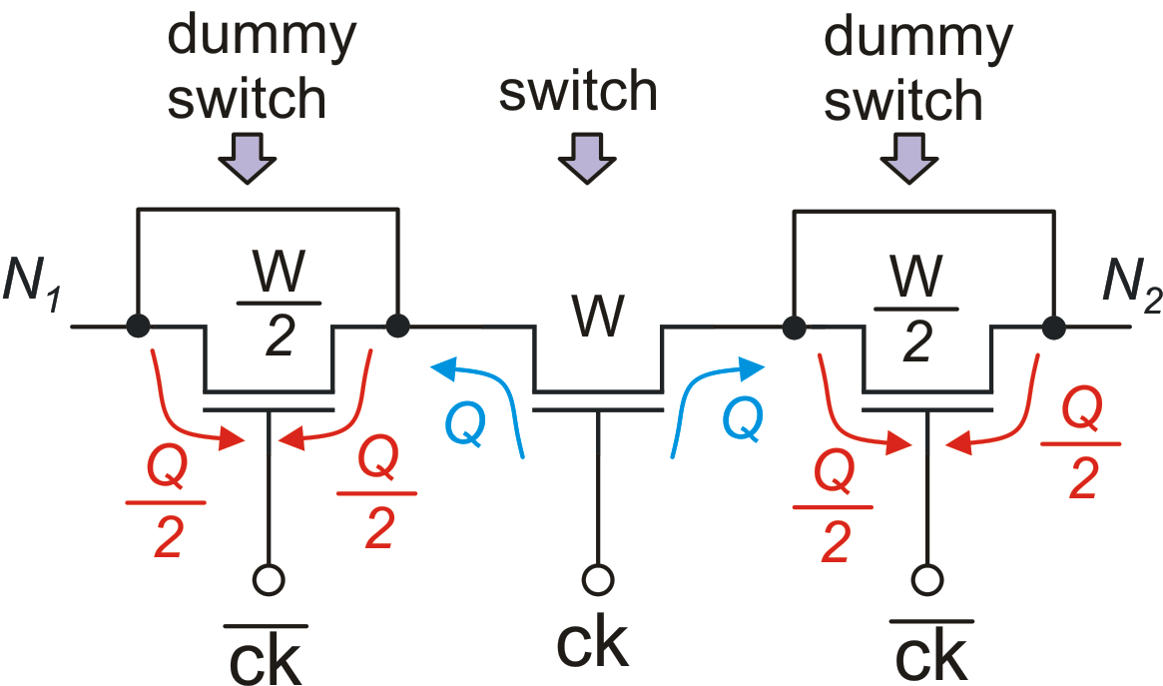
Signal independent charge injection compensation
The dummy-switch does not affect the switching function, since it is short-circuited.
Its injected charge is opposite to that of the main switch because it is driven by the complementary control signal
The dummy switches have the same length of the main switch but they have half the width.
Dummy switches can be applied to both the p-mos and n-mos of a pass-gate

Slide 12
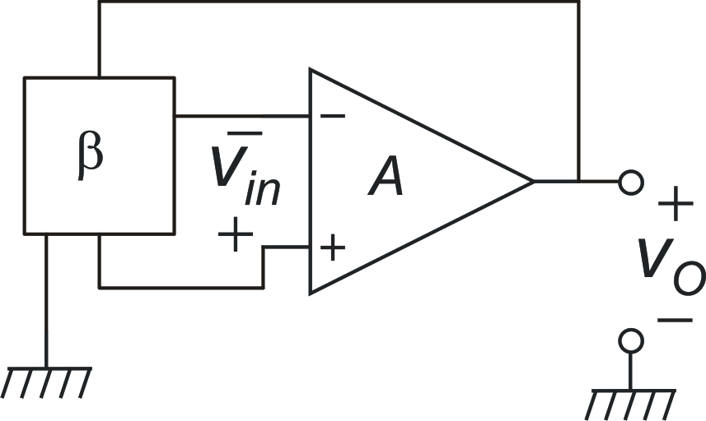
The input voltage of op-amps in the presence of noise

Slide 13
The input voltage of op-amps in the presence of noise
Let us focus on the effect of noise:
The fact that this term can be non-negligibile is the origin of the finite gain error, We will not consider it for now.

Slide 14
The input voltage of op-amps in the presence of noise
At the input of the op-amp we find a low-pass filtered version of the input referred noise
The cut-off frequency of the filter is nearly β₀f₀

Slide 15
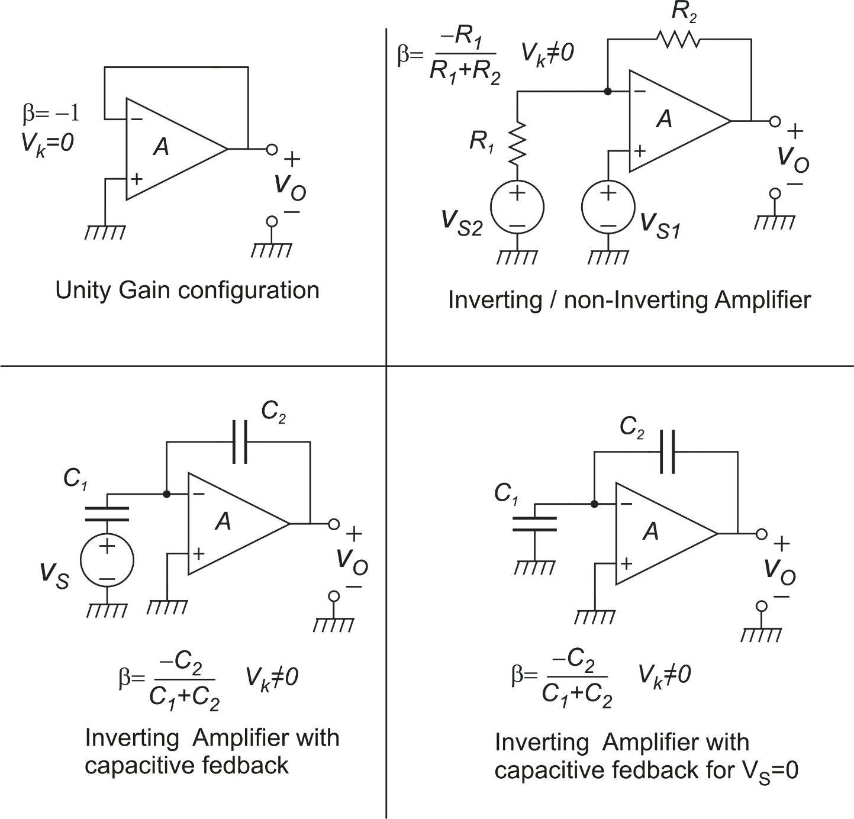
A few examples

Slide 16
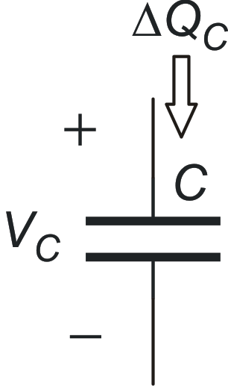
Charges through capacitors: convenctions
Charge that pass through the capacitor from time t_{i} to time t_{f}
i_{c}(t)

Slide 17
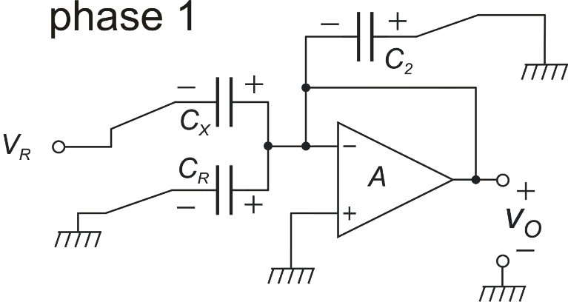
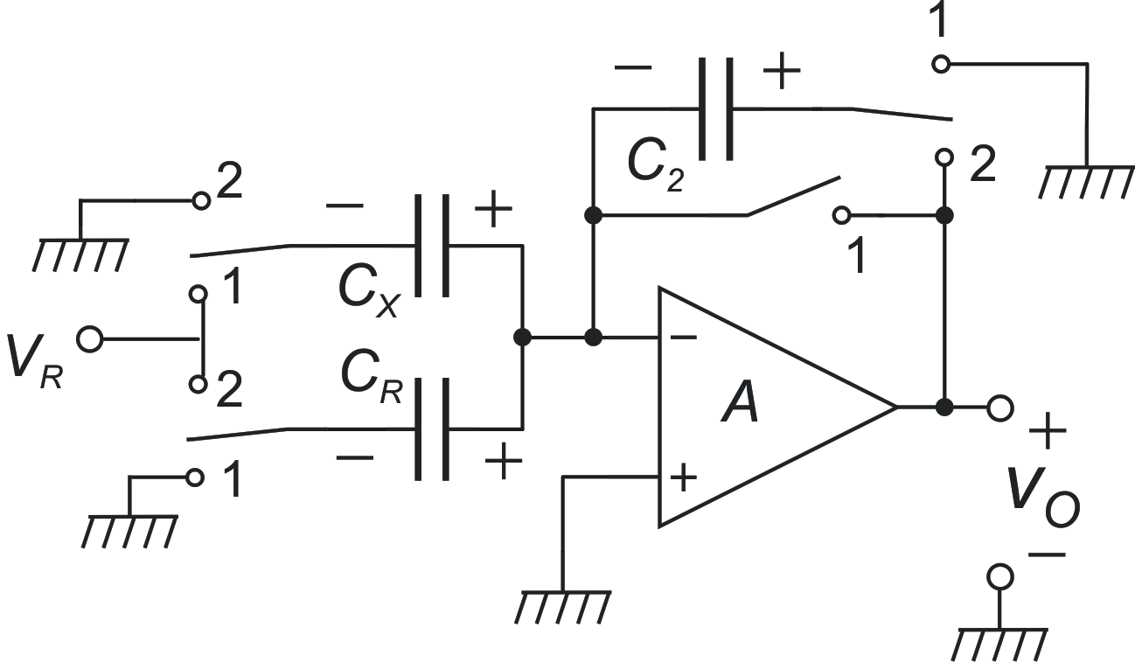
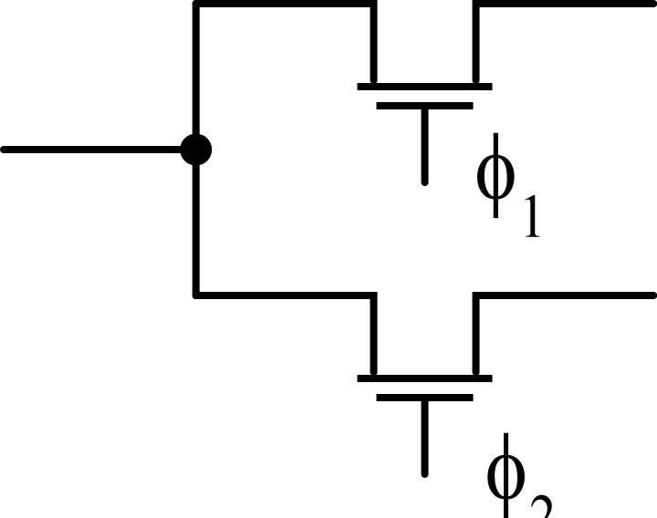
SC interface for capacitive sensors
possible implementation

Slide 18
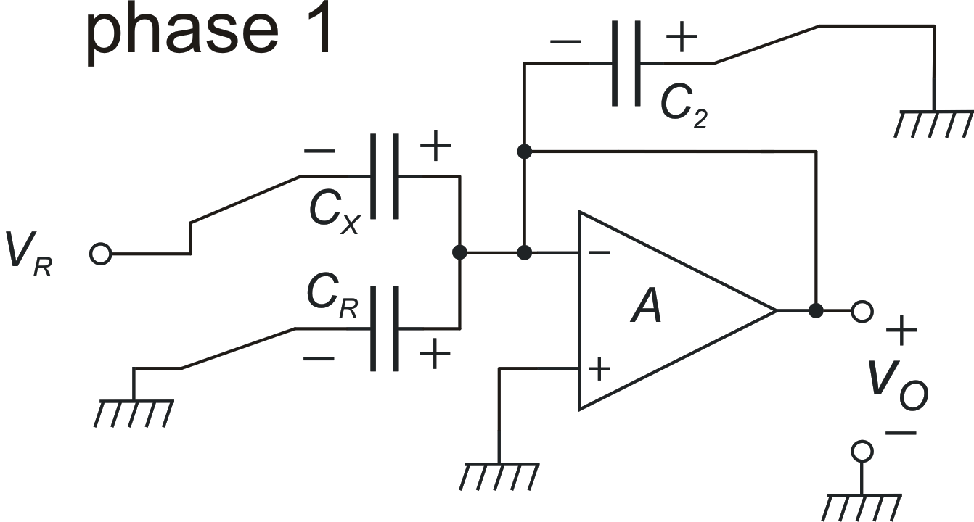
Phase 1: Capacitor voltages
+
−

Slide 19
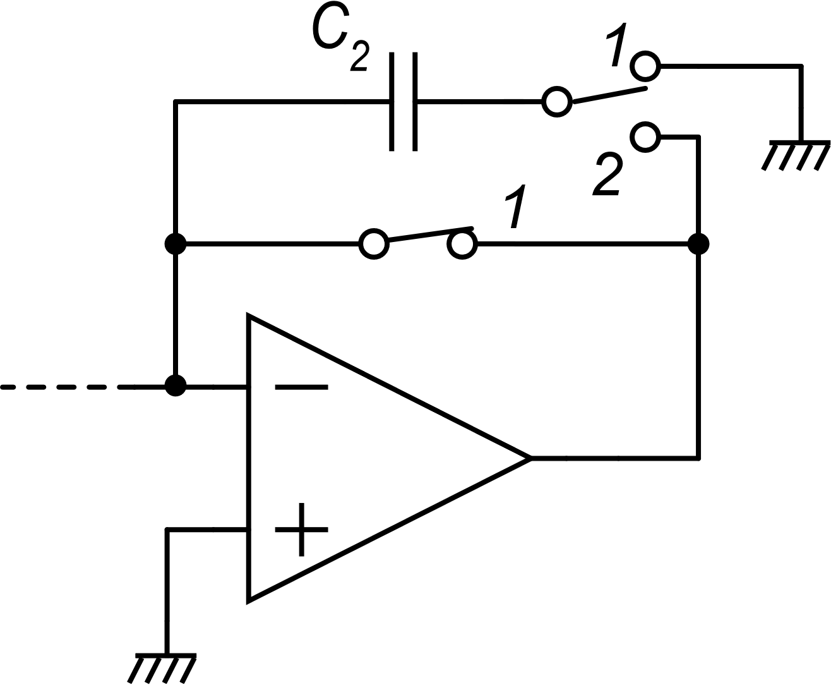
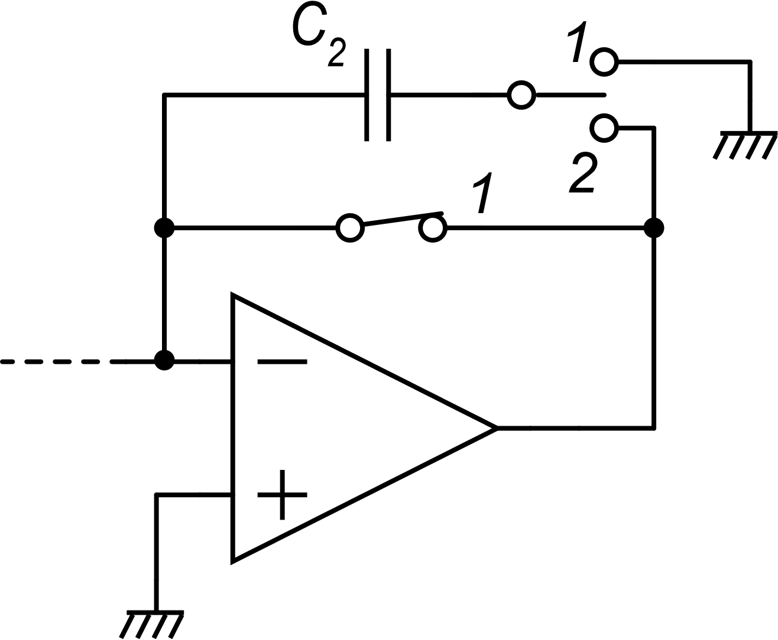
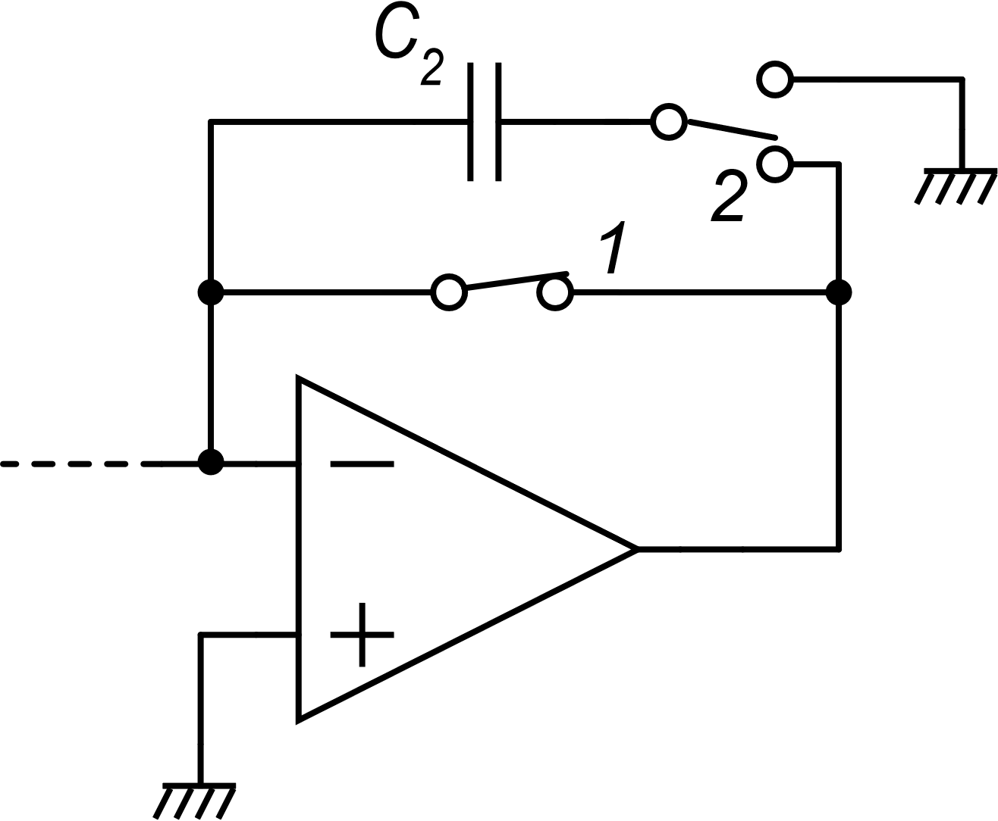
Transition to phase 2
In SC circuits, timing of the switches is critical, due to the risk to alter the charge stored into the capacitors
If S₁ is still closed in the previous position (phase 1), when S₂ closes to phase 2 position, C₂ is short circuited
S₂ opens and
C₂ samples
S₂
S₁

Slide 20
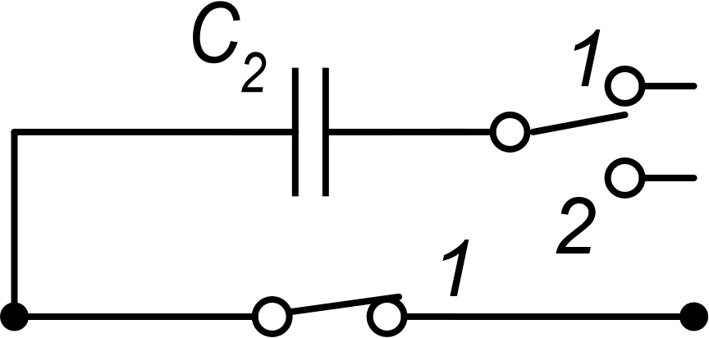
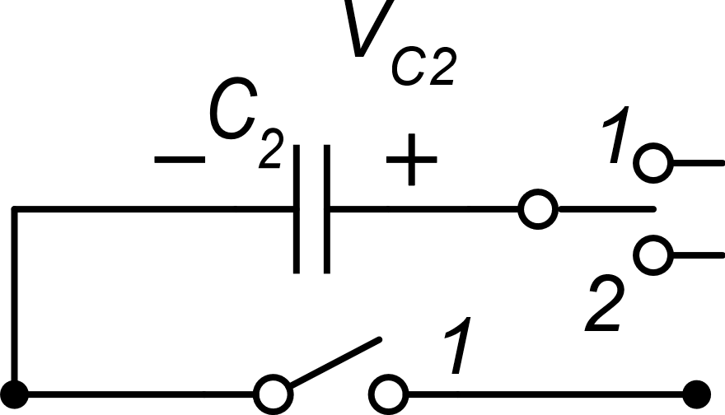
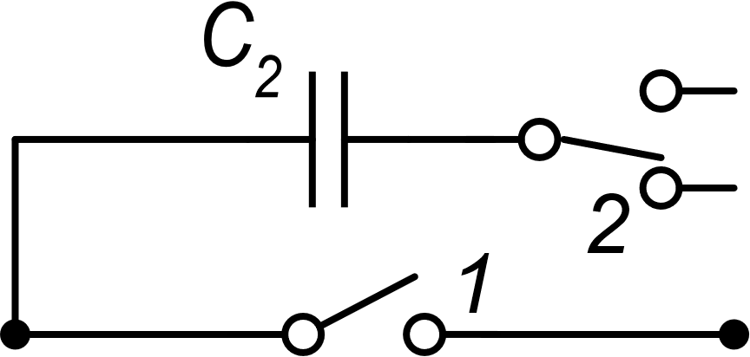
The intermediate phase "i"
In order to avoid the occurrence of unwanted temporary short-circuits the transition from phase 1 to phase 2 occurs according the following steps:
Switches are closed
in position 1
phase 1
All switches opens
(capacitors sample their voltages)
phase "i"
kT/C noise
Switches close
in position 2
phase 2

Slide 21
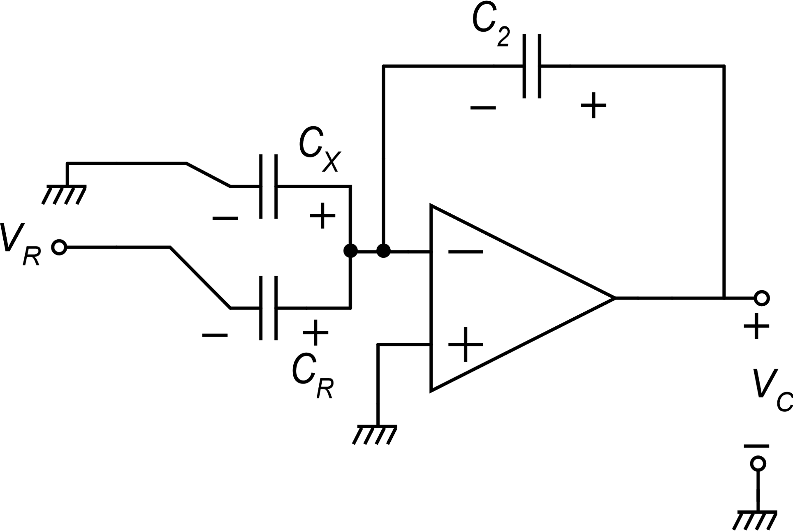
Phase 1 to phase 2 transition
ΔQ_{X}
ΔQ₂
ΔQ_{R}

Slide 22
Phase 2 voltages

Slide 23
Phase 2 output voltage

Slide 24
Output voltage components
useful signal
sensitivity: $\frac{V_{R}}{C_{2}}$
Amplifier noise (CDS)
kT/C noise
Referred to the input diff. capacitance

Slide 25
Example: DR of the SC interface considering only kT/C noise

Slide 26
Example: DR of the SC interface considering only kT/C noise
rms value of the kT/C noise associated to ΔC_{FS}

