Slide 1
Low frequency disturbances: offset and flicker noise
The offset strongly affects the accuracy of most sensor interfaces and their detection limit
When the quantity estimation require integration operations, such as dead reckoning (position from acceleration or speed), the offset result in a drift of the final quantity.
The flicker noise, with its power accumulation at low frequency, make the problem worse, reducing resolution.

Slide 2
State of art of amplifier offset
The best amplifiers use BJTs and resistor trimming, to achieve offsets as low as 15 μV with 0.1 μV/°C drift (typical) and low frequency noise < 0.5 μV pp in the 0.1-10 Hz frequency band.
Often this is not sufficient: for a thermocouple temperature sensor, a 10 μV input offset voltage results into an error of the order of 0.2 °C.
It is obtained with very large area and a non-CMOS technology, resulting non suitable for modern SoCs.
Trimming of the individual amplifiers is required

Slide 3
Dynamic techniques for the offset and noise flicker reduction
Three main techniques
Auto-zero (AZ)
Correlated Double Sampling (CDS)
Chopper modulation (CHS = Chopper stabilization)
We are interested in understanding the principle of operation, the residual noise spectrum and possible limitations of the various techniques.
The three techniques are not limited to pure electronic circuits, but can in general be applied to other physical systems and, in particular, in a DAS, may involve also the sensor.

Slide 4
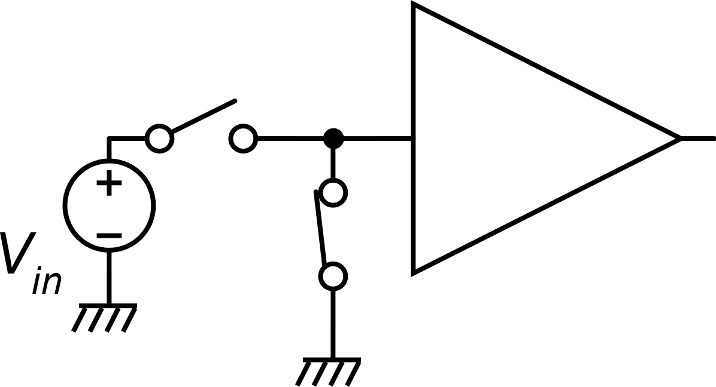
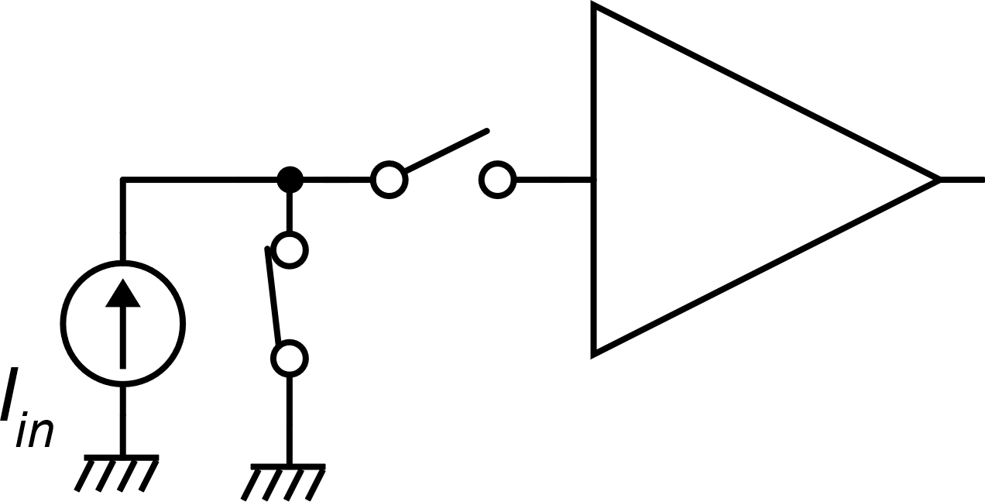
Premise
In all cases, in order to simplify the formalism, we will refer to the case of a voltage amplifier:
where v_{n} includes both the input referred noise and offset voltage.
If we remove the signal from the amplifier input, the output becomes:
Nulling the input
signal in:
Current - input
Voltage - input

Slide 5
Auto – Zero (AZ)
Two phases: AZ and NO (Normal operation)
Principle:
In the AZ phase the signal is removed and the effect of vn (noise/offset) is stored in a memory (typically an analog memory, i.e. a capacitor)
In the NO phase, the signal is connected and the vn value stored in previous phase is subtracted.
Example, for an amplifier with voltage input

Slide 6
Auto-Zero: effective input noise v_{n}
Amplifier output during the AZ phase.
At the end of the AZ phase (instant t_{s}), the
output signal is sampled and stored
Amplifier output during the NO phase

Slide 7
Auto-Zero: phases and signal diagrams
NO
AZ

Slide 8
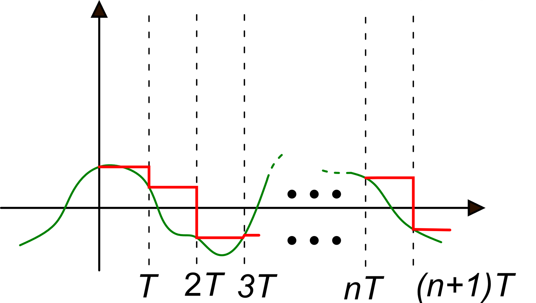
Auto-Zero simplified noise model
We consider that the duration of the AZ phase can be considered zero, then the amplifier is in NO phase during the whole period.
for each clock cycle, t_{S} coincides with the beginning of the cycle
t_{S} instants form a discrete set
(a sequence nT)
v_{n}(t)

Slide 9
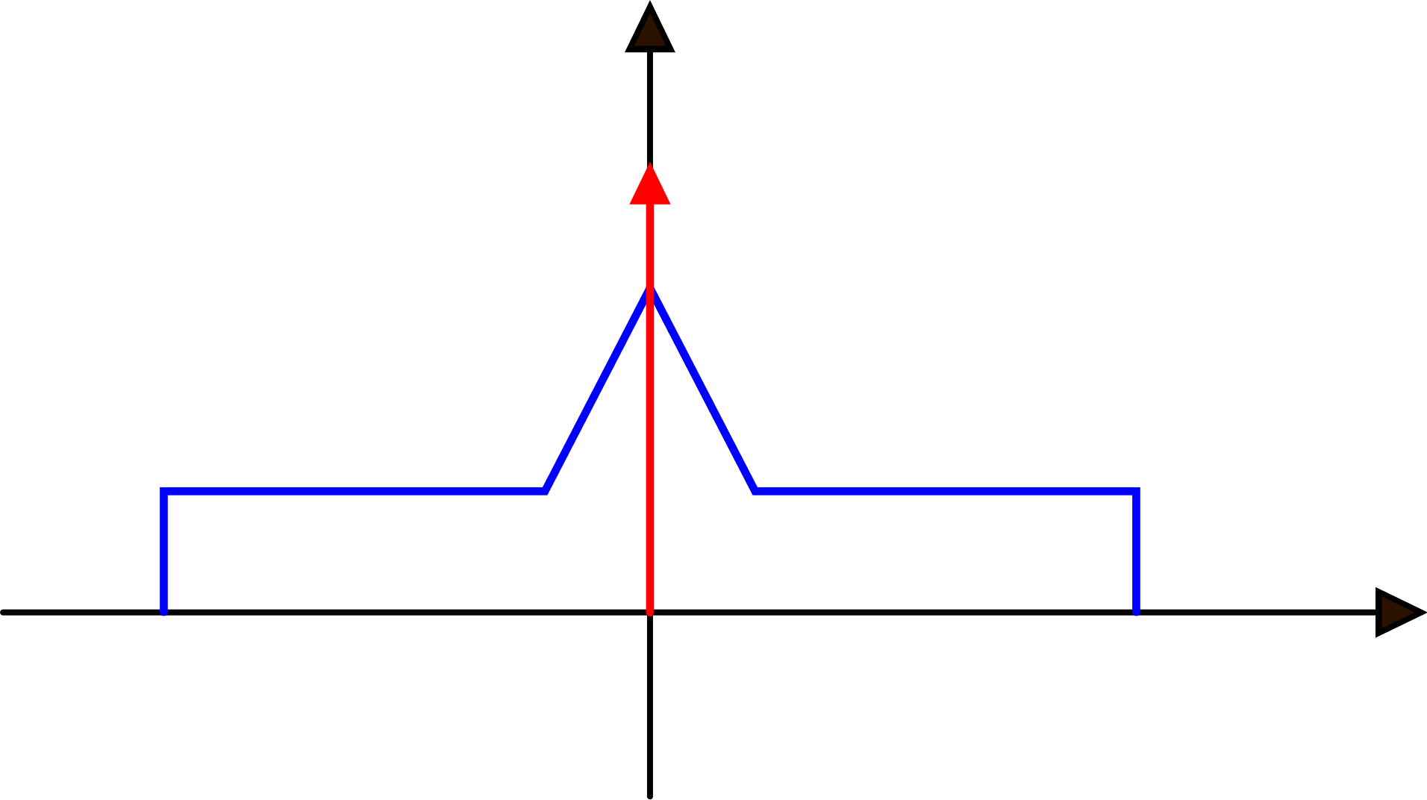
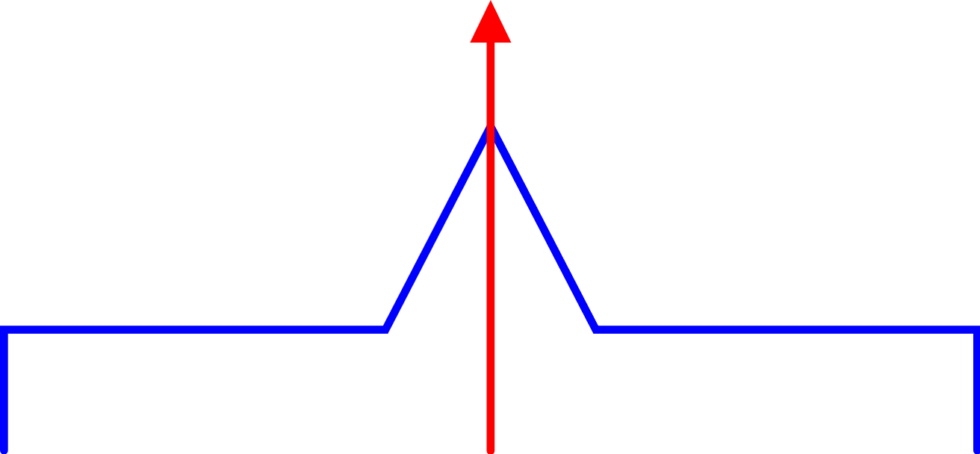
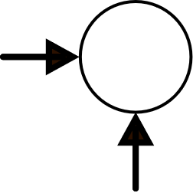
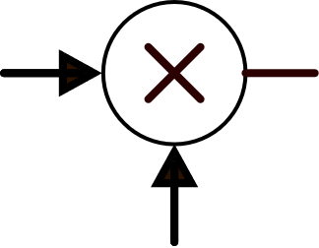

Calculation of the spectrum of the residual noise v_{n-eff}
We consider a single realization of the noise random process
-f_{S}
0
f_{S}
2f_{S}
-2f_{S}
V_{n}(f)
Fourier Transform
+
−

Slide 10
Calculation of the spectrum of the residual noise v_{n-eff}
H₀(f)
H₁(f)

Slide 11
Calculation of the spectrum of the residual noise v_{n-eff}
Now, remember that this transformation is applied to the rendom process v_{n}(t) with spectral density S_{vn}(f):

Slide 12
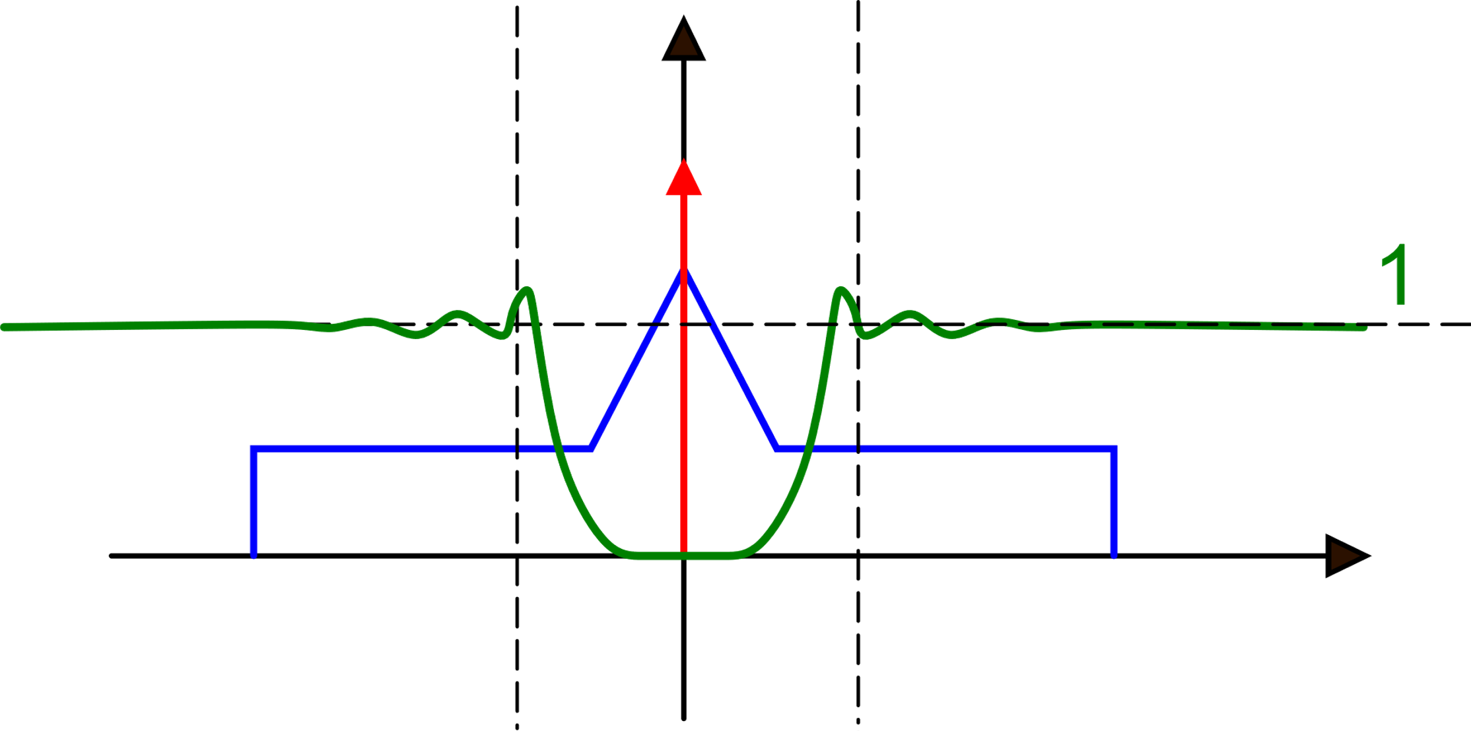
Calculation of the spectrum of the residual noise v_{n-eff}
-f_{S}
f_{S}
|H₀(f)|²
The 0-th replica is weighted by H₀(f):
The offset is cancelled
The flicker noise is strongly reduced
For f>>fck (f_{S})the spectrom is nearly unchanged

Slide 13
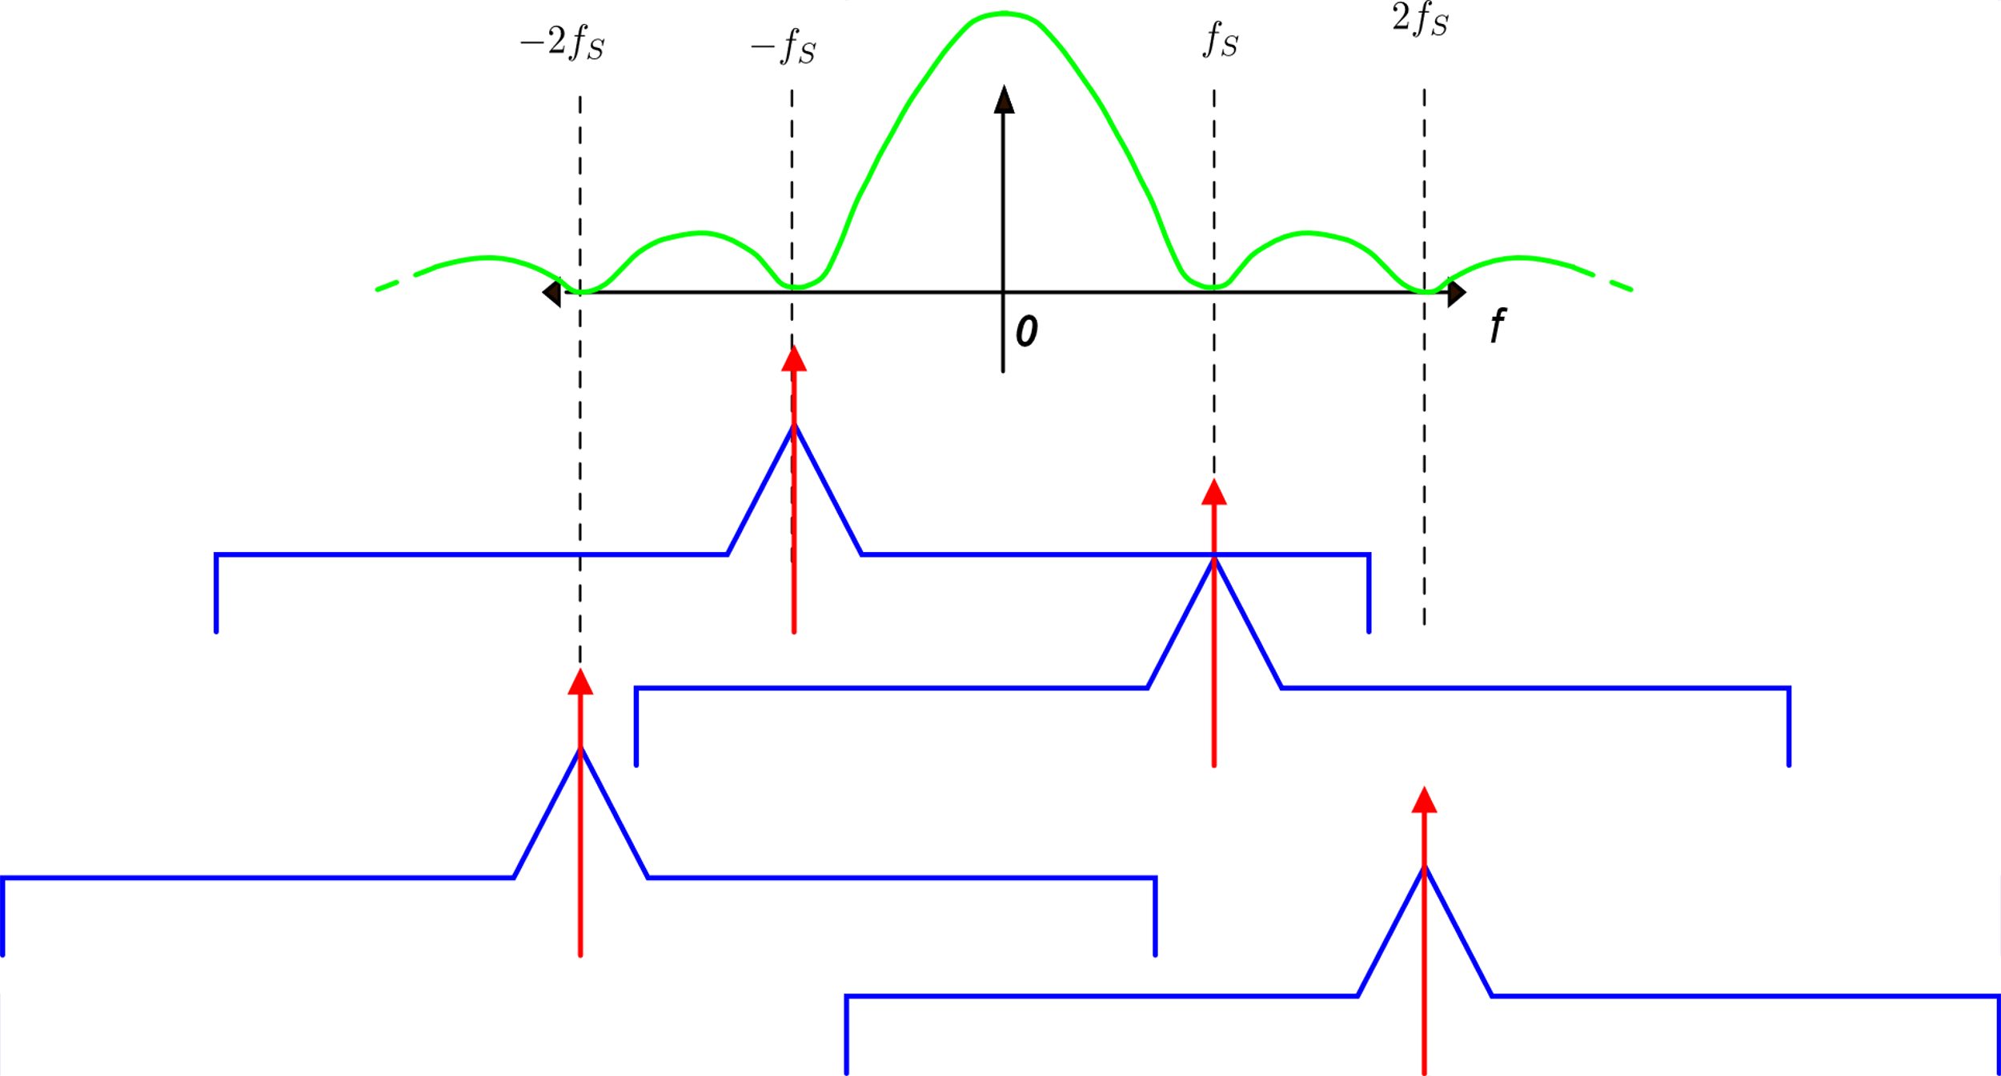
Contribution of replicas other than 0-th one
for f>>fck: large attenuation
For f<f_{ck} (f_{S}), several contribution equal to S_{VBB} are added together. For f<<f_{ck} the sinc leaves the sum unchanged
The offset delta functions and the flicker regions of each replica fall over one of the zeros (at f_{ck}) of the sinc and are deleted or strongly reduced

Slide 14
In Summary:
Contribution of replicas different from 0-th
for f<<fck

Slide 15
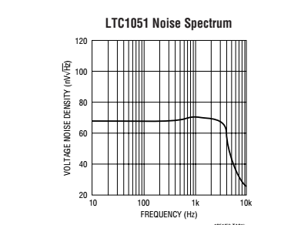
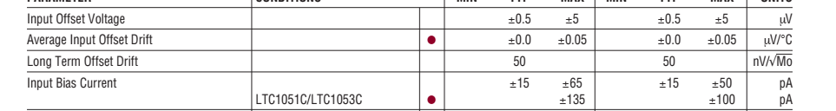
Example: LTC 1051, a commercial auto-zero operational amplifier

Slide 16
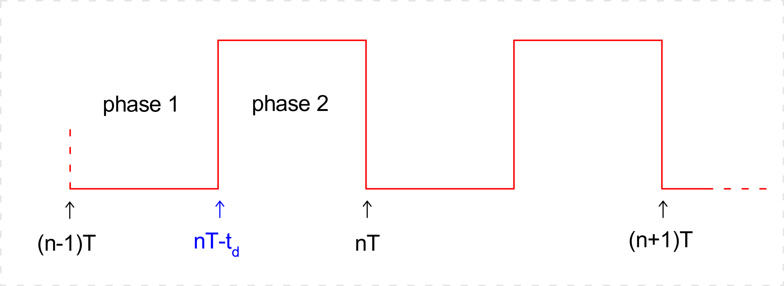
Correlated Double Sampling (CDS)
CDS is a sampled data approach. Both the signal and the noise are discrete-time signals.
It involves two clock phases: phase 1 and phase 2
at nT-t_{D} the signal is removed
and the noise/offset is sampled
at nT the signal is sampled
(together with noise/offset )

Slide 17
Correlated Double Sampling
The output voltage at instant NT of the system that adopts the
CDS technique is the difference between the two samples:
Differently from the autozero, also the signal is sampled.
Then, all limitation coming from the Shannon theorem applies
We have the subtraction of two samples (hence "Double Sampling").
If the sample are similar ("Correlated") they cancel each other effectively

Slide 18
CDS: effective noise
Generally t_{D}=T/2, thus:
The operation applied to the noise involve sampled data and should be analyzed using the typical approaches of this domain, such as the
Z-transform.
Problem: not all samples are sampled at instants that are multiple of T

Slide 19
CDS: effective noise
It is then preferred to use a mixed continuous-time / discrete-time approach, that does not represent the actual operations but that gives the same final result.
CT
DT
nT
nT
Sampling at intervals nT
we obtain the CDS effective
noise
Equivalent model of the operations applied to the original noise by the CDS approach.

Slide 20
CDS: effective noise
We are interested in the transfer function from the input of the model to the input of the sampler. In the frequency domain:
H(f)

Slide 21
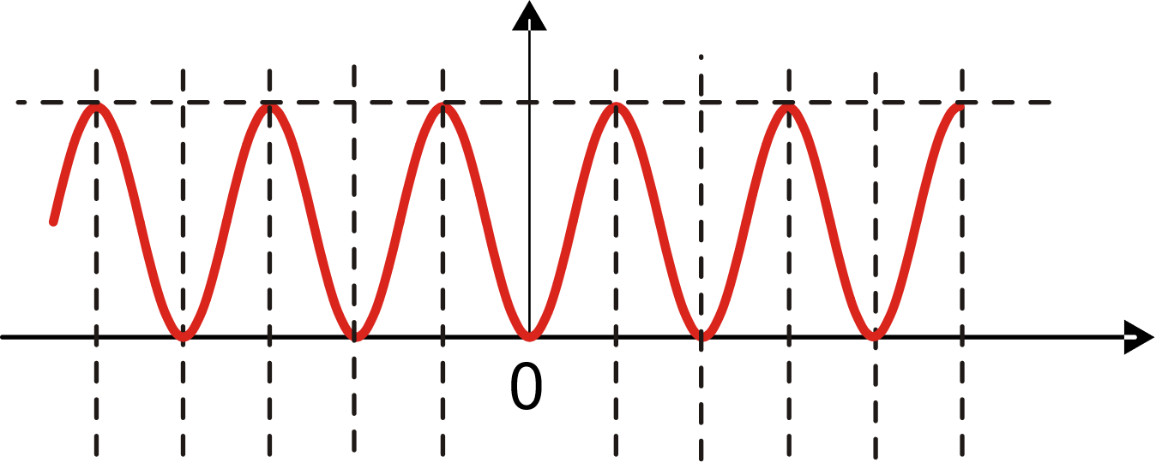
CDS: effective noise
Noise spectral density:
4
f_{ck}
2f_{ck}

Slide 22
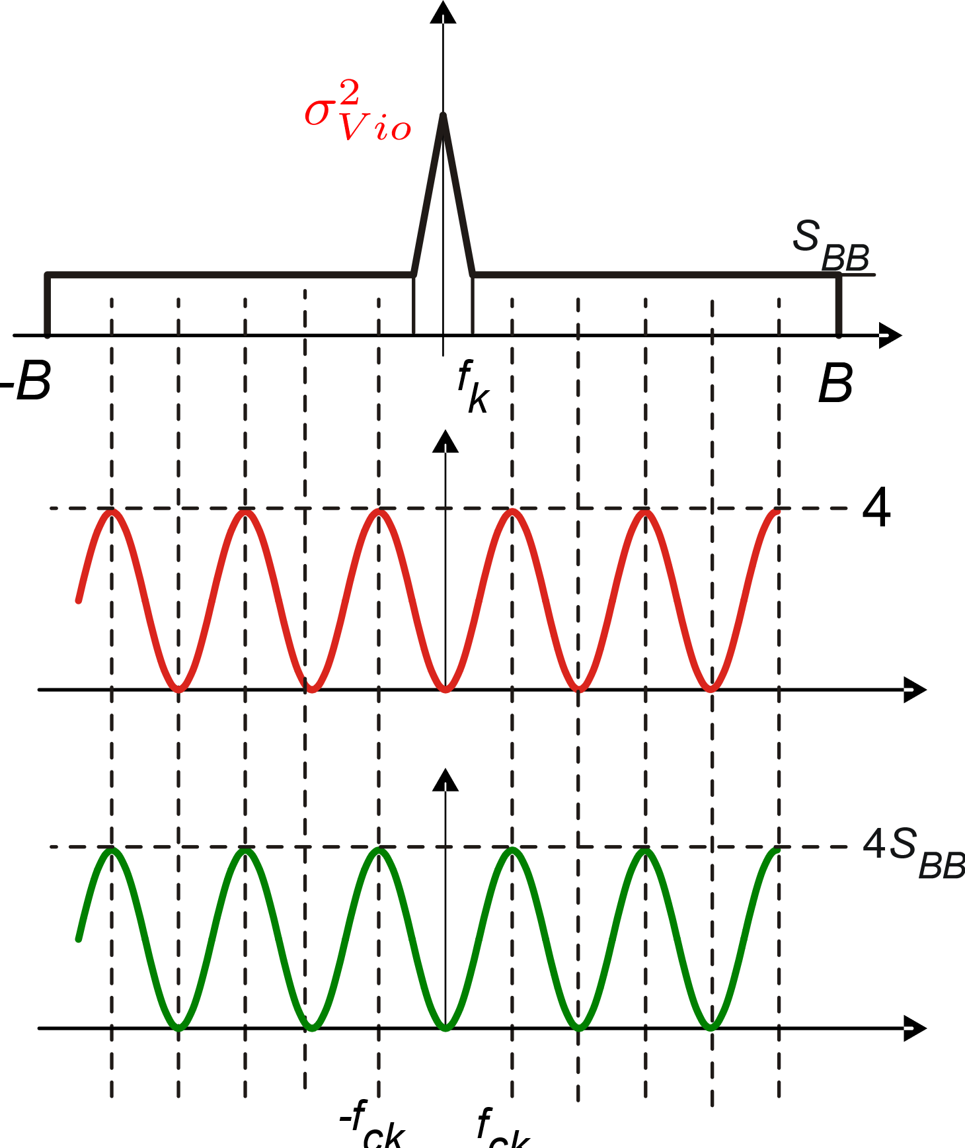
CDS: effective noise
X
=

Slide 23
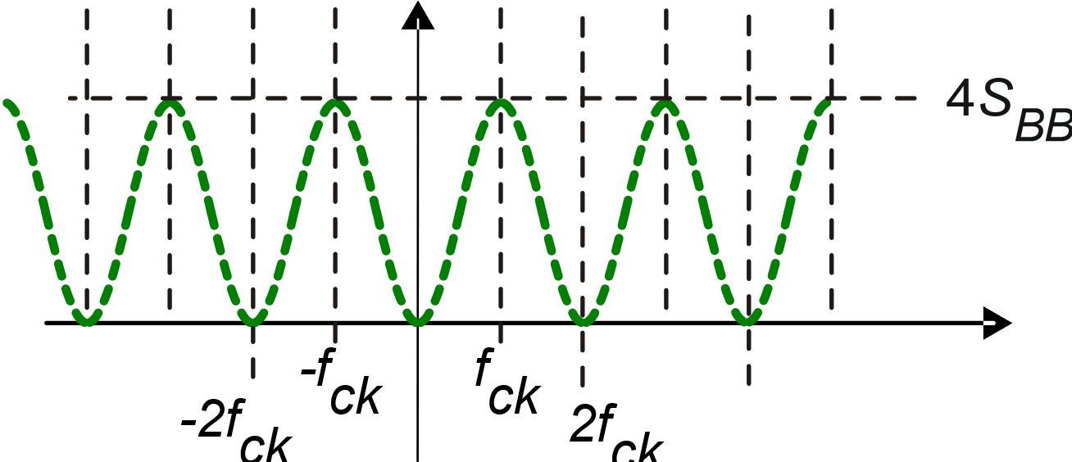
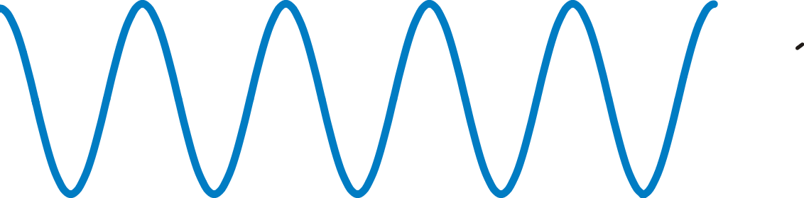

Effect of sampler
f_{ck}
+
2f_{ck}
=1

Slide 24
CDS: Residual noise in the DT frequency domain
odd + even replica
(2k+1)f_{ck}
odd
2kf_{ck}
even
Every two replicas (an odd and an even replica) we have a contribution equal to 4S_{BB}.
Total number of replica pairs:
Total PSD in
the DT domain:
DT domain

Slide 25
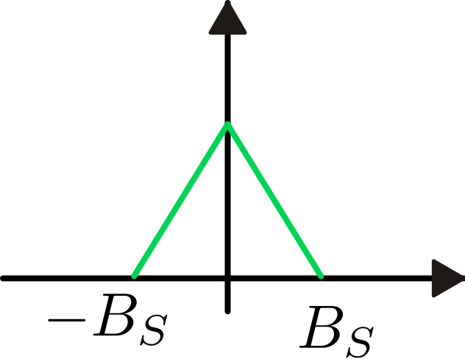
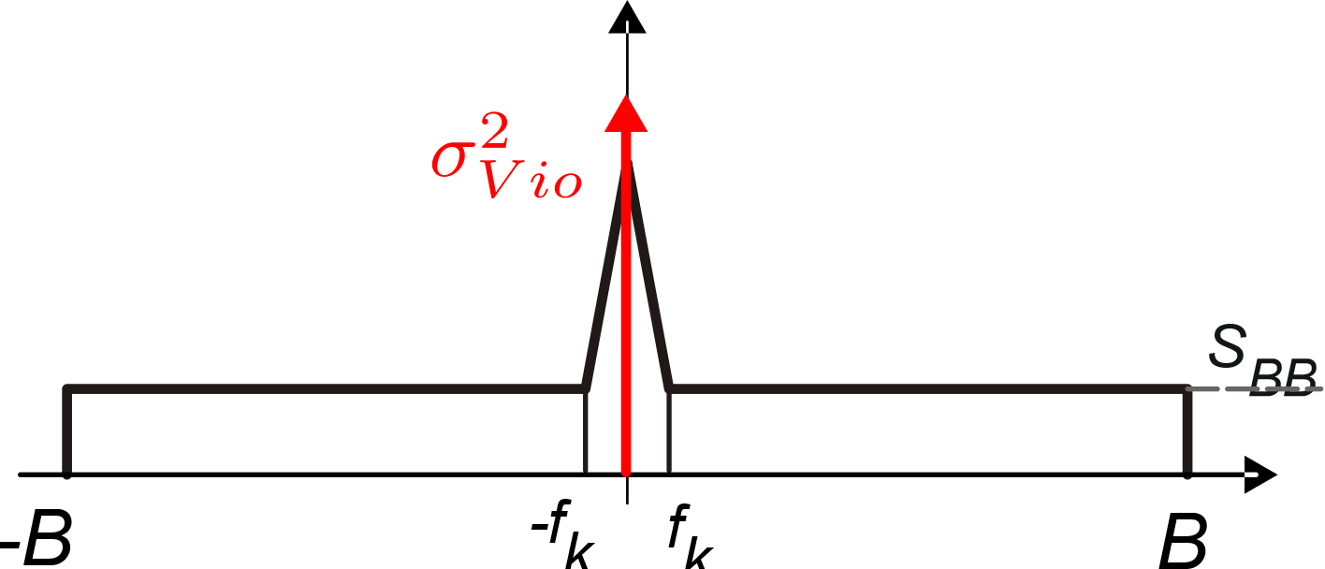
Chopper modulation: a premise.
sinusoidal modulation
signal modulation
f₀
signal demodulation
S_{BB}

Slide 26
Problems of the sinusoidal modulation
Sinusoidal modulation requires a real analog multiplier (i.e a Gilber Cell), that is marked by a very large equivalent input offset and noise.
Generation of sinusoidal waveform with precise magnitude is not simple using only on-chip components

Slide 27
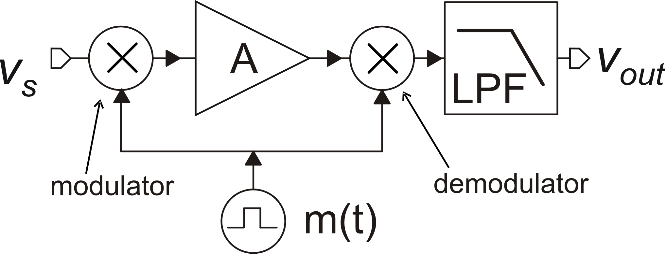
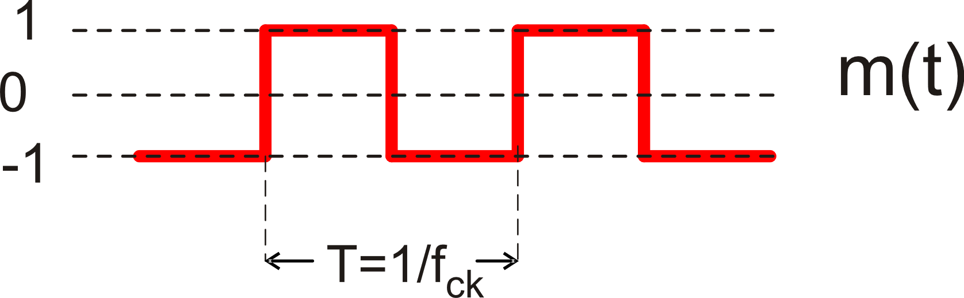
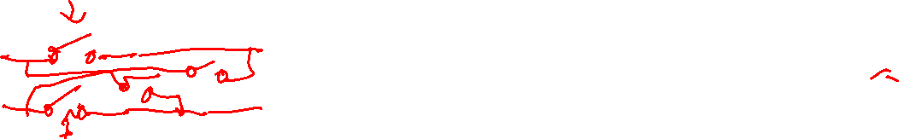
Chopper modulation: based on a square wafeform
Modulator and demodulator can be implemented by switch matrices: virtually free from 1/f noise and offset
Dimensionless square waveform
with unity magnitude and strictly
50 % dutycycle

Slide 28
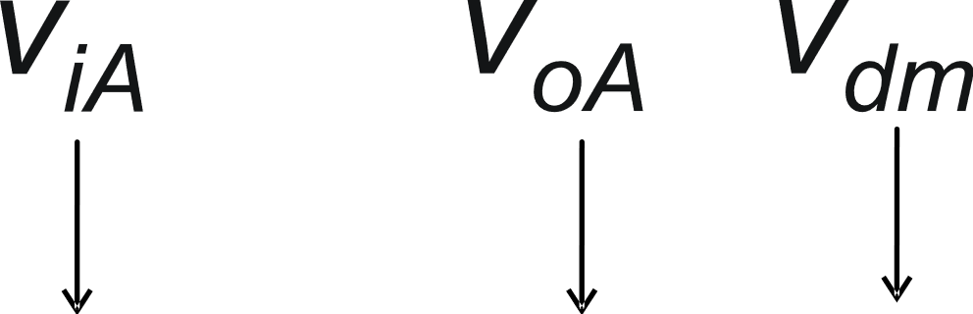
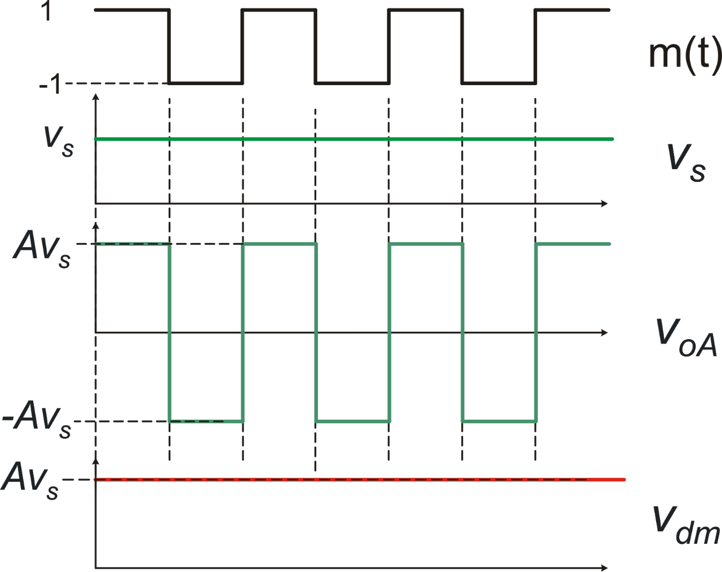
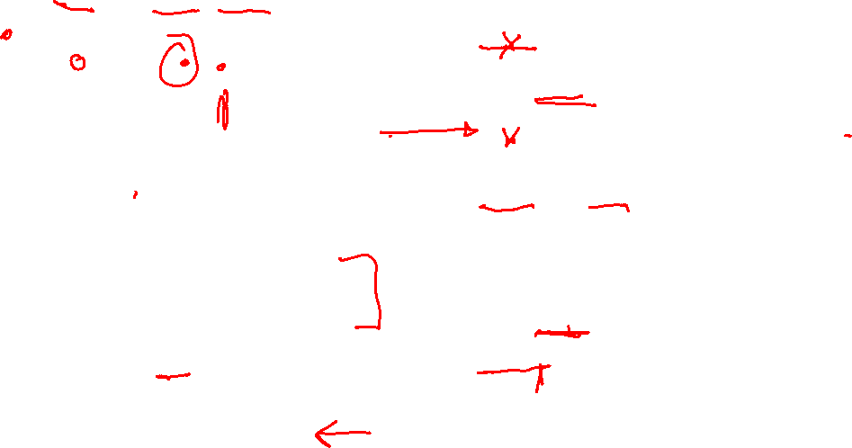
A simplified analysis in the time domain
Hypotheses:
The amplifier has infinite bandwidth and zero delay
The input signal (V_{S}) is constant
Zero noise and offset

Slide 29
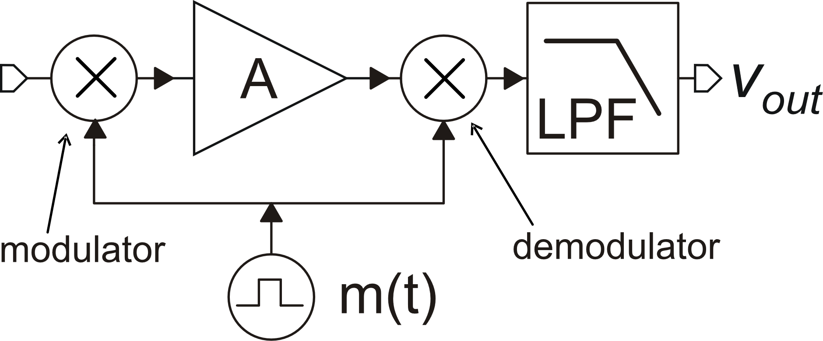
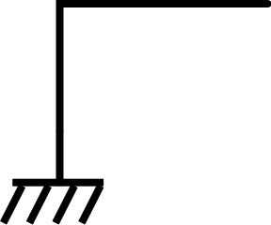
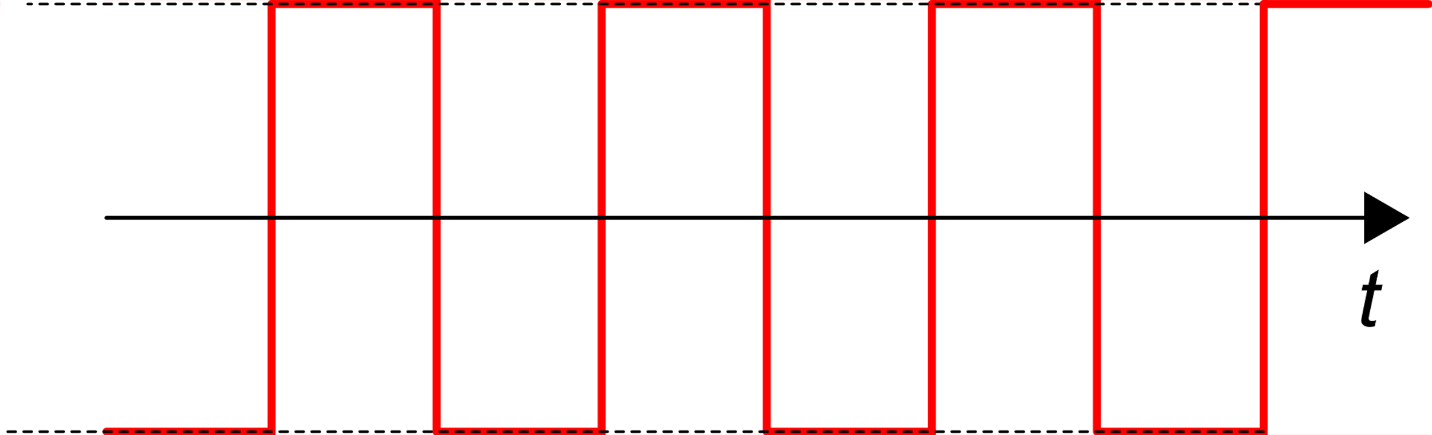
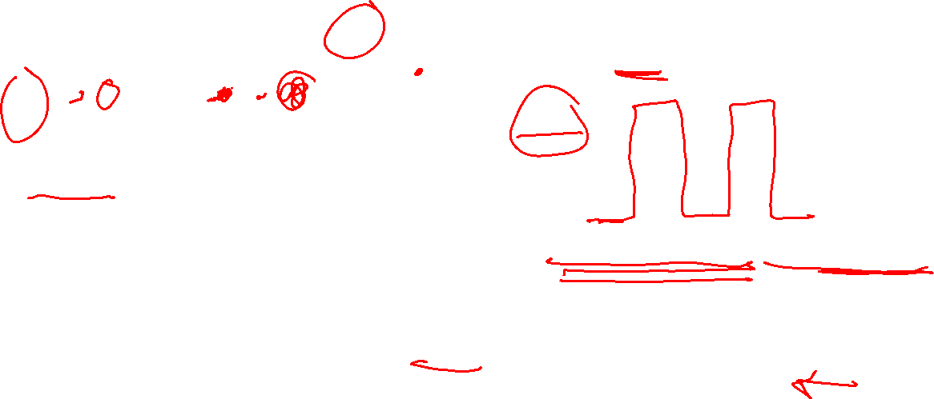
Simplified time-domain analysis: how the offset is processed
f_{H}
V_{dm}
OFFSET RIPPLE: frequency = f_{ck}
The effect of the offset is
The offset ripple is completely deleted if:
LPF: f_{H}<f_{ck}
<m(t)>=0 (requires duty-cycle=50%)

Slide 30
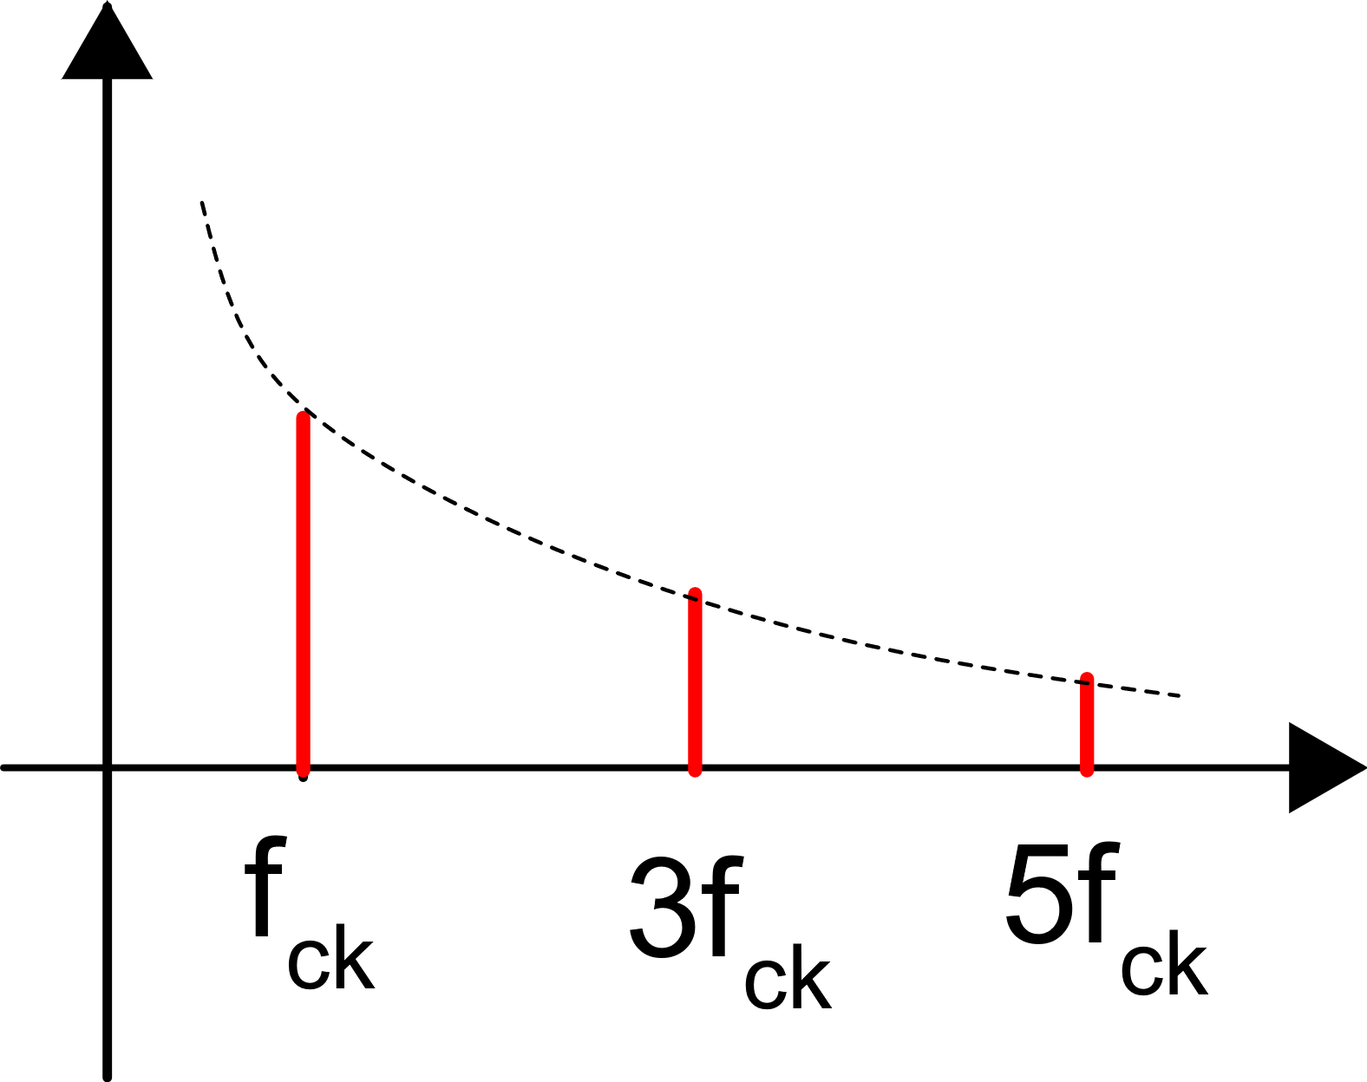
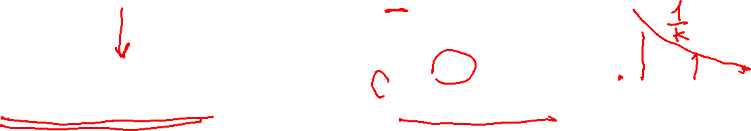
Chopper modulation: analysis in the frequency domain
The simplified analysis in the time domain is useful to gain an intuitive understanding of the CHS principle of operation but can give quantitative prediction for non-constant signal and noise components
In order to model the effect on non-constant signal and noise components it is necessary to perform the analysis in the frequency domain.
Fourier series of the m(t) waveform

Slide 31
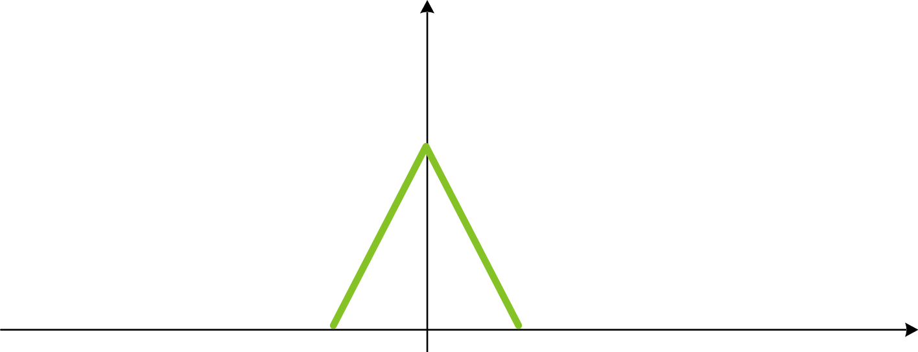
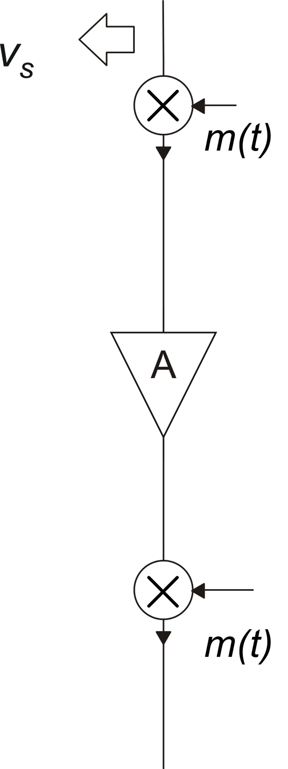
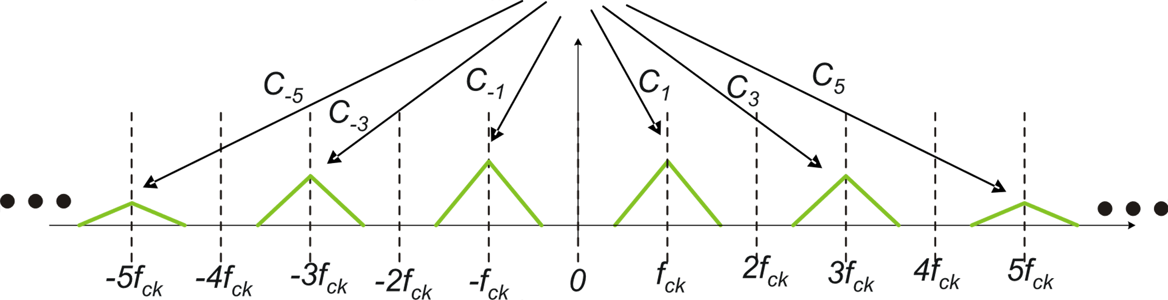

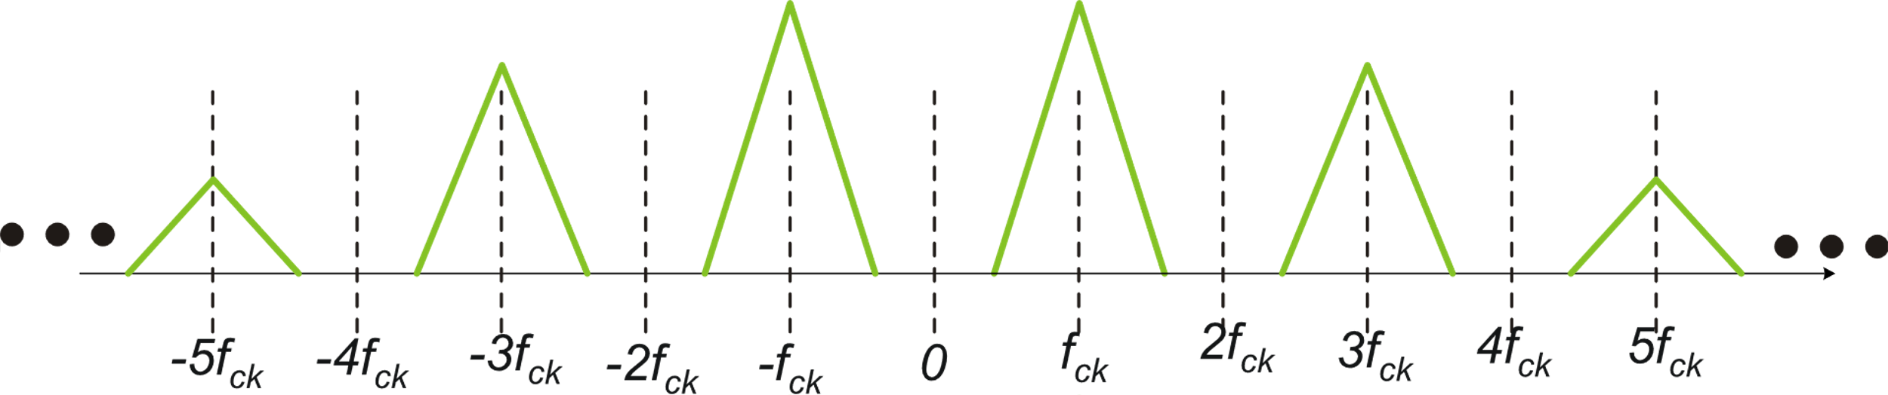

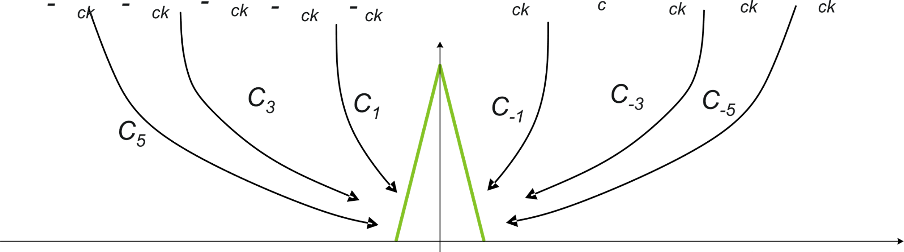

Effect of modulation on the signal
V_{S}(f)
LPF

Slide 32
Effect of modulation on the signal
Power of the modulating waveform m(t)
Power =
Application of chopper modulation in the case of INFINITE bandwidth and null delay does not alter the function and gain of the original amplifier

Slide 33
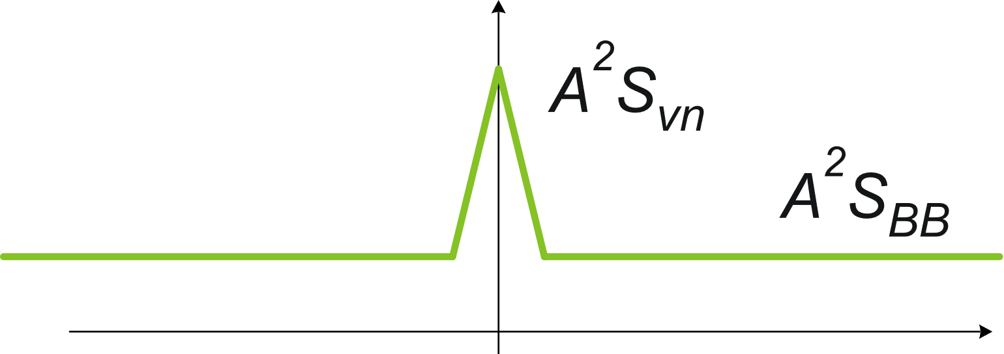


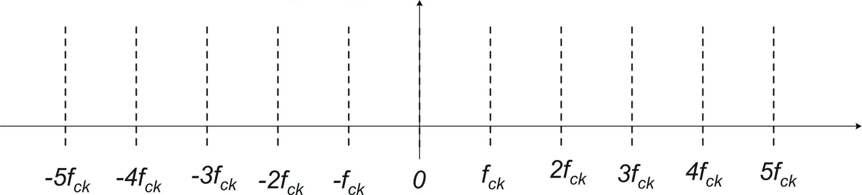
Effect of CHS on the noise spectrum
LPF

Slide 34
Effective noise PSD referred to the input
Application of chopper modulation in the case of INFINITE bandwidth result in cancellation of the flicker noise and in a residual noise in the signal bandwidth just equal to the broadband noise PSD of the original amplifier
No Noise foldover occurs!

Slide 35
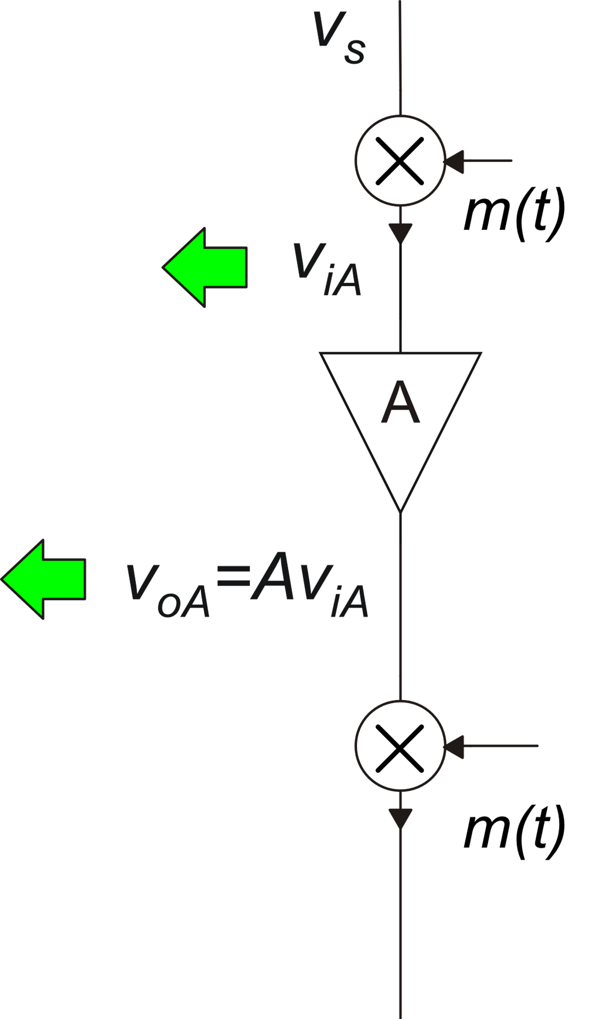
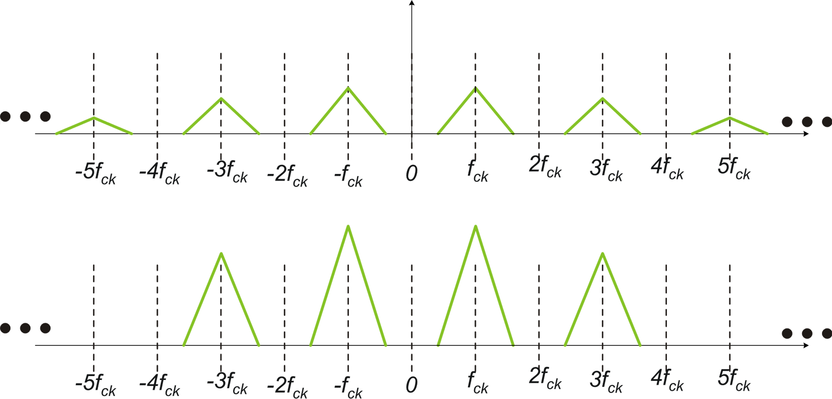

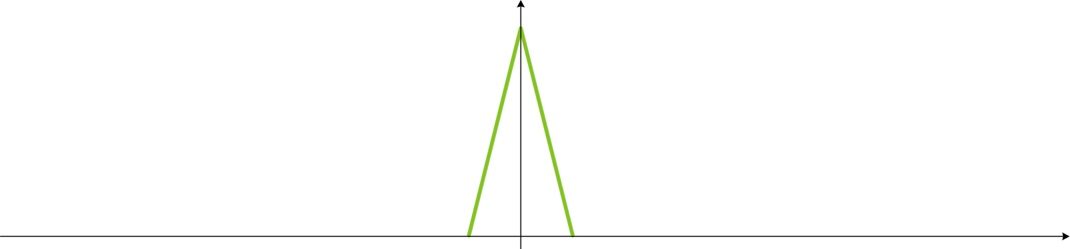
Effect of finite amplifier bandwidth

Slide 36
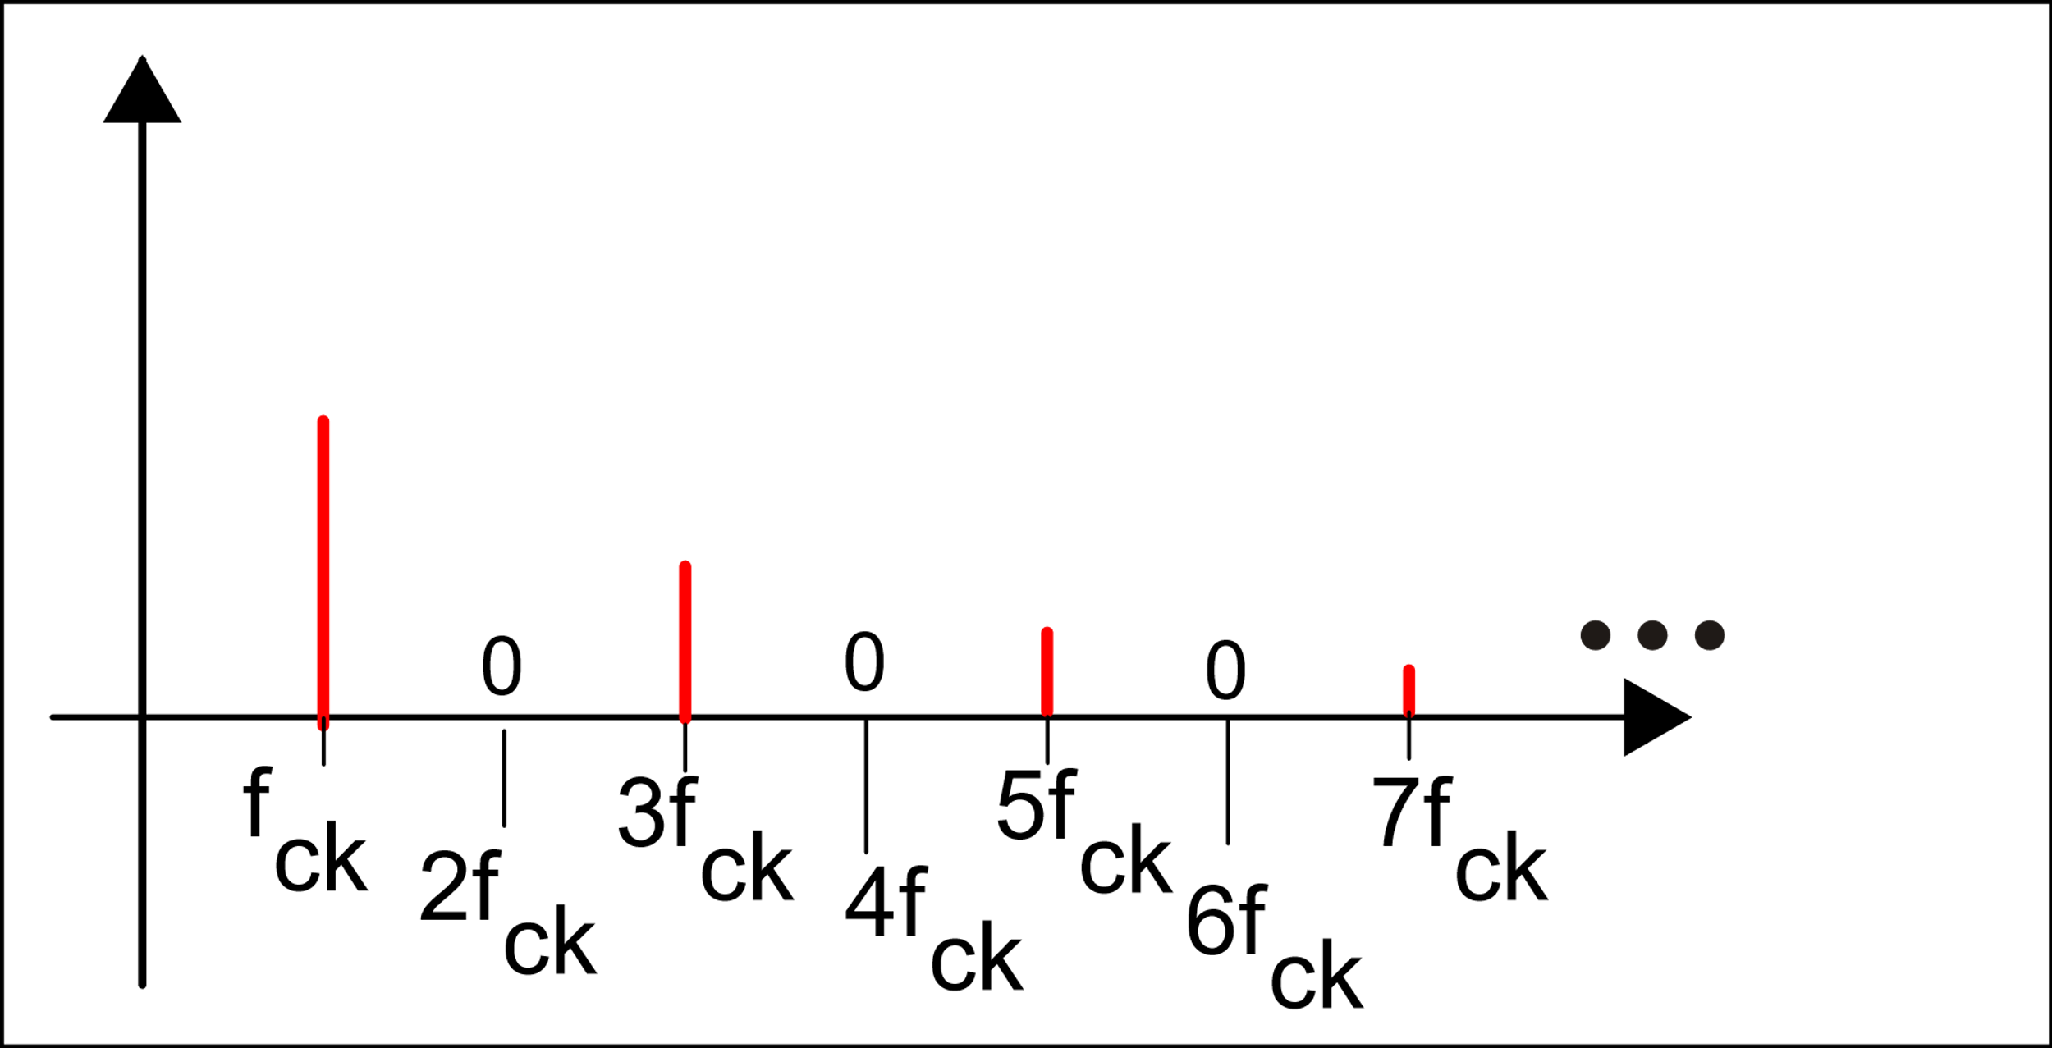
Effect of finite amplifier bandwidth
Summation is now limited to a finite number of terms
Let us consider only positive vaules of index k
B

Slide 37
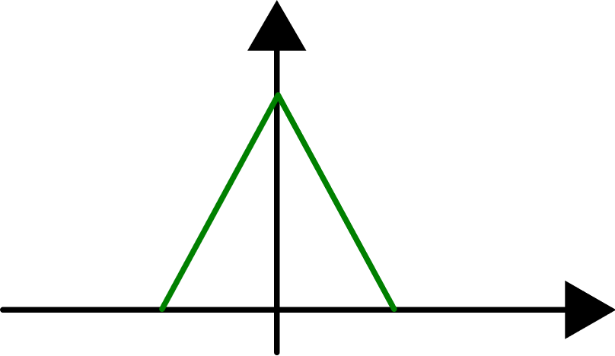
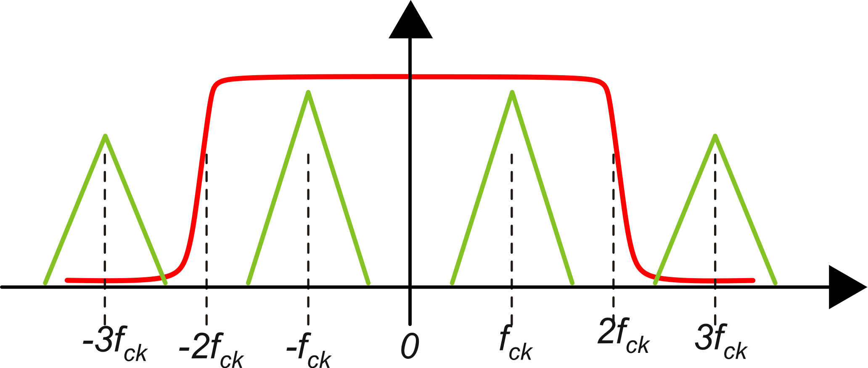
Minimum amplifier bandwidth
Minimum amplifier bandwidth to amplify at least one signal replica
Case N=1
amplifier frequency response

Slide 38
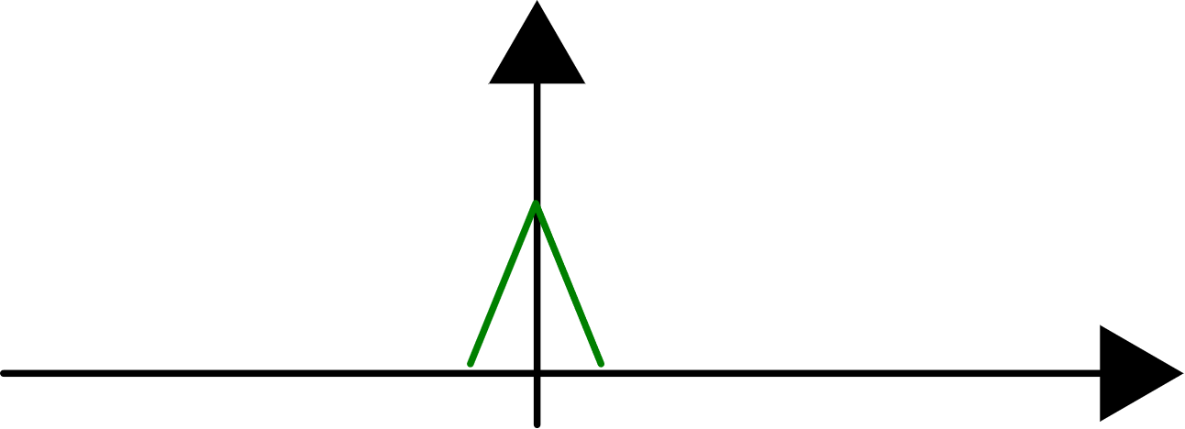
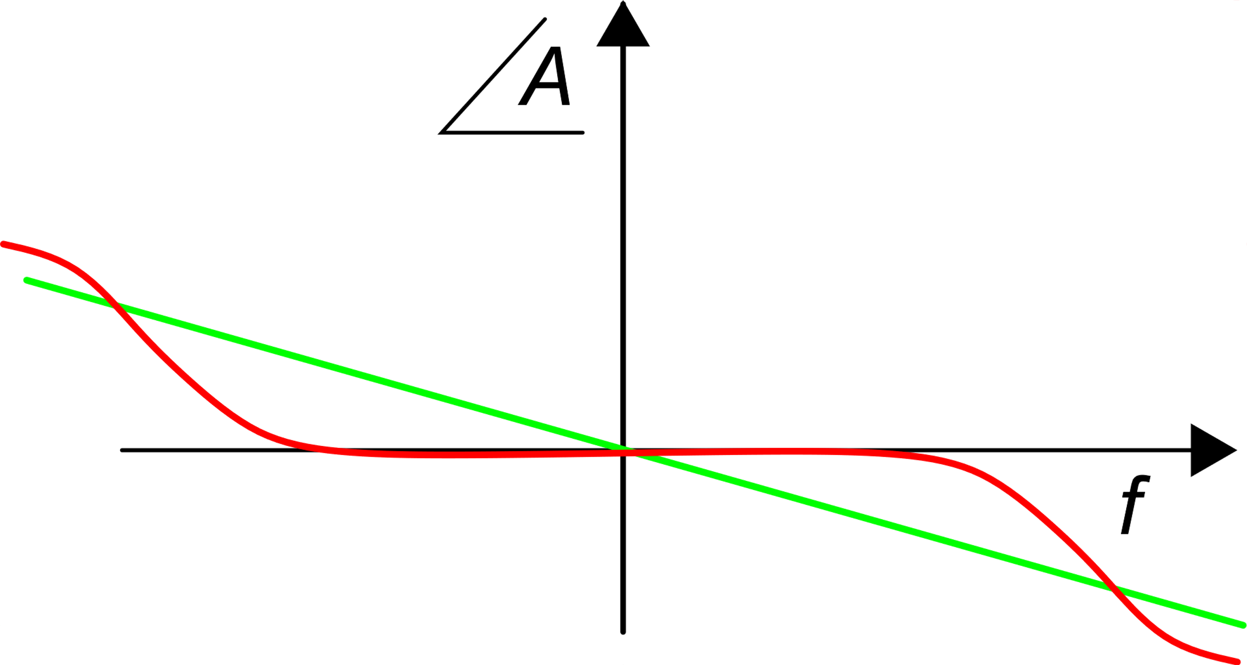
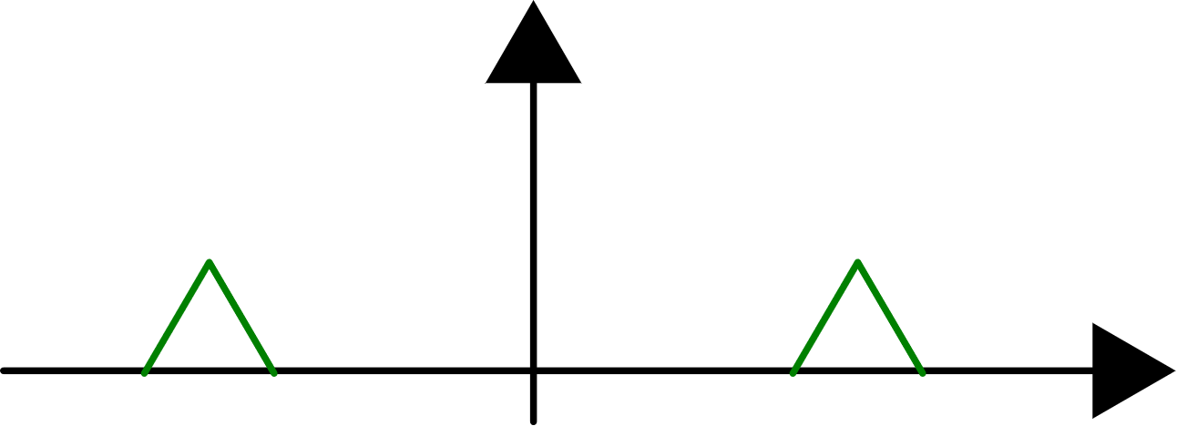
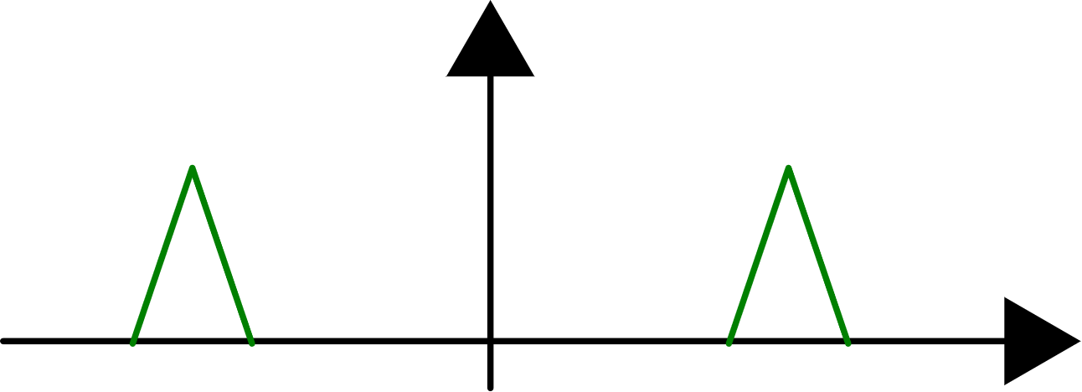
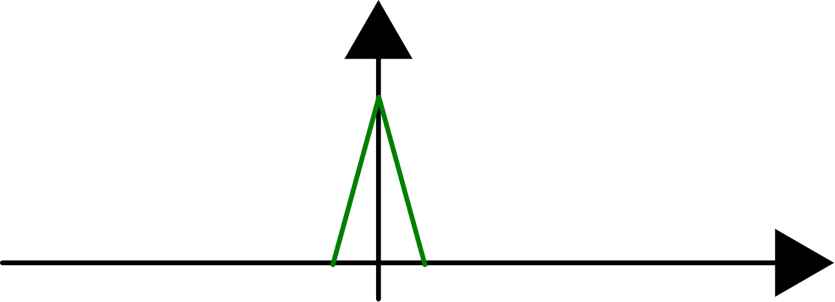
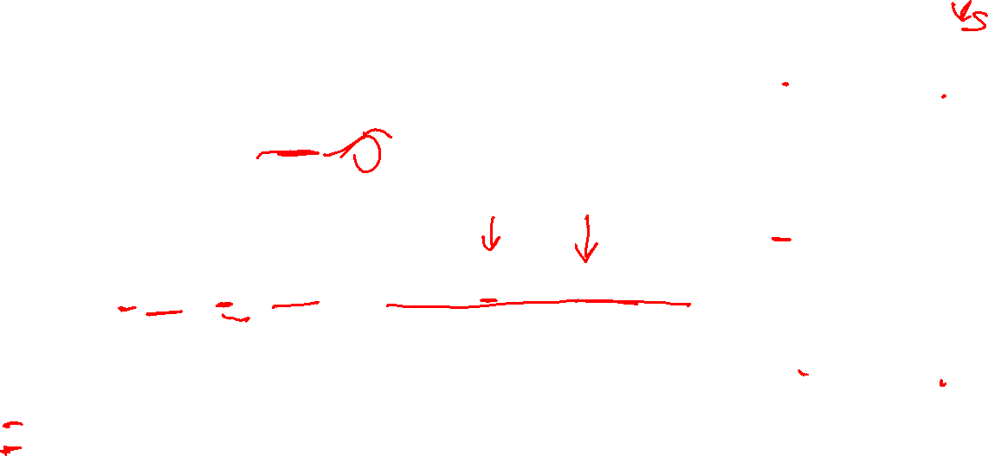
Effect of phase delays
typical amplifier
phase response
simple delay
Replicas that undergo a phase shift are attenuated when they are brought back to baseband.
For θ=90° total cancellation of the contribution
For θ=180° the sign of the contribution is reversed

Slide 39
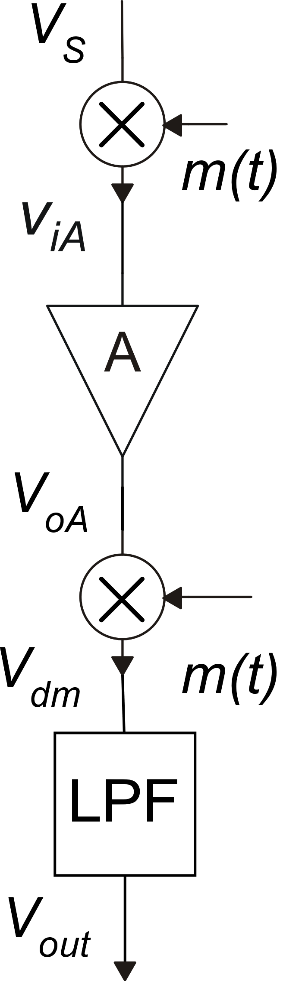





Time domain analysis with finite aplifier bandwidth

Slide 40







Effect of the amplifier finite bandwidth on the output noise PSD
LPF
Maximum order of replica that still gives a contribution in the baseband:

Slide 41


Finite bandwidth: effective input referred noise density
Amplifier effective gain:
Output noise PSD
N | 1 | 3 | 5 | 15
$$α$$ | 0.8106 | 0.9006 | 0.9331 | 0.9747
1/$α$ | 1.234 | 1.110 | 1.072 | 1.026

Slide 42
AZ, CDS and CHS compared
Residual noise at low frequencies
The CHS technique gives the lower residual noise in the signal bandwidth, for the same broadband SBB of the original amplifier
AZ:
The AZ and CDS techniques suffer from noise foldover, which is represented by the ratio B/f_{ck}. The minimum value of this ratio is not the same for the two techniques
CDS:
CHS:

Slide 43

B/f_{ck} ratio requirements for AZ
In the AZ phase the amplifier passes from full output signal to a small value (-Av_{n}). At the end of the AZ phase, the residual error should be small, otherwise part of the output signal is sampled together with the noise/offset

Slide 44


B/f_{ck} ratio requirements for CDS
In the CDS the amplifier must settle to the final value in a period equal to half the clock cycle (T/2).
In practice, the requirement for small residual error (high accuracy) and the occurrence of the slew rate phenomenon impose larger value for B/fck. Generally:

Slide 45

AZ, CDS and CHS compared
Method | Signal bandwidth (B_{S}) | Residual baseband noise (f<f_{ck}/2) | f_{ck} constraints | Particular characteristics
AZ | B_{S}=B |  | f_{ck}<<B | Maintains the original time continuous frequency response of the amplifier.
CDS | B_{S}< f_{ck}/2 |  | f_{ck}<B/3 | Fully sampled data system.
CHS | B_{S}<f_{ck} | S_{BB} | f_{ck}+B_{S}<B B_{S}<f_{CK} | Requires fully-differential architecture and the presence of an effective low pass filter.

Slide 46

The ping-pong approach to reduce the B/f_{ck} ratio in AZ systems

Slide 47
Simple example of circuital implementations
AZ Amplifier

Slide 48
Simple example of circuital implementations
CDS Amplifier
V_{out}
φ_{2-S}
φ_{2-S}

Slide 49
Simple example of circuital implementations
Chopper Amplifier
A differential input and differential output facilitate the implementation of the modulator and demodulator, respectively (fully-differential amplifier)
The amplifier gain cannot be arbitrarily high, otherwise the amplified offset could saturate the amplifier. Typical values of A are < 1000

