Slide 1
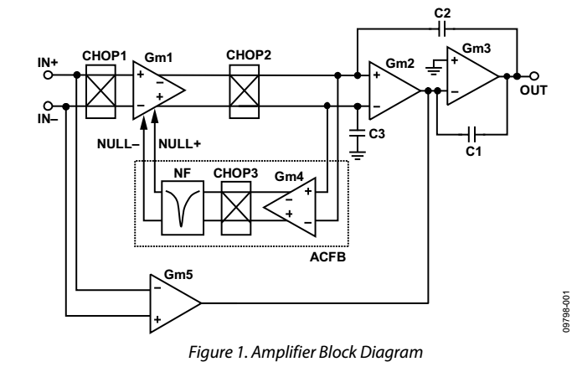
AD 4528 equivalent block diagram (from AN-1114 application note of Analog Design)
Chopper modulation is
applied only to the first stage
Feedback loop for reduction
of the offset ripple
High frequency path (not chopped)
to obtain a wide bandwidth

Slide 2
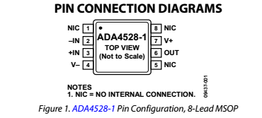
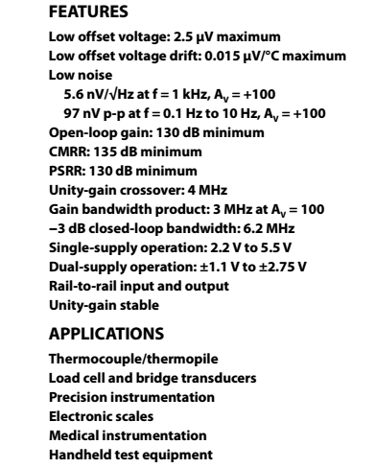
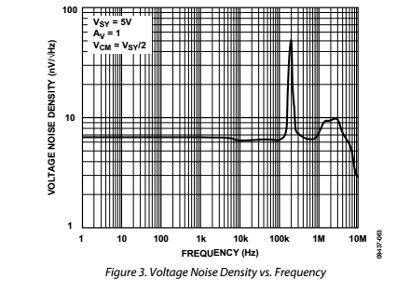
A recently introduced chopper op-amp
Very low offset voltage
Note: residual
offset and flicker noise
shifted at the clock frequency
Very low noise density down
to low frequencies

Slide 3
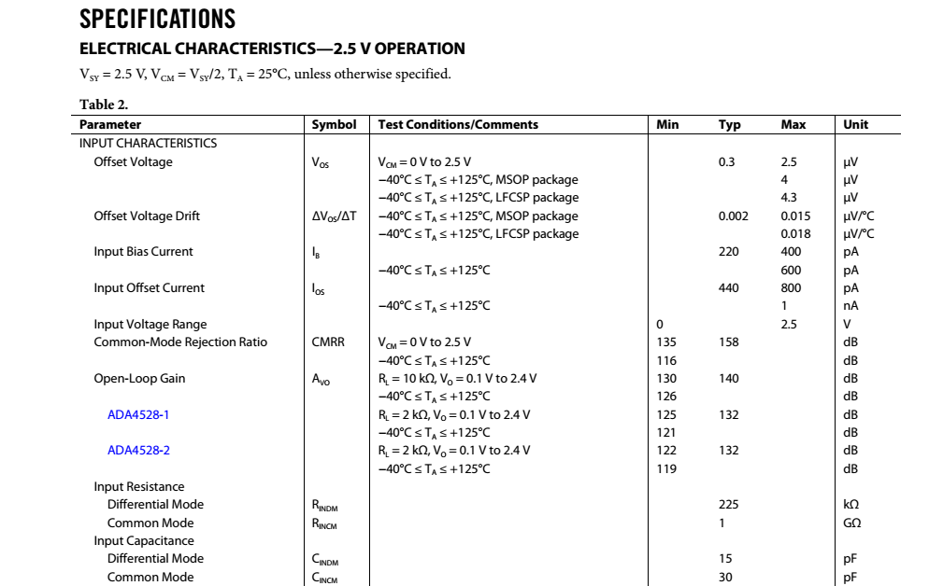
Note: relatively high bias currents
for a CMOS amplifier: effect of
charge injection from the input
switches
Note: relatively low input resistance
(effect of alternating Vin and –Vin
across the input capacitance)

Slide 4
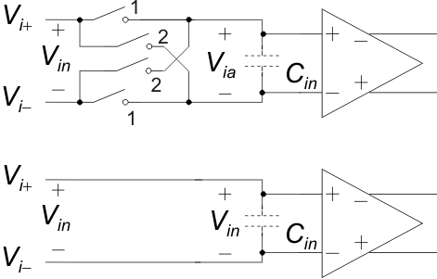
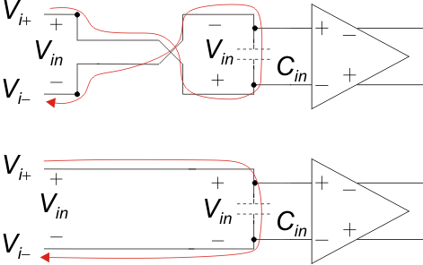
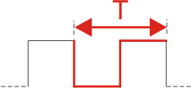
Finite input resistance of chopper amplifiers
Input modulator
Amplifier input
capacitance
Phase 2
Let us start from phase 1 …
Phase 1 again
(one period)

