Slide 1
Mixed-Signal Design Flow and Example of SAR ADC Design Dr. Alessandro Catania and Dr. Michele Dei

Slide 2
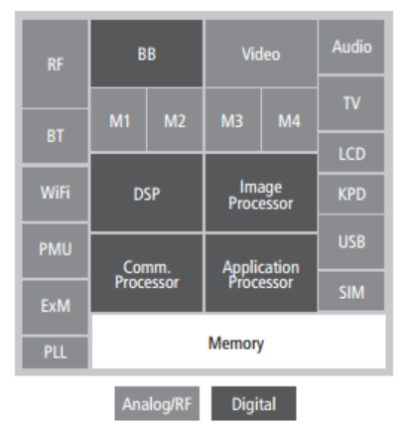
Mixed Signal Design Flow
Traditional mixed circuit system
(e.g. interface for a MEMS sensor)
System on a chip with distribution of analog and digital units
Digital control
unit
Analog units
Both are examples of Mixed Signal integrated circuits

Slide 3
Possible design flows
Analog centric (or analog on top): the analog and digital units are designed with their proper tools and integration is performed using the analog tool.
Digital centric (or digital on top): the analog and digital units are designed with their proper tools and integration is performed using the (highly automated) digital tool.

Slide 4
Analog Design Flow and examples of CAD tools
Schematic design
Virtuoso schematic editor
Electrical simulation
Analog Design Environment (ADE)
Spectre electrical simulator
CADENCE
Layout design
Virtuoso layout editor
Verification:
DRC
LVS
PEX
Assura
Calibre
Mentor
Graphics
PEX: Parasitic extraction (for post-layout simulations)

Slide 5
Digital Design Flow and CADENCE tools
High level description
(HDL - RTL)
Text Editor (e.g. "Gedit")
Logic Simulation
CADENCE “Xcelium”
Gate-Level Synthesis
CADENCE “Genus”
Automatic Place and Route
CADENCE “Innovus”

Slide 6
Mixed Signal Design Flow: Analog Centric Approach
Mixed Signal system level design
("pen-and-paper", SIMULINK-SIMSCAPE, VHDL-AMS, Verilog-A ...)
Analog cells
Digital cells
Analog Schematic design
High level description
(HDL - RTL)
Electrical simulation
Logic Simulation
digital netlists
Gate-Level Synthesis
Mixed Signal simulation
Mixed Signal Schematic design
Automatic Place and Route
Verification
Analog Layout
(mainly manual)
Digital layout
Layout of the Mixed Signal Circuit
(mainly manual)

Slide 7
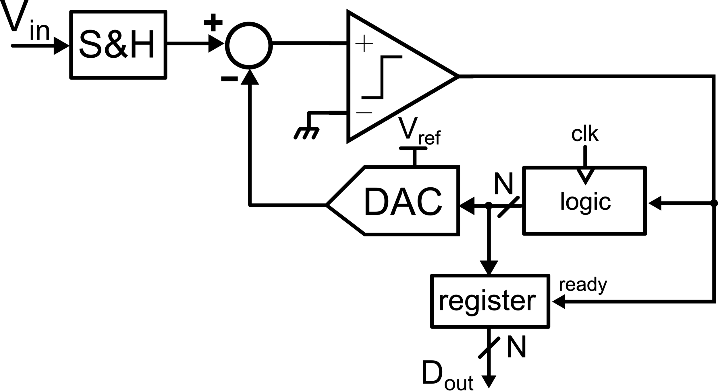
An Example: Design of a SAR ADC
High-level behavioural description of the SAR algorithm (e.g. MATLAB)
Transistor-level design and simulations of the comparator and the DAC
HDL description and digital simulations of the SAR control logic
Mixed-signal simulations of the whole ADC
Layout of the analog blocks / synthesis and place-and-route of the SAR logic

Slide 8
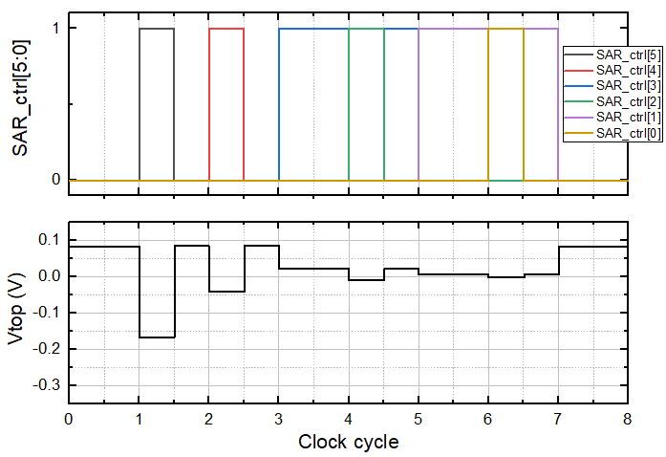
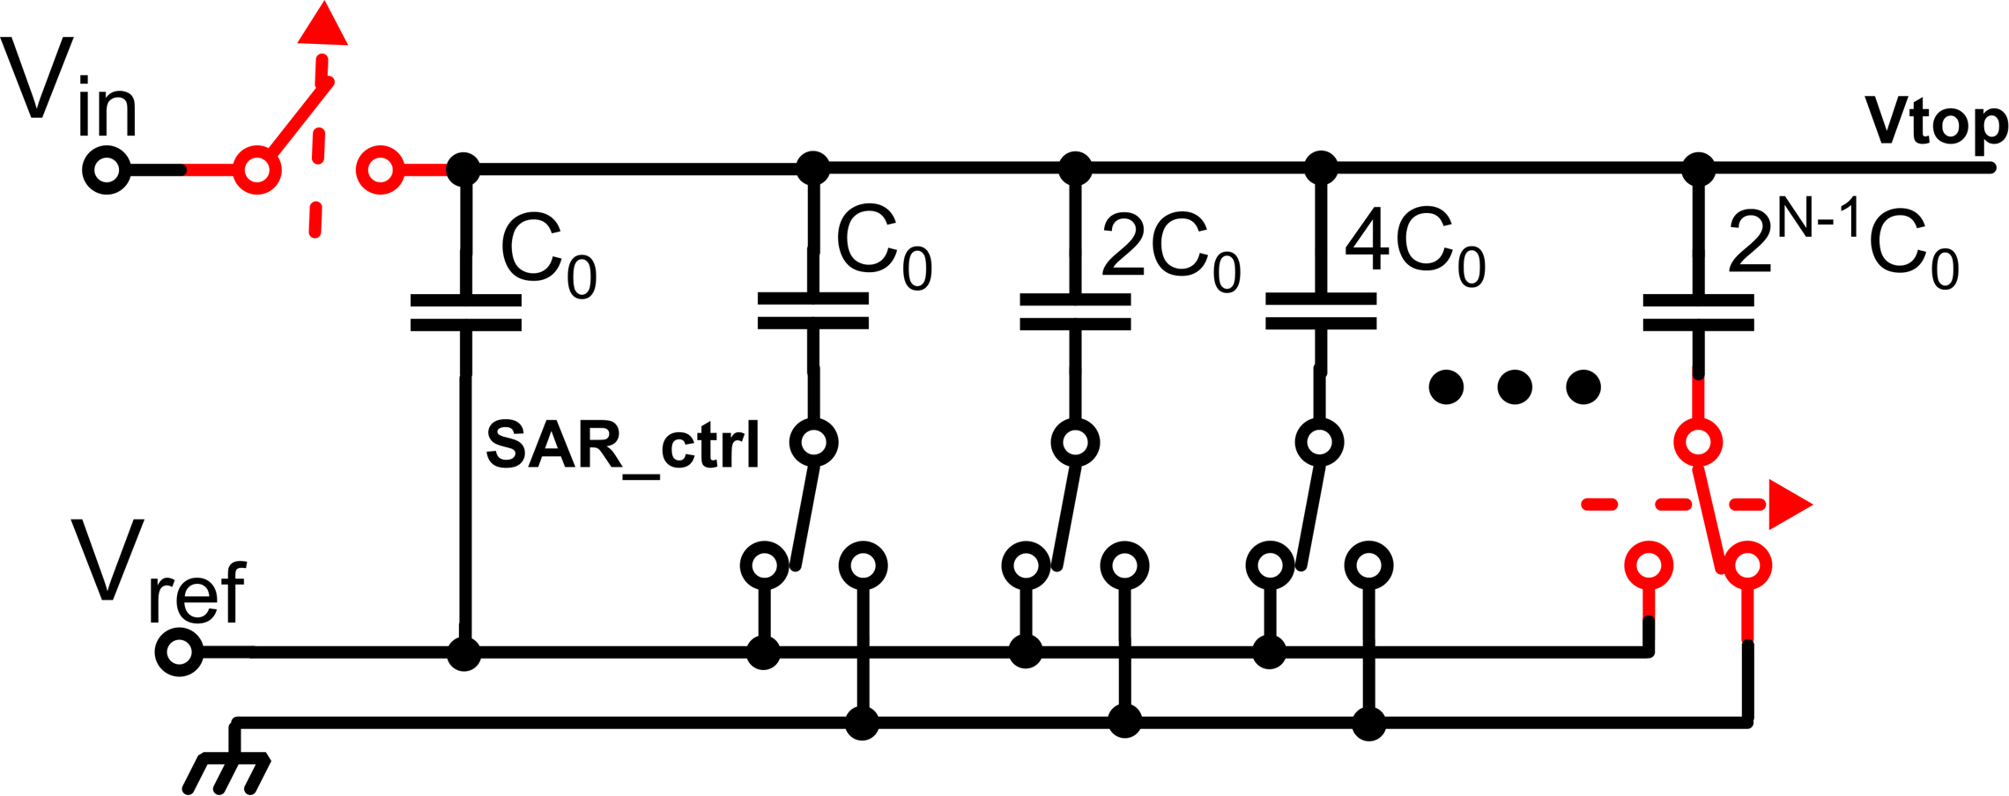
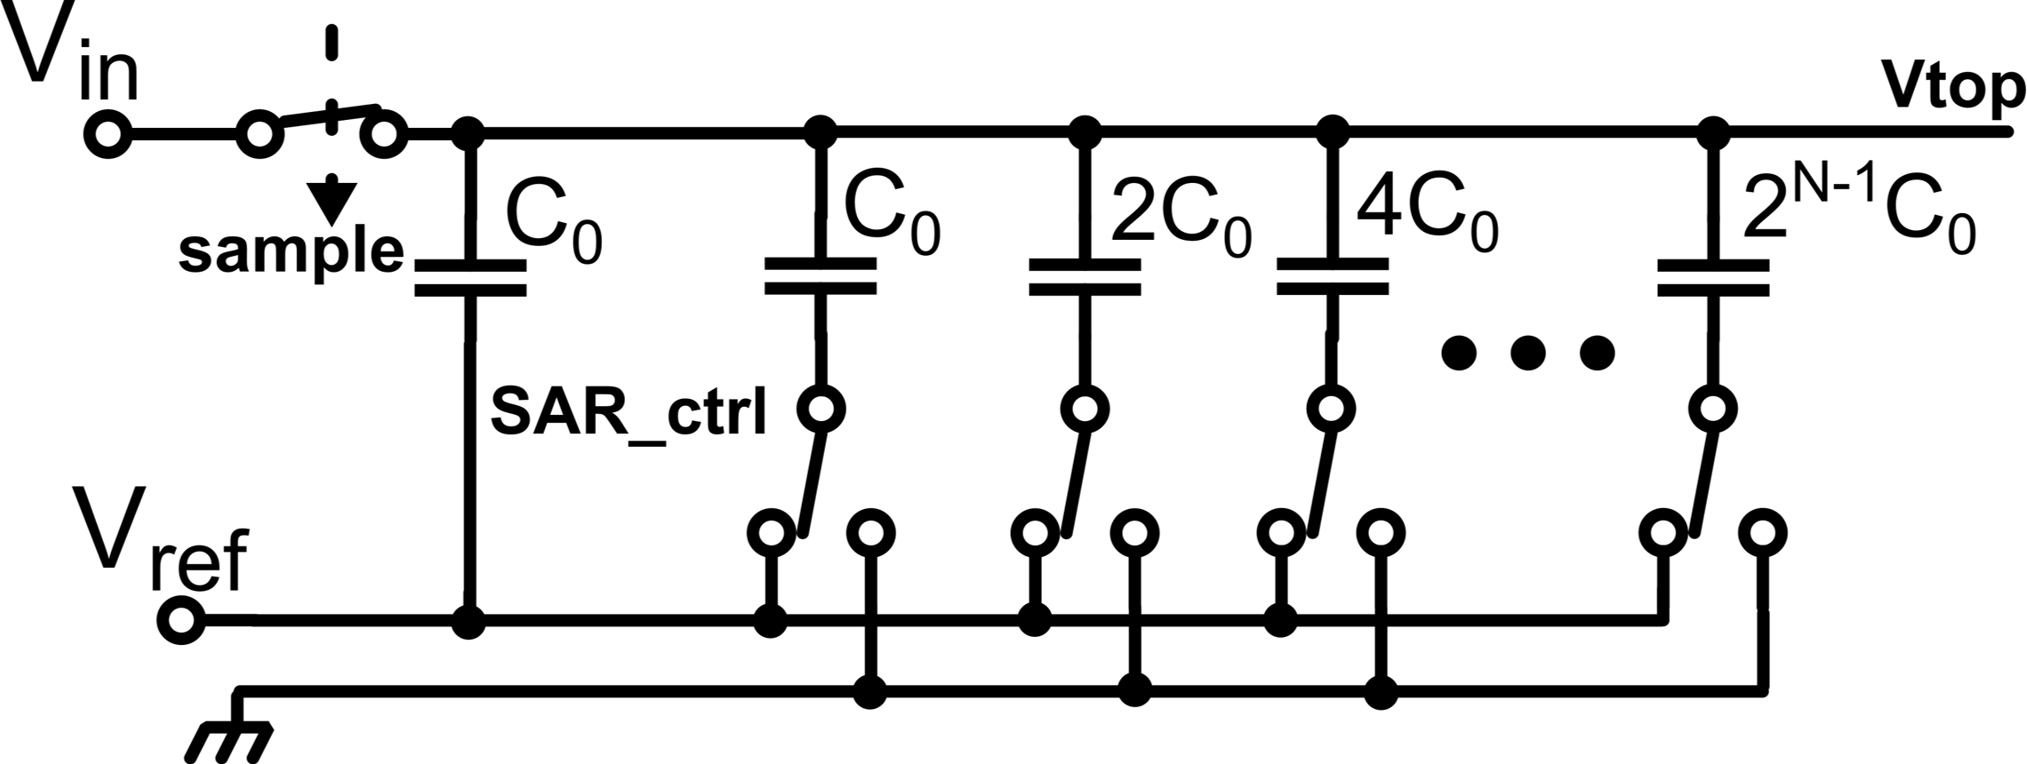
Successive Approximation Register ADC (6 bit)
$$V_{in}$$
$$V_{in}−\frac{V_{ref}}{8}$$
$$V_{in}−\frac{5V_{ref}}{32}$$
Sampling
$$V_{in}−\frac{3V_{ref}}{16}$$
$$V_{in}−\frac{11V_{ref}}{64}$$
$$V_{in}−\frac{V_{ref}}{4}$$
$$V_{in}−\frac{V_{ref}}{2}$$
$${V_{top}=V}_{in}$$
$$∆V_{top}=∆V\frac{2^{N−1}C_{0}}{C_{tot}}=−V_{ref}\frac{2^{N−1}C_{0}}{2^{N}C_{0}}=−\frac{V_{ref}}{2}$$
0
0
1
0
1
0
V_{in} = 82.7 mV
D_{out}=001010
(10 in decimale)
V_{ref} = 500 mV
A/D (N = 6)

Slide 9
Behavioural description of the SAR algorithm
SAMPLING
SAR algorithm:
Signal sampling
SAR conversion (N phases)
SAR_ctrl[5] = 1
Keep SAR_ctrl[5]
1
Dout[5] = 1
SAR_PHASE 5
out_cmp ?
0
SAR_ctrl[5] = 0
SAR phase:
DAC update (initial guess)
Verify the comparator output
DAC correction (if needed)
Dout[5] = 0
SAR_ctrl[4] = 1
Keep SAR_ctrl[4]
SAR_PHASE 4
1
out_cmp ?
Dout[4] = 1
0
…
SAR_ctrl[4] = 0
Dout[4] = 0
SAR_PHASE 0
out_cmp ?
Dout[0]

Slide 10
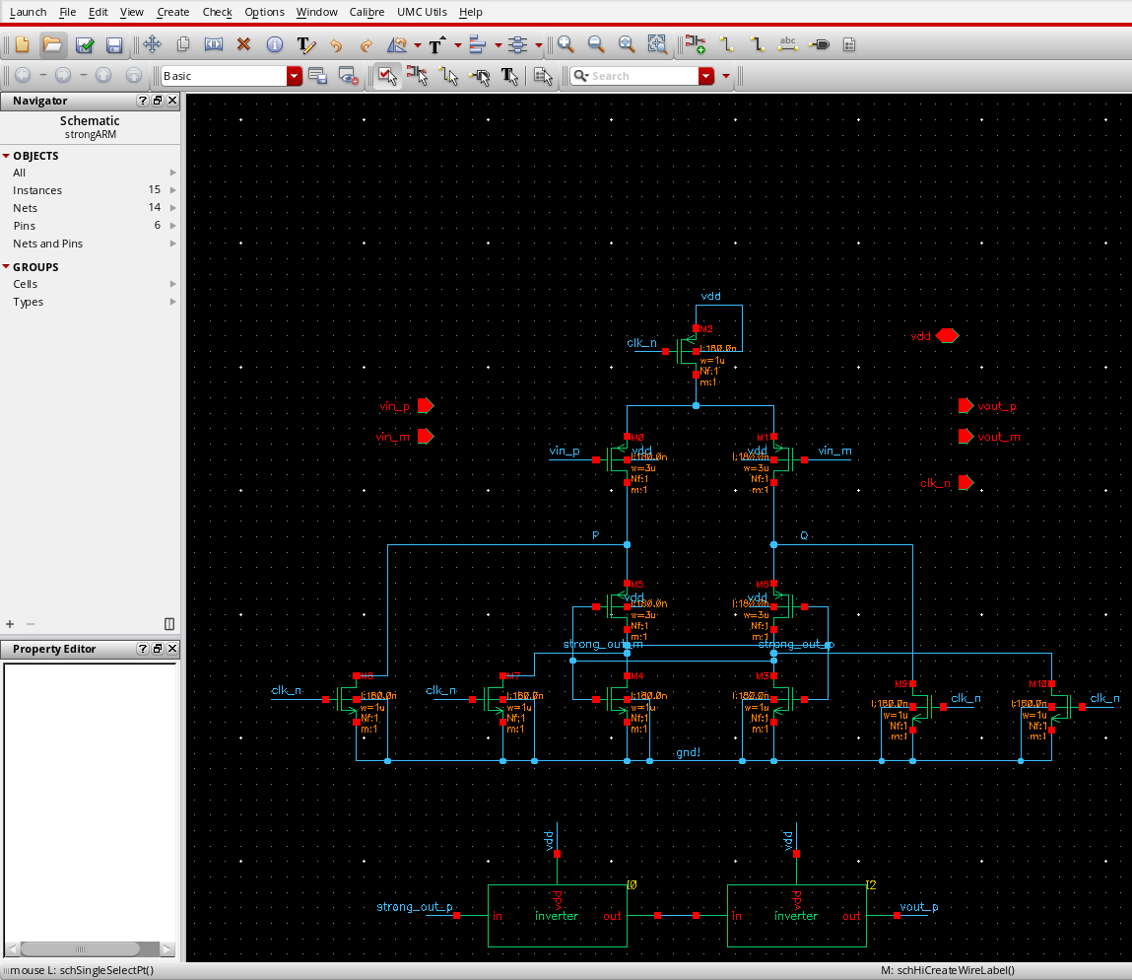
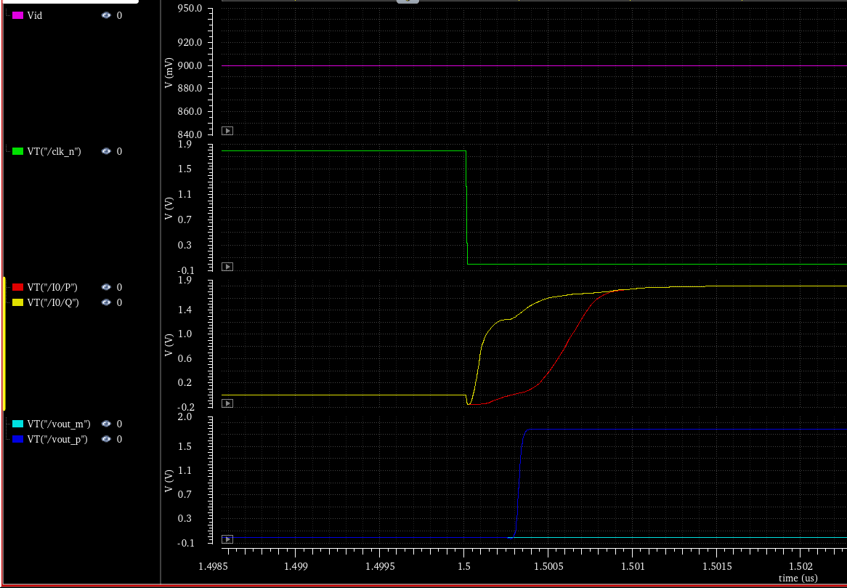
Analog Design and Simulations (Spectre simulator)

Slide 11
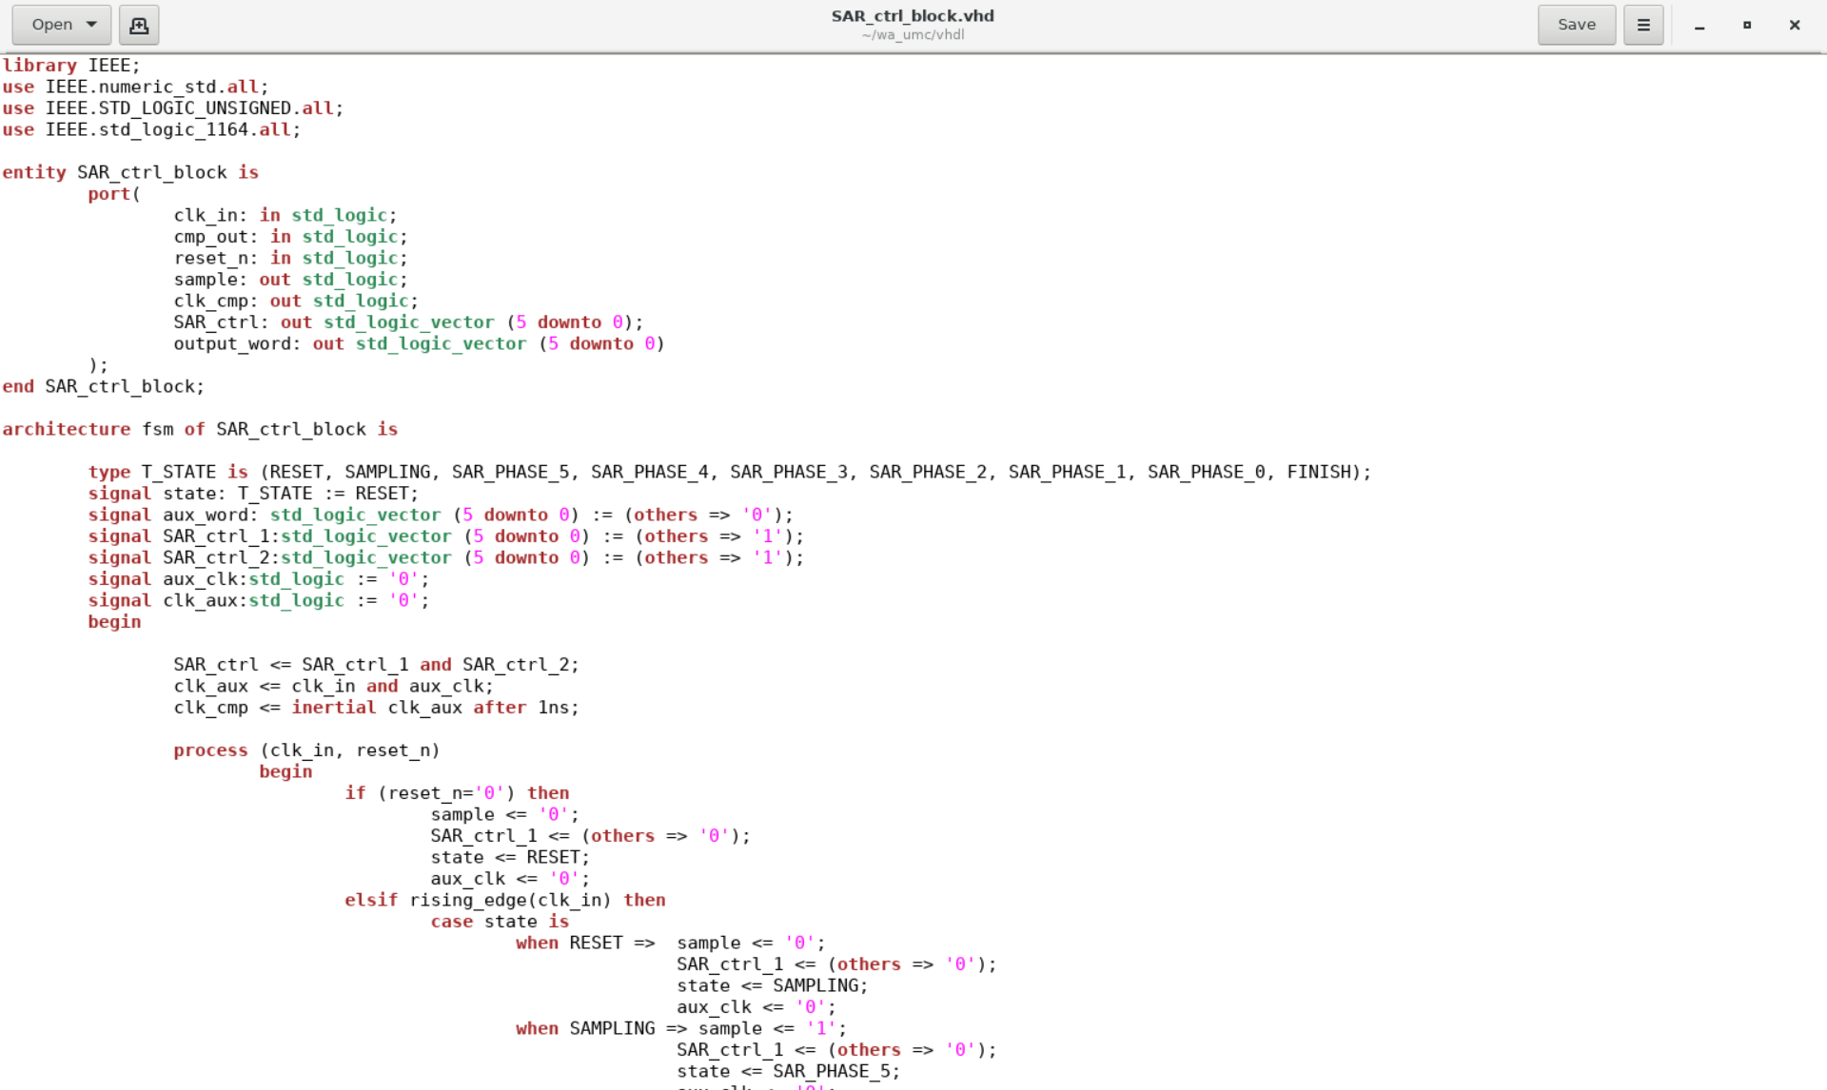
VHDL description of the SAR digital control block
VHDL Code
Digital simulations (XCELIUM)

Slide 12
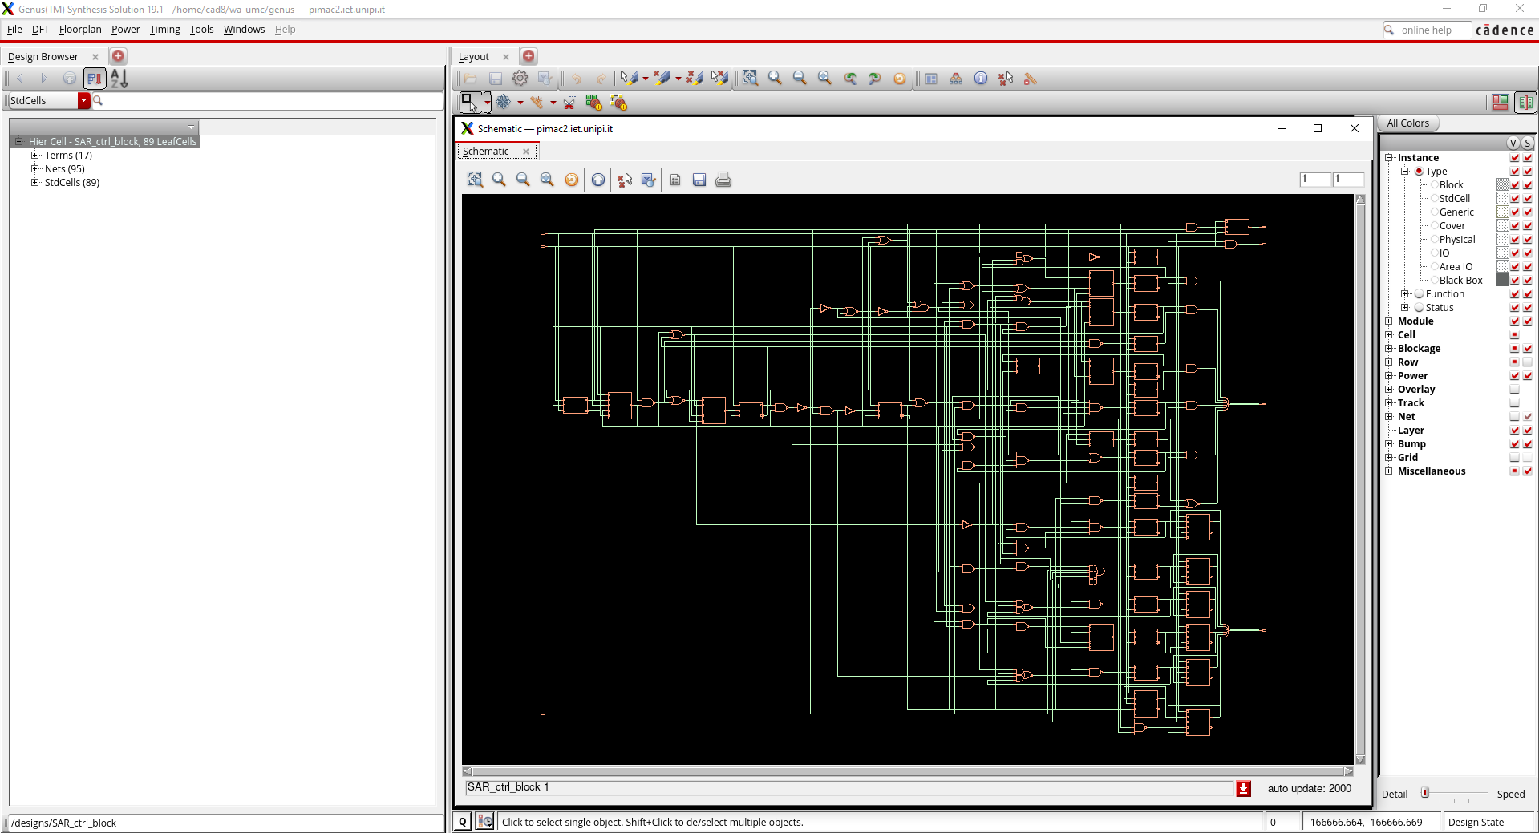
Digital synthesis (GENUS)

Slide 13
Digital synthesis (GENUS)
RTL (Register Transfer Level) Description
(GENUS input)
Gate Level Description
(GENUS output)

Slide 14
Automatic layout generation (Automatic Place and Route, P&R)
The LEF format is more versatile than GDS, since it allows easy partial description (e.g. creation of layout abstract views, where only the information for the P&R are included
Standard cells:
Velirog description
Layout (LEF or GDS)
Automatic P&R tool
Layout (GDS)
Gate level netlist:
Verilog description
Delay file
Post P&R netlist (verilog)
In the P&R operation, the tool changes the original network adding components that allow respecting the timing requirements (e.g. clock buffers)
Automation script file

Slide 15
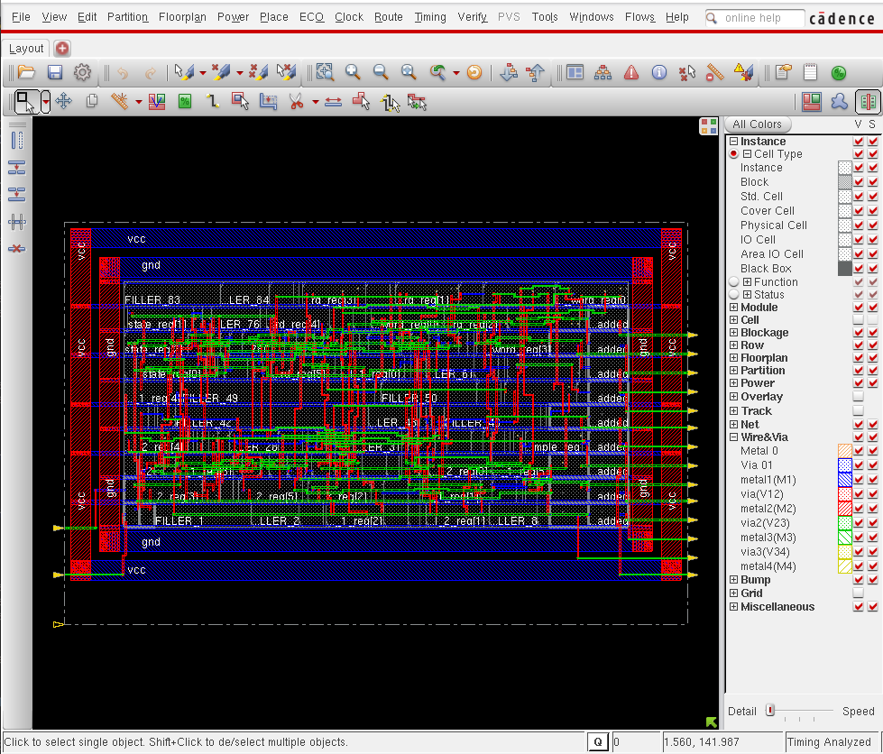
Automatic Place-and-Route (INNOVUS)
Empty spaces between cells are covered by "filler" elements in the final layout. Fillers include n-wells and other layers that improve continuity between cells

Slide 16
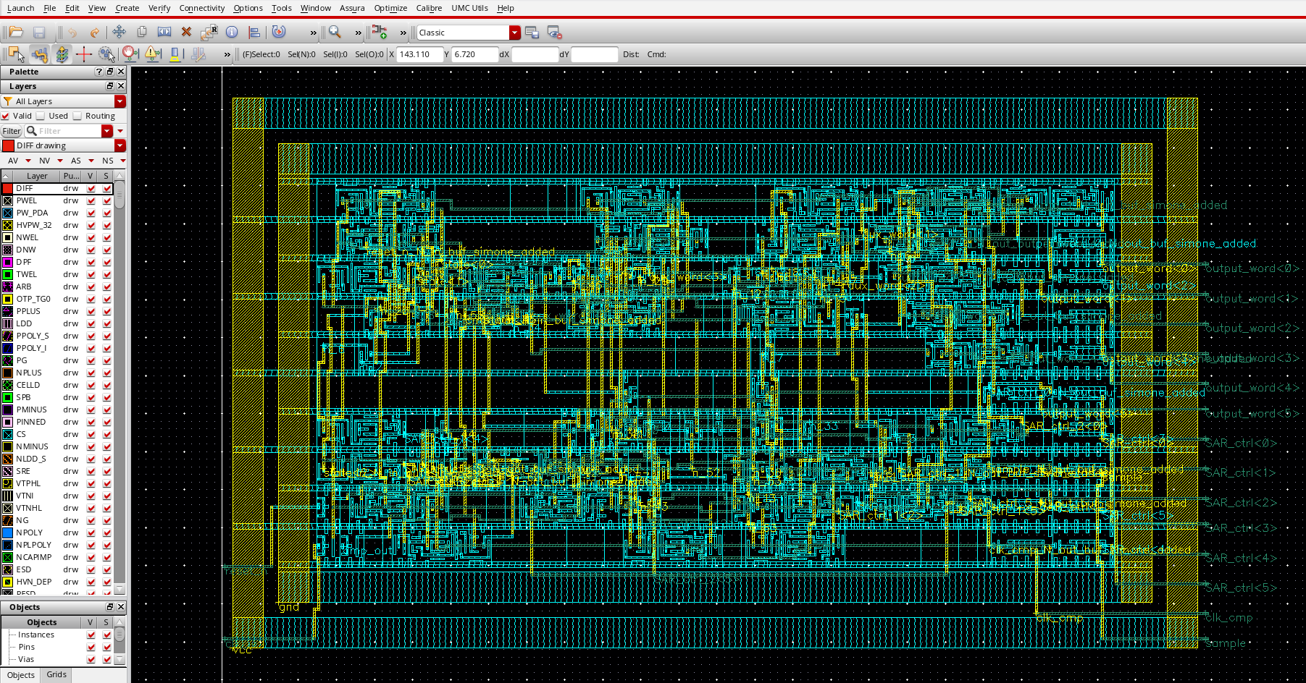
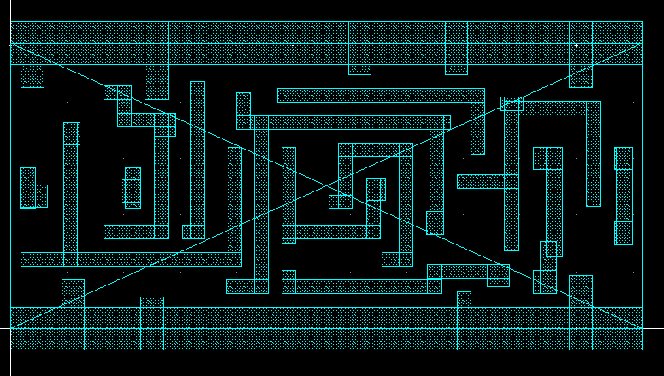
Layout imported in Virtuoso
Abstract view of D Flip-Flop

Slide 17
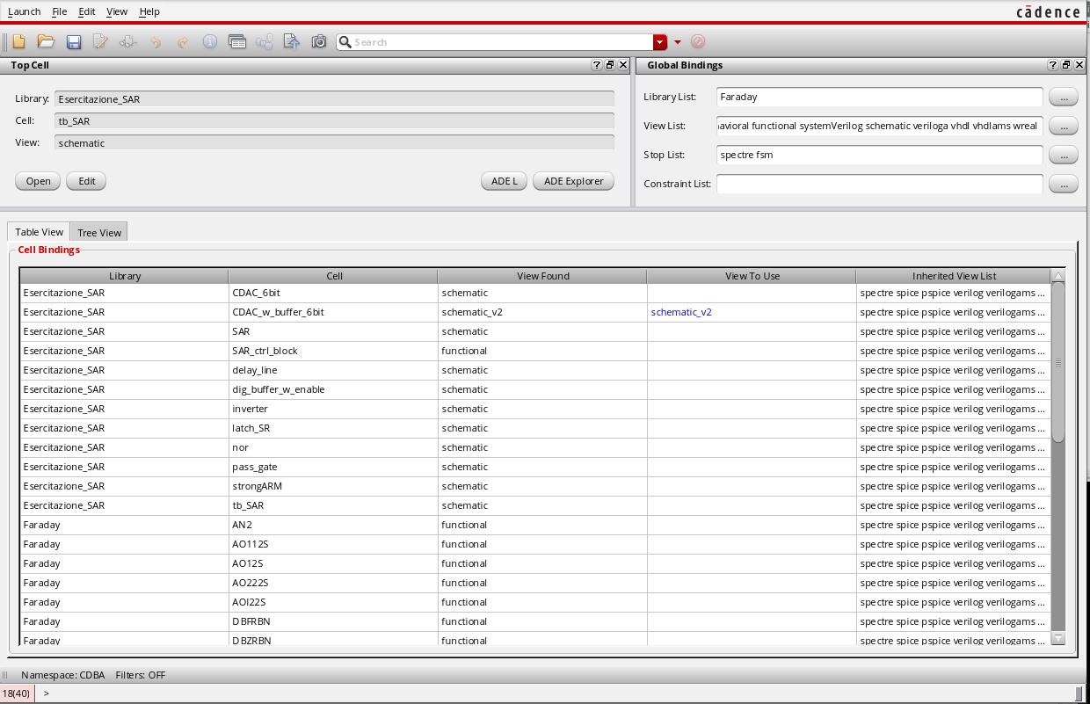
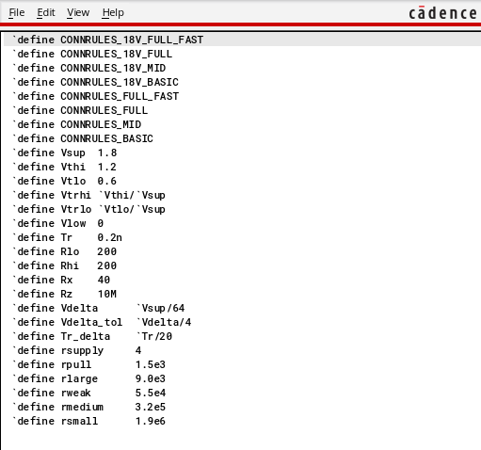
Mixed-Signal Simulations (ams simulator)
Config view of the testbench
Connect rules

Slide 18
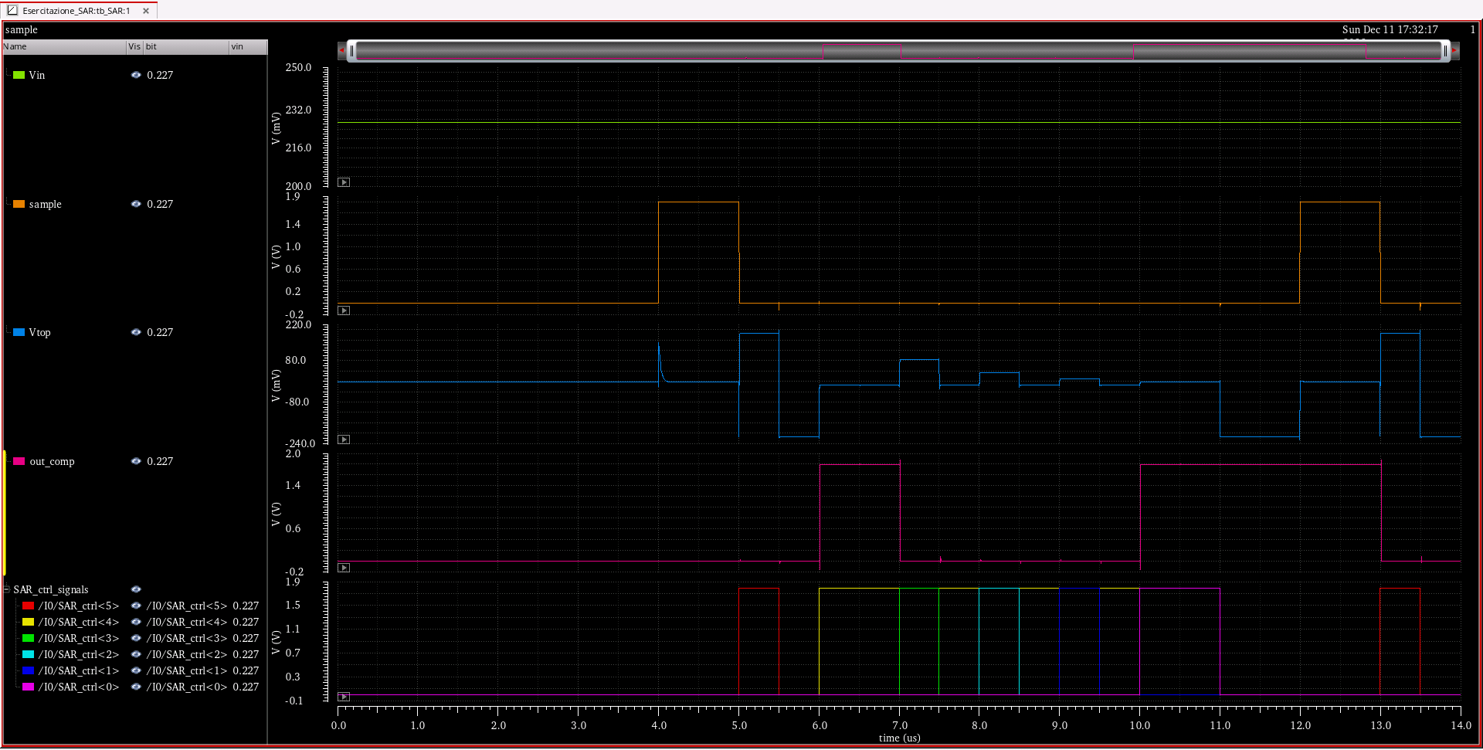
Mixed-Signal Simulations

