Slide 1
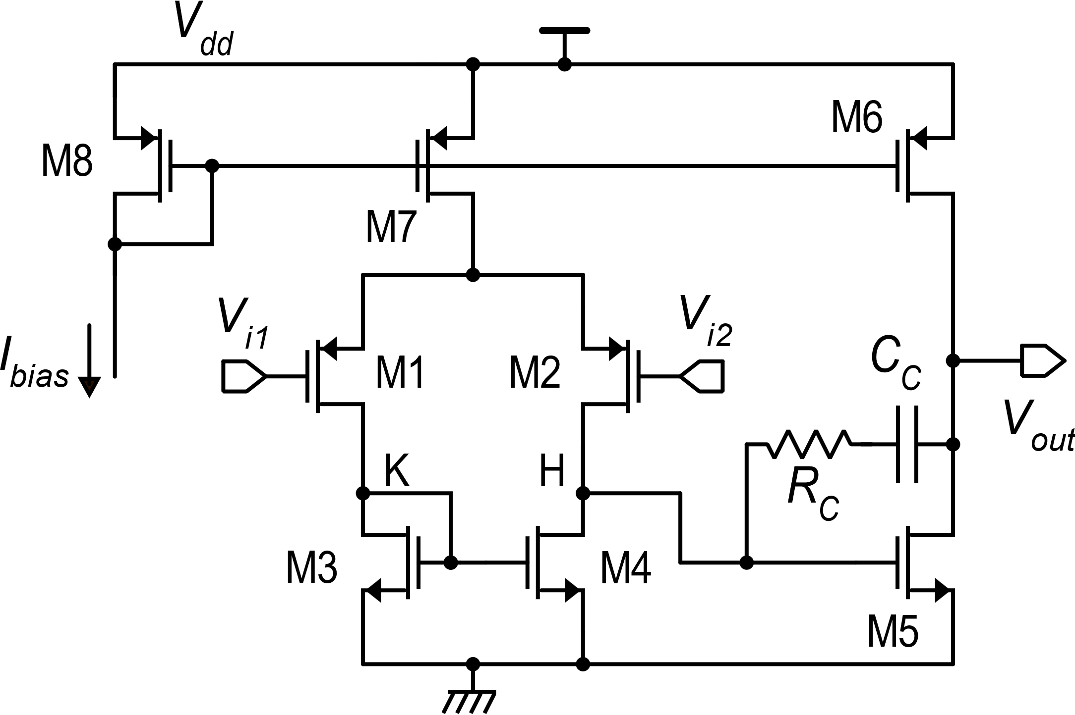
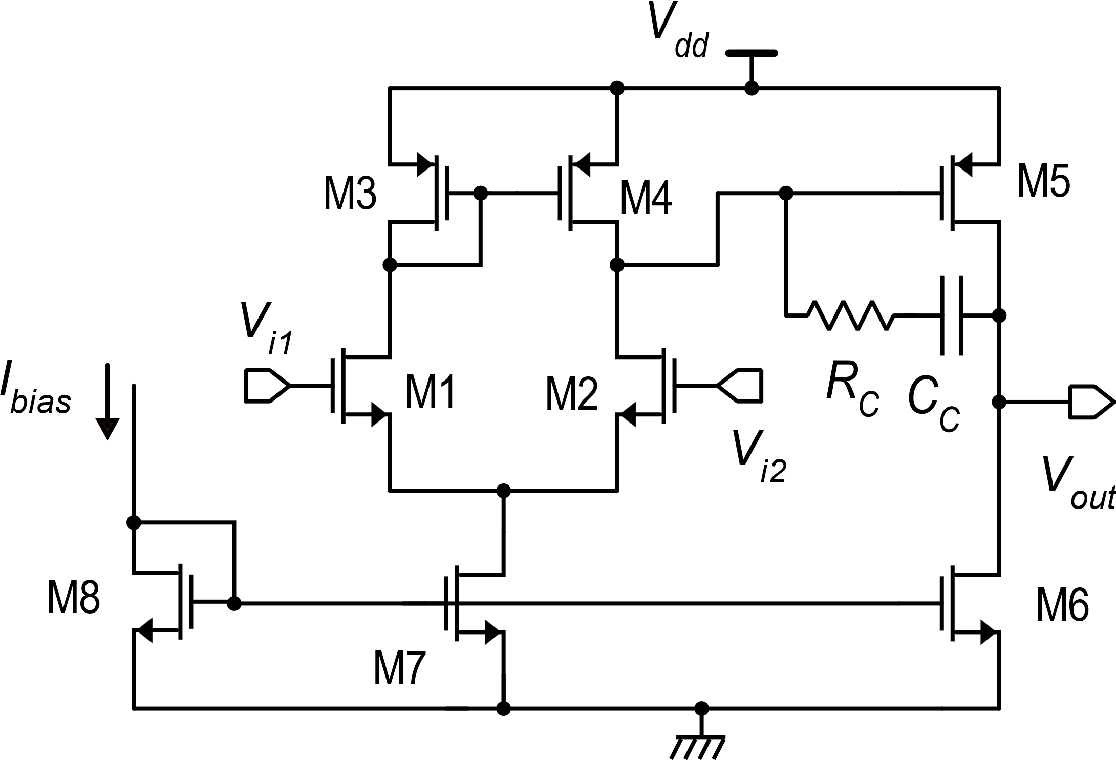
Popular op-amp topologies
Two stage op-amp with simple differential amplifier in the input stage and class-A common-source output stage
p-input version
Input range may include gnd
May sink large currents
n-input version
Input range may include V_{dd}
May source large currents

Slide 2
Improved topologies (better performances, but greater complexity)
Cascode stages
Class AB stages
Larger gain, simpler Rail-to-Rail input stages
Large output current with small quiescent power consumption

Slide 3
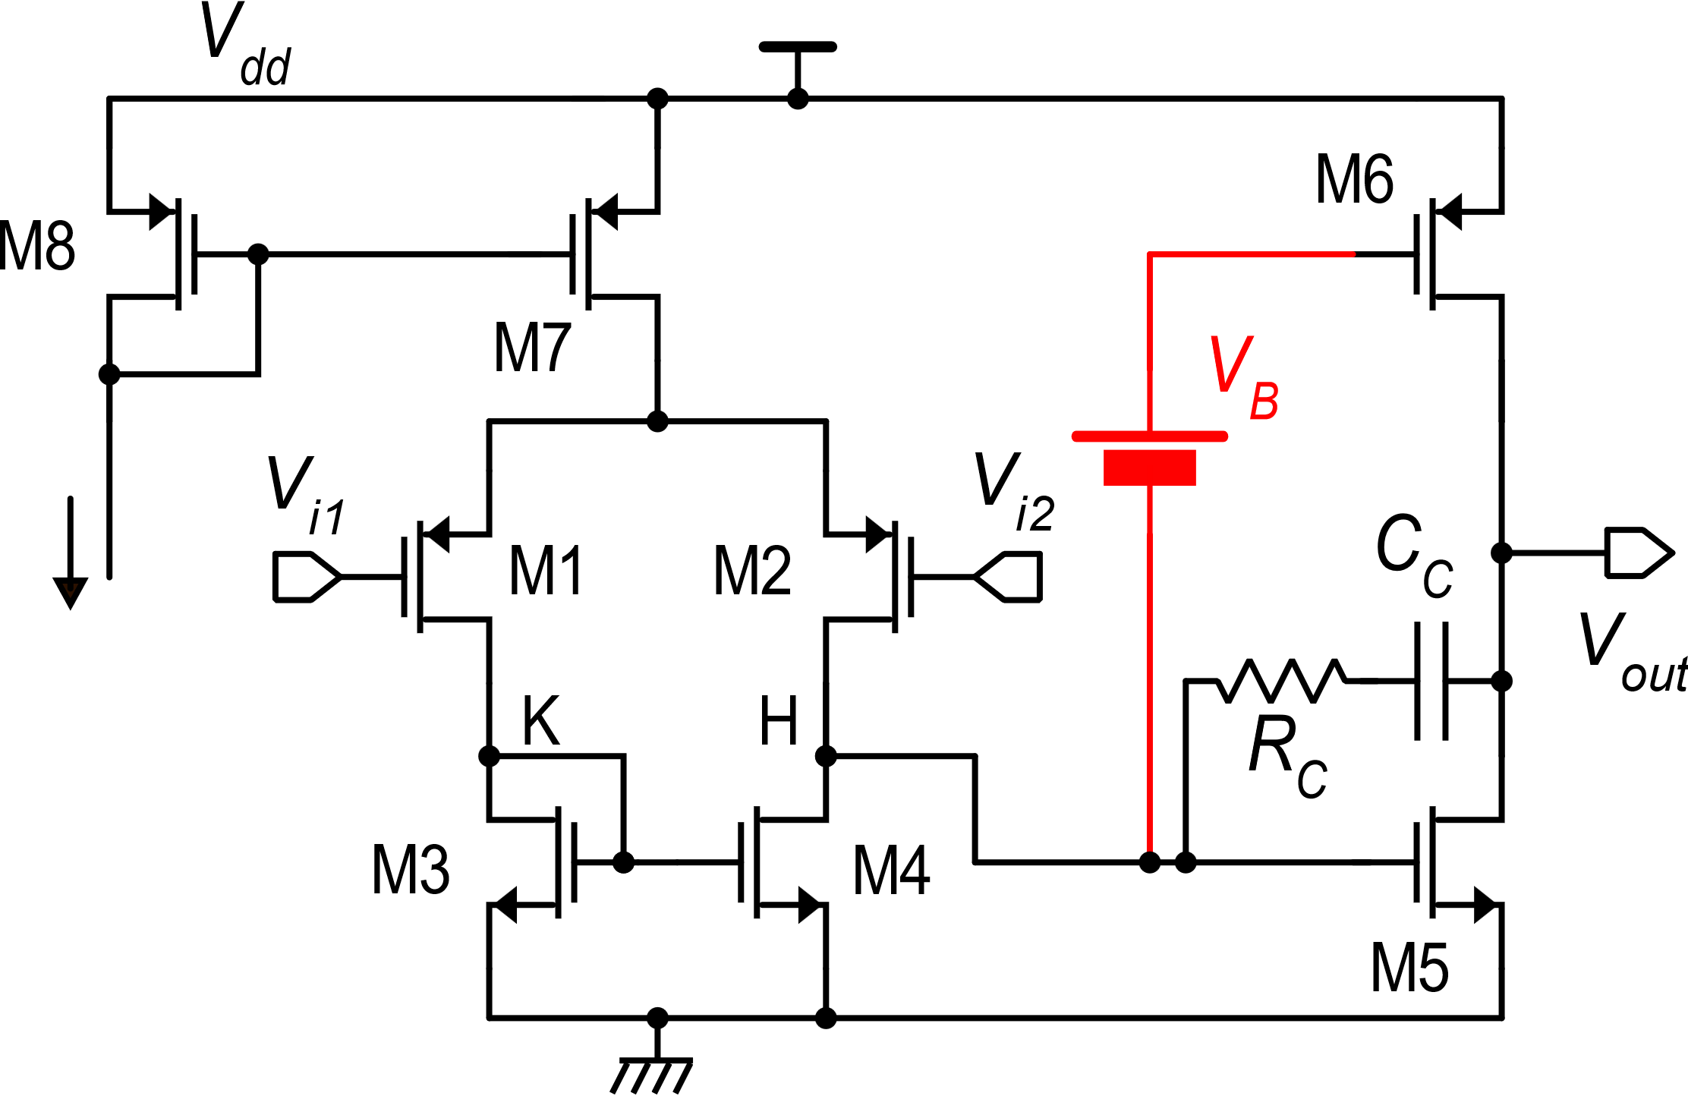
Class-AB output stages
$$I_{bias}$$
Quiescent currents:
I_{D5} does not depend on V_{dd}, while I_{D6} does.
The output short circuit current depends on V_{dd}
Poor PSRR

Slide 4
Op-amps with class- AB output stages
If we want to save this solution, we need to adapt both V_{GS5} and V_{GS6} when V_{dd} changes, and guarantee that:
is always valid

Slide 5
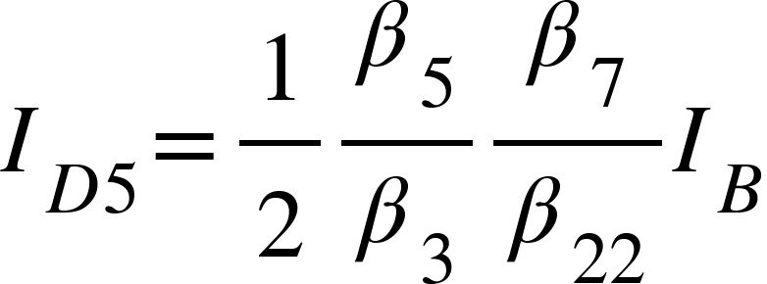
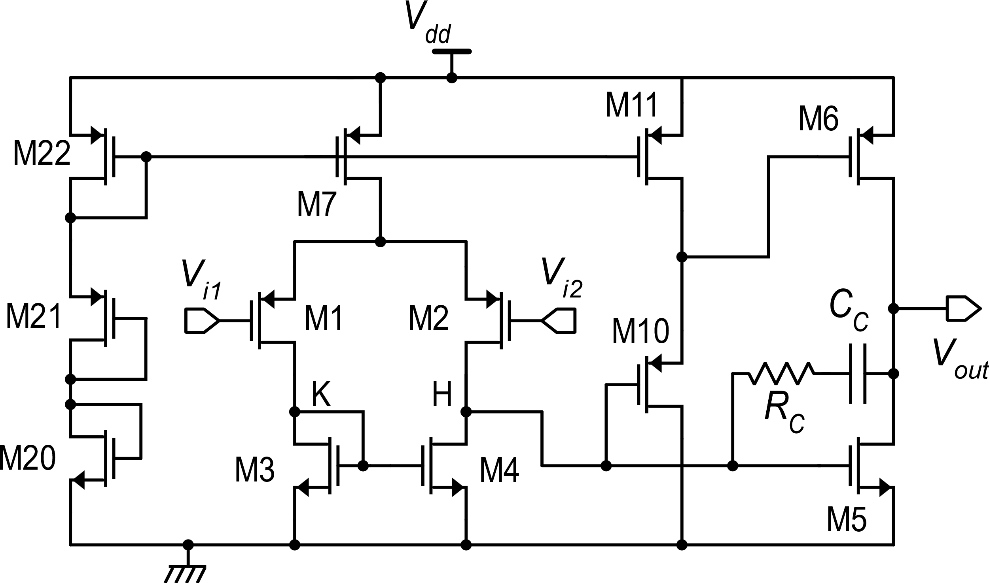
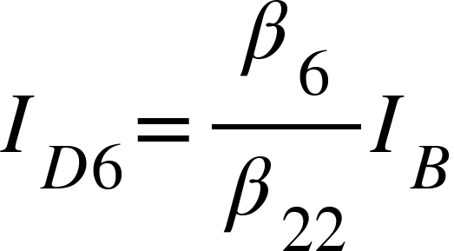
Op-amps with class- AB output stages
Bias chain
Voltage shifter
I_{B}
Good PSRR

Slide 6
Op-amps with class- AB output stages
Second stage
Second stage
Voltage shifter:
additional singularities
Y_{m2}(s) G_{m2}(s)
G_{m2}=g_{m5}+g_{m6}

Slide 7
Limitations: minimum V_{dd}
For the class-A amplifier, the minimum Vdd was only V_{GS}+2V_{DSAT} ≅ 0.9 V
Minimum Vdd: 3V_{GS}≅ 2.1 V

Slide 8
Reduced V_{GS} excursion for the output devices
Both V_{GS5} and V_{GS6} cannot reach V_{dd}. If large output currents are required, this means that M5 and M6 should be designed with very large W
I_{ON-MAX} strongly depends on the input common mode voltage

Slide 9
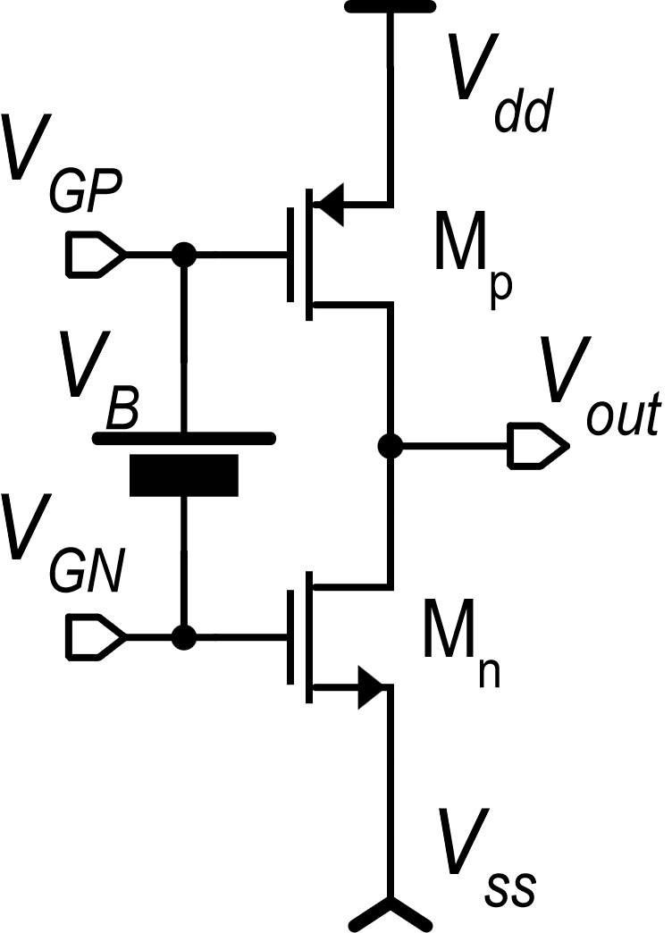
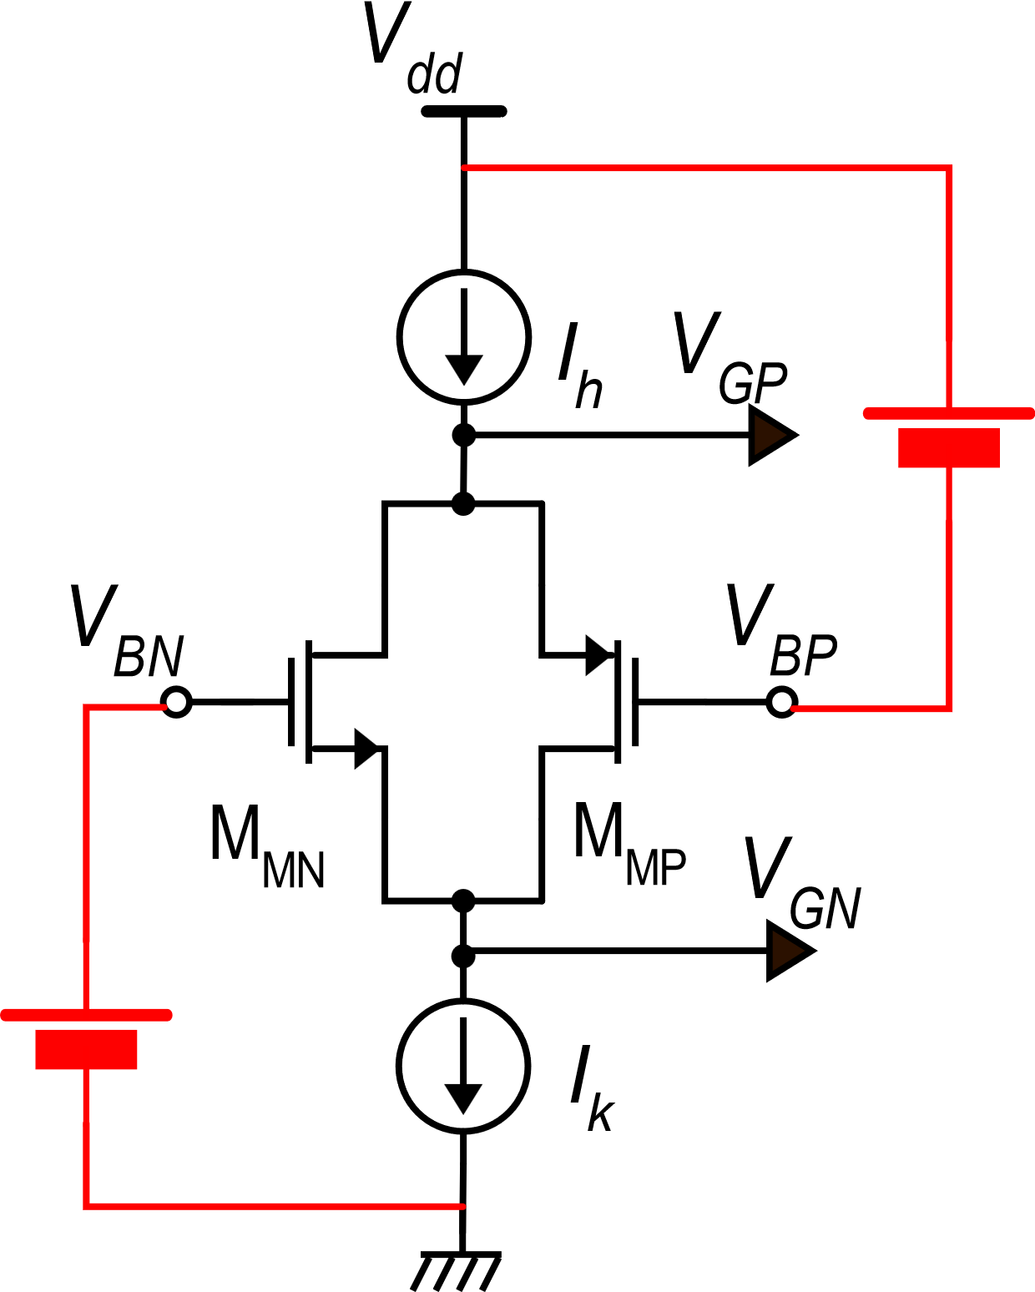
The Monticelli's class-AB stage
I_{h} and I_{k} includes also the variations due to the input signal and have a high output differential resistance (not shown for simplicity)
I_{n}
I_{p}
Floating battery
D. M. Monticelli, “A quad CMOS single-supply op amp with rail-to-rail
output swing,” IEEE J. Solid-State Circuits, vol. SC-21, pp. 1026-1034, Dec. 1986.

Slide 10
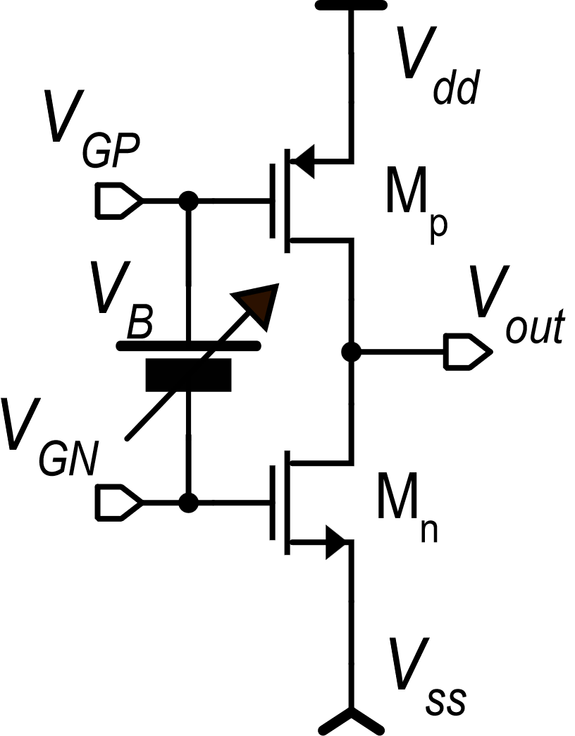
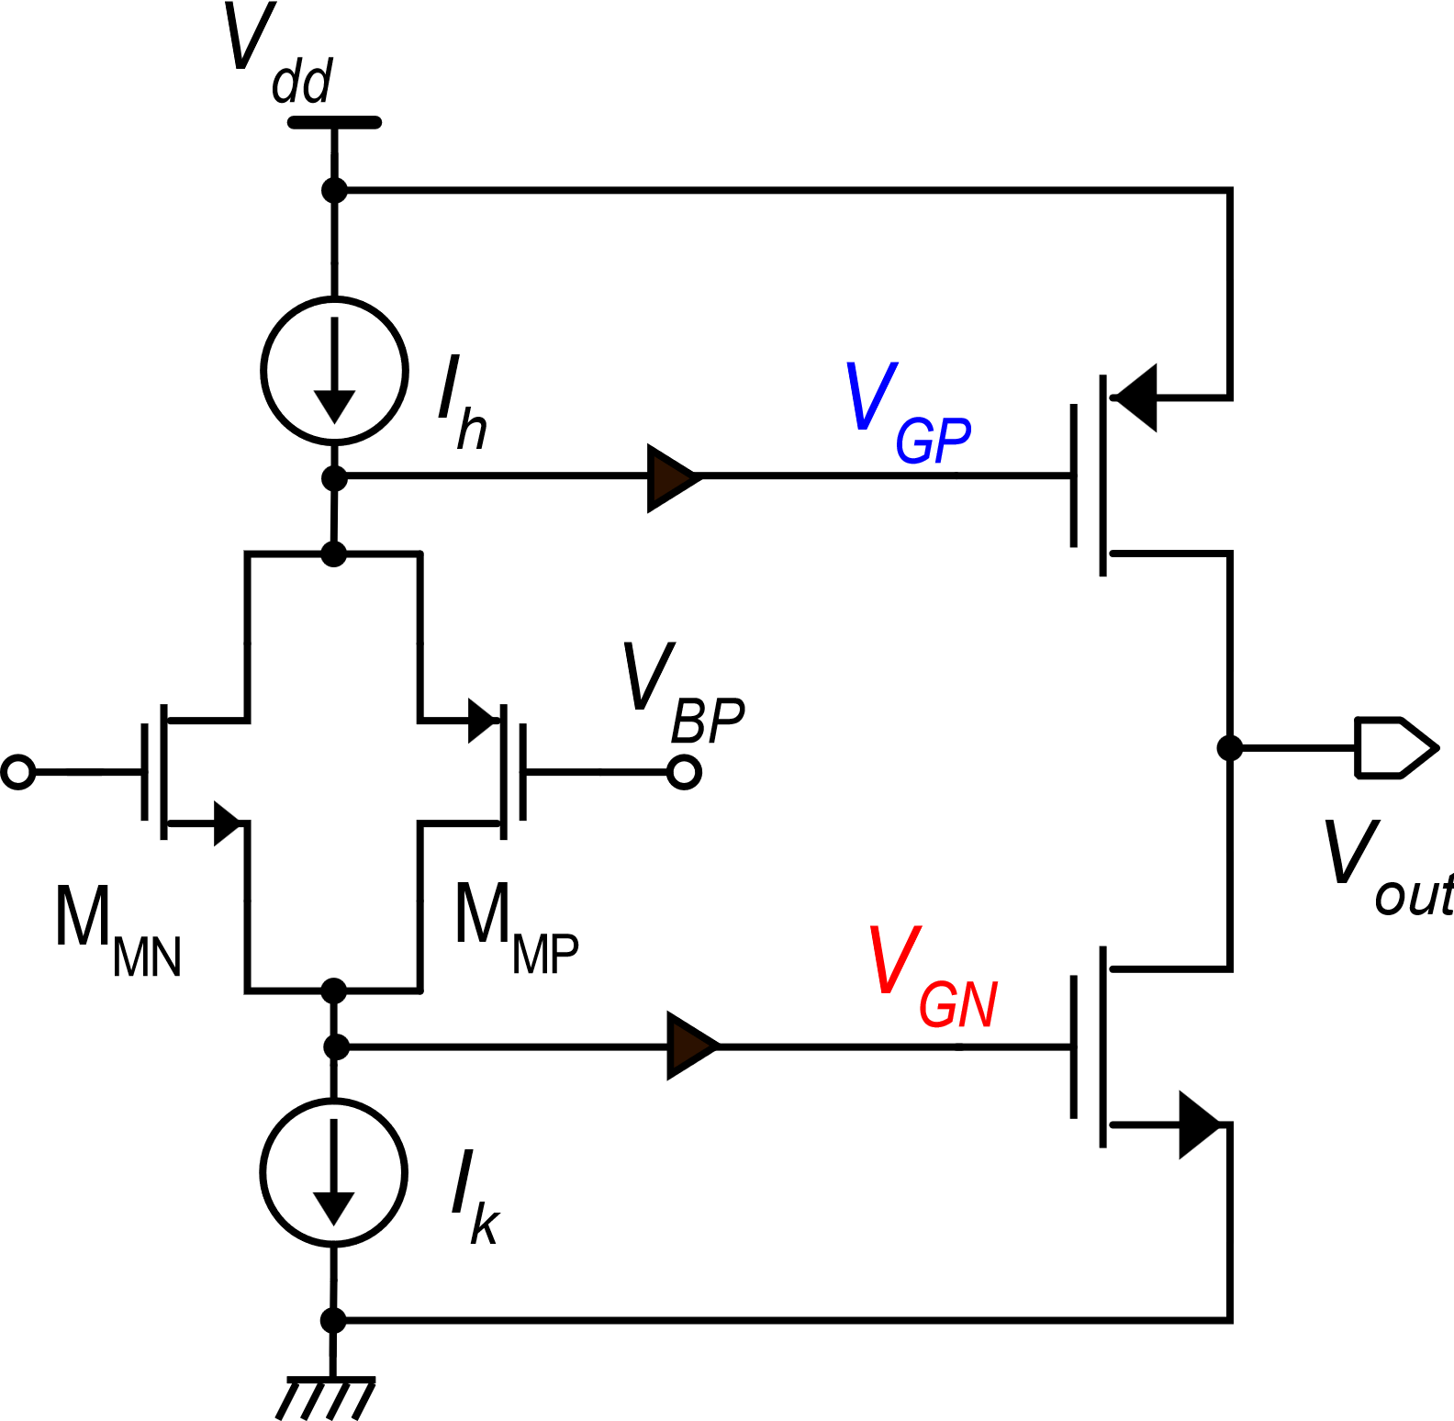
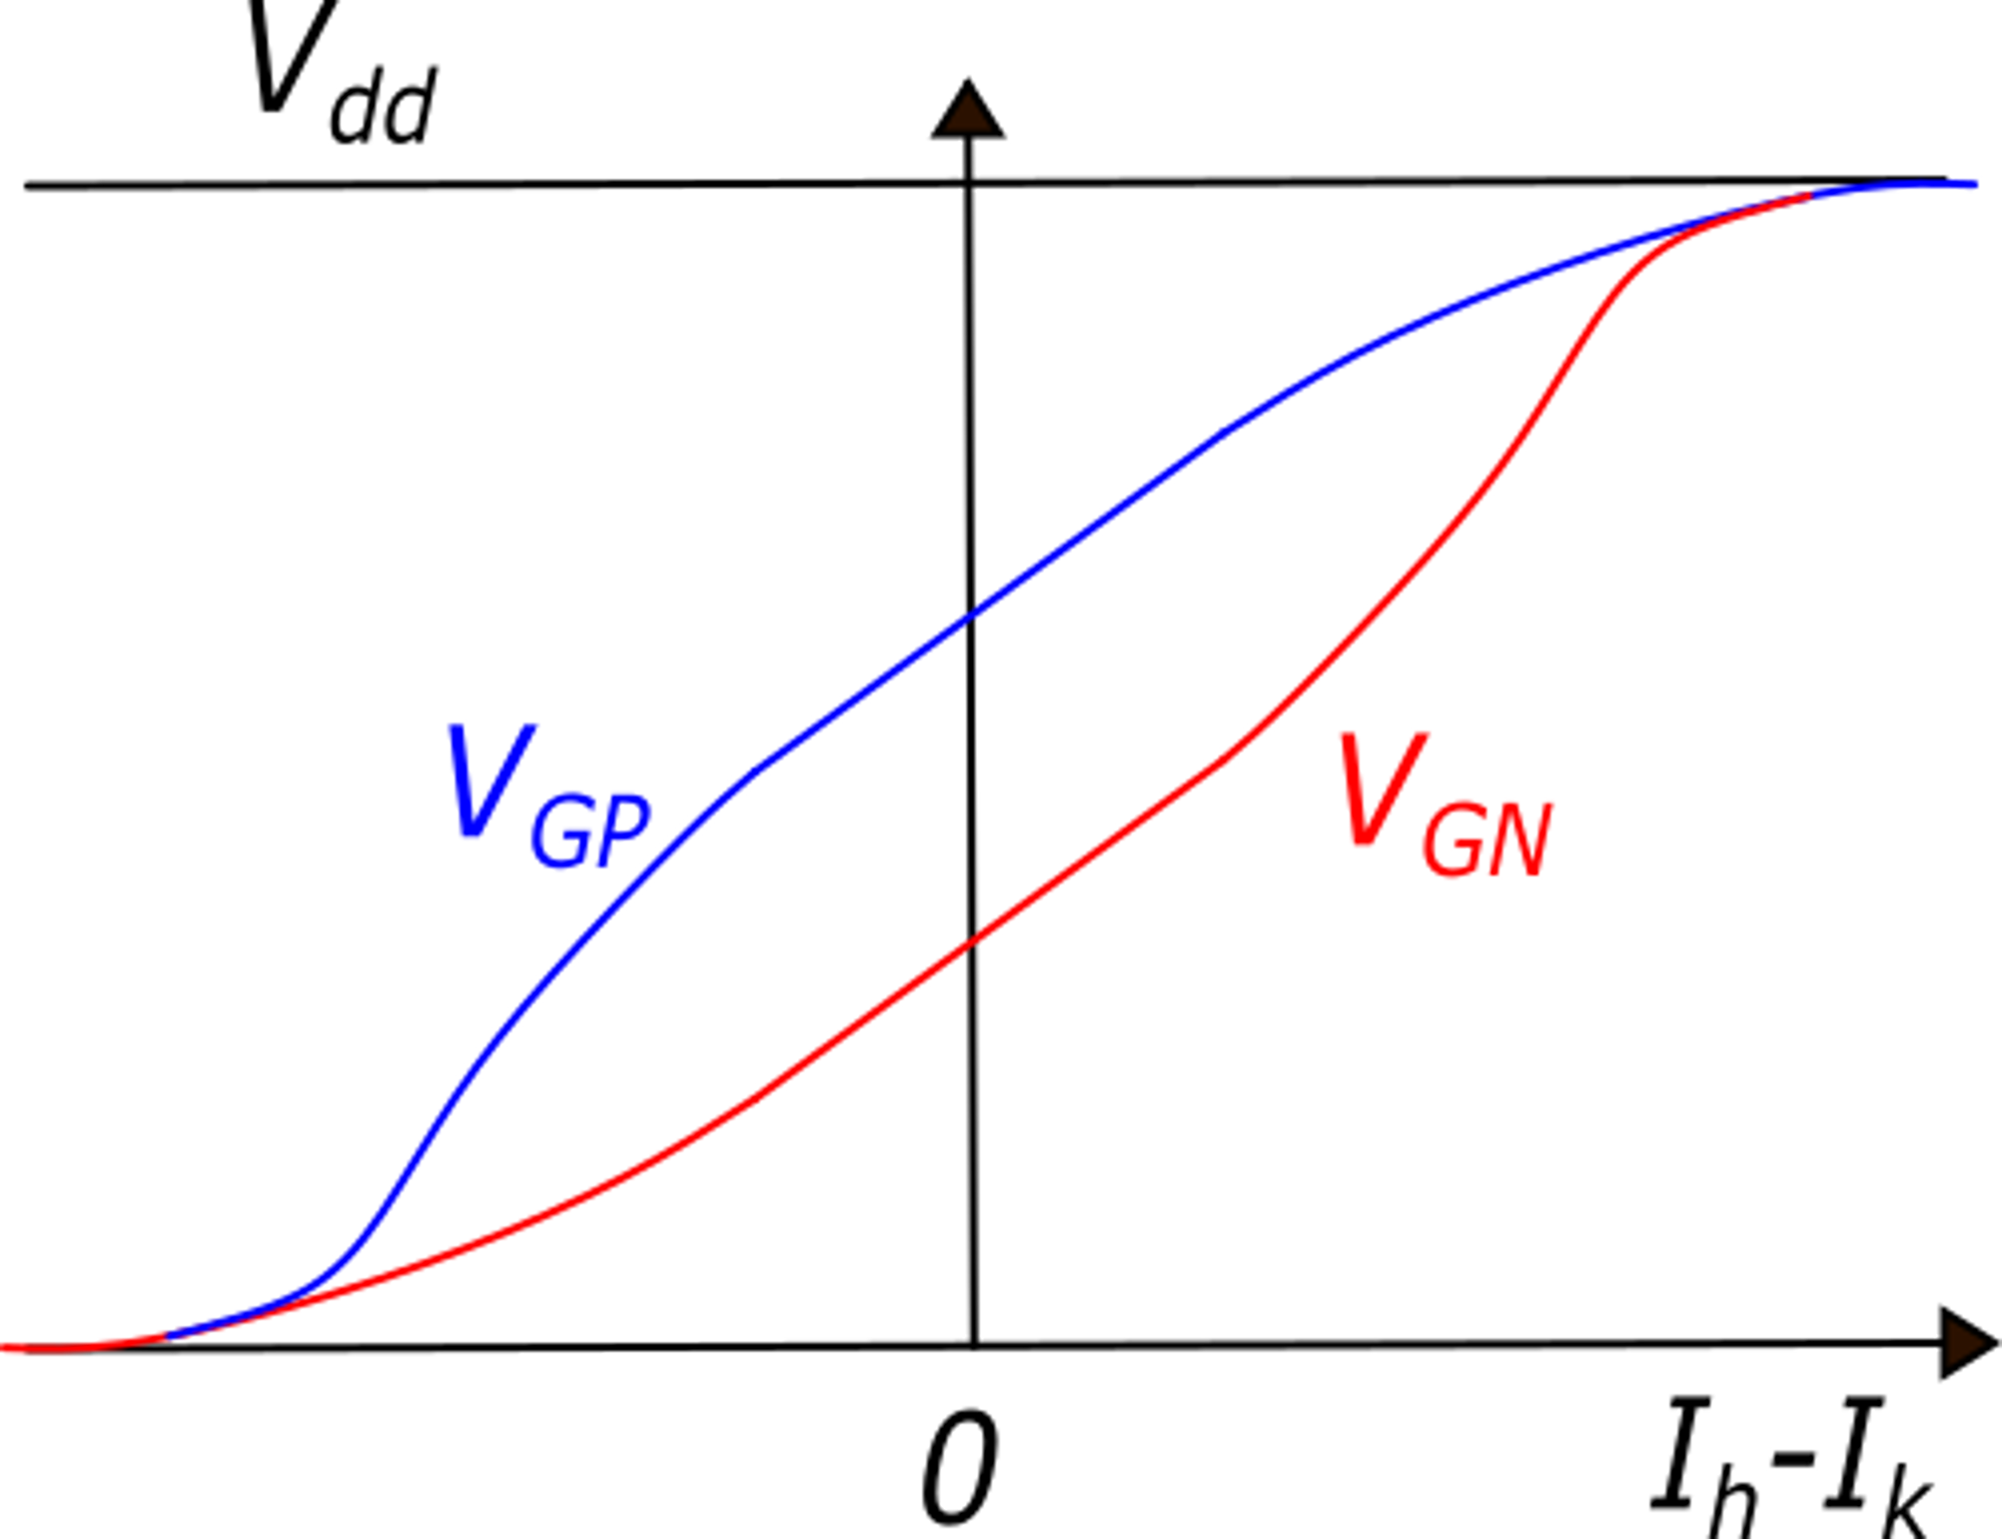
The Monticelli's class-AB stage
Here, Ip>>In, then v_{gn}>>v_{gp}
and V_{B} reduces
V_{B}
V_{BN}
output devices
M_{NM} and M_{MP}, are designed to have same g_{m} in the operating point: v_{gn}=v_{gp} (variations)

Slide 11
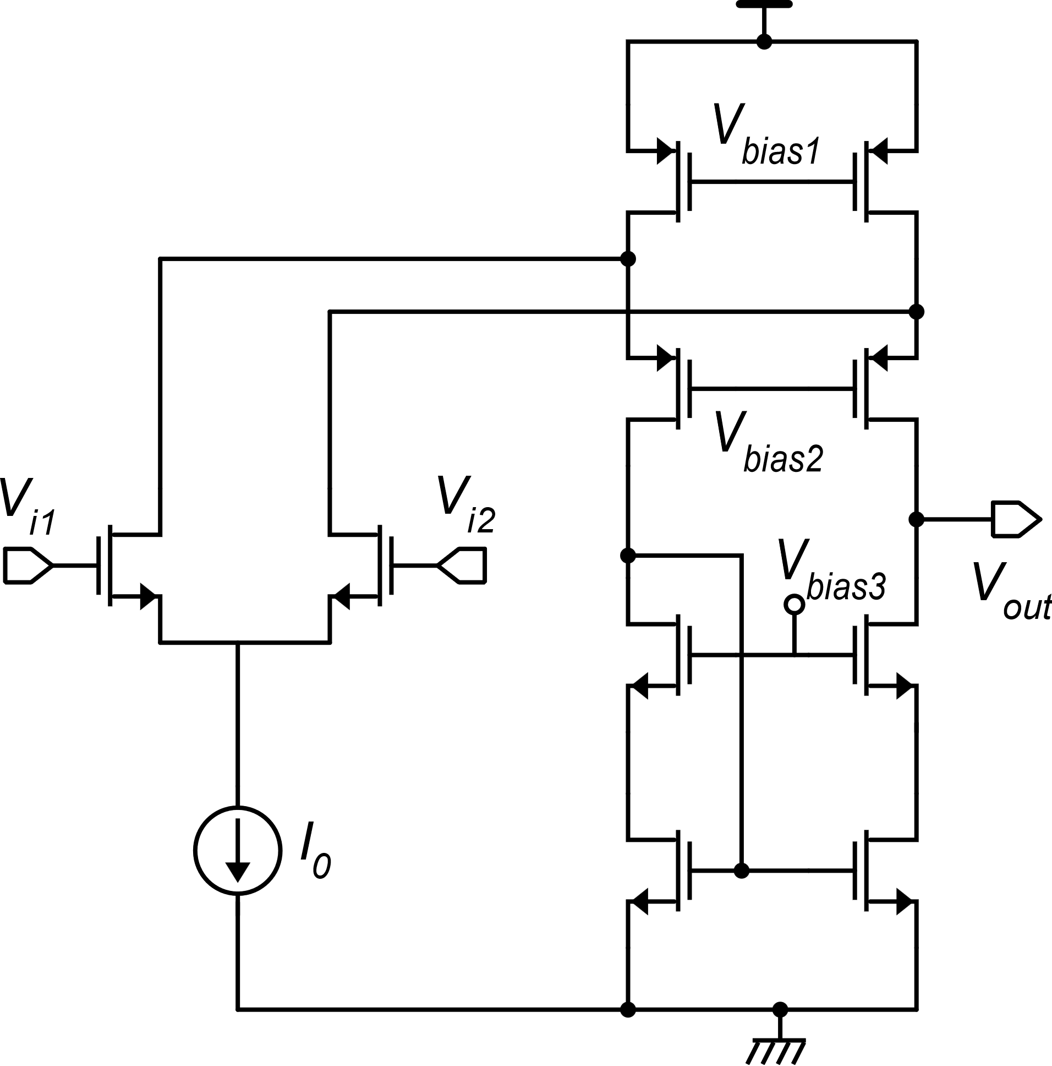
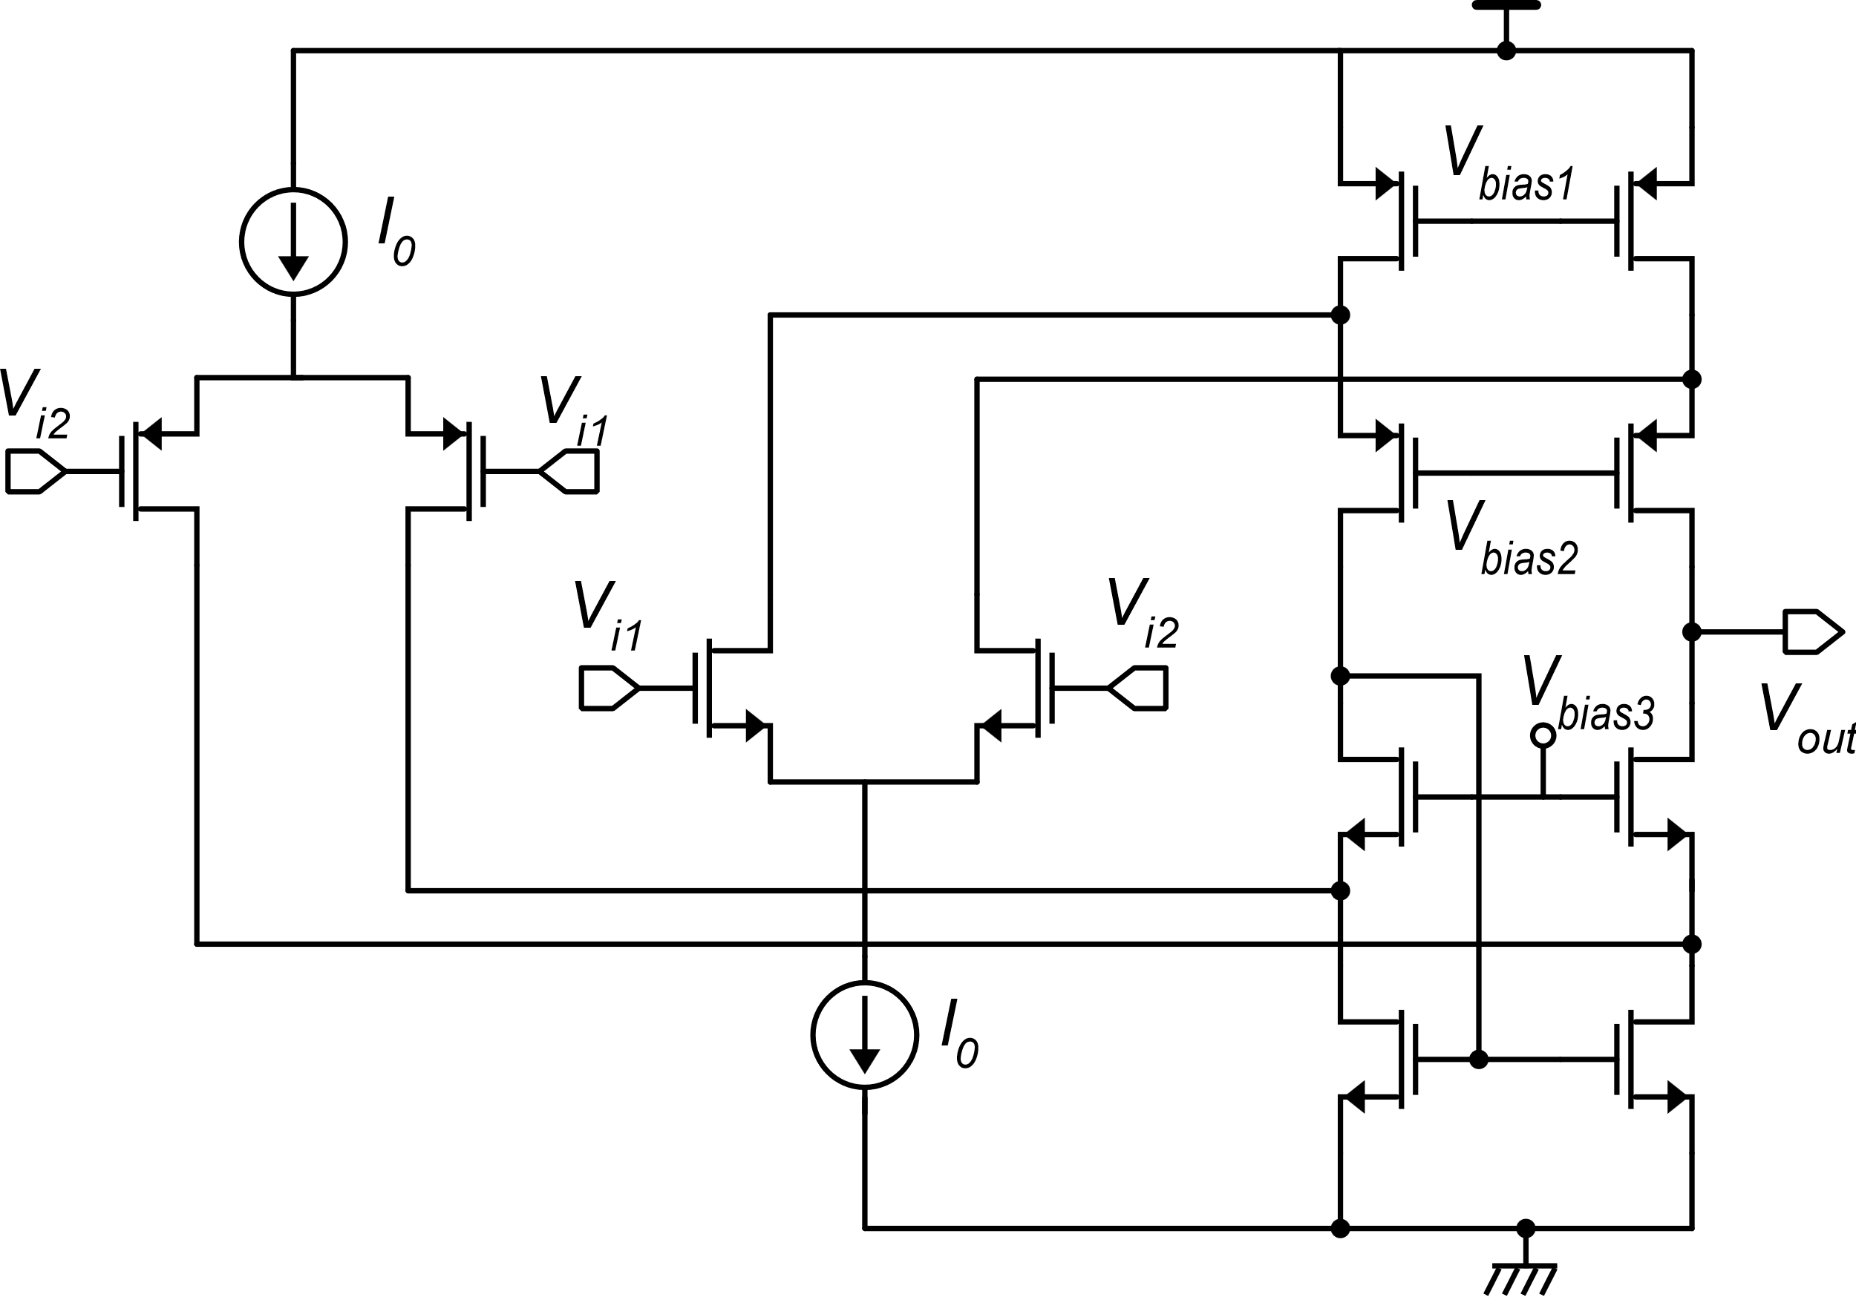
First stage: folded cascode for improved gain and larger swing
n-input folded cascode
Folded cascode with rail-to-rail input range

Slide 12
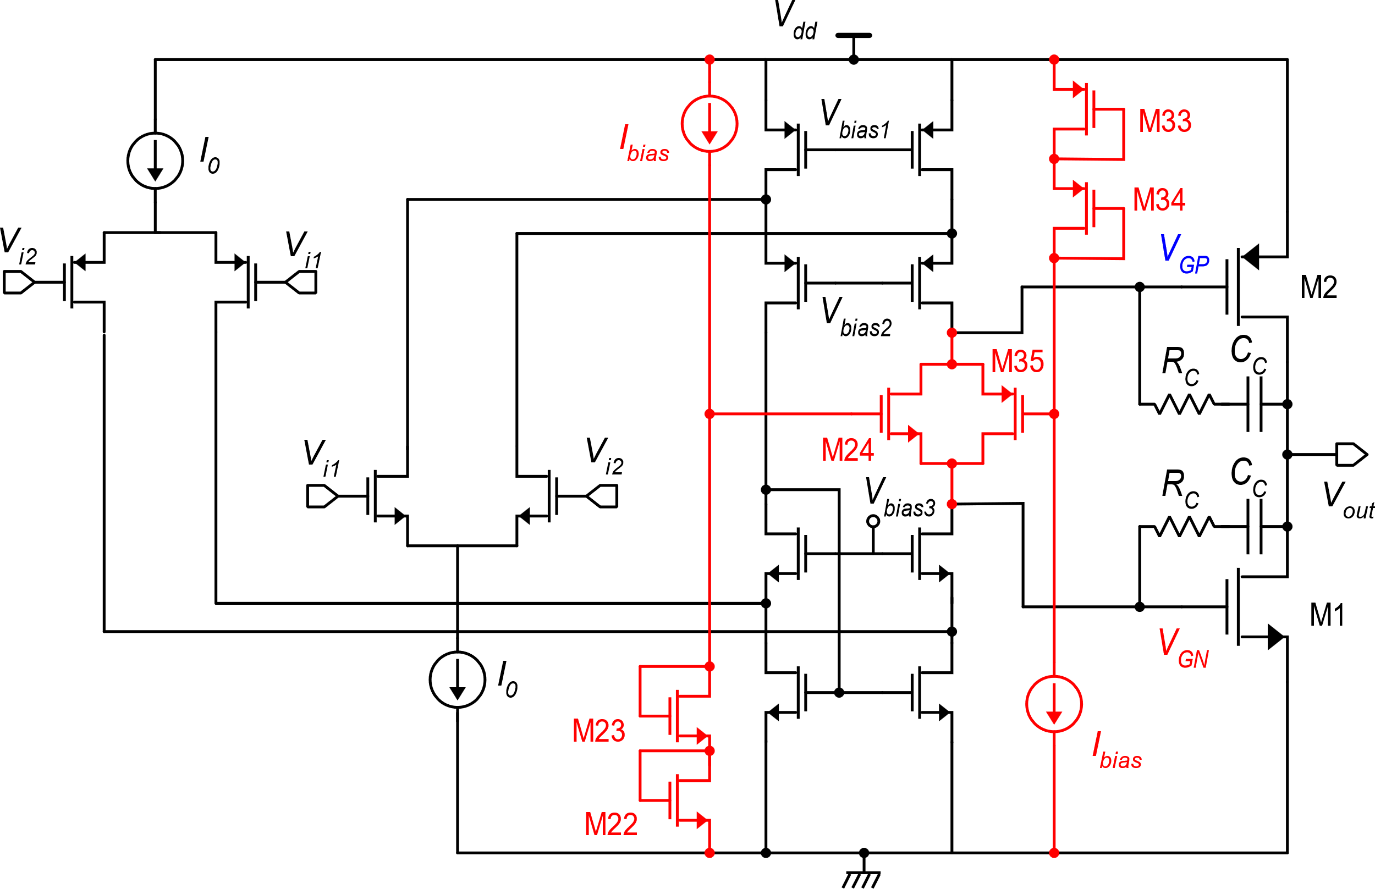
High performance - two-stage CMOS op-amp
High gain:${ ≈\left(g_{m}r_{d}\right)}^{3}$
Class-AB output stage
Rail-to-Rail input range
M24 and M35 form the Monticelli's cell
M22-M23 and M33-M34 produce the gate bias for M24 and M35, respectively
In quiescent conditions, we design I_{bias}, M23 and M34 to make: V_{GS24}=V_{GS23} and V_{GS35}=V_{GS34}
Minimum Vdd: 2V_{GS}+V_{DSAT} ≅ 1.5 V
This simplify setting of M1,M2 quiescent current
R. Hogervorst et al., “A Compact Power-Efficient 3 V CMOS Rail-to-Rail Input/Output Operational Amplifier for VLSI Cell Libraries”, IEEE JSSC, 1994

Slide 13
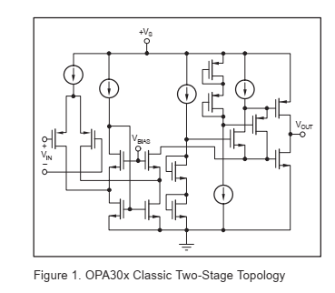
Commercial products

