Slide 1
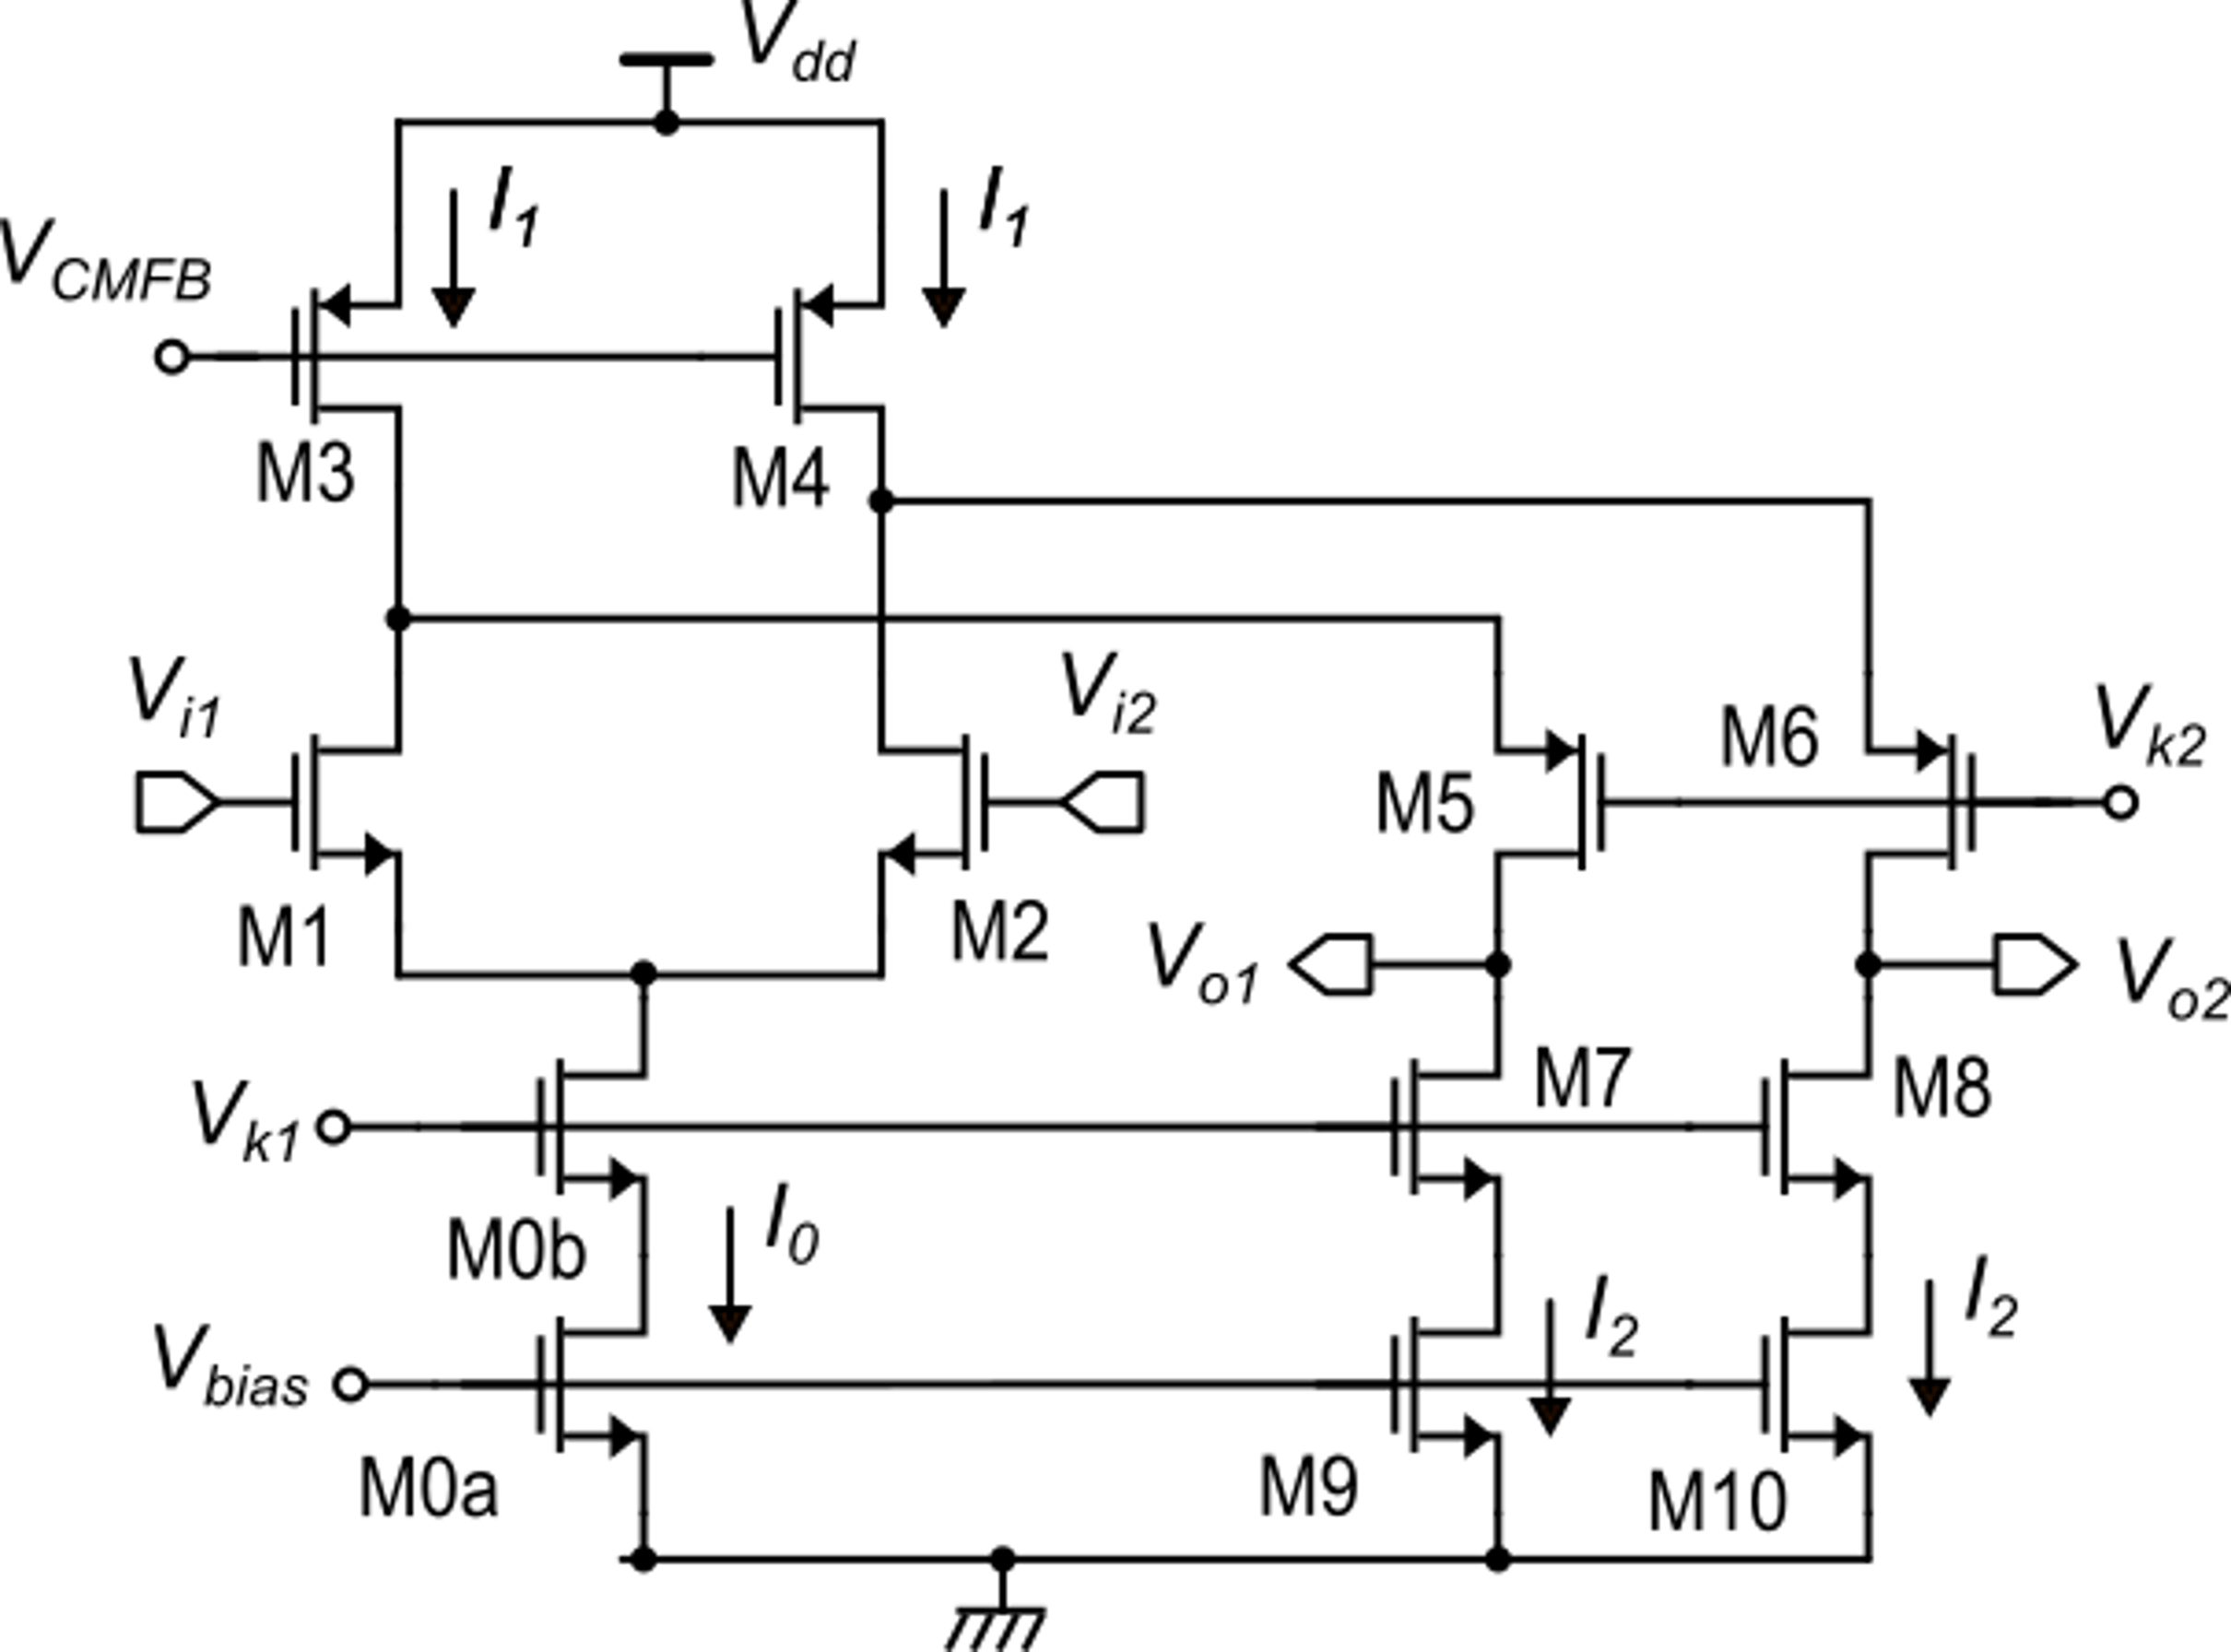
Folded cascode amplifier: quiescent current and total supply current
In order to avoid turning off M5 and M6 for all v_{id} values such that |v_{id}| < V_{dmax}
We usually choose:
Since it must be:
then:
The supply current is:

Slide 2
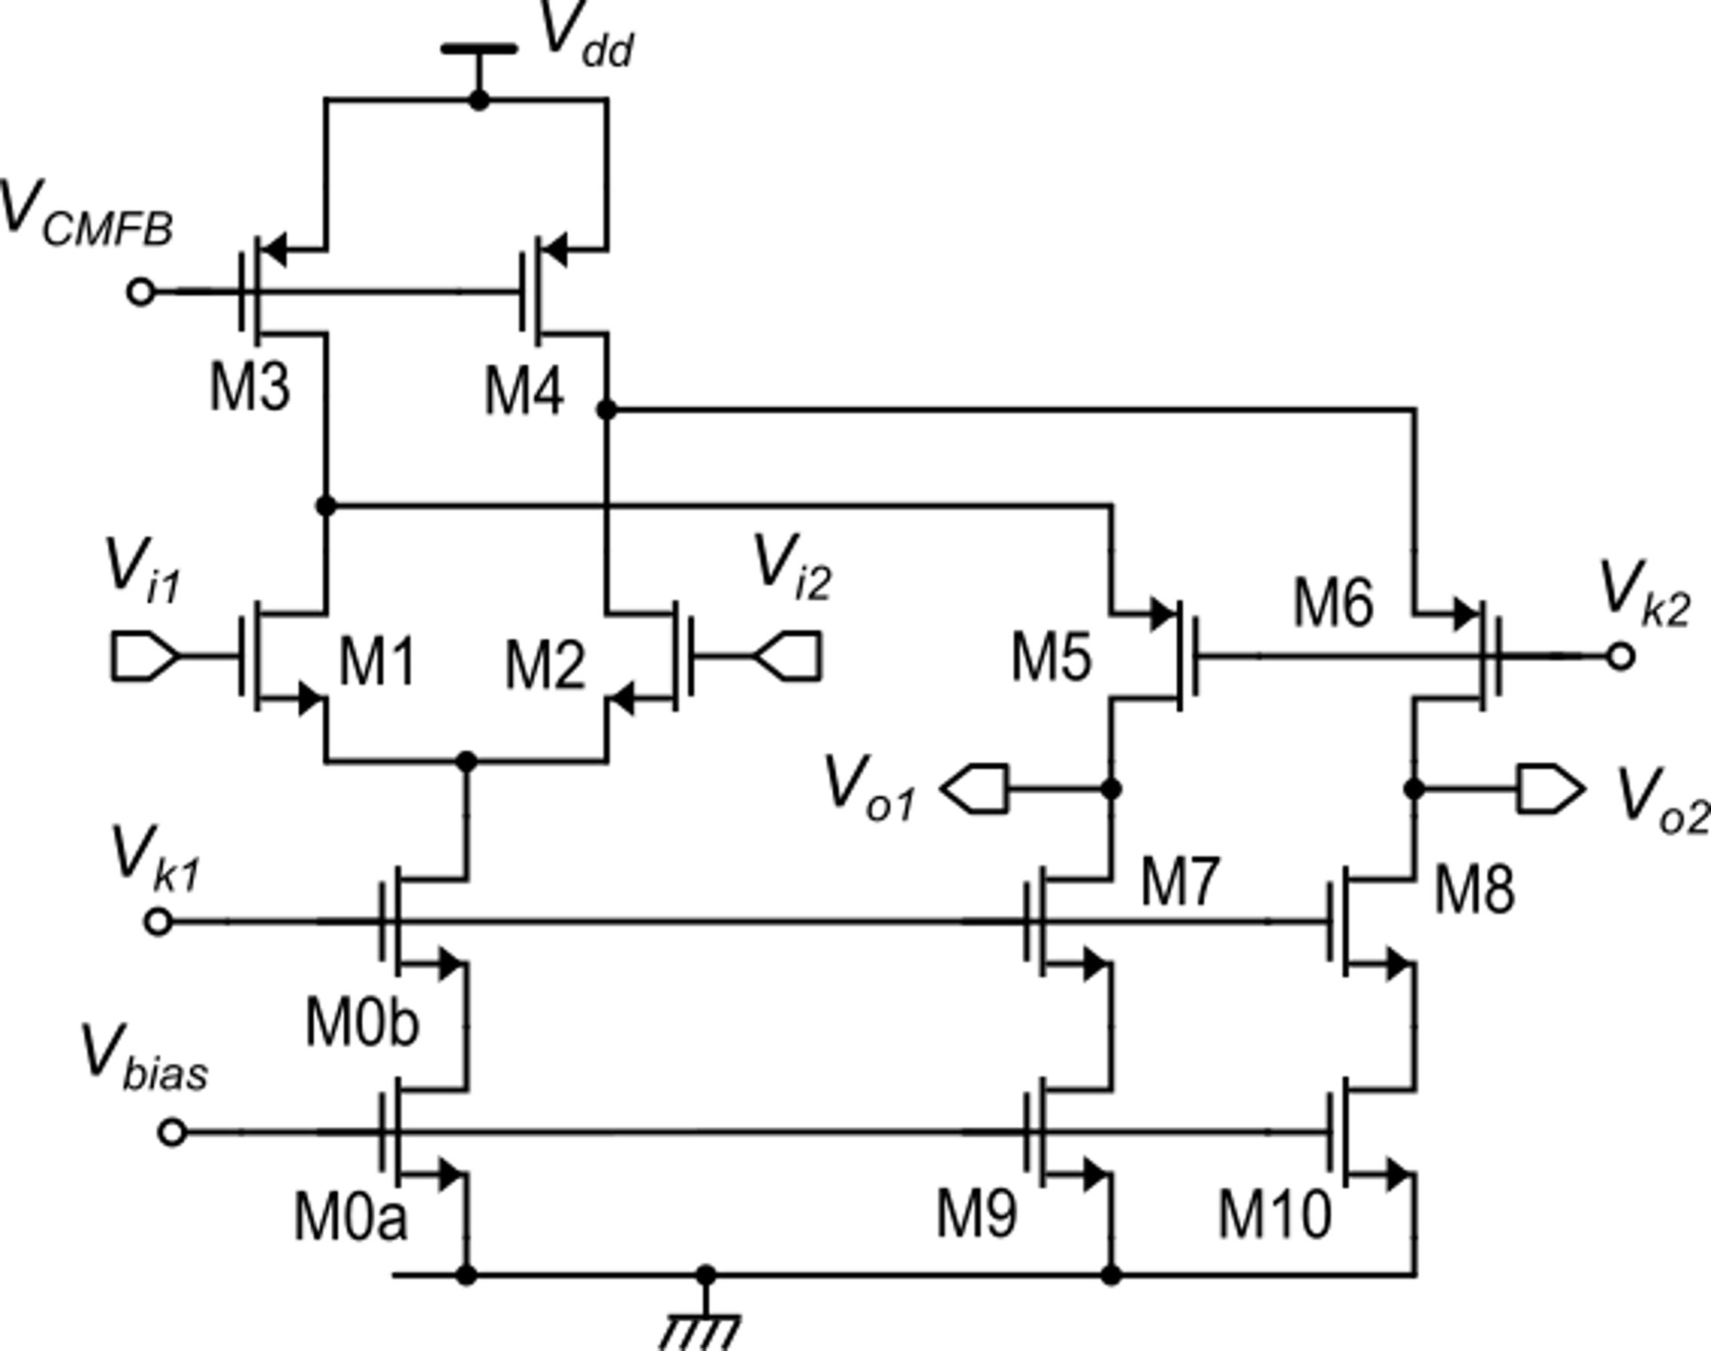
Folded cascode fully-differential amplifier: noise analysis
All these MOSFET form common gate stages.
These devices give
common mode contributions (except when the amplifier is unbalanced by a large differential input voltage)
Their noise and offset contribution can be neglected up to relatively high frequencies

Slide 3
Fully-differential amplifier: noise analysis
Devices that gives a significant contribution to the amplifier noise and offset

Slide 4
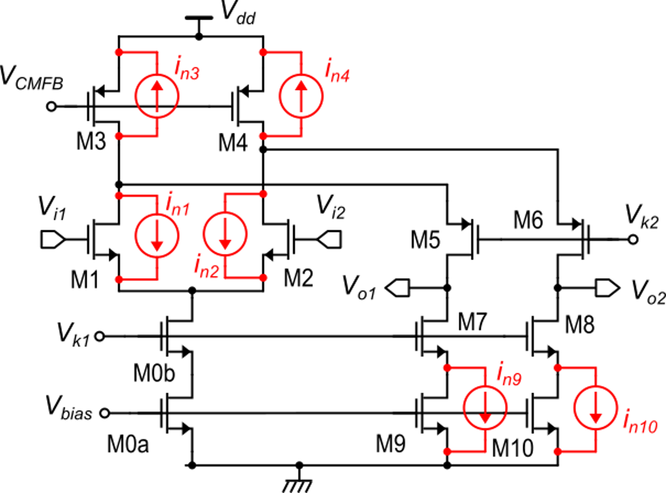
Calculation of the input referred noise (and offset).

Slide 5
Calculation of the input referred noise.
This expression can be used for both the noise and offset analysis

Slide 6
Noise
Expressing the S_{I} as a function of the PSDs of the gate referred voltage noise (S_{V})

Slide 7
Fully-differential amplifier: noise analysis
F₃ is difficult to make <<1 since it includes a factor of 2 and making V_{TE3} >> V_{TE1} would result in reduced output swing

Slide 8
Frequency response of the folded cascode op-amp
Let us analyze the frequency response of the output short circuit currents.
The drain current variations produced by the input pair reach the output port passing through the common gate stage
Let us indicate the transfer function of the common gate as A_{I-CG}(s)

Slide 9
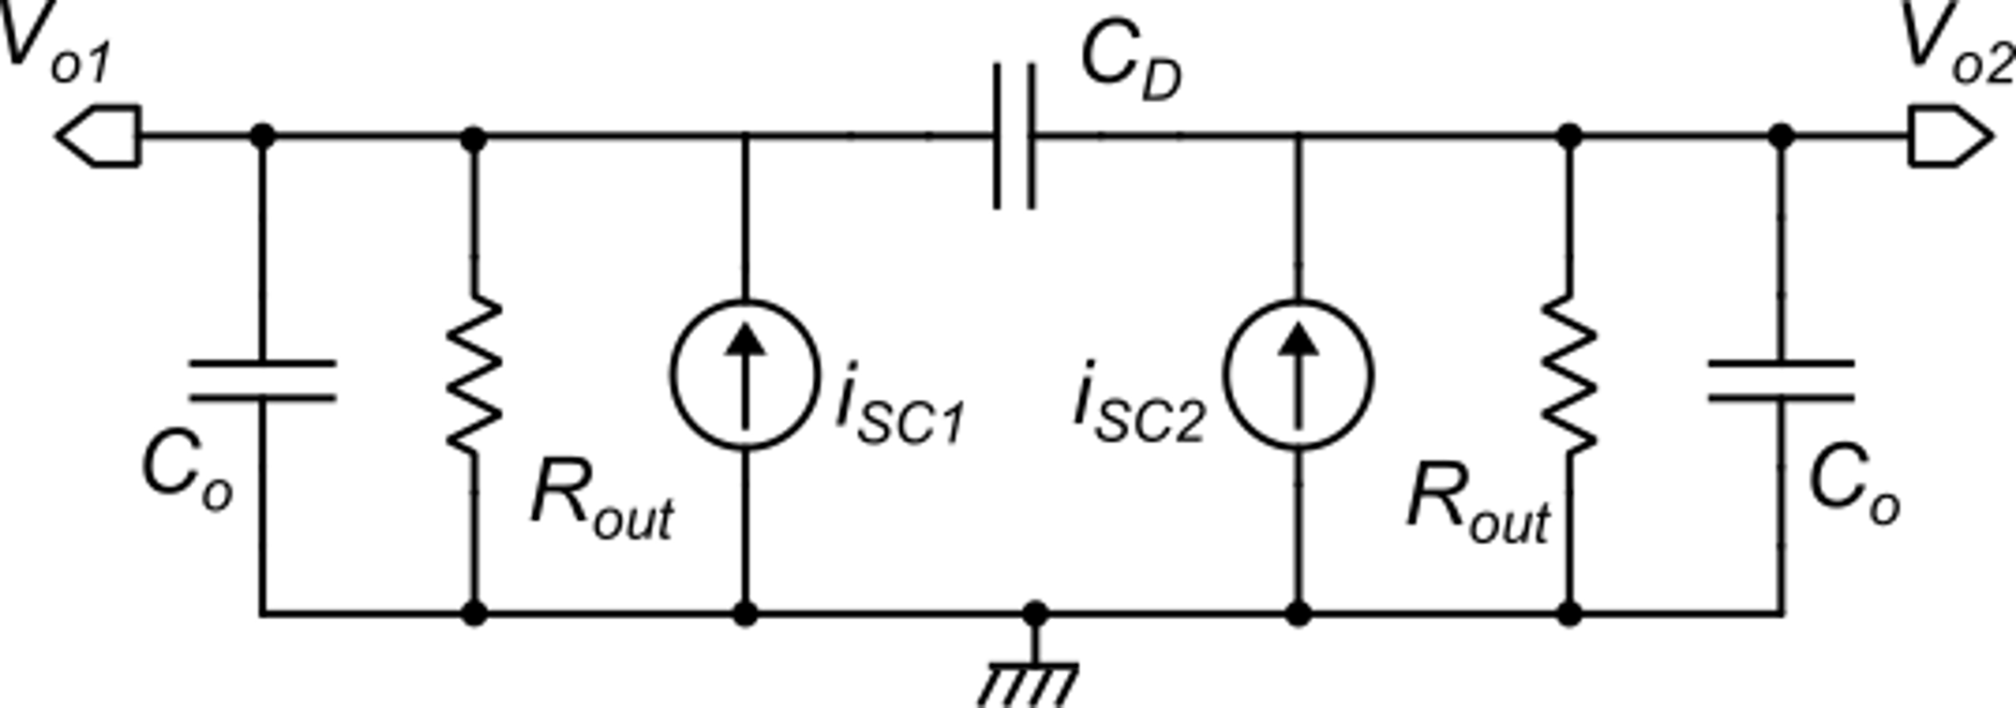
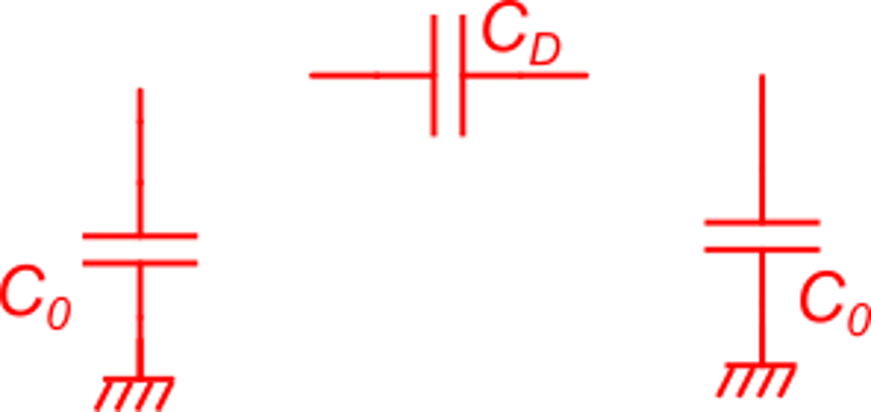
Frequency response of the folded cascode op-amp
Small signal circuit of the output ports
C_{O},C_{D}: Load capacitances

Slide 10
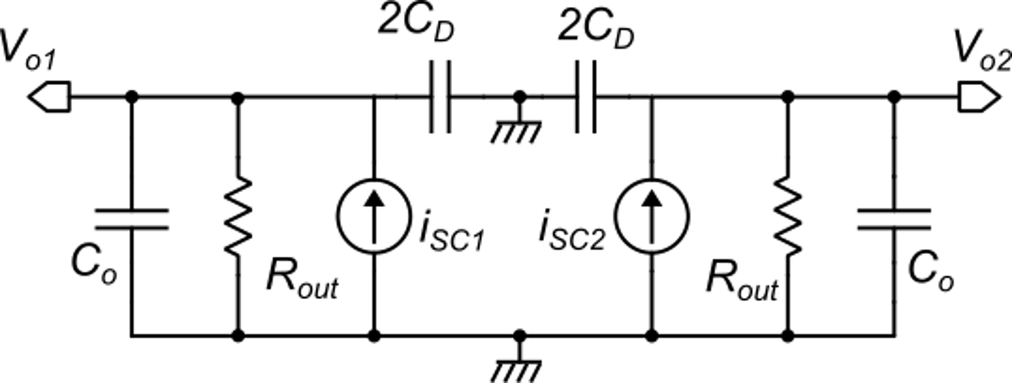
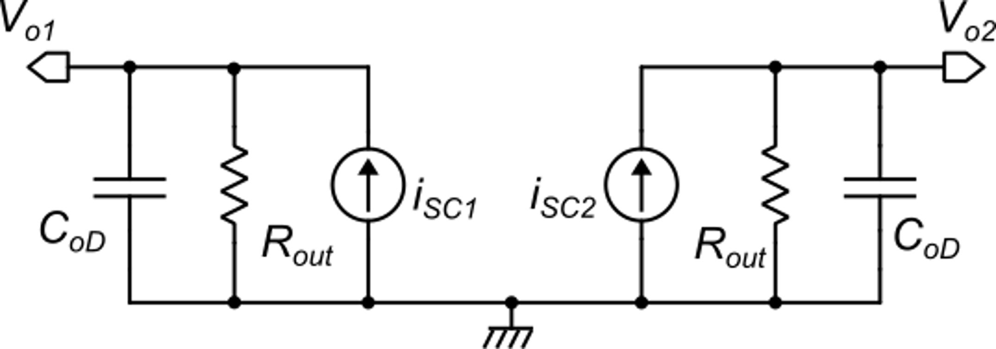
Differential mode analysis

Slide 11
Differential mode analysis
Response of the common gate

Slide 12
Differential mode analysis
Common gate
C_{p-cg}
C_{p-cg}
Dominant pole:
First non dominant pole:

Slide 13
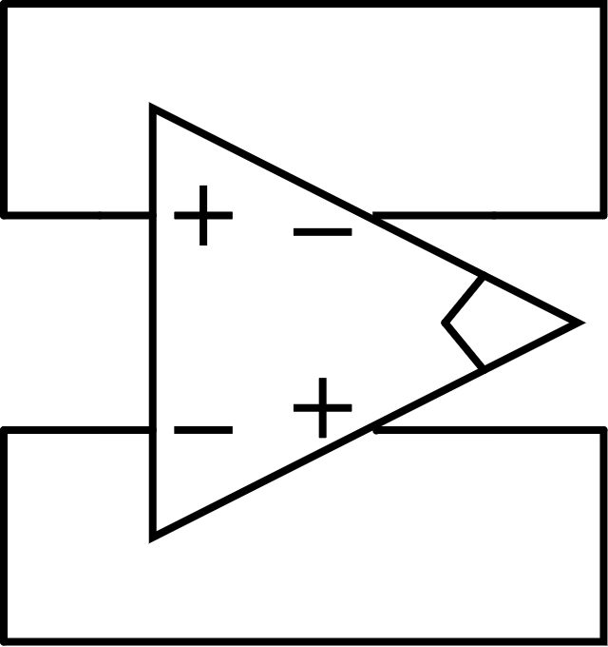
Differential mode analysis: stability in closed loop configurations
Unity gain angular-frequency:
C_{oD}
C_{oD}
First non dominant pole:
Worst case for stability: |β|=1
To have about 70° phase margin:
Increasing the equivalent differential-mode load capacitances (C_{oD}) reduces the unity gain angular frequency (ω_{0d}), improving the phase margin but also reduces the GBW.

Slide 14
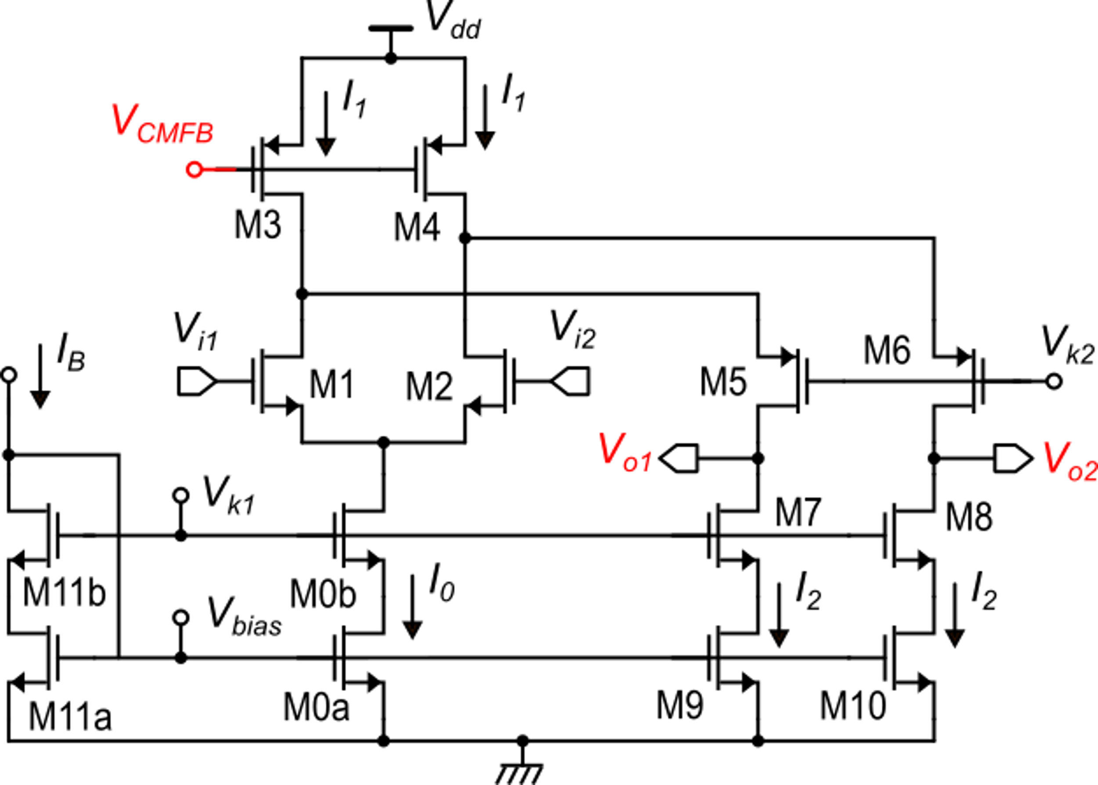
Mention to common mode stability
Considering small signal components, this is a feedback loop that can lead to instability
v_{oc}
CMFB
circuit
The dominant pole of the common mode loop is still due to the output capacitance
C_{L}
C_{L}
The load capacitances, if connected between the outputs and ground, help reducing the 0-dB frequency of the CMFB loop, improving stability

Slide 15
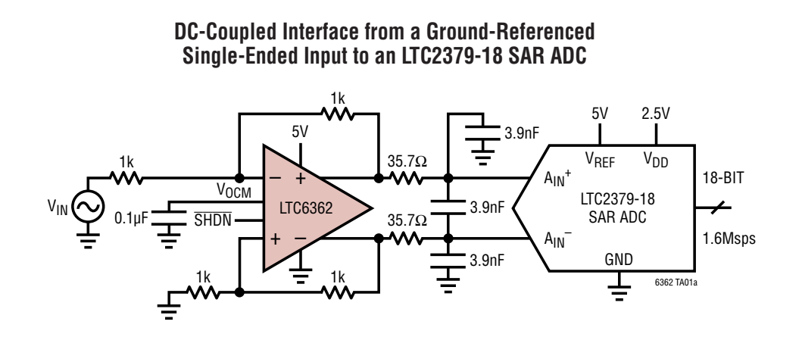
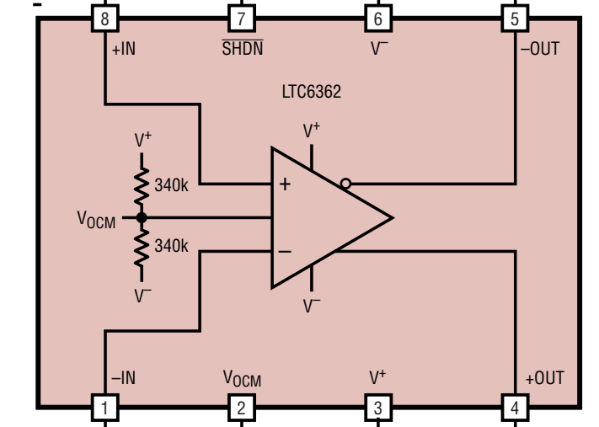
Example of commercial fully-differential op-amp: LTC6362

