Slide 1
StrongARM: insights from literature
Analysis inspired by “The StrongARM Latch” paper from Prof. B. Razavi
DOI: 10.1109/MSSC.2015.2418155

Slide 2
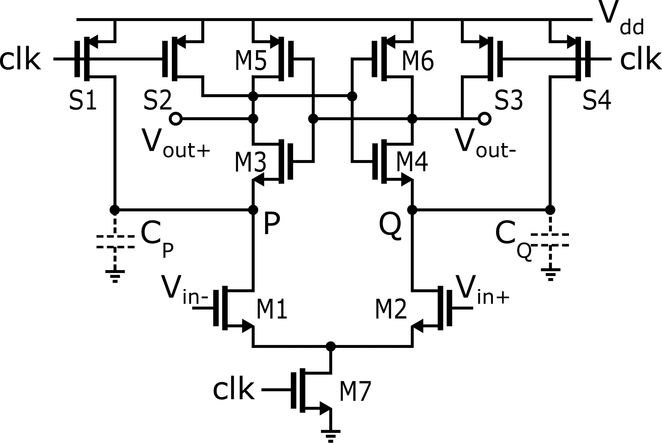
Dynamic comparator: StrongARM structure
Reset switches
First proposed as Sense Amplifier for SRAM (used in StrongARM microprocessor, in the ‘90s)
No static-power consumption
Rail-to-rail outputs
Compares V_{id} = V_{in}⁺-V_{in}⁻ on the rising edge of the clock signal
Output valid when clk=1. During clk=0, both Vout+, Vout- are at Vdd
Latch
Clocked differential pair

Slide 3
Dynamic comparator: StrongARM structure
Reset switches
Zero input-referred hysteresis: at each reset phase, the comparator loses ‘memory’ of the previous cycle state.
Nevertheless: the comparator will evolve to a full logical state. (Latch: level regeneration)
Operation in 3 phases: (i) Reset, (ii) Amplification, (iii) Regeneration
Latch
Clocked differential pair

Slide 4
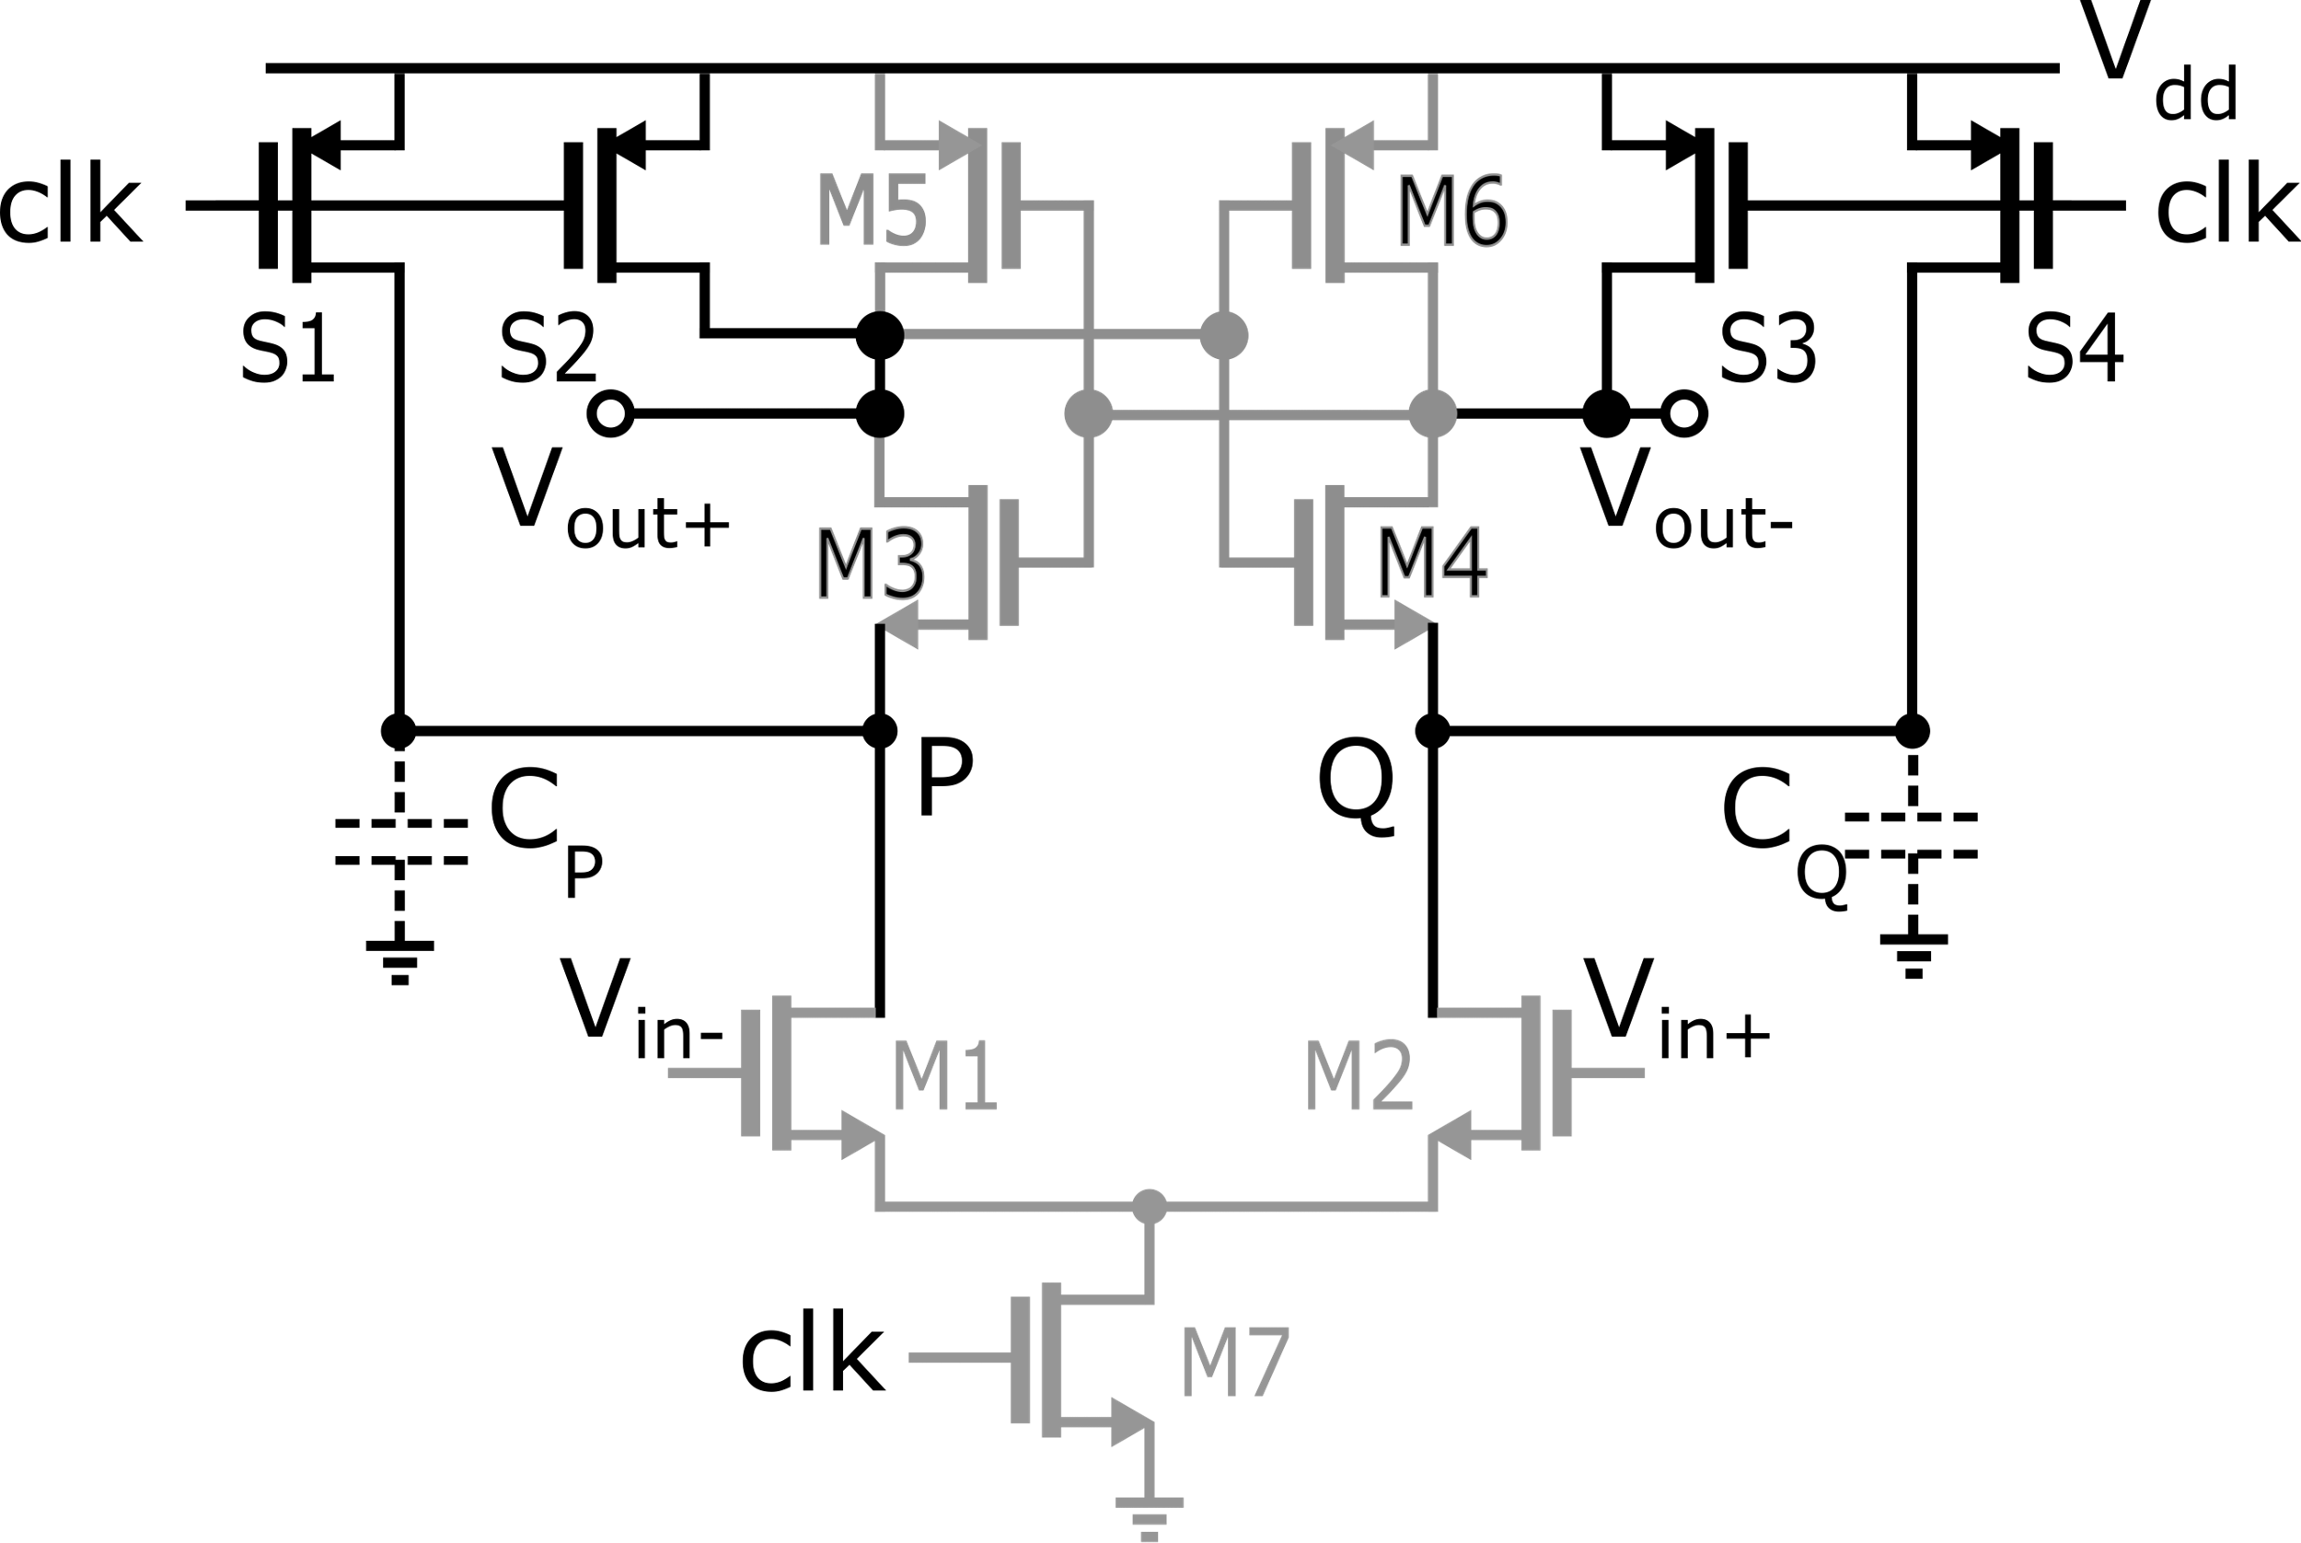
StrongARM: Reset Phase
0
0
The input pair devices are off
Nodes P, Q, V_{out+}, V_{out-} are connected to V_{dd} through S1-S4
Latch is inactive
Parassitic CP and CQ are precharged to Vdd
0

Slide 5
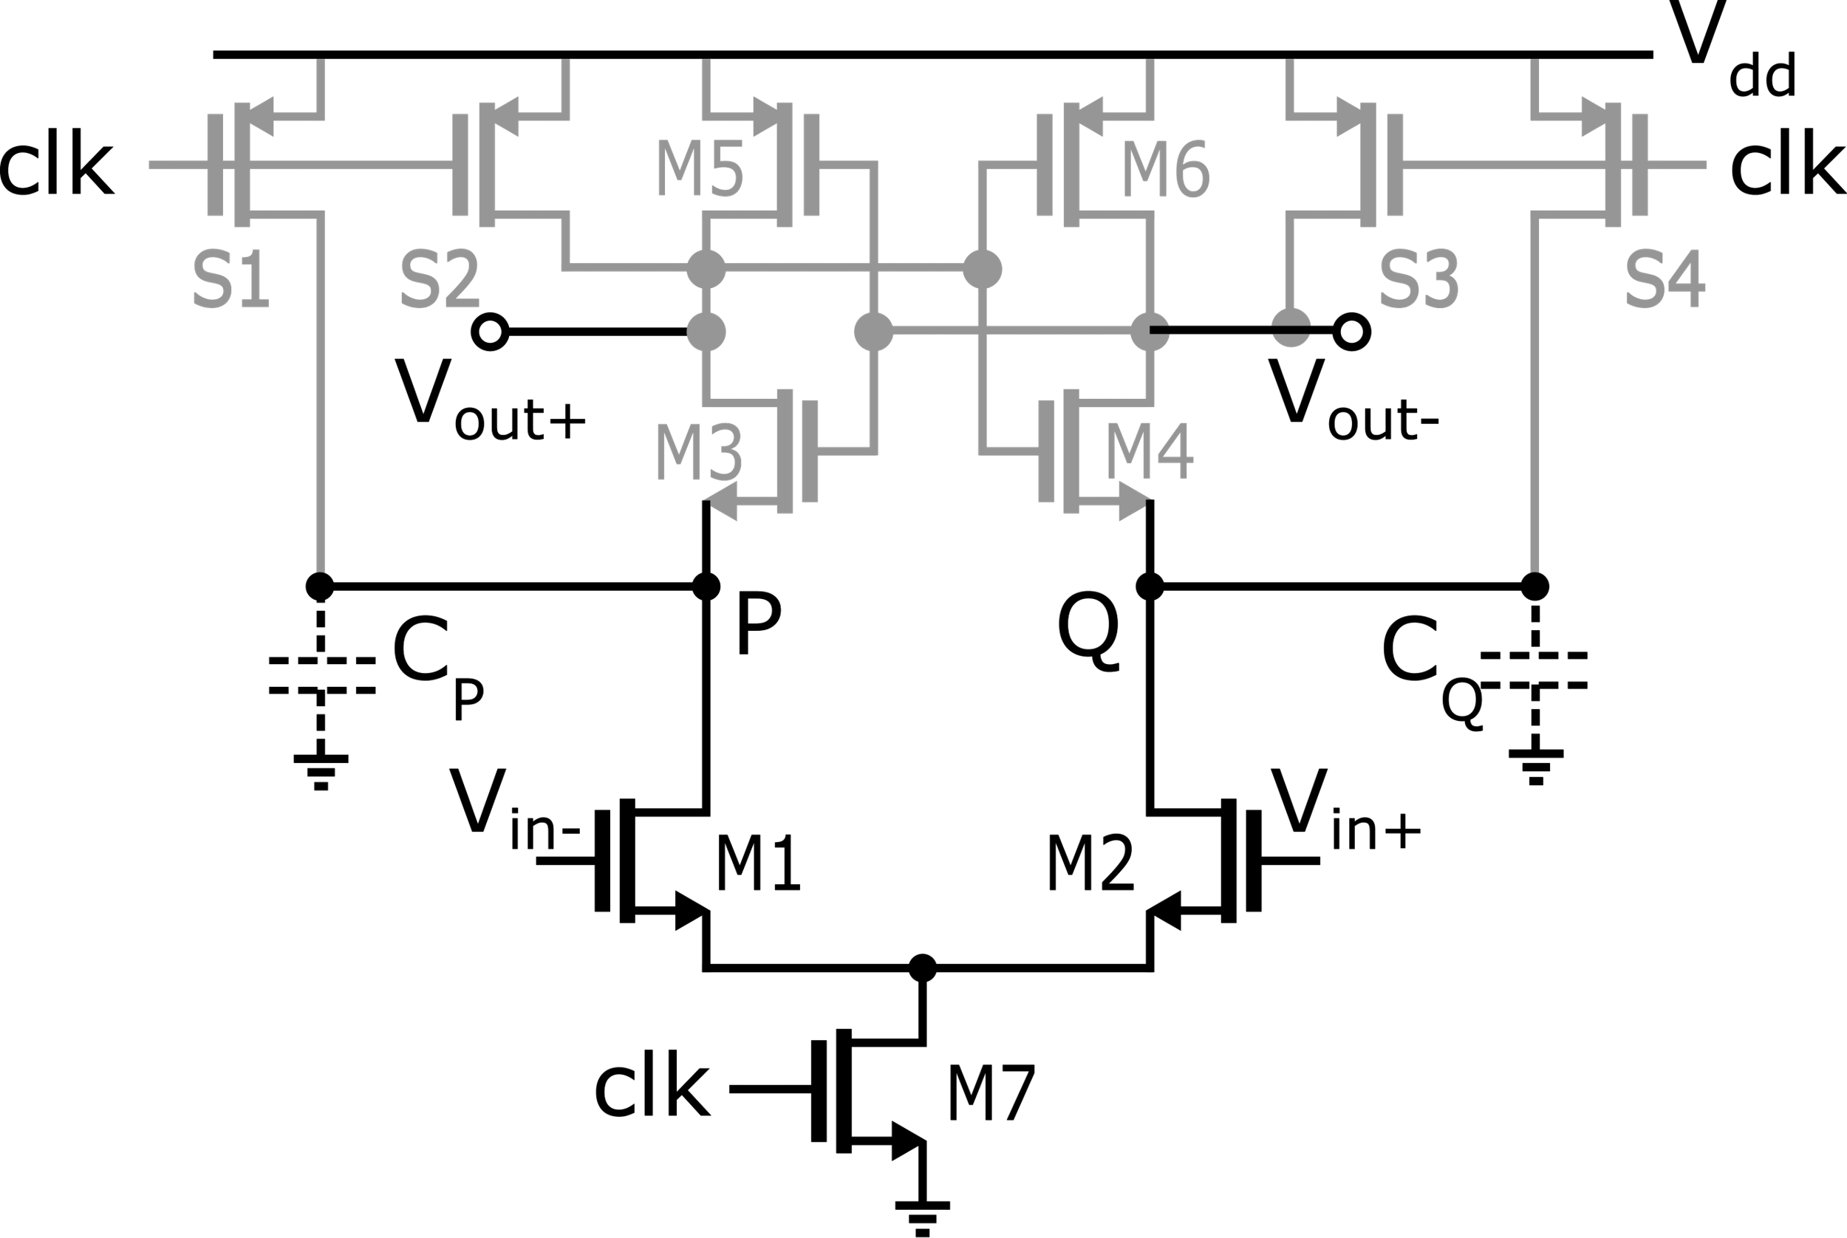
StrongARM: Amplification Phase
1
1
S1-S4 go off, M7 goes on
The input pair is on
I₁, I₂ start discharging the parasitic capacitances C_{P}, C_{Q} at nodes P, Q
Depending on V_{id}= V_{in+} - V_{in-} node P is discharged faster/slower than node Q
I₁
I₂
1

Slide 6
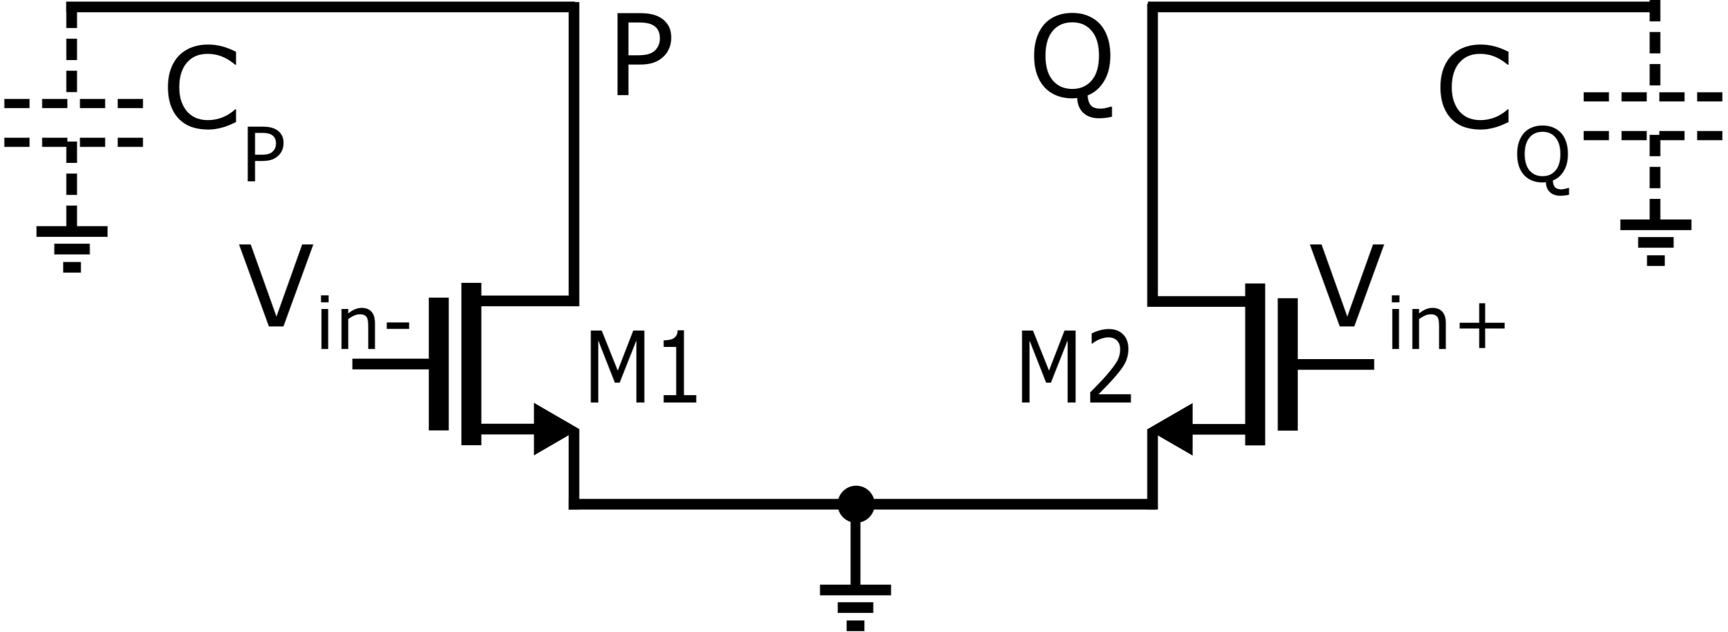
StrongARM: Amplification Phase
1
1
I₁
I₂
S
S
I_{CM}
1
small V_{id}
Pseudo-differential pair
(when clk=1, M7 connects node S to gnd)

Slide 7
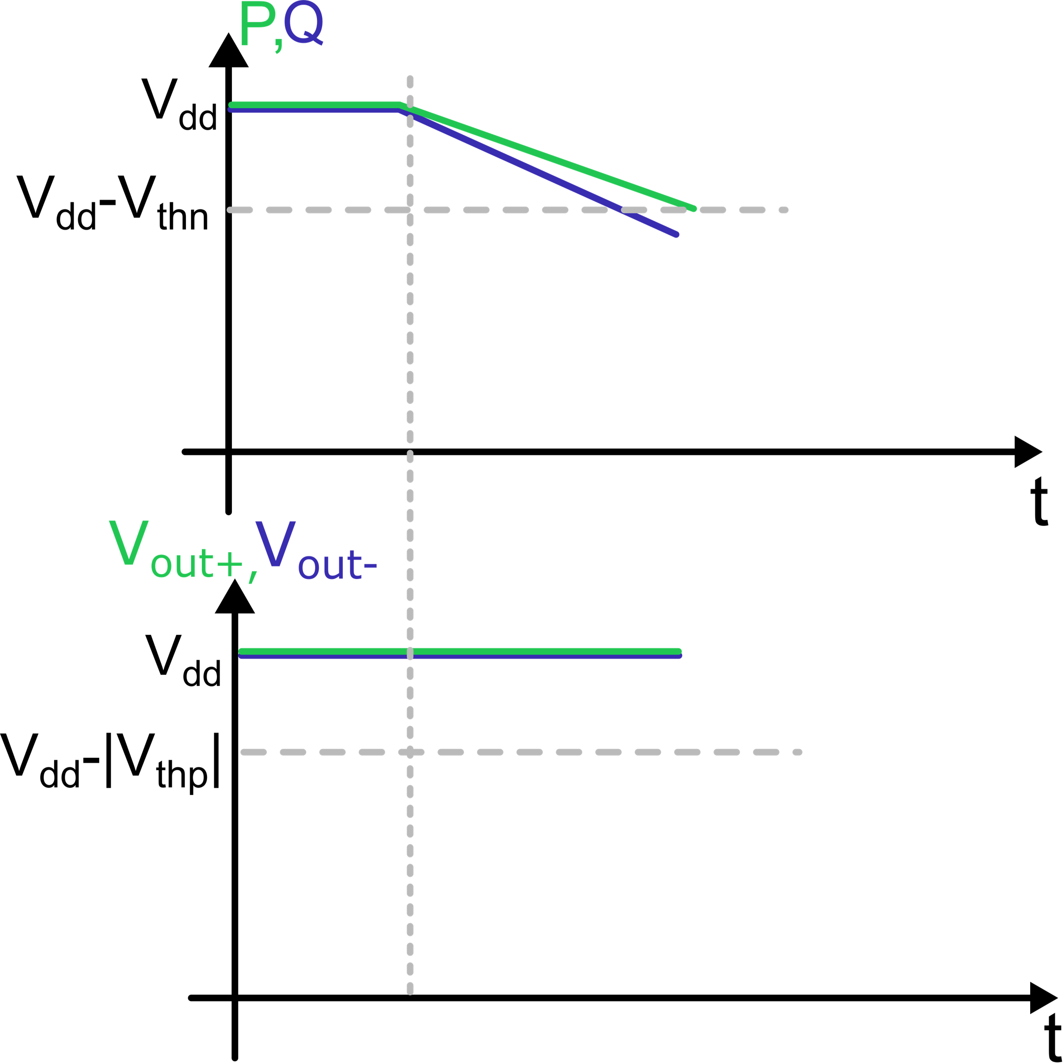
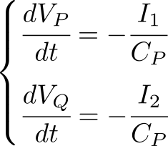
StrongARM: Amplification Phase
Amplification phase (clk=1)
Reset (clk=0)
1
1
V_{id} = V_{in}⁺-V_{in}⁻ > 0
I₁
I₂
S
1
Amplification lasts appromidatively until
(VP+VQ)/2 reaches V_{dd}-V_{thn}

Slide 8
StrongARM: Amplification Phase
Amplification phase (clk=1)
Reset (clk=0)
tA is also dependent on input common mode, slower for lower Vcmi
V_{id} = V_{in}⁺-V_{in}⁻ > 0
gain A
Gain A is not precise, and it is dependent on input common mode:
Is the condition A>1 always guaranteed?
Numerical example: Vcmi=1.7 V, Vt = 0.5 V (input pair)
Vthn = 0.6 V (cross coupled NMOS, beneficial body effect)
→ A = 1. For Vcmi > 1.7 V, there is no amplification!

Slide 9
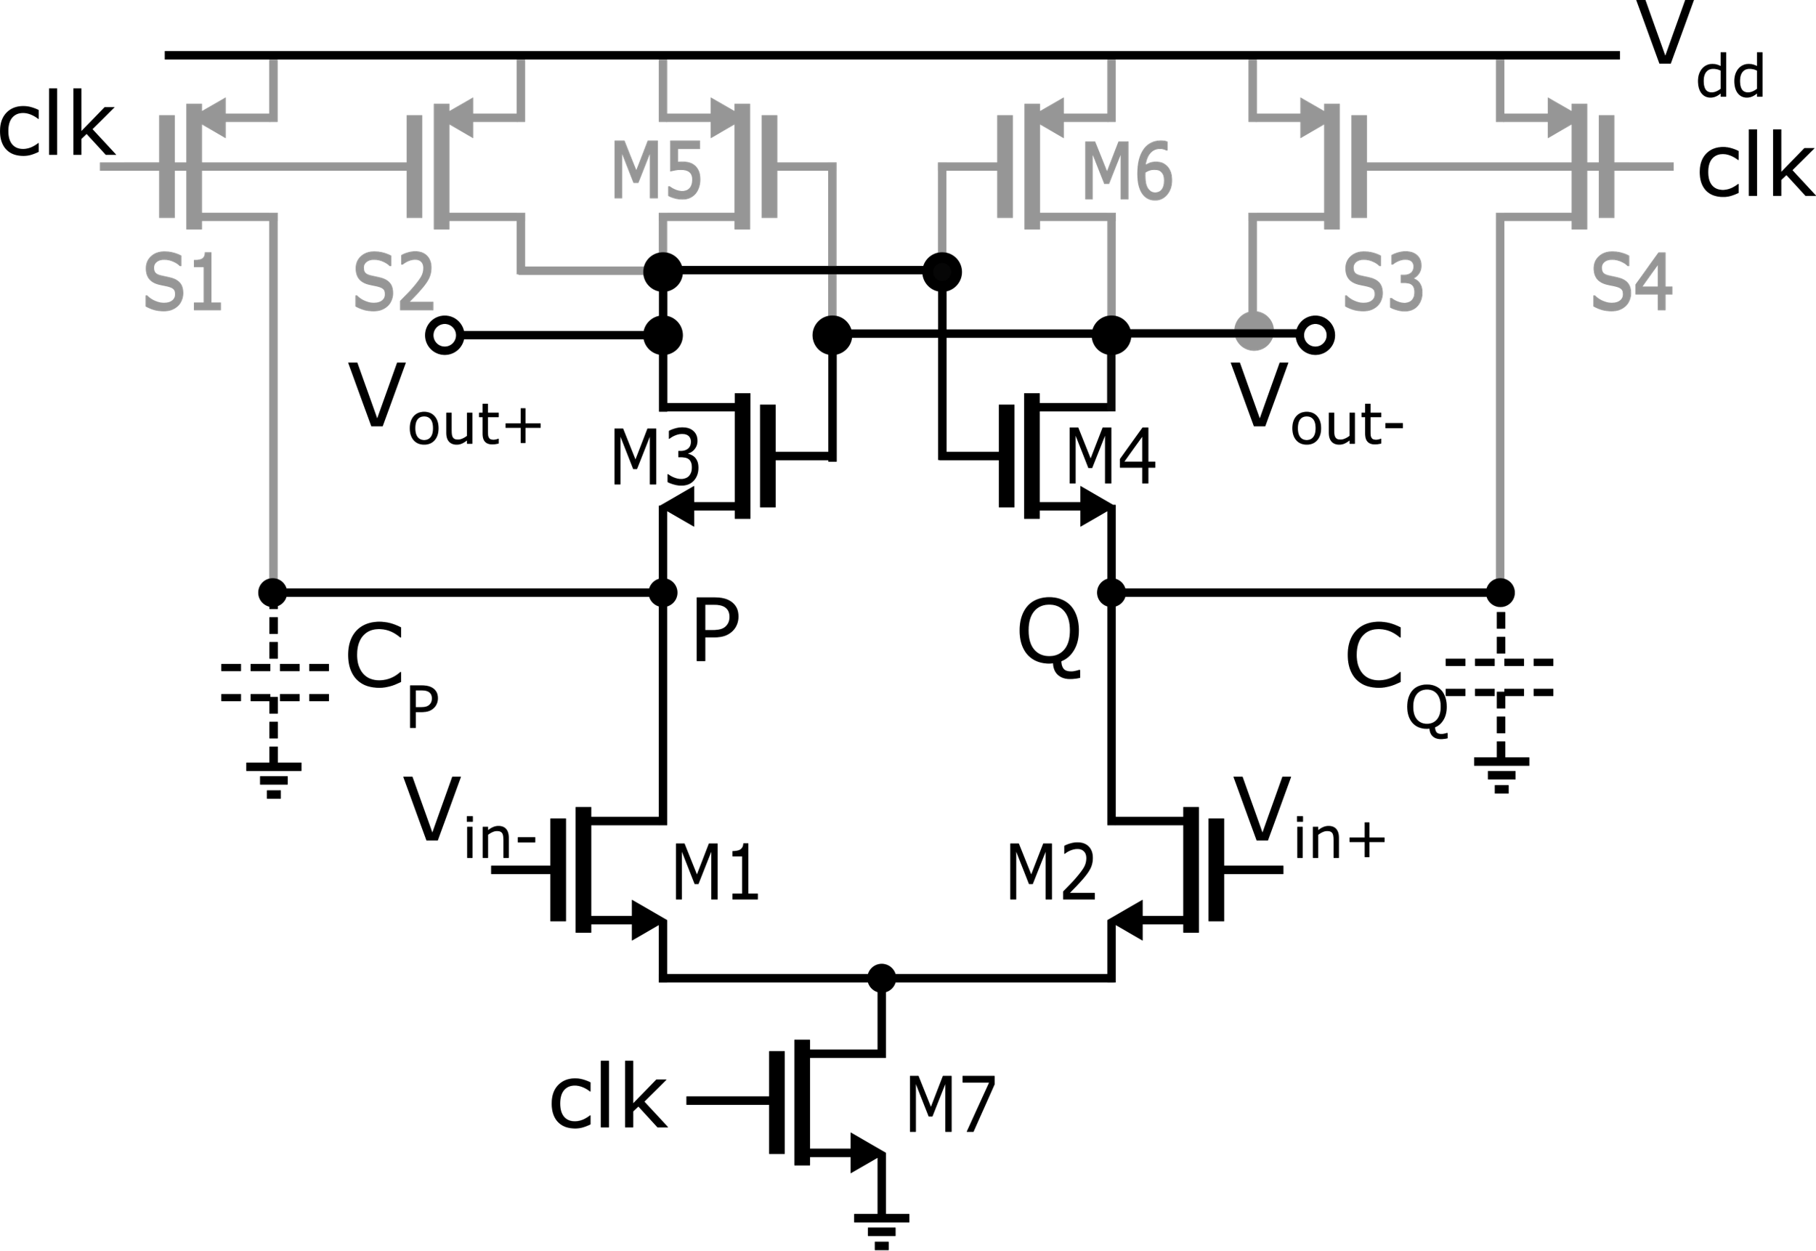
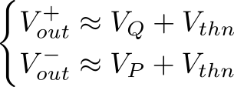
StrongARM: Amplification Phase, continued
When voltages at nodes P,Q go lower than V_{dd}-V_{thn}, M3-M4 turn on
Once on, M3-M4 can be regarded as batteries (~Vthn):
Nodes P,Q keep discharging and V_{out+}, V_{out-} start discharging differently according to the unbalance of P and Q
1
1
1

Slide 10
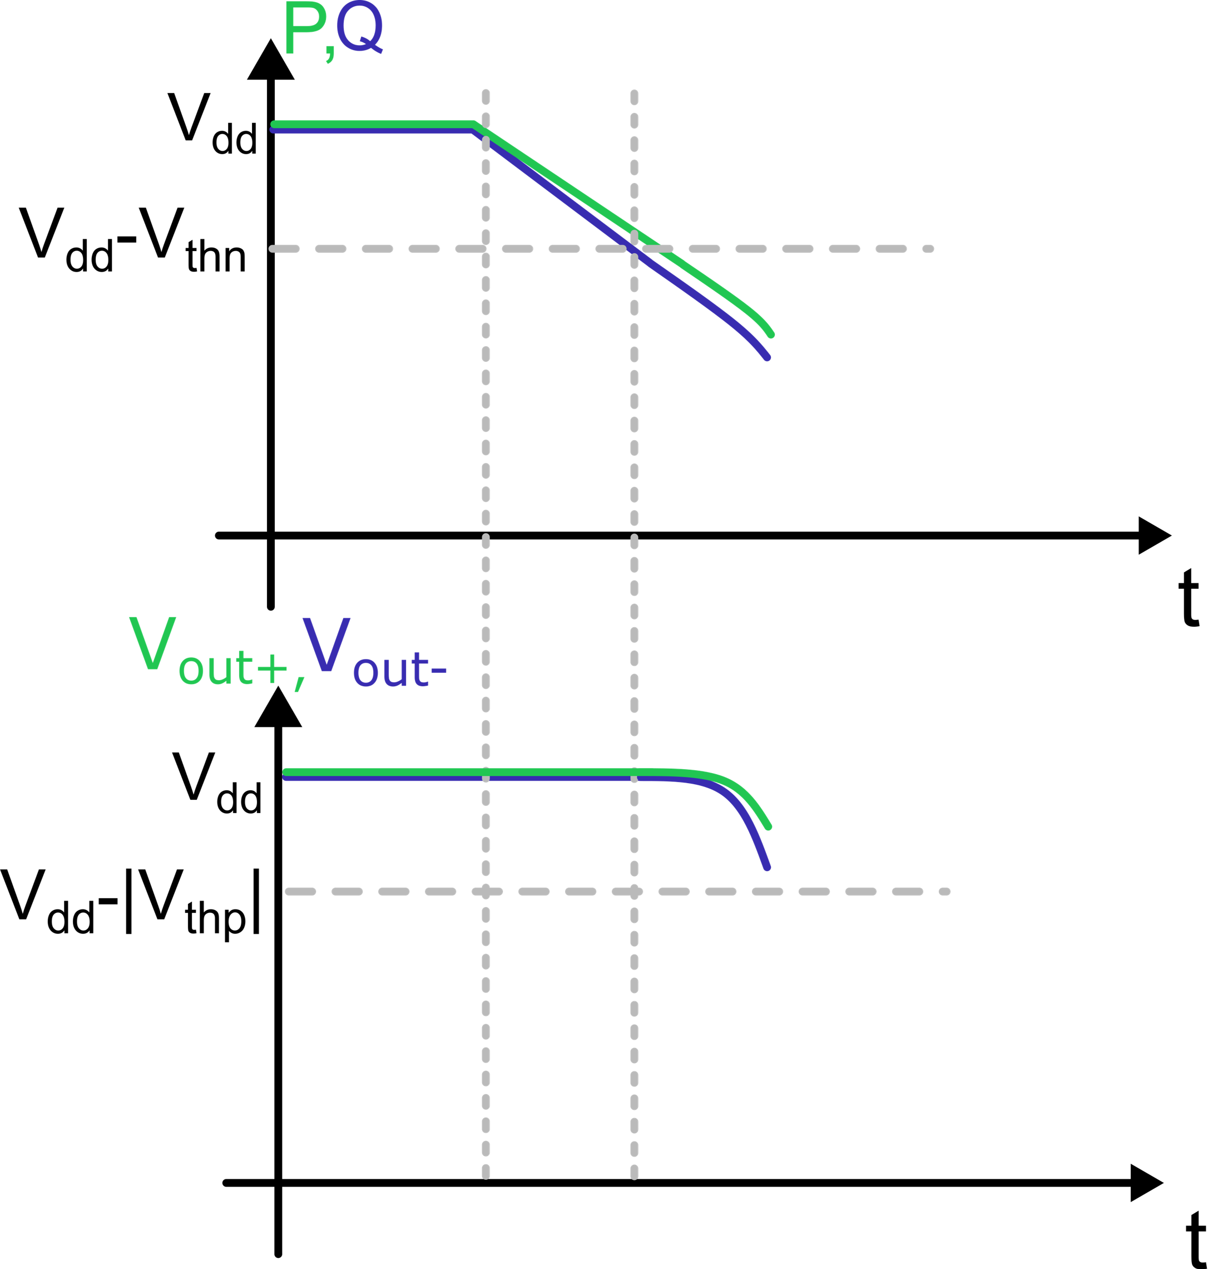
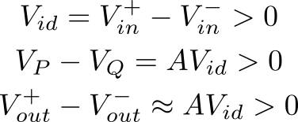
StrongARM: Amplification Phase, continued
Reset (clk=0)
Amplification (clk=1)
1
1
1
At some point either Vout+ hits the threshold to turn on M5

Slide 11
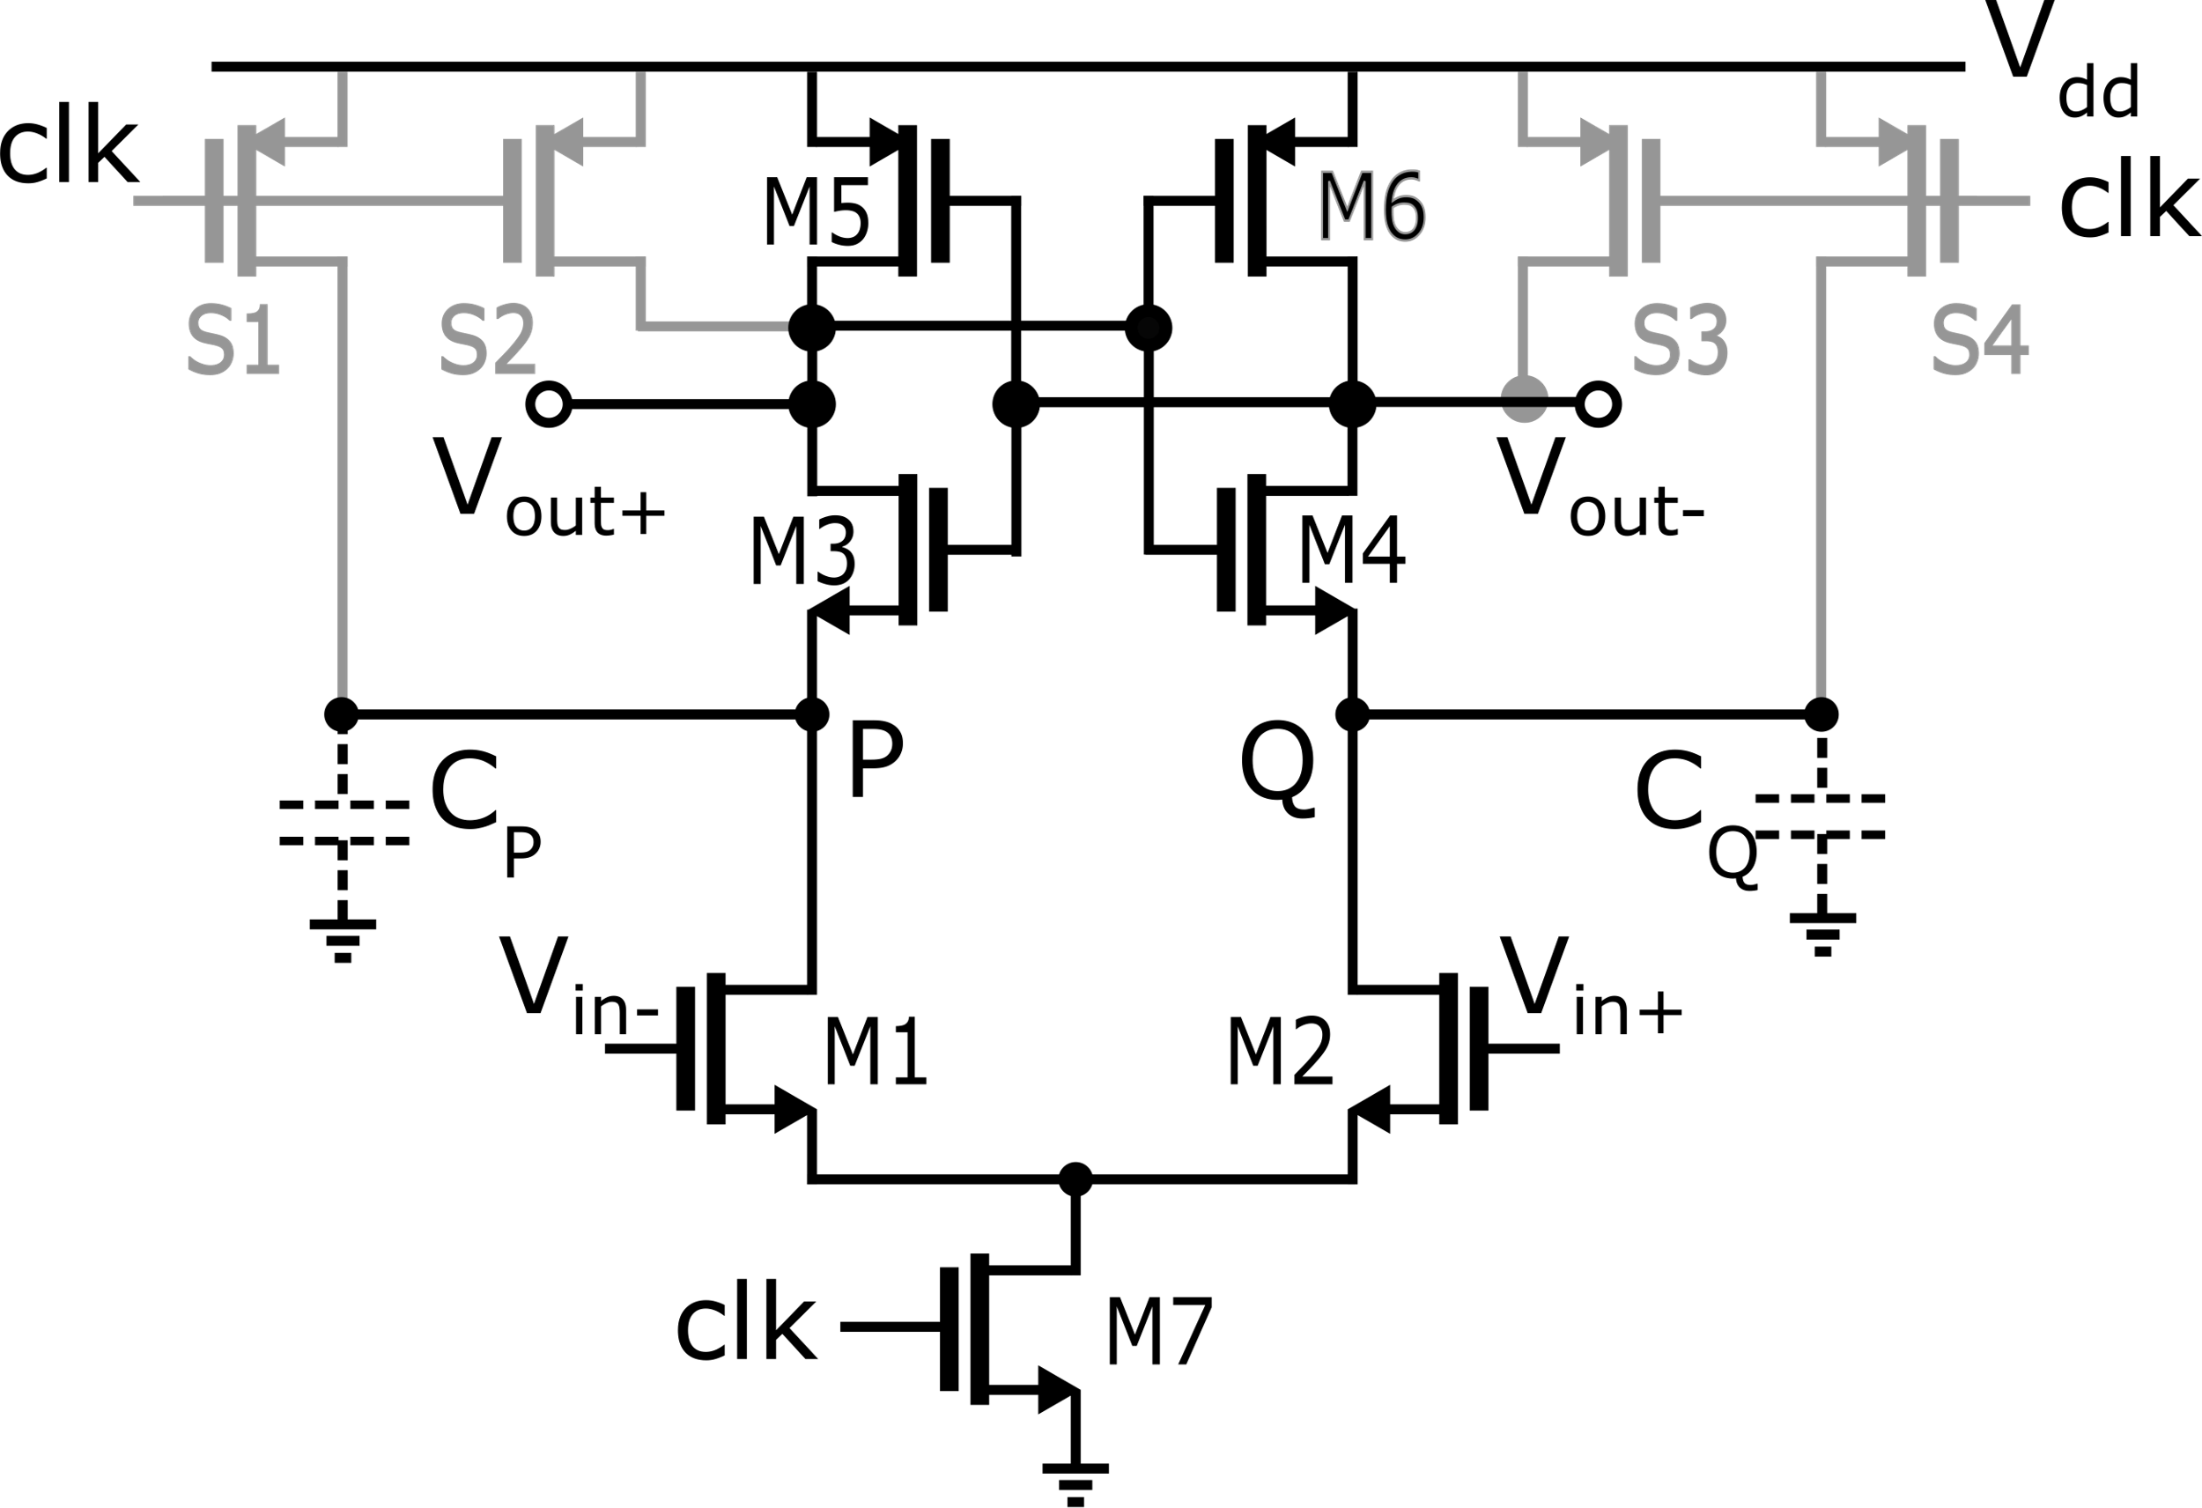
StrongARM: Regeneration Phase
When V_{out}⁺ or V_{out}⁻ goes lower than V_{dd}-|V_{thp}|, one between M5 and M6 turns on:
If Vout- hits first, M5 turns on, and Vout+ is pulled towards Vdd (M6 is off)
M4 is more “conductive” allowing Vout- to lower. M2 evuentually enters linear region.
M3 progressively turns off due to lowering Vout-. Hence it cuts the M5-M3 DC path
1
1
1
Positive feedback loop (regenerative)

Slide 12
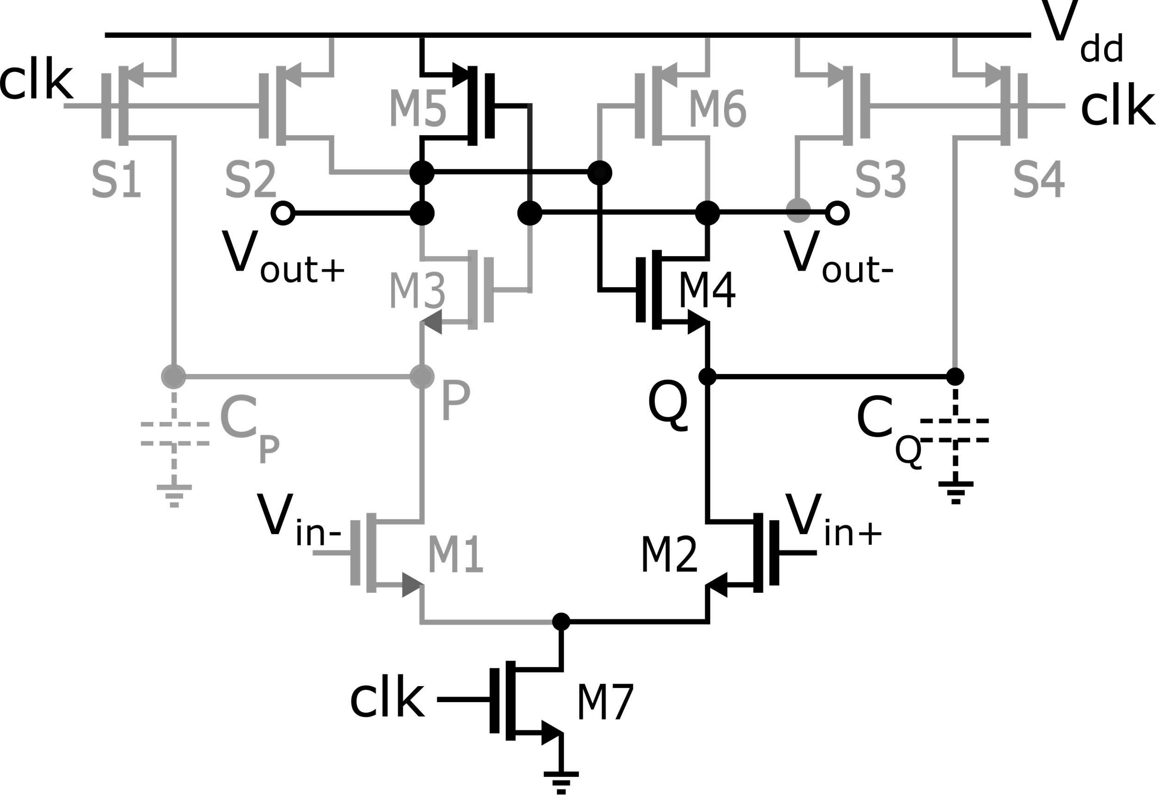
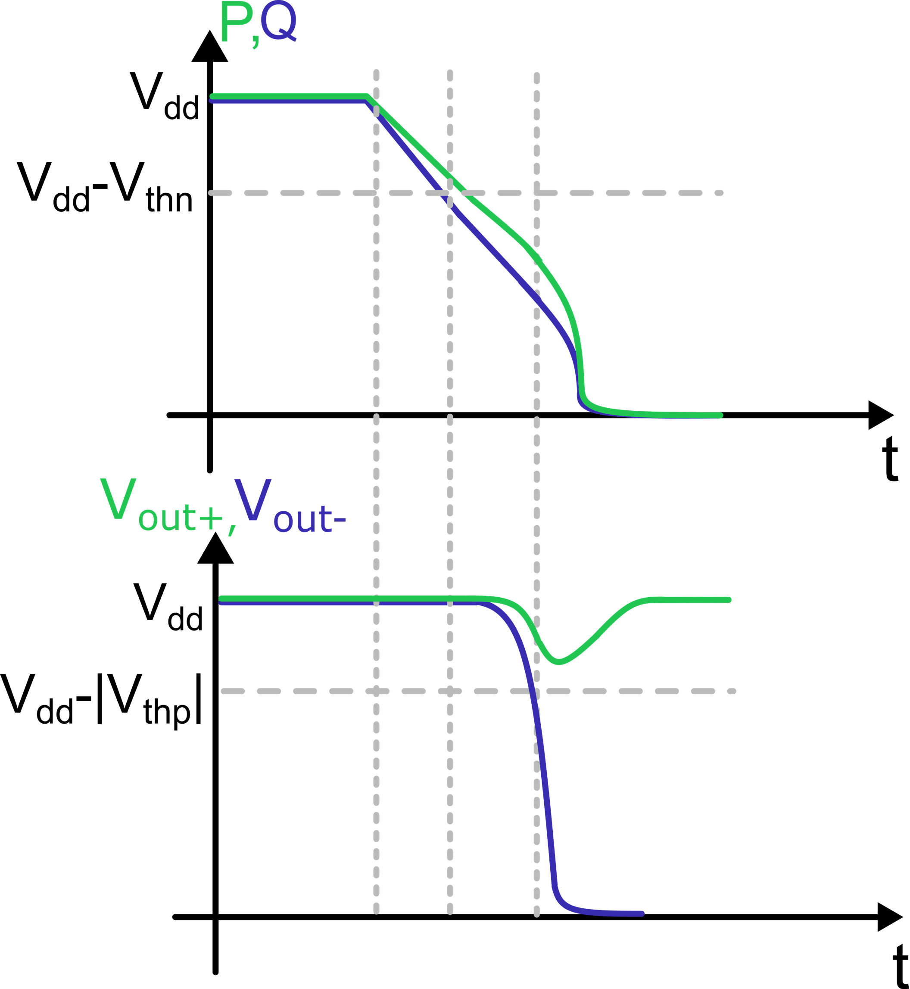
StrongARM: Regeneration Phase
Reset (clk=0)
Regeneration (clk=1)
1
Amplification (clk=1)
1
V_{id} = V_{in}⁺-V_{in}⁻ > 0
1
Regeneration Phase: Vout- is allowed to reach gnd
Once the regeneration is finished, no static power consumption is present (M3 cuts off the current path from V_{dd} to ground)
V_{out}⁺= V_{dd}
V_{out}⁻= 0

Slide 13
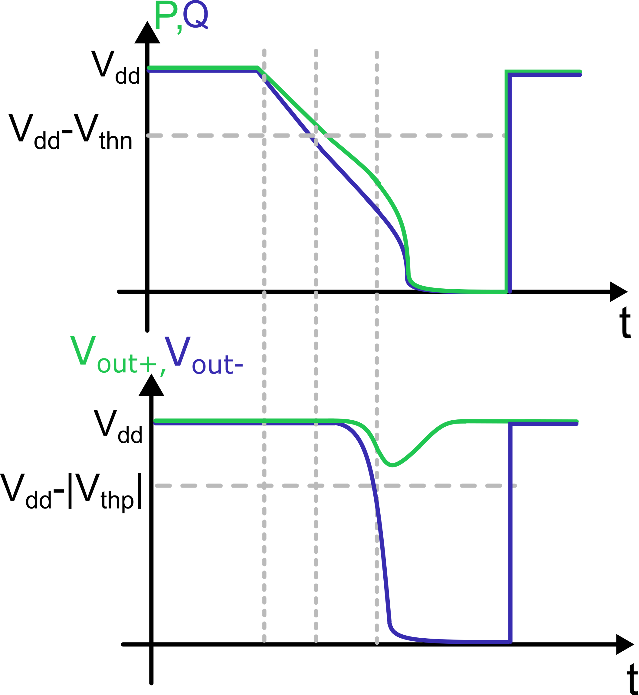
StrongARM: (Next) Reset Phase
Amplification (clk=1)
Reset (clk=0)
Reset (clk=0)
0
0
Regeneration (clk=1)
0
S1-S4 recharge node P, Q, V_{out}⁺, V_{out}⁻ to V_{dd}
Need of a second latch to store the result of the comparison during the reset phase

Slide 14
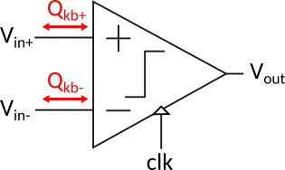
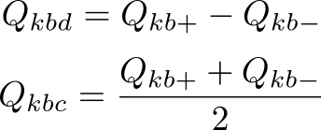
StrongARM: Kick back effect
The kick back effect is evident at the comparator inputs Vin- and Vin+
It implies a sudden demand of charge seen at those input terminals due to the sharp transition of the internal voltages, similar to the charge injection effects of a switch turn-on and turn-off
For each comparison cycle, input pair devices (M1, M2) are first turned on, and the regenerative action of the latch bring them again to the off state
Charge demand is different from port Vin- and port Vin+: it has a differential-mode component (Qkbd) and a common-mode component (Qkbc)
Qkbd depends on Vid (input differential voltage)

Slide 15
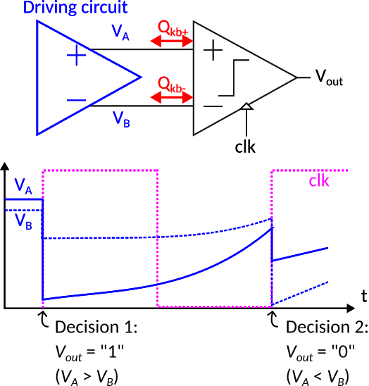
StrongARM: Kick back effect
Suppose a “weak” driving circuit: (Typically an OTA with high impedance output nodes, cap-loaded, or a compensated 2-stage OTA)
Suppose the case of a constant VA > VB
The first decision is correct (Vout=”1”), if VA and VB would be kept constant all the following decisions should be “1”
However: VA and VB are upset by a different amount due to Qkbd
The system is slow to recover, hence when the second clk rising edge occurs VA < VB: the comparator now provides a wrong decision
The result of the second decision has been influenced by the result of the previous decision: this is similar to an hysteretic effect (undesired in this case)

Slide 16
StrongARM: Kick back effect

Slide 17
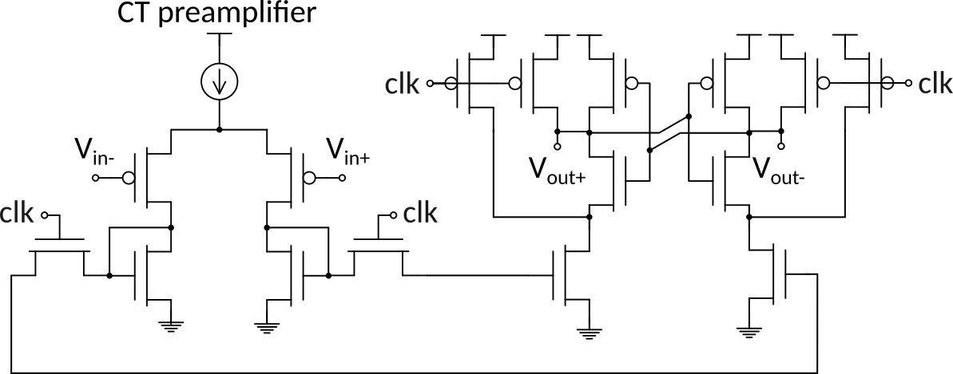
StrongARM: Kick back effect, possible solution
Use of a preamp-like structure:
Greatly reduces signal swing coupled to the input pair.
Implies static power consumption

Slide 18
StrongARM: input referred noise characterization
For such strongly non-linear circuit transfer function is undefined, hence there exist no straight-forward “referring to input” procedure
Most of the noise that may affect the decision is produced before the regeneration phase (i.e. during the amplification phase)
The amplification phase is governed by the input pair (M1, M2). Once the cross coupled M3 and M4 turn on (during the last part of the amplification phase) they also provide a small contribution to total accumulated noise charge on CP, CQ.
The gain during the amplification phase is “dynamic”: it depends on a time interval (tA, tR). Analytical expressions can be found but are complex
1
1
1

Slide 19
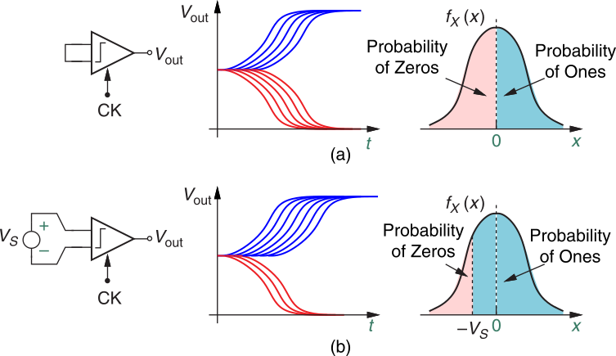
StrongARM: input referred noise characterization
The goal is to find the sigma of a supposed normal distribution (Transient Noise simulations)
If inputs are at the same potential there is equal probability of having “0s” (n0) and “1s” (n1)
Differential input slightly skewed to have different n0 and n1 counts. In the example n1>n0

Slide 20
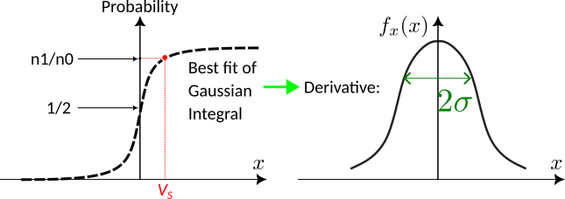
StrongARM: input referred noise characterization
Eventually try a couple of VS values to provide more points for best fit algorithm
Note: VS should be chosen to be reasonably distant from probability = 1, 0 and ½

