Slide 1
Amplifier Norton schematization with output referred noise source
It is possible to model any amplifier
(whole amplifier or single amplifier stage) with a Norton equivalent circuit of the output port
v_{i2}
i_{on-sc}
z_{out}
v_{in}
v_{o}
and take into account noise with an additional current source i_{on-sc}
v_{i1}
Y_{m}(s)v_{in}
Input referred noise voltage
General input-output law of a voltage amplifier with noise/offset:

Slide 2
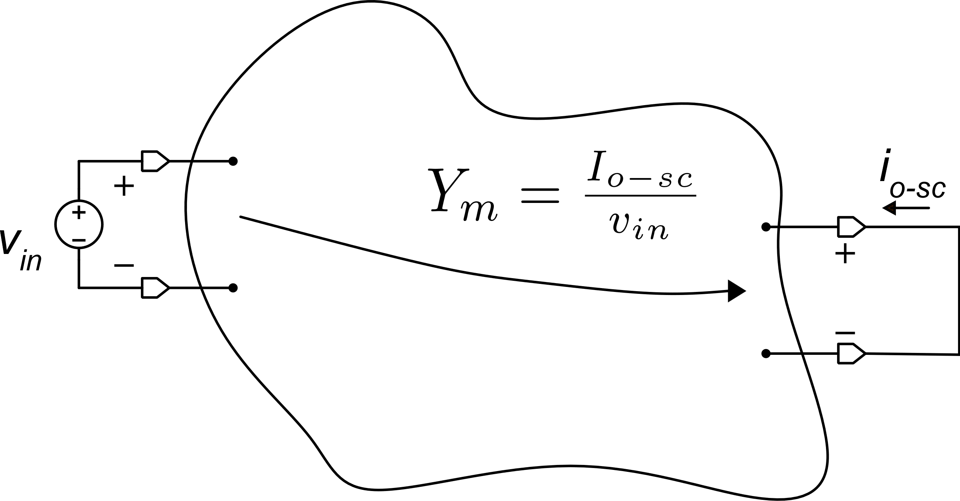
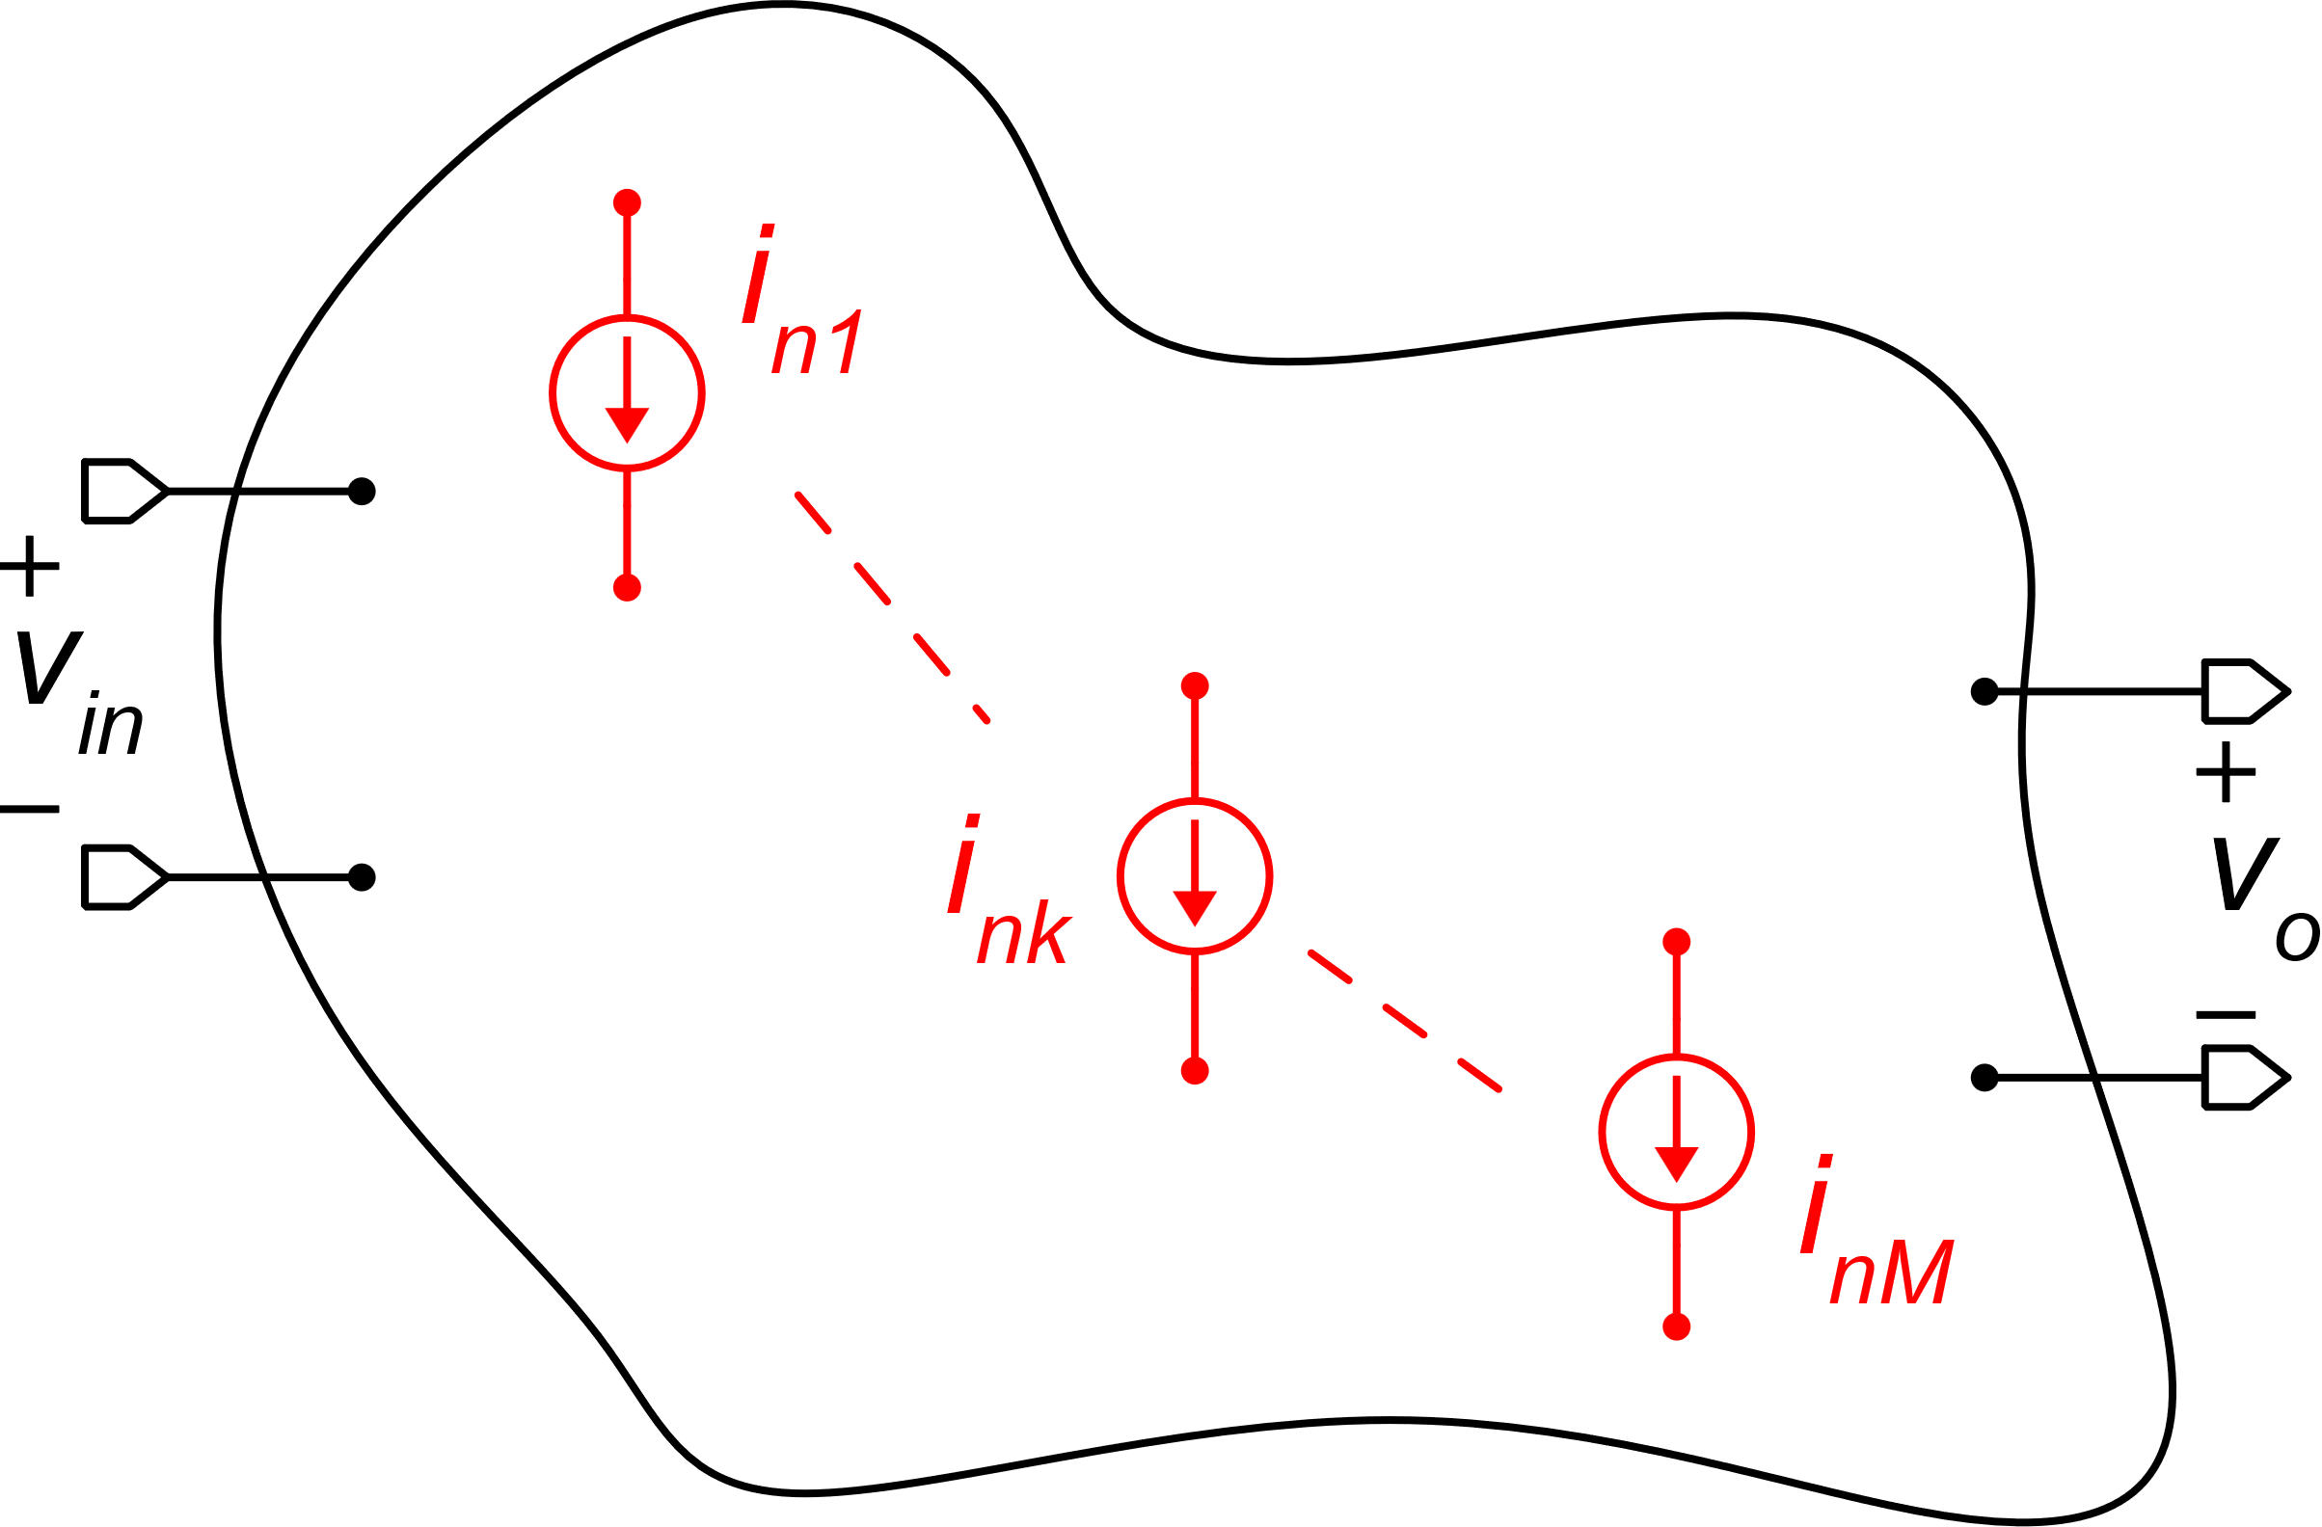
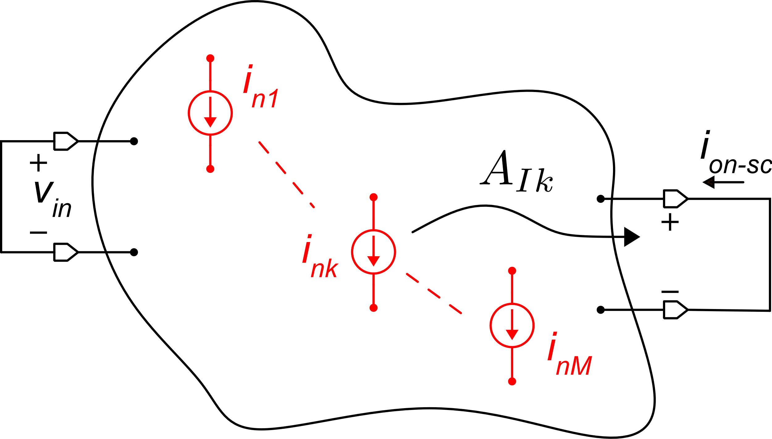
General method to calculate the input referred noise / offset
Step 1. Noise sources off, input signal on, determine Y_{m}
Step. 2 Signal off, determine i_{on-sc} with the superposition theorem
Generic amplifier with M internal noise current sources

Slide 3
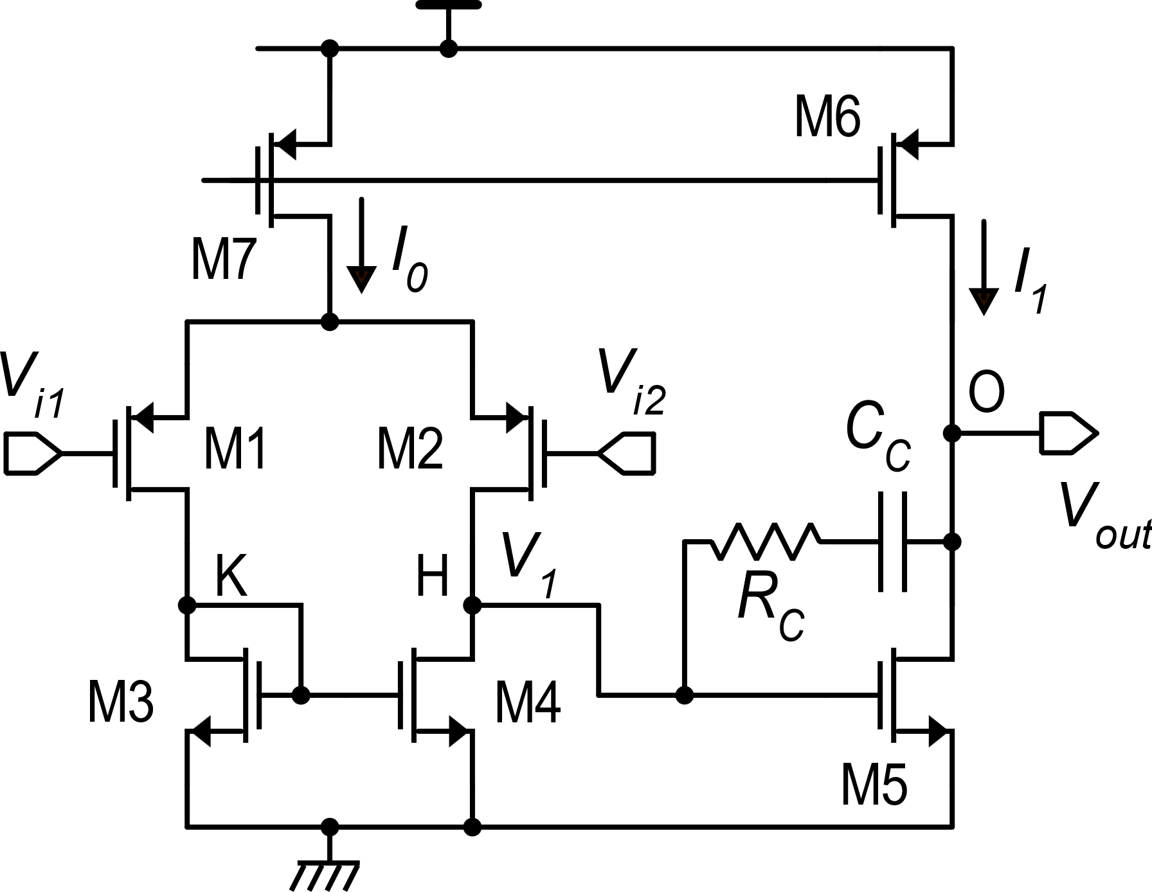
Application of the method to the two-stage op-amp
It is convenient to calculate the equivalent output noise currents of the two stages individually, and then study the whole amplifier using the following equivalent circuit.
R_{C}
C_{C}
v_{out}
h
v₁
o
v_{id}
i_{2n-sc}
R₁
i_{1n-sc}
R₂
C₂
G_{m1}v_{id}
C₁
G_{m2}v₁
First stage
Second stage
First stage
Second stage

Slide 4
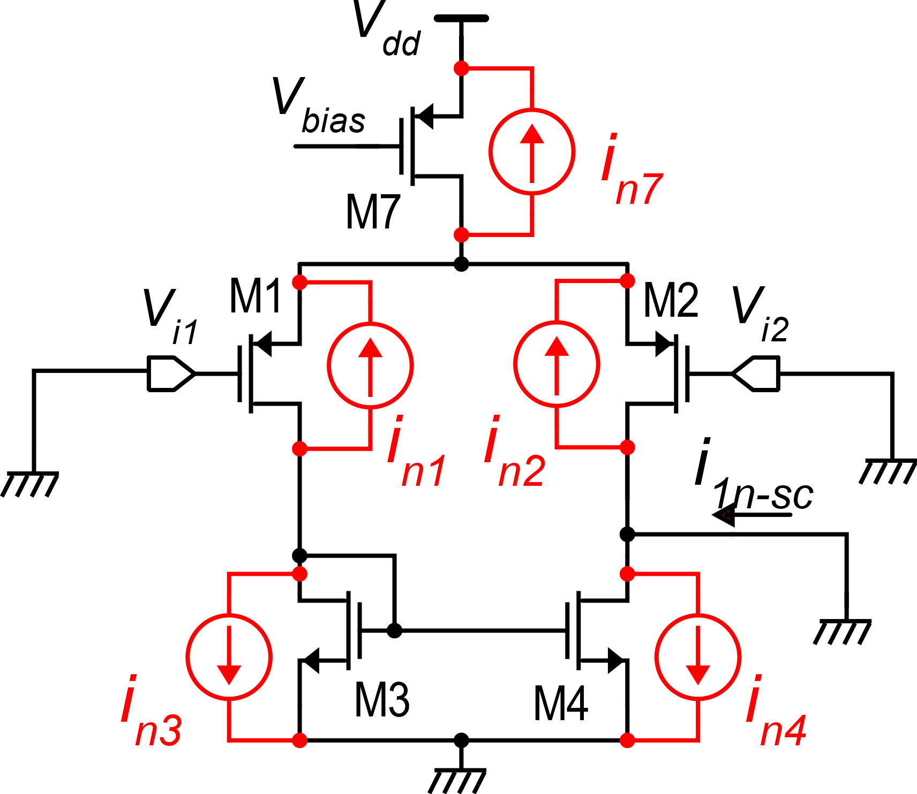
Output noise short circuit current of the first stage
In order to calculate the output noise short-circuit current, we need to calculate the current gains A_{Ik}, from each one of the MOSFET noise sources to the output short circuit current.
Input stage with noise current sources of all devices

Slide 5
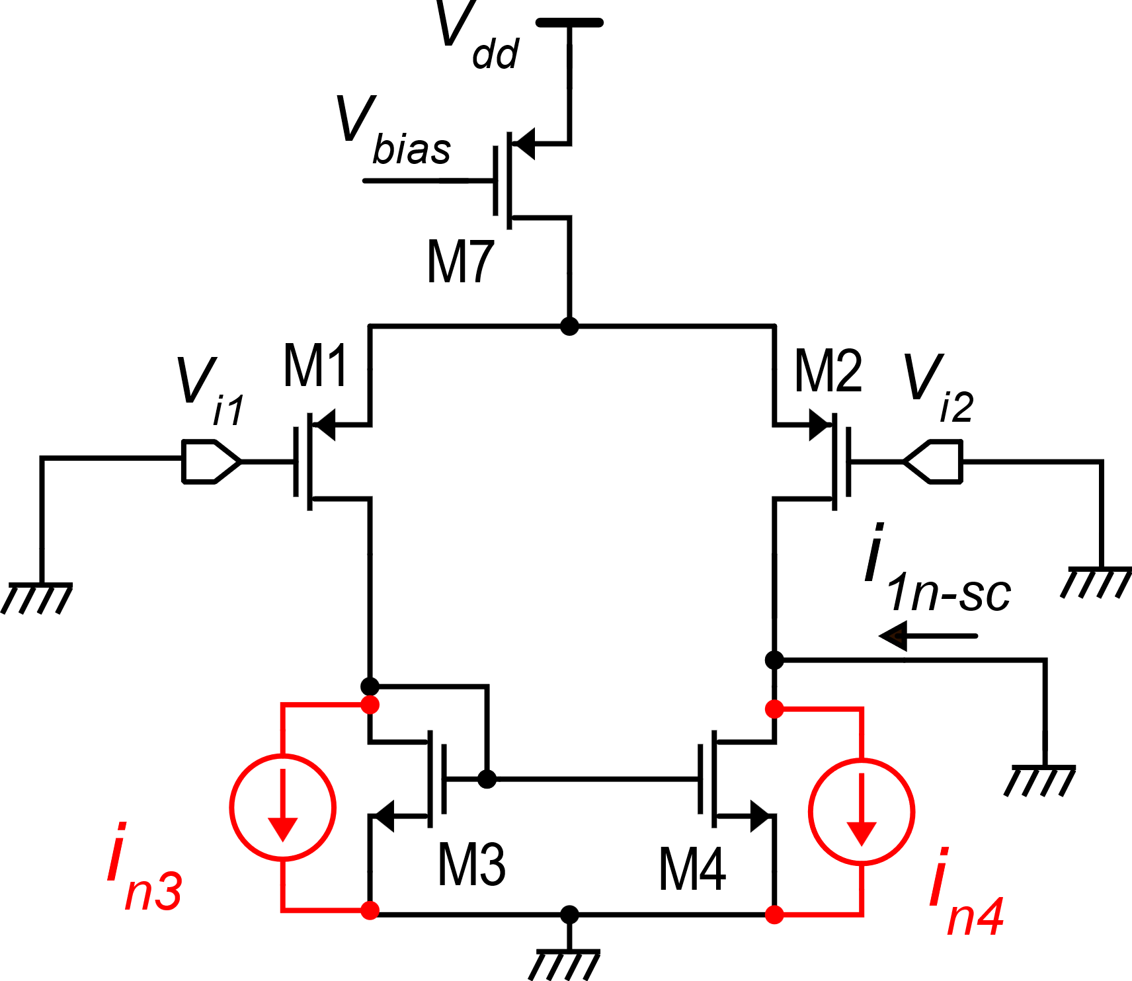
Effect of i_{n3}, i_{n4}
i_{n4} is directly connected to the output port, then it flows directly into the output short circuit:
i_{n3} is directly connected to the input of the current mirror. It sees a low resistance towards the mirror and high resistance towards M1 (2r_{d1}). Then it flows almost completely into the mirror and reaches the output port after an inversion (caused by the mirror).

Slide 6
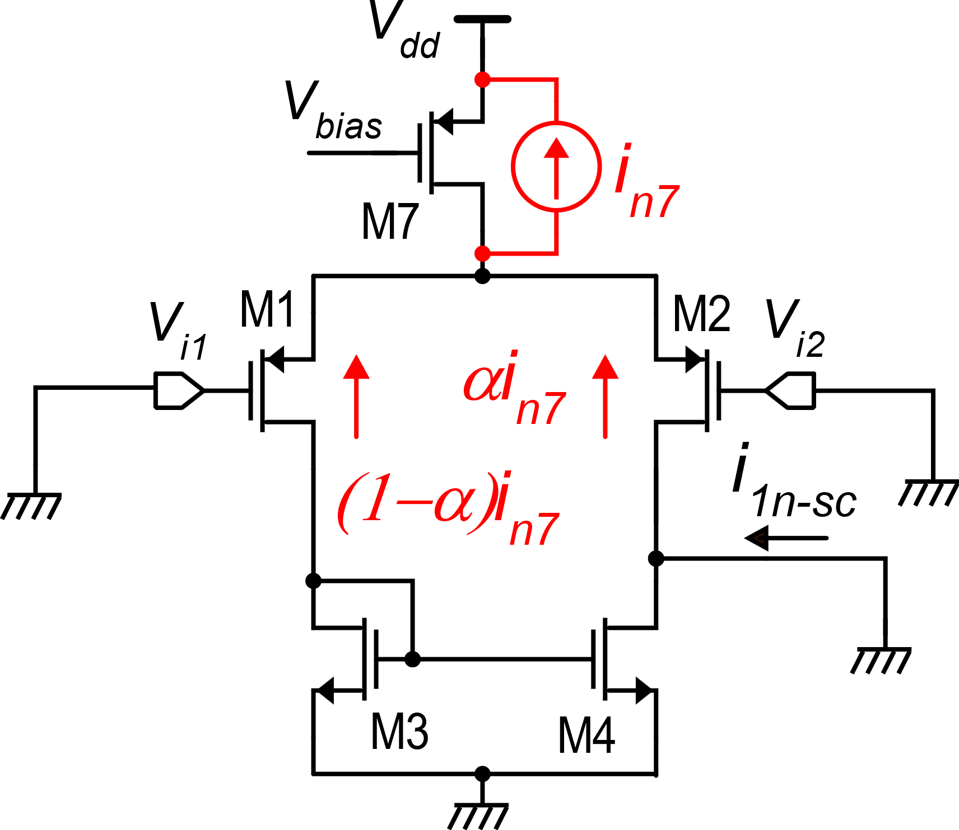
Effect of i_{n7}
In the case of perfect symmetry and zero input differential voltage (V_{id}=0), which is the case that we are analyzing:
If a relatively large input differential voltage is present, α can be significantly different from 0.5 and the effect of i_{n7} is no more negligible.
In the following part of this analysis, we will consider α=0.5

Slide 7
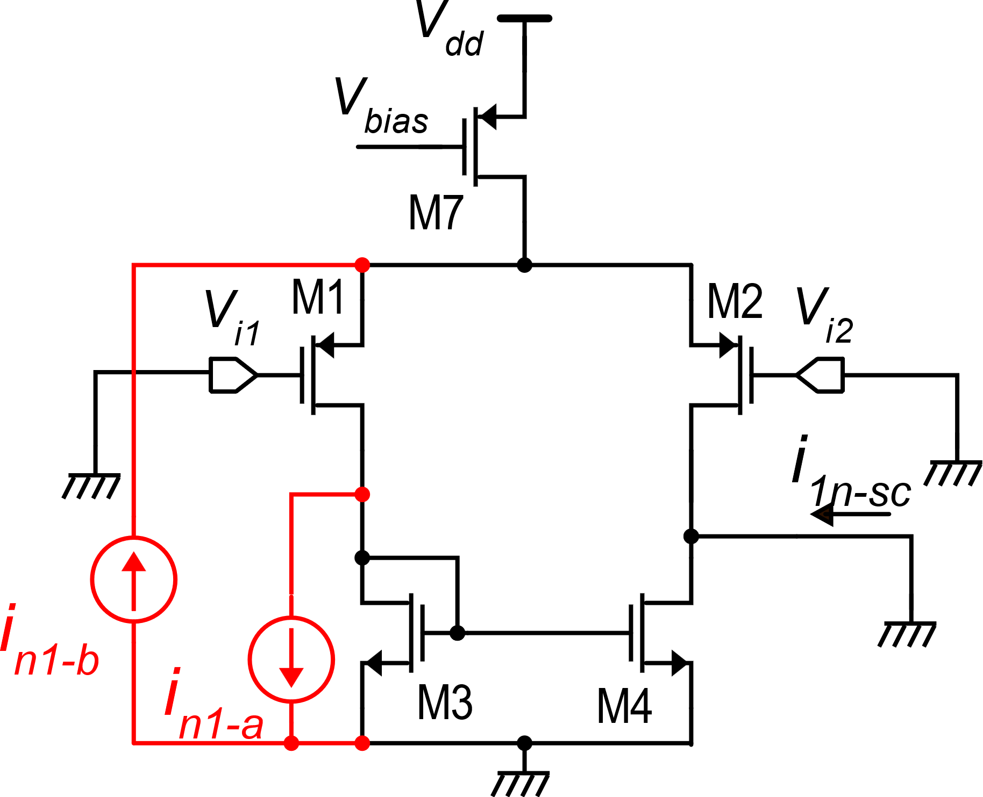
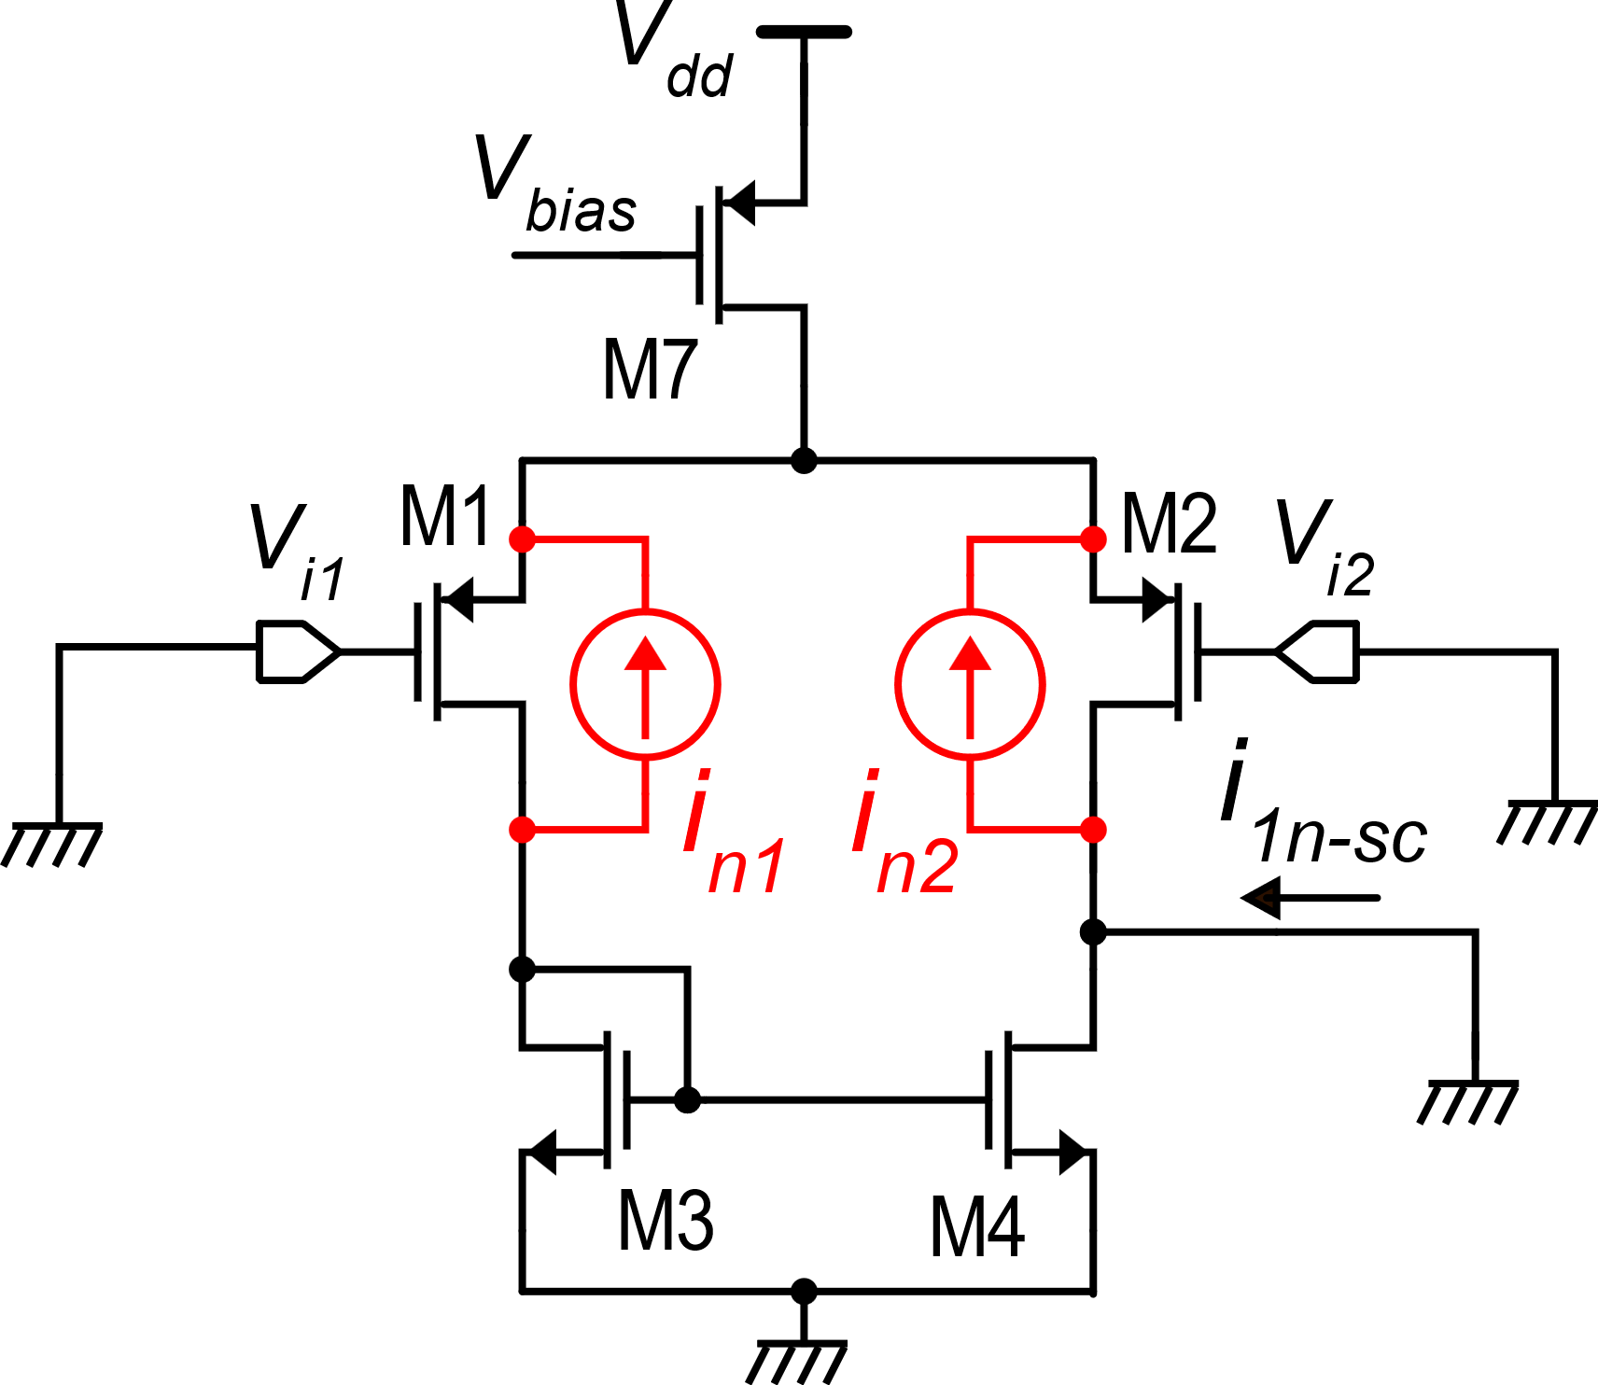
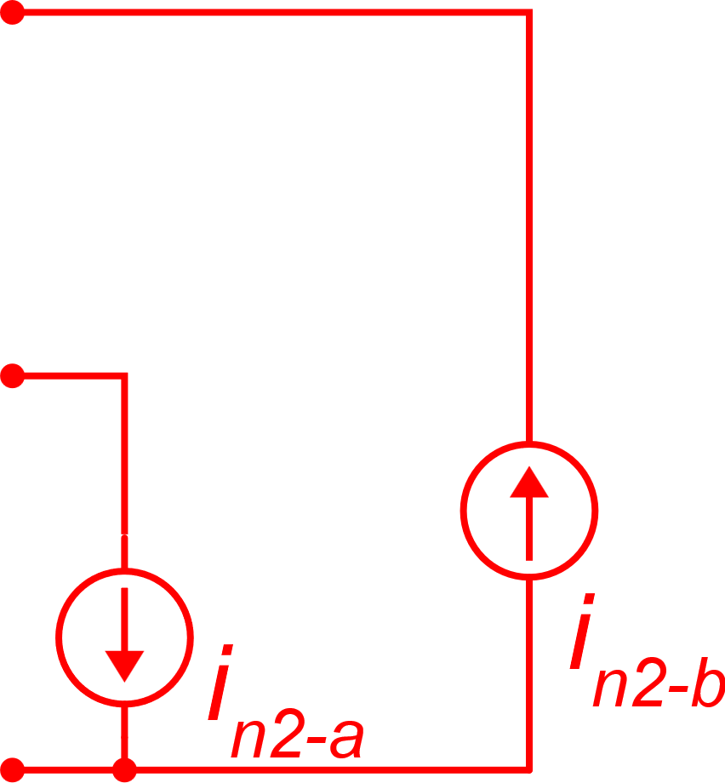
Effect of i_{n1}, i_{n2}
Since i_{n1} and i_{n2} are floating, we can split them into two sources with a terminal at gnd.
i_{n1-a}: same effect as i_{n3}: A_{I1-a} ≅ −1
i_{n1-b}: same effect as i_{n7}: A_{I1-b} ≅ 0
Repeating the procedure for i_{n2}

Slide 8
Putting all contribution together for the first stage:

Slide 9
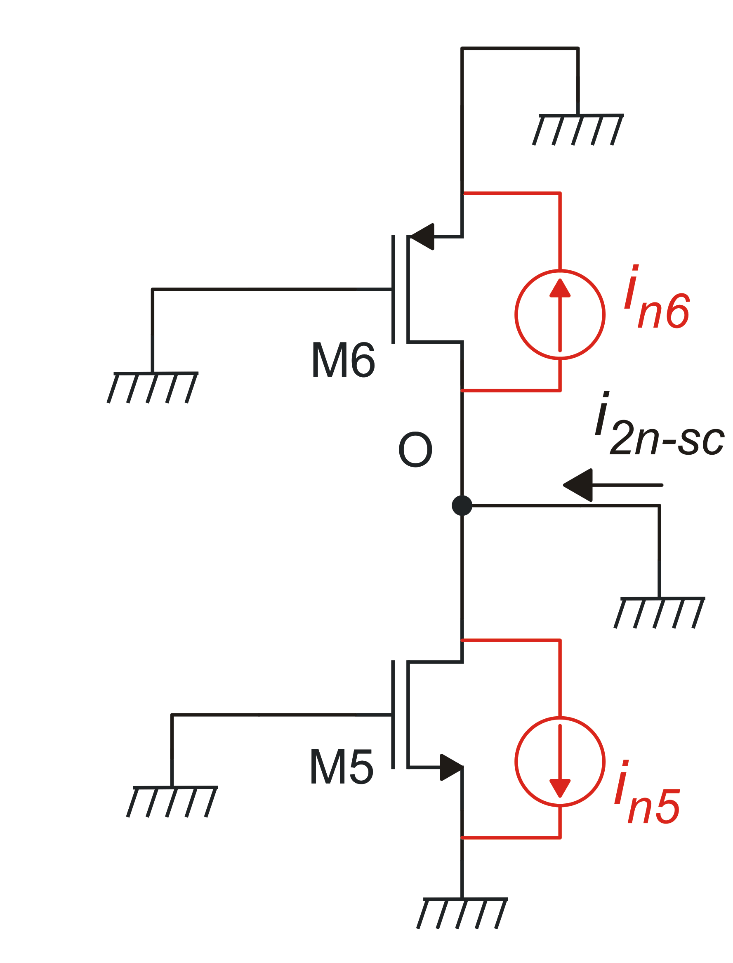
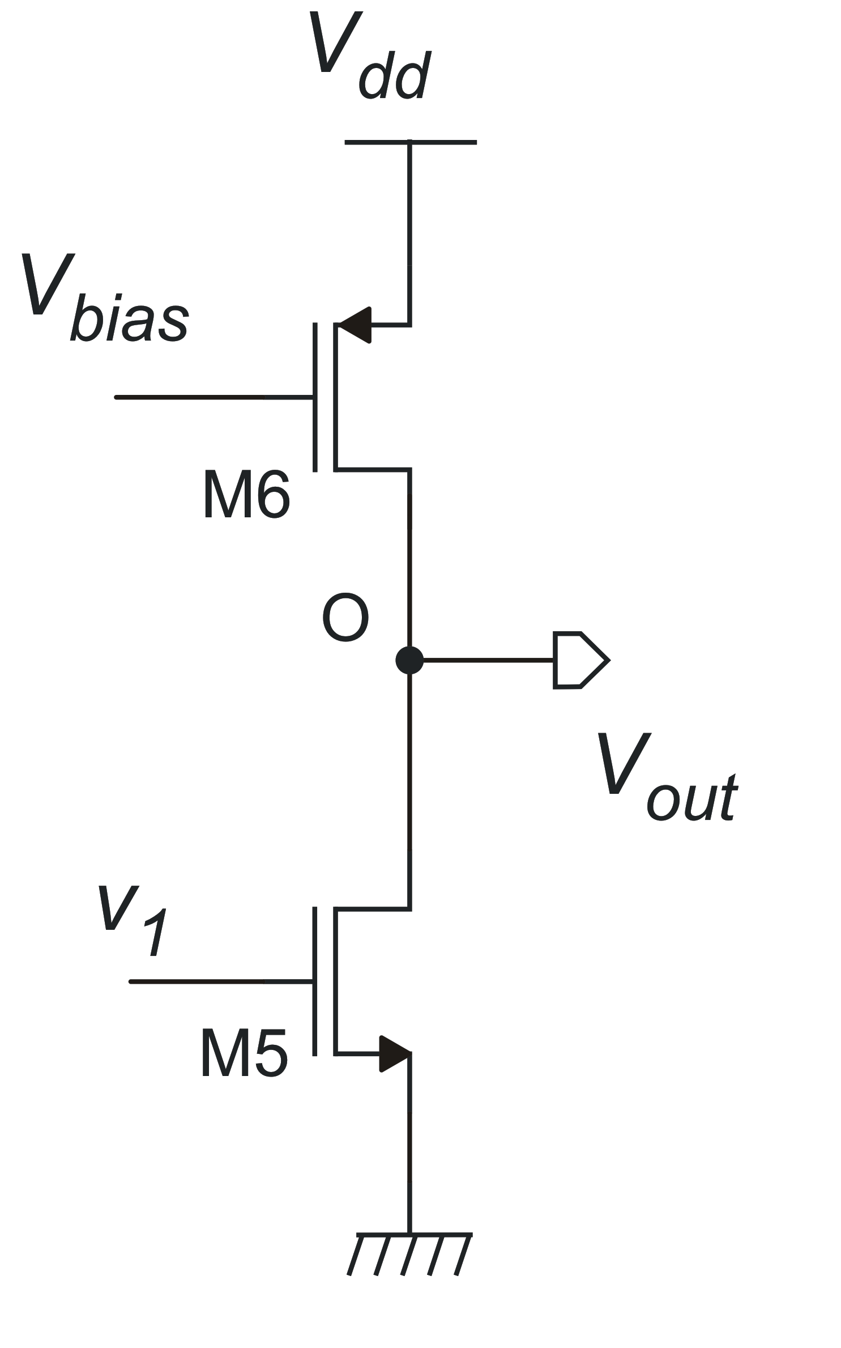
Equivalent output noise current of the second stage
No input signal because we are calculating the effect of noise
Equivalent small signal circuit with current sources

Slide 10
Putting the two stages together
Step 1. Calculate the Y_{m} of the op-amp
A_{Ih} is the transfer function (current gain) from a current source connected between node h and gnd to the output short circuit current

Slide 11
Calculation of A_{Ih}
admittance Y_{C}

Slide 12
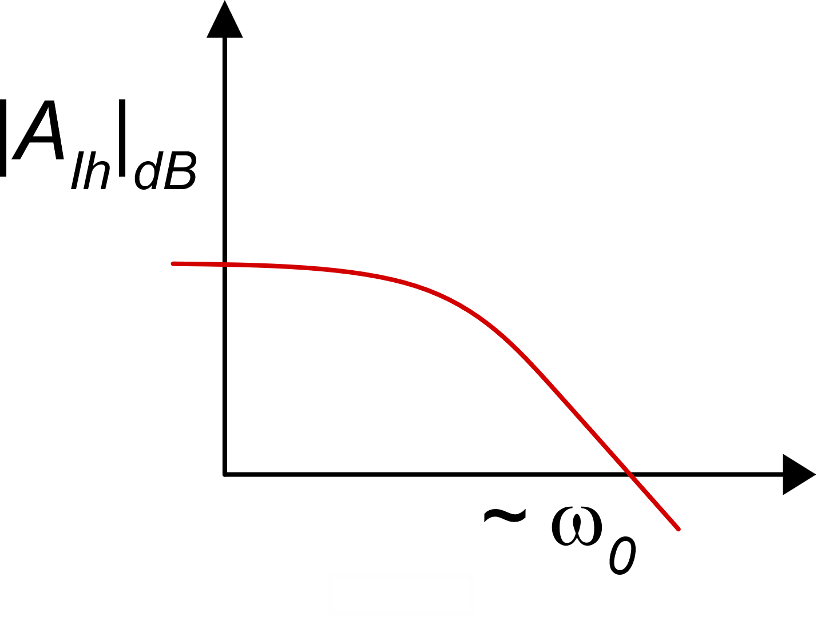
Calculation of A_{Ih}
dc value:
A_{Ih} drops below 1 (0 dB)
around the unity-gain
frequency of the op-amp:
qualitative frequency
dependence

Slide 13
Let us come back to the noise
Circuit for calculation of the total output noise current

Slide 14
In the simple 2-stage op-amp
A more interesting formula can be obtained substituting the equivalent gate noise voltage

Slide 15
Input noise density of the op-amp
For this amplifier I_{D3}=I_{D1}, then:

Slide 16
Thermal noise
using:

Slide 17
Flicker noise
using:
with:

Slide 18
General considerations about the op-amp noise:
Let us recall the thermal noise and use: g_{m1}=I_{D1}/V_{TE1})
Thermal
Flicker
For both the thermal and flicker noise, it is convenient to set F<<1 (V_{TE1}<<V_{TE3})
The larger I_{D1}, the lower the input thermal noise voltage density
A small V_{TE1} helps obtaining small thermal noise densities with lower current
A small flicker noise density can be obtained using large M1 and M3 areas

Slide 19
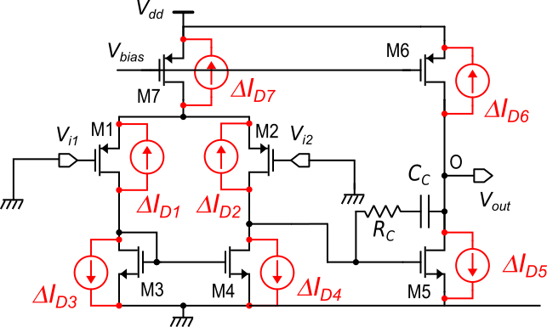
Input offset voltage of the op-amp
Let us just replace the noise current sources with the equivalent current sources of parameter variations
Note that M1,M2 and M3,M4 form pairs of matched devices.
Op-amp with the equivalent current sources that takes into account parameter variations
Then, we can group their parameter variation sources into single contributions that contain only matching errors

Slide 20
Input offset voltage of the op-amp
in strong inversion

Slide 21
Input offset voltage of the op-amp
F
in strong inversion:
Contribution of the input pair devices
Contribution of the mirror devices

Slide 22
Input offset voltage of the op-amp: standard deviation

Slide 23
Design for input offset voltage
Total gate area of the input pair and mirror:

Slide 24
Offset voltage: area optimization procedure
Example: if a=1, we are assigning the same area to the input pair and to the mirror
Optimization problem: find the value of a that allows obtaining the required σ_{vio} with the minimum area occupation.
We need to find the minimum of this function of a

Slide 25
Offset voltage: area optimization procedure
$$∞$$
$$∞$$
only these two terms depend on a. then
we have to find the minimum of:
f(a)
(a>0)
a

Slide 26
Current consumption of the op-amp
In this section, we will consider the main factors that affect the current consumption of the operational amplifier.
We have already found an expression that ties the current consumption with the GBW specification
Here, we will review that expression, introducing also the role of the "F" parameter that comes from the noise and offset analysis
After that, we will find an expression of the current consumption that highlights the relationship with the thermal noise specification

Slide 27
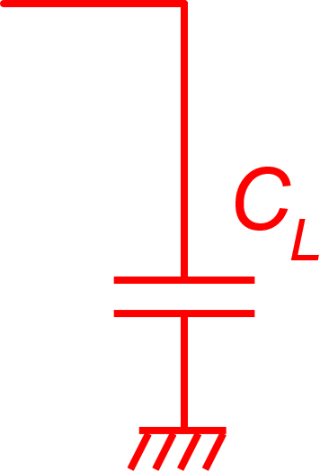
GBW and supply current (from the GBW and ϕ_{m} design procedure)
define:
Since V_{GS5}=V_{GS3}
Fraction due to
the second stage
Fraction due to
the first stage

Slide 28
Current consumption of the op-amp - role of the thermal noise spec
If the "dominant" specification is the thermal noise PSD (S_{Vn-th}), we can use a different expression
Let us start again from the general formula:
... and consider the expression of the input thermal noise voltage PSD:
We need to highlight the role of g_{m1}

Slide 29
Current consumption of the op-amp
Note: F and 1/F appear: an optimum F value can be calculated
Note:
low thermal noise (S_{vn-th}) means high current consumption
Fraction due to
the first stage
Fraction due to
the second stage

Slide 30
Examples
Case 1:
Case 2: as above, but the GBW specification is replaced by noise specs:

Slide 31
Consistent and contrasting specifications
As we have seen in previous example, the GBW specification and thermal noise density specification are consistent, since for both the following rule holds: the stricter the specification, the higher the required supply-current.
If the design include both specifications, then one of them is likely to be dominant. In the previous example, the noise specification dominates: the minimum supply current required to meet the required noise specification is much larger the current required for the given GBW-C_{L} combination. Then, if we design the amplifier for the noise density, we certainly meet the GBW requirement.
Other specification pairs are likely to be contrasting: thermal noise and speed are in contrast with the supply current specification. The same can be said about flicker noise and area.

Slide 32
Action of various specifications:
Power Consumption
GBW
g_{m1}, g_{m5}
W₁/L₁, W₅/L₅
W₁L₁, W₃L₃
Flicker Noise
W₁,L₁,W₃,L₃, W₅,L₅
V_{TE5}
S_{vn-th}
W₁/L₁, W₅/L₅
W₁L₁, W₃L₃
g_{m1}, g_{m5}
Offset
C_{L}, ϕ_{m}
W₃/L₃
V_{TE1}
V_{TE1}
g_{m3}
AREA
A₀
V_{TE1,} V_{TE3,} L_{1,} L_{3,} L_{5,} L_{6,}
F

Slide 33
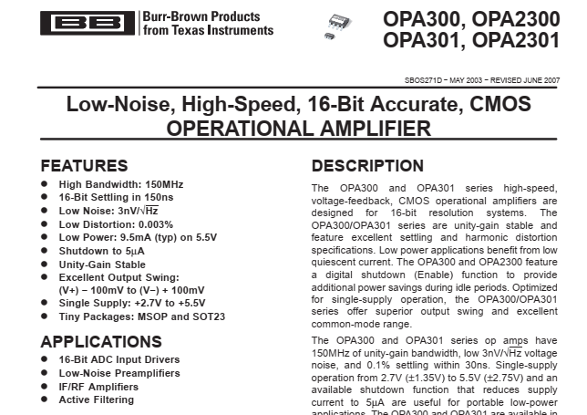
Commercial products: high speed - low thermal noise CMOS op-amp
low power?

Slide 34
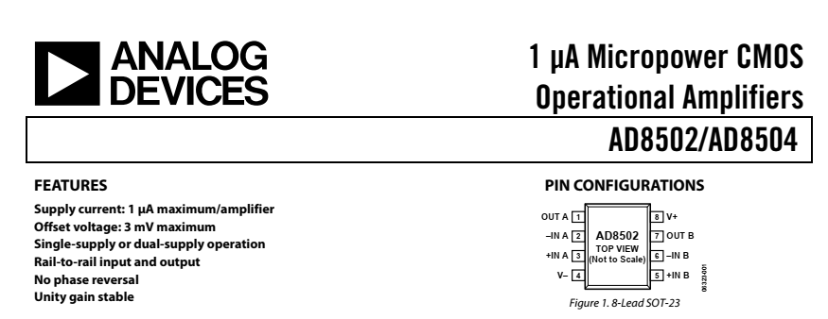
Commercial product: low power op-amp

