Slide 1
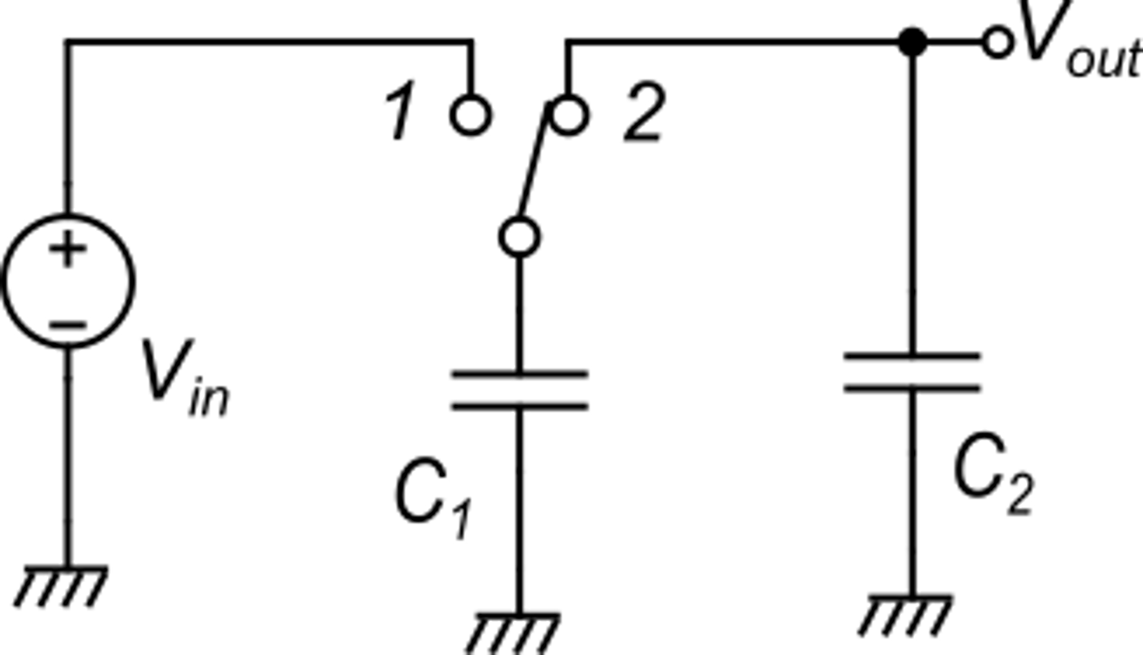
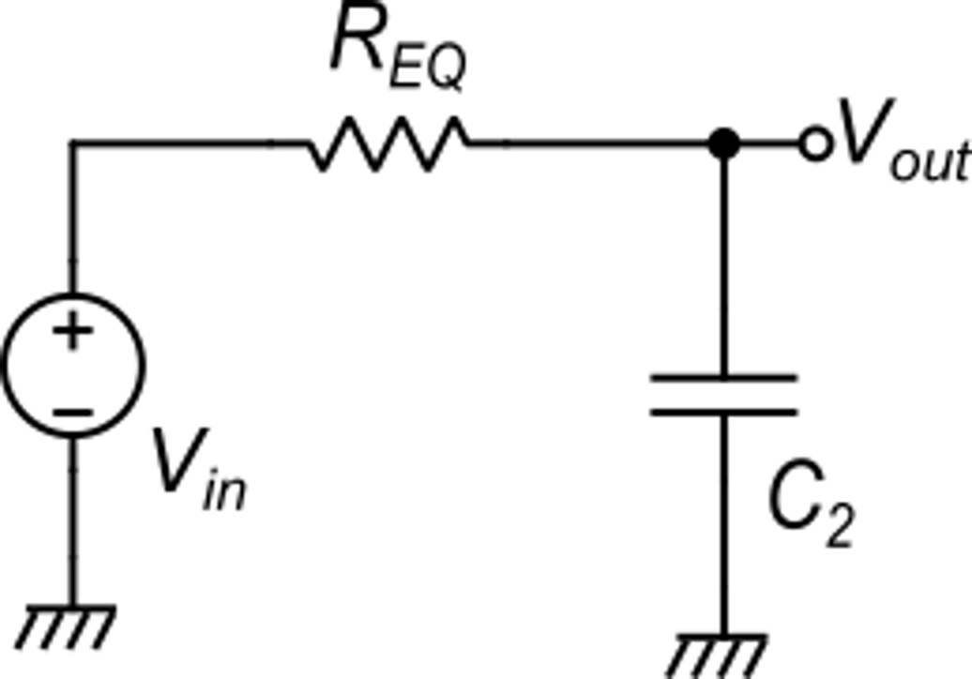
Switched Capacitor (SC) circuits: general considerations
The SC equivalent resistance
ck
ck

Slide 2
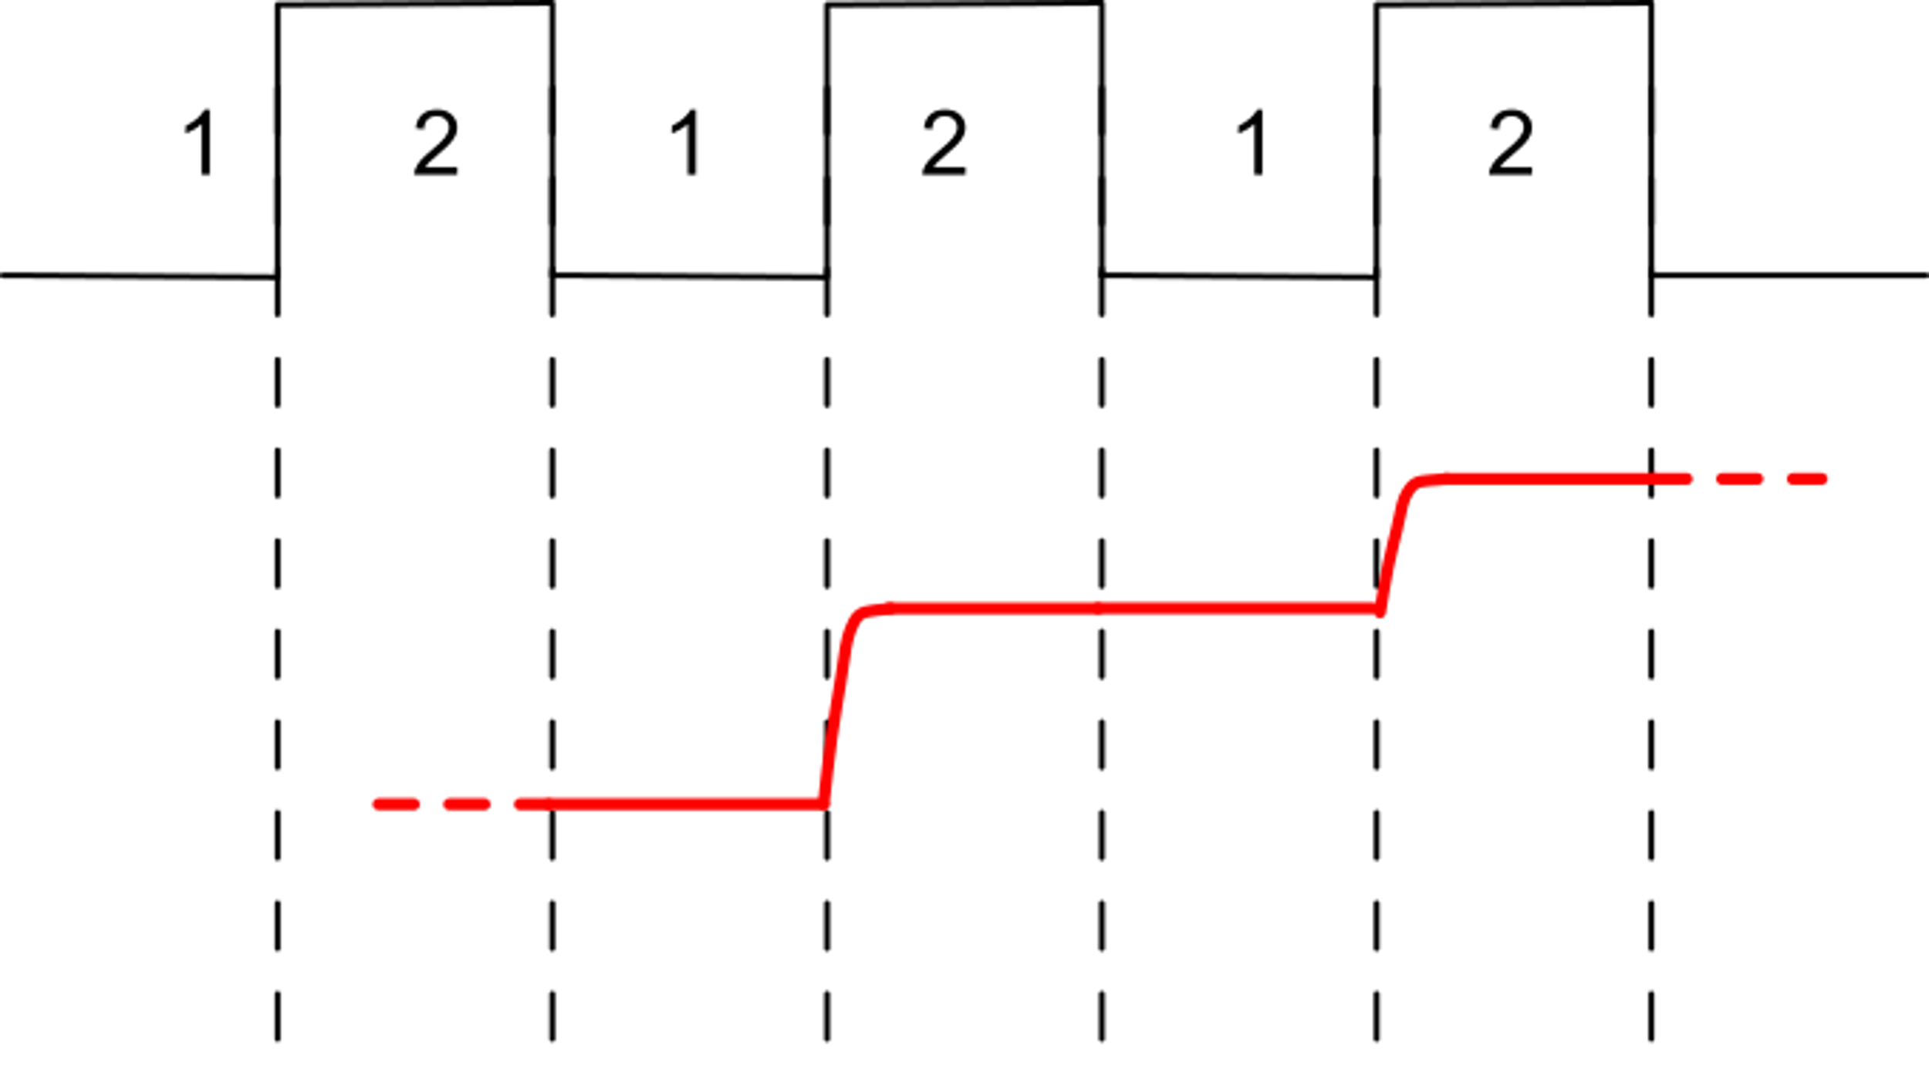
Switched Capacitor (SC) circuits: general considerations
The discrete time nature of SC circuits
Phase 1: V_{out} holds, V_{C1}=V_{IN}
Phase 2: C₁ samples V_{IN} and discharges into C₂
This discrete-time equation is valid at any frequency

Slide 3
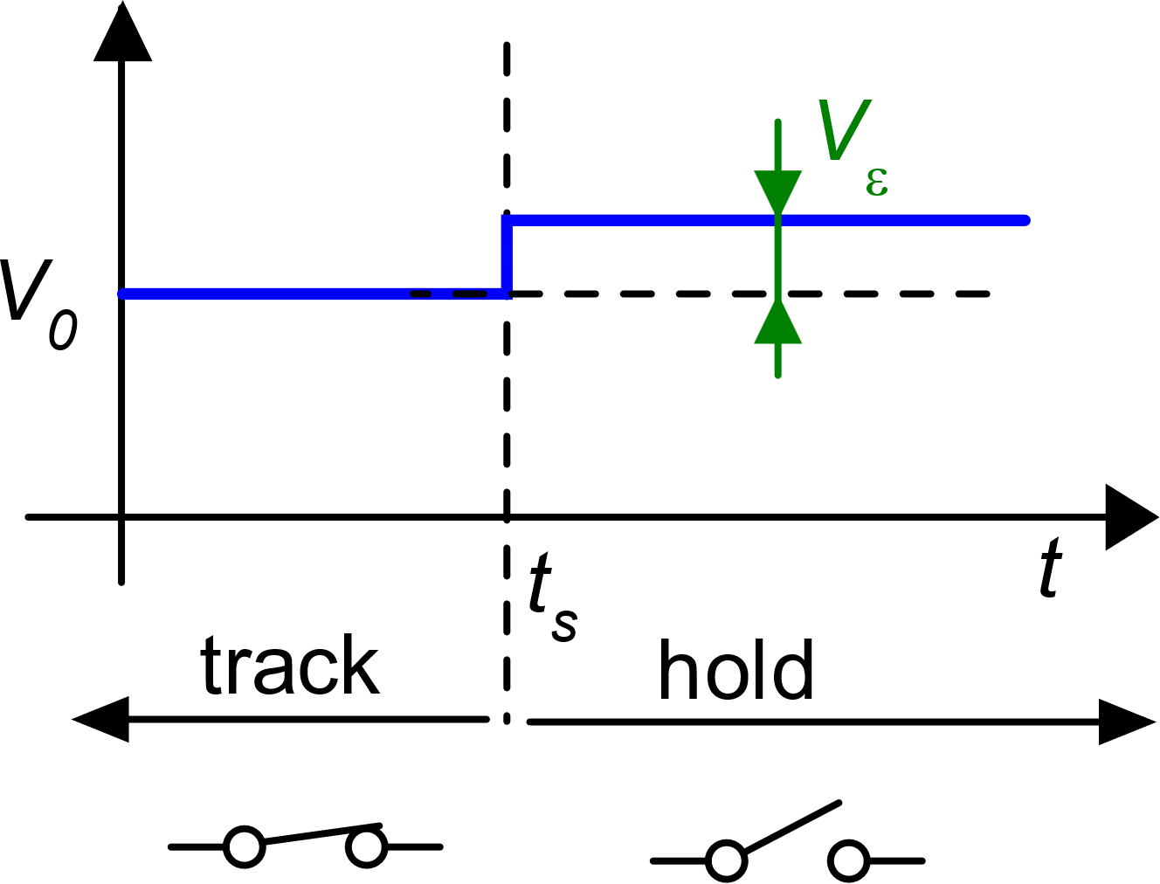
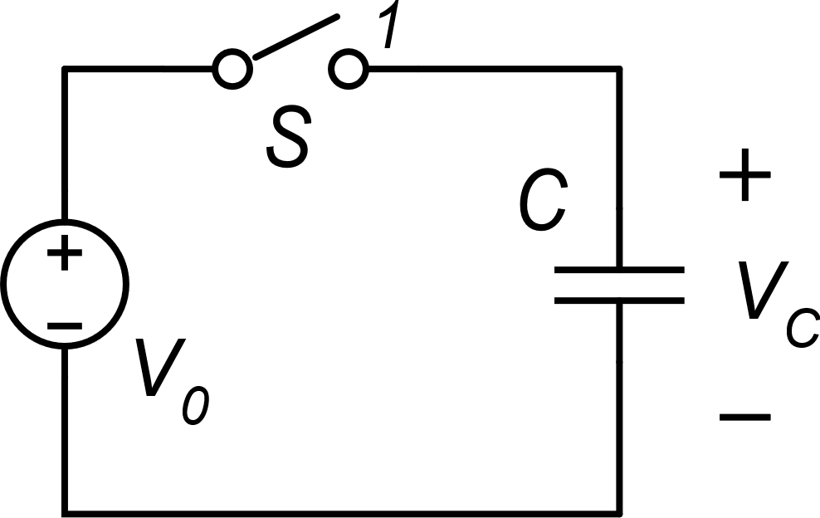
Non-idealities in (SC) circuits
Sampling of a voltage on a capacitor: errors
kT/C noise
Charge injection
Vε is present even if the switch is perfectly ideal
The kT/C noise:
a simple example
Simple example:
V₀ is constant
What is the origin of Vε ?
Phase 1: track
Phase 2: hold

Slide 4
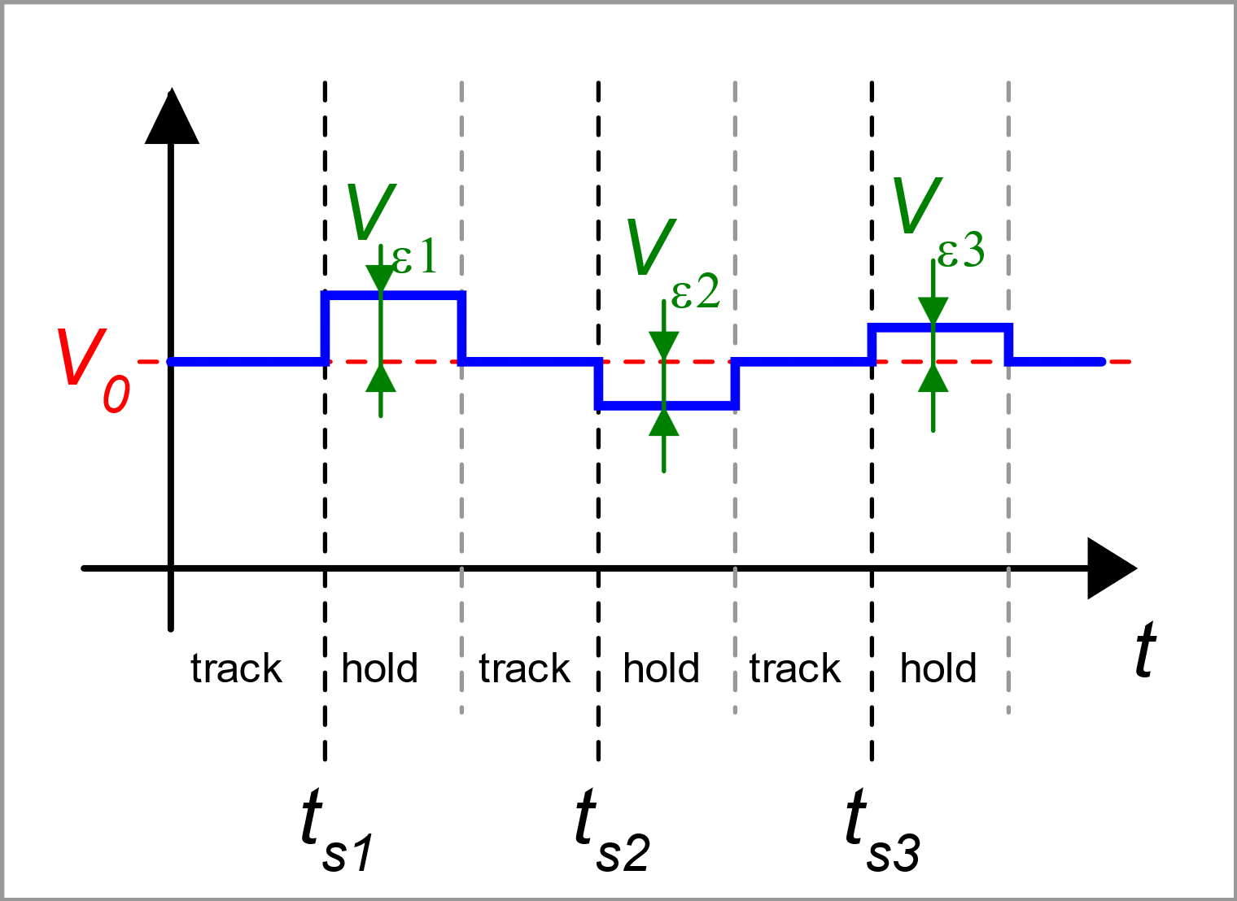
Random nature of Vε
Repeating the sampling operation several time, the error is everytime different both in terms of magnitude and sign: it is a random process
Its mean square value is determined only by:
capacitor value
temperature

Slide 5
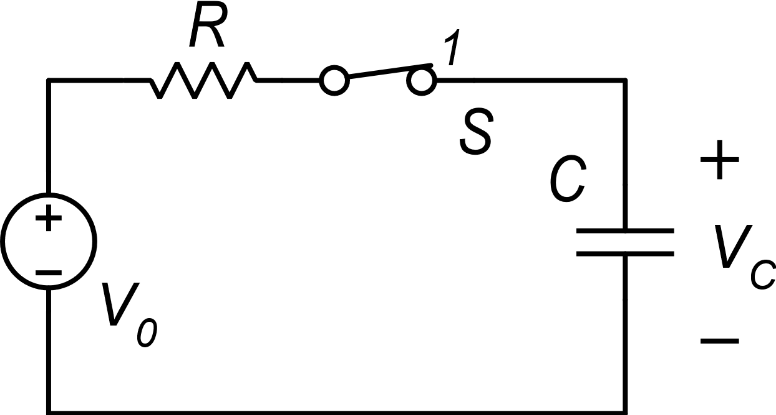
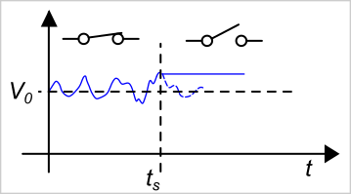
Origin of the kT/C noise
Let us add a series resistance: it can be due to the switch on-resistance and to the equivalent resistance of voltage source V₀.
Now it is clearer: voltage V_{C} was already fluctuating due to the noise of the resistor and we simply sample V₀ together with the noise sampled at t_{S}

Slide 6
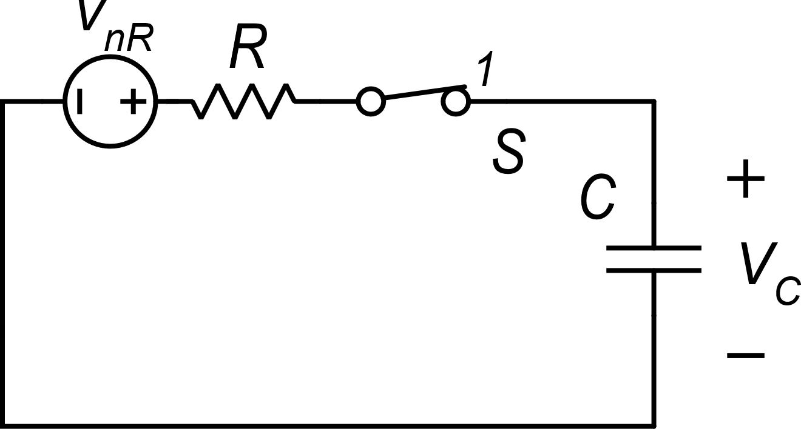
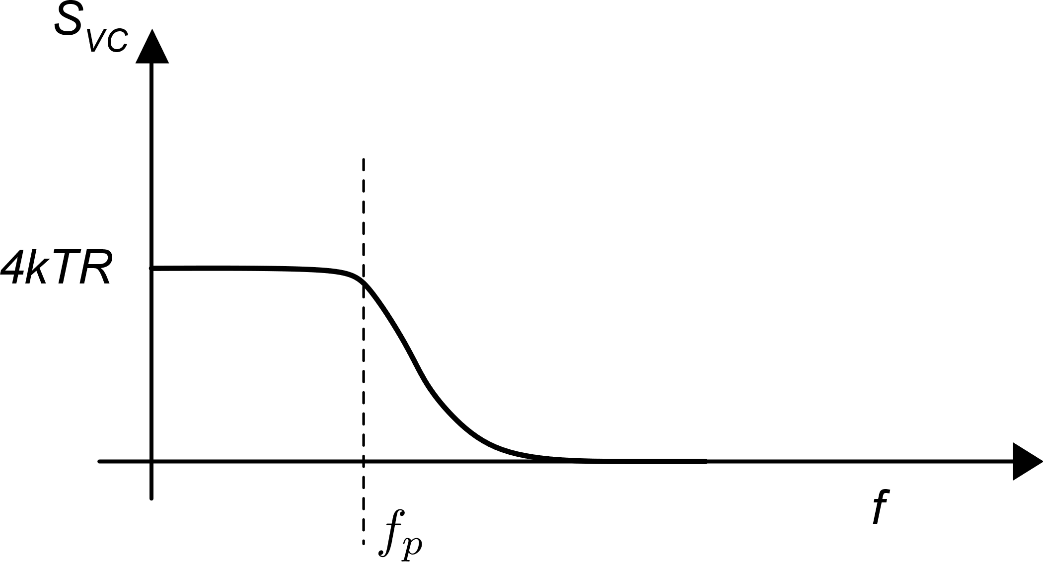
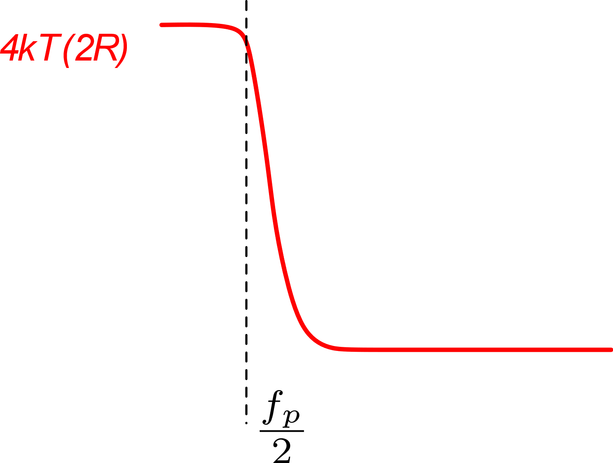
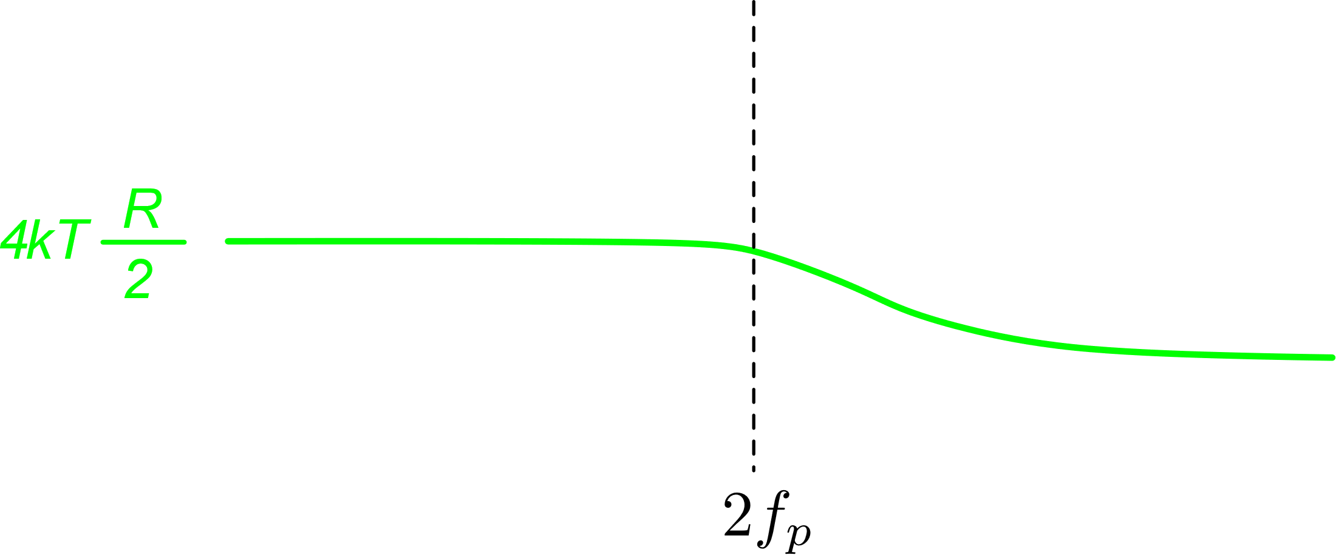
Origin of the kT/C noise
R-> 2R
R-> R/2
Circuit with only the noise source
(V₀ is removed)
The integral is still the same
The ideal case (R=0) represents a limit where 4kTR tends to zero and f_{p} tends to infinity. Again, the integral is still the same

Slide 7
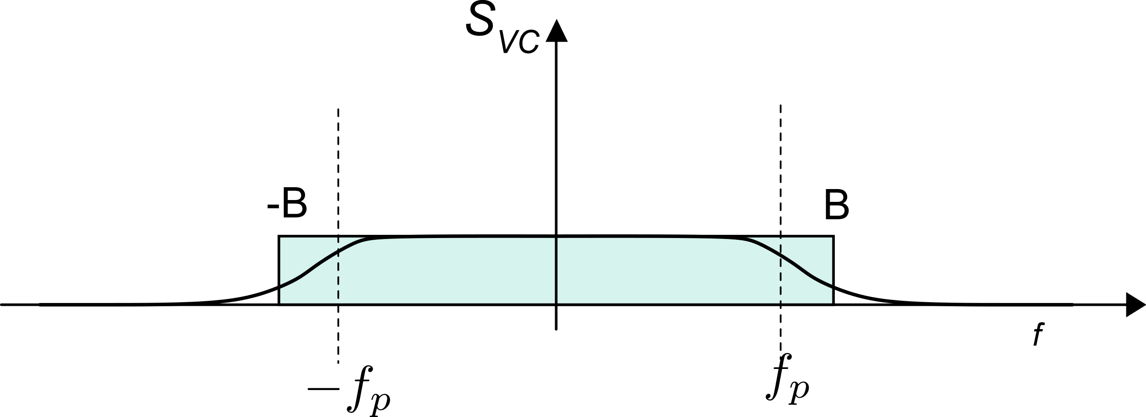
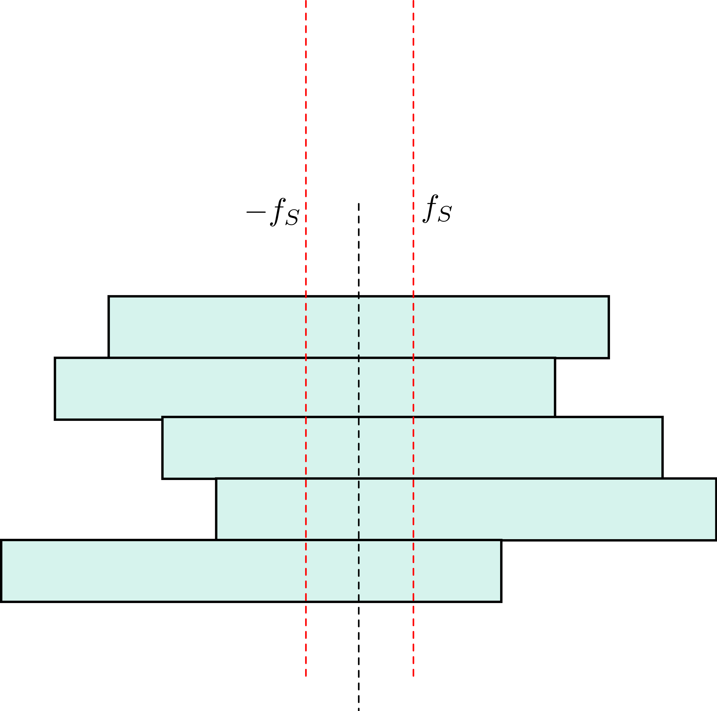
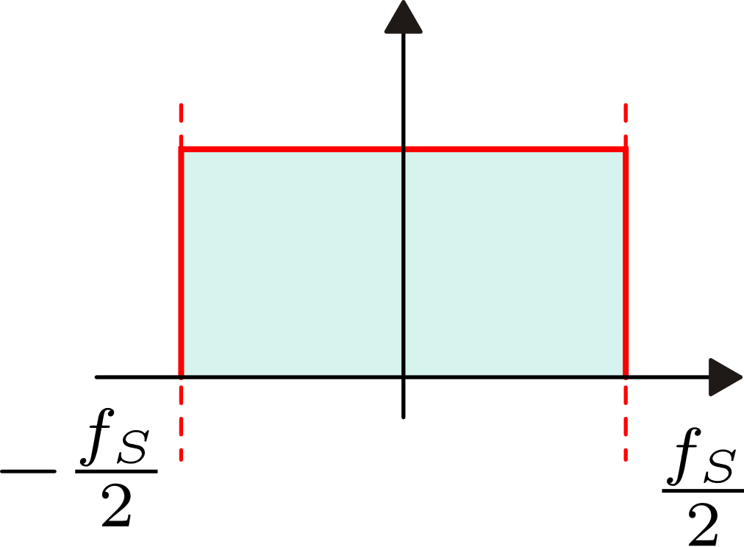
kT/C noise as a result of continuous time noise sampling
Two-sided spectral density of voltage V_{C}
The green rectangle is a simplified representation of the PSD
Effect of sampling and aliasing
For the integral (i.e. mean square voltage of V_{C}) to be the same, B must be the effective noise BW:
Discrete time
PSD

Slide 8
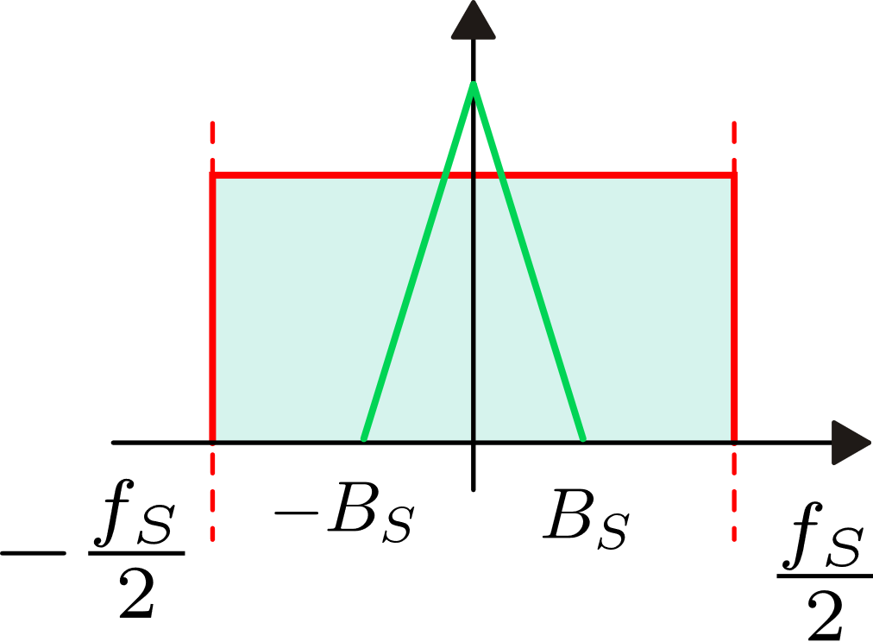
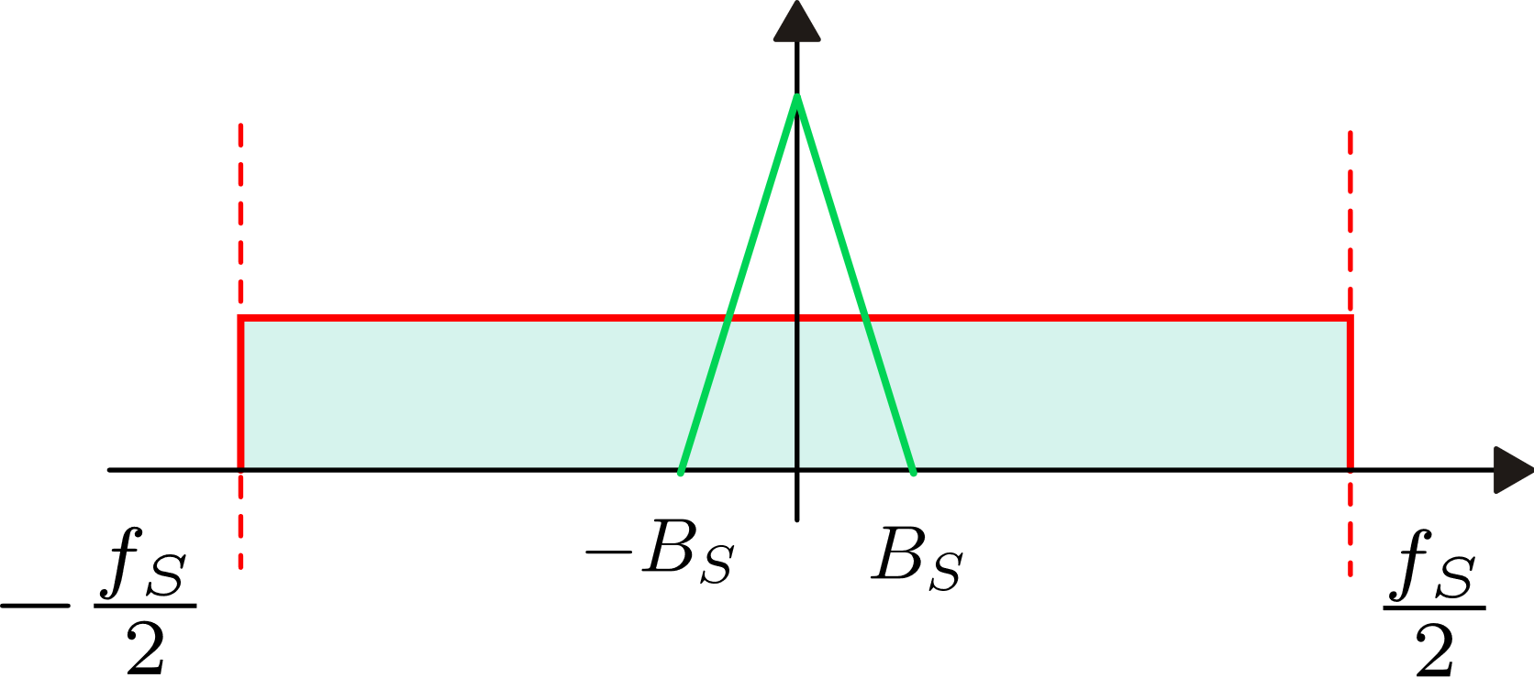
Changing the sampling frequency
The integral of the kT/C noise PSD is
equal to kT/C, independently of the
sampling frequency
Increasing the sampling frequency,
the PSD is reduced proportionally to maintain
the integral constant
In this way, filtering the output sequence in
the discrete time domain (either by digital
or analog processing), we get less noise in
the signal bandwidth

Slide 9
kT/C noise in summary
kT/C noise is always present when we sample a voltage on a capacitor. The mean-square voltage of the samples is equal to kT/C and is independent of the series resistances of the switch, voltage source and capacitor.
The result of sampling with a uniform sampling period produces a discrete time sequence affected by kT/C noise.
If the sampling frequency f_{S} is << f_{p}, (i.e. B>>f_{s}), then the PSD of the kT/C noise is constant over the DT-frequency interval -f_{S}/2, f_{S}/2.
Sometimes it is convenient to refer to the noise in terms of charge accumulated into the capacitor. In this case:

Slide 10
The charge injection phenomenon: a systematic error in SC circuits
Differently from the kT/C noise, charge injection is due to switch non-idealities
The n-MOS switch
Presence of overlap capacitance between the switch terminals and the control voltage
In the on-state, there is charge accumulated into the channel (the mobile charge) that have to be drawn from the drain and source where it has to be pushed back when the switch is turned off

Slide 11
Charge injection during the on-to-off transient

Slide 12
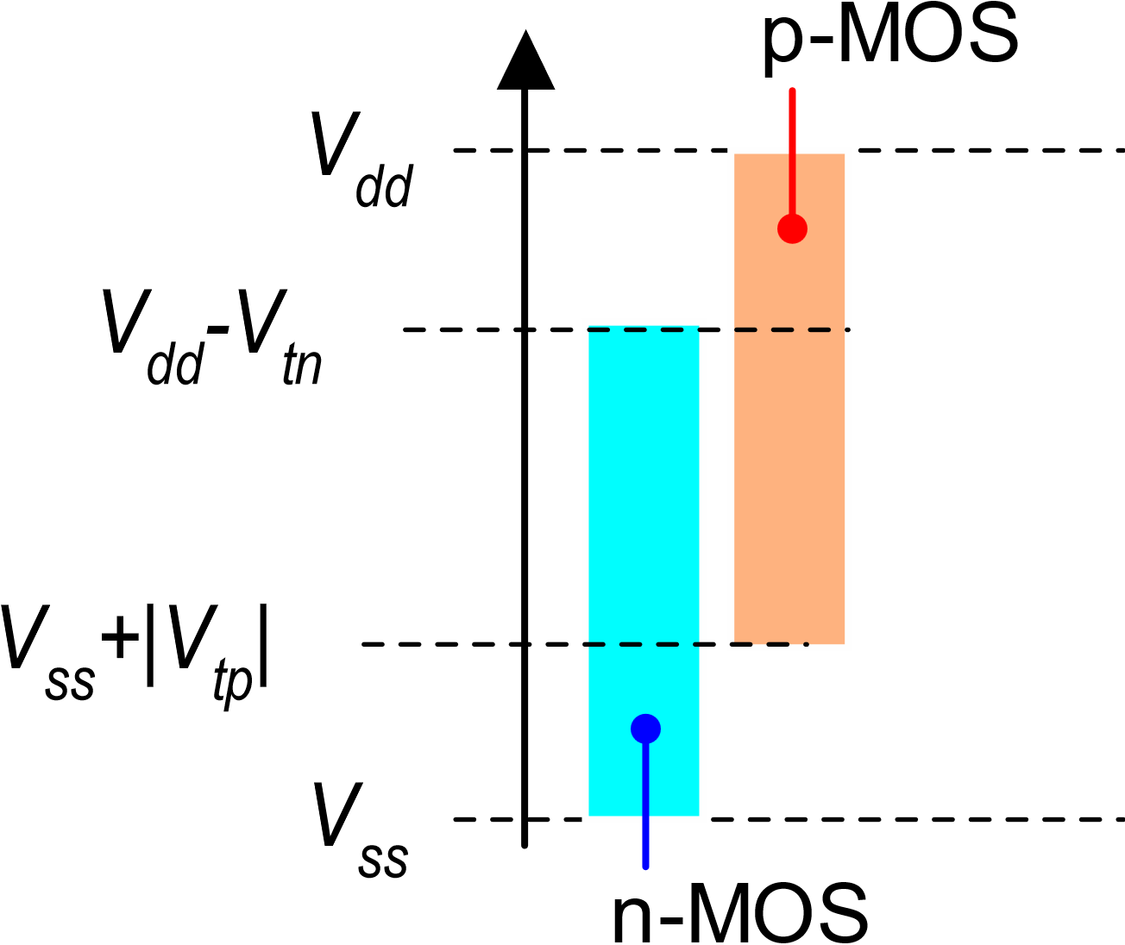
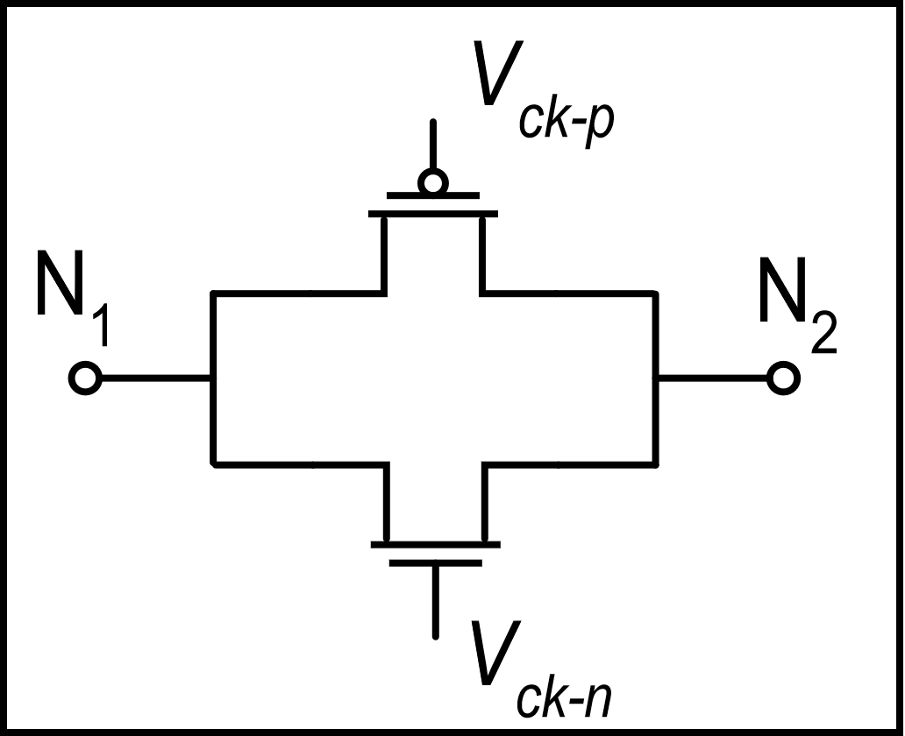
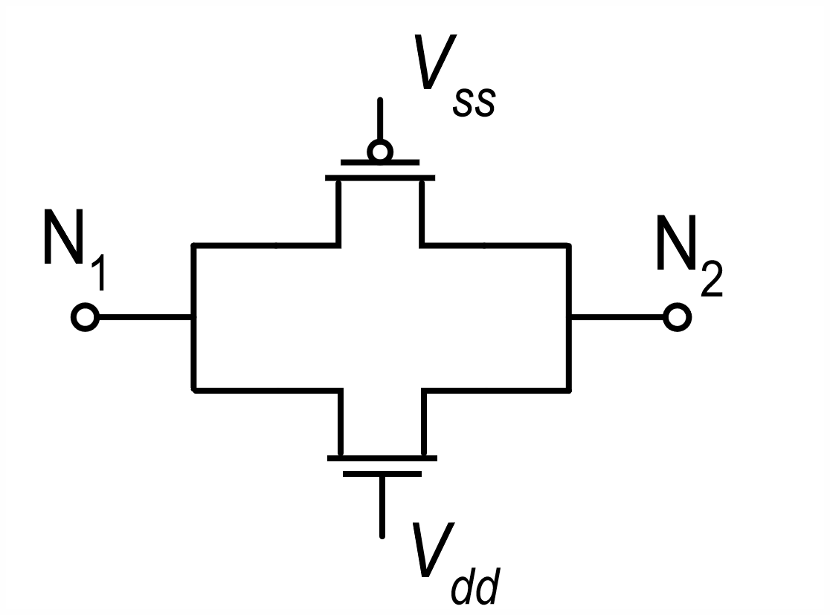
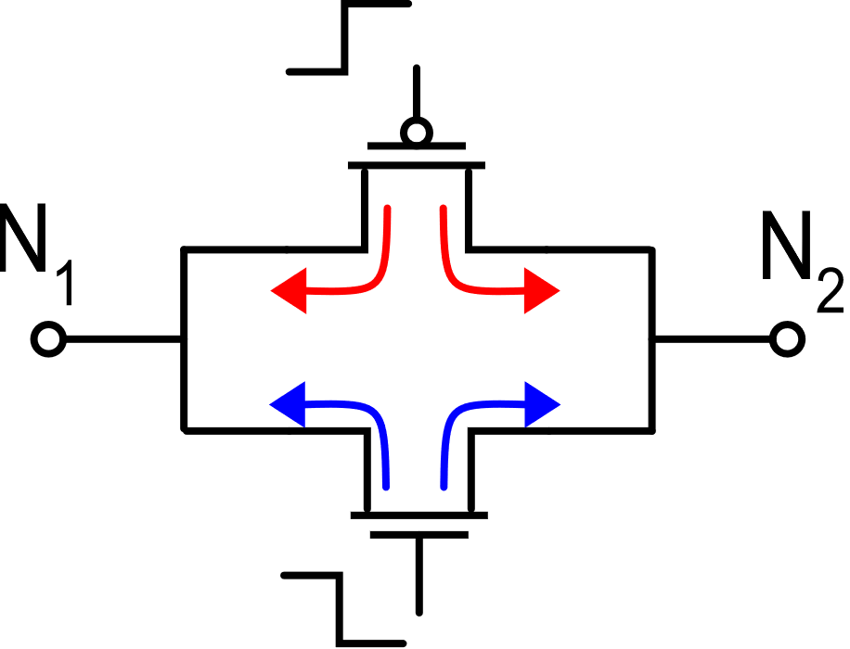
Charge injection in the pass-gate (transmission gate)
on-state
pass gate
Voltage levels that are correctly transmitted by the n-MOS and p-MOS switches in the on-state
Charge injection in the on-to-off transient:
charges are of opposite sign, but compensation is
imperfect since the mobile charge depends on the
V_{GS} and then on voltages at the N₁, N₂ nodes

Slide 13
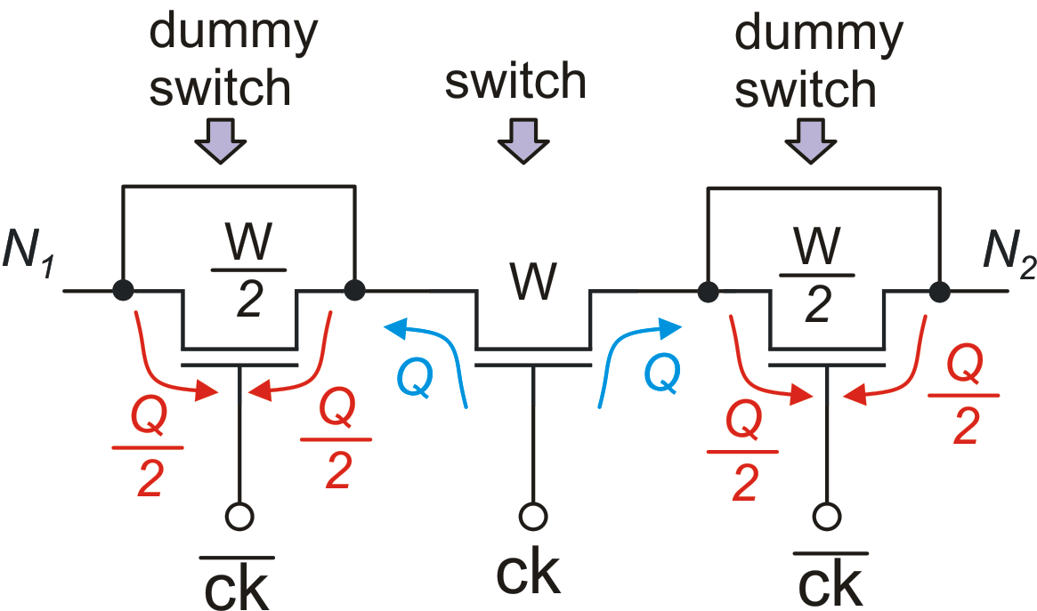
Signal independent charge injection compensation
The dummy-switch does not affect the switching function, since it is short-circuited.
Its injected charge is opposite to that of the main switch because it is driven by the complementary control signal
The dummy switches have the same length of the main switch but they have half the width.
Dummy switches can be applied to both the p-mos and n-mos of a pass-gate

Slide 14
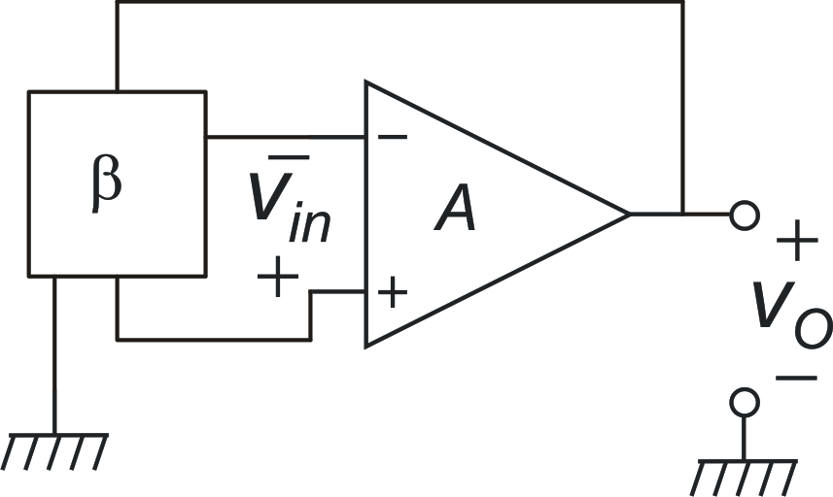
The input voltage of op-amps in closed loop configuration and in presence of noise / offset
Amplifier:
Feedback network:

Slide 15
The input voltage of op-amps in closed loop configuration and in presence of noise / offset
Let us focus on the effect of noise:
The fact that this term can be non-negligible is the origin of the finite gain error, We will not consider it for now.

Slide 16
The input voltage of op-amps in the presence of noise
At the input of the op-amp we find a low-pass filtered version of the input referred noise
The cut-off frequency of the filter is nearly β₀f₀

Slide 17
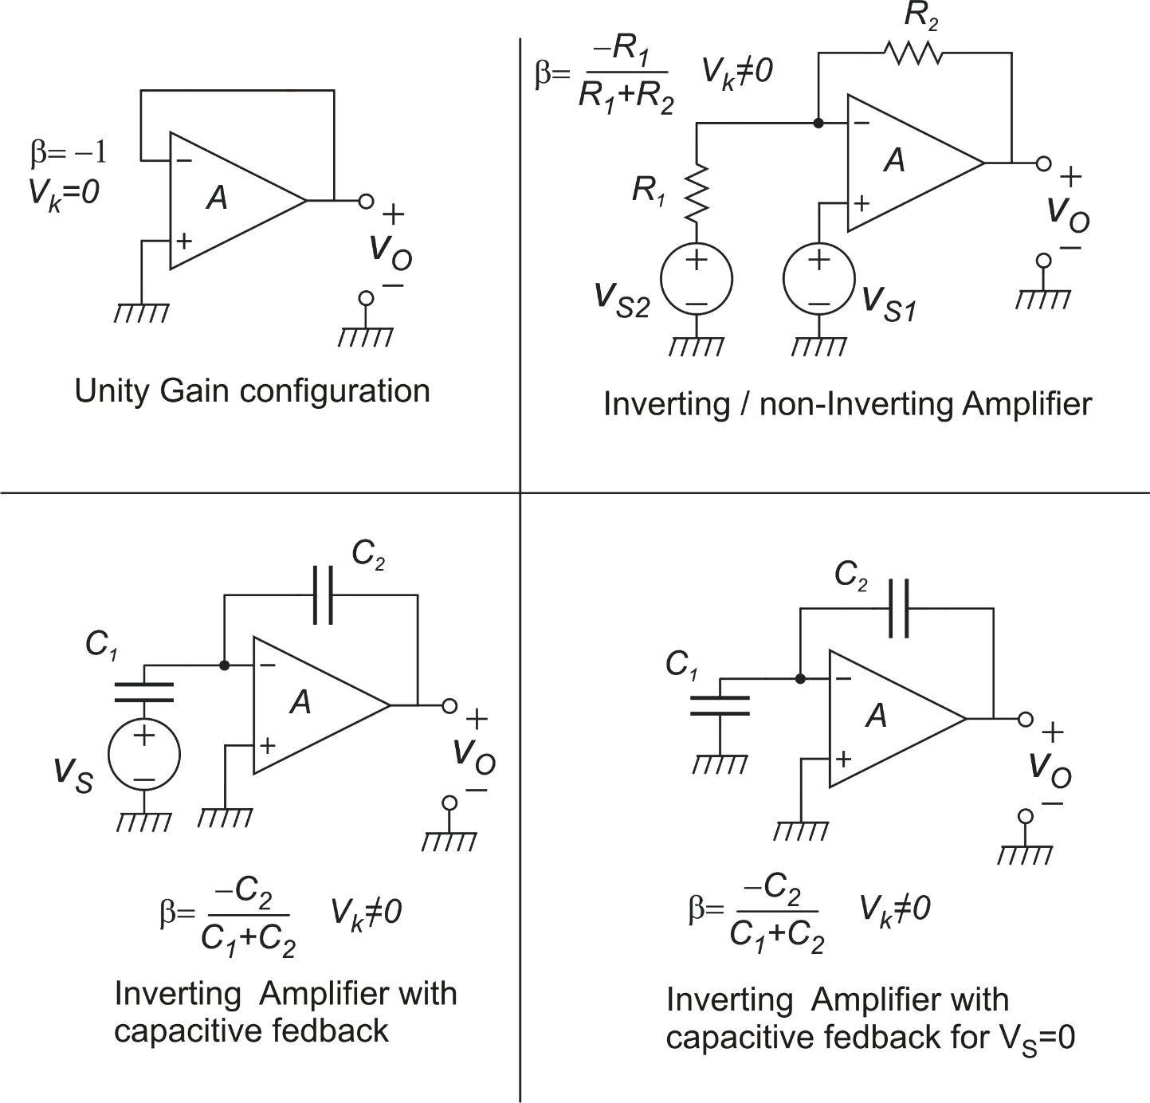
A few examples

Slide 18
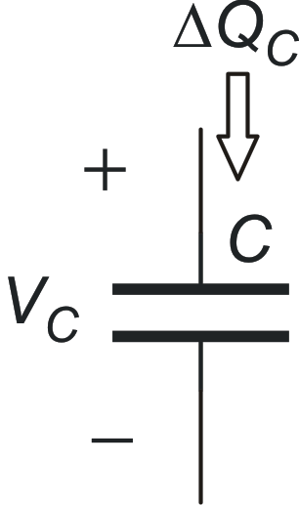
Charges through capacitors: conventions
Conventions on signs:
A charge is positive if it enters the plus terminal
Charge that pass through the capacitor from time t_{i} to time t_{f}
i_{c}(t)

