Slide 1
Progettazione Mixed Signal
(Design of Mixed Signal Circuits and Systems)
CFU: 9 (90 ore)
A.A. 2023-2024
Teachers: Ore
Paolo Bruschi (paolo.bruschi@unipi.it) 60
Michele Dei (michele.dei@unipi.it) 20
Alessandro Catania (alessandro.catania@unipi.it) 10

Slide 2
The Sensor Systems Engineering program (15 CFU)
Curriculum: Sensor System Engineering
Sistemi sensoriali per l’automazione, l’ambiente e la salute (6 cfu)
Progettazione mixed signal (9 cfu)
Design of integrated cells for:
Sensor interfacing
Analog control systems
Analog signal processing
Data conversion (ADCs & DACs)
Digital and Analog circuit integration

Slide 3
Main Topics (not in chronological order)
1) High level description of a collection of fundamental Analog and Mixed Signal (AMS) systems:
DAS ( Data Acquisition Systems) and elementary sensor interfaces
Methods for offset and flicker noise cancellation
Fully-differential architectures
Analog Integrated Filters
Data converters (ADC-DAC)
2) Complement of Mixed Signal Analysis & Design Methods
Design friendly MOSFET and BJT noise models
Useful network theorems (feedback system design, parameter variation effects, ...)
Mixed Signal design flow
3) Transistor level Analysis & Design of main analog cells
Elementary blocks: Switches and Current Mirrors
Operational amplifiers (S/E and Fully-Differential)
Integrated Comparators

Slide 4
Experimental Lectures
Design and Simulation of a few important analog blocks (LTSpice)
Experiments performed by the teacher with dedicated analog circuits and computer-controlled oscilloscopes / signal generators
Final Exam
Only oral: typically, two questions (transistor-level topic + system level topic)
Suggested Prerequisites
Progettazione di Sistemi Microelettronici (PSM)
Elettronica Analogica

Slide 5
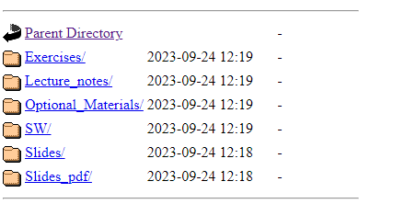
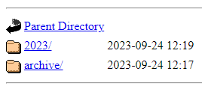
Didattic material
From teacher's web page: (http://www2.ing.unipi.it/~a008309)
http://www2.ing.unipi.it/~a008309/mat_stud/lista_dida.html
Past years
material
This-year material
(will be made available progressively)

