Slide 1
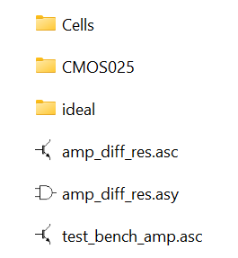
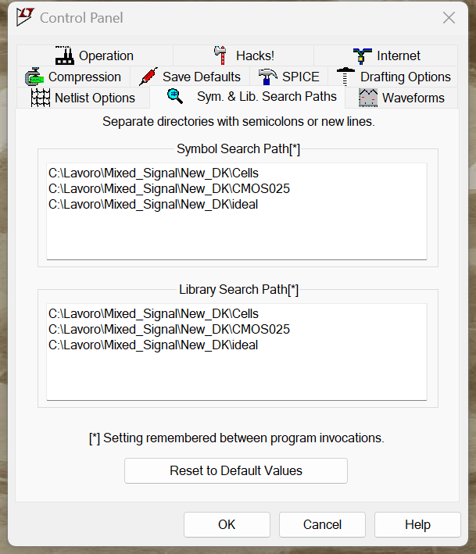
Installation and Use of the LTSpice custom libraries
Uncompress the New_DK.zip file into a directory, possibly with a not too long path (e.g. c:\Users\my_home\Mixed_Signal)
Launch LTSpice
Open the LTSpice control panel, "Sym & Lim Search path"
Add the path of the tree directories "Cells", "CMOS025", "Ideal" to both the "symbol search" and "library search" fields

Slide 2
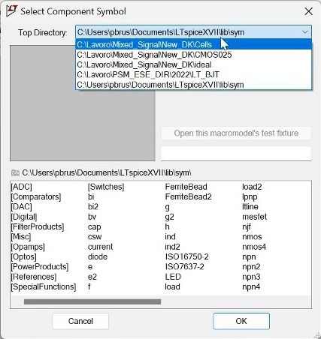
How to include a cell into a schematic view
Simply operate as usual, by command "F2".
In the window that opens, now the added libraries appears in addition to the standard LTSpice Libs
CMOS025 : components of the process (CMOSN025 and CMOSP025)
Cells: Some CMOS cells useful for the exercises (e.g. pass-gate)
Ideal: Ideal components to be used to simplify simulations.

Slide 3
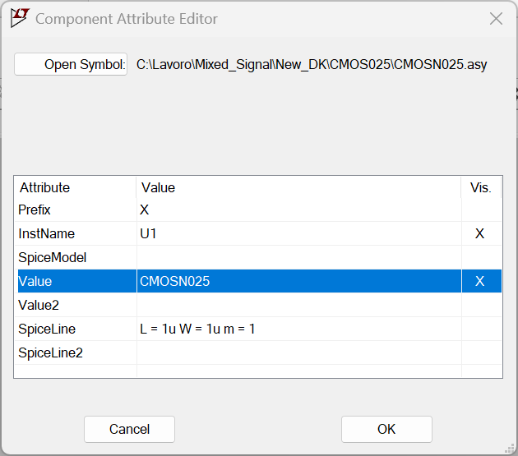
How to set the L and W parameter of MOSFETS
After right-clicking on the MOSFET of interest, this window opens
Simply edit this line. Be careful not to delete the "u" suffix (microns).
Note: It is not necessary to put the ".lib " command into LTSPICE schematic view

